Slide 1
MA Department of Public Utilities
Damage Prevention Program
Jennifer Cabrera, Program Manager
www.Mass.Gov/Dig-Safe
Email: DPU.DamagePrevention@Mass.Gov

Slide 2
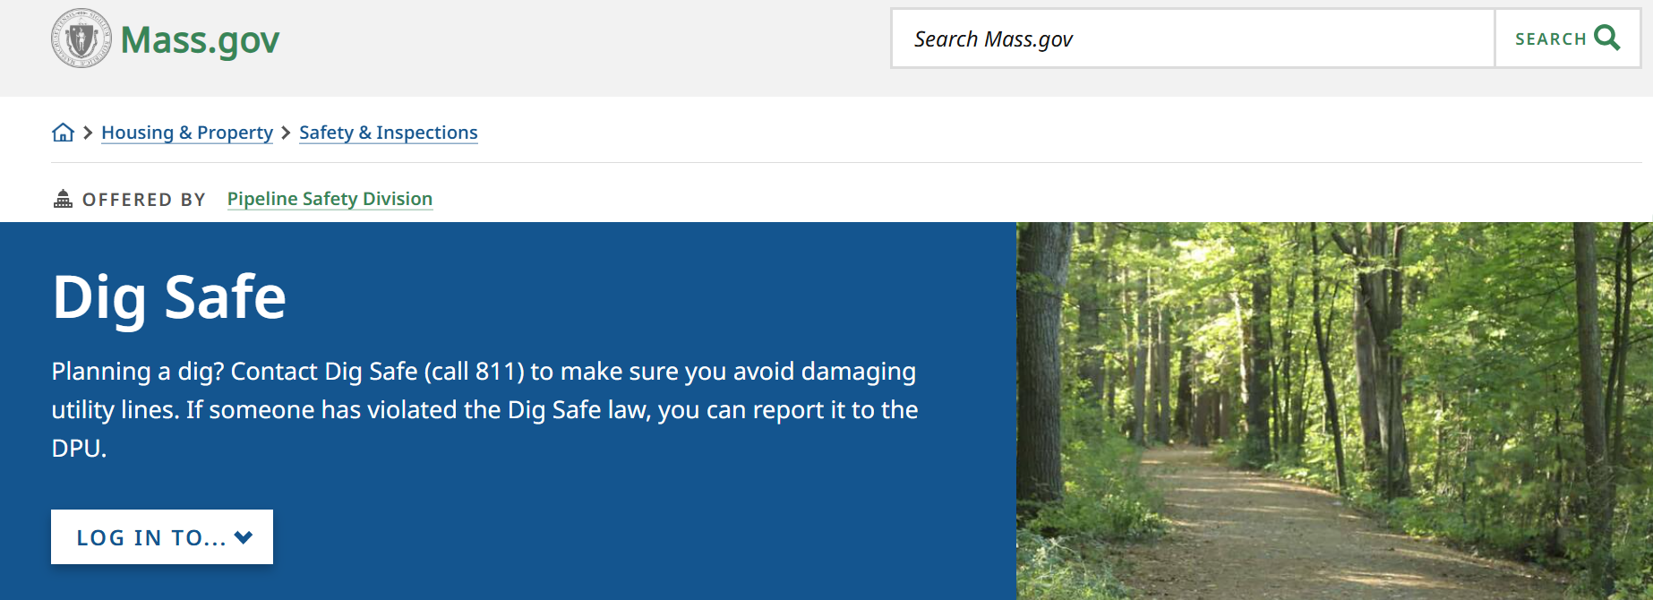



www.Mass.Gov/Dig-Safe
Learn about MA Dig Safe Law and
report any underground incident to us!
Pipeline and Hazardous Materials Safety Administration
www.PHMSA.DOT.Gov
Click into www.DigSafe.com Request a new Dig Safe Ticket or Renew a Dig Safe Ticket
Additional free online trainings through, www.Training.CommonGroundAlliance.com

Slide 3
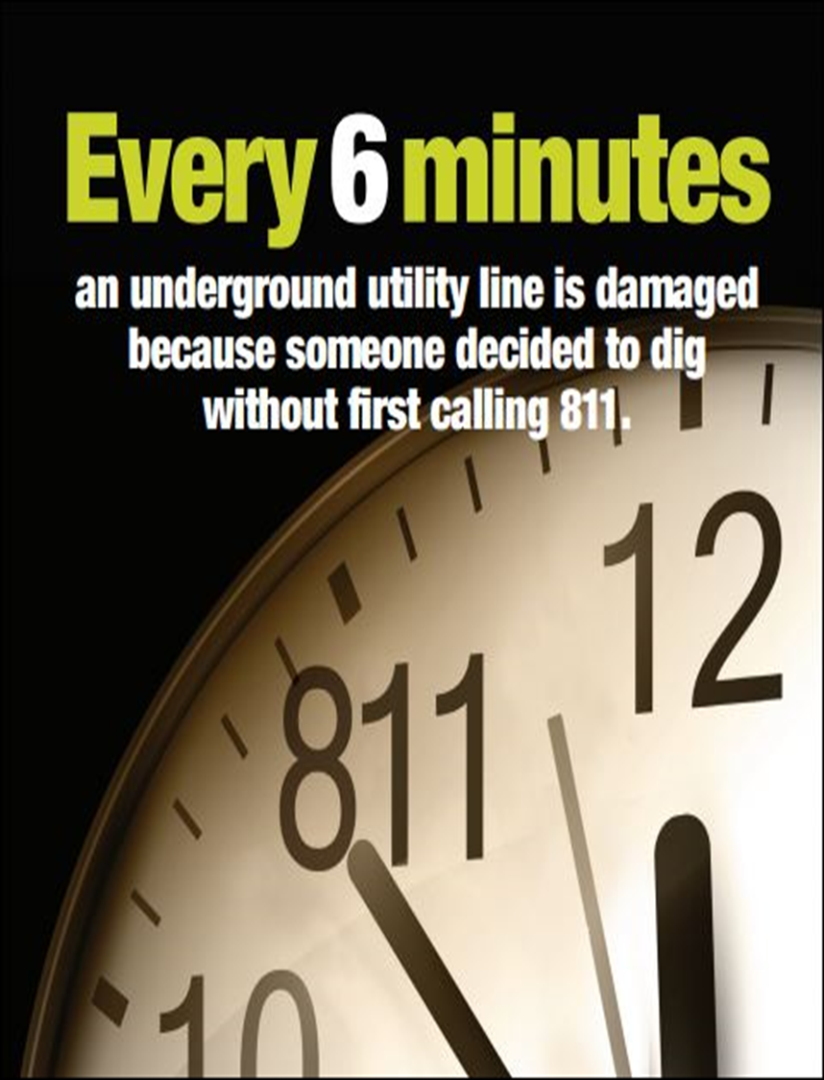
Consequences of Damage
Explosion
Fire
Electrocution
Injuries/fatalities
Property damage
Interruption of service to customers
Spills/emissions
State Violations
Damage Prevention Record

Slide 4
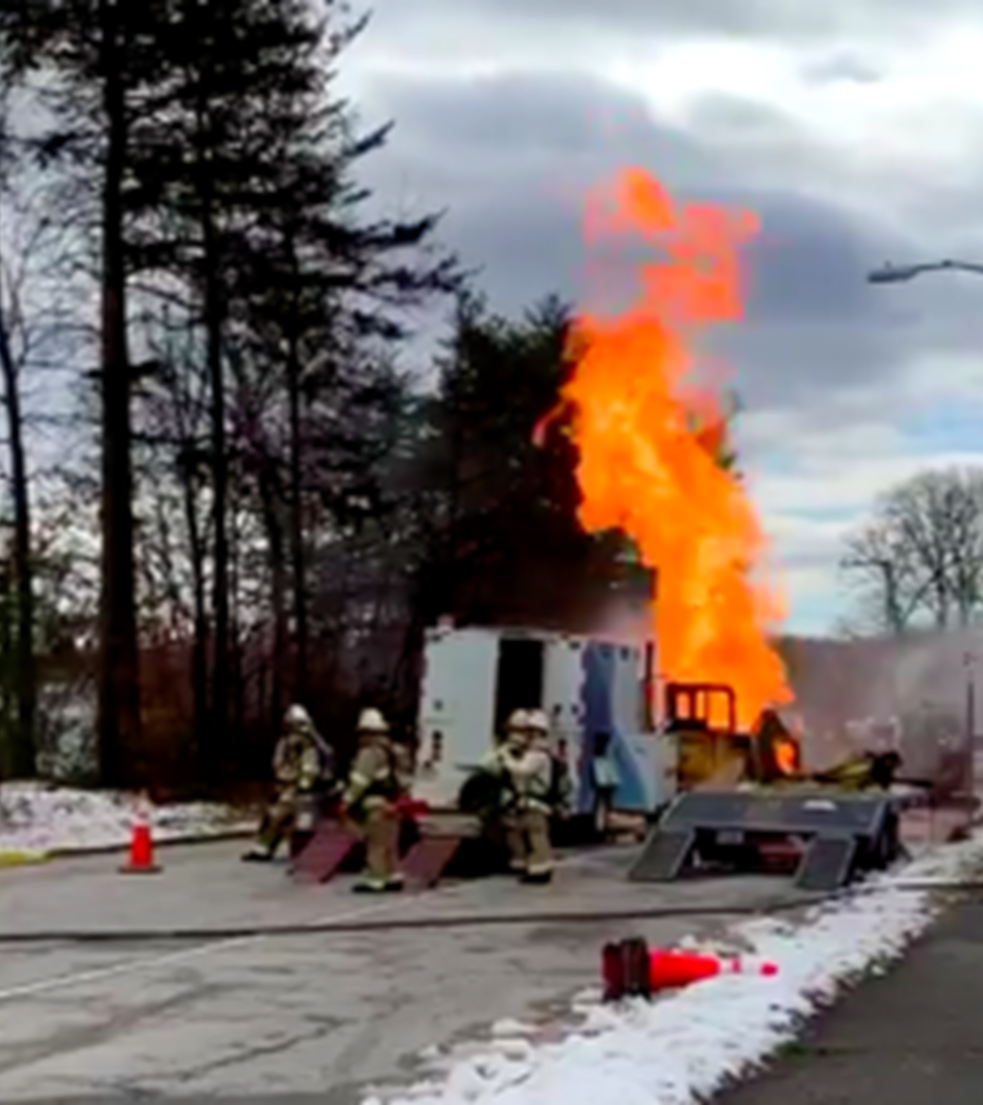
Springfield, Northern Virginia
Excavator strikes a gas line sparked an explosion that injured three Washington Gas workers and evacuated eight homes.
Flames extending 50 to 70 feet high.
The fire was being fed from a free flowing, six-inch gas line.
The fire destroyed two vehicles.
Feb 4, 2021

Slide 5
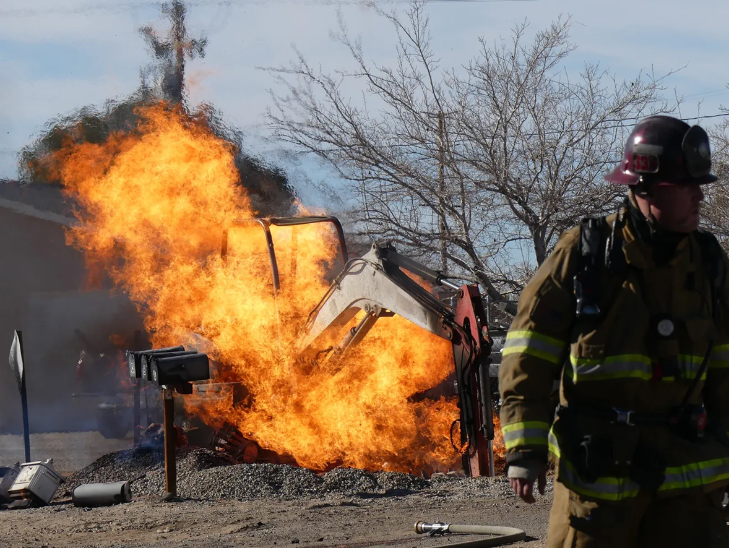
Apple Valley, California
Septic company using an excavator ruptured a gas line, which ignited the fire.
This occurred next to a residential complex and a nearby high school.
Thankfully, no injuries.
Feb 4, 2022

Slide 6
Dig Safe Violation Types January 2024 – December 2024

Slide 7
Changes to Regulations
Emergency notifications only for true emergencies: 220 CMR 99.05
Companies must mark out new installations: 220 CMR 99.06(9)
Dig Safe ticket valid for only 30 days: 220 CMR 99.07(2)
Suspend work upon call for remarking: 220 CMR 99.07(5)
Call 911 if damage leads to gas escaping: 220 CMR 99.07(8)
Requirement to report damage: 220 CMR 99.07(10)
Higher penalties for natural gas-related violations: 220 CMR 99.14 and the 2021 Act Creating a Next Generation Roadmap for Massachusetts Climate Policy

Slide 8
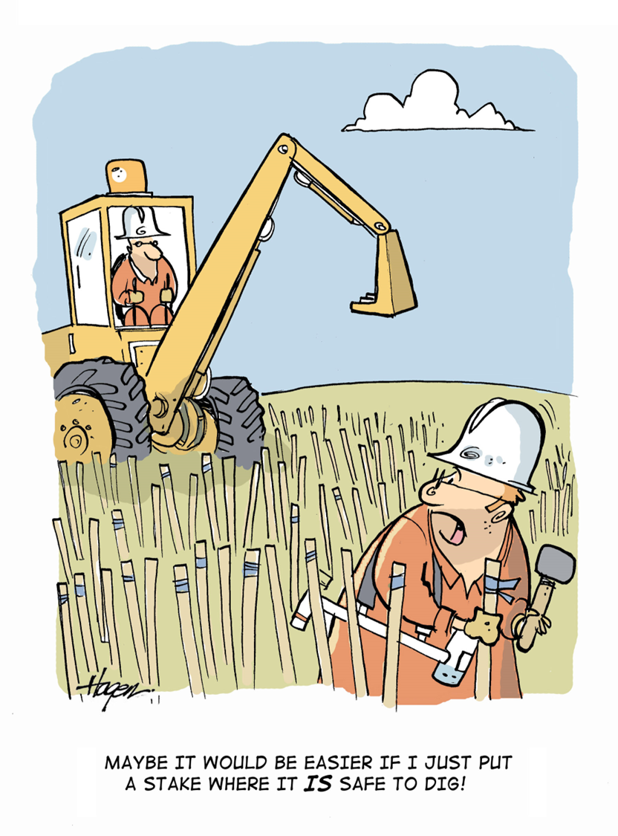
Dig Safe Violations: What to Know

Slide 9
What is EXCAVATION?
G.L. c. 82 s. 40 defines excavation BROADLY.
“Excavation”, an operation for the purpose of movement or removal of earth, rock or the materials in the ground including, but not limited to, digging, blasting, auguring, backfilling, test boring, drilling, pile driving, grading, plowing in, hammering, pulling in, jacking in, trenching, tunneling and demolition of structures.

Slide 10
Civil Penalty Amounts
Violations related to natural gas:
Fines can be issued up to $500,000 for each violation for each day that the violation exists, up to a maximum of $10,000,000 for a related series of violations.
Fine for 1st offence start with minimum of $1,000.
Violations other than natural gas for example electrical, communications, water, sewer, etc.:
Fine for 2nd offense within 12 months are $5,000 to $10,000.
These dollar amounts shall be doubled if similar violation(s) in the past three years.

Slide 11
What Must Be Done BEFORE The Excavation
Premark the area with WHITE or PINK including private property.
Explain your plans in detail when submitted to www.DigSafe.com.
Municipalities are not required to become members of Dig Safe, Inc.
Dig Safe Ticket will provide the EFFECTIVE START DATE & TIME as well as EXPIRATION DATE.
Your ticket is ONLY VALID 30 DAYS.
Be sure to RENEW DIG SAFE TICKET if needed before expiration.

Slide 12
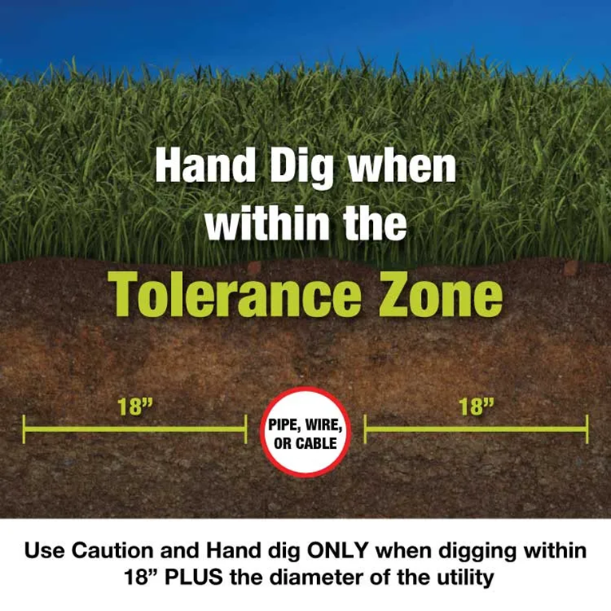
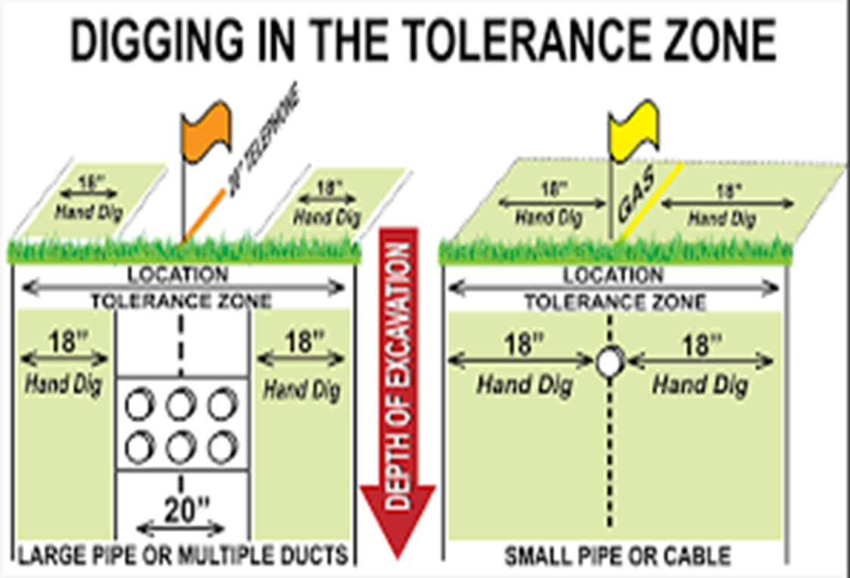
Understanding The Tolerance Zone

Slide 13



Hand Tools Can Cause Damages

Slide 14
What Must Be Done DURING The Excavation: Employ REASONABLE PRECAUTIONS
NO MECHANICAL MEANS withing tolerance zone EXCEPT when used to for initial penetration of pavement, cement, etc. Thereafter, only use of hand tools within tolerance zone.
BE CAREFUL, MA Dig Safe Law states we are “depth blind”.
Employ REASONABLE PRECAUITIONS to avoid damage to any part of underground facilities to include trace wires, conduits, the protective coating, wires, services and mains.
Always protect the utility, ESPECIALLY if it is exposed.
If damage occurs or utility is compromised in any way, the excavator MUST notify the utility AND MA DPU Damage Prevention.

Slide 15
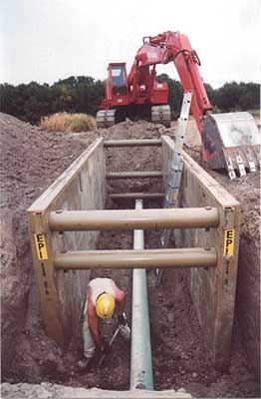
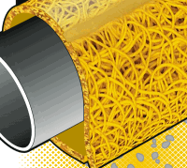
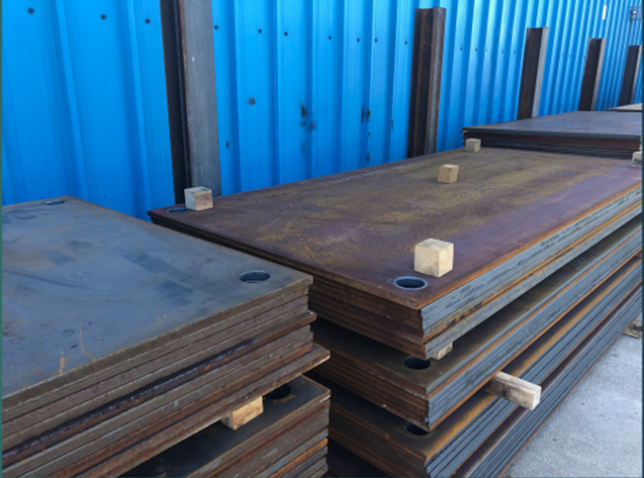

Protect Exposed Utilities

Slide 16
What Must Be Done DURING The Excavation: Employ REASONABLE PRECAUTIONS
Utilize a spotter to communicate with excavator while working.
Don’t “curl” the bucket over marked utilities.
Maintain markings ensuring they are visible. Do not covered markings with spoils.
Ensure all spoils are at least 2 feet away from exposed utilities.
When moving spoils, do not carry spoils over the exposed utility.
If at any point you are concerned, stop and contact the utility directly to ask for guidance/assistance.

Slide 17
Emergency Excavation
Emergency notifications are only for true emergencies: 220 CMR 99.05
Definition of an Emergency: “A sudden or unexpected occurrence involving a clear and imminent danger demanding immediate action to prevent or mitigate loss of, or damage to, life, health, property, or essential public services, but not including a loss of business or profits.”

Slide 18
Reporting Damages/Violations
www.Mass.Gov/Dig-Safe
MA Dig Safe Law requires, ANYONE WITH KNOWLEDGE of suspected violations be reported to the DPU Damage Prevention Program.
Why is this important?
It provides both sides of the incident, potentially saving them from an NOPV at the onset.
If we don’t know it happened, then no one is held accountable to address it preventing the same issue in the future.
Help us improve Dig Safe Culture for everyone!!

Slide 19
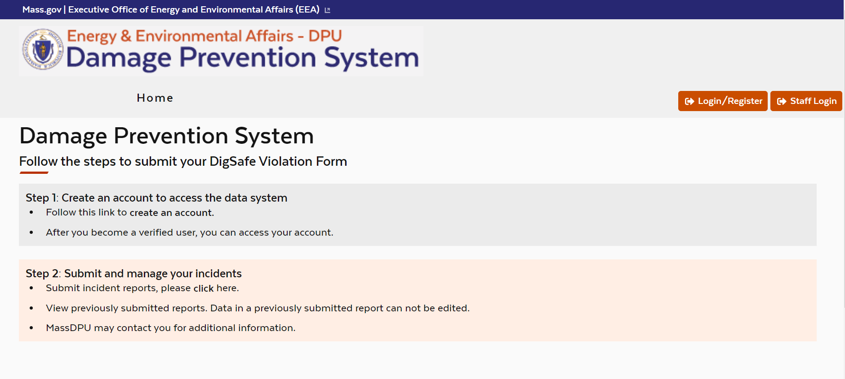
Dig Safe Violation Report (DSVR)

Slide 20
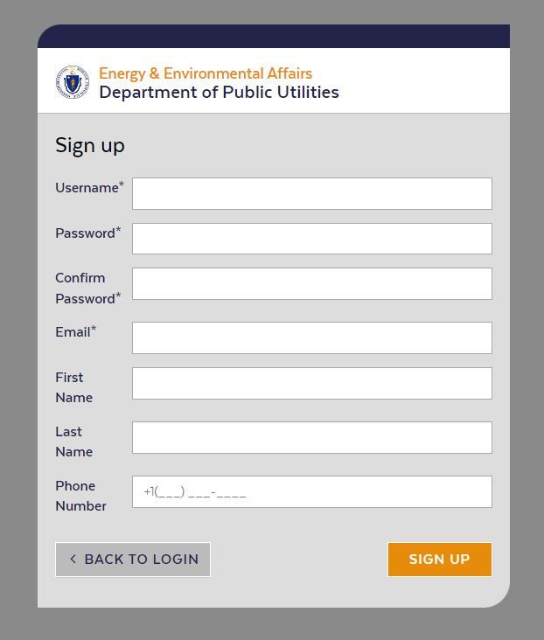
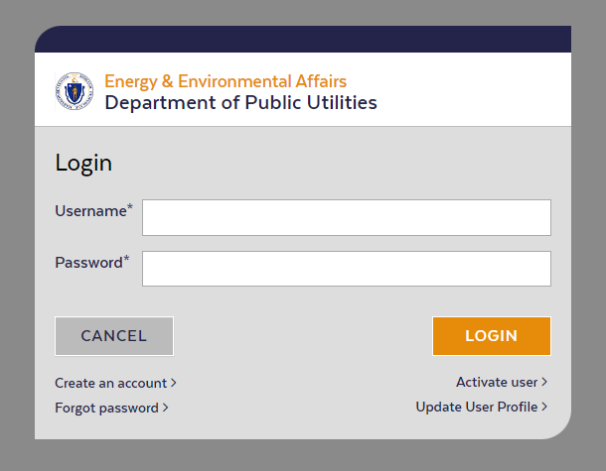
Dig Safe Violation Report (DSVR)

Slide 21
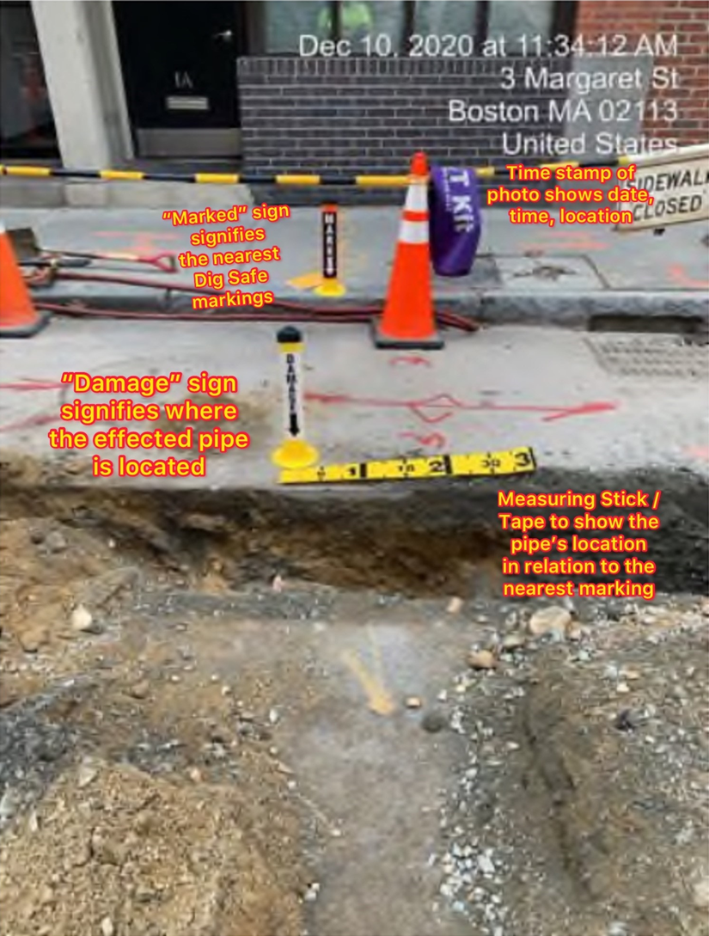
Providing Photos are Crucial!

Slide 22
Flow Chart of Enforcement Process
NOPV
Informal Conference
IRD
Adjudicatory Hearing
DSVR

Slide 23
Questions? Contact us to attend our FREE online trainings. Email: DPU.DamagePrevention@mass.gov www.Mass.Gov/Dig-Safe

