Slide 1
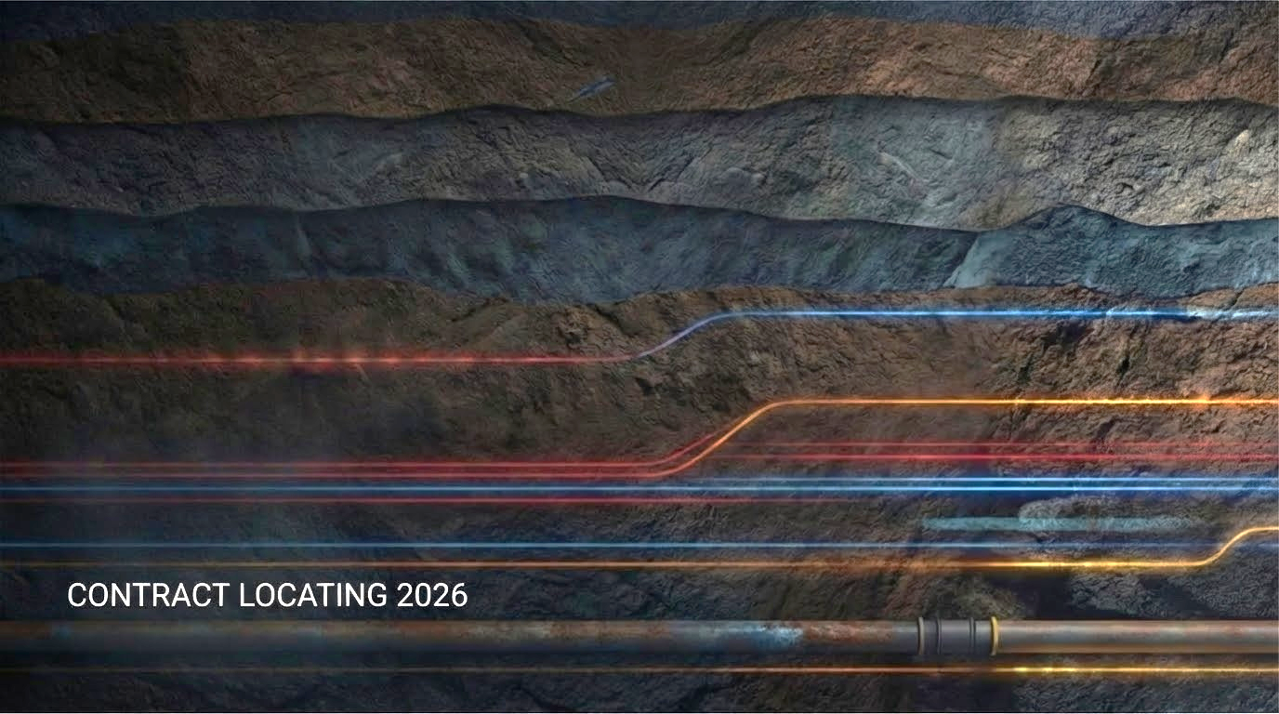
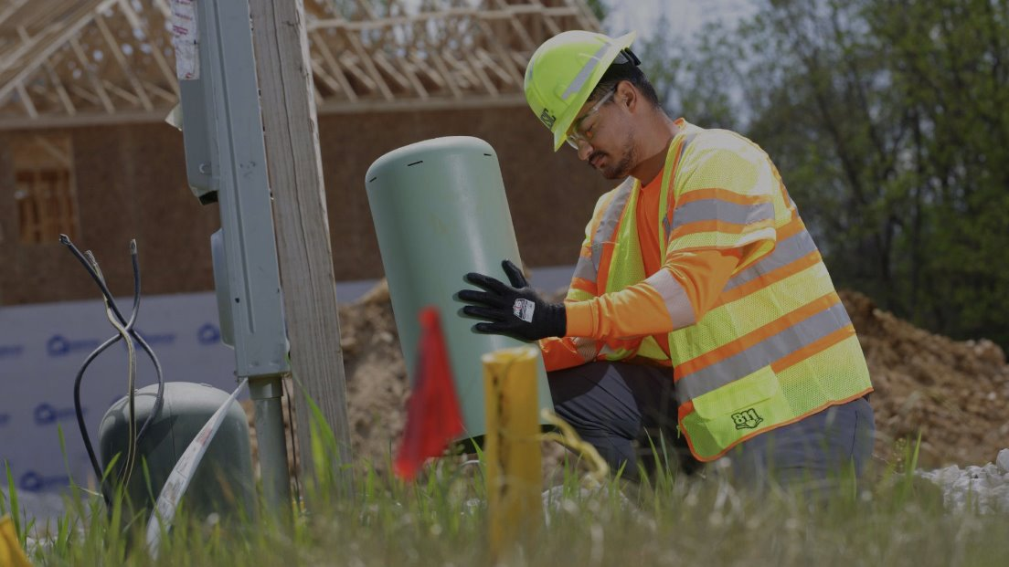
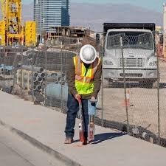
PARTNERS IN DAMAGE PREVENTION
2026

Slide 2
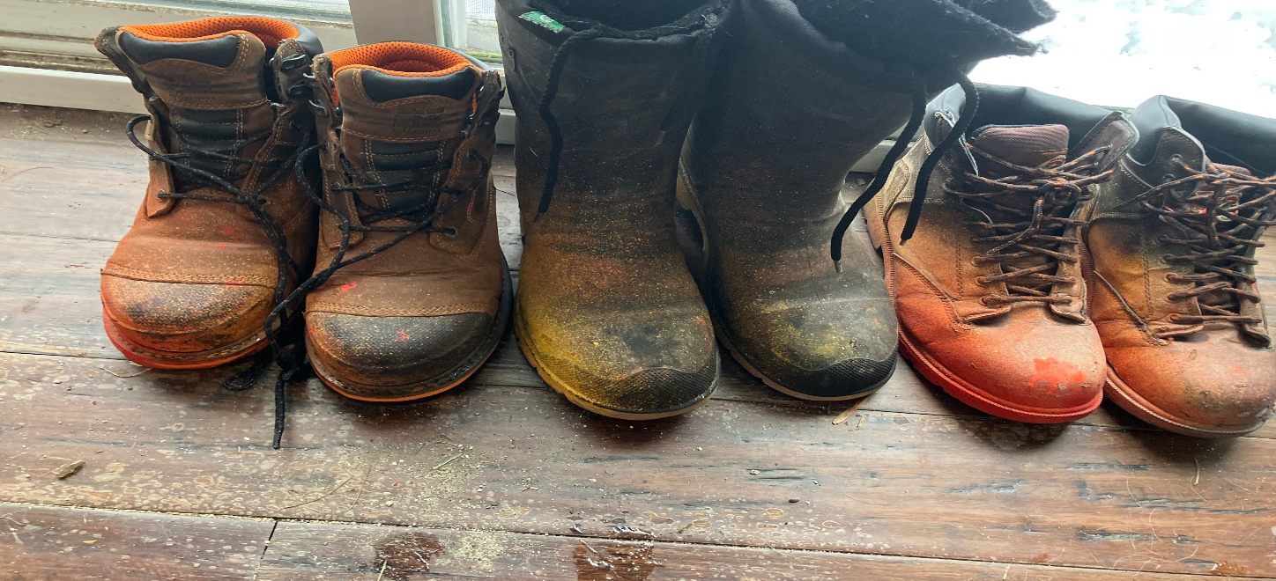
WALK A MILE IN OUR SHOES
Our goal is to work together to reduce damages, down time on projects, and improve safety standards.
Let’s work together to build stronger relationships and safer sites for everyone.

Slide 3
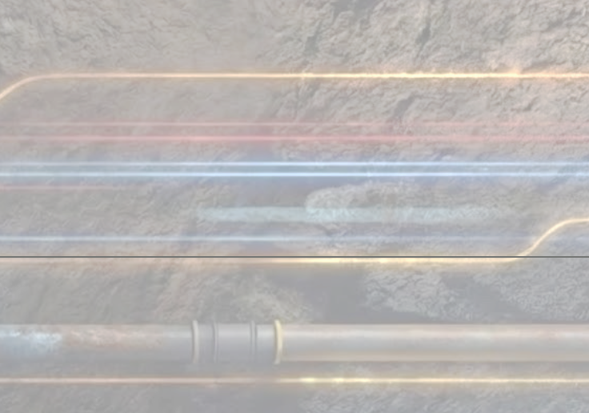
Ticket Expiration Times
In all 5 states, tickets expire if excavation does not commence by the 30th day from the date of issue. Renew tickets online with Exactix or by calling 811.
MA, NH, and VT – 30 days
ME - 60 days, but work must start within 30 days
RI - Tickets do not expire if the marks are maintained.

Slide 4
Dates
Ticket Start Dates: We must respond within
72 business hours in MA, ME, NH, VT and RI
Weekend and holidays don’t count toward the start date

Slide 5
Dates
Remarks: Remark notices can be submitted if marks are faded and your ticket is still valid
48 business hours in RI
72 business hours in VT (new ticket)
72 business hours in New Hampshire (new ticket)
24 business hours in MA and ME
Tickets do not expire in RI

Slide 6
In Reference Notice
Call 811 to have a message sent out regarding an existing ticket
Report no marks
Ask for clarification of marks
Add sub-contractor
Provide additional location information

Slide 7
Ticket Process: Start to Finish
Once you get your work order you should complete the following steps.
Visit the site
Pre-mark entire work area, including all poles on the ticket if for pole replacements
Make sure your pre-marks match the entire scope of work

Slide 8
Ticket Process: Start to Finish
4. Submit a ticket with Exactix at DigSafe.com or by calling 811
5. Include Contact Info of the FIELD PERSON on the ticket:
Phone number
Email address
Alternate phone number
6. Give Description of Jobsite Location:
Address or address range with building/house number
GPS Coordinates
Place names, pole numbers, between cross streets

Slide 9
Ticket Mistakes to Avoid
Putting too much on one ticket
Too many poles
Entire neighborhoods
Town line to Town line
Not enough information on the ticket
Large projects in stages
Correct contact information
Pre-marking
Submitting tickets too early

Slide 10
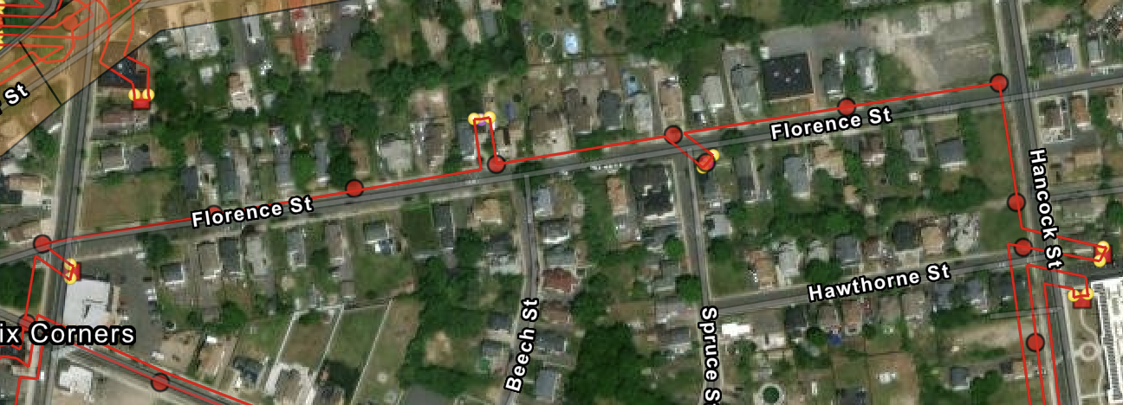
Long Mark outs

Slide 11
Renewals & Ongoing Projects
Updating the pre-marks when requesting renewals
Submit a new ticket rather than request remarks
Maintaining previous marks

Slide 12
Contractor Responsibilities
Remember that the excavator is responsible for maintaining the marks for 30 days
Use the appropriate paint color and type of markings when you are maintaining the marks
Take pics/videos before any work takes place

Slide 13
Importance of Pre-Marks
Pre-marks are required for all tickets
2. Required to be completed prior to submitting ticket
Must be marked in white paint, stakes, ribbons or flags.
In winter time use Pink paint for Pre-marks
4. Label with contractor name or initials

Slide 14
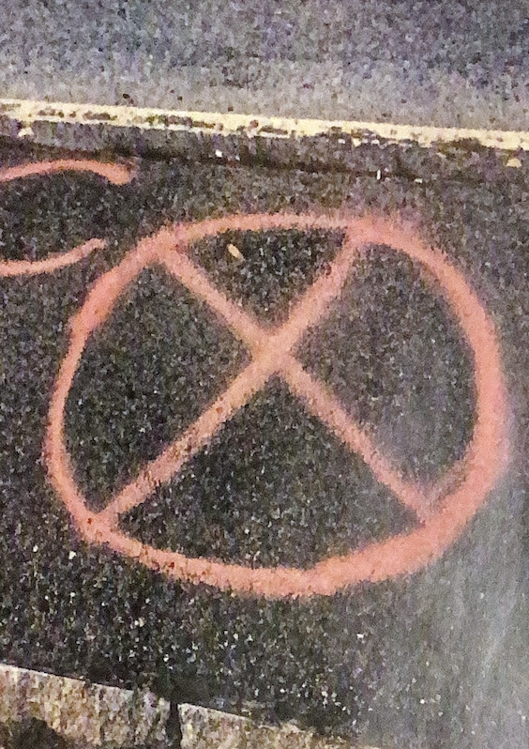
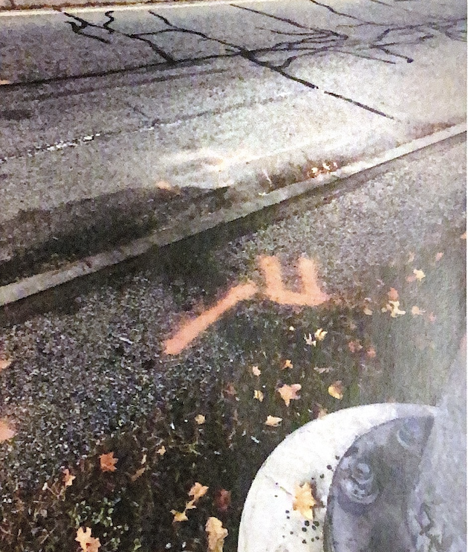
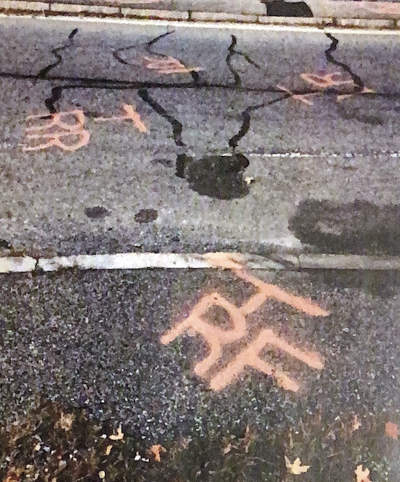
Bad pre-marks

Slide 15
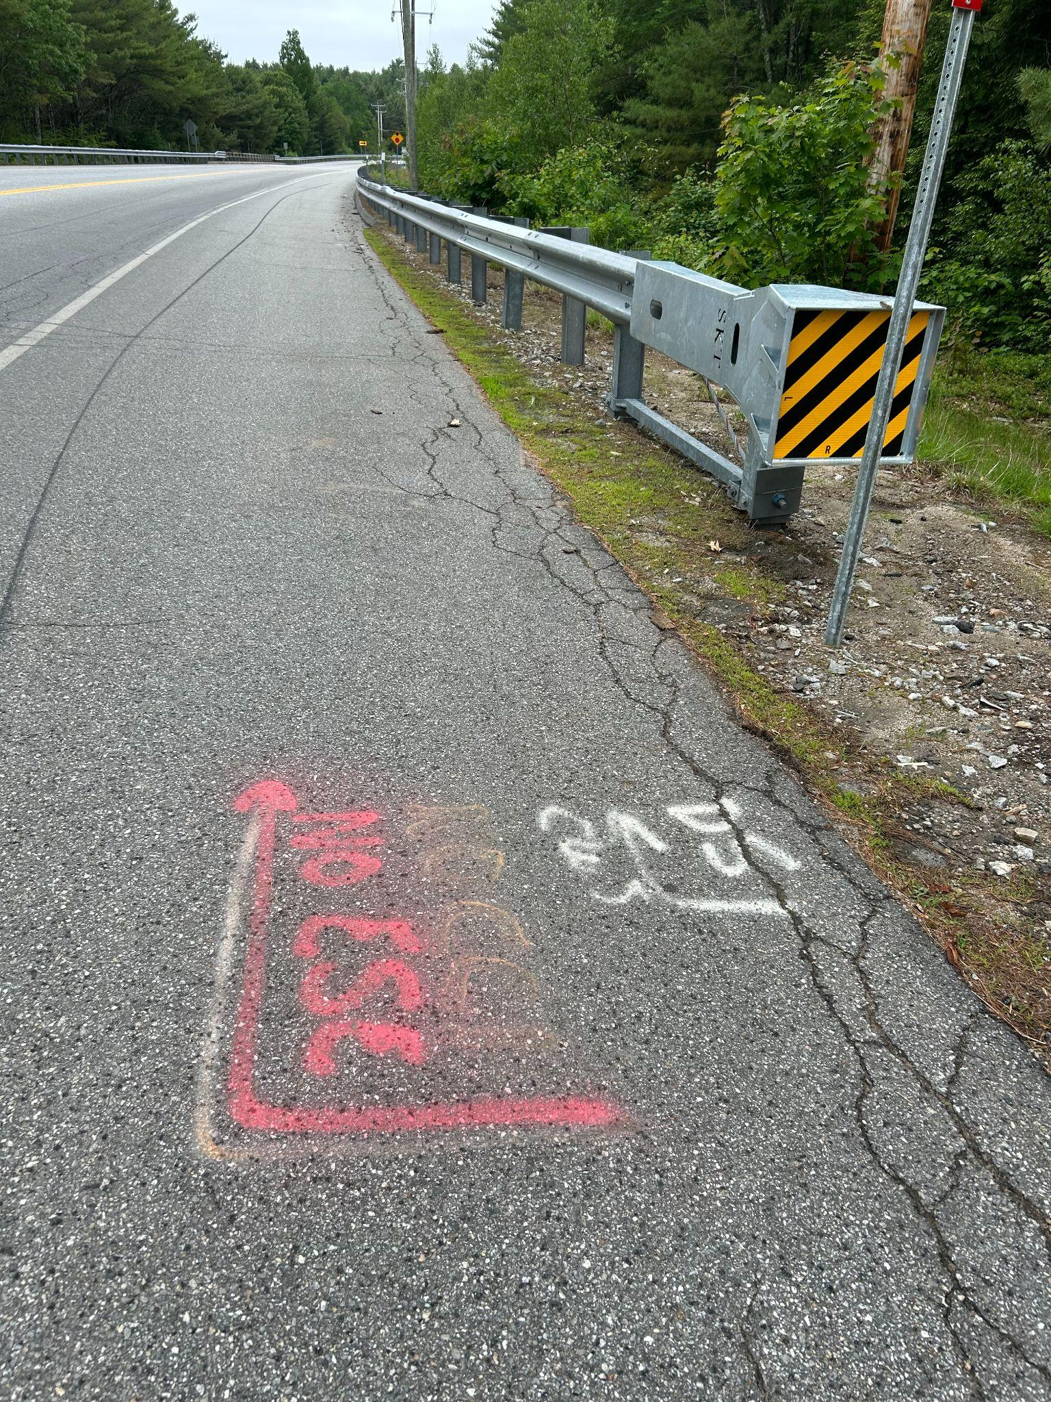
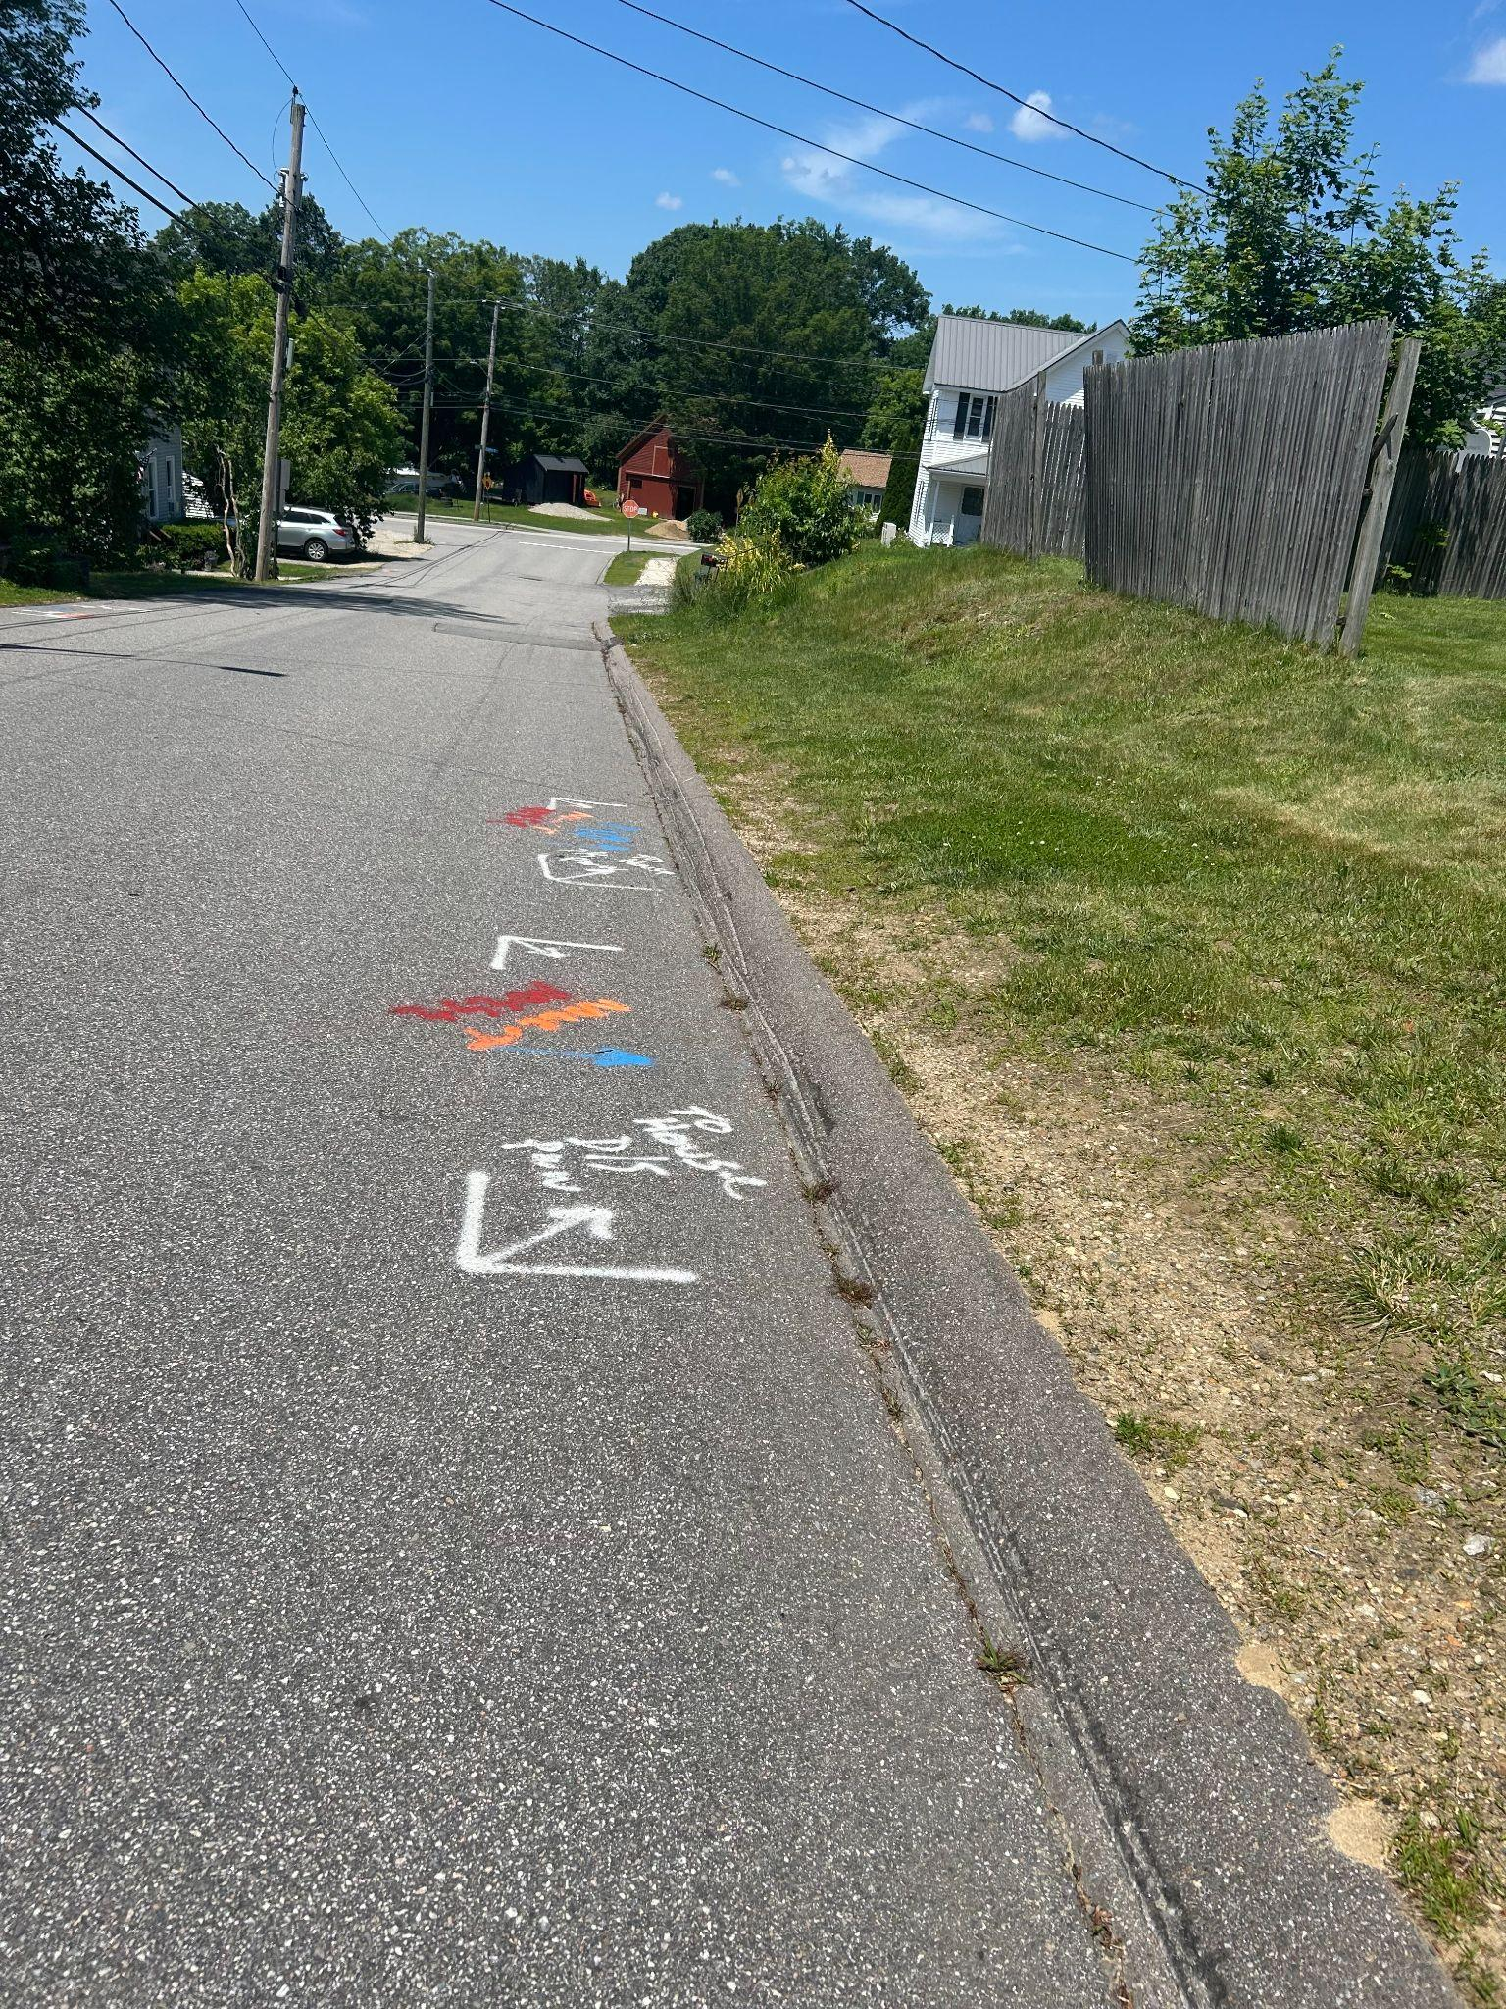
Good Pre-Marks

Slide 16
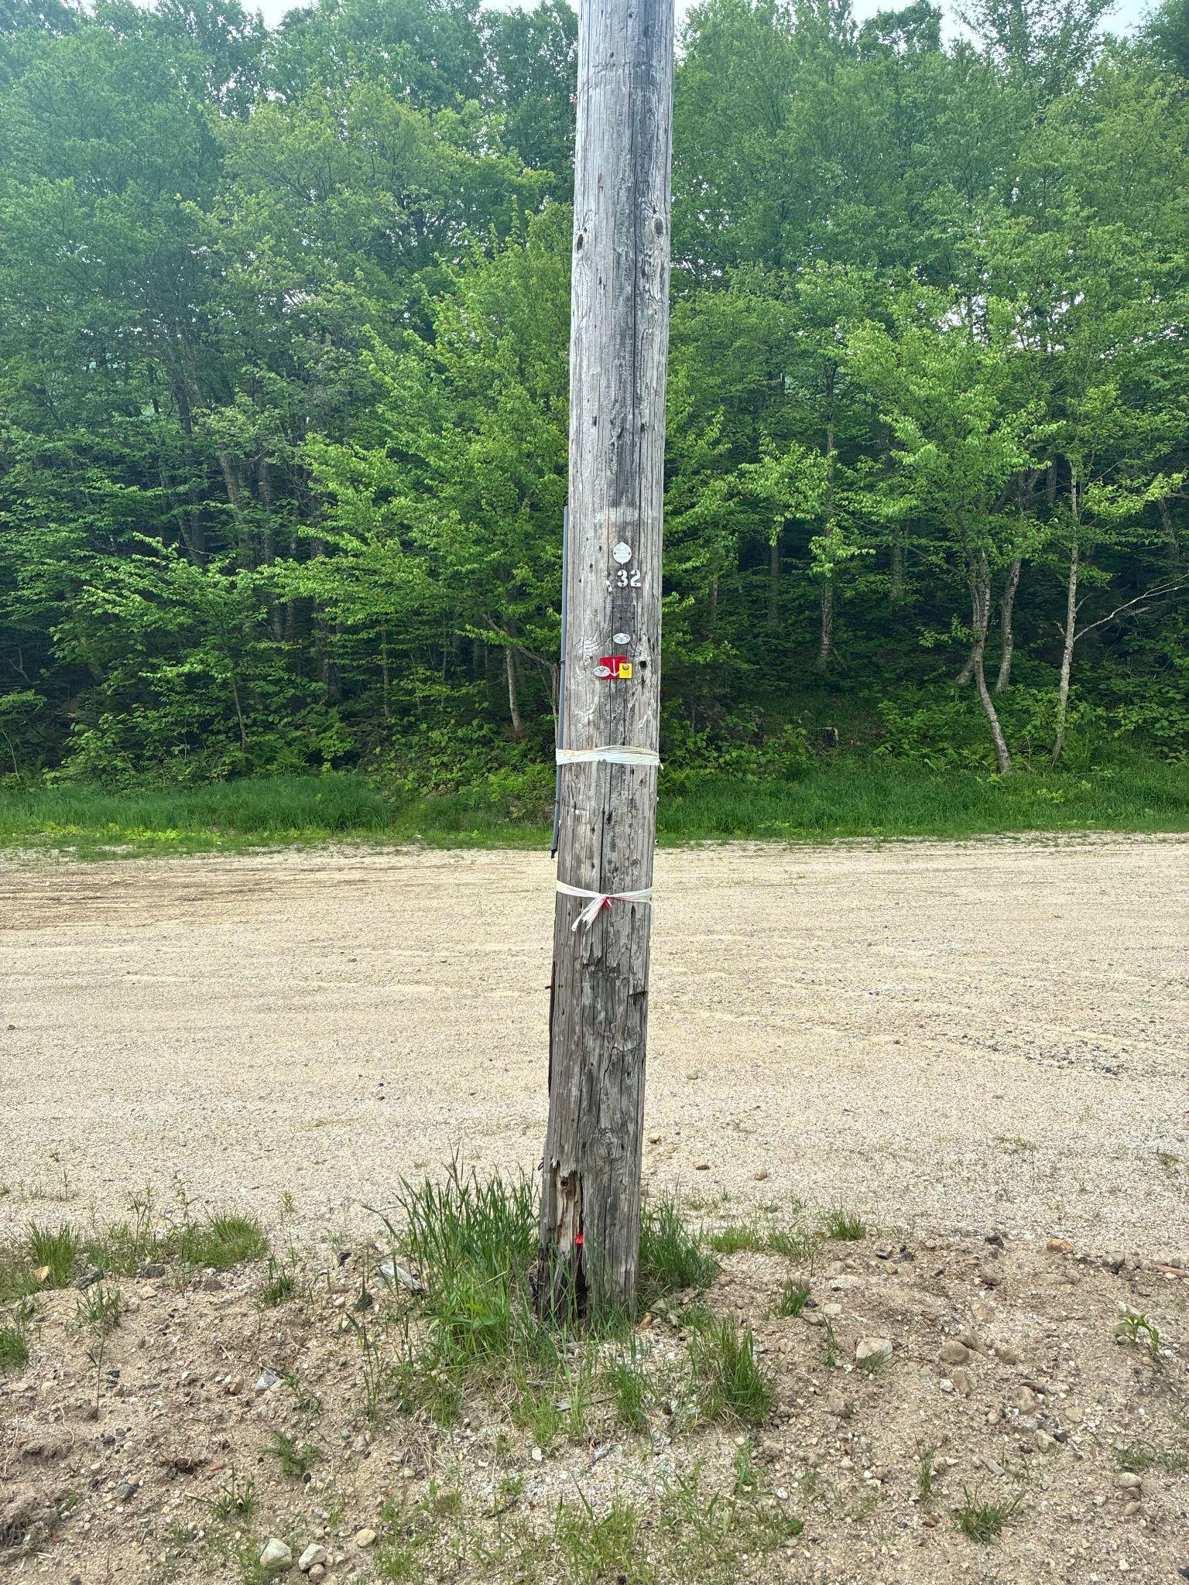
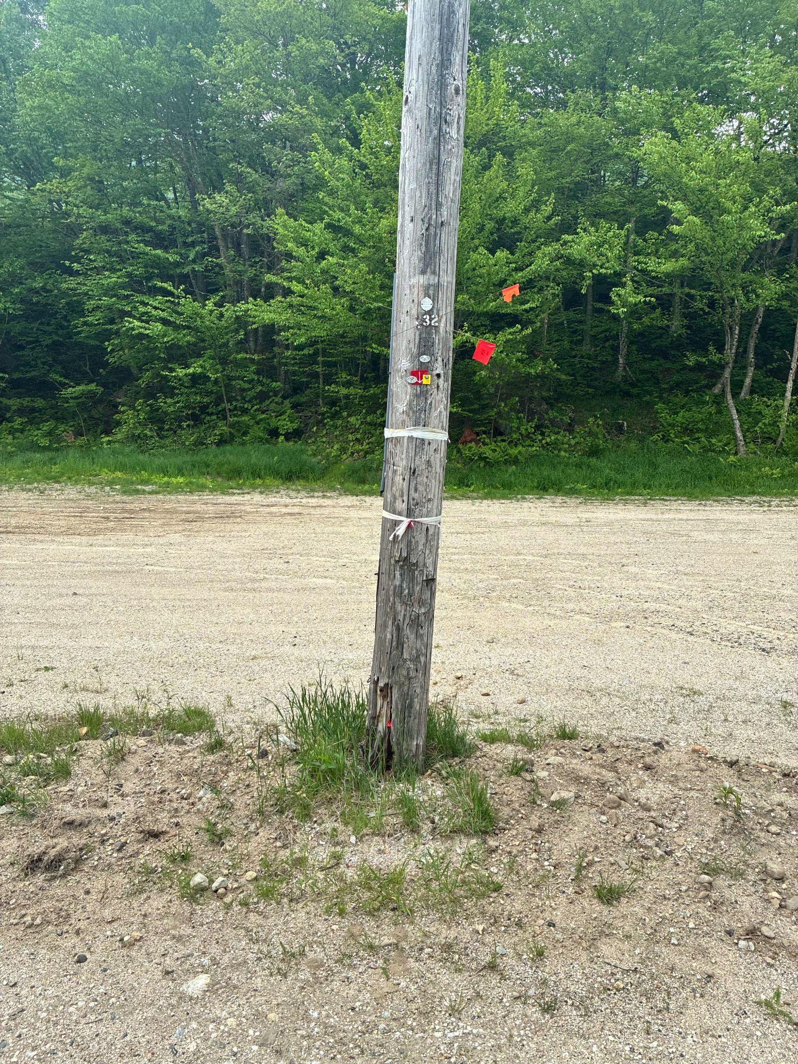
Pre-marked
Marked
Notes:
Pole on the left is pre-marked with white tape. Pole on the right is marked with flags.

Slide 17
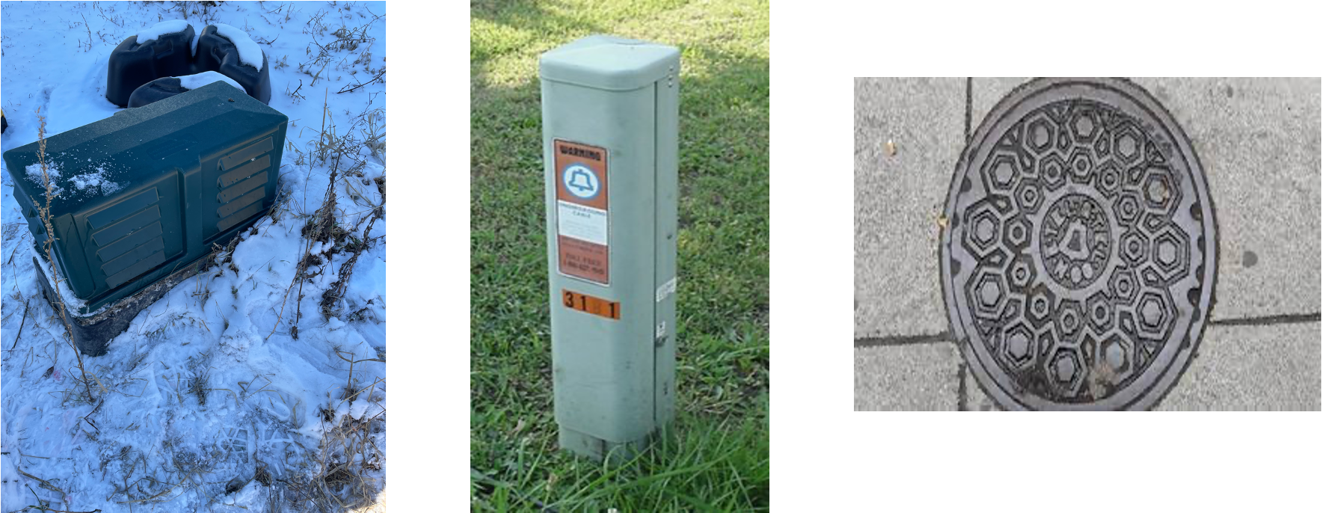
If you see any of these structures with no markings, call before you dig.

Slide 18
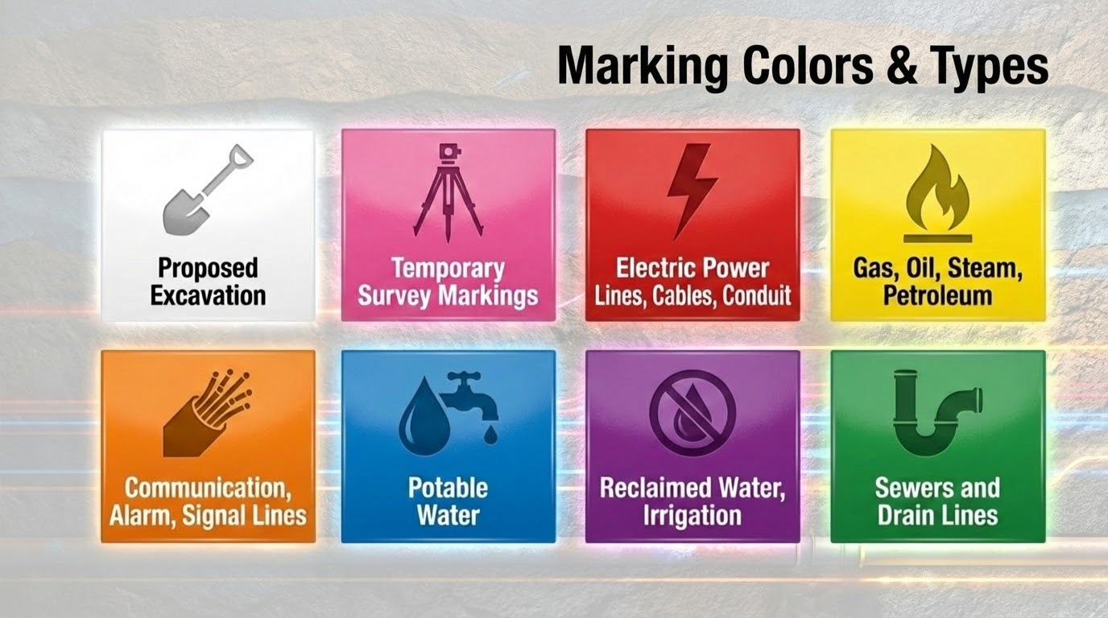

Slide 19
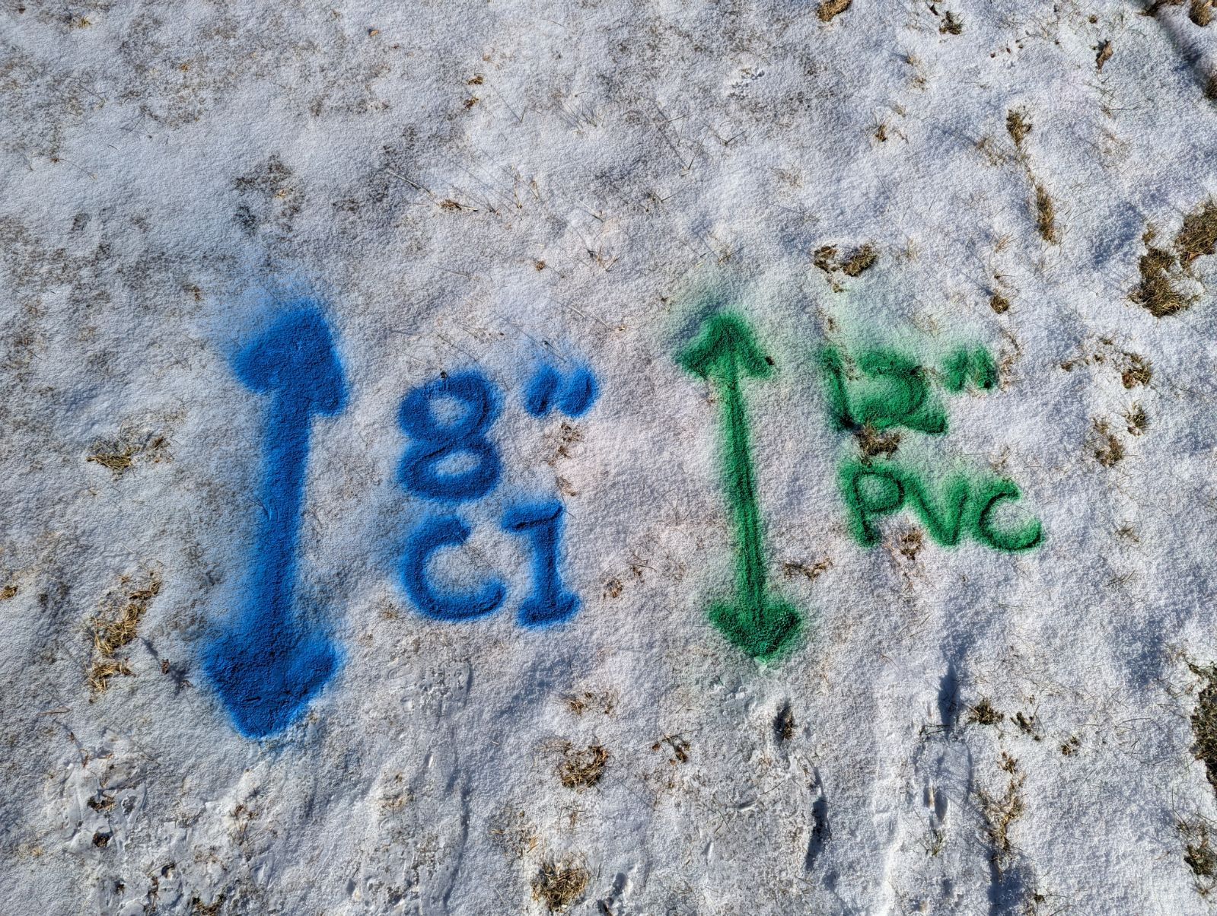
Single Direct Buried Cables with Tolerance Zones (18”)

Slide 20
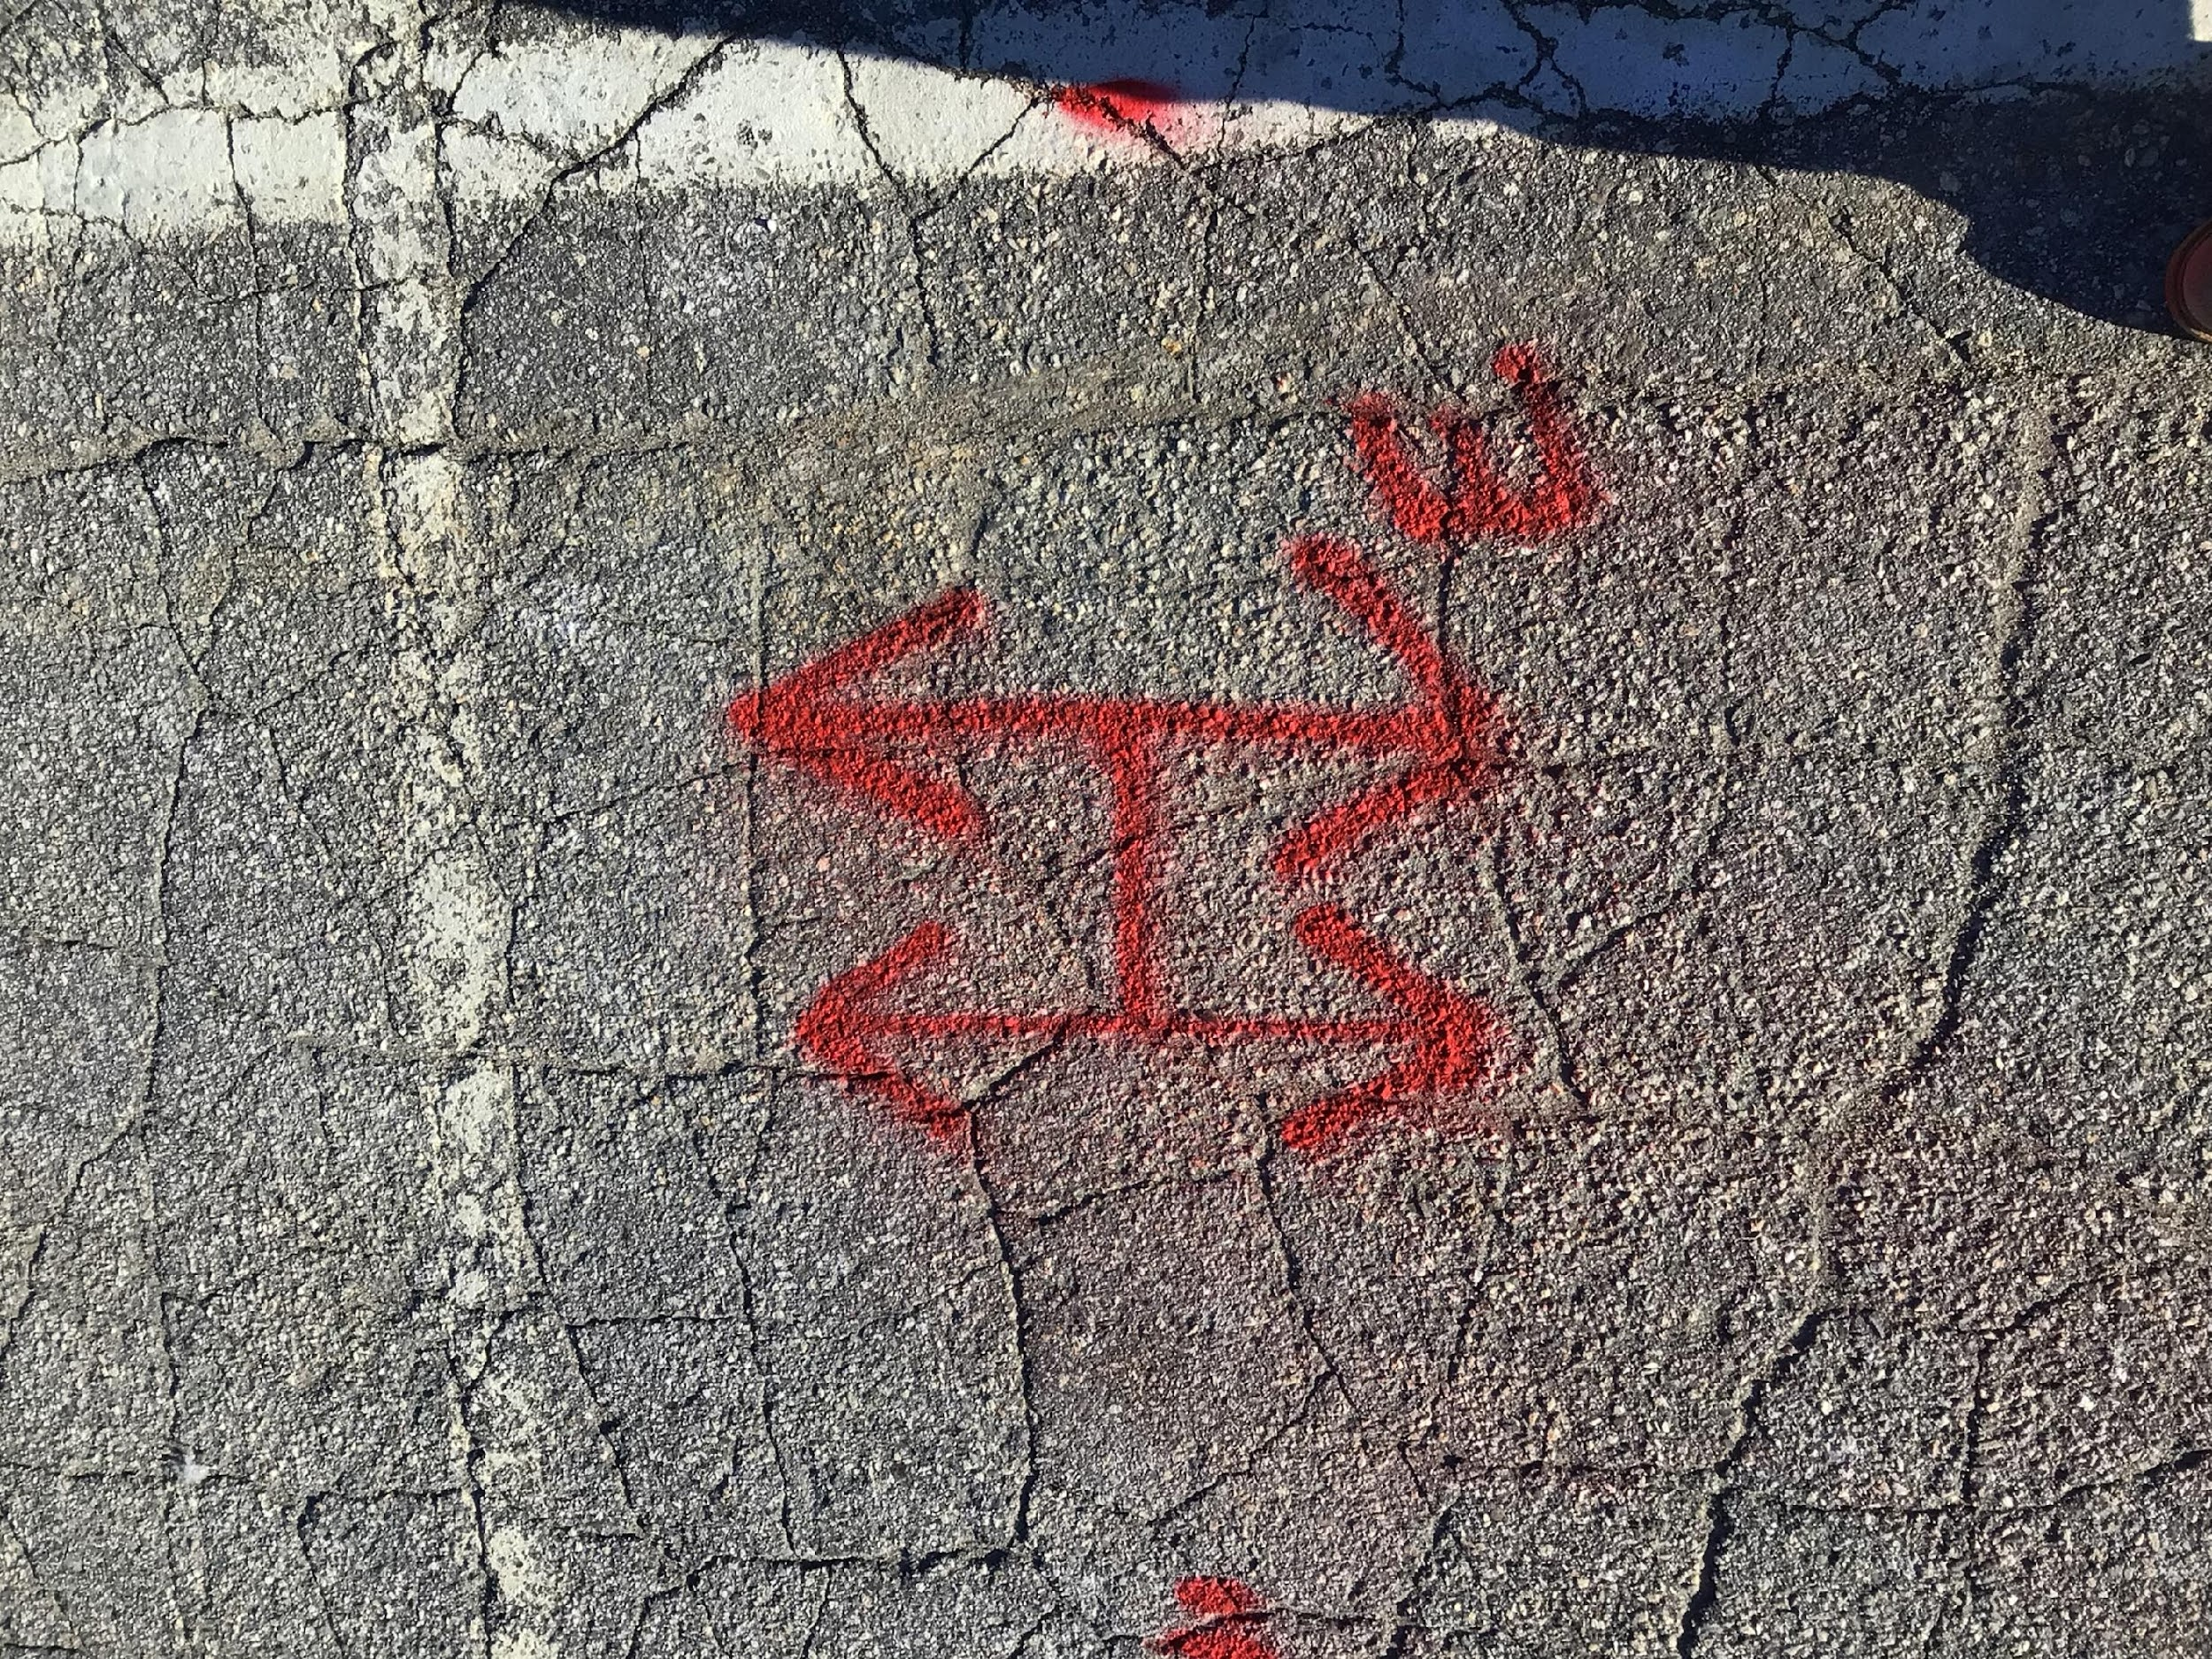
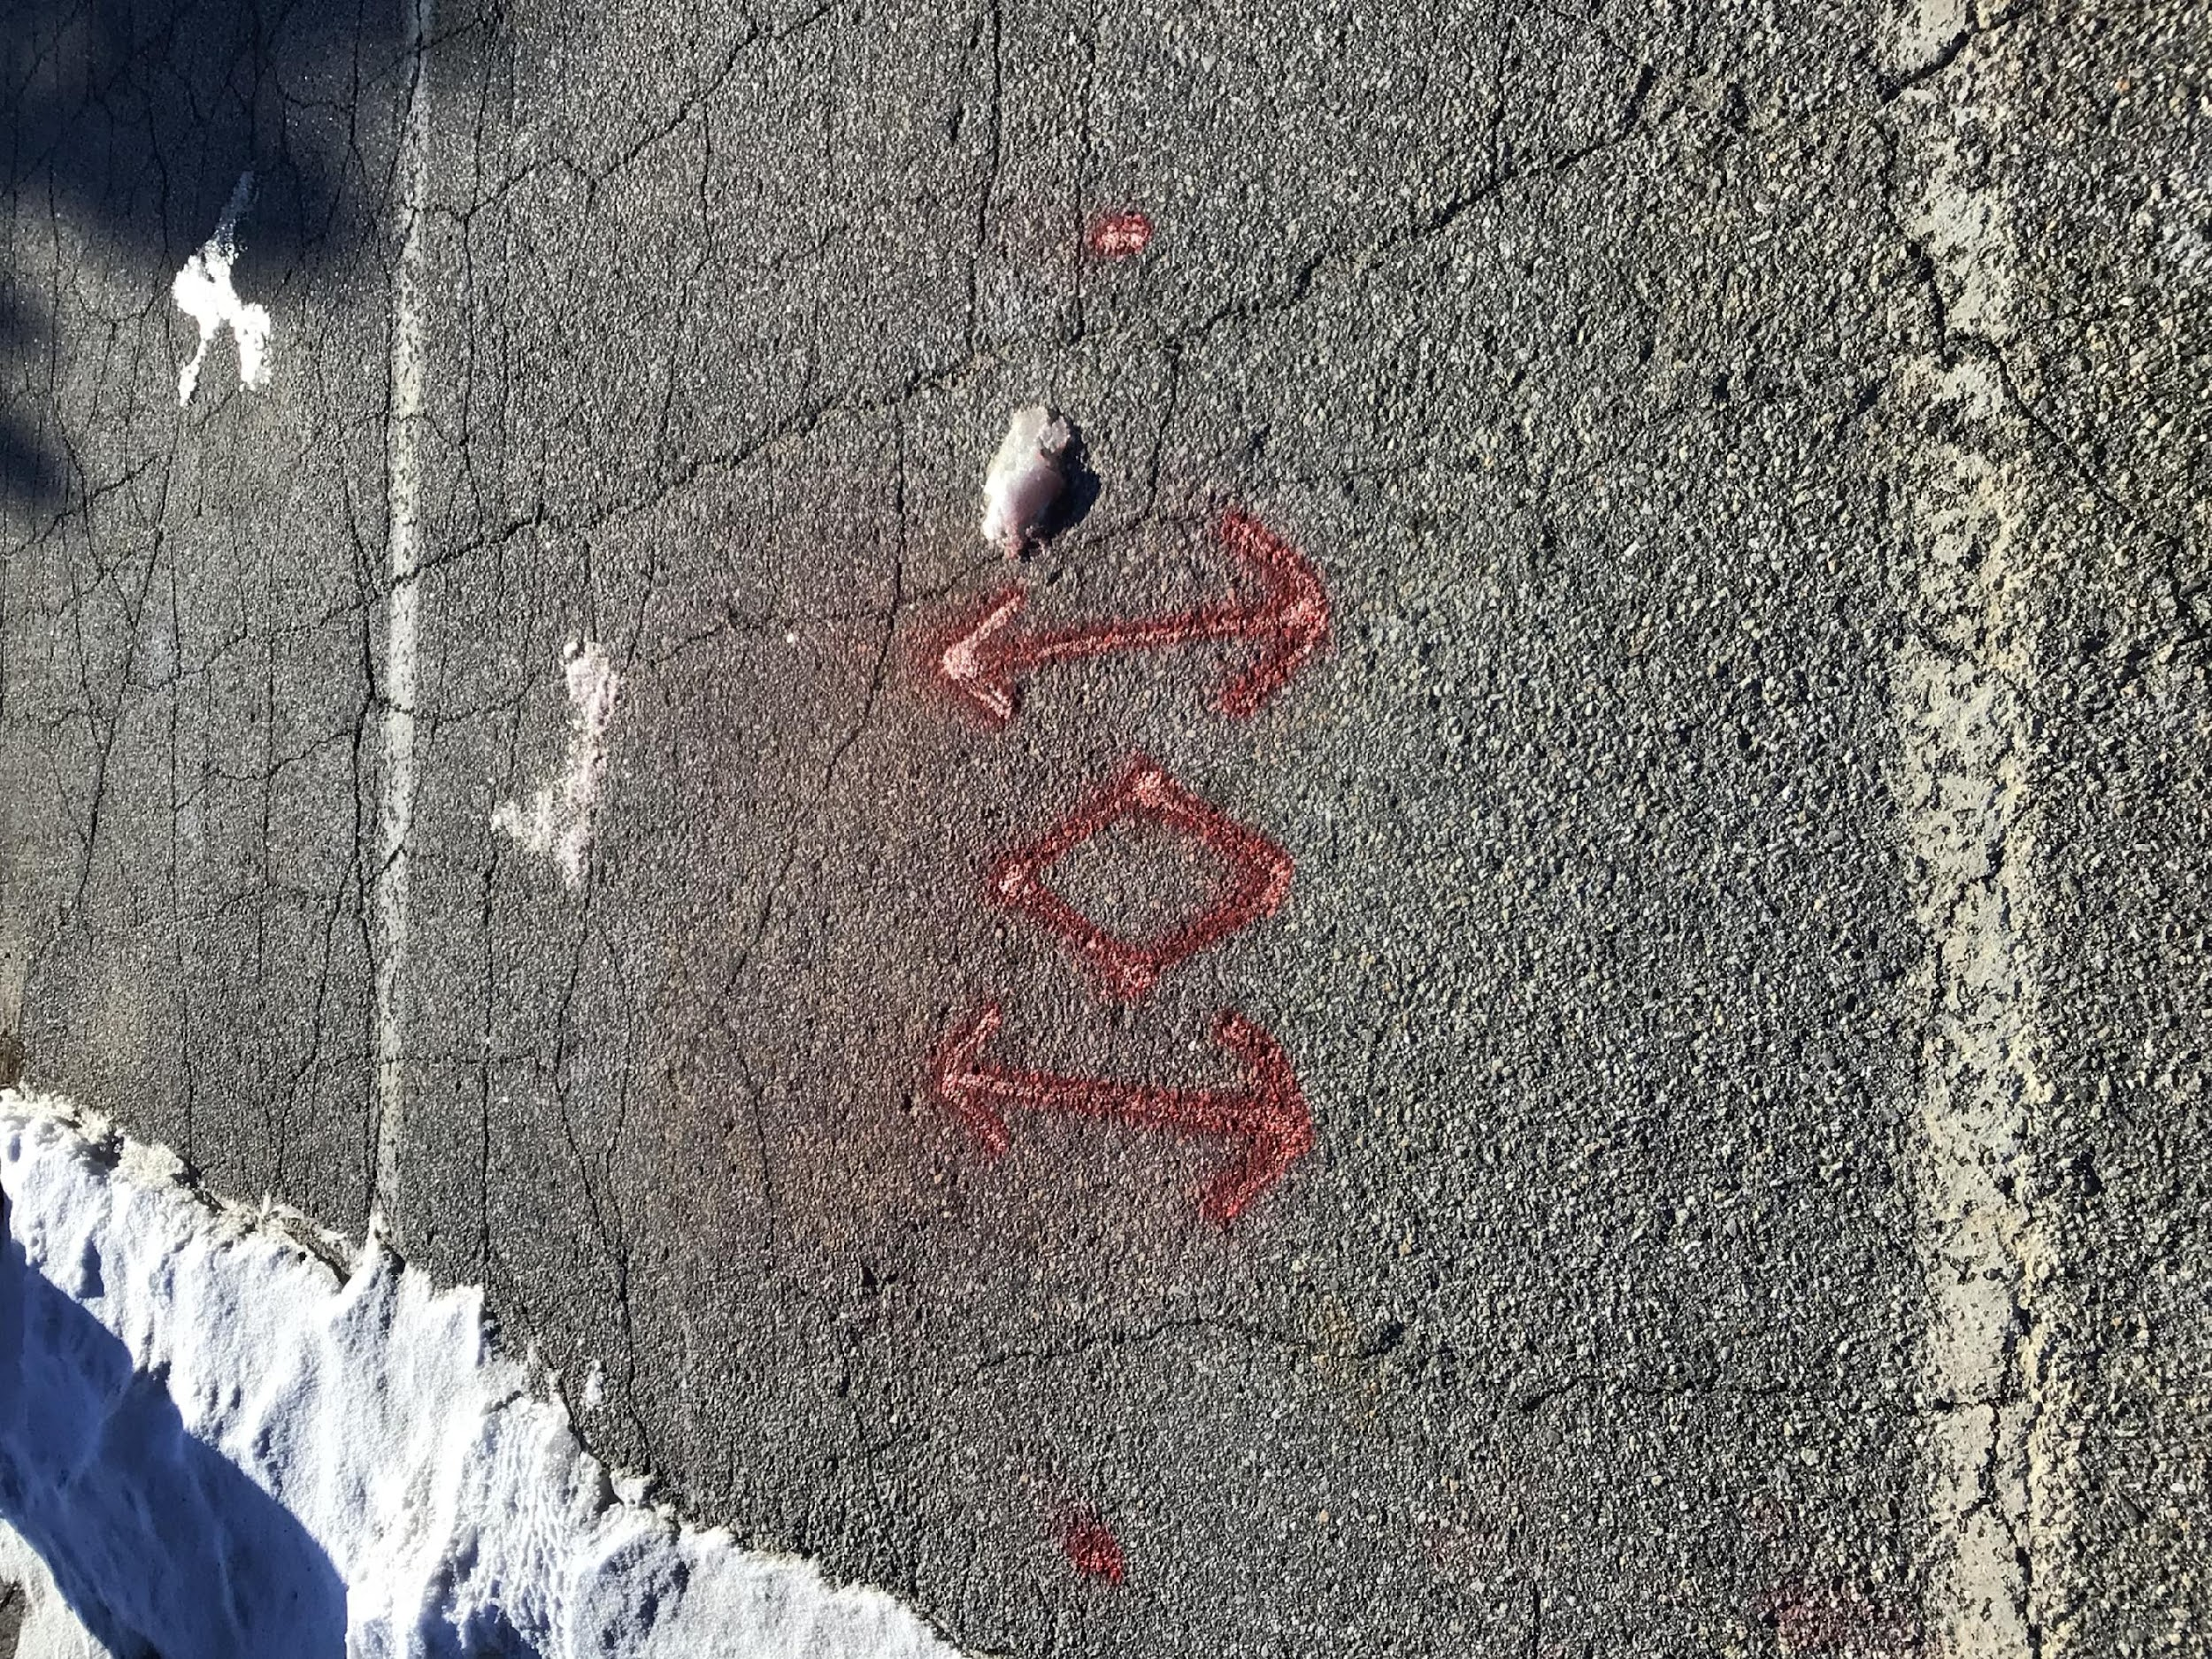
Multiple Direct Buried With Tolerance Zones (18”) and Duct Structure Marks

Slide 21
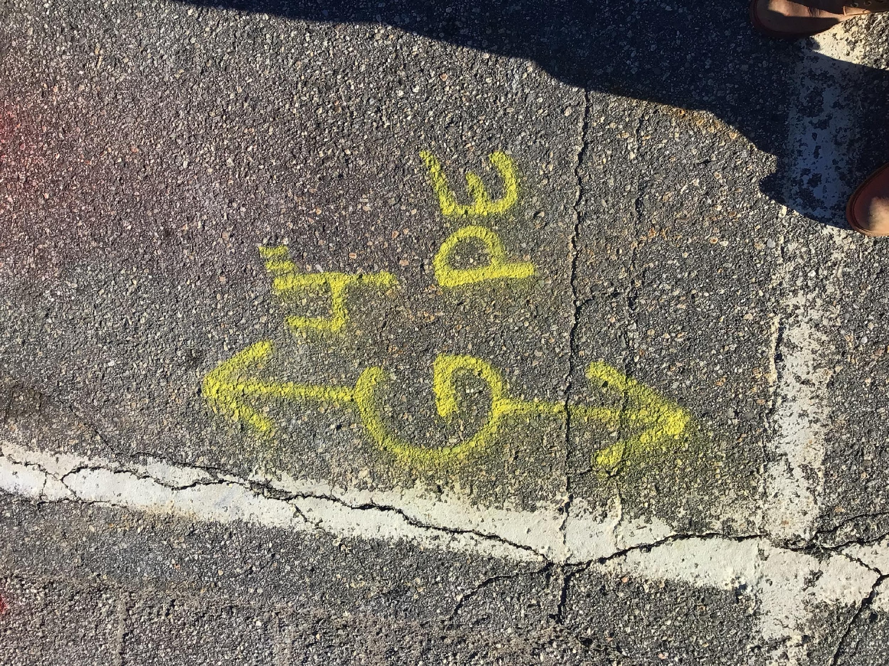
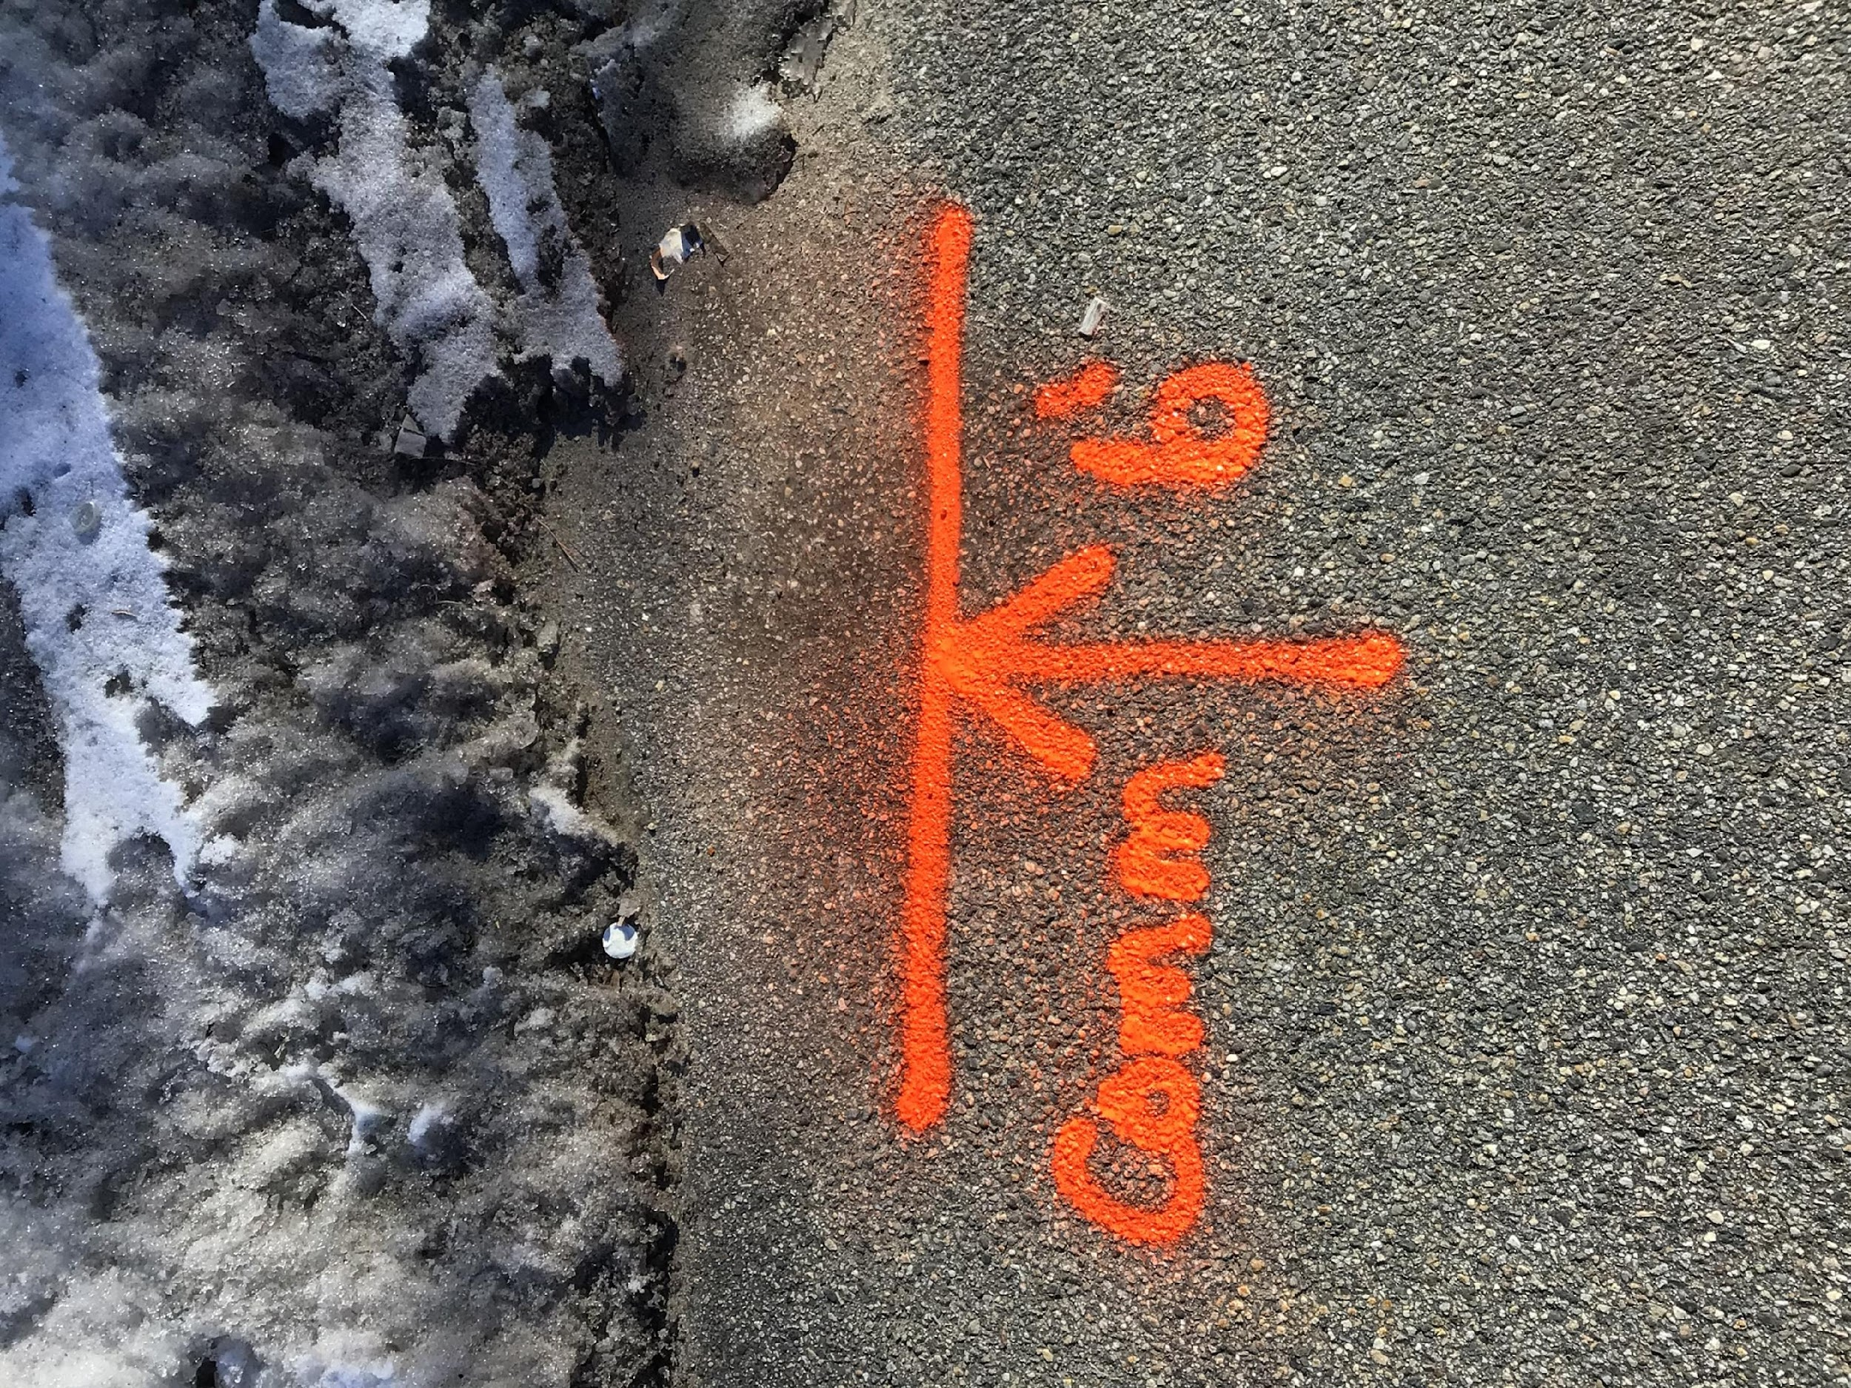
Gas Service and Offset Marks

Slide 22
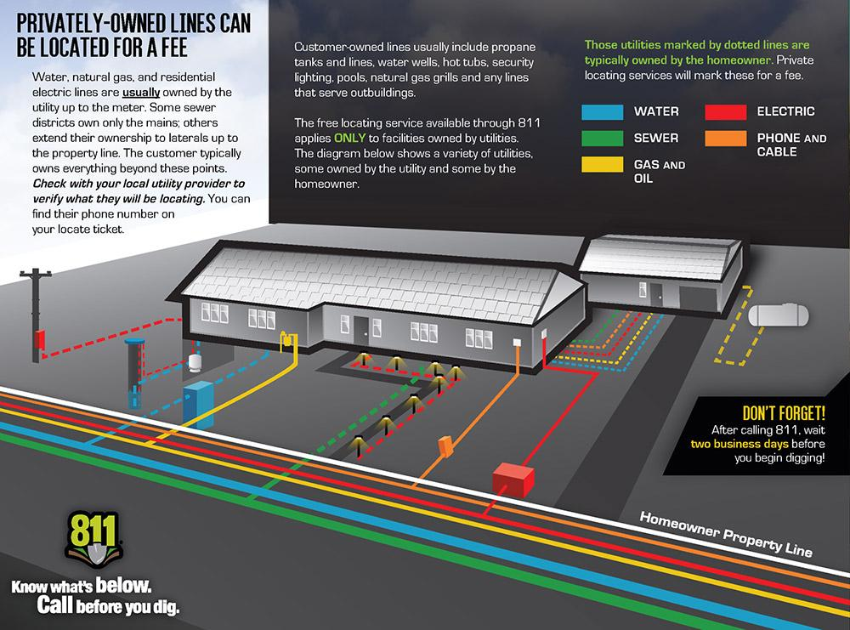
Private vs Public Utilities

Slide 23
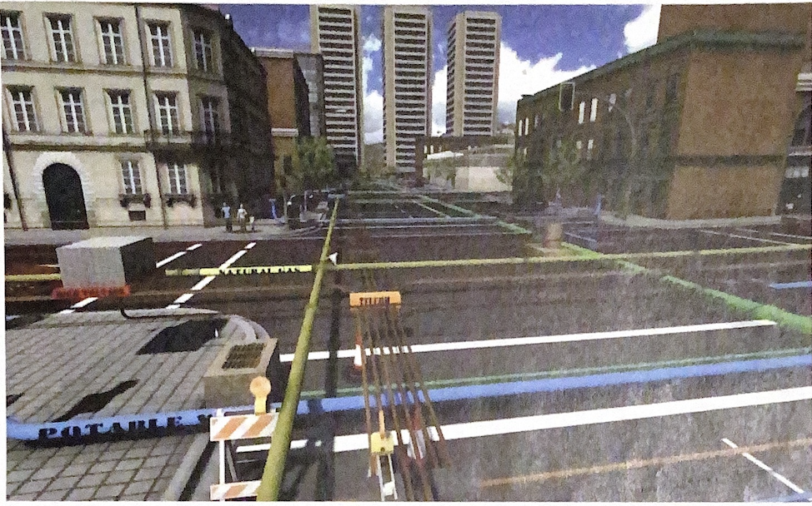
Private vs Public Utilities

Slide 24
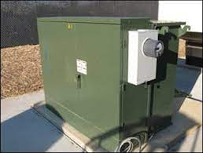
Who Owns That?
For Example:
Electrical Lines after the meter
Sewer Laterals/Services
Water services after the service valves
Most lighting in parking lots/businesses
Most Schools/Universities and Hospitals
Steam lines, propane, O2, drainage

Slide 25
How we can help each other
Communication is Key
If something doesn’t look right, or you don’t see any markings on site, make a phone call
Be willing and prepared to answer questions about a site.
Try to have two or more methods of communication on your ticket (Email/multiple phone numbers)
Have distinct and identifiable pre-marks at your job site

Slide 26
How we can help each other
Try to stagger the tickets that you submit.
Tickets for multiple large jobs submitted at once is very difficult to complete on time
One or two poles/anchors per ticket, rather than 8-10
Break down tickets for large jobs in sections, rather than all in one ticket.

Slide 27
How we can help each other
It’s good practice to have a copy of the ticket info on site because:
Multiple locators will arrive on site to respond to different utilities
Great way to track which utilities have already marked/cleared the site

Slide 28
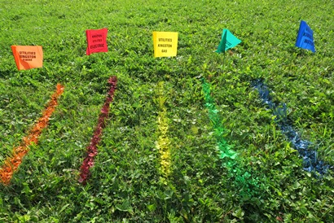
What you can expect from us
Safe Excavation
On-time quality locates
Less extensions
Less damages
Less work stoppages

Slide 29
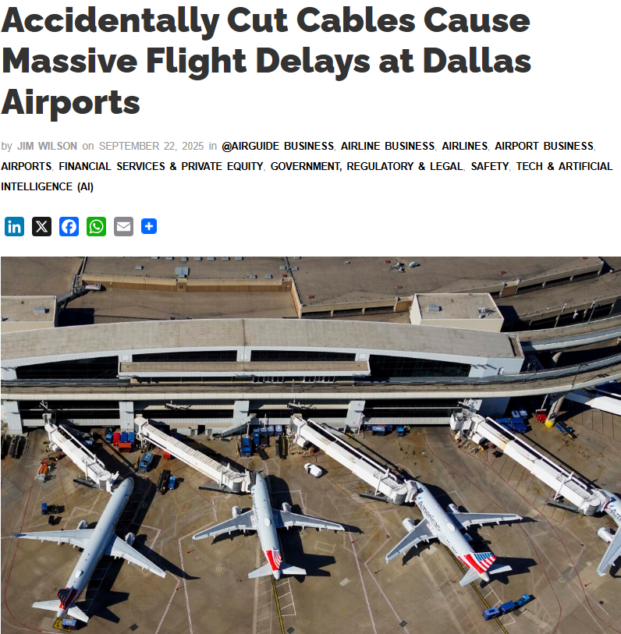
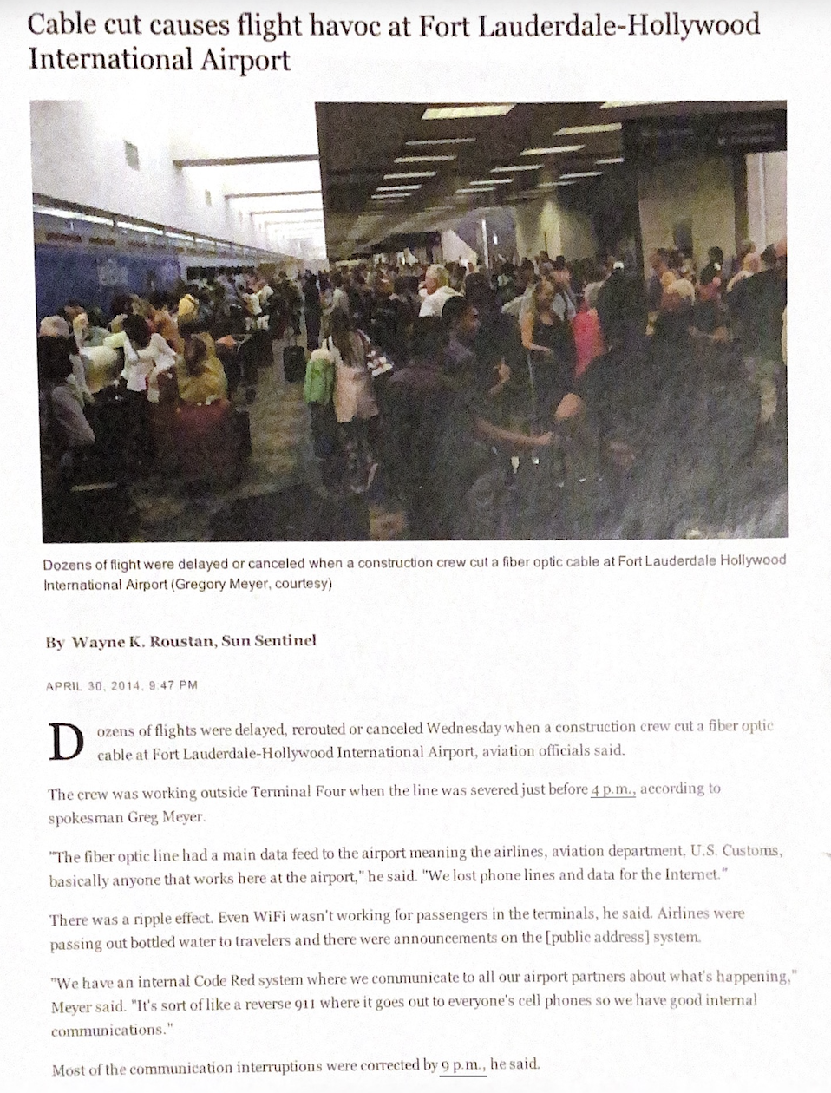

Slide 30
NH RULE CHANGE
d) Excessive notifications by the same excavator on the same day may constitute extraordinary circumstances causing an operator to be unable to designate the location of underground facilities in a timely manner as required in En 806.02. It shall be presumed to be an extraordinary circumstance causing an operator to be unable to designate the locations of underground facilities as required in En 806.02 when the same excavator makes in excess of 15 notifications on the same day, provided that the operator complies with En 806.01(g) with respect to the notifications in excess of 15.

Slide 31


Points of Contact
(207) 852-8315
(317) 575-7800

