Slide 1

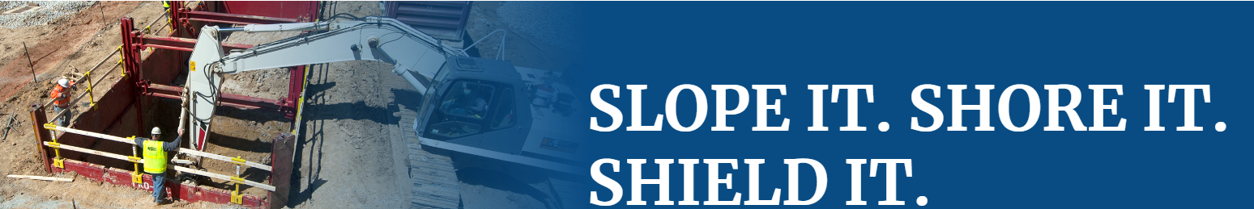

Slide 2

Agency Priority:
National Emphasis Program on Trenching & Excavating
→ Reduce Trenching Hazards Through Enforcement and Compliance Assistance
Oct 1, 2018 - National Emphasis Program on Trenching & Excavation
→ CSHOs shall initiate inspections under this NEP whenever they observe an open trench or an open excavation, regardless of whether or not a violation is readily observed.

Slide 3
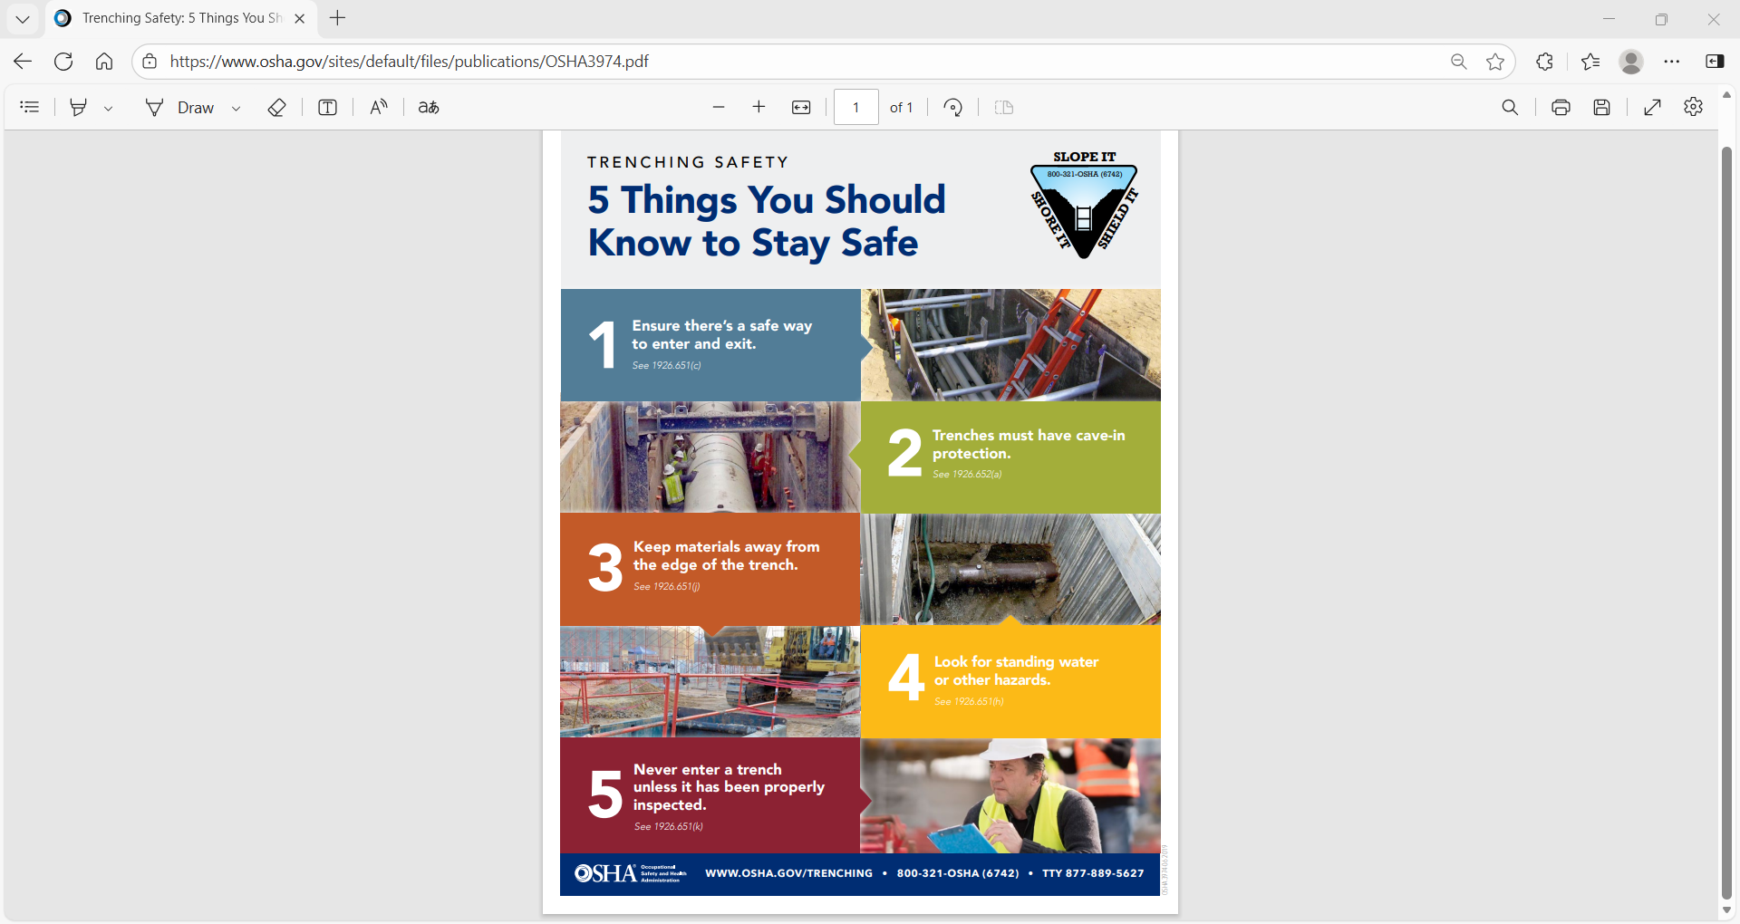

Slide 4
OSHA Penalty Levels: 2026
Type of Violation | New Maximum
Serious and Other-Than-Serious Posting Requirements | $16,550 per violation
Willful or Repeated | $165,514 per violation
Failure to Abate | $16,550 per day beyond the abatement date

Slide 5
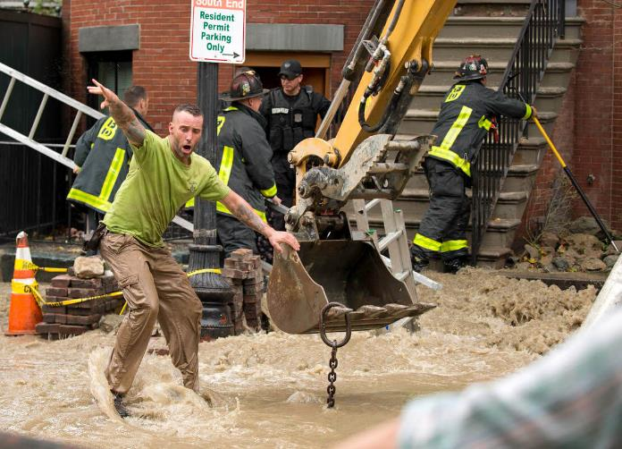
Atlantic
Drain
Trenching
Fatality
The Standard Times

Slide 6

Criminal Investigation Team
The owner of a company involved in a deadly trench collapse in Boston three years ago has been convicted on two counts of manslaughter in connection with the incident that killed two workers.
Atlantic Drain Service and owner Kevin Otto were found guilty Thursday in a jury-waived trial in Suffolk County Superior Court, the office of District Attorney Rachael Rollins said.
Robert Higgins and Kelvin Mattocks, employees of Atlantic Drain Service Co., were killed on Oct. 21, 2016, when the trench in which they were working collapsed and filled with water from a fire hydrant supply line.
The Boston Globe

Slide 7


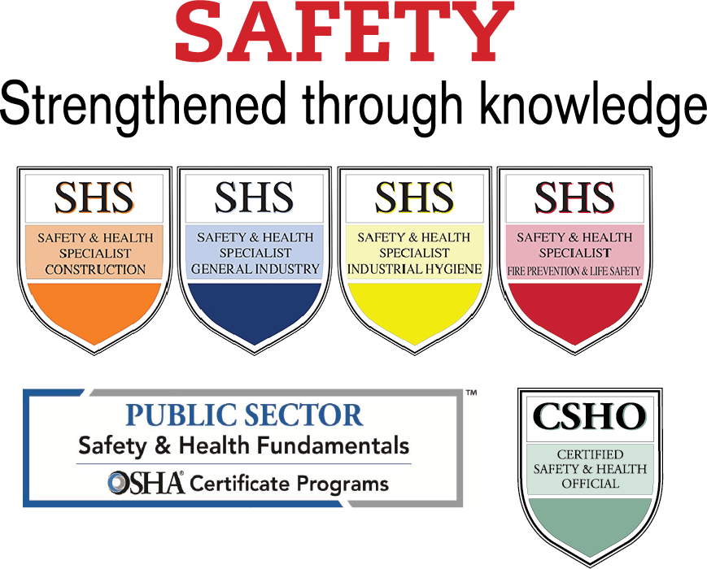

New England Boston OSHA Education Center /
Keene State College
Offers more than 30 of OSHAs premier OTIEC courses and Outreach training plus 30+ additional safety courses through Keene State College Safety Center
  Train about 3,000 students each year
Open enrollment in all six states with headquarters in Manchester NH
Customized on-site training available
Virtual Instructor Led Training

Slide 8

On-Site Consultation Program
Primarily for smaller businesses, no-cost, confidential consultations help employers identify and address hazards and establish or improve safety and health programs. Services are provided by consultants from state agencies or universities.
Did you know that the OSHA On-Site Consultation Program prevents over 8,700 workplace injuries and saves the U.S. economy almost $1.5 billion every year? Learn more about how OSHA On-Site Consultation benefits small business employers, workers, and the worker's compensation system.

