Slide 1

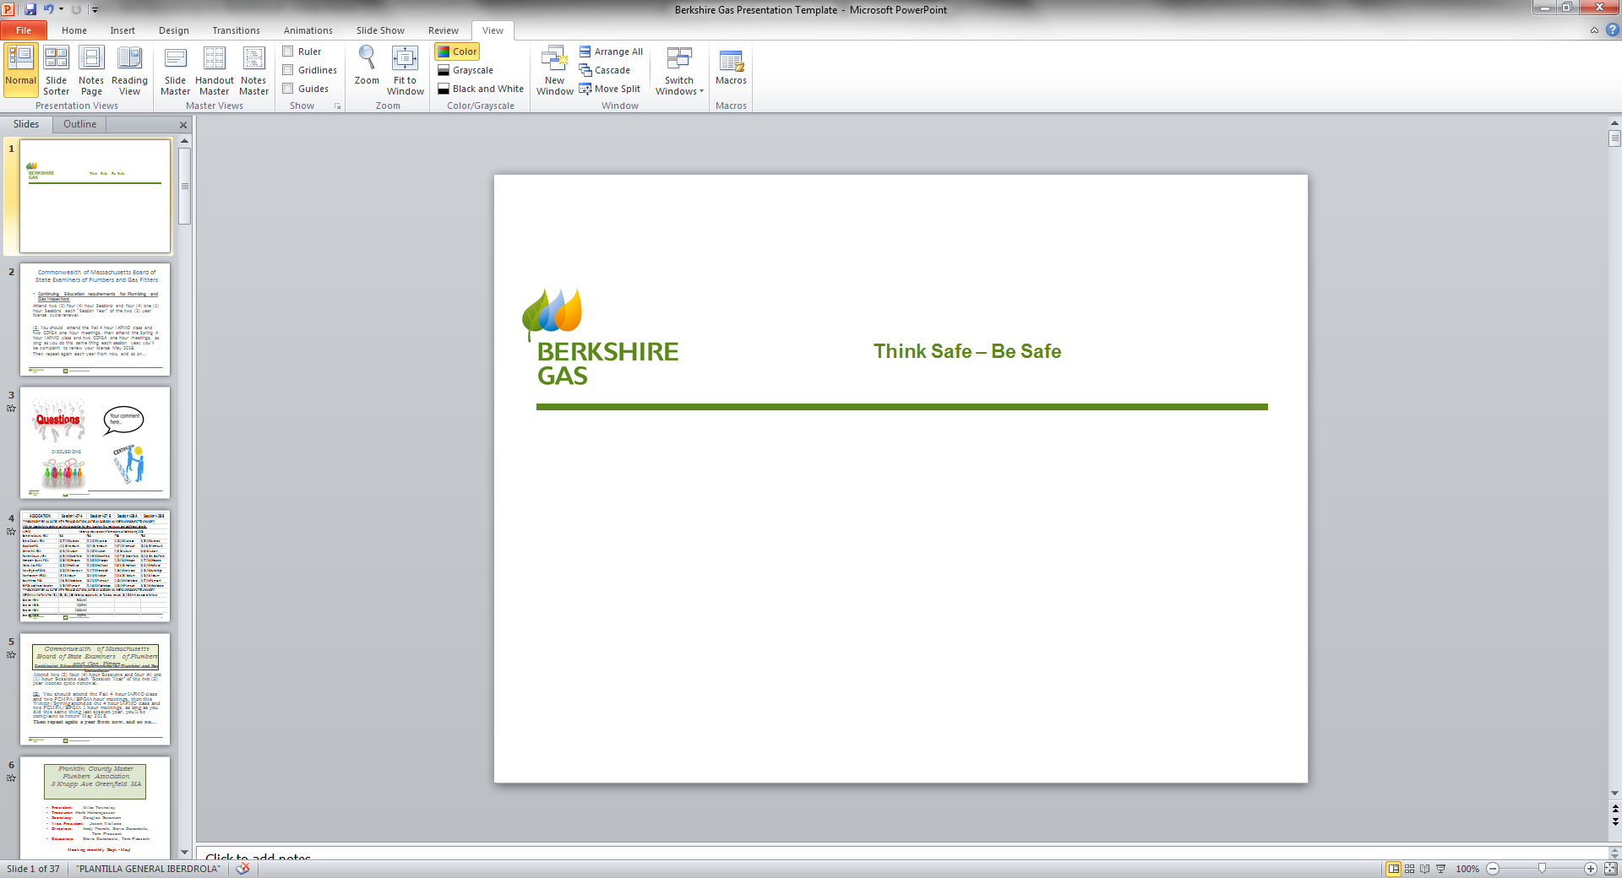

February 24, 2026

Slide 2
The Importance of Pre-marking
Safety First: Premarks identify exactly where the digging will happen.
Legal Requirement State law mandates pre-marking before calling 811.
Locating Efficiency: The helps utility locators focus their efforts, leading to faster and more accurate markings of underground facilities.
Cost & Time Savings: Prevents damage, which avoids expensive repairs, project shutdowns, and potential legal issues, keeping your project on schedule.
Clear Communication: Provides a visual, universal language (white paint/flags) for excavators to communicate the scope of work to locators, even for non-member utilities.

Slide 3
Section 40A: Excavations; notice
Section 40A. No excavator installing a new facility or an addition to an existing facility or the relay or repair of an existing facility shall, except in an emergency, make an excavation, in any public or private way, any company right-of-way or easement or any public or privately owned land or way, unless at least 72 hours, exclusive of Saturdays, Sundays and legal holidays but not more than 30 days before the proposed excavation is to be made, such excavator has premarked not more than 500 feet of the proposed excavation and given an initial notice to the system. Such initial notice shall set forth a description of the excavation location in the manner as herein defined. In addition, such initial notice shall indicate whether any such excavation will involve blasting and, if so, the date and the location at which such blasting is to occur.

Slide 4
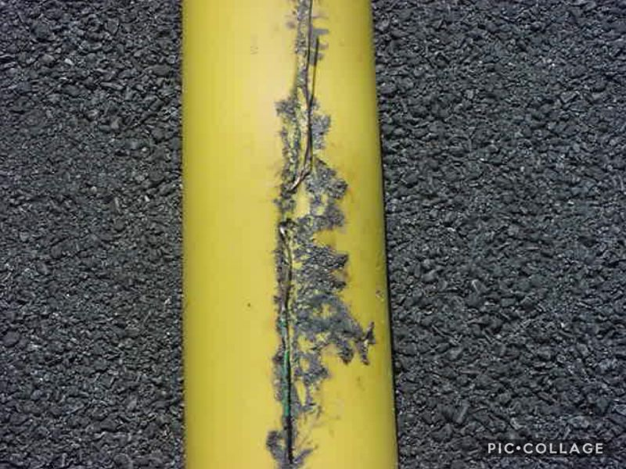
Locating Challenges
Tracer wire broken, corroded or damaged (i.e. lightening strike)
Inadequate or missing pre-marks
Scope of work is excessive
Description of work is lacking

Slide 5
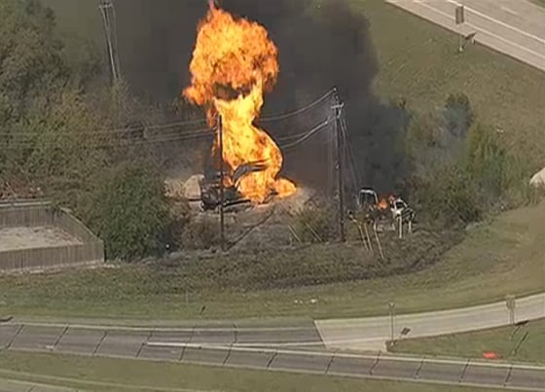

Accidents Happen Be Prepared

Slide 6

When an excavator causes any damage to an underground facility, the excavator shall:
CALL 911 IMMEDIATELY IF THE DAMAGE RESULTS IN THE ESCAPE OF ANY REGULATED NATURAL OR OTHER GAS !!
Evacuate nearby structures if necessary;
Report the damage to the facility owner or operator at the earliest practical moment following the discovery of the damage;
ATTEMPT NO REPAIRS, UNLESS DIRECTED TO BY THE FACILITY OWNER OR OPERATOR; and
Report the damage to the Department of Public Utilities within 30 days using a form deemed necessary and appropriate by the Department.

Slide 7
Berkshire Gas Company Dispatch Center
24/7 Call Direct!
Direct lines:
1-413-445-0230 OR
1-413-445-0286

Slide 8
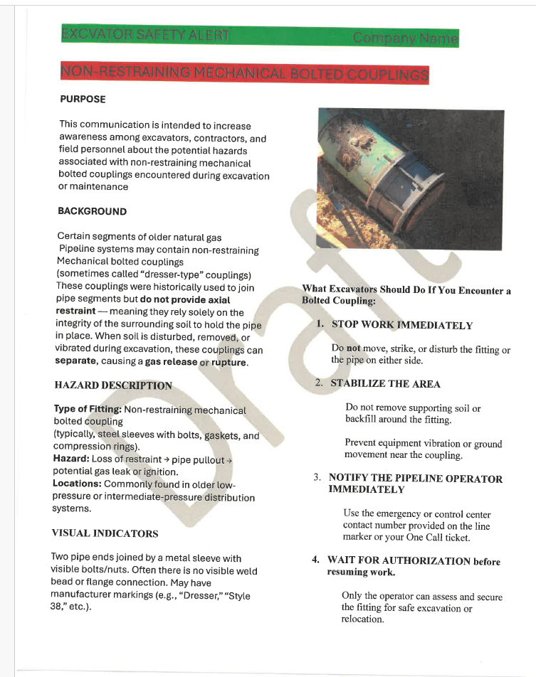

Slide 9


DISCUSSIONS
Todays Presenter for Berkshire Gas Company:
Bill Tessier
Damage Prevention Supervisor
(413) 209-1791

