Slide 1

Eversource Gas
Eversource Gas of Massachusetts
Liberty Utilities
Gas Distribution

Slide 2
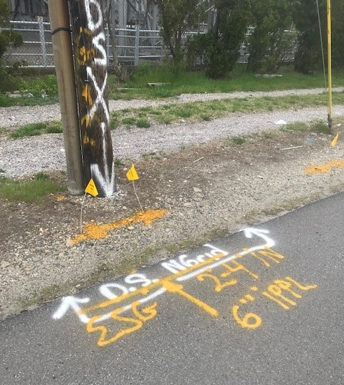
Before You Dig
Premark the site
Have a valid Dig Safe ticket
Wait for the ticket to be legal before excavation (72 hours)
The area of excavation is clearly listed on the ticket along with the excavator(s)
Reminder: Dig Safe tickets expire every 30 days

Slide 3
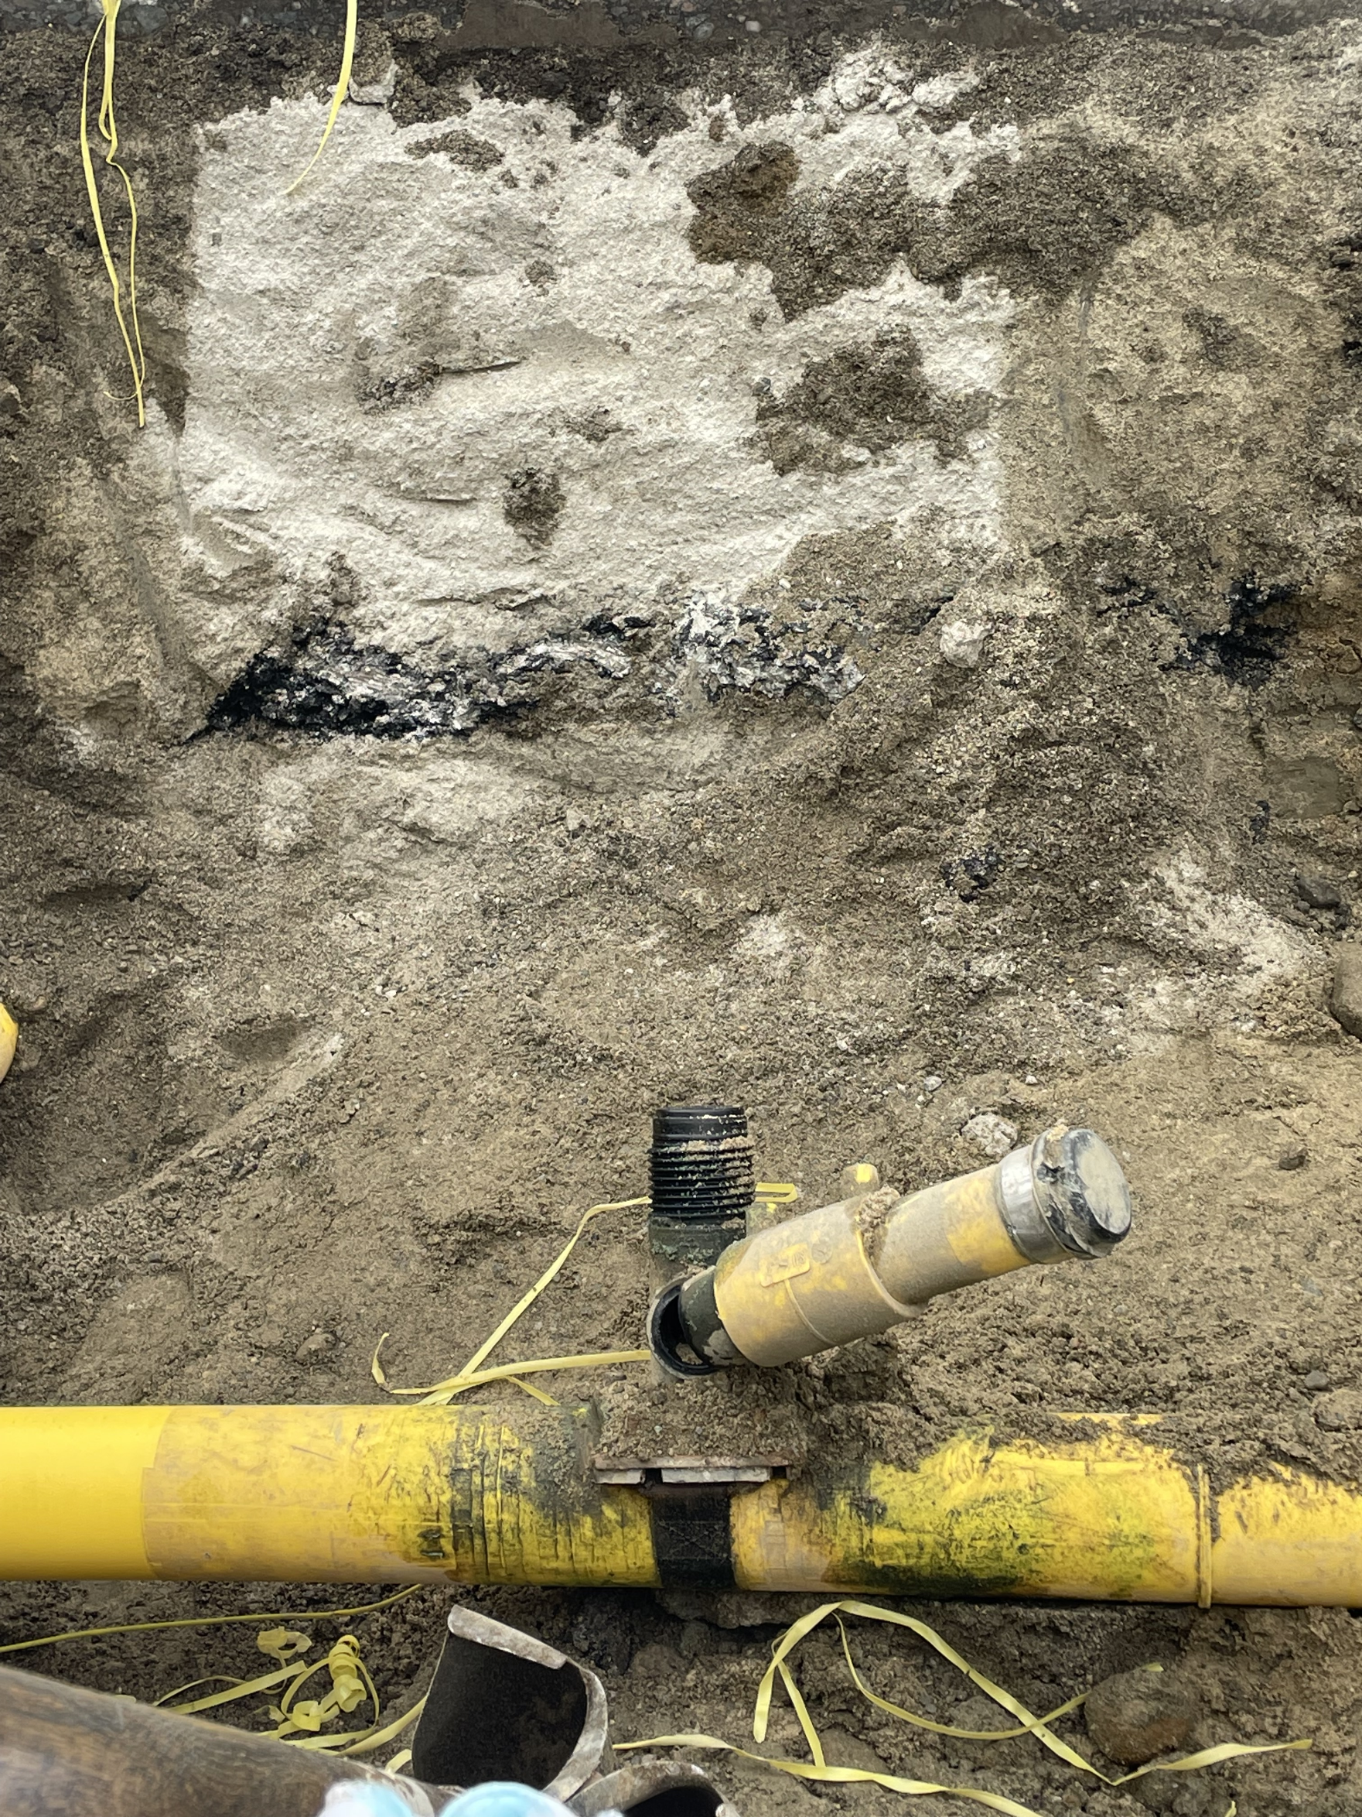
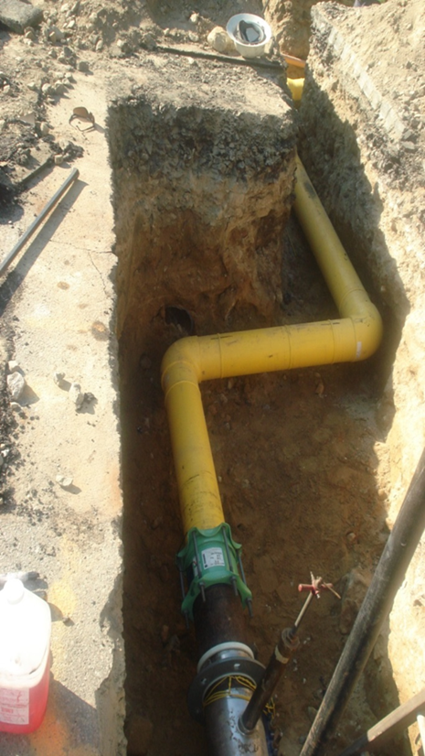
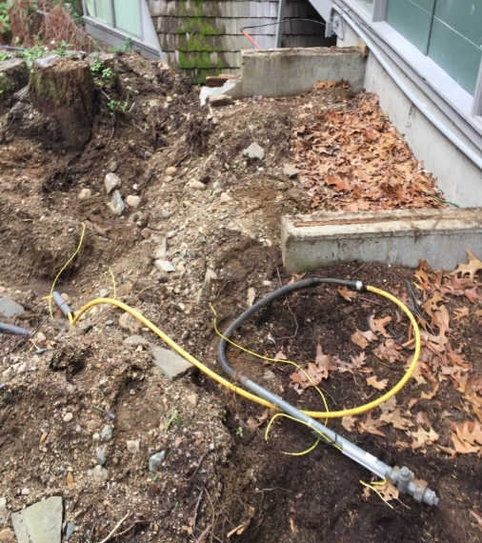
Safe Excavation Best Practices
Review the job brief with all personnel and any potential hazards
Pay attention to any changes in direction that the facilities may take – not all facilities run in a straight line!
Don't put spoil piles over marks
Use a spotter
Protect the underground facility once it is exposed

Slide 4
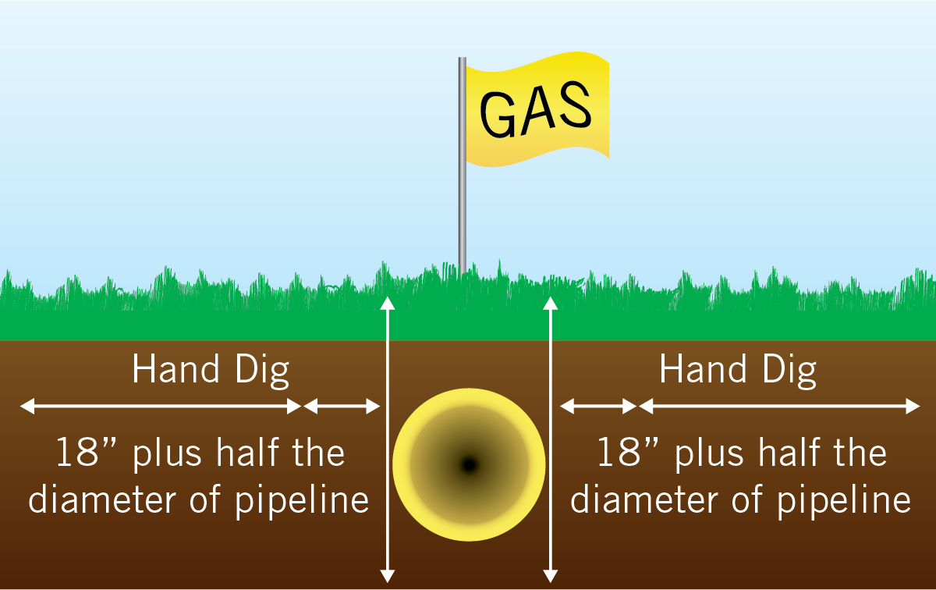
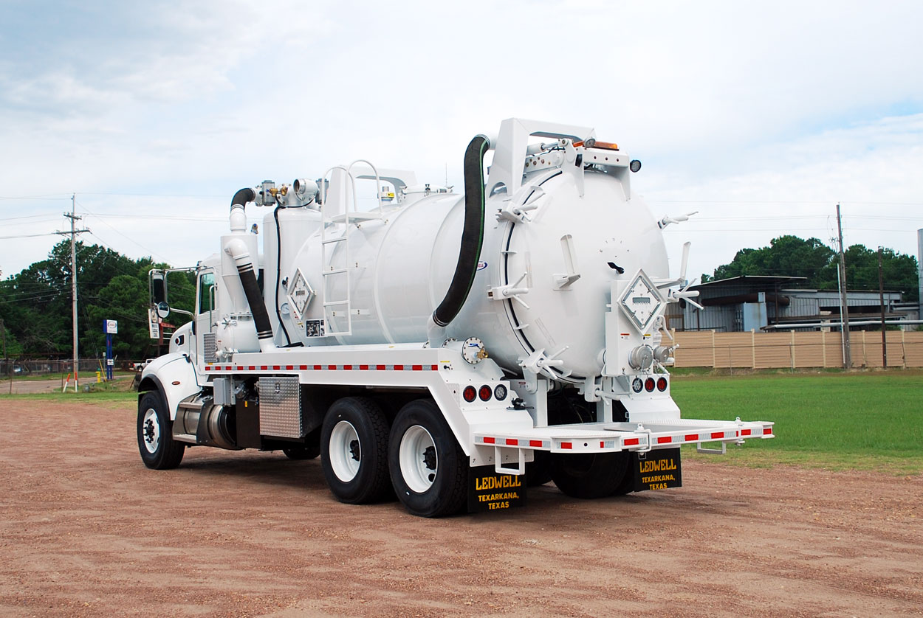
Tolerance Zone
No mechanical means in tolerance zone
Hand dig, utilize air lance, vacuum truck
Protect facilities once they are exposed

Slide 5
Natural Gas Pipe Materials
Cast Iron
Brittle (subject to cracking
Bell & spigot joint every 12 feet
Exposed joints need to be encapsulated to prevent leaks
Need to call gas company if you uncover cast iron main
Steel
Can be bare or coated
Corrodes over time if not protected
If the coating is damaged, do not backfill. Call the gas company to have the coating repaired
Plastic
Not always buried in a straight line
Buried with tracer wire
Static electricity can cause an incident
Small diameter plastic can be severed with a shovel

Slide 6
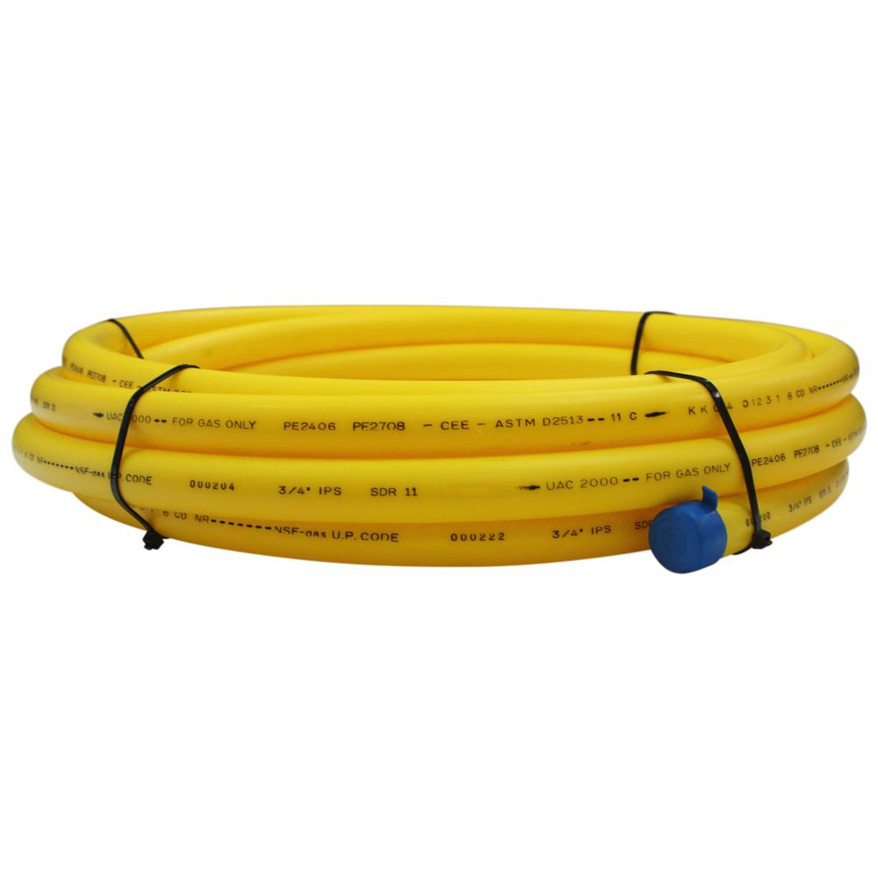
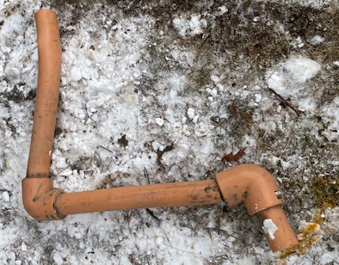
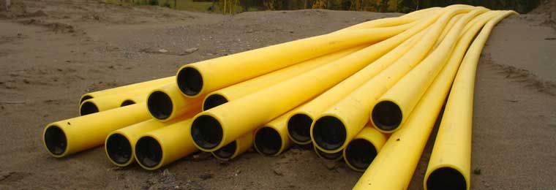
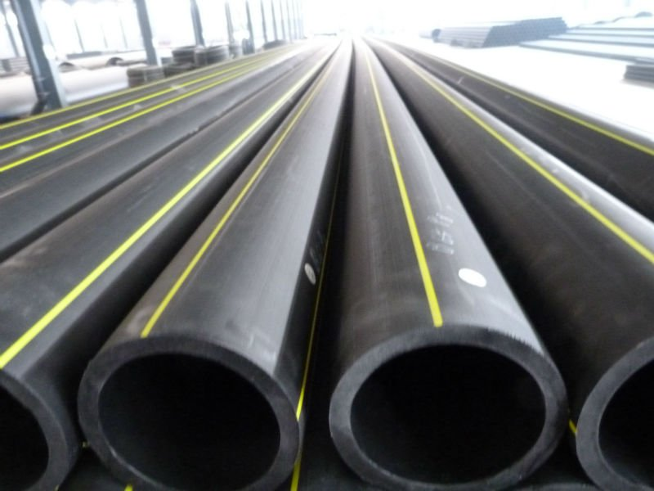
Types of Plastic Pipe
Polyethylene yellow
Aldyl-A
High Density

Slide 7
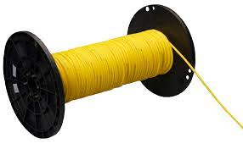
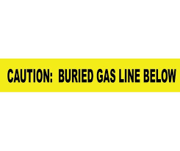
Tracer Wire or Caution Tape Damage
If tracer wire or caution tape is damaged during an excavation, please notify us prior to backfilling so we can make repairs. There is no charge for repair to tracer wire or caution tape.
Tracer wire is used to locate plastic pipe. If damaged, repairs are necessary to ensure a conductive path for future locates.
Damaged caution tape must be replaced prior to backfill to mitigate damage risk during future excavations.

Slide 8
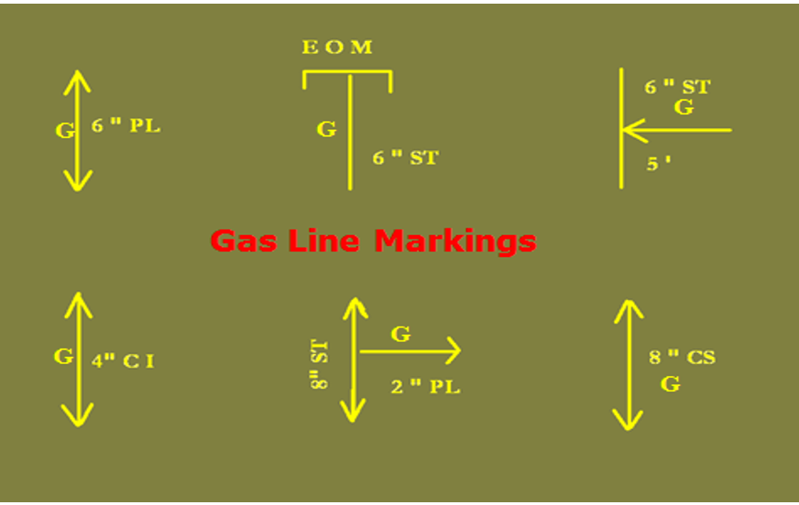
Centerline Gas Markings

Slide 9
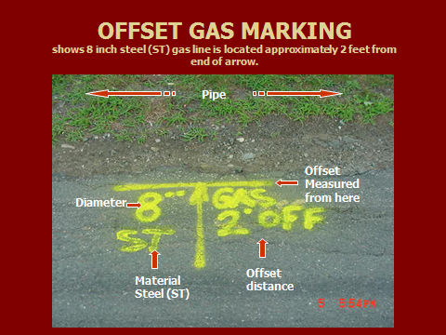
Offset Gas Markings
Offset markings are used when gas facilities are located in an area where marks may be removed or easily destroyed

Slide 10
Re-marks & Maintaining Marks
If marks become faded or destroyed, re-notify Dig Safe, stop work for 24 hours for re-marks
If the scope of the job changes - call in a new Dig Safe ticket
It is the excavator's responsibility to maintain all marks
If your excavation causes the removal or disturbance of the marks, establish offset marks to maintain a reference point for those underground utilities
If there are any questions about the marks reach out to the utility

Slide 11
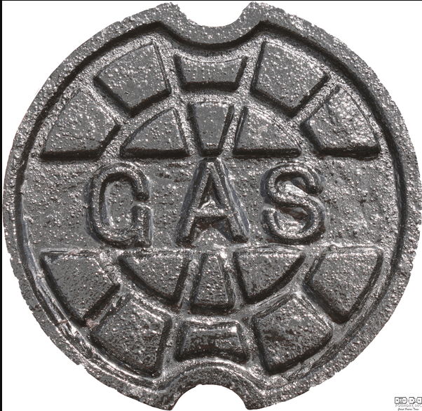
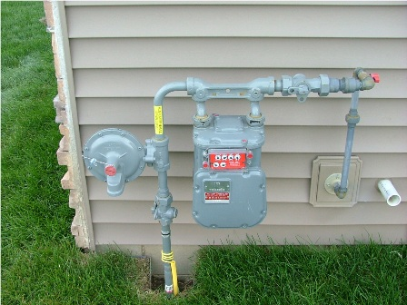
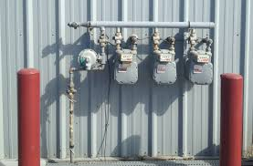
Visual Cues of Gas Facilities in the Area
Valve boxes
Cathodic protection test boxes
Trenches and/or repair patches
Meters or regulator vents at buildings

Slide 12
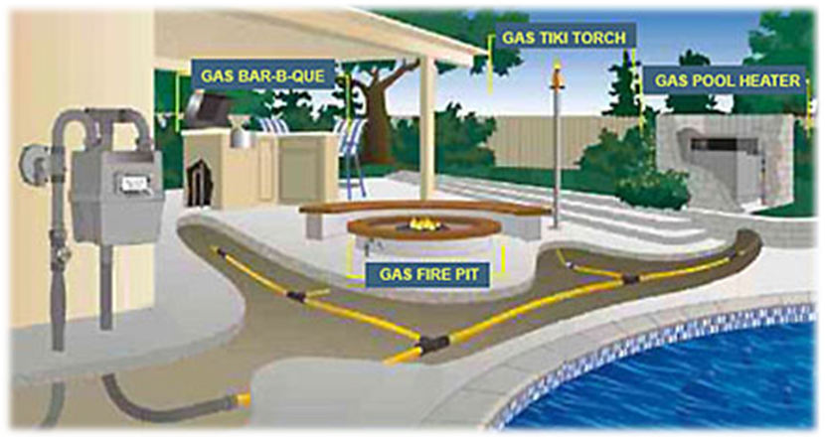
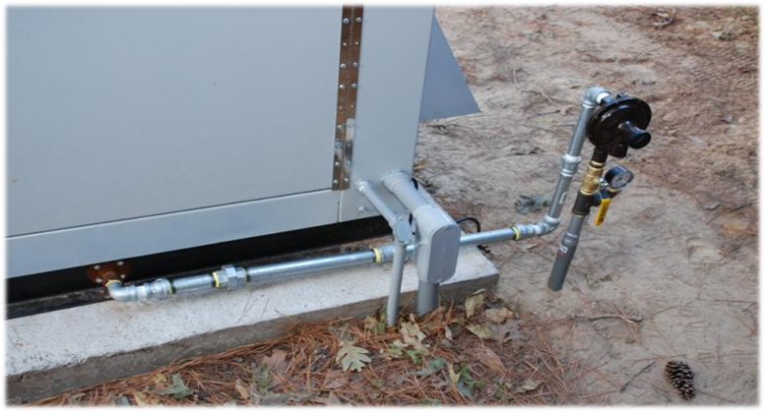
Private Gas and Master Meter Sets
Gas distribution companies only mark the facilities they own
Private gas after the meter must be located by a private utility company – propane is also not marked by the LDC
Some locations have a master meter – anything after the master meter is considered private
Generators, grills, fire pits are examples of structures that can have private gas

Slide 13
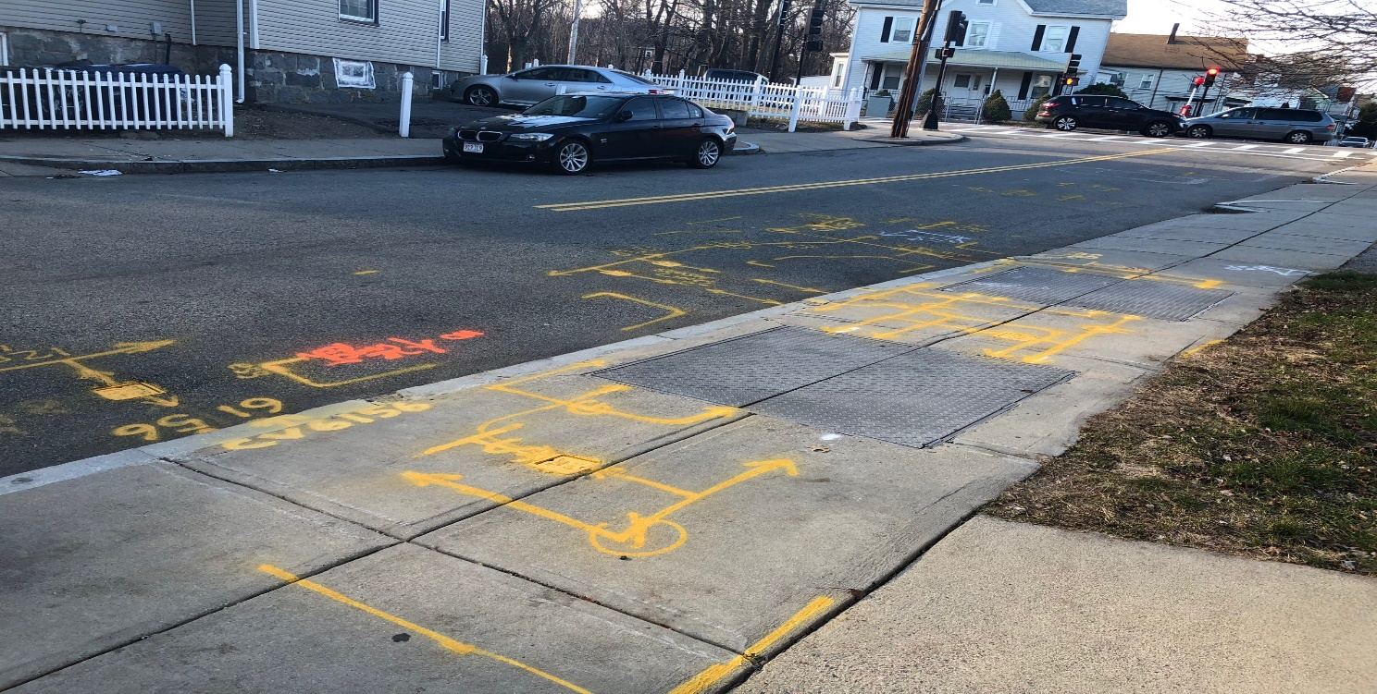
Regulator Stations
Please contact the local gas distribution company prior to any excavation in the vicinity of a regulator pit or station.
Regulator stations are used to monitor and control the operating pressure of the gas distribution system.
A site meeting and standby is required for excavation within 50 feet of a regulator station. A minimum of 24 hours notice from the excavator is required to schedule standby personnel prior to excavation.

Slide 14
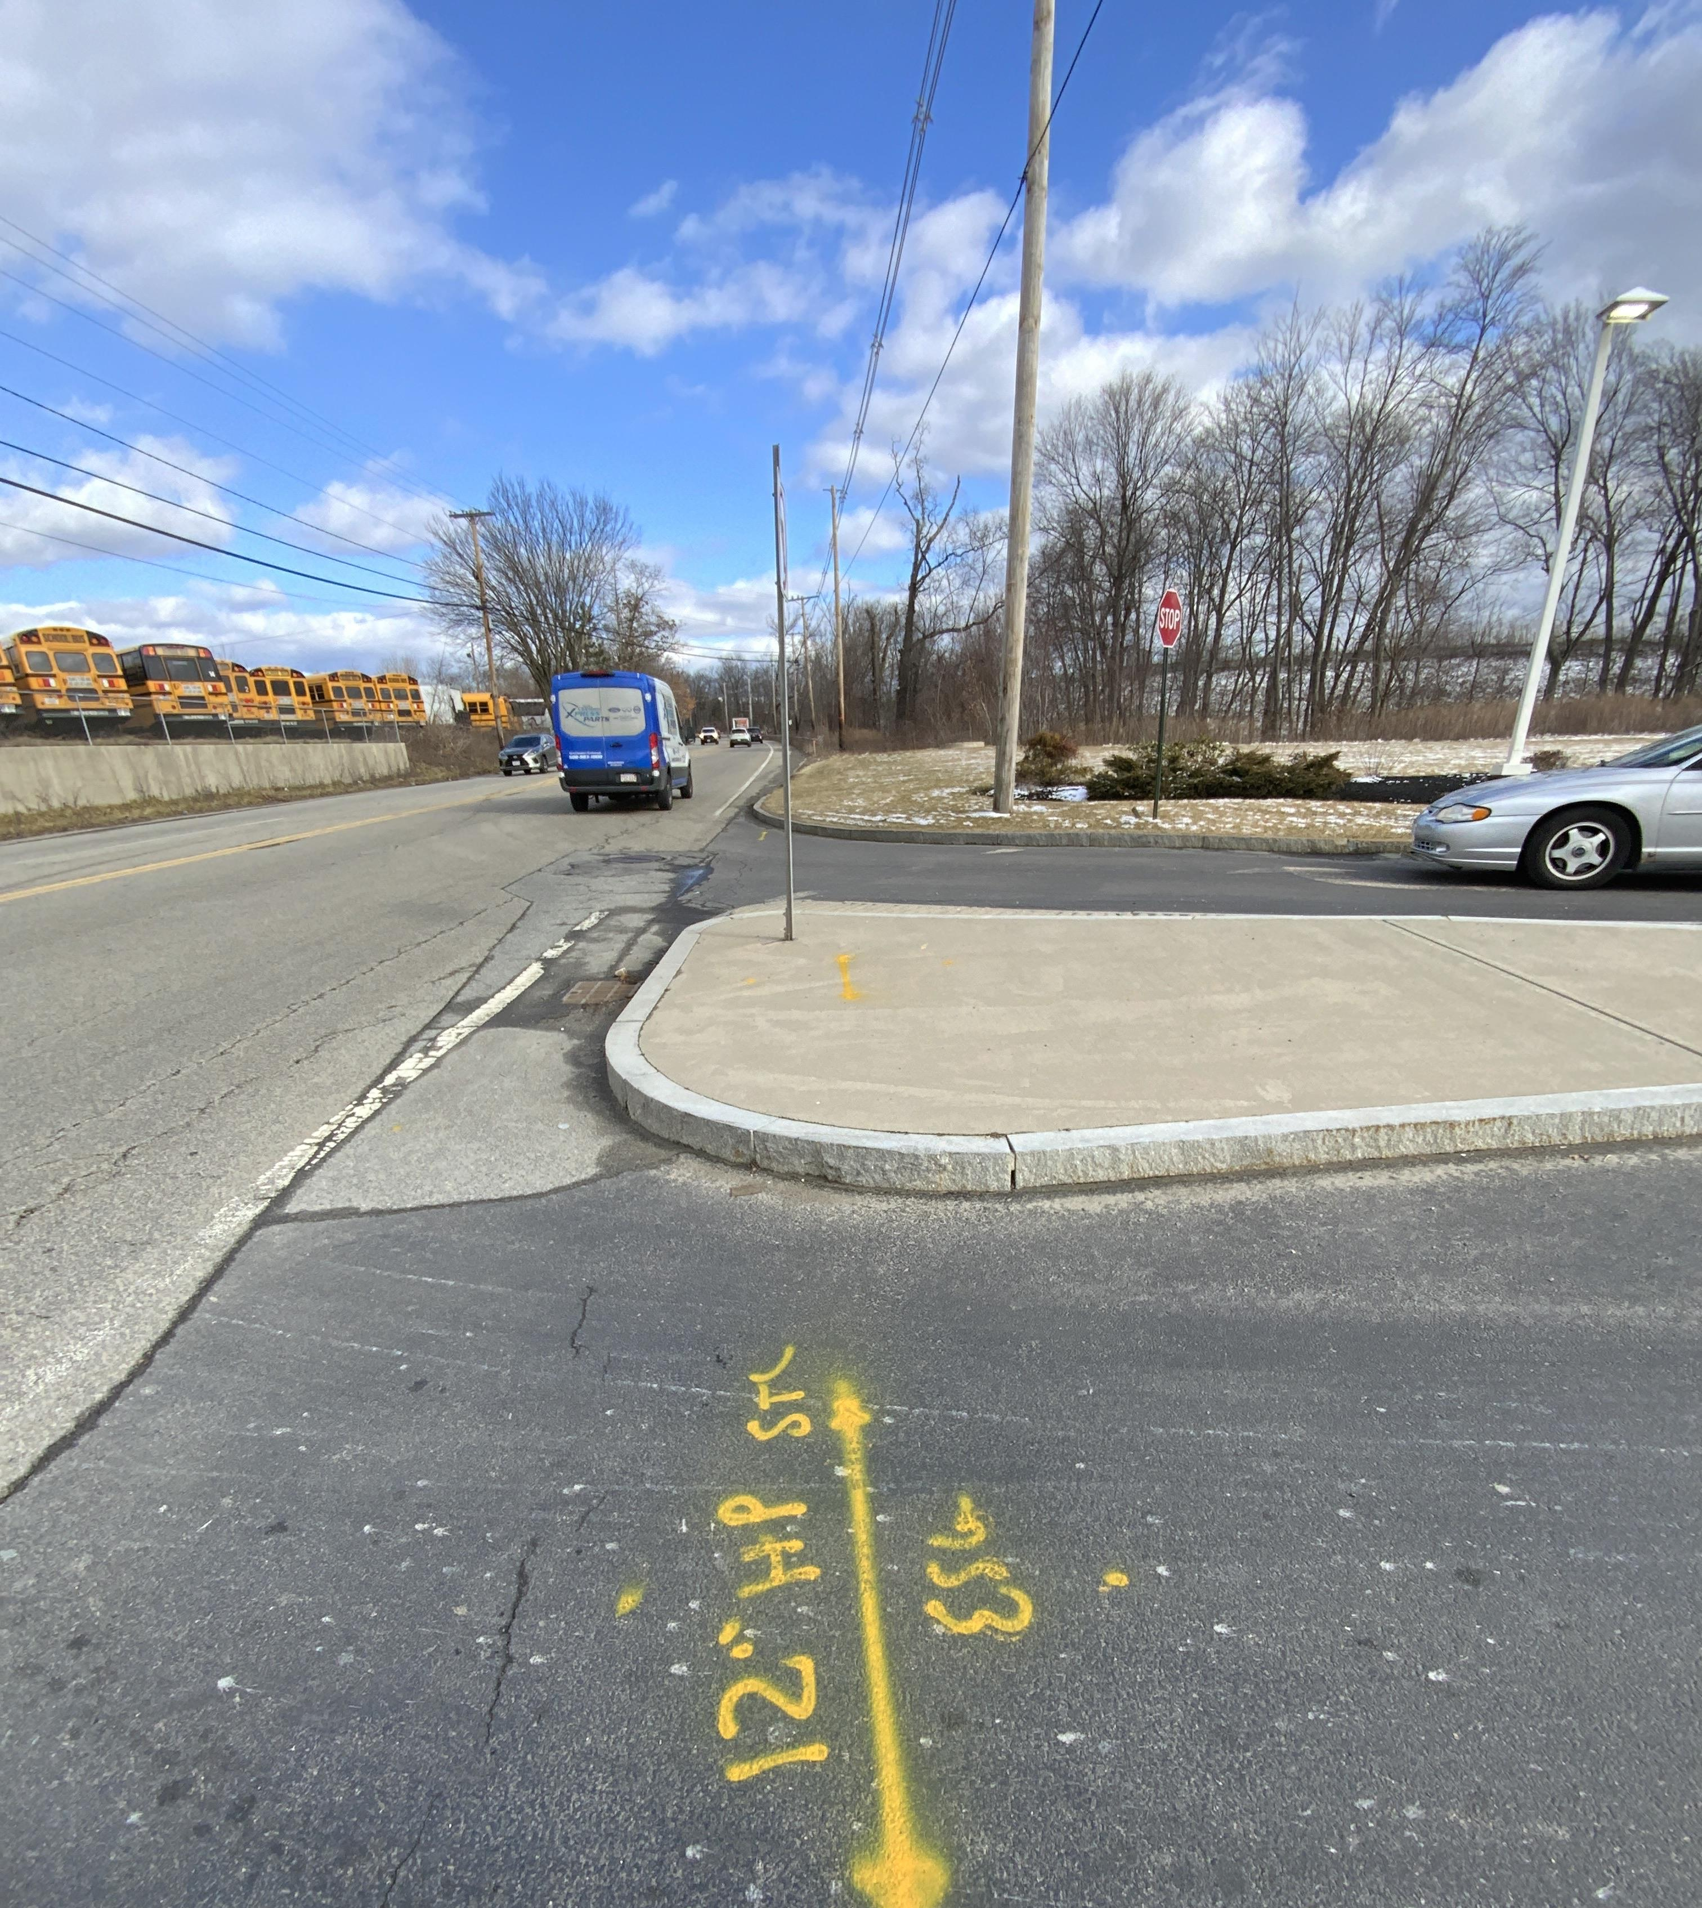
High Pressure Standby
If working near HP expect a phone call from the locator and Damage Prevention Supervisor
Ticket system will also send a notification email regarding critical facilities
If working within 10 feet of HP, Eversource will have a technician on site
Always update ticket at Dig Safe and notify Eversource Supervisor if scope of work changes

Slide 15
Blasting
Eversource and Liberty procedures require our personnel work cooperatively with contractors engaged in blasting operations within 100 feet of our gas pipelines to minimize the potential for damage to gas facilities.
When gas facilities have the potential to be affected by blasting operations, contractors must submit a blast plan to the gas company for approval. Leak survey is scheduled accordingly.

Slide 16
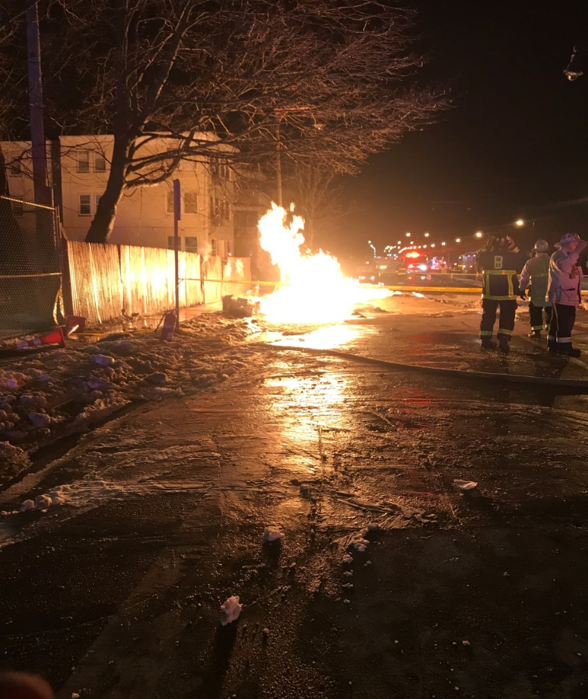
Signs of a Hit Gas Pipe
Blowing or hissing sound
Dust blowing from the hole
Continuous bubbling in wet area
Rotten egg smell
Flames – if gas has ignited

Slide 17
What to Do If a Damage Occurs
Shut down all machinery
Move away from the affected area
Do not do anything that could cause a spark
Call 911
Notify gas company
Keep public away from area
Do not reenter excavation or attempt to stop the flow of gas
Additional direction will be given by 911 and the gas company
If natural gas is escaping inside a building or is entering a building through an opening, knock on the door to notify the building occupants to evacuate. Do not ring the doorbell.

Slide 18
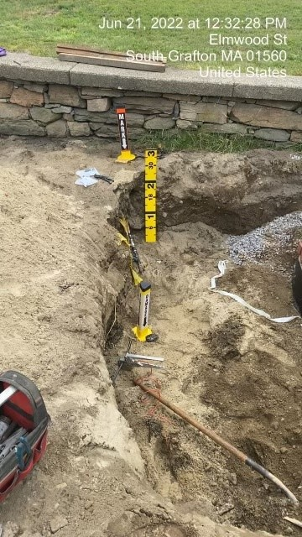
What to Expect If a Damage Occurs
Investigation by the LDC
Gas crew will respond to complete repairs
Operator will be asked for Hoisting License
Supervisor/Foreman will be asked for information
Photographs of damage and marks

Slide 19
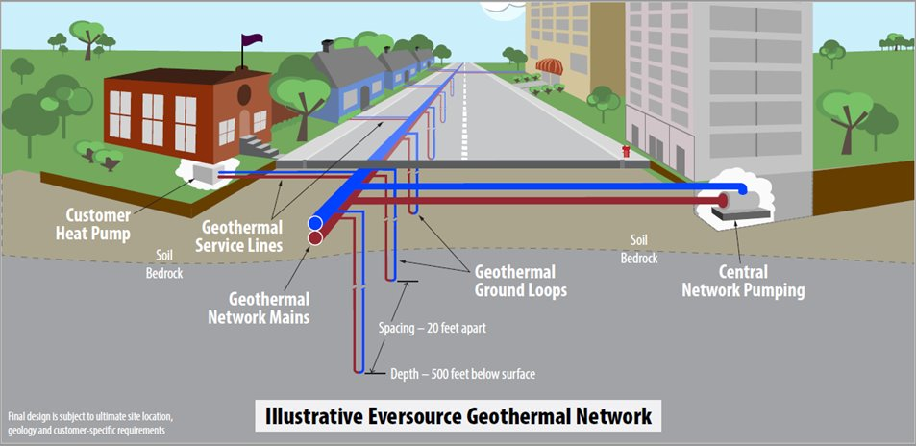
Networked Geothermal Pilot
Ground source heat pump (GSHP) system is a heating and cooling solution for customers
Use the relatively stable temperature of the ground to provide heating and cooling
Very efficient systems, with Coefficients of Performance (COP) of 300-600%

Slide 20
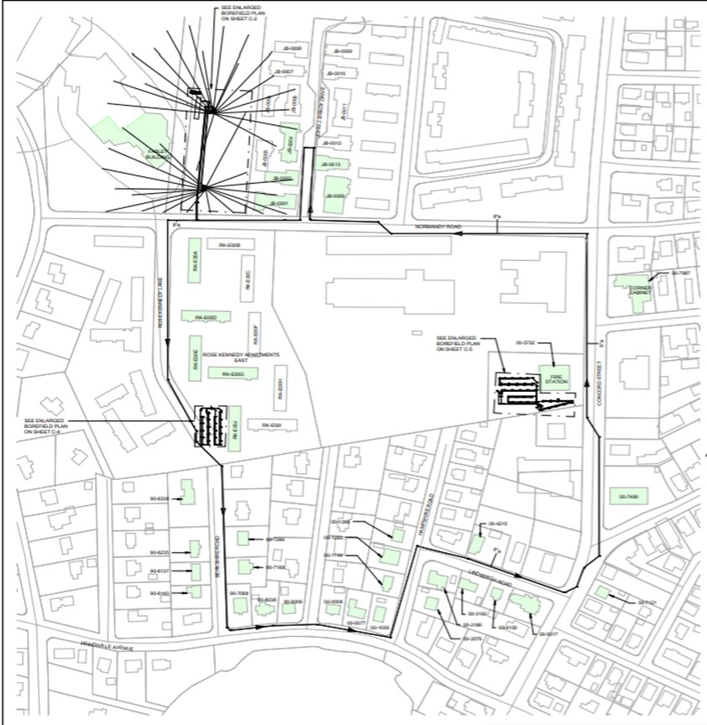
Framingham Pilot Background
Ongoing Pilot loop
1-mile single pipe system
Support approximately 140 customers
40 connected buildings
Main borefield with 2x satellite borefields
Main temperature should stay within about 2 deg F throughout the loop

Slide 21
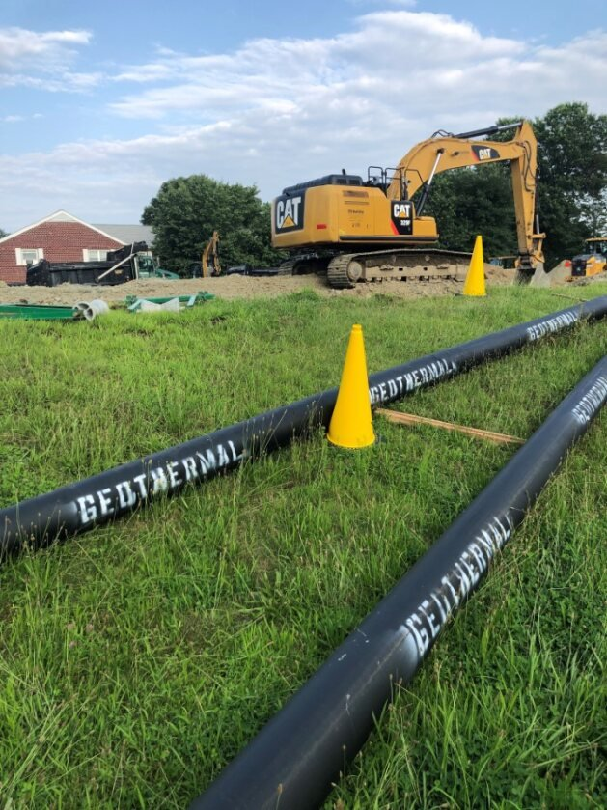
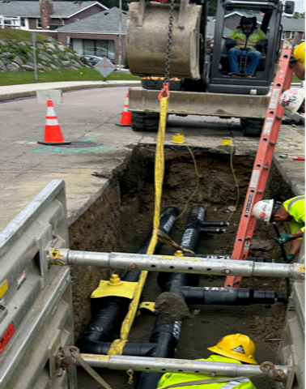
Geothermal Main Installation
8” HDPE pipe is being used for the distribution loop
Installation method similar to water or gas like work in the public right of way
Installation depth of 5 feet underneath roadways

Slide 22
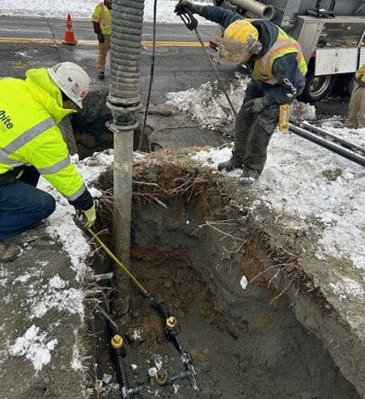
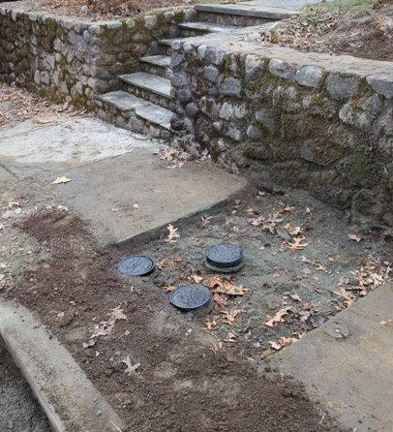
Geothermal Service Installations
Service sizes range from 1”-3”
Two lines installed (send/receive) with shutoffs and a bypass
Standard round valve covers at the curb

Slide 23
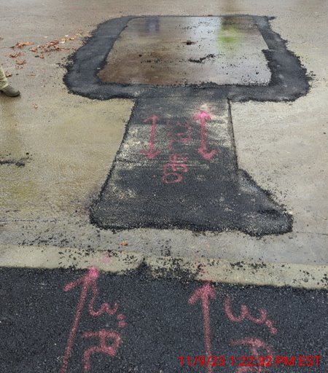
Geothermal Markout Examples
Assets will be marked in purple
Descriptors will contain size, material, and GEO

Slide 24
Emergency Contacts
Eversource 1-800-592-2000
EGMA 1-800-525-8222
Liberty Utilities 1-800-936-7000
National Grid 1-800-233-5323

