Slide 1
Electric Safety Awareness
February 2026

Slide 2
Electric Safety Awareness
Types of Underground Electric Facilities
What to Look For Before Digging
What to do in the Event of a Damage
Contact Information

Slide 3
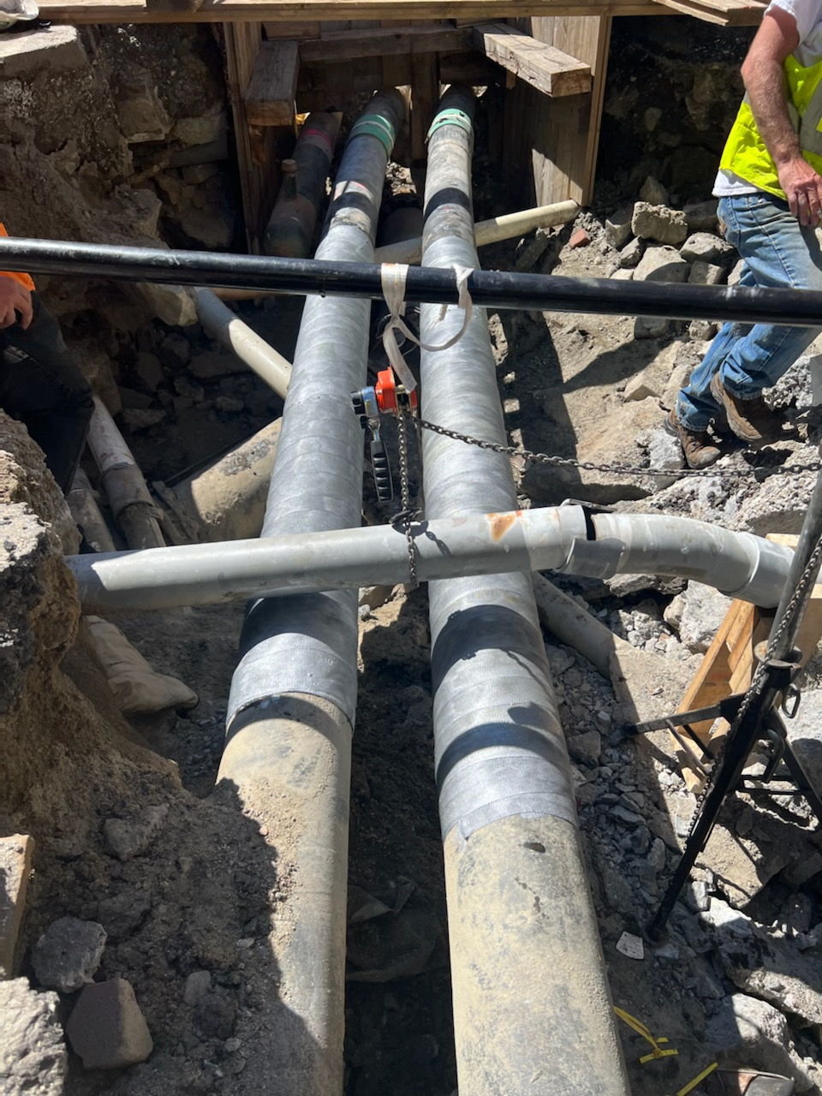
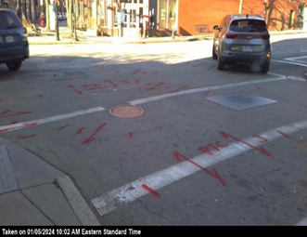
Pipe Type Cable (PTC)

Slide 4
Pipe Type Cable (PTC)
PTC is our most critical underground asset.
High Voltage ranges from 115kV to 345kV.
Steel Pipes, 6”-10” in diameter, filled with cable and high-pressure oil.
Can be marked with added, special descriptors like, PTC, Oil, or 115kV-345kV.
Special Precautions must be taken when excavating near PTC.

Slide 5
Excavating Around PTC
Calls and/or emails placed to the excavator listed on ticket to discuss expectations when excavating around these critical facilities.
Expect Eversource stand-by when operating near these pipes.
Soft excavation is must be used when digging near these facilities.
Vac excavation, hand digging, air lance, etc…
Stress the hazards of operating recklessly around these facilities.
Serious harm to public and property.
Significant repair and clean up costs associated with a PTC damage.
Minor cost now vs. major oil leak and cost later.
A scratch in the protective coating will lead to a leak in the future, be proactive and coordinate coating repair.
Awareness = Damage Prevention

Slide 6
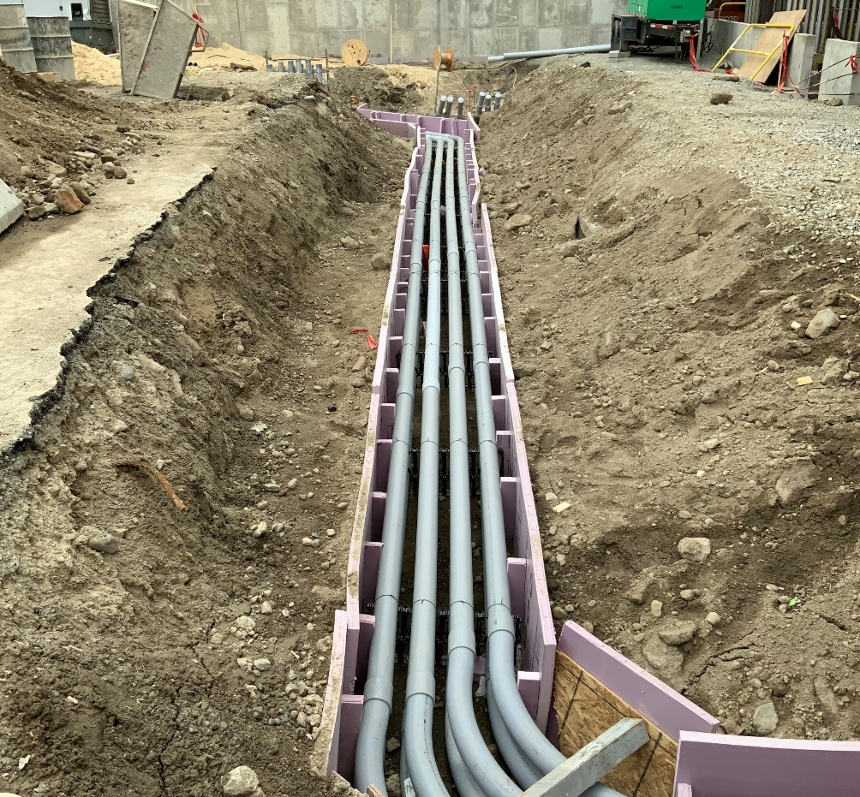
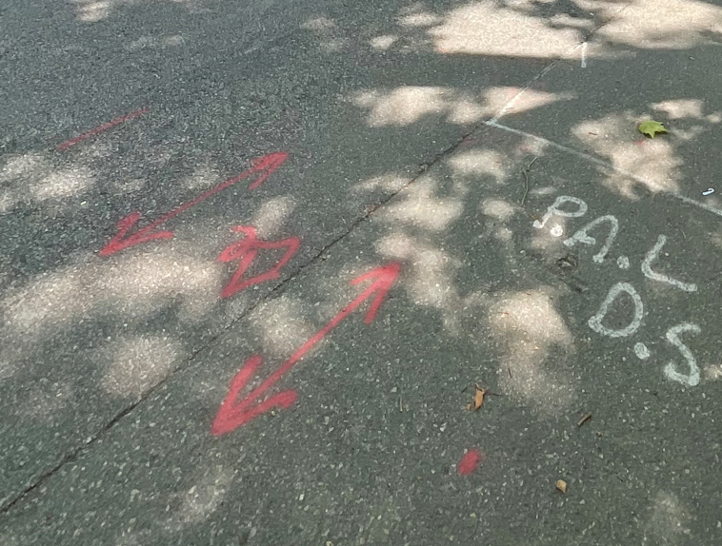
Primary Duct Banks

Slide 7
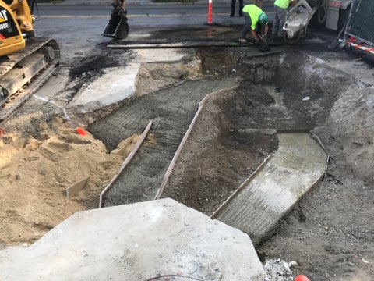
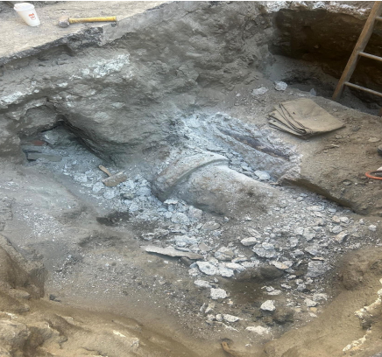
Primary Duct Banks
Multiple primary duct systems are commonly concrete encased.
Conduit is typically PVC in newer construction but, in older systems, fiber and clay duct were commonly used.
Voltage from 5kV – 24kV.
Most common system found in roadways.
NEVER CHIP AN EVERSOURCE DUCT BANK

Slide 8
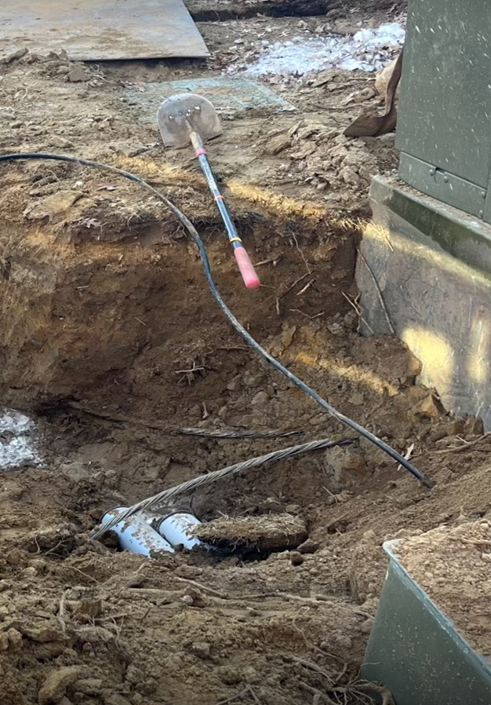
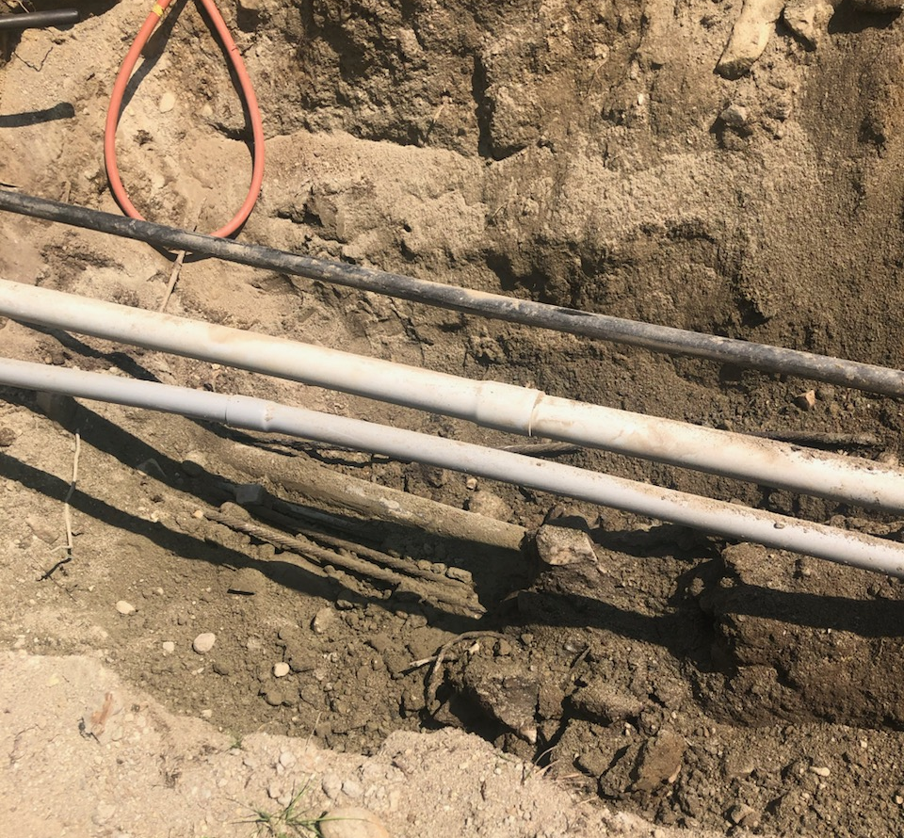
Direct Buried Cable
Bare cable that is not encased in concrete and does not have conduit protection
Common in suburban developments
No longer installed due to vulnerability of the asset

Slide 9
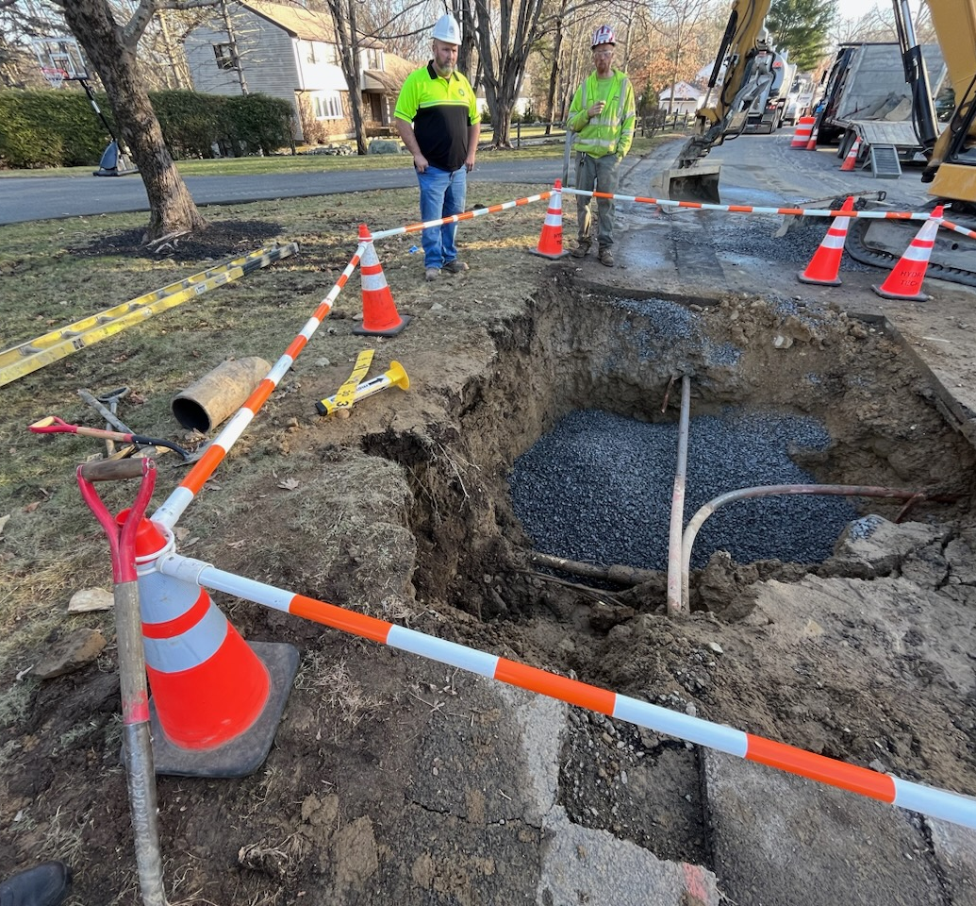
Secondary / Services
Underground secondaries are typically single conduits but occasionally run together.
Generally, conduit is not encased.
House services, streetlights, lamps, etc.

Slide 10
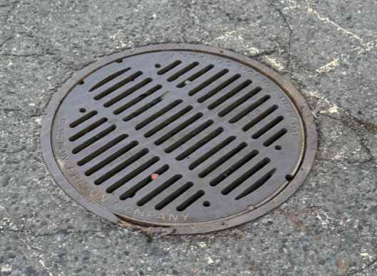
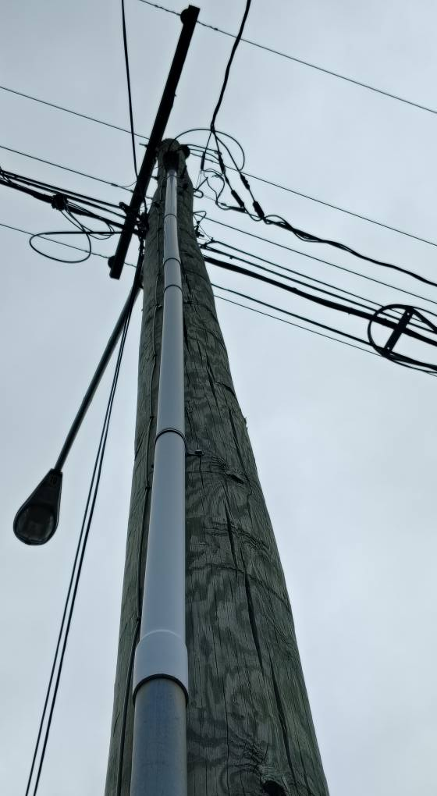
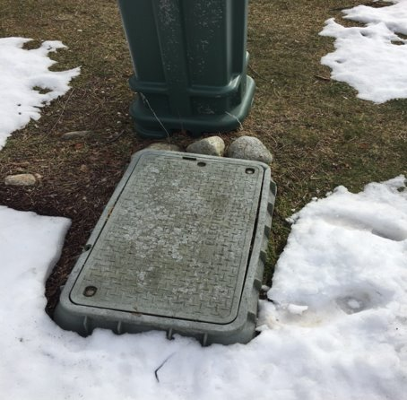
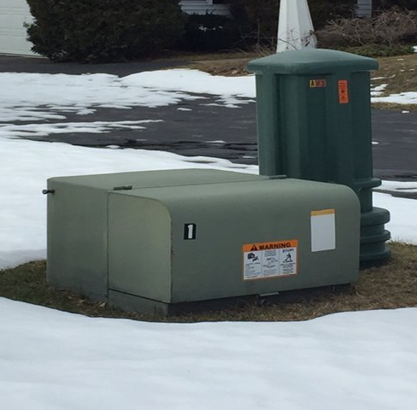
What To Look For Before Digging

Slide 11
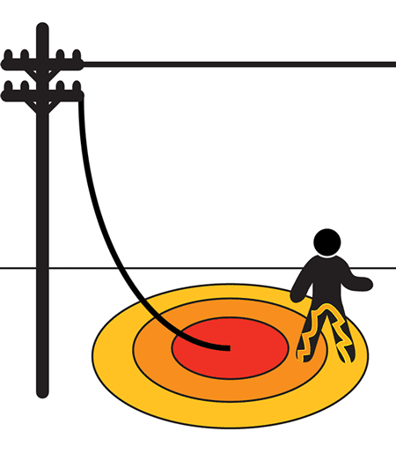
Step Potential
Step potential refers to the voltage difference between your feet when you are standing near a downed power line, and your feet are in different rings of electrical current with different voltages
You can be injured without even touching the conductor
Shuffle away from the downed power line. Keep feet together and shuffle while never lifting your feet and keeping them in constant contact

Slide 12
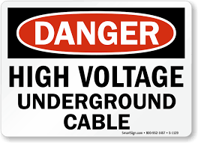
What To Do If An Electric Facility Is Damaged
For any emergency, hazard, or injury immediately dial 911
After ensuring safety of personnel, report the damage to Eversource (800-592-2000)
Conduit Group Supervisor / Inspector will be notified, and troubleshooters will be dispatched to make area safe for repairs

Slide 13
Eversource Electric Damage Prevention Contacts
Patrick O’Sullivan – Manager (MA) 857-222-7228 patrick.osullivan@eversource.com
Chris Bezza – Supervisor (EMA) 857-265-0386 chris.bezza@eversource.com
Matt Paze – Supervisor (EMA) 978-726-9723 matthew.pazejr@eversource.com
Kristen Connors – Supervisor (EMA) 781-308-9597 kristen.connors@eversource.com
Jay Gardiner – Supervisor (WMA) 401-834-5525 jason.y.gardiner@eversource.com

