Slide 1
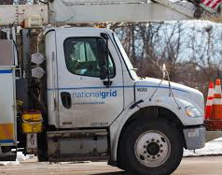
Electric
Dave Soltys, Supervisor
Damage Prevention

Slide 2
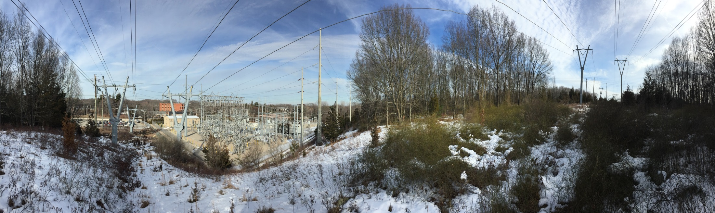
High Voltage Electricity Working around it safely

Slide 3
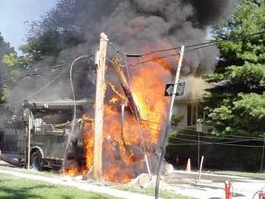
Purpose of this Presentation
Raise Awareness
Explain Hazards of
Working with Electricity
Possible Solutions to
Hazards

Slide 4
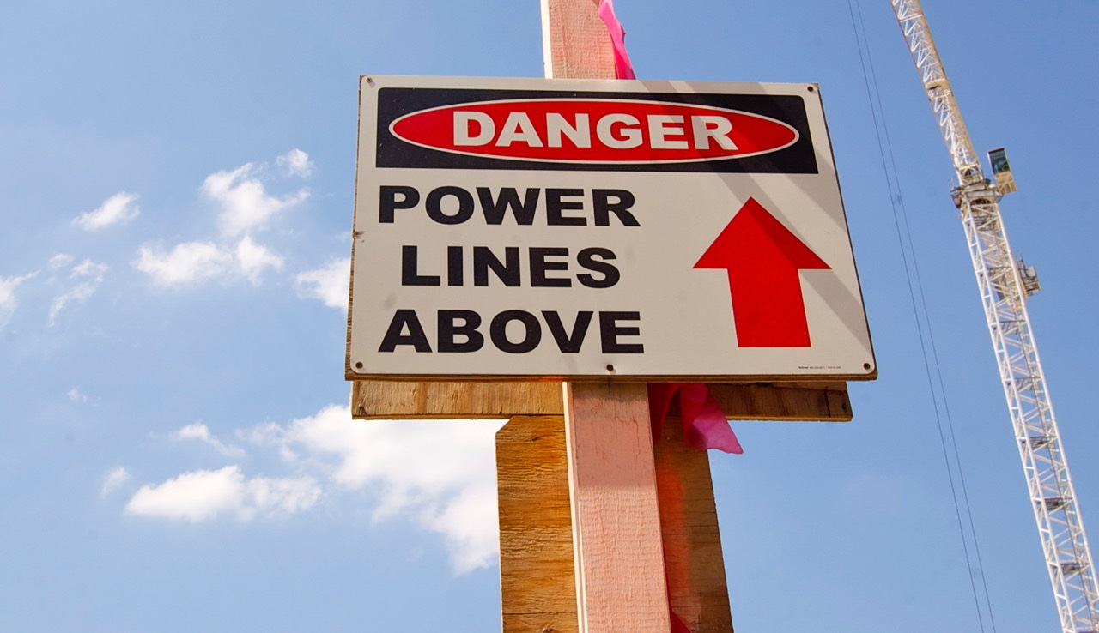
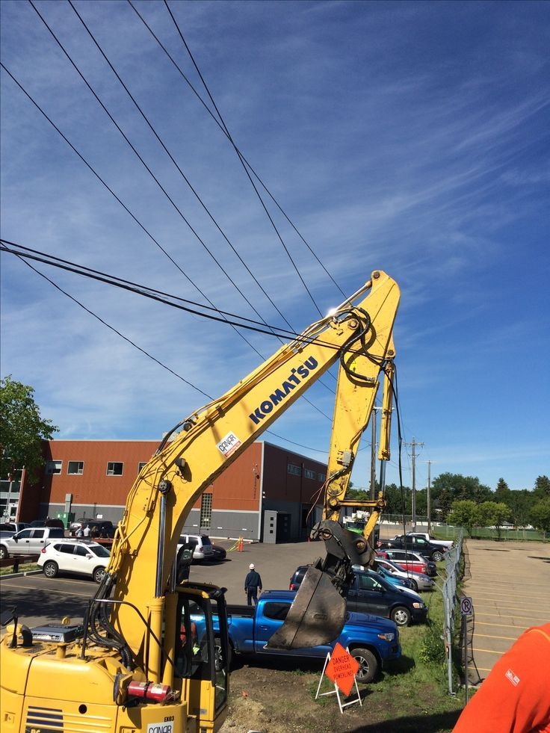
High Voltage Proximity Act
Voltage Level (Phase to Phase | 50kV & below | 115kV | 230kV | 345kV
Minimum distance in any direction between men or equipment to energized conductors | 10 ft | 15 ft | 17 ft | 20 ft

Slide 5
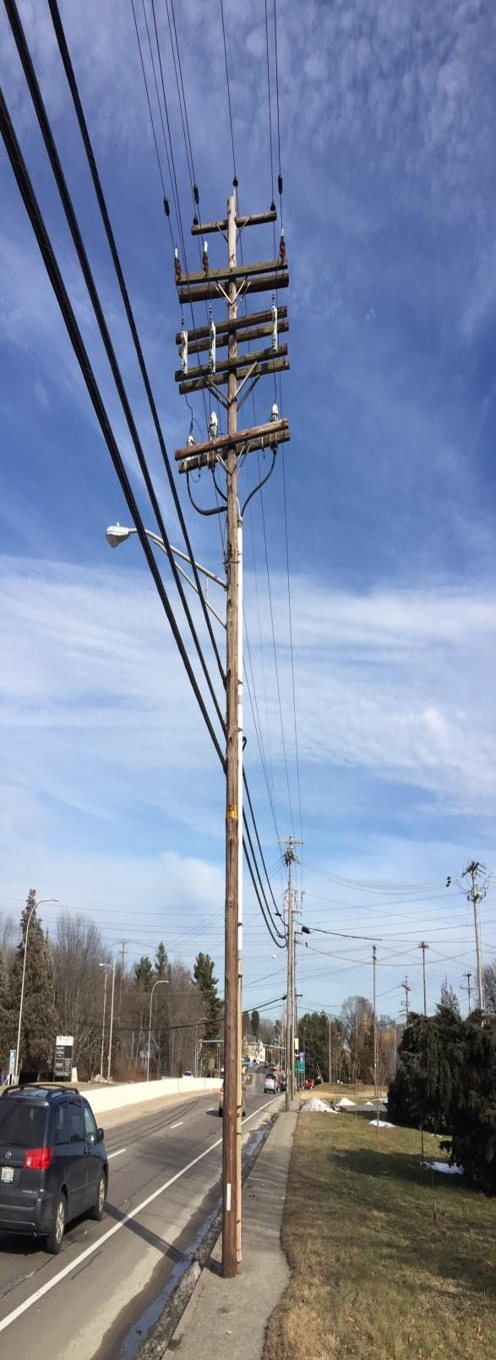
23kV – 46kV
Transmission
13kV
Primary
2.4kV – 5kV
Primary & Street Ltg.
(up to 6k volts)
120V & 240V
Secondary
Notes:
Here’s an example of the different voltages on our poles. The coating is not considered insulation (like an extension cord), it is to protect the metal conductor from the elements. Below our stuff is telephone and CATV.

Slide 6
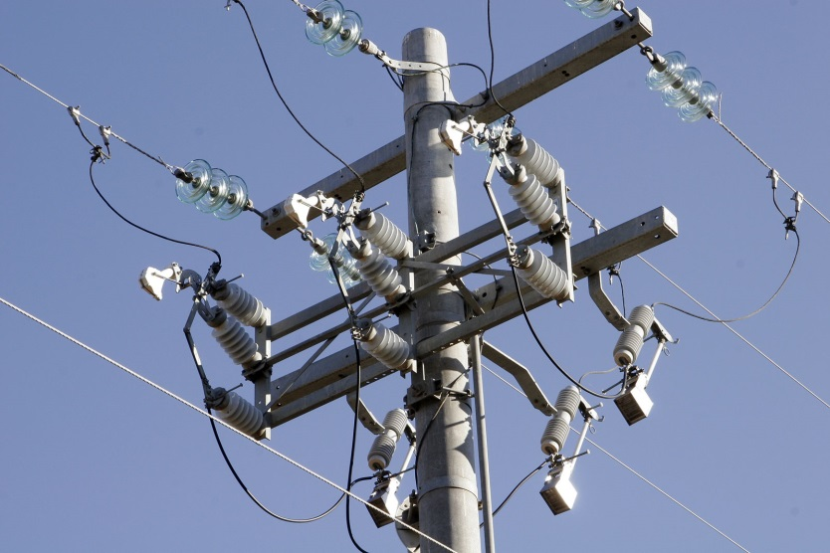
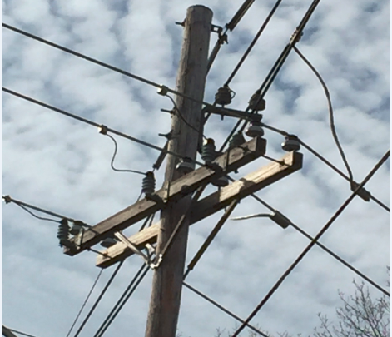
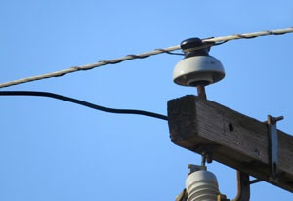
Typical Insulators & Method of Mounting on Poles
Multi-Skirt
Bell Shape
TRANSMISSION POST
INSULATOR
23,000 - 45,000 volts
PRIMARY
INSULATOR
13,200 volts
PRIMARY
INSULATOR
4,000 - 5,000 volts
Notes:
Example of insulators used for different voltages

Slide 7
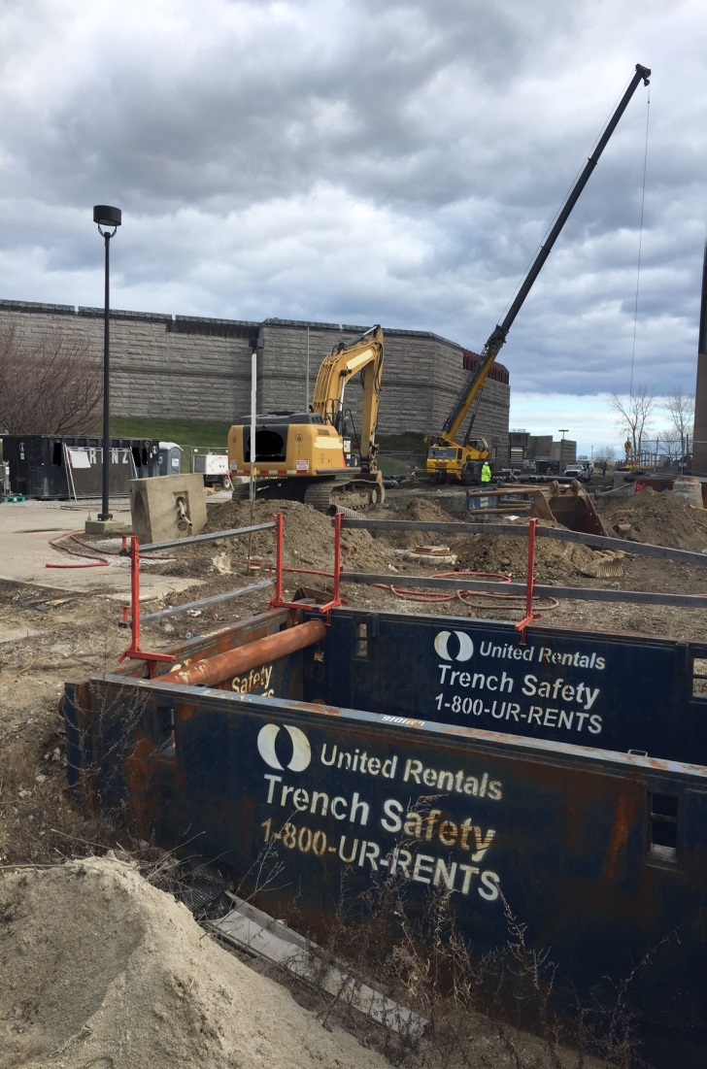
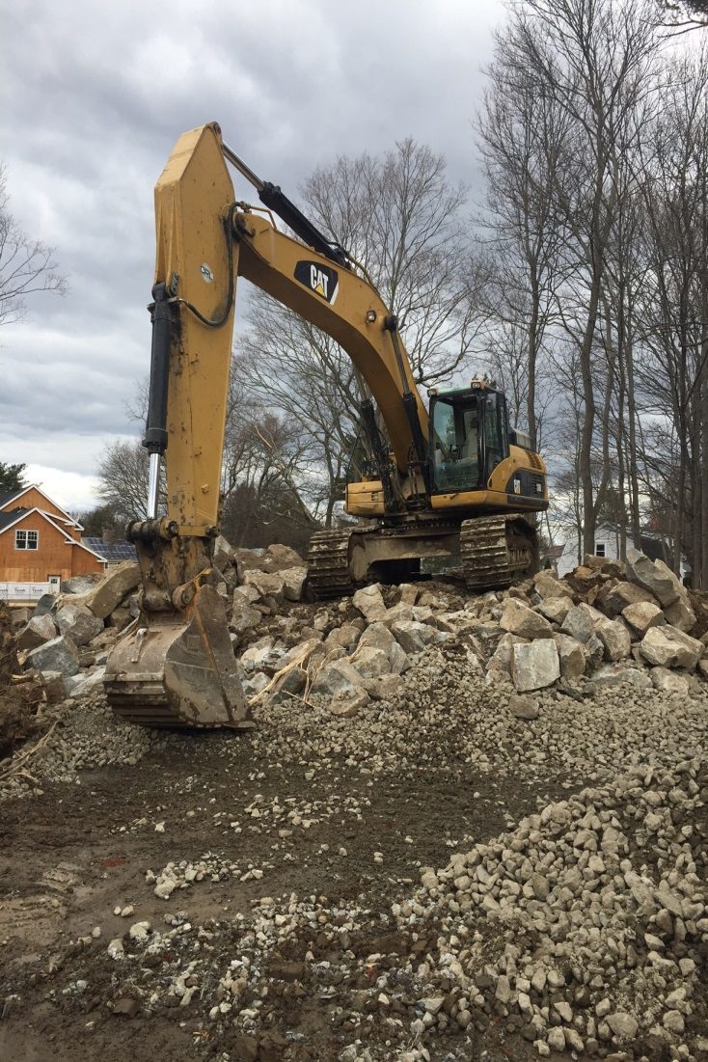
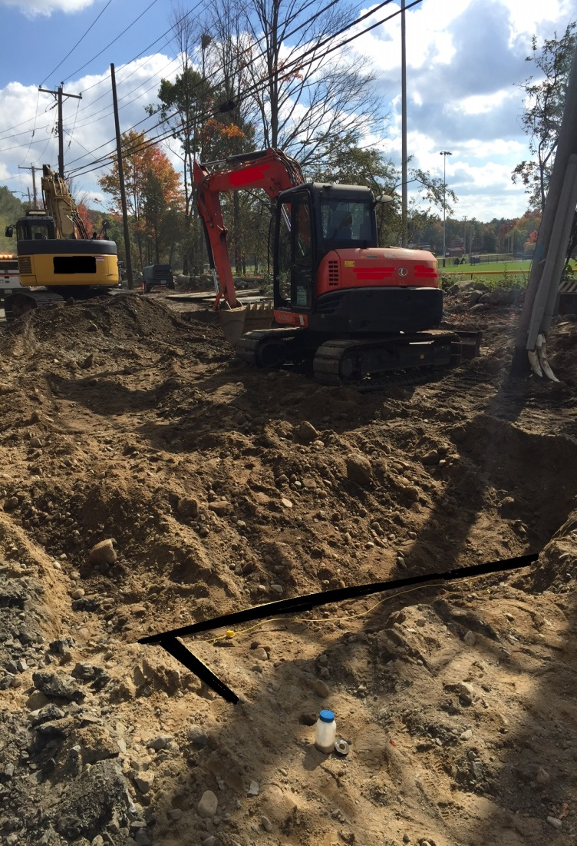
Overhead Wire Touch Potential
10 Foot Minimum Clearance around all Electric Lines.
Be aware of your surroundings.
Notes:
2 ways in which workers are exposed to electric hazards are step potential and touch potential…..
Touch potential is when hazardous voltage goes to ground through the body. Hand to hand, hand to feet etc.

Slide 8
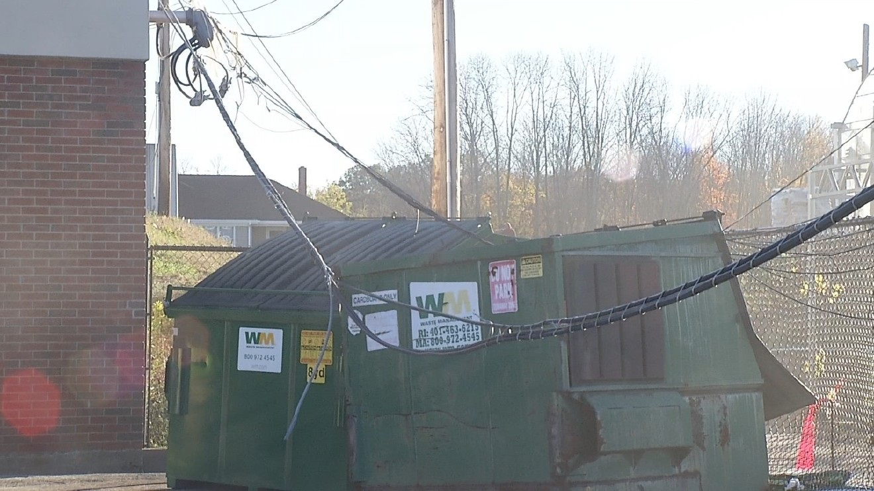
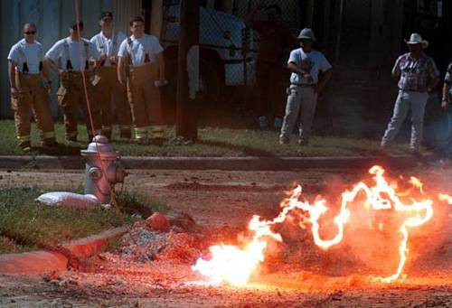
All Downed Wires Must Be Considered
ENERGIZED & DEADLY !
They will energize any conductor they contact.
Survey the area closely.
Potential Conductors include: fences, gutters, antennas, railroad tracks, & aluminum siding.

Slide 9
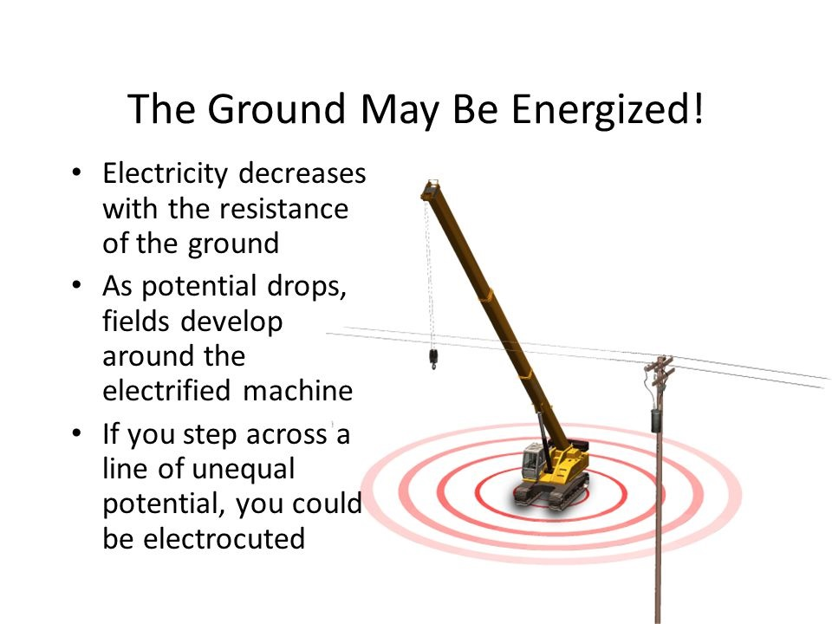
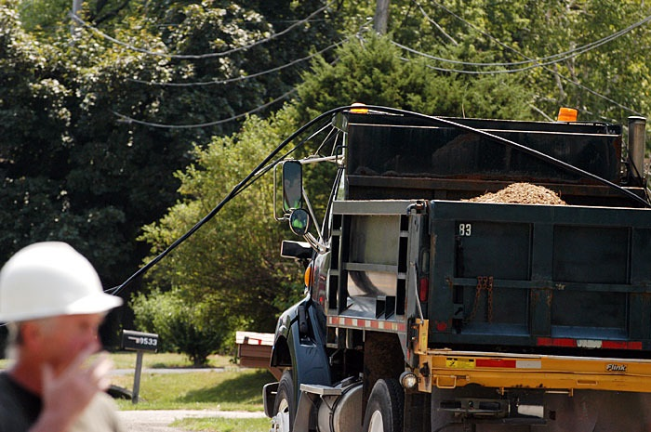
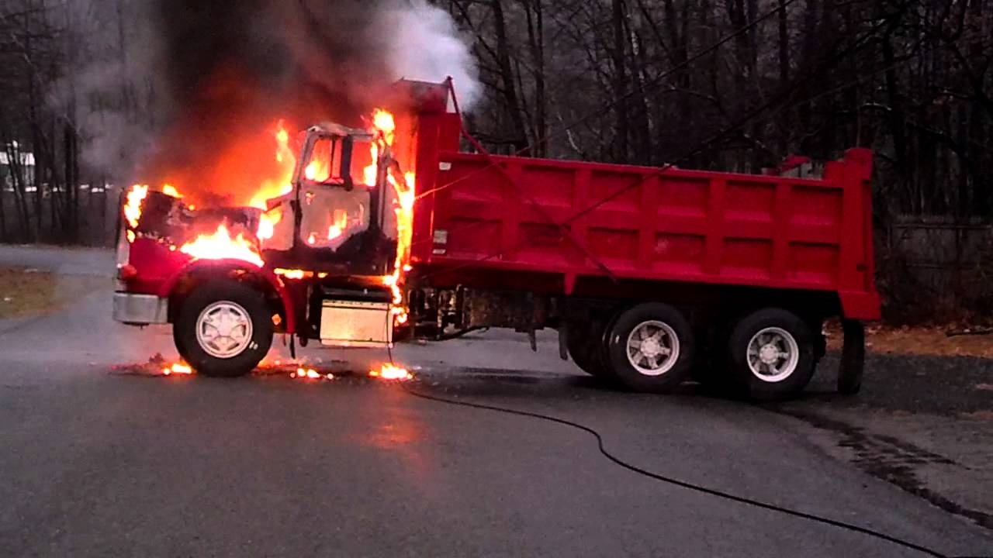
The Ground May Be Energized
Notes:
Step potential is like the ripples in a pond. As energy moves away from the source the potential weakens. When a person steps away from a downed line the potential at one foot may be greater than the other foot and the electricity goes through the body if it has less resistance than the ground. Our employees are required to wear electric hazard (EH) rated work boots to minimize step potential. ( This is why it is recommended that if you are in an energized vehicle or piece of equipment you stay inside. If there is a greater hazard associated with staying inside i.e. fire, jump from the running board and land with both feet together as far away as possible.)

Slide 10
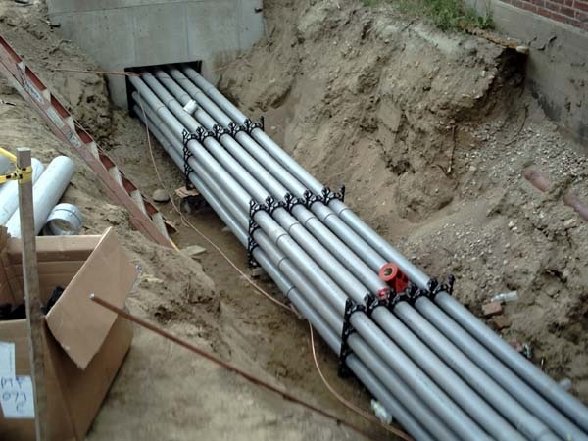
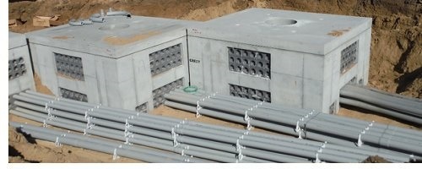
Underground Electric Facilities
Duct Banks w/ multiple conduit (concrete/clay)
Conduit (Steel and Plastic)
Direct Buried Cables
Man Holes or Vaults

Slide 11
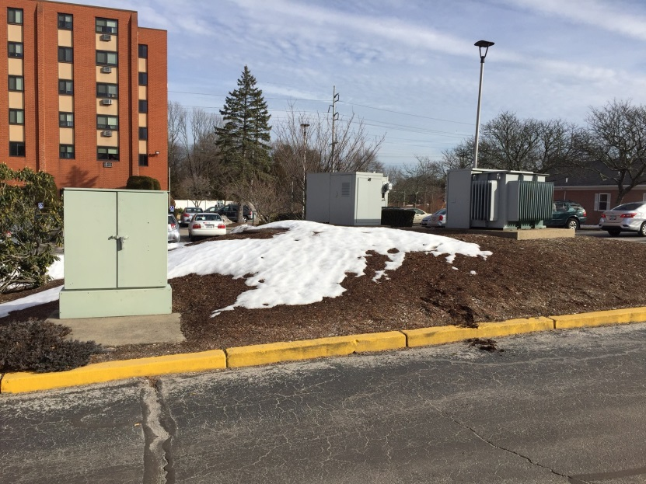
Survey your surroundings BEFORE you dig
Look For:
Riser Poles/Pole Drops
Underground Vaults/Manholes/Handholes
Pad mounted transformers/Switches
Notes:
Learn to read work area for clues to underground facilities…here is a riser pole

Slide 12
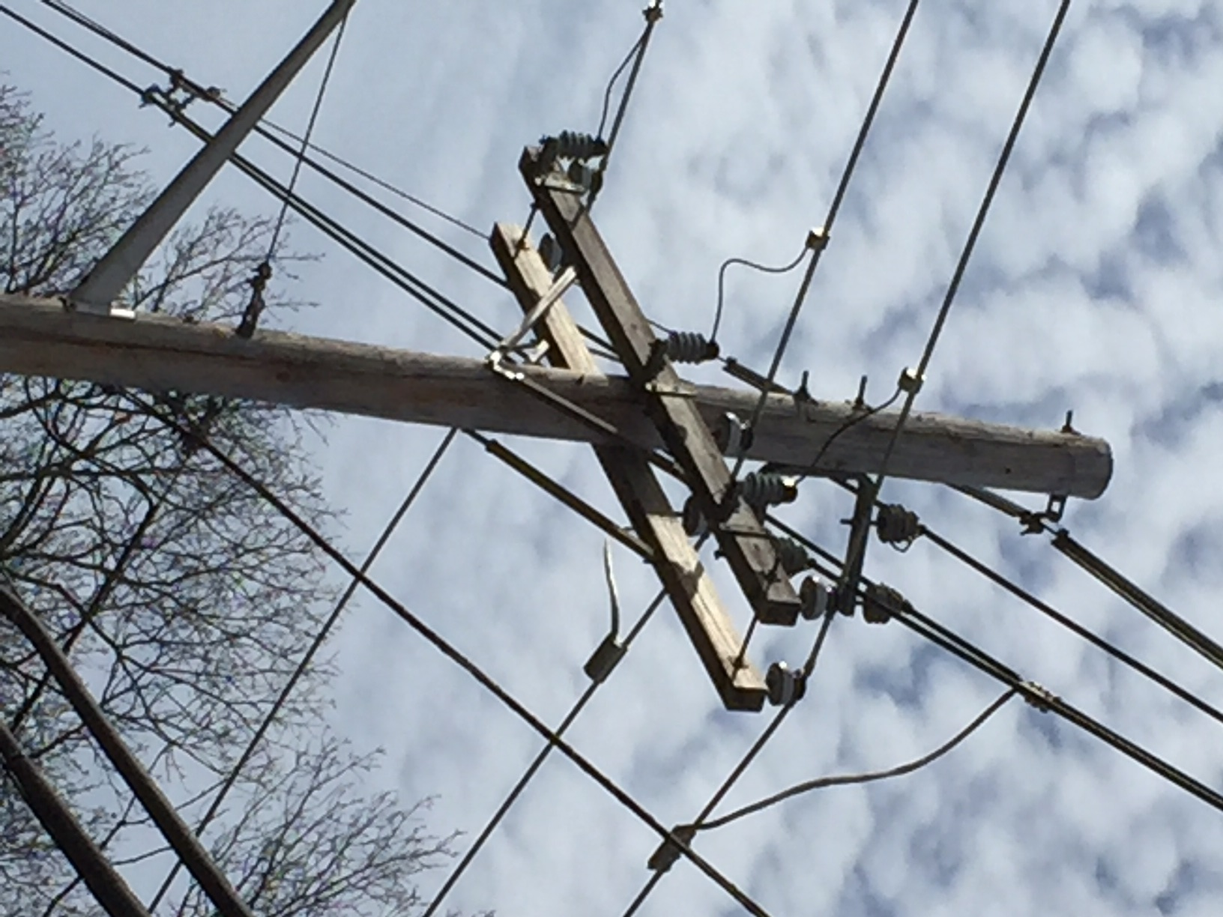
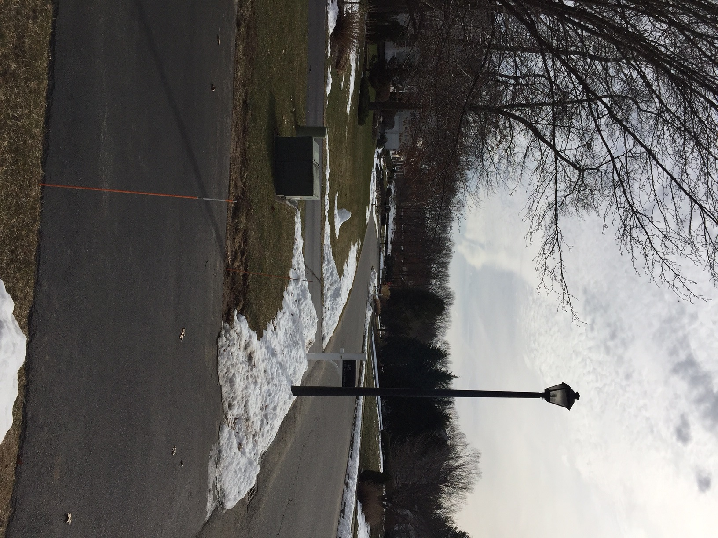

Slide 13
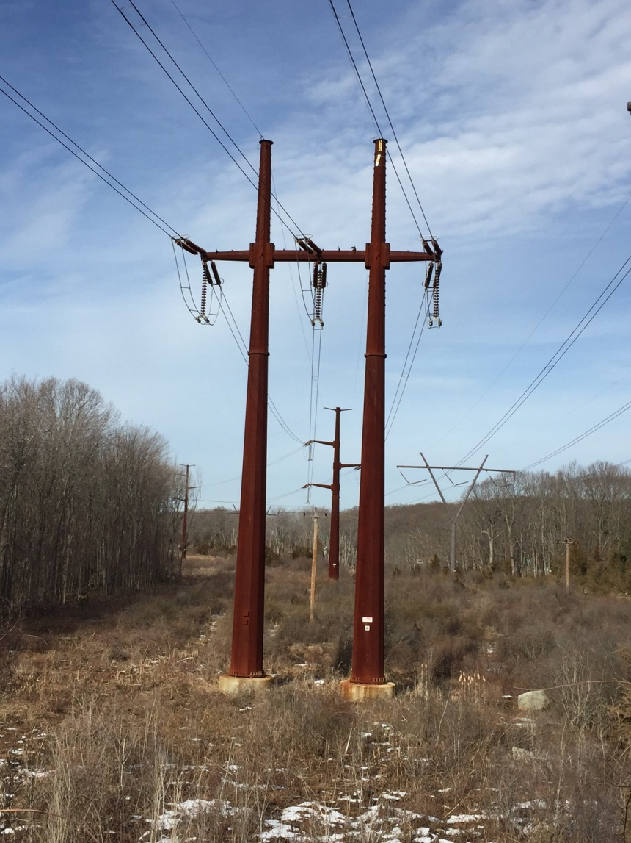
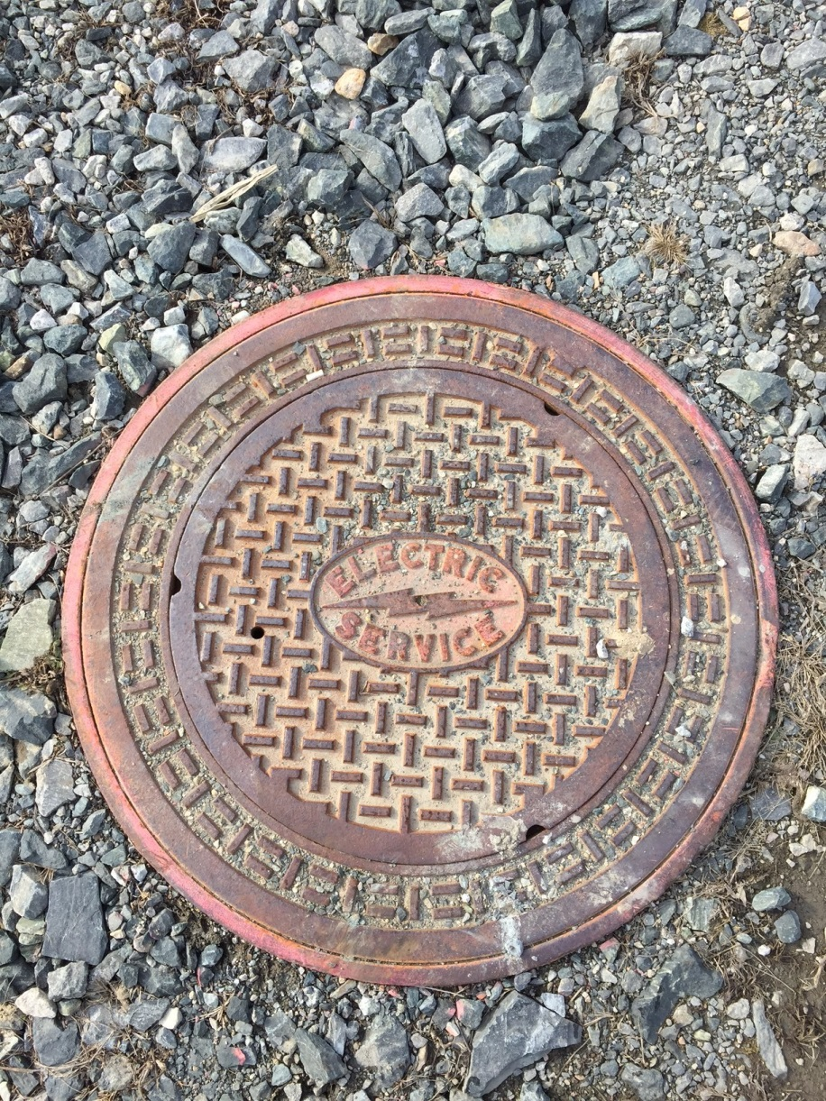
High Tension Lines
aka Electric Transmission
Electric Manholes

Slide 14
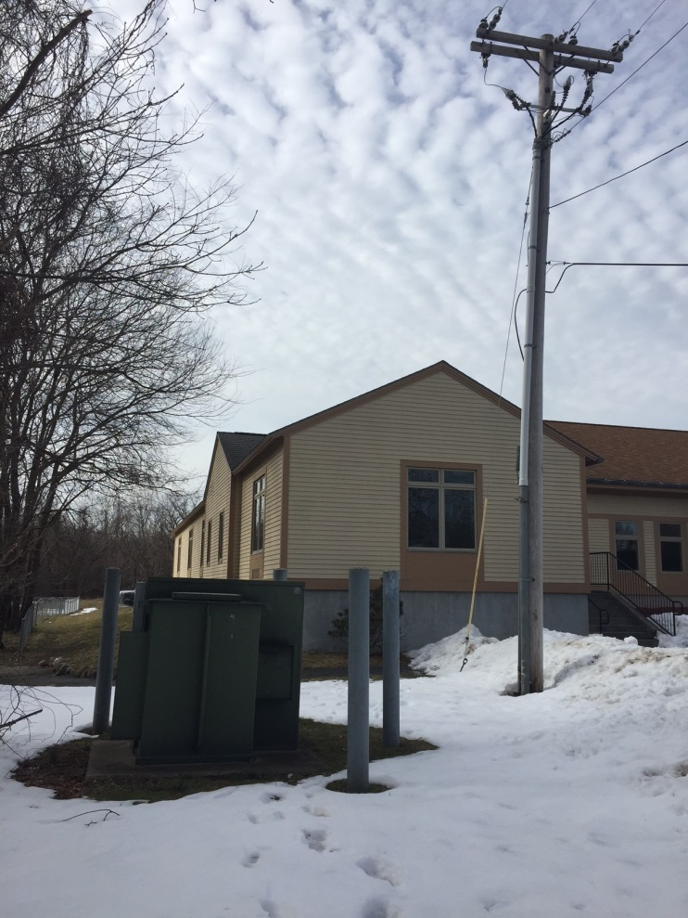
Riser drops
Notes:
Here’s a riser pole feeding a pad mounted transformer…(what’s up with all the sneakers on our lines??)

Slide 15
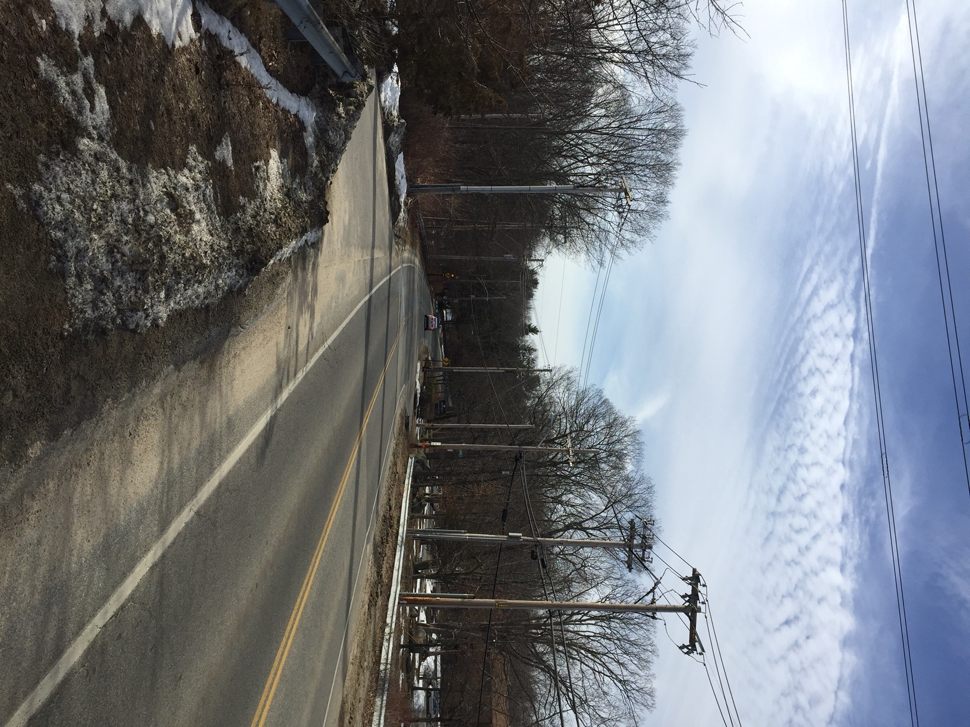
How many drops do you see?

Slide 16
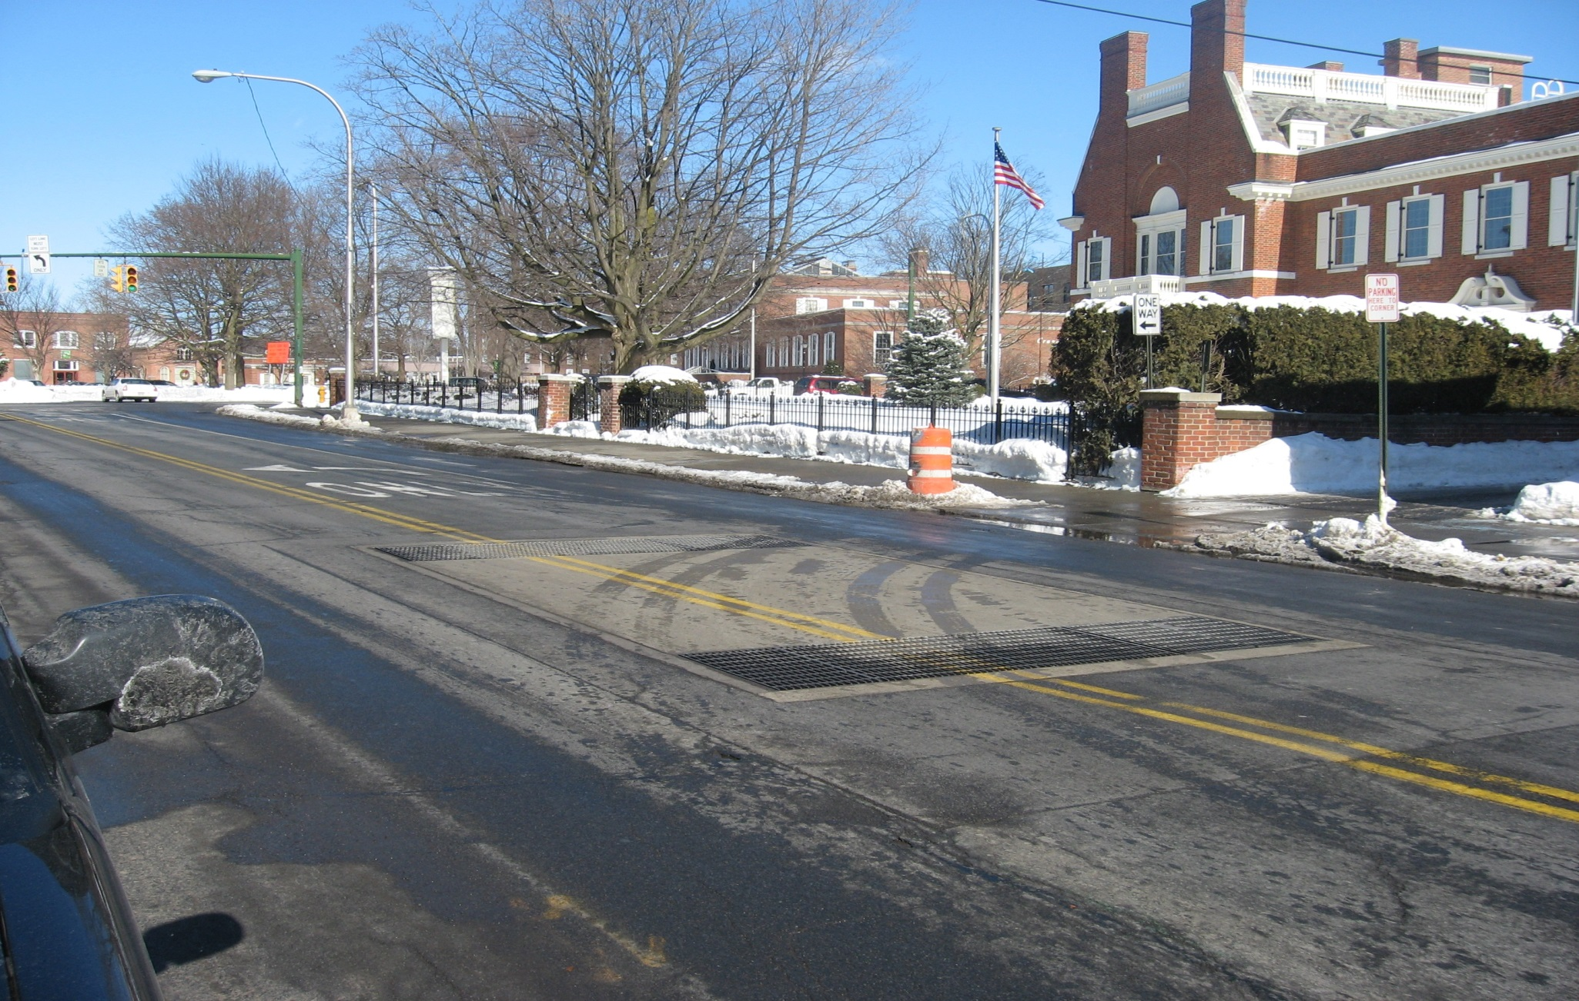
Underground Vaults/Manholes
Notes:
Vaults/Manholes are primarily found in cities and house equipment and cable systems for the underground network.

Slide 17
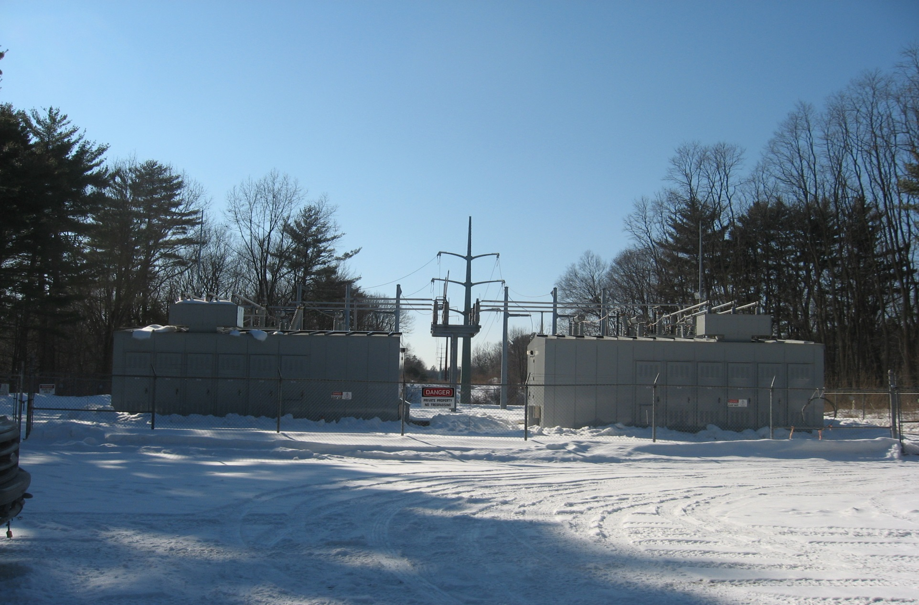
Substations

Slide 18
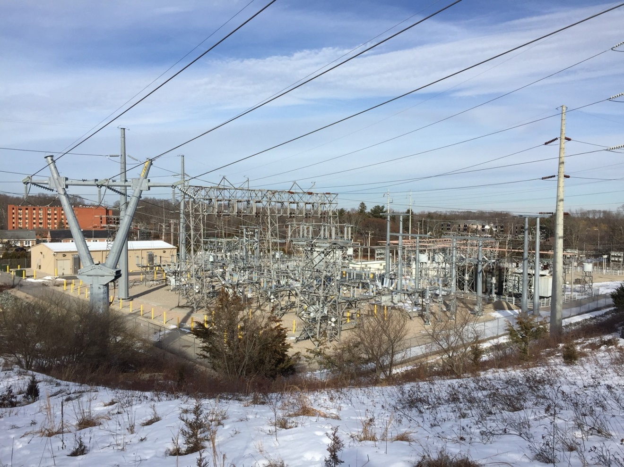
Substations

Slide 19
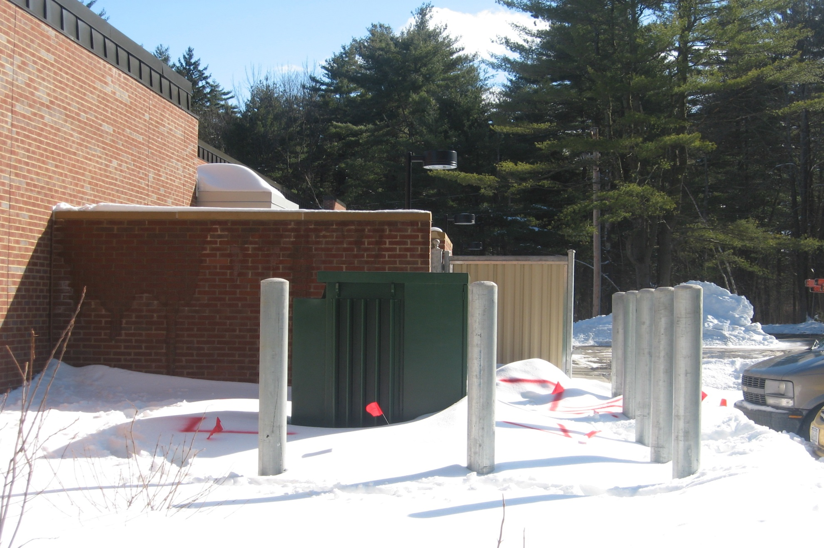
Pad Mount Transformers/Switches
Notes:
Notice mark out 2’ around equipment to protect ground grid

Slide 20
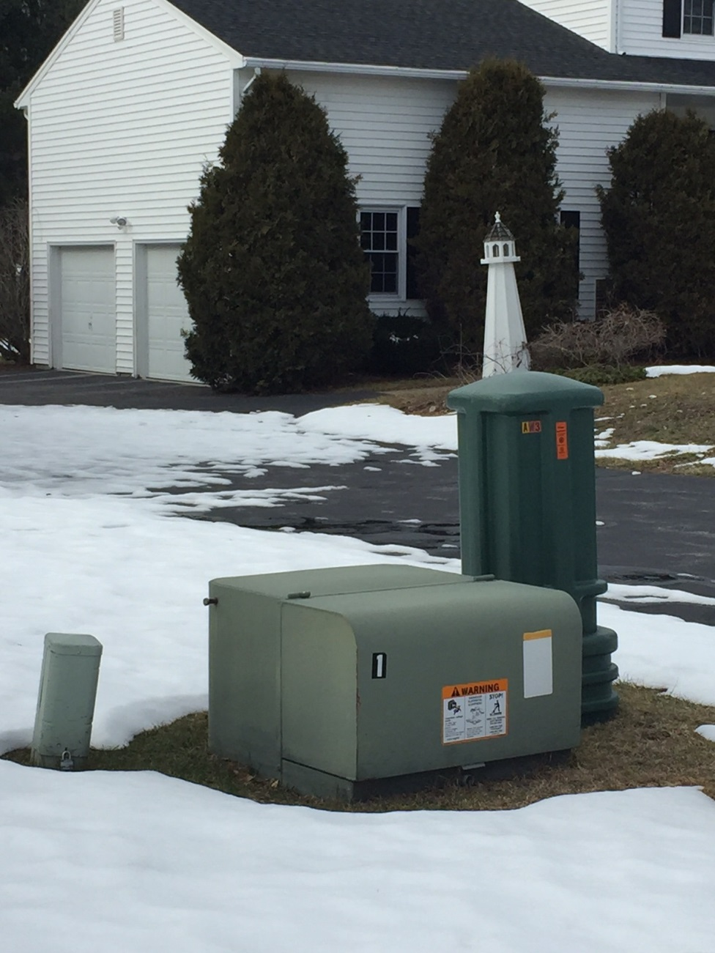
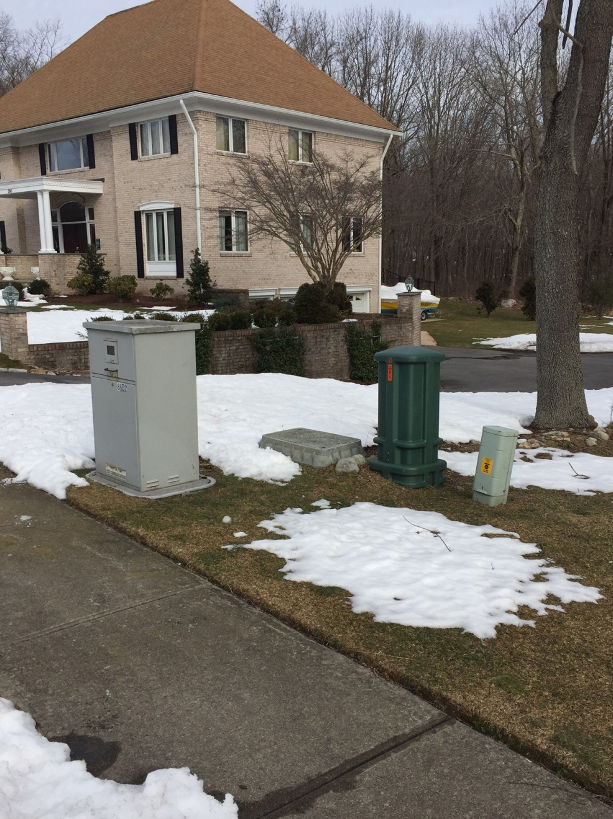
Transformers & Handholes

Slide 21
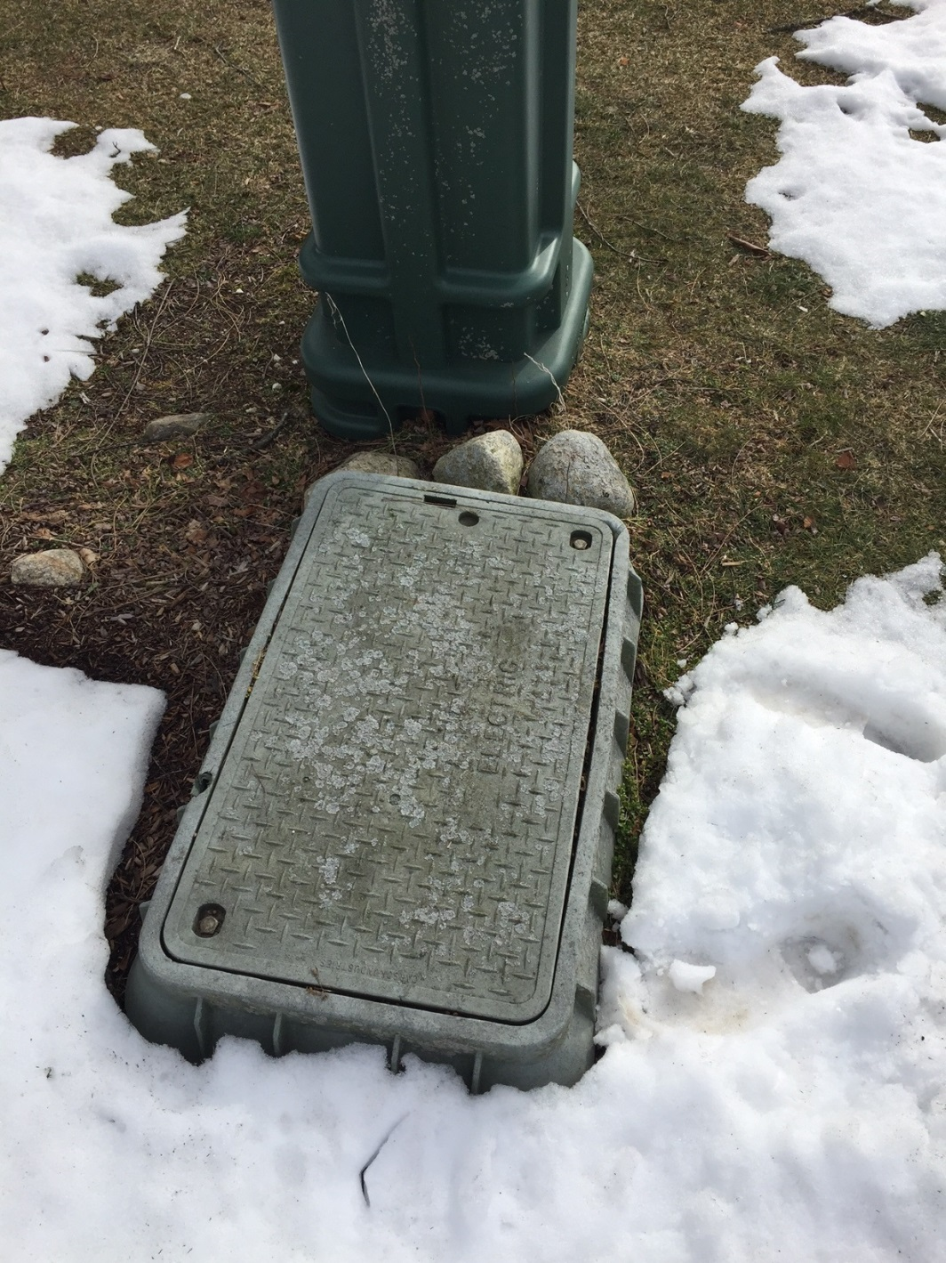
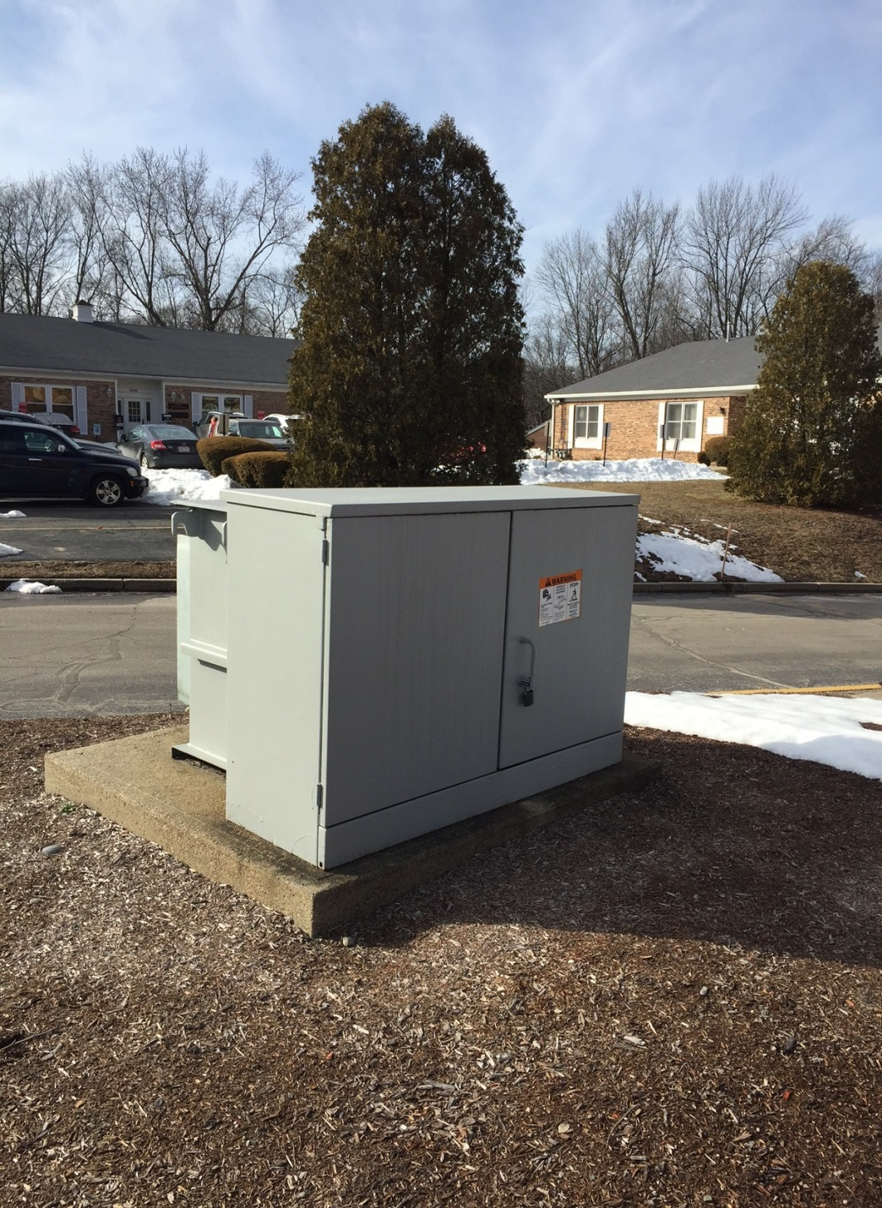
Transformers
& Handholes

Slide 22
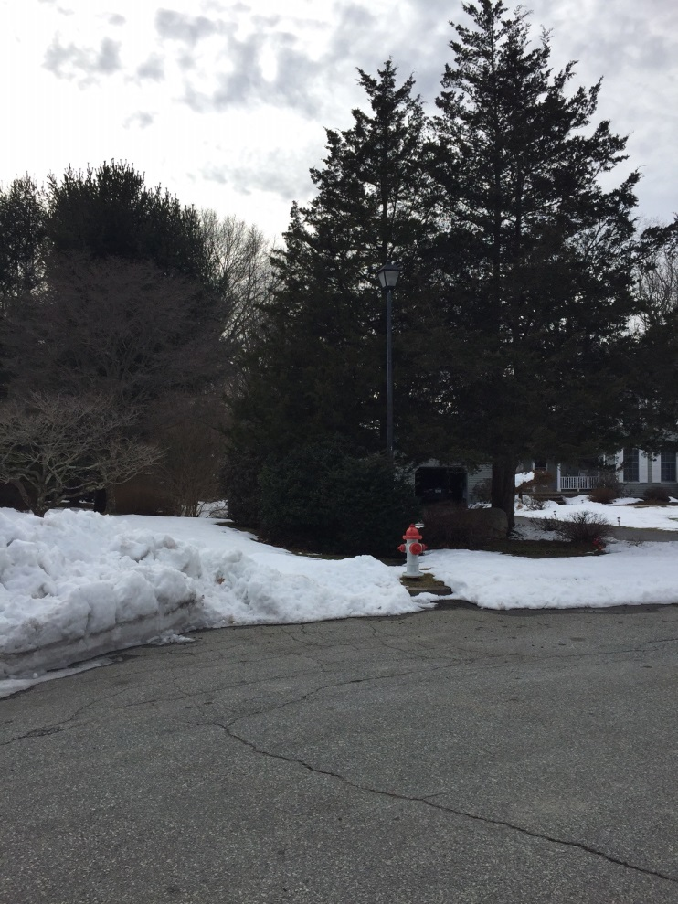
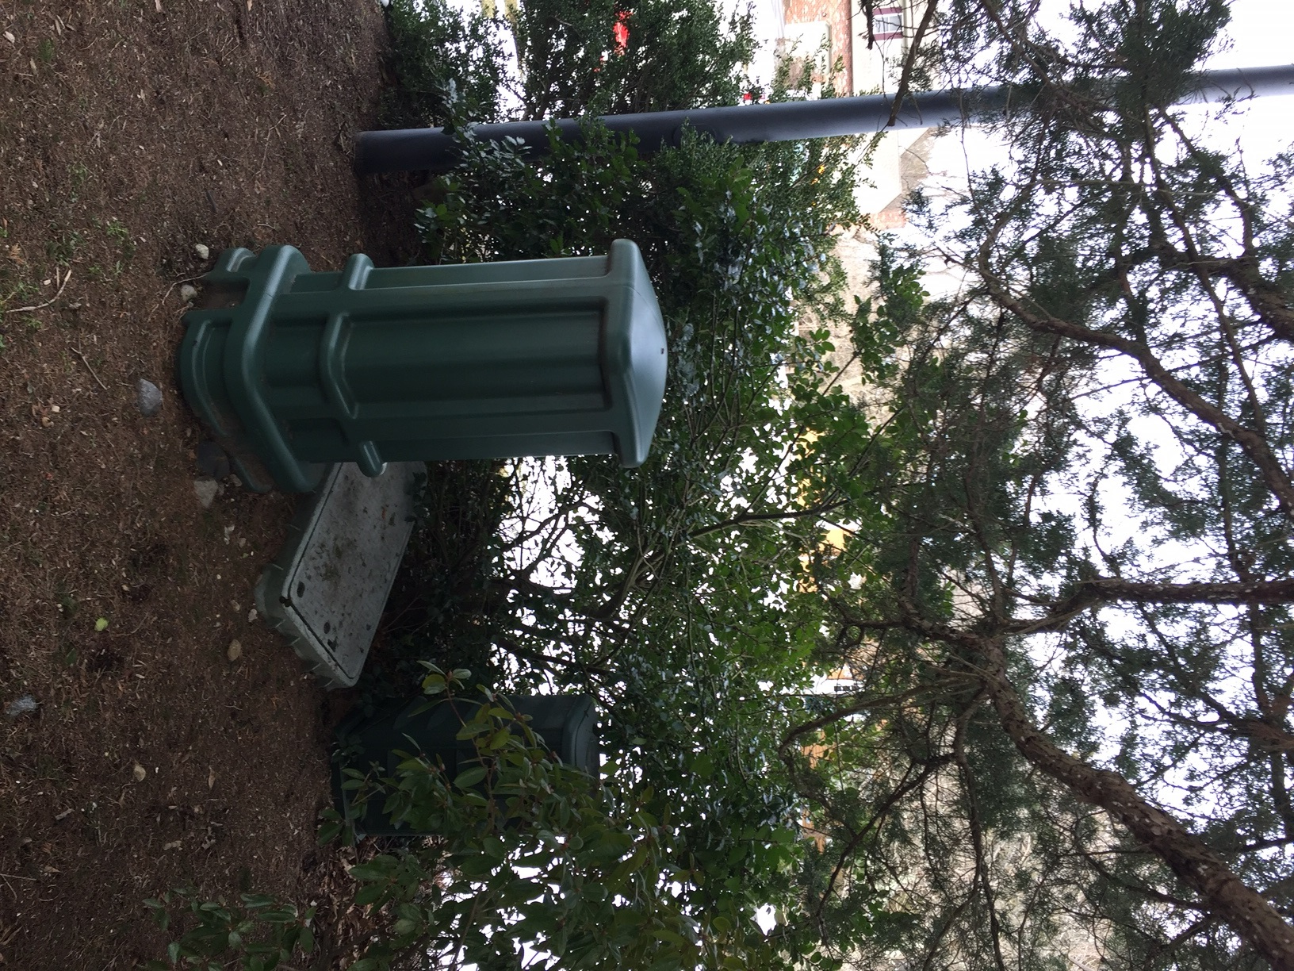
Notes:
Picture on left is from the street in, notice the bushes behind the fire Hydrant. Picture on the right is what’s behind the bushes.

Slide 23
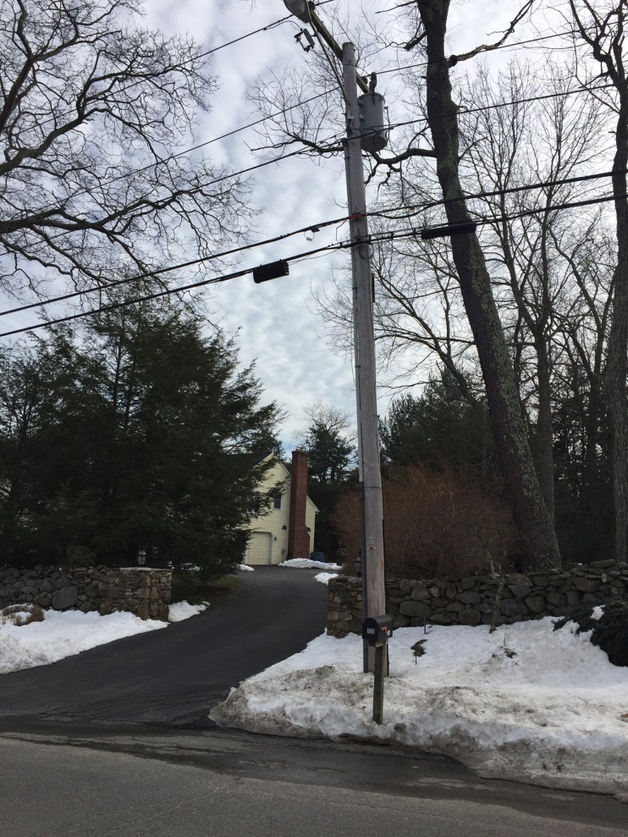
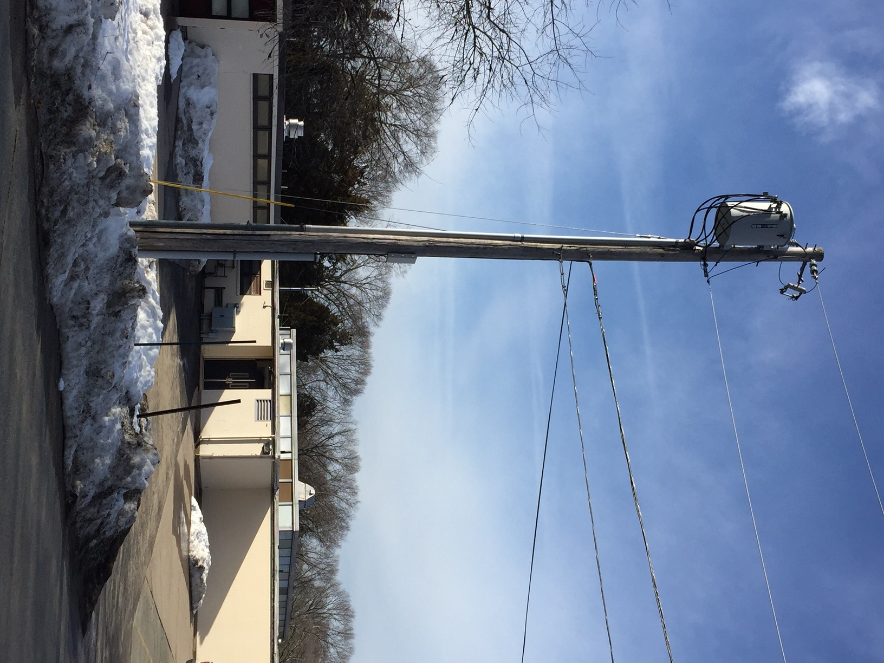
Private Electric

Slide 24
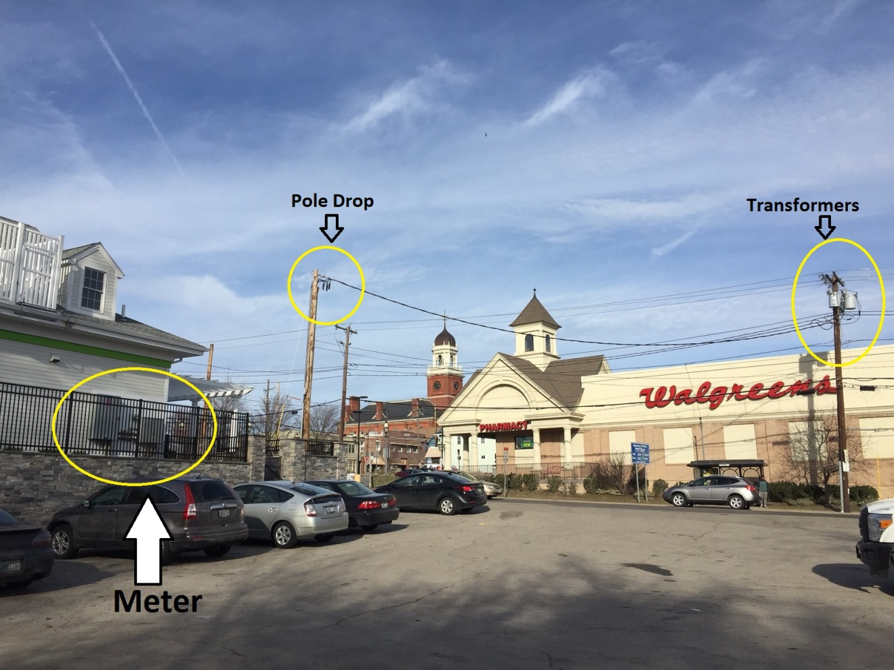
Private Electric

Slide 25
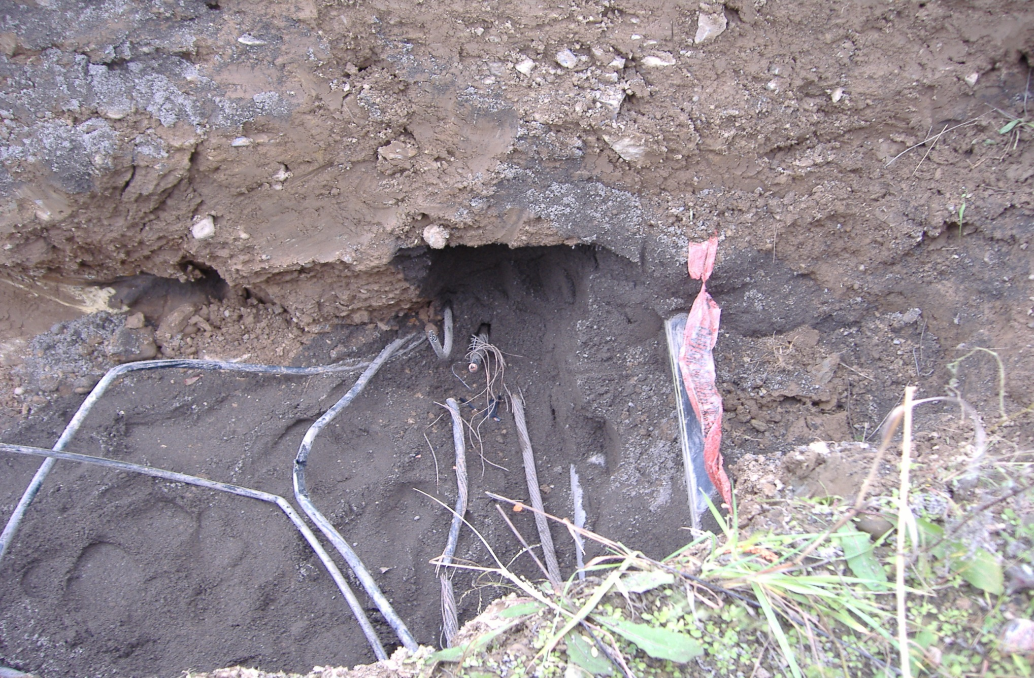
Electric Damage

Slide 26
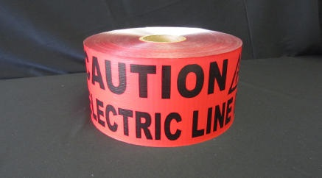
Effects of Electricity On the Body
Varies from no lasting affect to sever burns and fatalities
Remember, if the circuit is not:
De-energized
Locked/tagged out
Tested and grounded
IT’S NOT DEAD
Notes:
If any employee experiences any electrical contact, they should be examined by a Dr immediately. Entry and exit wounds could appear very small but do severe damage to internal organs over time

Slide 27
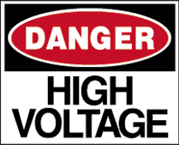
Questions?

