Slide 1
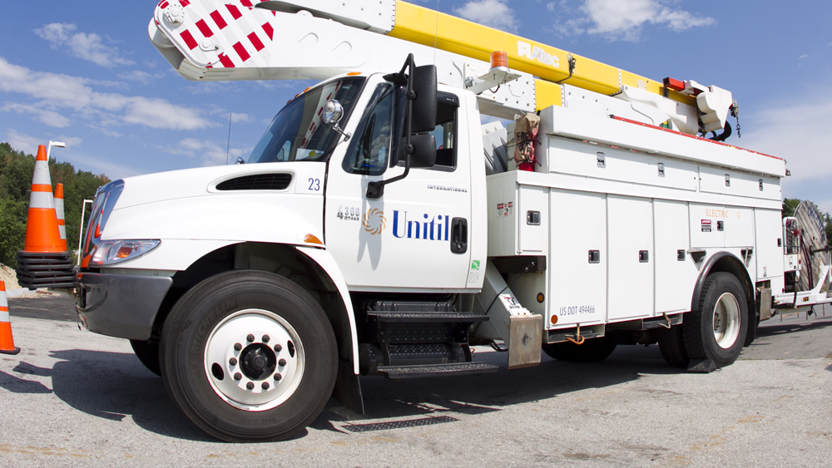
Unitil 2026 Safety “A” MUST
Make The Safe Choice, Make the right Choice!
February 26, 2026

Slide 2
Keith Caribo Manager Electric Operations, MA Work Number 978-353-3263 E-Mail Caribo@unitil.com

Slide 3
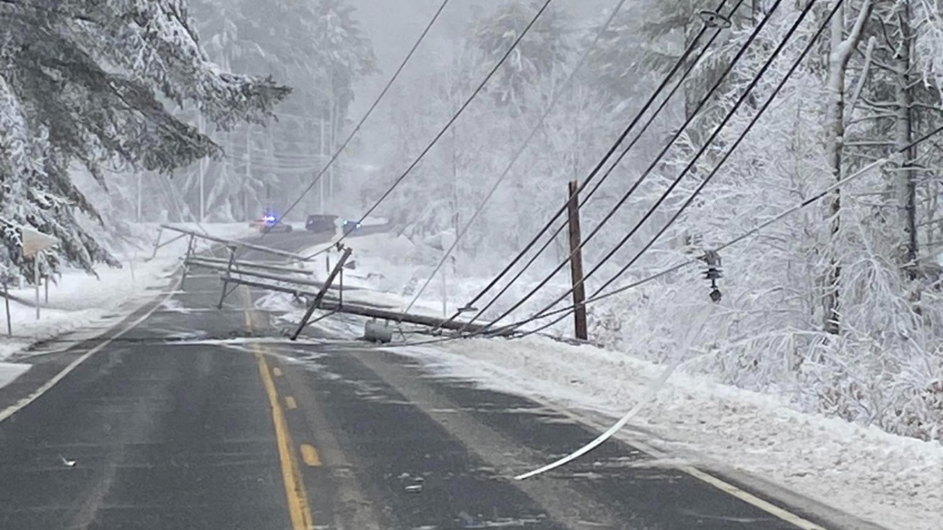
Safety Message - Understanding Back feed
This section of line is not connected to electrical system on either end
A homeowner starts up their generator and plugs the cord into a wall outlet
Power is back fed into the panel, out through the meter, into the low voltage side of the transformer and out the high voltage bushings…
This line is now energized by the backyard Honda generator, and you are at RISK!

Slide 4
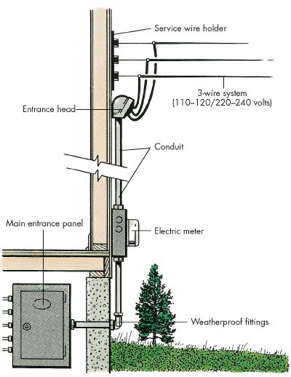
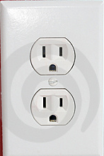
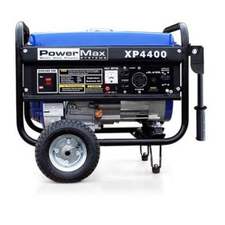
Understanding Back feed = Source
Safety Message
House voltage goes back to low side of transformer, through transformer in reverse and out the high side as high voltage
Improperly wired
Voltage now goes
t0 the panel
Out to the
System

Slide 5
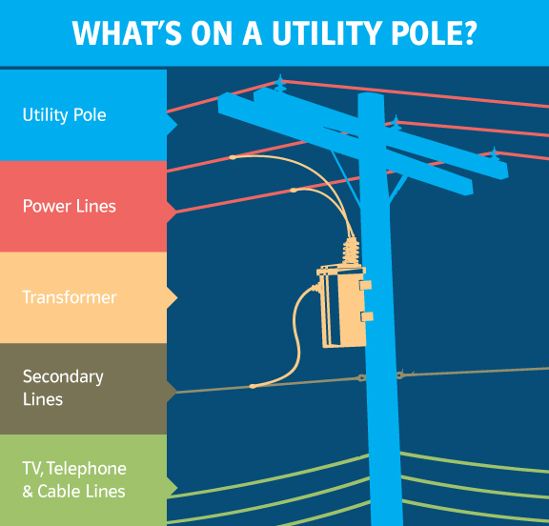
A Closer Look
Typical Pole Construction layout
Location on pole governed by NESC National Electric Safety Code

Slide 6
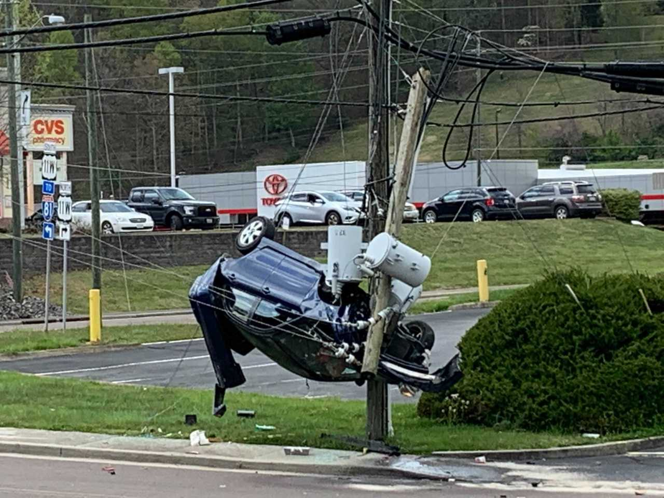
Touch Potential
Car in contact with energized wires
Touching the car will result in electric shock
That is an example of touch potential

Slide 7
Hidden Hazards- Touch Potential
Definition:
“Touch potential" is the voltage between the energized object and the feet of a person in contact with the object.

Slide 8
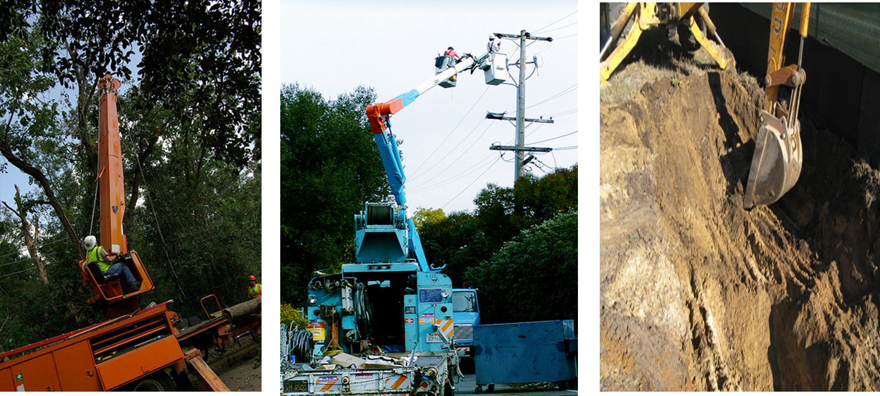
Touch Potential
Avoid touching any bucket trucks, diggers or attached trailers when booms are in the air near energized conductors- Touch Potential

Slide 9
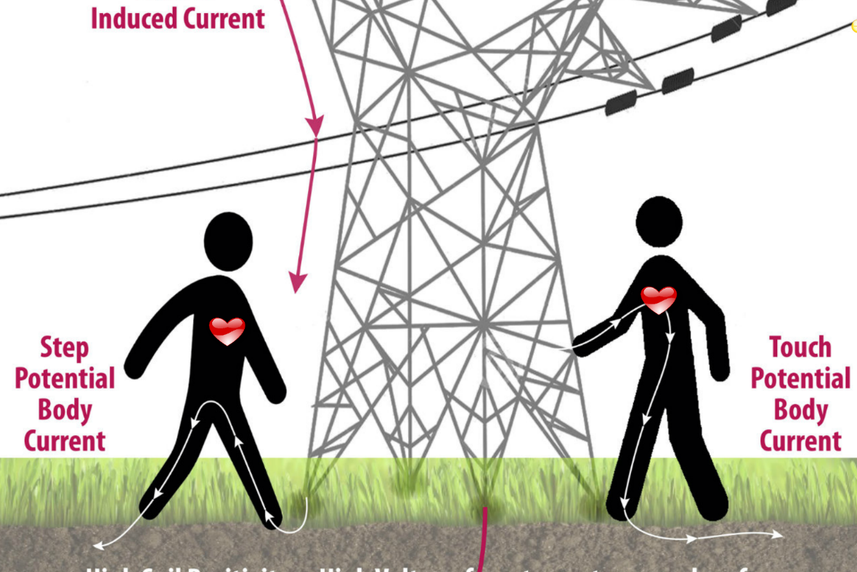
Hidden Hazards – Step Potential
Definition:
The voltage across a worker who stops across an energized path of earth

Slide 10
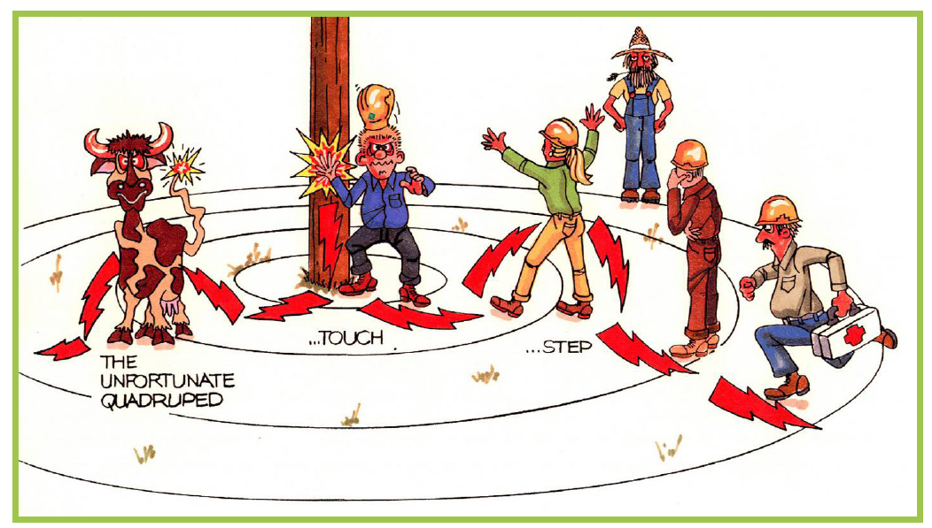
Who’s Safe? Why?

Slide 11
Who’s Safe? Why?
1- No, Touch and Step Potential 2- No, Step Potential
3- Yes, if he doesn’t move
4- No, Step Potential
5- Yes, if he doesn’t move
6- No, Step Potential

Slide 12
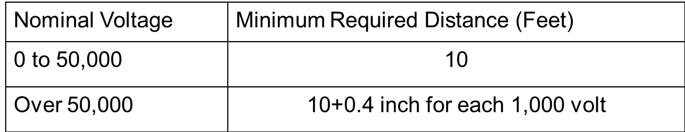
Protecting Yourself
What is a safe distance to stay back for down wires or equipment in contact with exposed electrical conductor?
10’
15’
20’
25’
30’
40’

Slide 13
Protecting Yourself
What is a safe distance to stay back for down wires or equipment in contact with exposed electrical conductor?
10’
15’
20’
25’
30’
40’
Stay back 30’ from the closest piece of down wire or electrical equipment….this avoids step potential

Slide 14
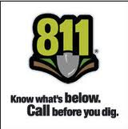
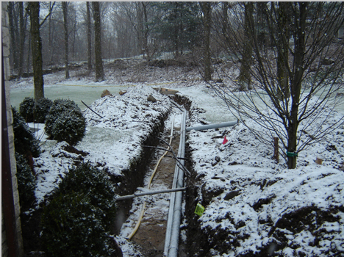
Safe Zone – The Importance to call before you dig
If you expose and believe there may be damage STOP, call the local utility. The damage we see is better than not
You may not always know what is under -ground, do you?

Slide 15
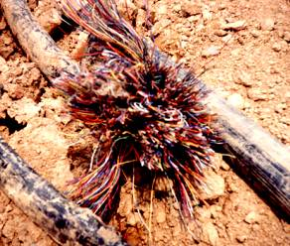
Underground Power Lines
Locate and mark the perimeter of underground lines
Exercise caution when excavating near power lines
Some manual excavation may be required
Stay away from pad mount transformers
Green metal box
Underground utility line that has been hit

Slide 16
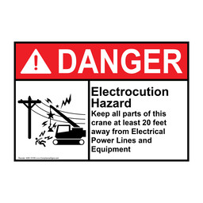
Injury Prevention
If you hit a power line
In case of no immediate danger
Move the equipment away
Have someone call 911
Stay on the equipment until you know it is safe.
Warn others to stay away
If you MUST get off the equipment, jump clear.

Slide 17
Questions?

