Slide 1
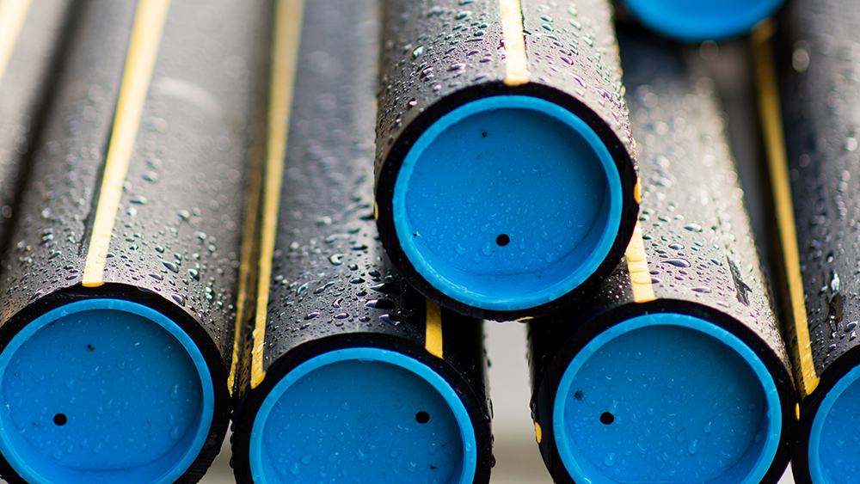


Damage Prevention and Natural Gas Presentation
March 3, 2026

Slide 2
Why we are here…
SAFETY
Commitment to ensuring a safe environment for our customers, co-workers, ourselves and our neighbors
PROTECT LIFE, PROPERTY, CONTINUITY OF SERVICE
Excavation Damages are the Largest Threat to the Gas System
  No matter how big or small

Slide 3
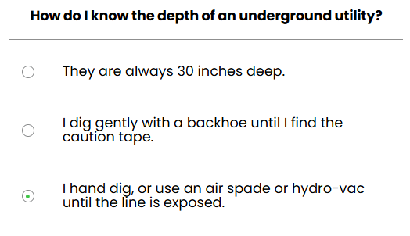
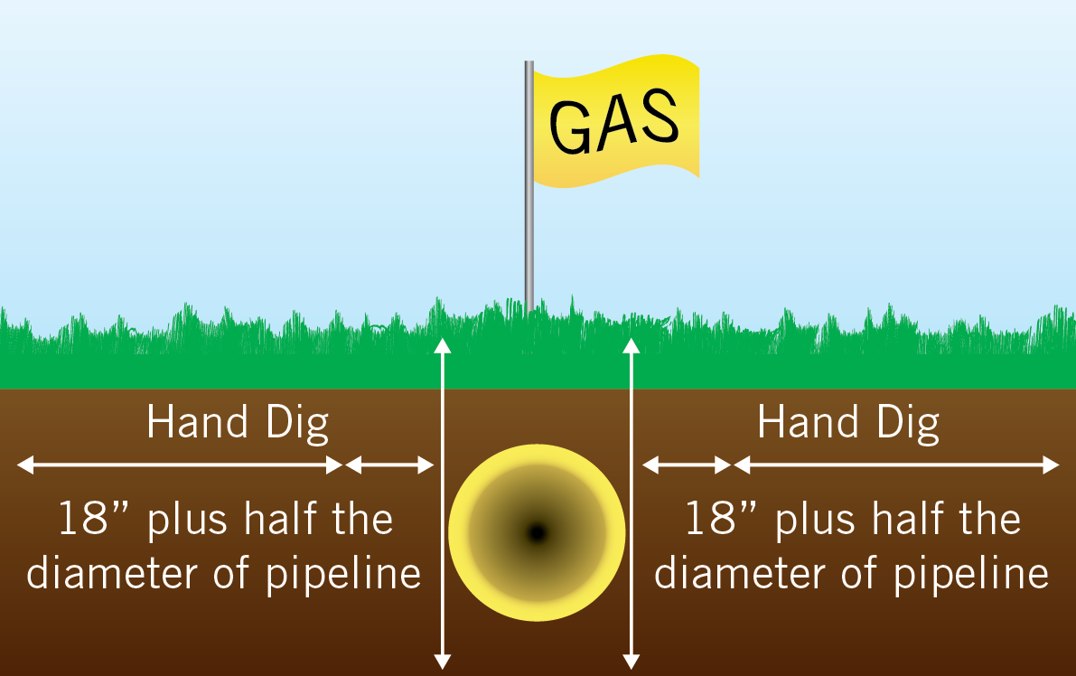
Hand Digging Requirements!

Slide 4
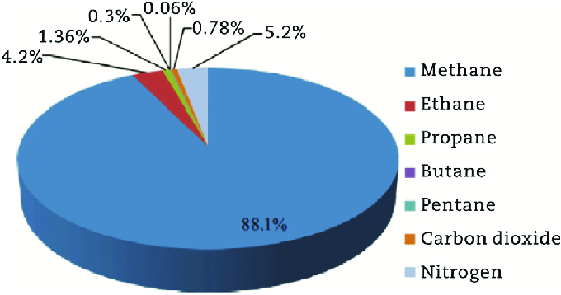
PROPERTIES OF NATURAL GAS
Natural Gas is:
  Colorless; Odorless; Tasteless; Non-Toxic;
  Lighter than air
Odorant added (Methyl mercaptan)
  Rotten-egg/cabbage smell
Natural gas is highly flammable and will burn when the
gas-to-air ratio is between about 5% and 15%
  Concentrations below 5% or above 15% will not burn
Liquefied gases, such as propane, have different properties than natural gas
Natural Gas Components

Slide 5
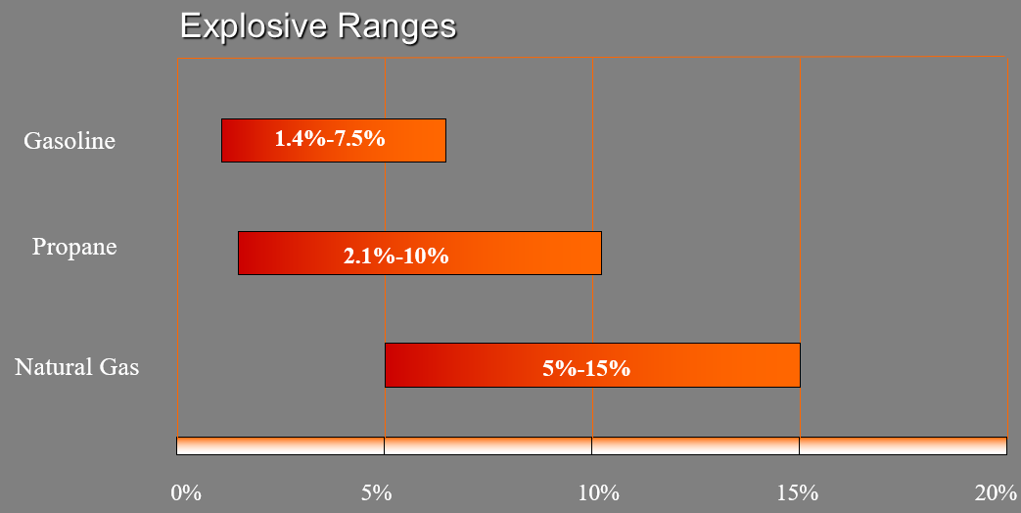
PROPERTIES OF NATURAL GAS

Slide 6
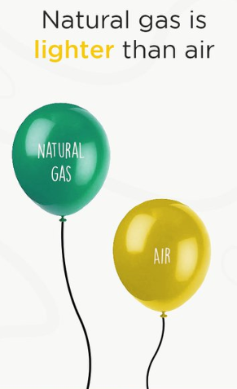
“Lighter than Air”
When released in the atmosphere:
  Natural gas will rise and quickly mix with air.
  Propane, gasoline and fuel oils will settle at ground level.
Natural gas:
  Will follow the path of least resistance.
  Can accumulate far away from initial leak by traveling through sewers and underground duct lines.

Slide 7
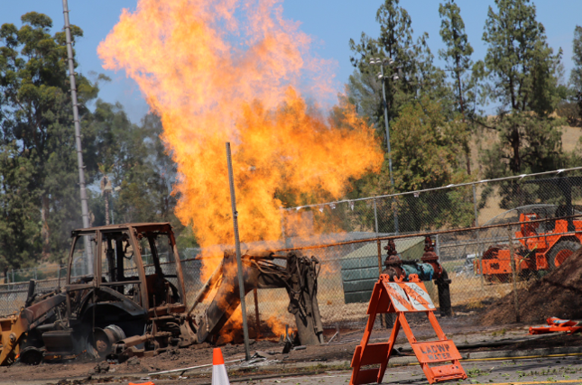

Potential Ignition Sources
Your Equipment
Static electricity
Ringing telephones
Light switches
Flashlights
Pilot lights
Open flames

Slide 8
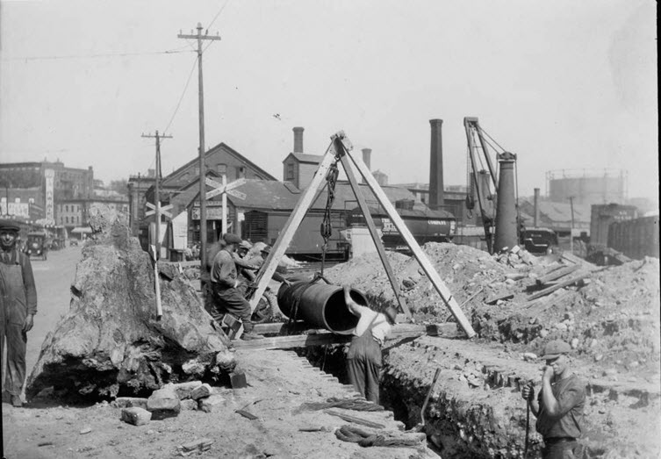

Gas Pipe Materials Types
Types:
  Cast Iron (1842 to 1950)
    Bell Joints
    Lacks Ductility
    Tensile Strength
  Bare Steel
    Corrosion leaks
  Coated steel
    Third Party Damage
    Occasional localized corrosion
  Plastic- High Density Polyethylene (HDPE) or Medium Density (MDPE)
    Third Party Damage

Slide 9
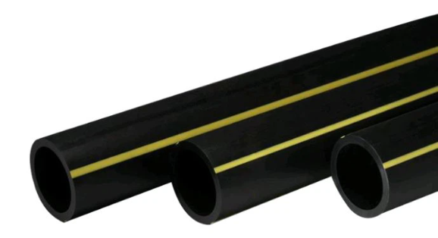
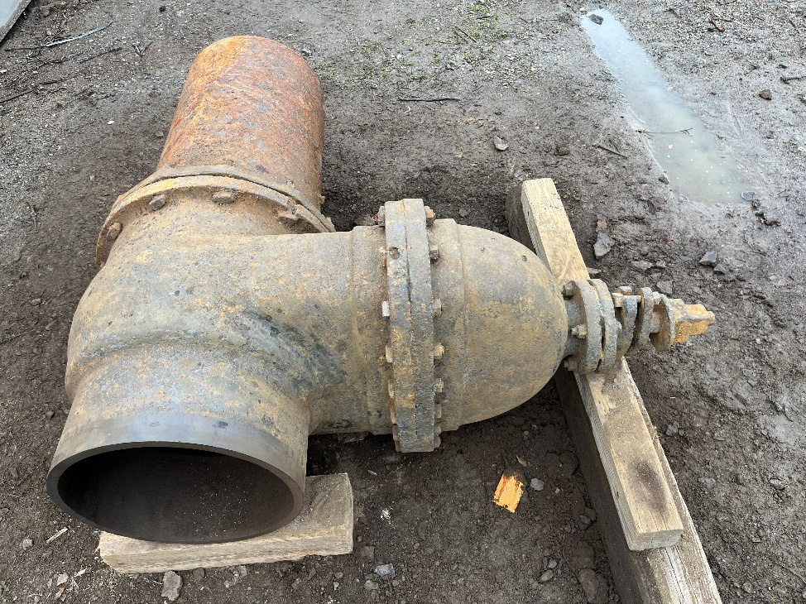
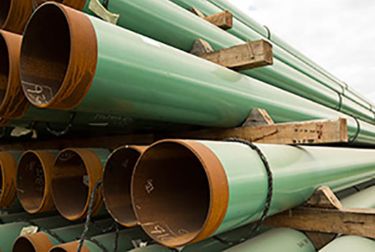

Slide 10
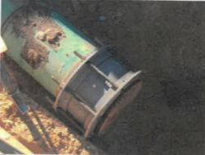
Unrestrained Fittings
Stop Work
Stabilize The Area
Notify the Gas Company
Wait Before Resuming Work

Slide 11
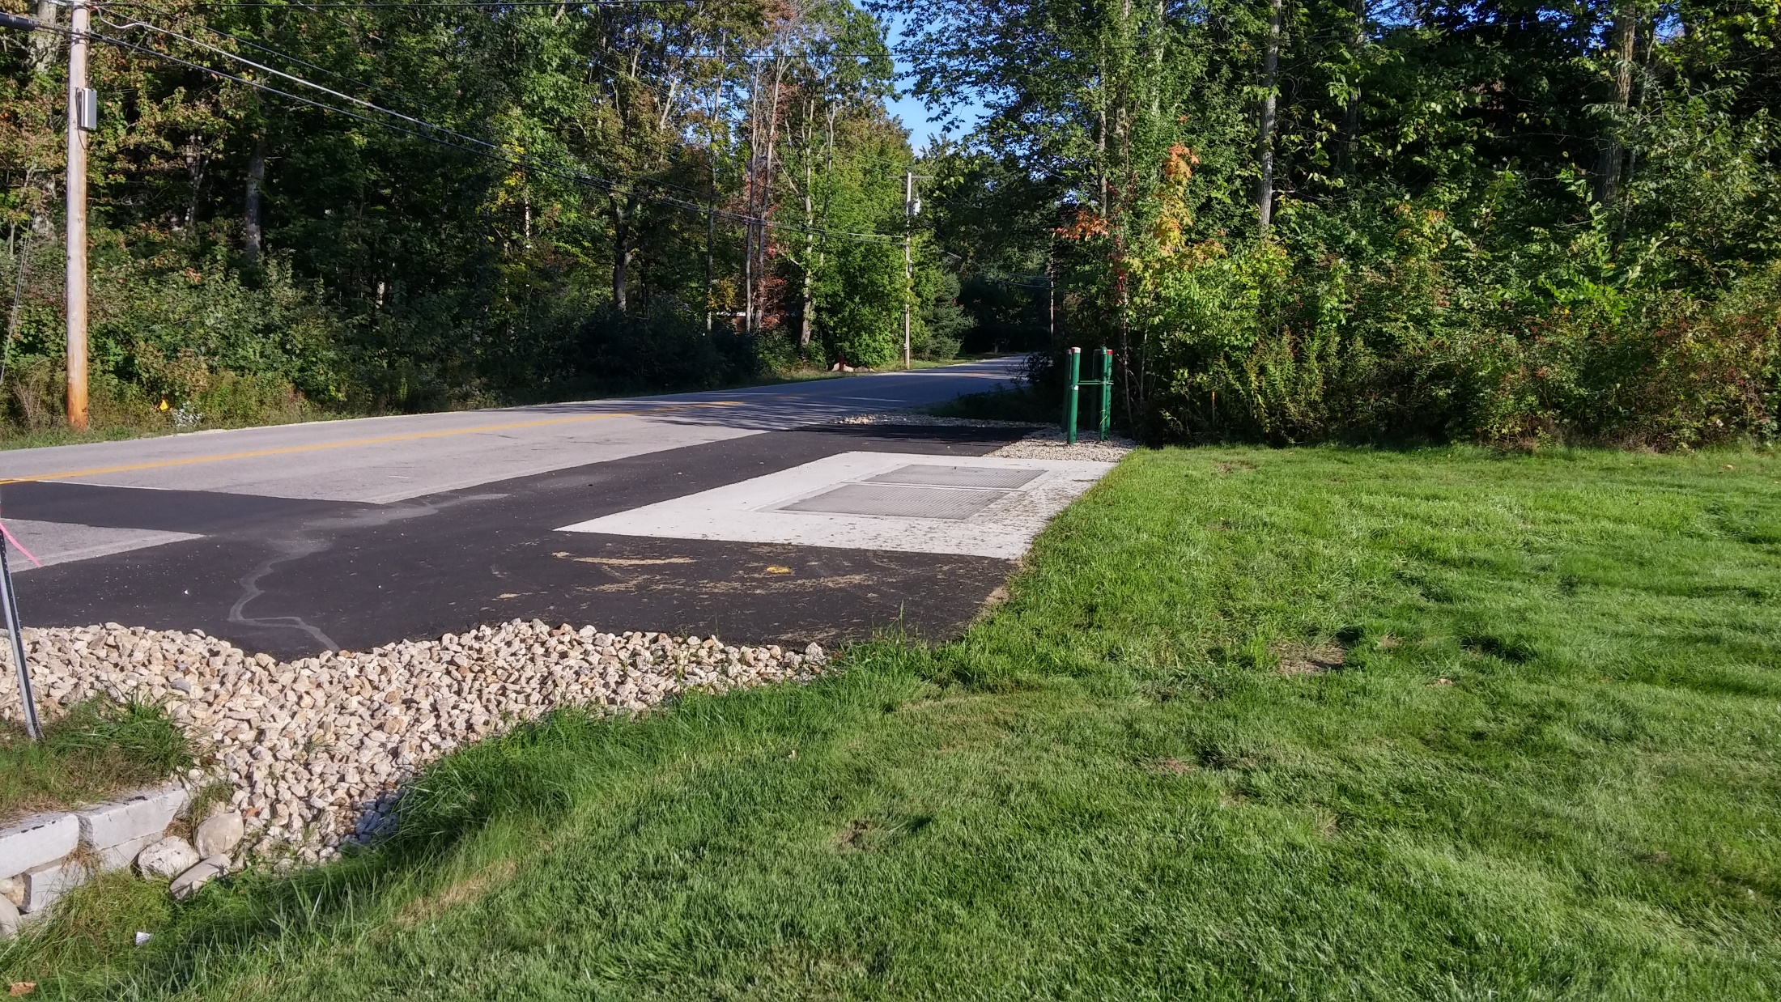
PROTECTION OF PRESSURE REGULATION FACILITIES AND SENSE LINES

Slide 12
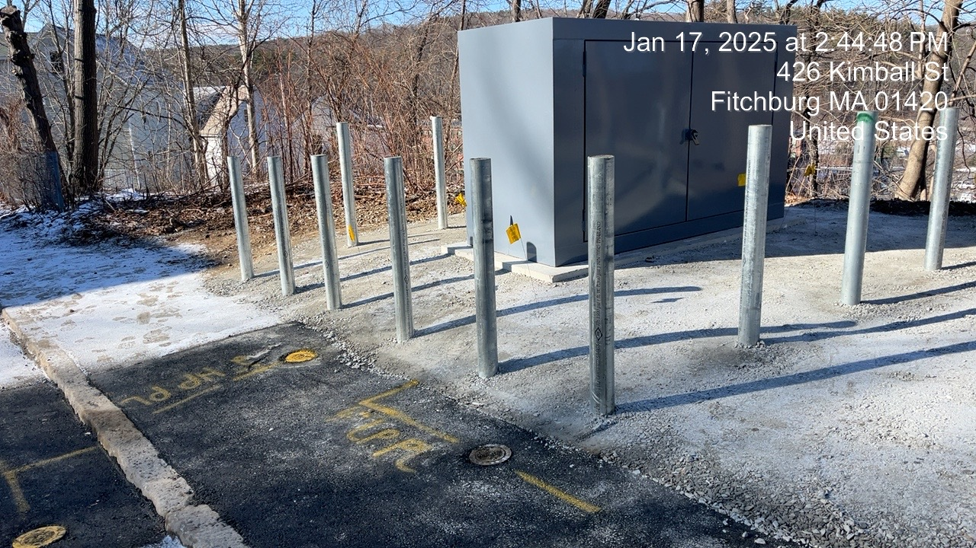

Slide 13
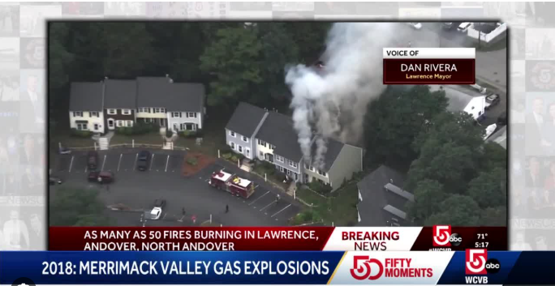
Concerns
Excavation poses a significant risk to system integrity if a damage occurs
  Over pressurization and public safety
Significant customer outages
Compliance with regulations
Damage to facility infrastructure- Expense

Slide 14
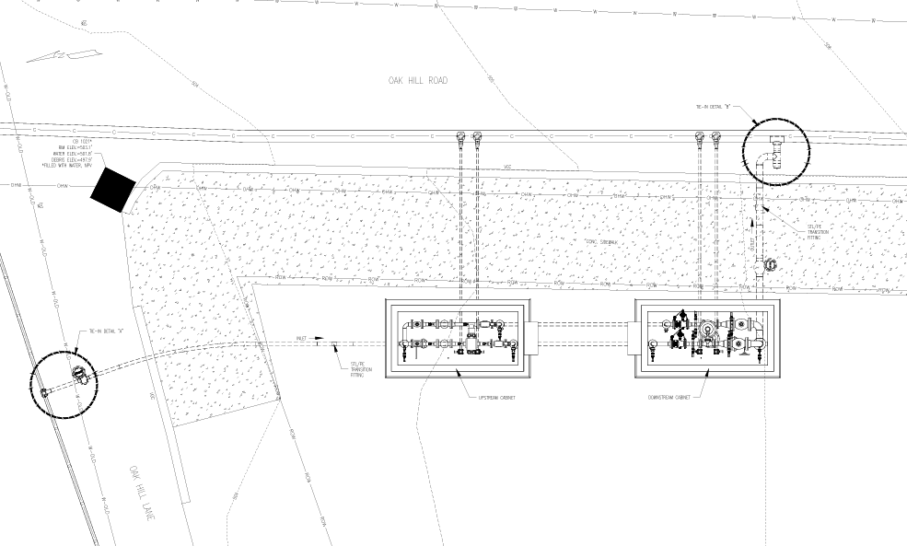

Slide 15
Proactive Mitigation Measures to Ensure Facility Integrity
Verification of sense line locations
Verification of station critical valves
Technician on standby when working in close proximity to stations
Location sense lines closer to facility or above ground
Installing steel sense lines or moving them above ground
Steel plating a legacy facilities

Slide 16
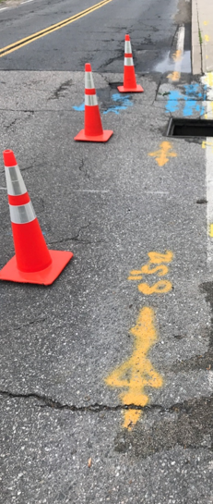
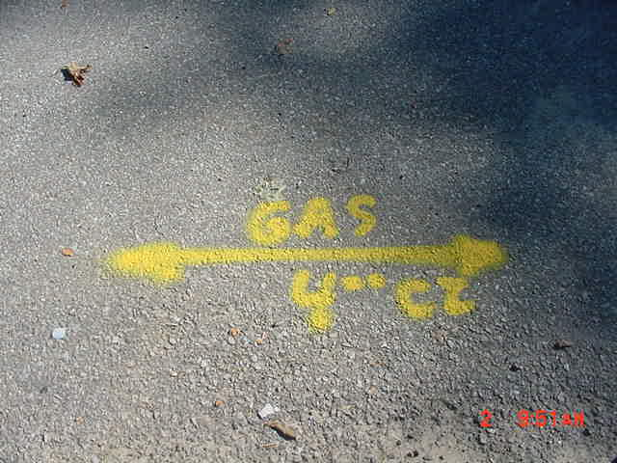
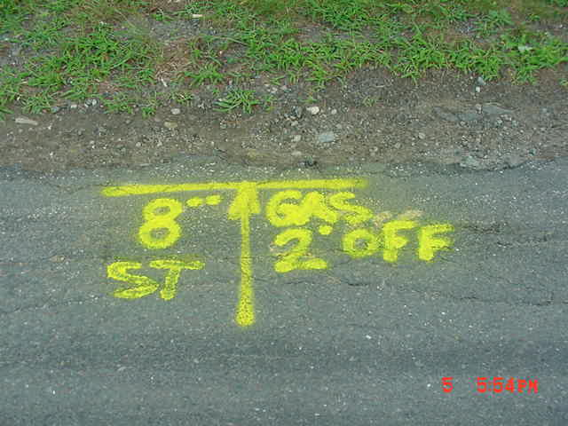
Understanding Gas Locate Marks

Slide 17
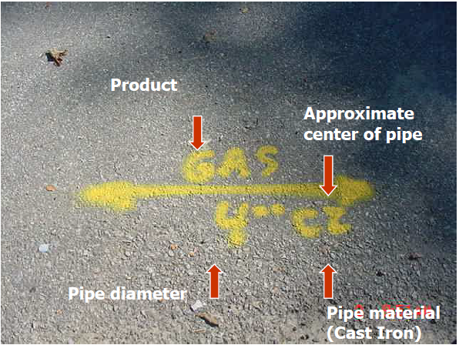
Gas Facility Marks

Slide 18
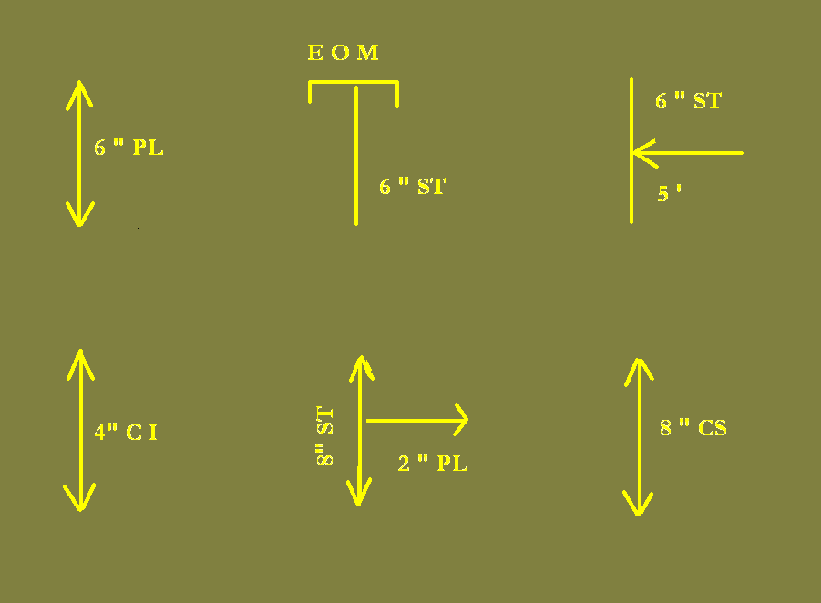
Gas Line Markings

Slide 19
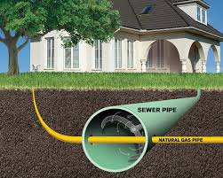
Cross Bore

Slide 20
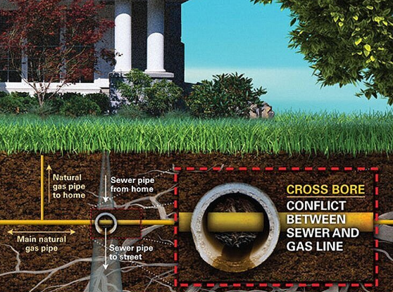
What are Cross-Bores and why is important to know?
A cross-bore is an intersection of one underground utility or structure, by a second utility that compromises the structural integrity of either the utility or underground structure.

Slide 21
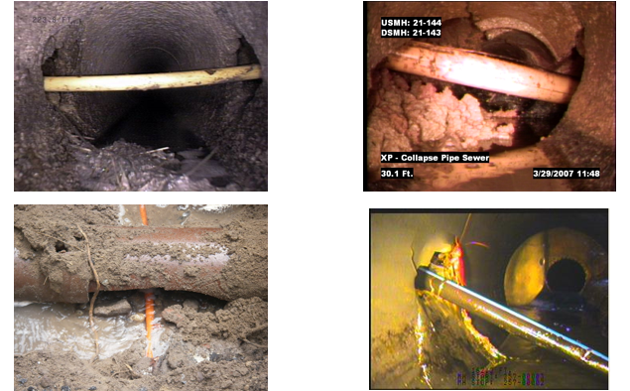
Cross Bore Examples

Slide 22
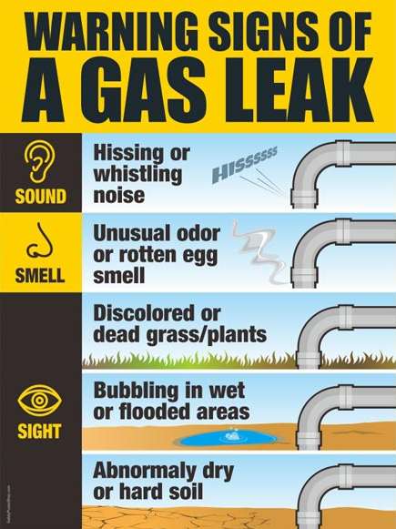
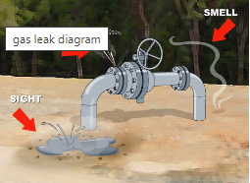
GAS LEAKS

Slide 23
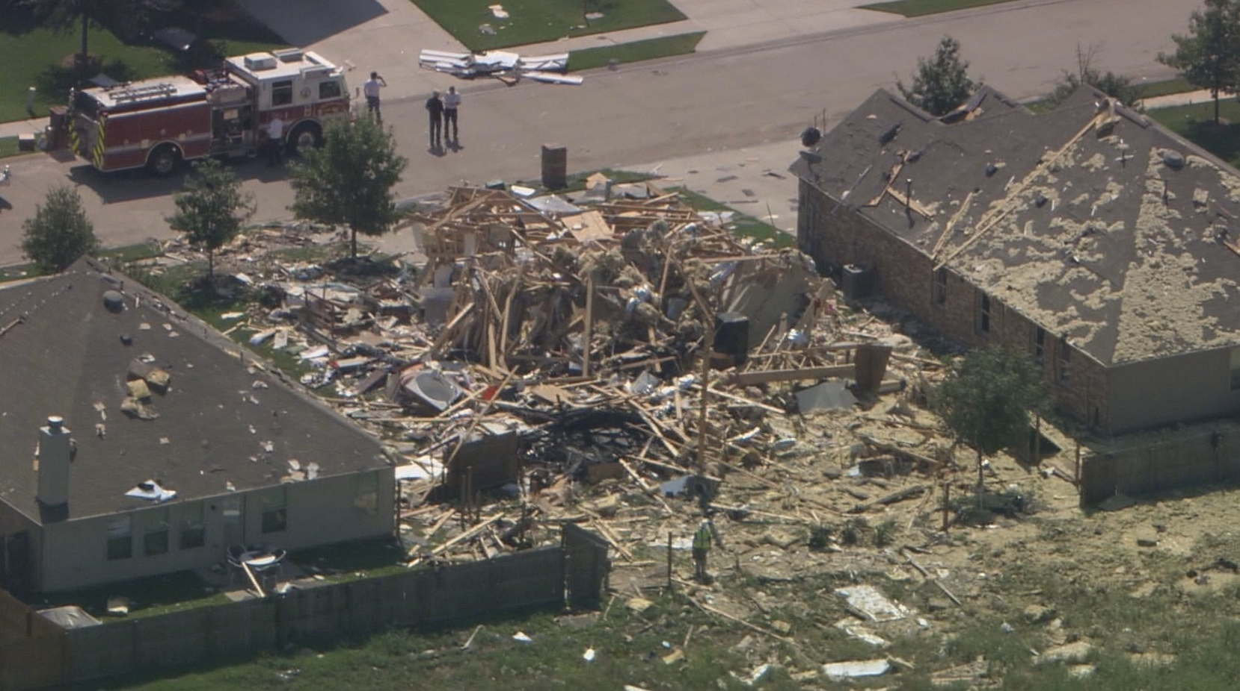
What to do when a gas line is damaged?
Stay Calm and Think
Stop Work
Rupture or release of Gas - CALL 911
Clear the Area – shut off engine/equipment
Evacuate Near-By Buildings/Homes
Call Gas Company immediately after calling 911
An excavator damage the gas line outside the home, injuring 3
  Unitil Emergency Line (1-866-542-3547)

Slide 24
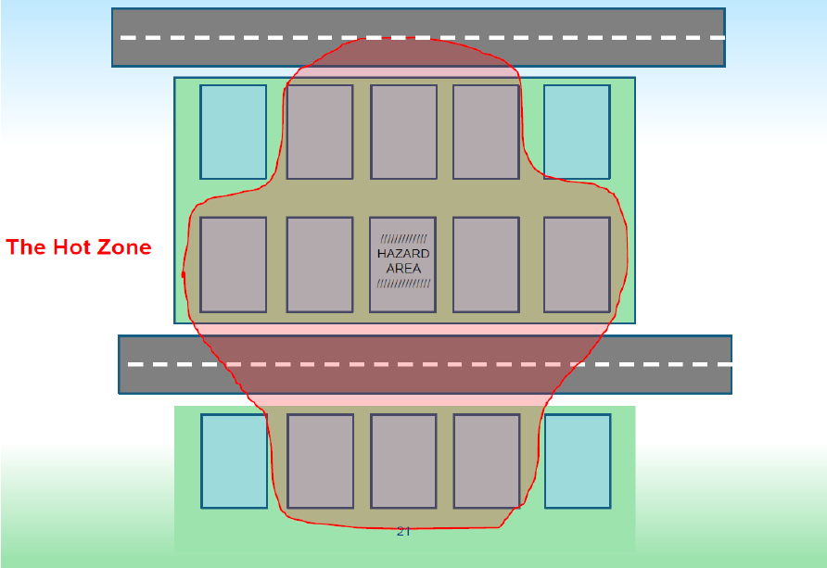
What to do when a gas line is damaged?
After calling 911
Evacuate the area
Think about adjacent structures
  Unitil Emergency Line (1-866-542-3547)

Slide 25
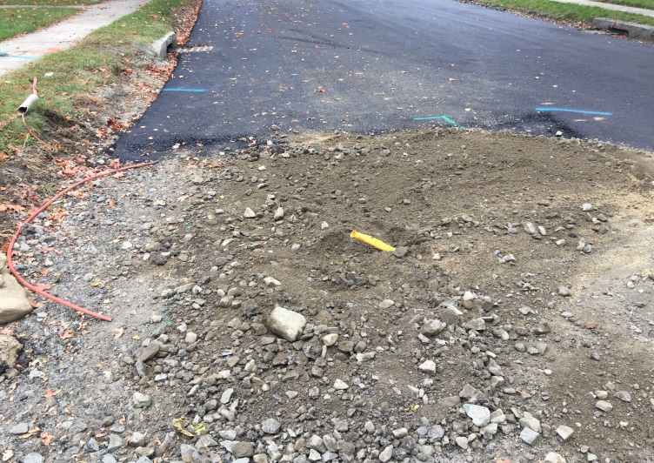
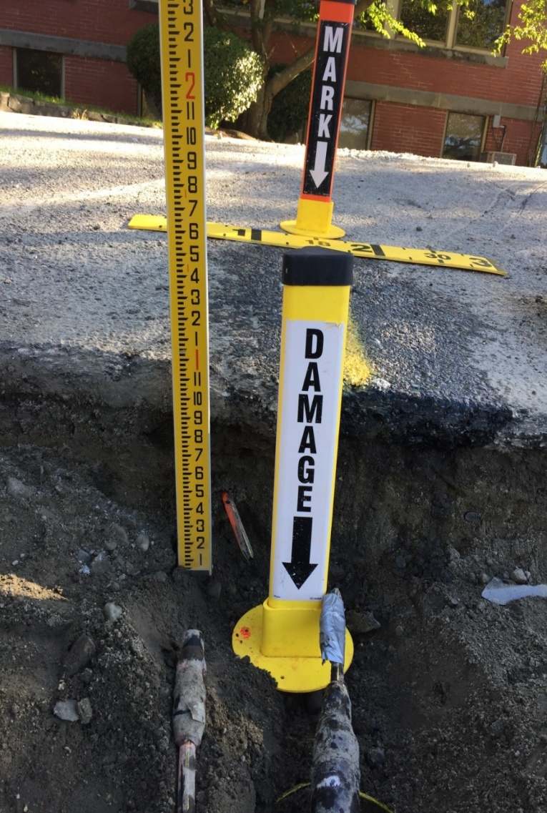
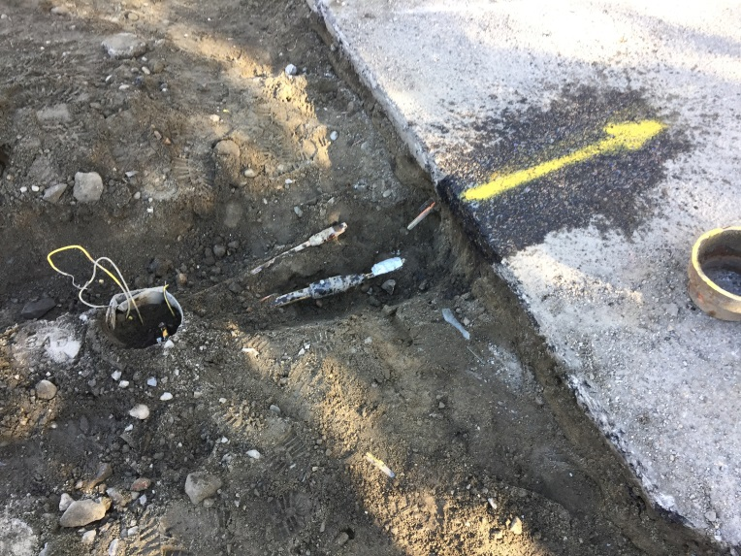
What NOT to do when a gas line is damaged
DON’T PANIC
DON’T Look in or get in the hole
DON’T Attempt to stop the flow of gas
DON’T Operate any valves on the gas system
DON’T Attempt to repair the damage
DON’T Backfill. Wait until the gas company has made the repair and gives the OK to do so

Slide 26
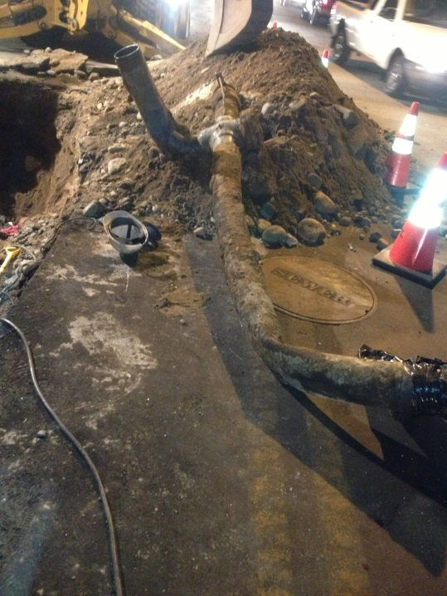
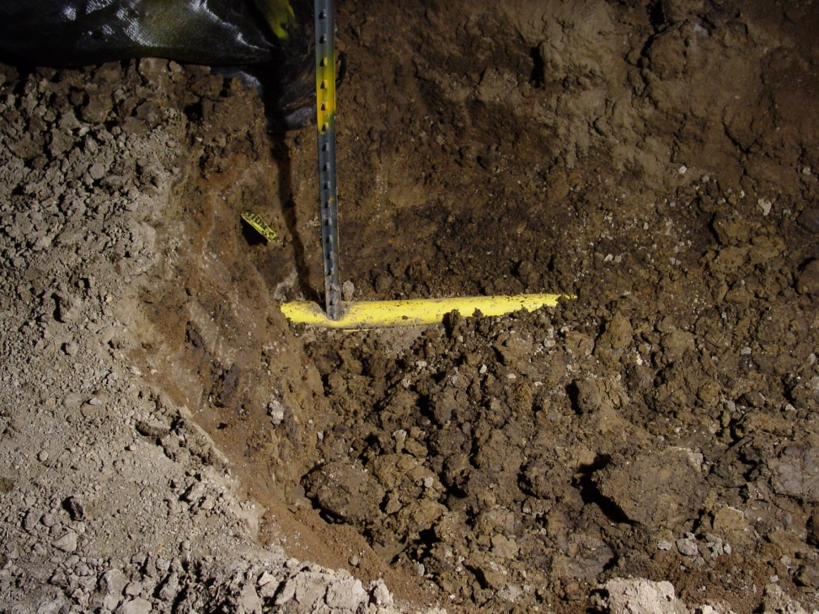
Reporting Damages
Report all Damages Immediately
Coating Damage
    Could lead to future leaks.
Broken Tracer Wire or Warning Tape
    Plastic is not conductive so without traceable wire and tape gas facilities can’t be located for future construction
Unmarked Gas Facilities
    Notify Gas Company immediately so we can correct possible mapping discrepancies
  Unitil Emergency Line (1-866-542-3547)

Slide 27
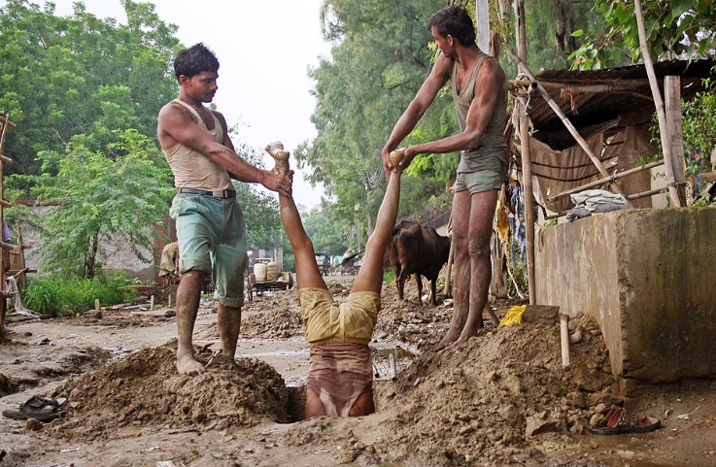
Be Safe and Hand Dig Around Our Pipes!

Slide 28



Questions?

