Slide 1



Erika Bennett
Supervisor of Operations
ebennett@summitnaturalgas.com
Joe Gauthier
Engineering
9 Industrial Parkway
Brunswick, ME 04011
207-729-0420
442 Civic Center Dr., Suite 425
Augusta, Maine 04330 207-716-6122
Notes:
Give opening statement: Summit Natural Gas of Maine and Unitil-MNG are committed to the safe and reliable delivery of natural gas. The safety of our customers and that of the general public is our #1 priority. The uncontrolled release of natural gas could result in situations hazardous to both life and property. Our goal is to work together to SAFELY bring emergency situations under control in the shortest time possible with a minimum impact to our customers. In the following presentation you will learn some facts about natural gas and the ways our two companies will work together to keep Augusta safe.
Discuss regulatory resources: PHMSA 192, MPUC 420, MPUC 895

Slide 2
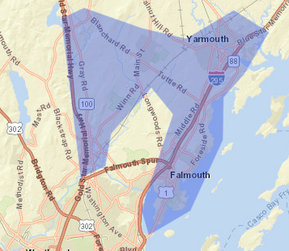
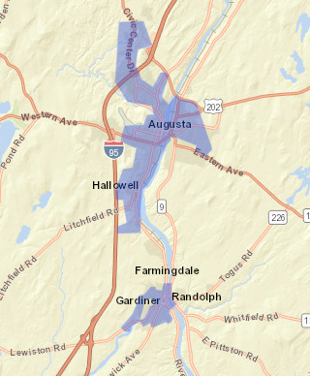
Summit Territory

Slide 3
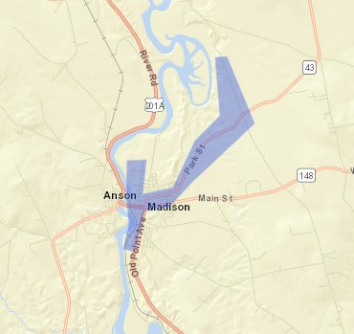
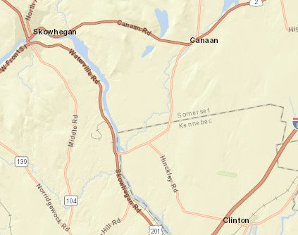
Summit Territory

Slide 4

Quick Statistics
Established in 2013
Approximately 67 miles of transmission piping and 249 miles of distribution
pipelines.
PEAKS – Renewable Natural Gas Digester
Safety is our HIGHEST Priority

Slide 5


Slide 6
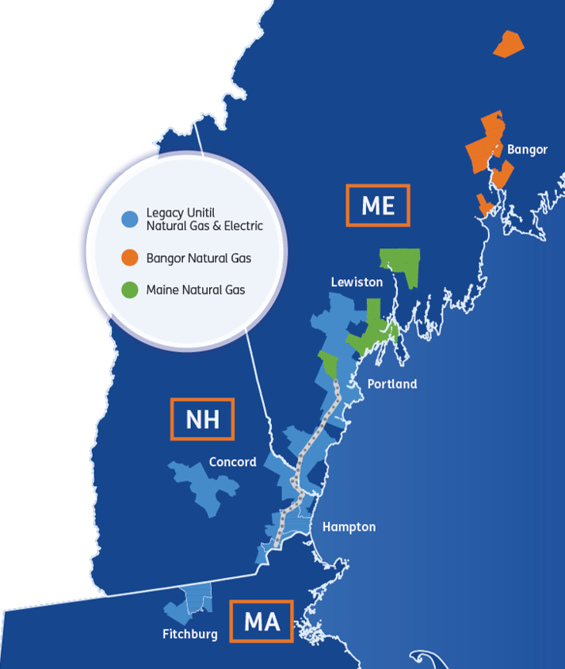
ABOUT UNITIL
An investor-owned utility
We provide energy for life, safely and reliably delivering natural gas and electricity in New England.
109,400
Electric Customers
103,197
Natural Gas Customers
Natural gas and electric distribution utility with operations in three states serving ~211,650 customers
Electric: ~109,400 customers
Gas: ~103,197 customers
Growing operations and customer base
Robust natural gas system expansion
597+ full-time employees with dual storm roles
Notes:
A Tid Bit about Unitil

Slide 7
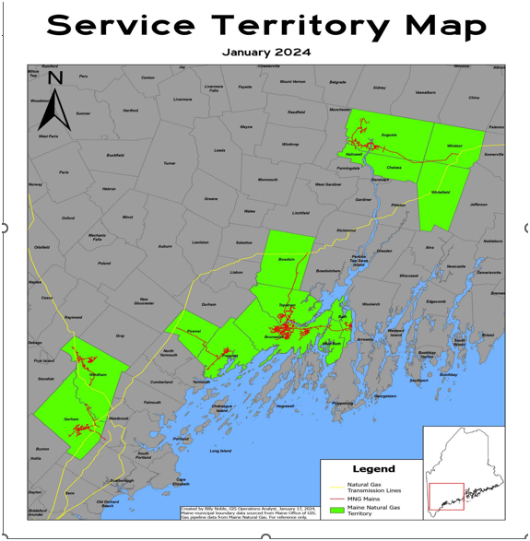
6300 Customers with assets in 15 cities and towns
Westbrook
Gorham
Pownal
Freeport
Brunswick
Bath
West Bath
Topsham
Augusta
Whitefield
Windsor
Chelsea
Hallowell

Slide 8
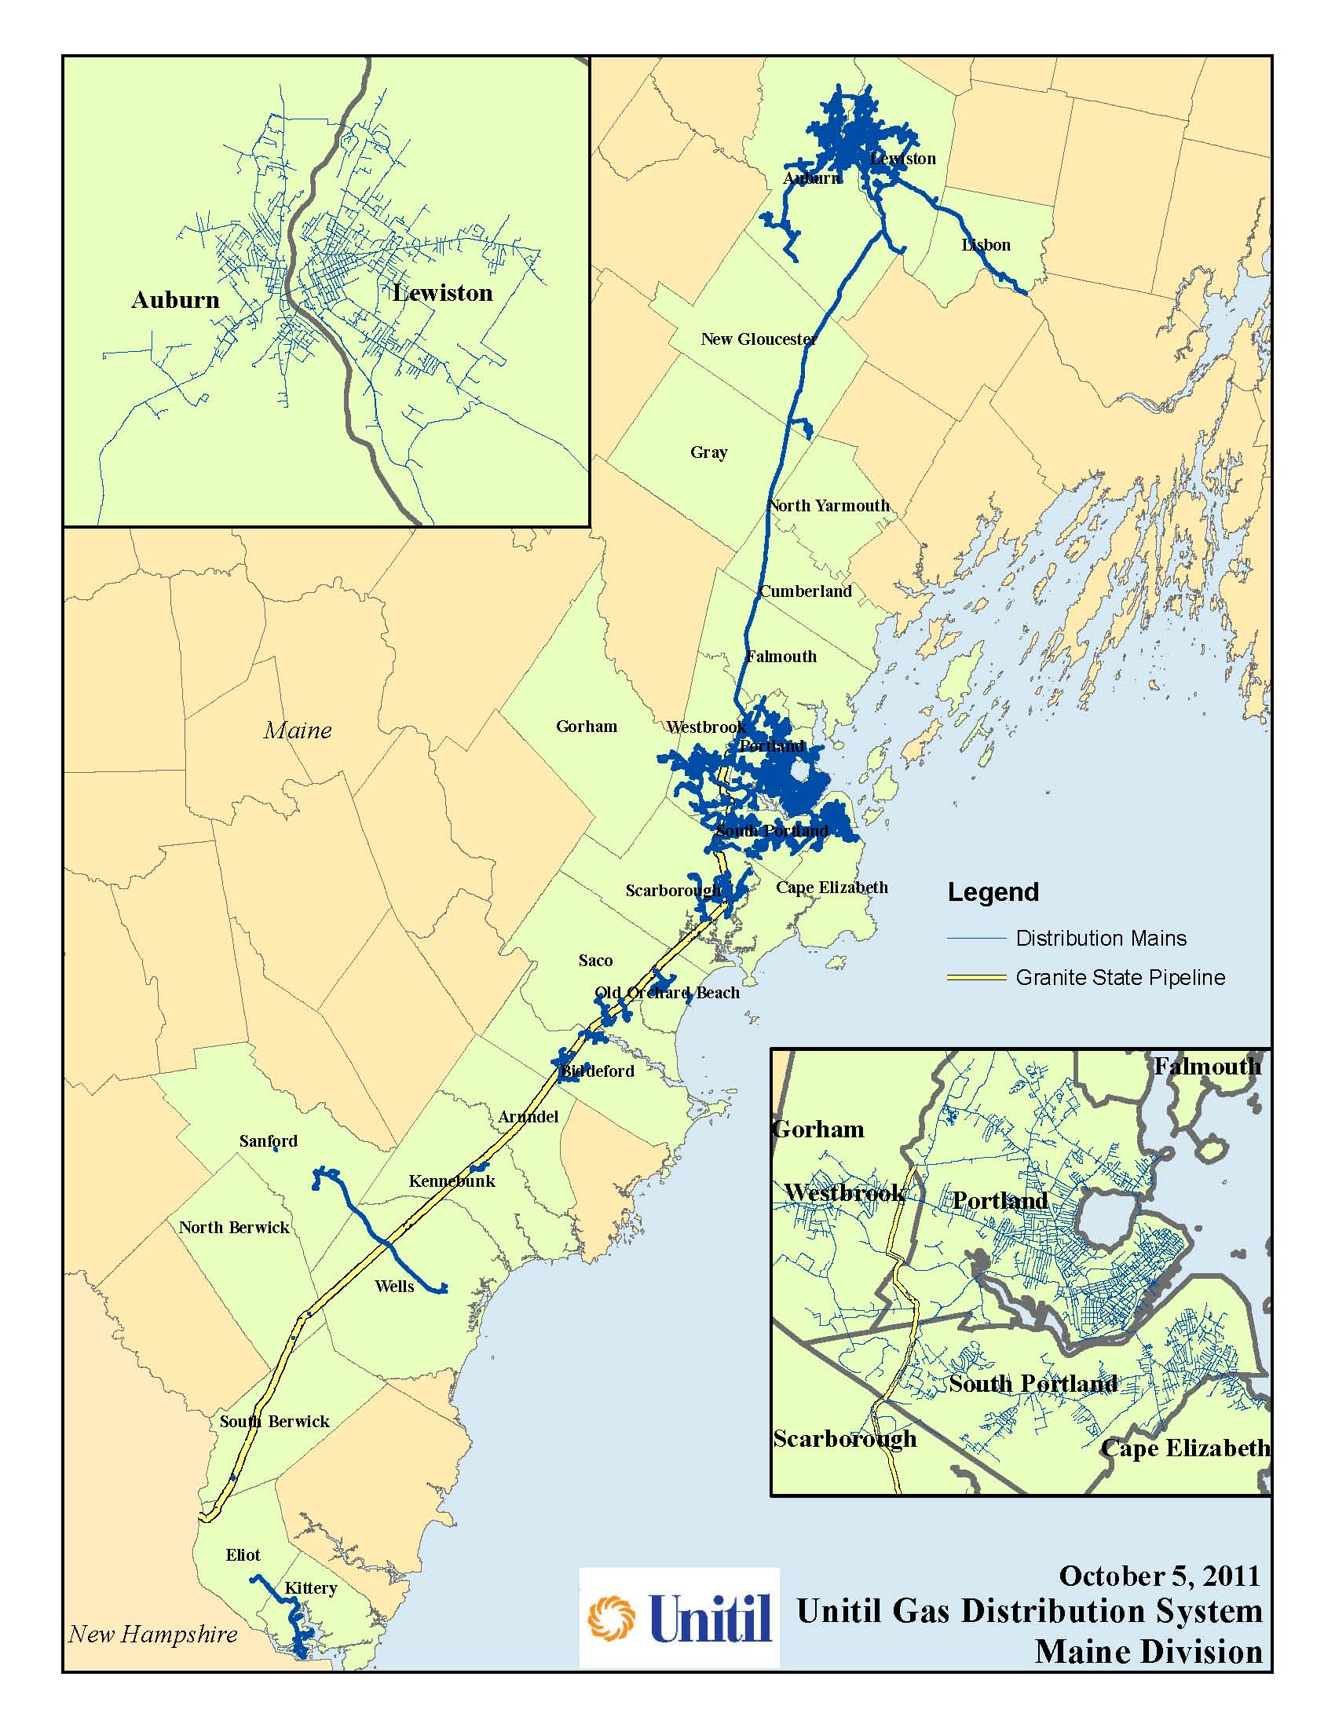
PORTLAND DOC DISTRIBUTION SERVICE TERRITORY
Approximately 36,120 customers in 26 cities / towns
Arundel
Auburn
Biddeford
Cape Elizabeth
Cumberland
Eliot
Gorham
Gray
Falmouth
Kennebunk
Kittery
Lewiston
Lisbon
New Gloucester
N. Berwick
N. Yarmouth
Old Orchard Beach
Poland
Portland
Saco
Sanford
Scarborough
S. Berwick
S. Portland
Wells
Westbrook
Notes:
Our service area is along the 95 Corridor beginning in Kittery north to Lewiston. The total length of Mains is 878.82 miles.

Slide 9
Contact Information
Jeff Haskell
Supervisor, Distribution & Damage Prevention
376 Riverside Industrial Pkwy, Portland ME 04103
T 603.227.4557
M 207.239.9890
Email haskellj@unitil.com
Unitil Gas Emergency 1-866-900-4460
Notes:
Most common sign of a gas leak is the rotten egg smell (Mercaptan)

Slide 10

Contact Information
Manager- Darren Turner
turnerd@unitil.com
C- (207) 922-6208
498 Maine Avenue
Bangor ME, 04401
1-888-301-7700
www.unitil.com/bng
Bangor Gas Emergency- 1-877-427-7991
Notes:
Most common sign of a gas leak is the rotten egg smell (Mercaptan)

Slide 11
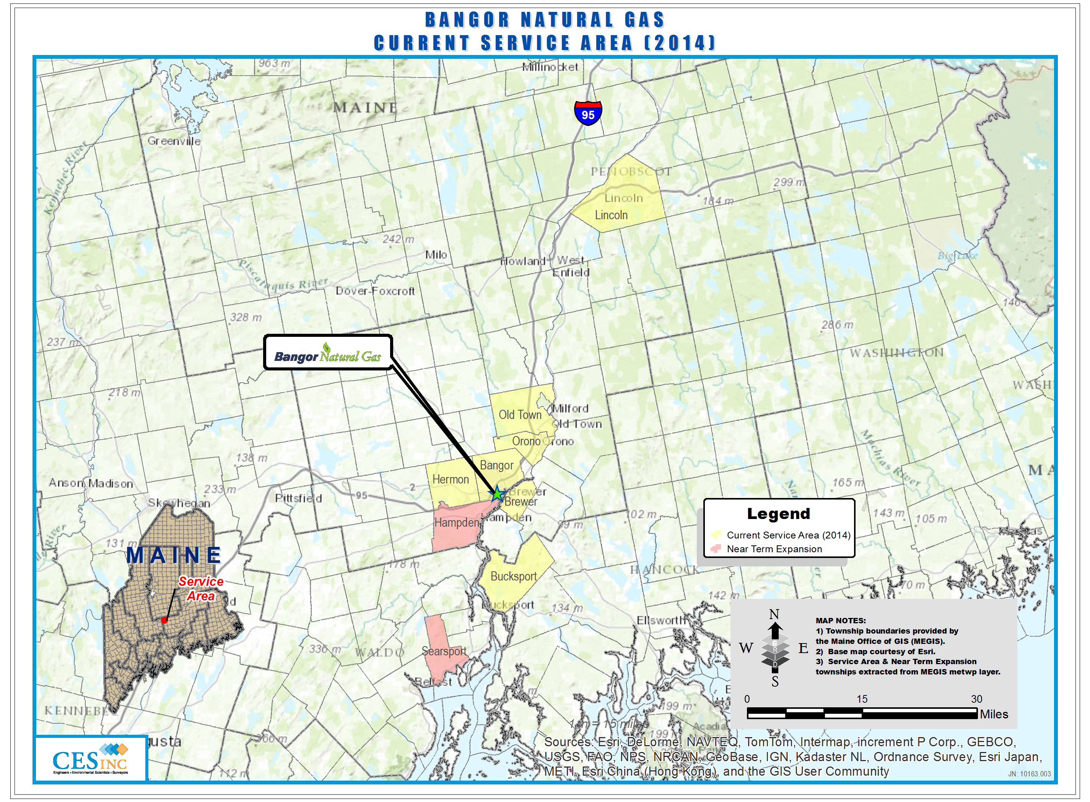


Slide 12
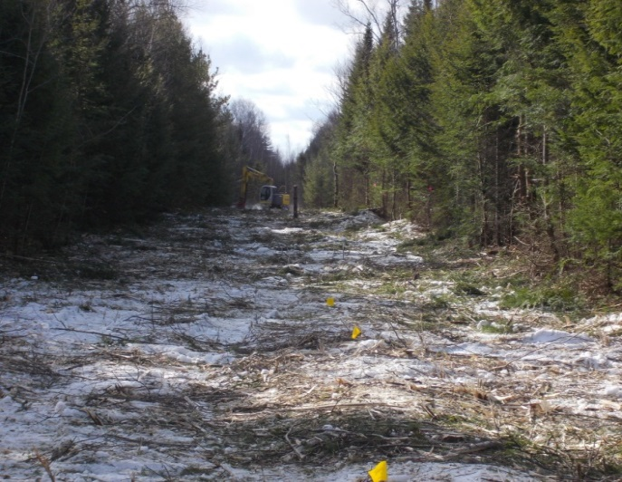
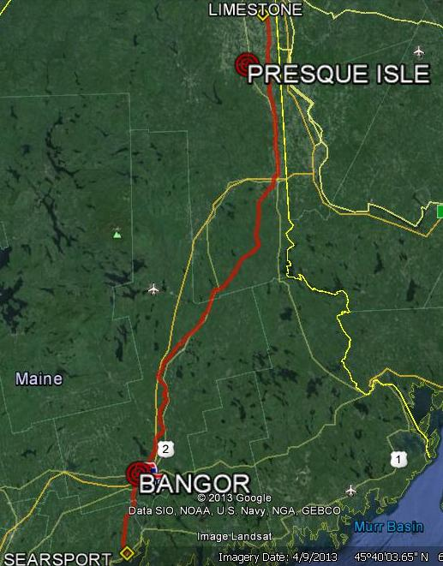
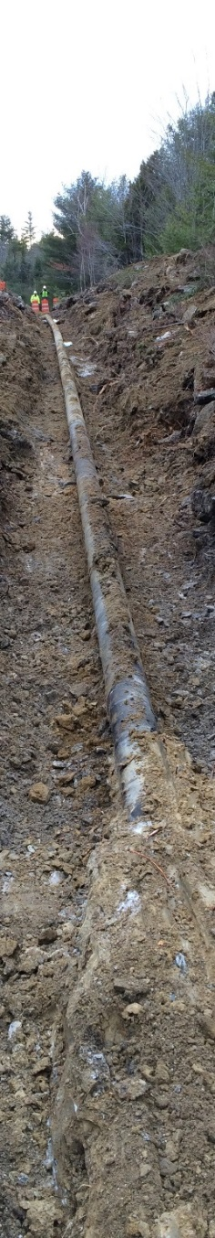
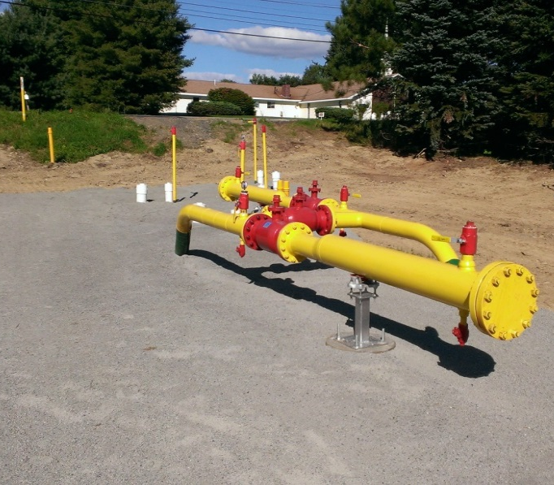
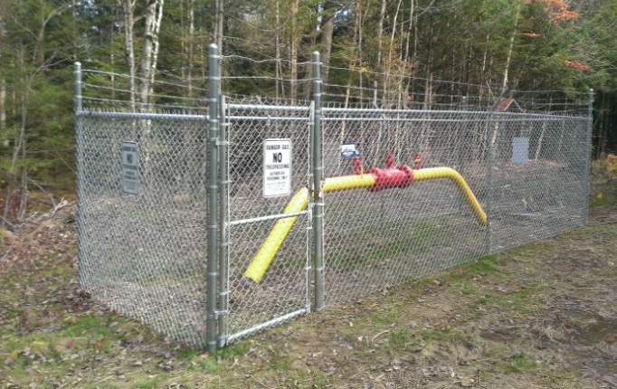
Loring Pipeline – Searsport to Limestone
MAP SOURCE: Google Earth

Slide 13
Overview
How to Handle Gas Emergencies
Behaviors of Natural Gas
Tolerance zone and digging around natural gas pipelines
Pipeline Infrastructure

Slide 14
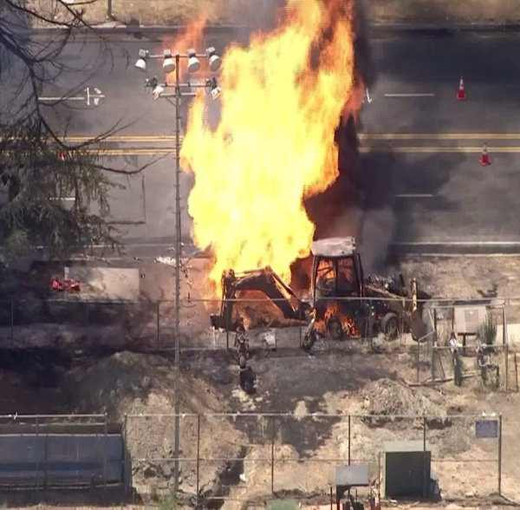
What to Do If Something Happens / Emergency Situations
In any situation with natural gas, safety is the top priority!
If you are excavating and strike a gas line...
Stop Work Immediately! Notify anyone in the immediate vicinity
Move to a Safe Environment
Call 911 – Any release of gas!
Call the Utility Emergency number: Do NOT call the Utility Locator or 811.
Call the Maine PUC Damage Investigator
Keep the public and traffic away and safe - Watch for rubber-neckers, YouTube Heroes, Etc., Keep them away. Potential for ignition sources. Keep up wind. 100 yards is a safe distance typically.
Do NOT attempt to fix it yourself. This includes stopping the leak. Let the utility techs make the proper repairs.
Notes:
Show Props! Excess Flow Valves, hit pipes, etc.

Slide 15
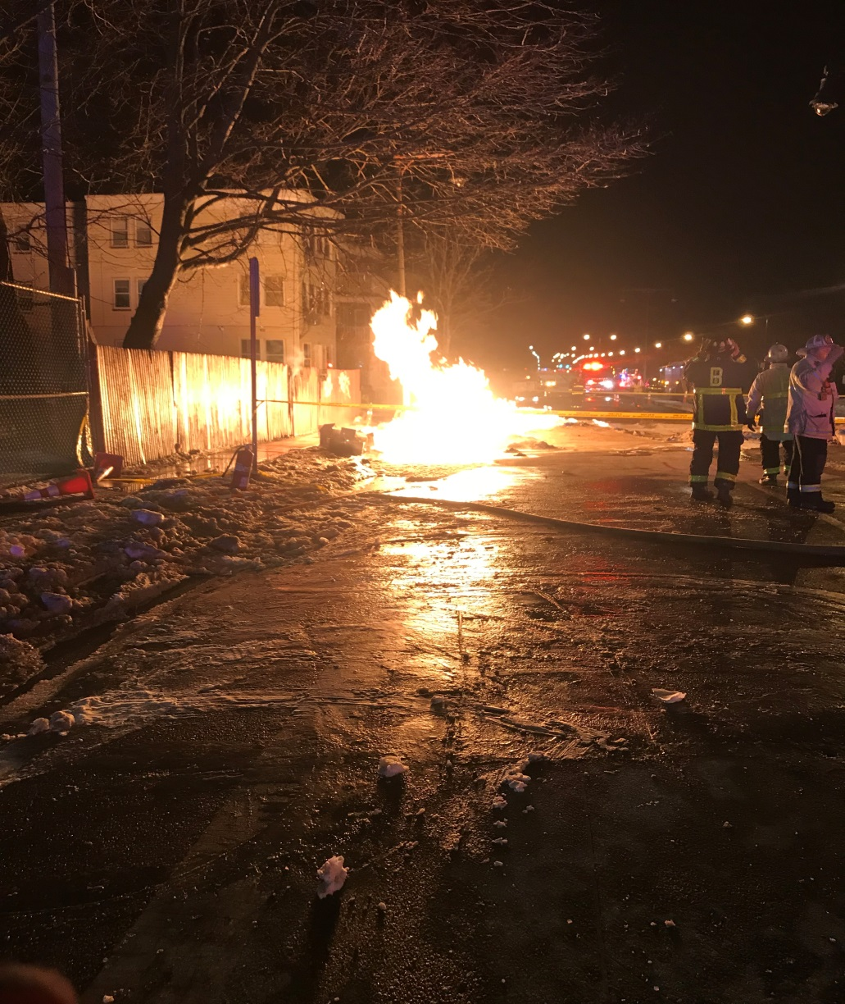
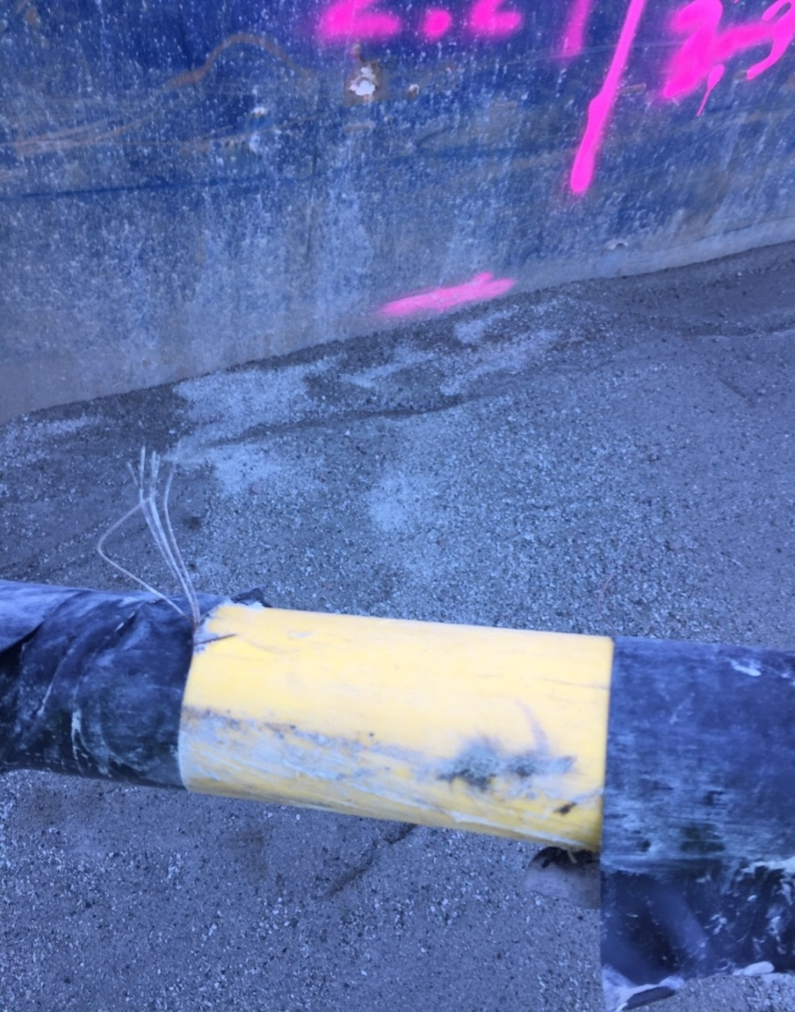
Signs of a Hit Gas Pipe
Blowing or hissing sound
Dust blowing from the hole
Continuous bubbling in wet area
Rotten egg smell
Flames (if gas has ignited)

Slide 16
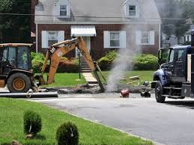
What NOT to Do When a Gas Line is Damaged
DON’T PANIC!
DON’T Look in or get in the hole
DON’T Attempt to stop the flow of gas
DON’T Operate any valves on the gas system
DON’T Attempt to repair the damage!
DON’T Backfill!!
DON’T Call Dig Safe

Slide 17
Report all Damages
What qualifies as damage:
Cut or damaged tracer wire
Damaged pipe coatings (steel)
Gouges, cuts, scrapes, etc. (plastic)
Damage to any fitting (tees, unions, taps)

Slide 18
Behaviors of Natural Gas
It rises: Natural gas is lighter than air, so it moves upward when it escapes.
It migrates sideways: Underground or in confined spaces, it can travel long distances along soil, pipes, trenches, or utility corridors before finding an escape.
It displaces oxygen: In enclosed areas, gas can push out breathable air, creating a dangerous atmosphere.
It can accumulate in pockets: Gas can collect in basements, crawl spaces, utility vaults, or other low‑ventilation areas.
It’s highly flammable: When mixed with air in the right concentration, even a small ignition source can cause fire or explosion.
Odorant added (Methyl Mercaptan): This gives it the rotten-egg/ cabbage smell

Slide 19
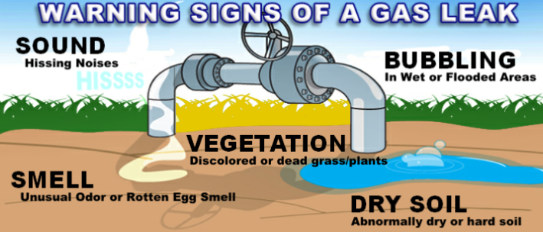
GAS LEAKS
Notes:
If you suspect there’s a gas leak, please call the Natural Gas Utility. If you can smell gas, call 911!

Slide 20
What makes up a Gas Pipeline?
Pipeline components
Tapping tees
High volume tees
EFVs
Valves
Couplings

Slide 21
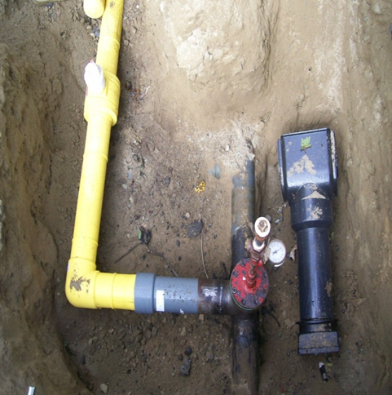
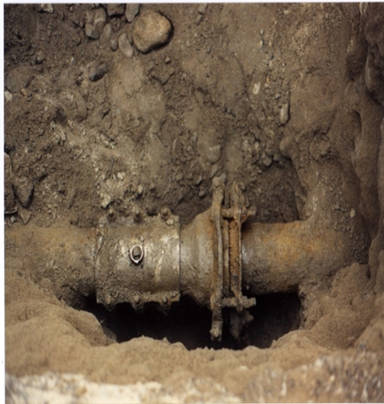
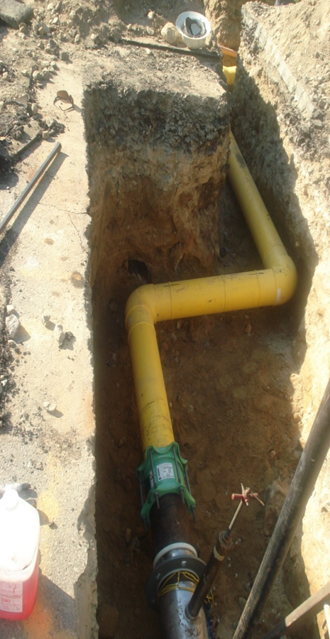
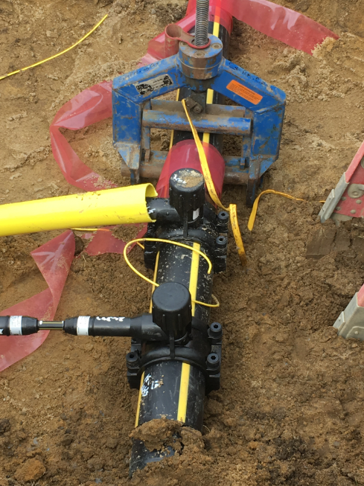
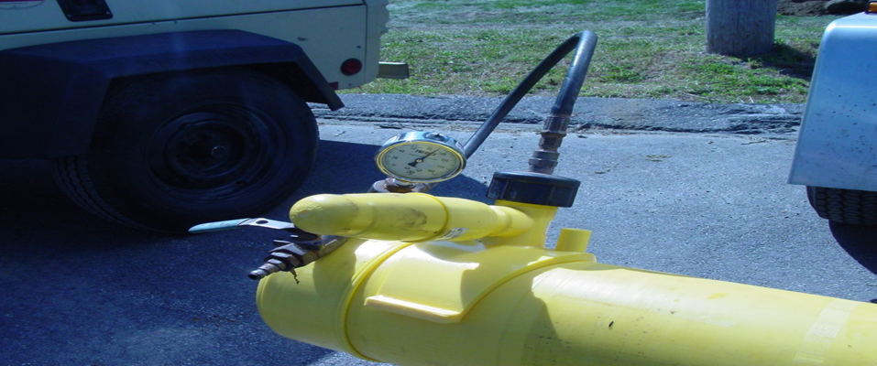
What gas pipes look like, they do not always run in a straight line
Notes:
Some different tees, stubs, purge points, drips, etc.

Slide 22
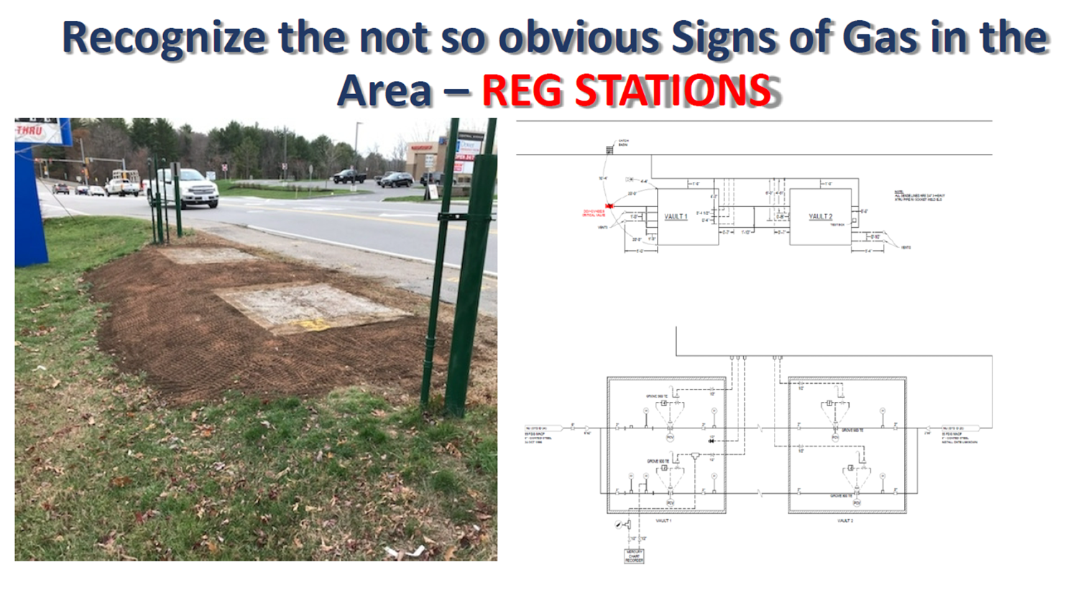

Slide 23
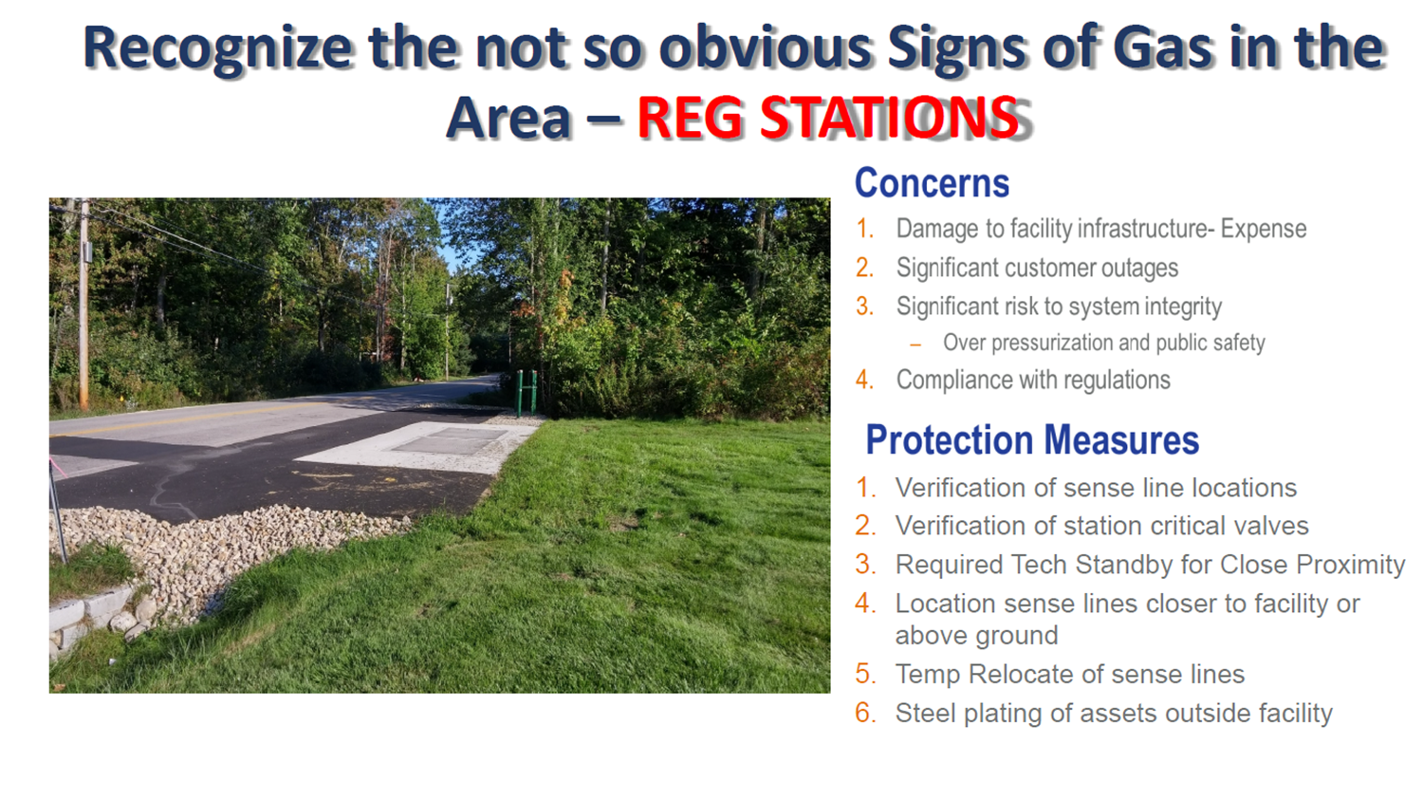

Slide 24
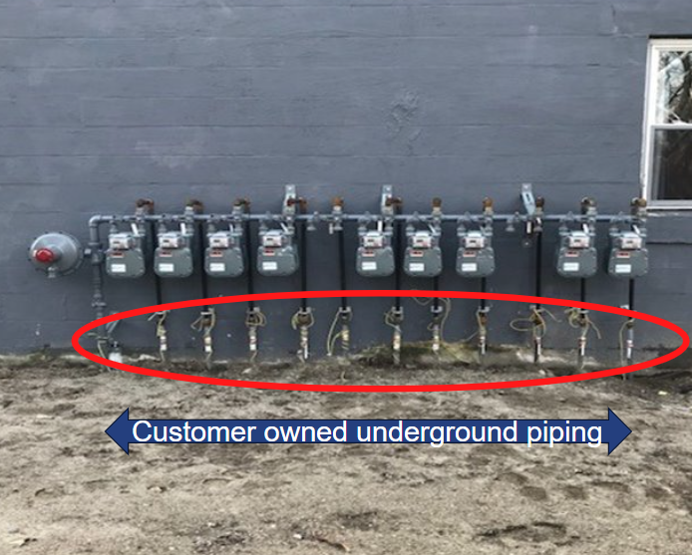
Customer Owned Facilities

Slide 25
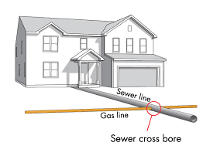
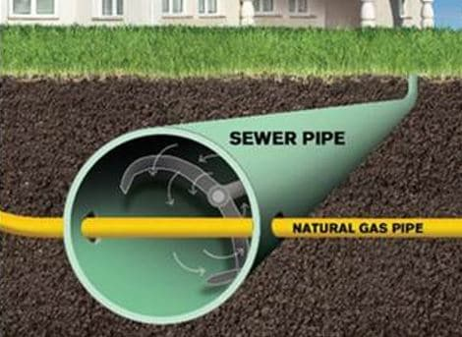
Cross Bore
Cross Bores

Slide 26
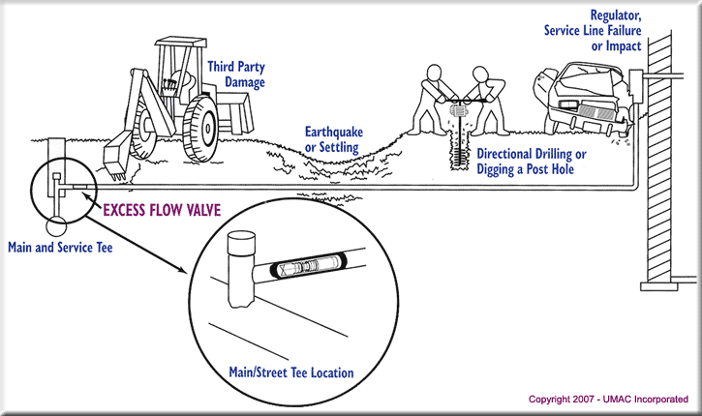
Flow Valves
Excess Flow Valves (EFVs)

Slide 27
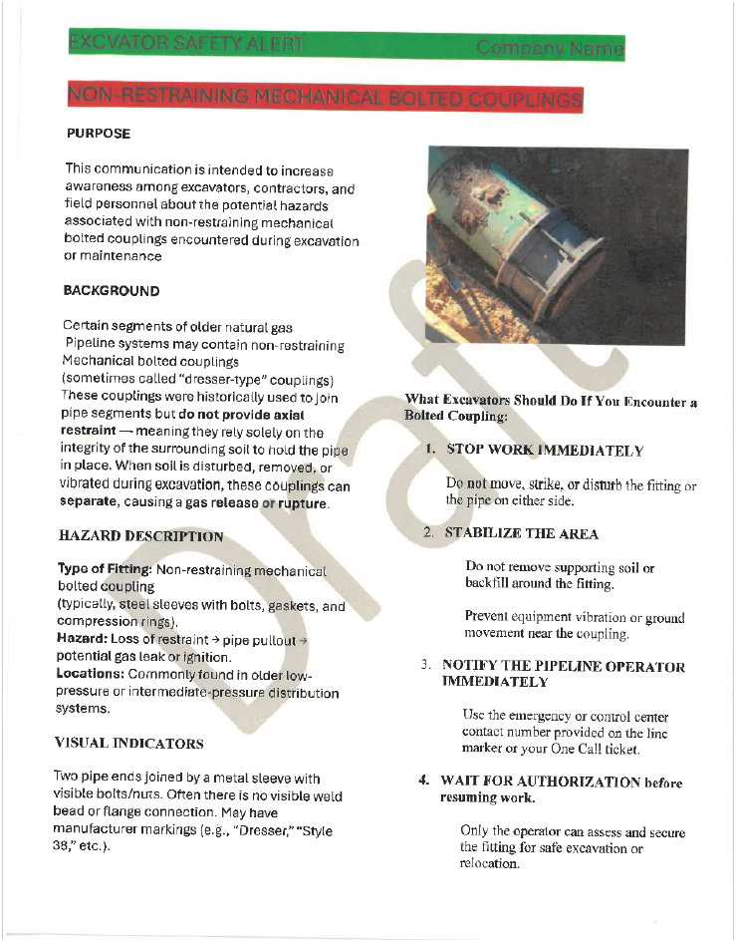
Notes:
Most common sign of a gas leak is the rotten egg smell (Mercaptan)

Slide 28
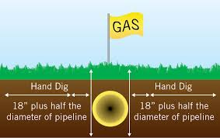
Digging Safely around Natural Gas and within the "Tolerance Zone"
To dig safely in a natural gas line's tolerance zone (the marked area plus 18-24 inches on each side), you must hand dig or use vacuum excavation, never power equipment, to carefully uncover the pipe, using blunted tools with a prying motion to avoid striking it
Notes:
Most common sign of a gas leak is the rotten egg smell (Mercaptan)

Slide 29
Emergency Phone Numbers
Summit Natural Gas
1- 800-909-7642
Unitil Natural Gas (MNG)
1- 877-532-5636
(1-877-LEAK-ODOR)
Unitil Natural Gas (BNG)
1- 877-427-7991
Unitil Natural Gas (NUME)
1- 866-900-4460

Slide 30

Thank You
Erika Bennett
Supervisor of Operations
ebennett@summitnaturalgas.com
Joe Gauthier
Gas Engineer
jgauthier@mainenaturalgas.com
442 Civic Center Dr., Suite 425
Augusta, Maine 04330 207-716-6122
9 Industrial Parkway
Brunswick, Maine 04011 207-729-0420

Slide 31
Contact Information
Jeff Haskell
Supervisor, Distribution & Damage Prevention
376 Riverside Industrial Pkwy, Portland ME 04103
T 603.227.4557
M 207.239.9890
Email haskellj@unitil.com
Unitil Gas Emergency 1-866-900-4460
Notes:
Most common sign of a gas leak is the rotten egg smell (Mercaptan)

Slide 32
Safety is our
TOP PRIORITY
Darren Turner
Manager
turnerd@unitil.com
1-888-301-7700
EMERGENCY- 1-877-427-7991

Slide 33
Contact Information
Jeff Haskell
Supervisor, Distribution & Damage Prevention
9 Industrial Parkway Brunswick, ME 04011
T 603.227.4557
M 207.239.9890
Email haskellj@unitil.com
Unitil-MNG Gas Emergency-
Notes:
Most common sign of a gas leak is the rotten egg smell (Mercaptan)

Slide 34
Questions?

