Slide 1
Rhode Island MUST Seminar
(Managing Underground Safety Training)
2026
Ken Soares
Sr. Safety Professional
Rhode Island Energy
Contractor Electrical Safety

Slide 2

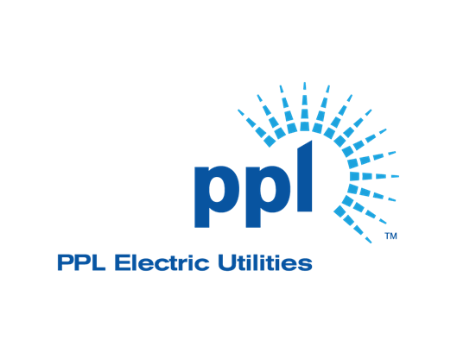

Keeping Contractors, Customers and our Employees Safe, is our Top Priority – ONE PPL (KY, PA, RI)

Slide 3
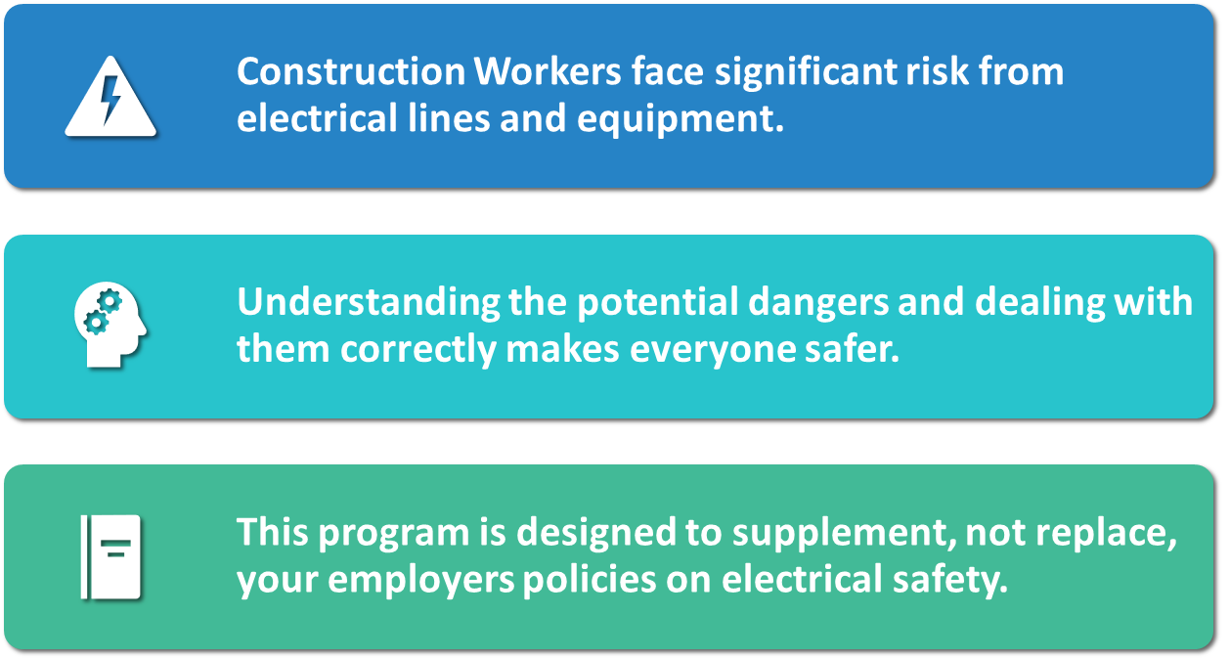
Working Around Electrical Facilities Safely

Slide 4
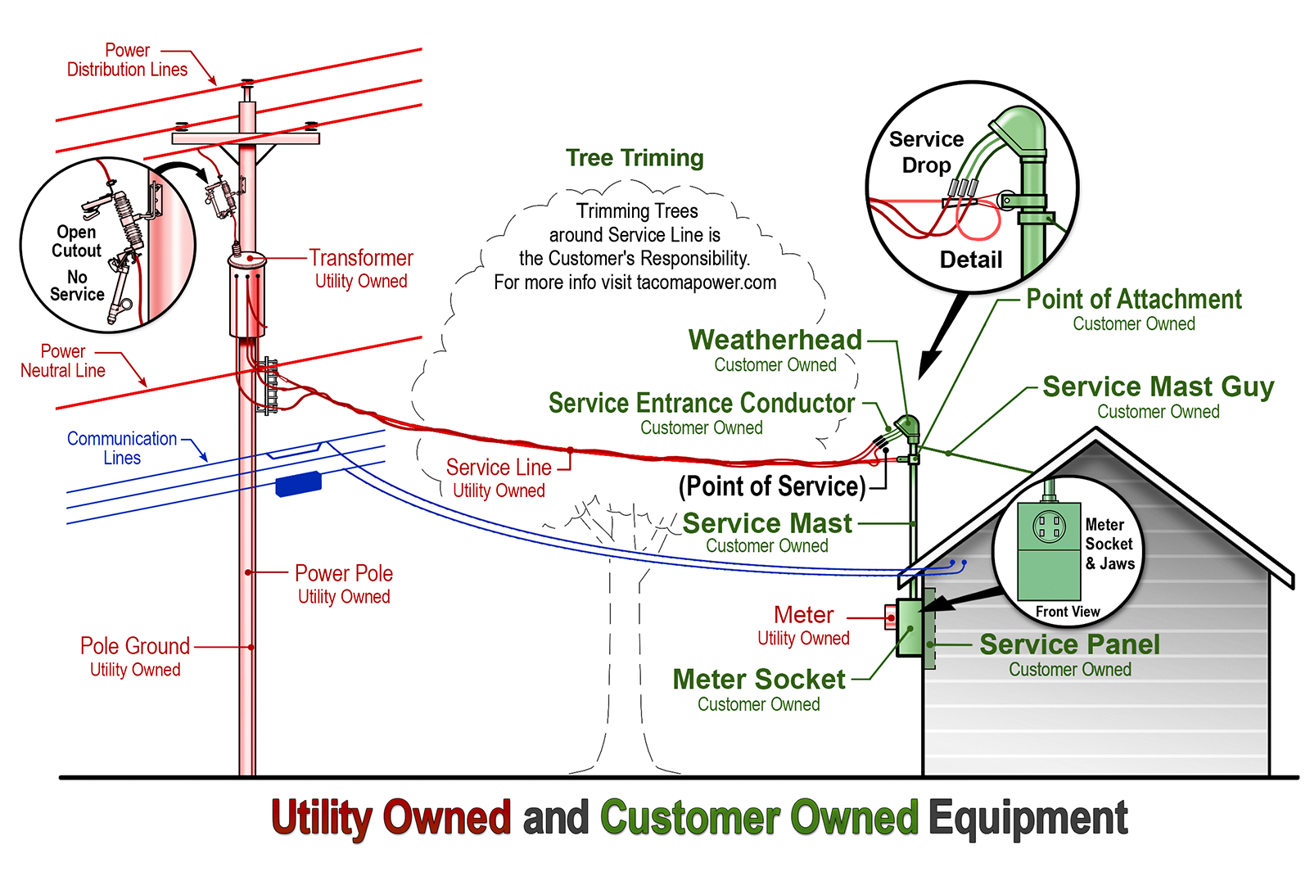
Electrical Distribution System Components

Slide 5
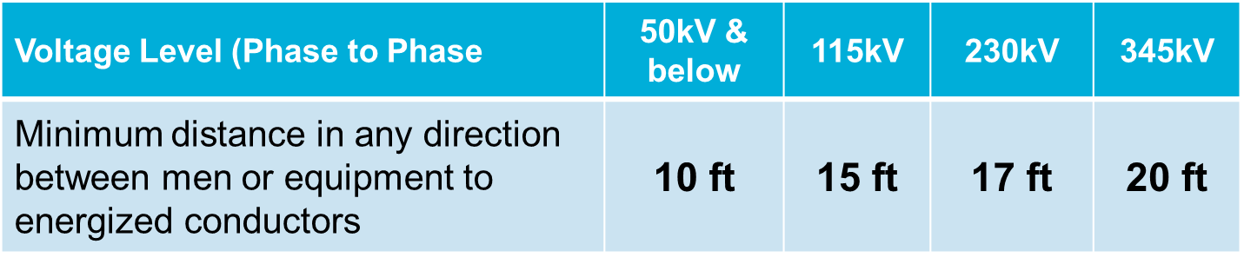
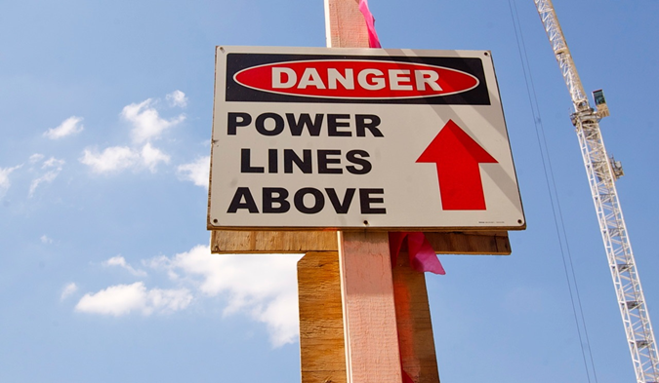
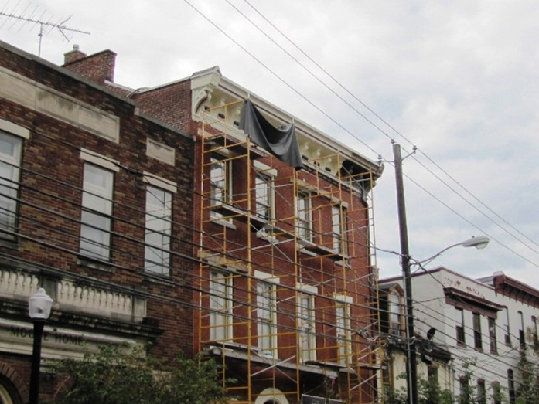
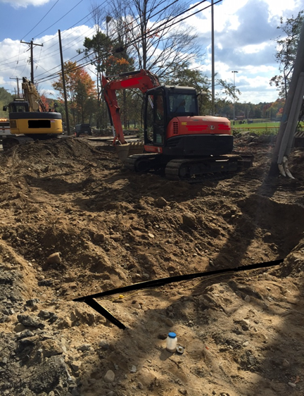
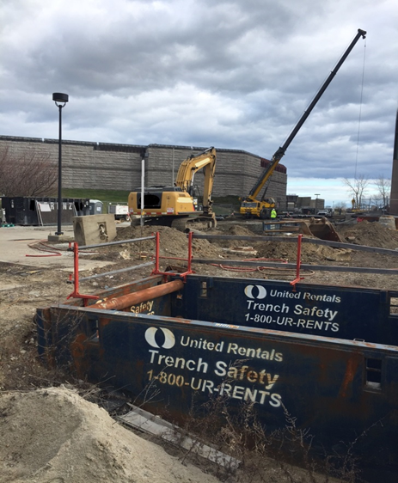
High Voltage Proximity Act
High Voltage Proximity Act
10 Foot Minimum Clearance around all Electric Lines.
(if you know the voltage of the line)
Be aware of your surroundings.

Slide 6
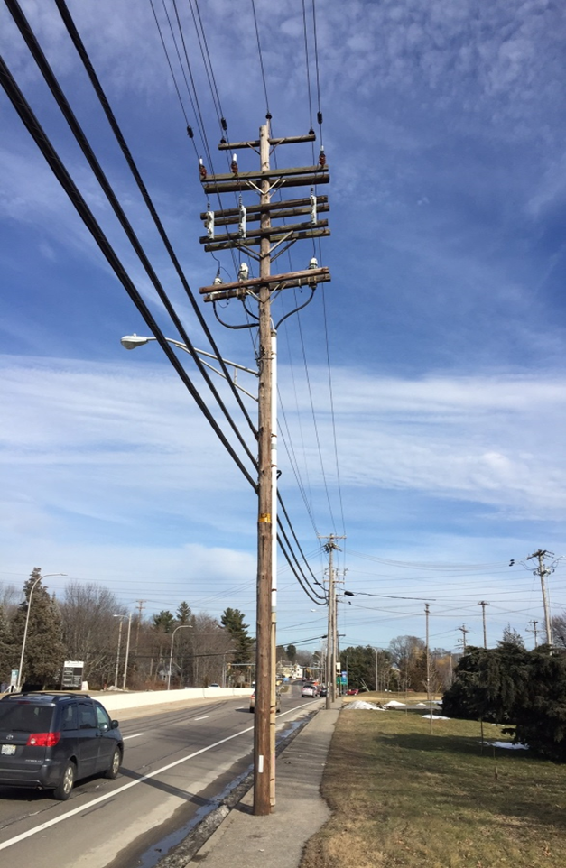
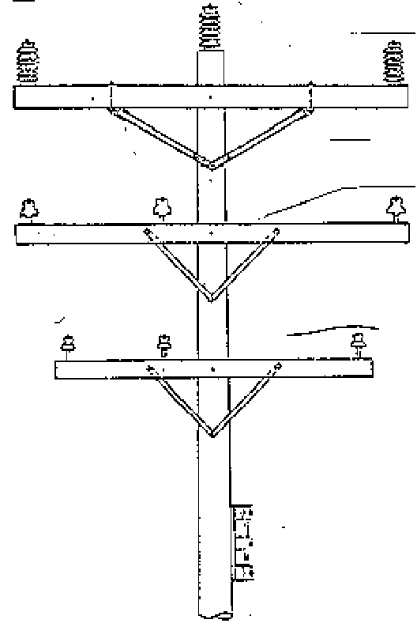
Facility Identification & Insulators
23kV – 46kV
Transmission
TRANSMISSION POST
INSULATOR
13kV
Primary
2.4kV – 5kV
Primary & Street Ltg.
(up to 6k volts)
PRIMARY
INSULATORS
120V & 240V
Secondary

Slide 7
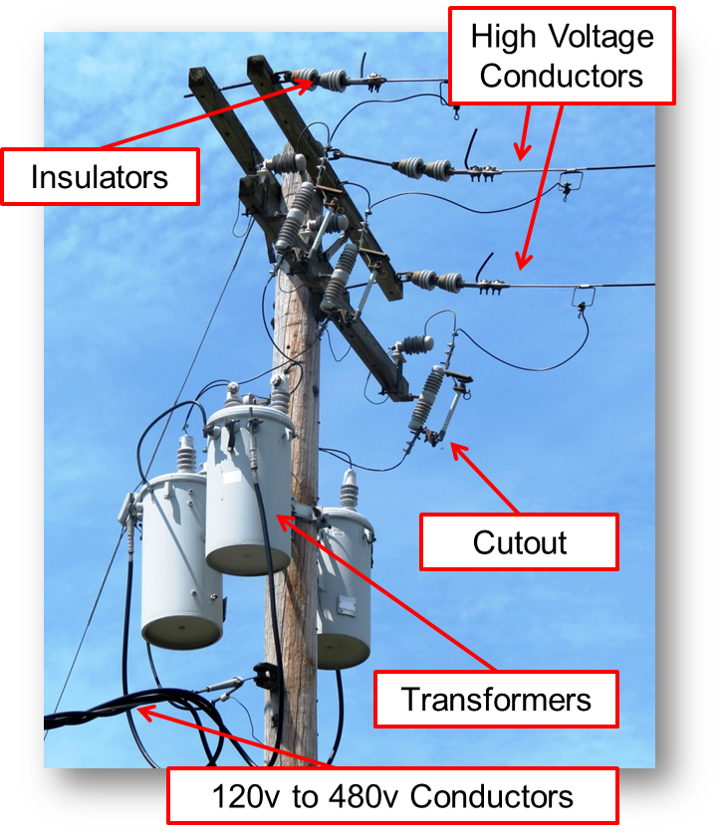
Facility Identification & Insulators
High Voltage Conductors-7200v to ground and 13,200v between phase wires.
Insulators keep the voltage from ground. The pole will conduct high voltage.
Cutouts can be used to switch off the transformer by opening the fuse. The fuse will blow open if high current from a fault is detected.
Transformers step down voltage and step up current. This could be reversed with back feed.

Slide 8
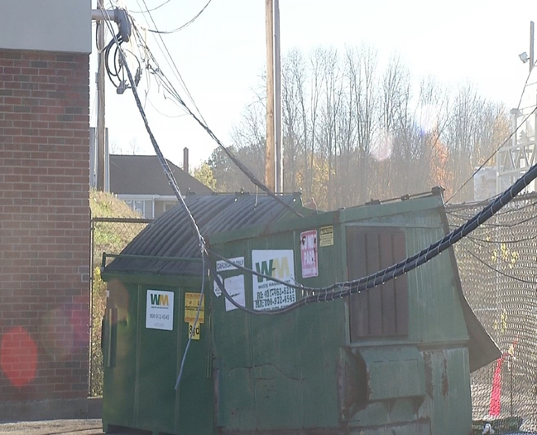
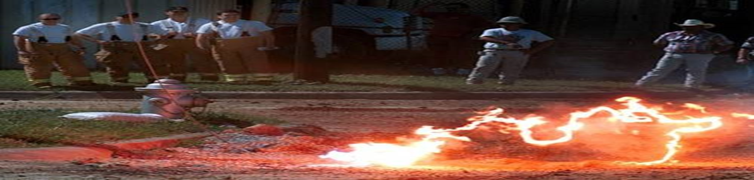
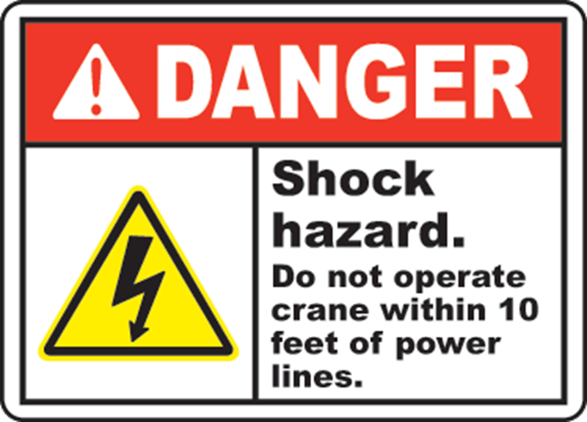
All Downed Wires Must Be Considered
ENERGIZED & DEADLY
Assume all lines are energized and keep yourself and your equipment AT LEAST 20 FEET away if you have not confirmed the lines actual voltage! (OSHA 1926.1407-1408)
Higher voltages require greater clearances.
Even low-voltage electric shock can be fatal.
They will energize any object they contact even phone lines.
Survey the area closely.
Potential Conductors include; fences, gutters, antennas, railroad tracks, aluminum siding & guide rail.

Slide 9
If Equipment Contacts a Powerline
Consider
the equipment energized
Call
the electric utility
Drive
Have the operator drive / move the equipment away from the line if possible
Stay
Tell the occupants to stay in the equipment if it cannot be driven away

Slide 10
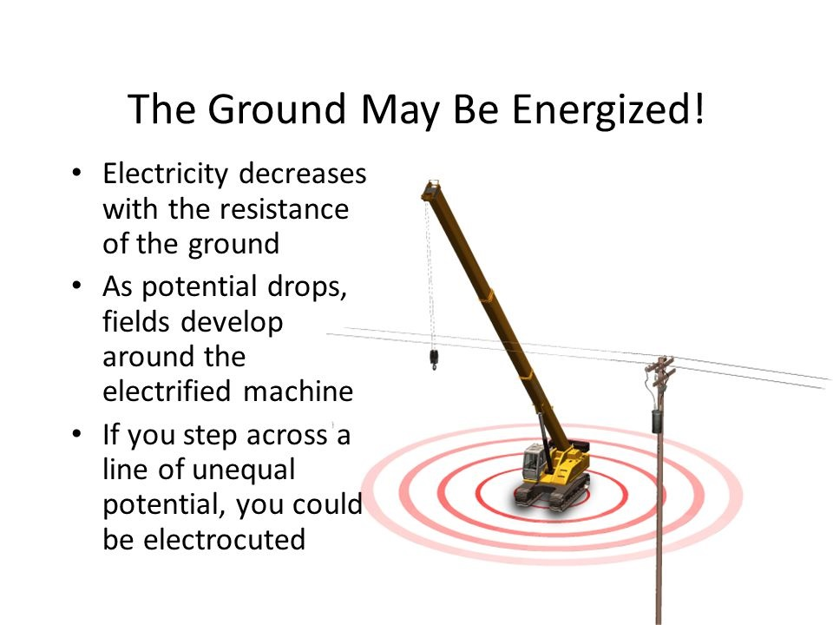
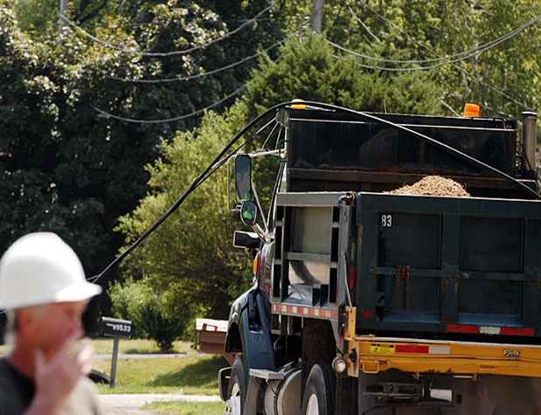
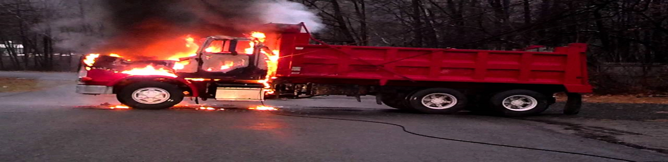
If Equipment Contacts a Powerline
Warn bystanders to stay away
until the electric utility says it’s safe!

Slide 11
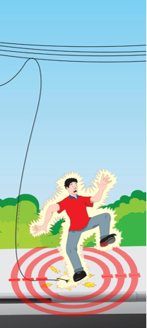
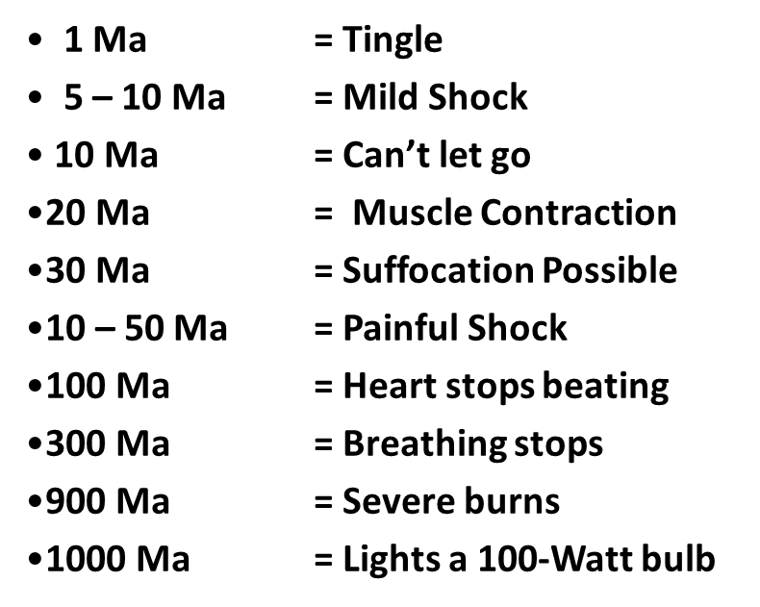
Step & Touch Potential
Properties of Electricity
Current Flow Effect
Milliamp (ma) = 1/1000 ampere
Notes:
Side bar on AED’s – will only provide a shock if NO electrical current is detected by the AED. Before delivering a shock make sure all bystanders are hands off and “Clear” to avoid them from receiving a shock.

Slide 12
Step & Touch Potential
Properties of Electricity
Current Flow Effect
15-20 (ma) range from an AED shock
Milliamp (ma) = 1/1000 ampere
Notes:
Side bar on AED’s – will only provide a shock if NO electrical current is detected by the AED. Before delivering a shock make sure all bystanders are hands off and “Clear” to avoid them from receiving a shock.

Slide 13
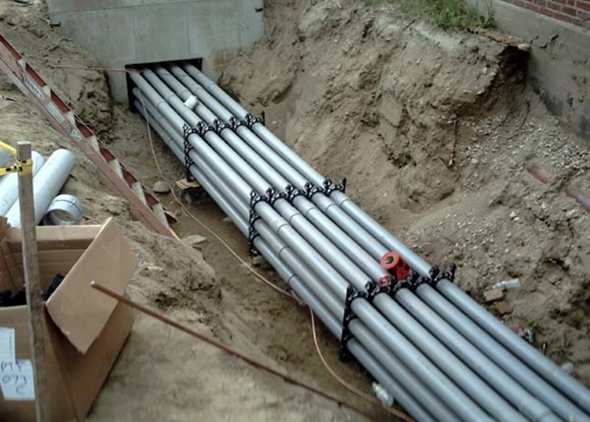
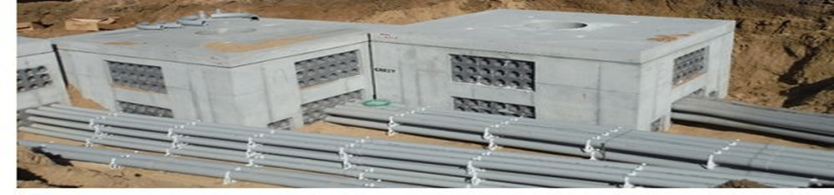
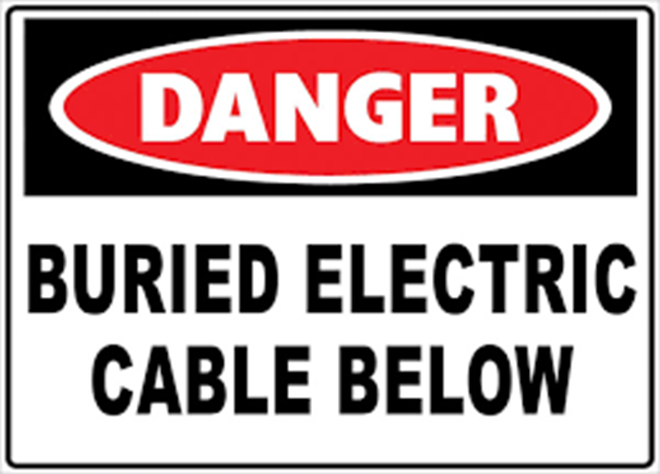
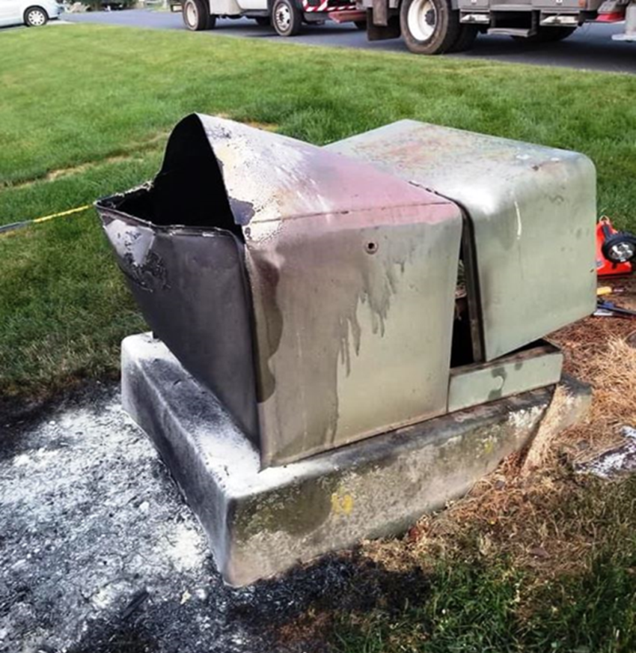
Underground Electric Facilities
Damaged
Pad-Mounted Equipment
  Duct Banks w/ multiple conduit (concrete/clay)
  Conduit (Steel and Plastic)
  Direct Buried Cables
  Man-Holes or Vaults
Keep everyone back, call the utility, and protect exposures
The outside can become energized if damaged
Stay clear!
Notes:
Damaged pad mounted equipment may leak contents that could be of a hazardous chemical nature/exposure – another reason to stay clear.

Slide 14
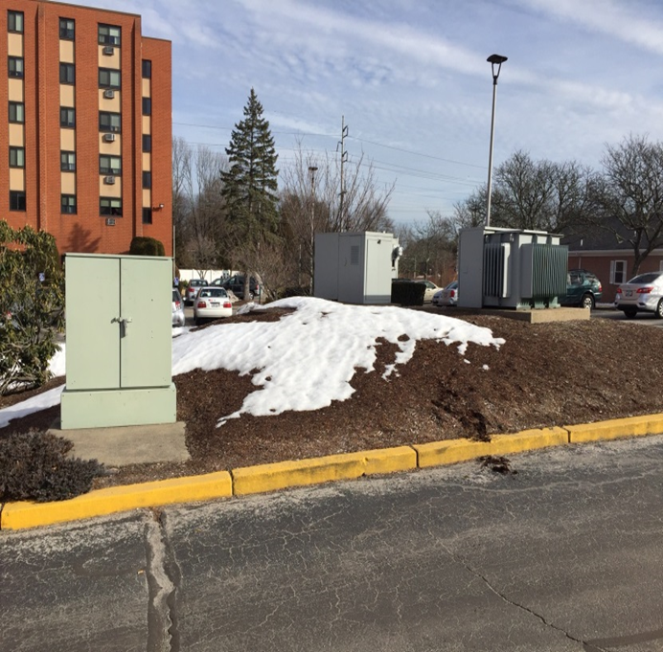
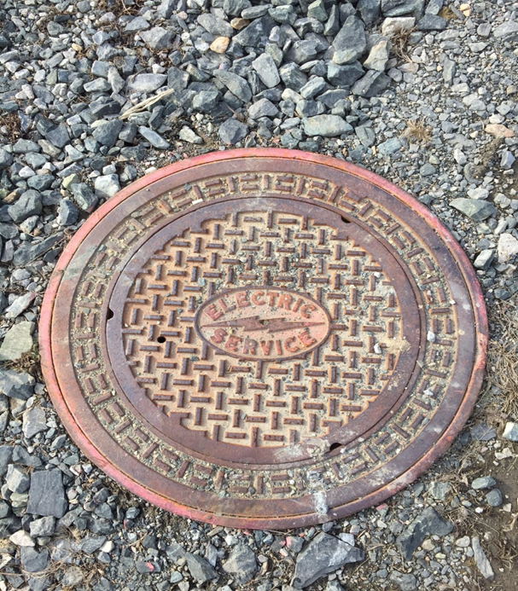
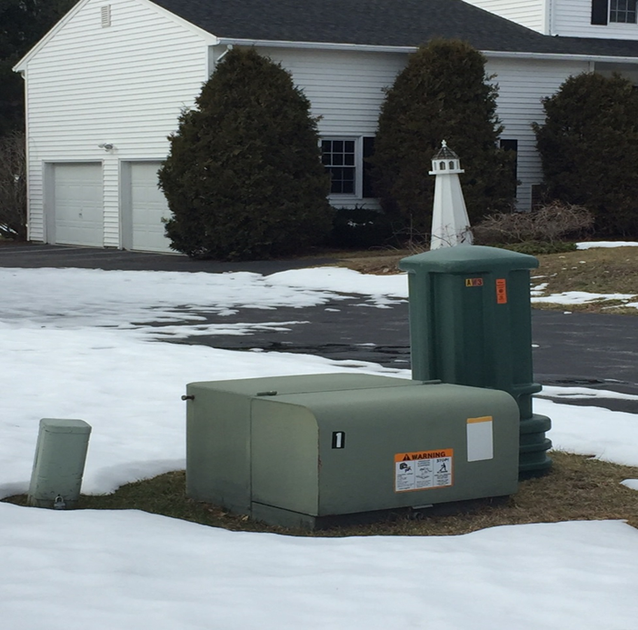
Underground Electric Facilities
Look For:
Riser Poles/Pole Drops
Underground Vaults/Manholes/Handholes
Pad mounted transformers/Switches
Notes:
You should always call 811 AT LEAST 2 DAYS before digging to have underground utility lines marked. The depth at which you should call 811 can vary by location, but in general, it's a good idea to call before digging any deeper than 12-24 inches. This can help prevent damage to underground utilities and ensure safety.

Slide 15
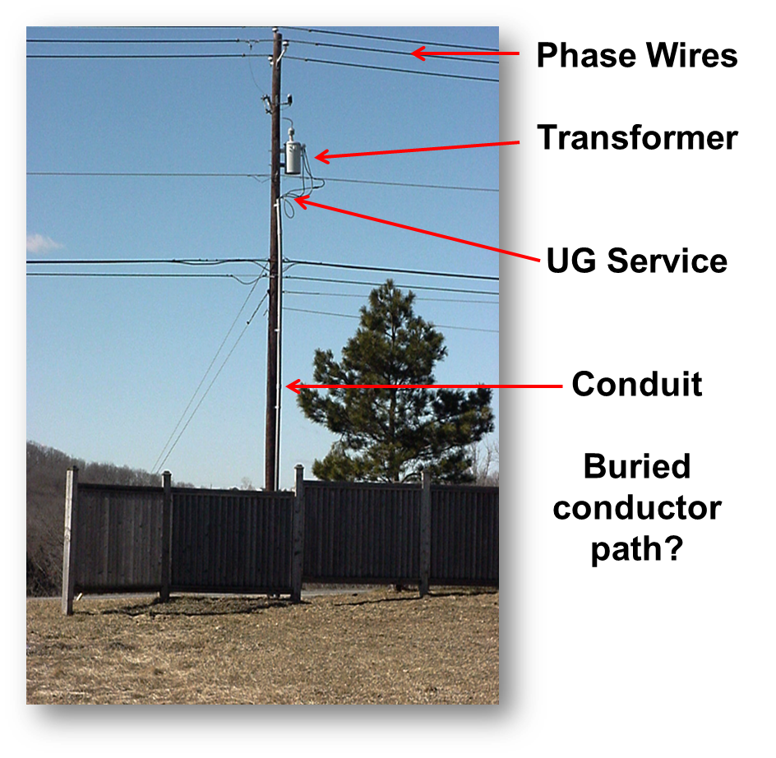
Underground Electric Facility Identification
Suspect buried electric facilities when:
Poles have conduit
Transformers are in yards
Electric meters are fed by underground wires in conduit instead of overhead wires.
Check for utility mark outs before digging.
Always use caution when digging or driving anything into the ground
Notes:
Keep digging AT LEAST 18 inches away either side from 811 markings. Dig Safe Color Marking: Red: Electric Yellow: Gas / Oil / Steam Orange: Communications / CATV Blue: Water
Green: Sewer.

Slide 16
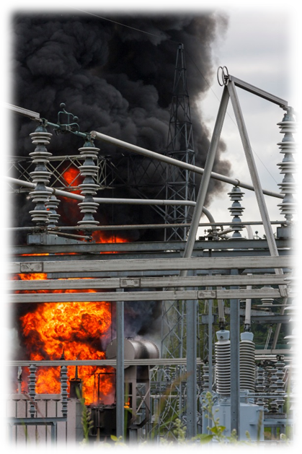
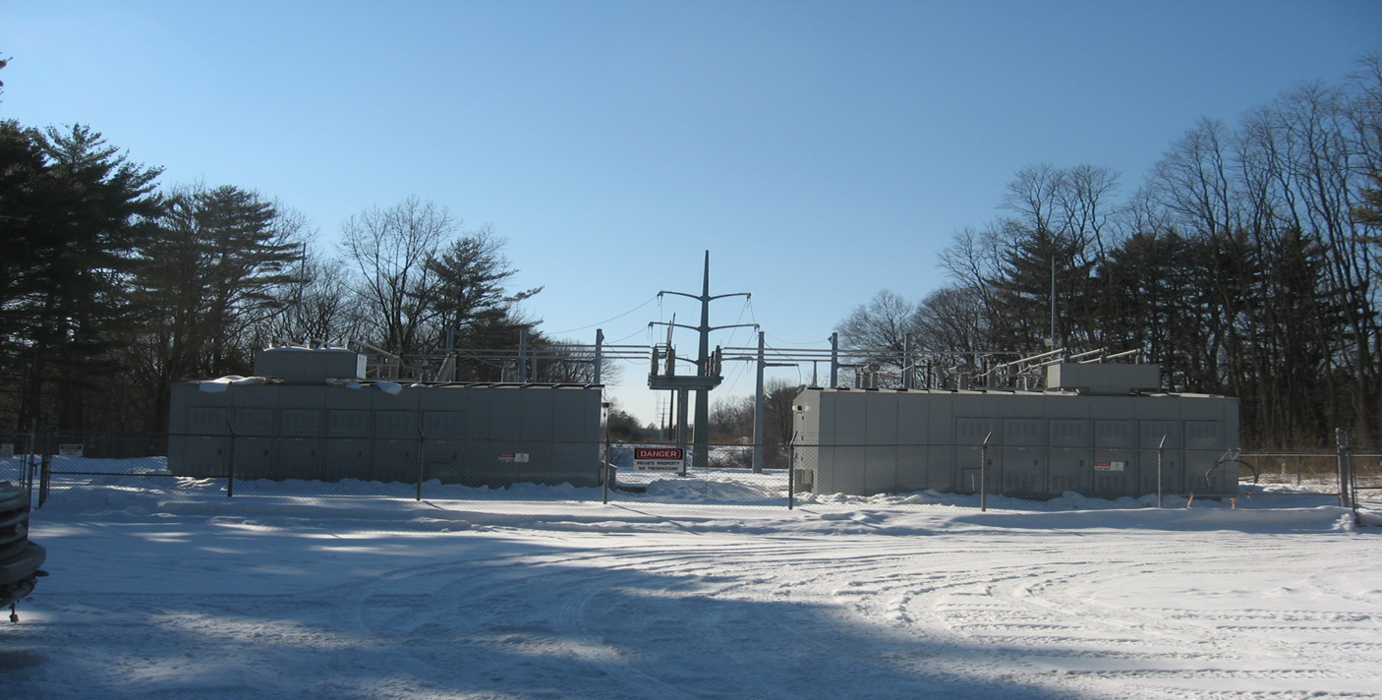
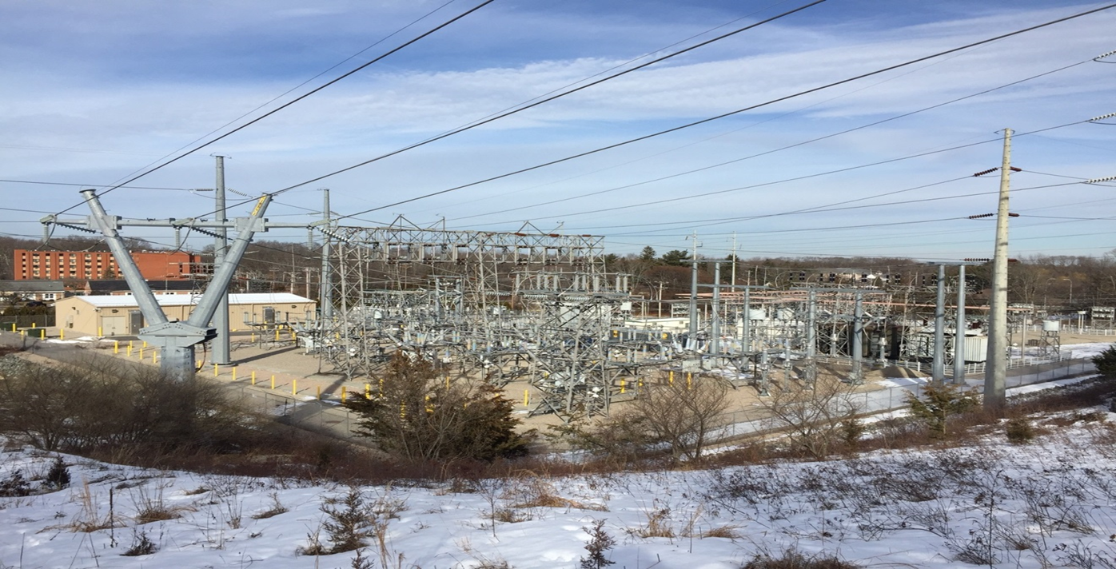
Substations
Substations take high voltage and step it down to voltages used inside of homes
If your working near an electrical substation be sure you're looking for underground get-a way markings. Distribution lines coming out of the substation are at a voltage of 13kV or more. Soft Vacuum excavation is encouraged in these areas.

Slide 17
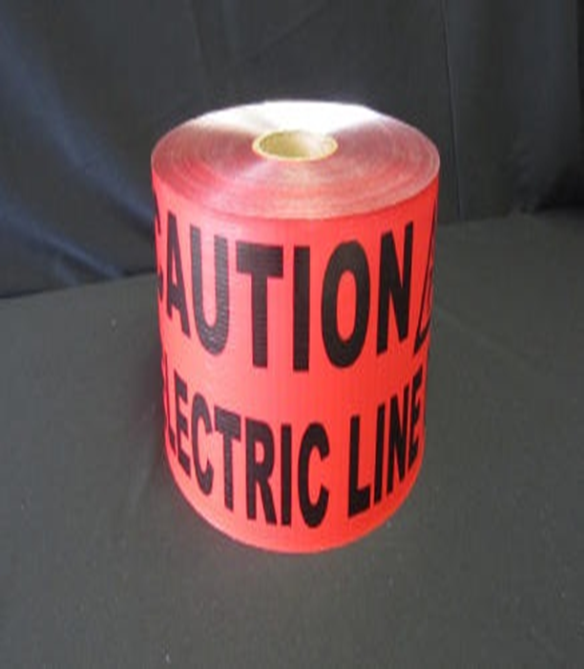
Effects of Electricity
On the Body
Varies from no lasting effects to sever burns and fatalities
Remember, if the circuit is not:
De-energized
Locked/tagged out
Tested and grounded
IT’S NOT DEAD!

Slide 18
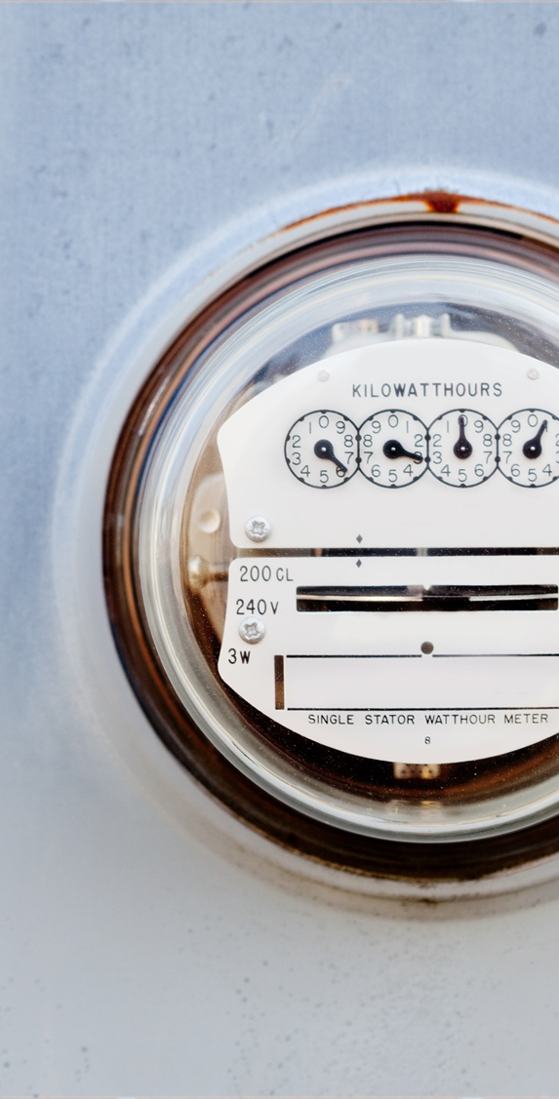
Electric Meters
Never attempt to disconnect or reconnect electrical services:
Never cut service wires
Never attempt to remove electrical meters. Failures during removal can be catastrophic
Removed meters will NOT de-energize all types of electric service

Slide 19
Contact information
In case of emergency, call 911
Rhode Island Energy is here to help you weather any storm.
We work before, during, and after a storm to restore your service and ensure your safety. Do all you can to protect yourself and your loved ones.
To report downed wires or report a power outage call 1-855-743-1101.
To report a gas leak gas related emergencies, call 1-800-640-1595.
Both telephone lines are available 24/7.
Notes:
911 calls – STAY CALM – relay key info to the 911 operator – location and type of emergency, number of injuries (if known), your name and number if requested – stay on the line until operator tells you to hang up or until EMS arrives

Slide 20
QUESTIONS?
MUST Seminar 2026

