Slide 1
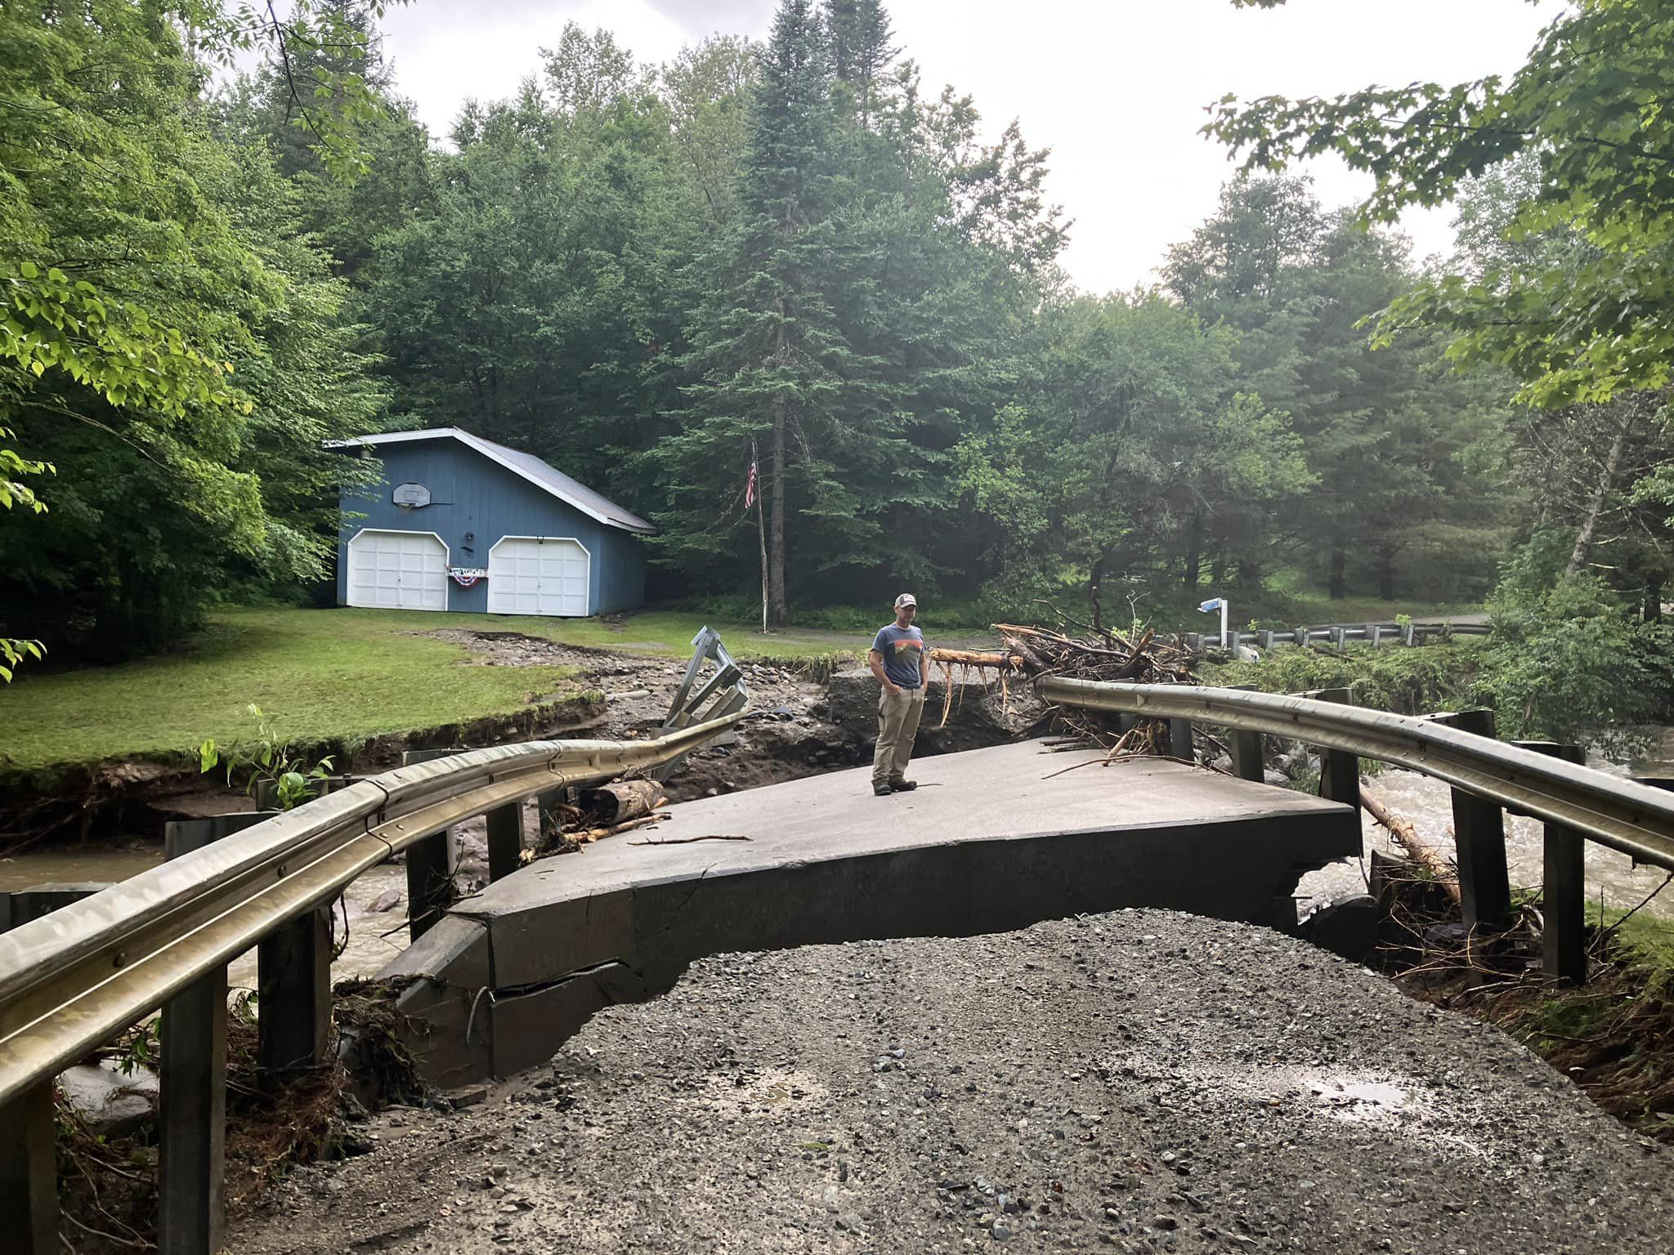

Vermont Emergency Management and the Public Assistance Program under the Federal Emergency Management Agency (FEMA)
Before a disaster hits: Know your trouble areas, know which roads are Federal Aid Roads (FHWA), the status of your infrastructure, bridges, culverts, water sewer, storm sewer systems.
TAKE PHOTOS of your facilities now, after the event, and when repairs are made. (GPS coordinates)
Familiarize yourself with Town’s procurement policy.
Meet and greet with Vtrans & ANR representatives
Before any work begins, obtain all PERMITS!!
Point of Contact for PA questions:
Kimberly Canarecci, Public Assistance Officer
Kim.Canarecci@vermont.gov
(802)-585-4209
Lisa Schaeffler, Public Assistance Coordinator
Lisa.Schaeffler@vermont.gov
SAFETY FIRST

