Slide 1


Notes:
OSHA is focusing on reducing trenching and excavation hazards. Trench collapses, or cave-ins, pose the greatest risk to workers' lives. To prevent cave-ins:
SLOPE or bench trench walls
SHORE trench walls with supports, or
SHIELD trench walls with trench boxes

Slide 2

Agency Priority
National Emphasis Program on Trenching & Excavating
→ Reduce Trenching Hazards Through Enforcement and Compliance Assistance
Oct 1, 2018 - National Emphasis Program on Trenching & Excavation
→ CSHOs shall initiate inspections under this NEP whenever they observe an open trench or an open excavation, regardless of whether or not a violation is readily observed.
Notes:
National Emphasis Programs (NEPs) are temporary programs that focus OSHA's resources on particular hazards and high-hazard industries. Existing and potential new emphasis programs are evaluated using inspection data, injury and illness data, National Institute for Occupational Safety and Health (NIOSH) reports, peer-reviewed literature, analysis of inspection findings, and other available information sources.

Slide 3
OSHA Penalty Levels: 2025
Type of Violation | New Maximum
Serious and Other-Than-Serious Posting Requirements | $16,550 per violation
Willful or Repeated | $165,514 per violation
Failure to Abate | $16,550 per day beyond the abatement date
www.osha.gov/penalties
Notes:
[Note to presenters: For a PPT on OSHA’s penalty levels, see the O drive at DCSP/CAS Resources/Presentations/Penalties/.]
Below are the maximum penalty amounts, with the annual adjustment for inflation, that may be assessed after Jan. 15, 2023.

Slide 4
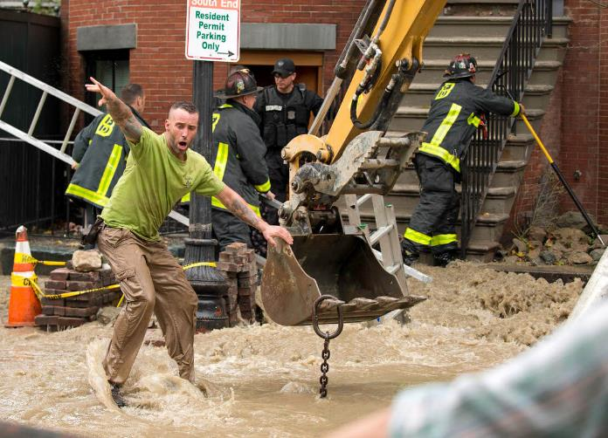
Atlantic Drain Trenching Fatality
The Standard Times

Slide 5

Criminal Investigation Team
The owner of a company involved in a deadly trench collapse in Boston three years ago has been convicted on two counts of manslaughter in connection with the incident that killed two workers.
Atlantic Drain Service and owner Kevin Otto were found guilty Thursday in a jury-waived trial in Suffolk County Superior Court, the office of District Attorney Rachael Rollins said.
Robert Higgins and Kelvin Mattocks, employees of Atlantic Drain Service Co., were killed on Oct. 21, 2016, when the trench in which they were working collapsed and filled with water from a fire hydrant supply line.
The Boston Globe

Slide 6


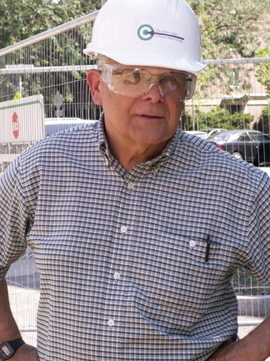
OSHA Training Institute Education Center
New England Region 1
Keene State College
John “Sean” Ryan
John.Ryan@Keene.edu
Our Mission
In keeping with OSHA’s mission statement “to assure, so far as possible, every working man and woman in the Nation safe and healthful working conditions,” OTIEC Region 1 seeks to nurture a cohesive community of safety and health professionals, working towards safer workplace environments in New England through OSHA education; we believe safety is strengthened through knowledge.
Celebrating 26 years of service to New England employers and employees 1994 – 2020
David Buck, Ed.D,
Originator of the OTIEC Grant 1994

Slide 7


New England Boston OSHA Education Center /
Keene State College
Offers more than 30 of OSHAs premier OTIEC courses and Outreach training plus 30+ additional safety courses through Keene State College Safety Center
  Train about 3,000 students each year
Open enrollment in all six states with headquarters in Manchester NH
Customized on-site training available
Virtual Instructor Led Training
Notes:
Synopsis of major changes - October 2008 – Outreach Training Program Guidelines:
-- These are covered in this presentation
Topics – 10 and 30-hour
Construction 10-hour – now 4 hours mandatory (was 3)
Construction 30-hour – now 12 hours mandatory (was 6)
General Industry 10-hour - now 6 hours mandatory (was 4)
General Industry 30-hour - now 11 hours mandatory (was 7)
OSHA Outreach Training Program Report
Trainer must sign to certify that the class was conducted in accordance with OSHA’s guidelines and accurate documentation was submitted
Requests additional course information: if conducted in another language, for youth, outside US, related to OSHA Alliance or Partnership
State where training held (or country if outside of US)
Shortcut formats require topic list and trainer certification language
Trainers complete student cards by printing or typing their name. May also sign.
Records. Trainers must maintain class files for 5 years which include:
o Student sign-in sheets for each class day
o Student addresses
o Copy of the documentation sent in to request cards.
o Records which indicate the card number dispensed to each student
Trainers complete student cards
o By printing or typing their name
o May also sign card, but name must be printed or typed in.
o May not alter the cards or use white out on them
Over 50 Students – must take attendance, OTIEC responsibility
In-Person training summary of major guidelines
Video conferencing – must provide info on materials, OTIEC responsibility
added - Outreach Training Tips – including Importance of Safety and Health and training in the audience’s language
added Further Assistance - Teen Workers, Spanish References and Trainers, Making the Business Case for Safety and Health, Construction Outreach Materials, Specific General Industry Resources, OSHA Quick Cards.

Slide 8

On-Site Consultation Program
Primarily for smaller businesses, no-cost, confidential consultations help employers identify and address hazards and establish or improve safety and health programs. Services are provided by consultants from state agencies or universities.
Did you know that the OSHA On-Site Consultation Program prevents over 8,700 workplace injuries and saves the U.S. economy almost $1.5 billion every year? Learn more about how OSHA On-Site Consultation benefits small business employers, workers, and the worker's compensation system.

