Slide 1


Damage Prevention Training
Department of Public Utilities
Damage Prevention Program www.Mass.Gov/Dig-Safe

Slide 2
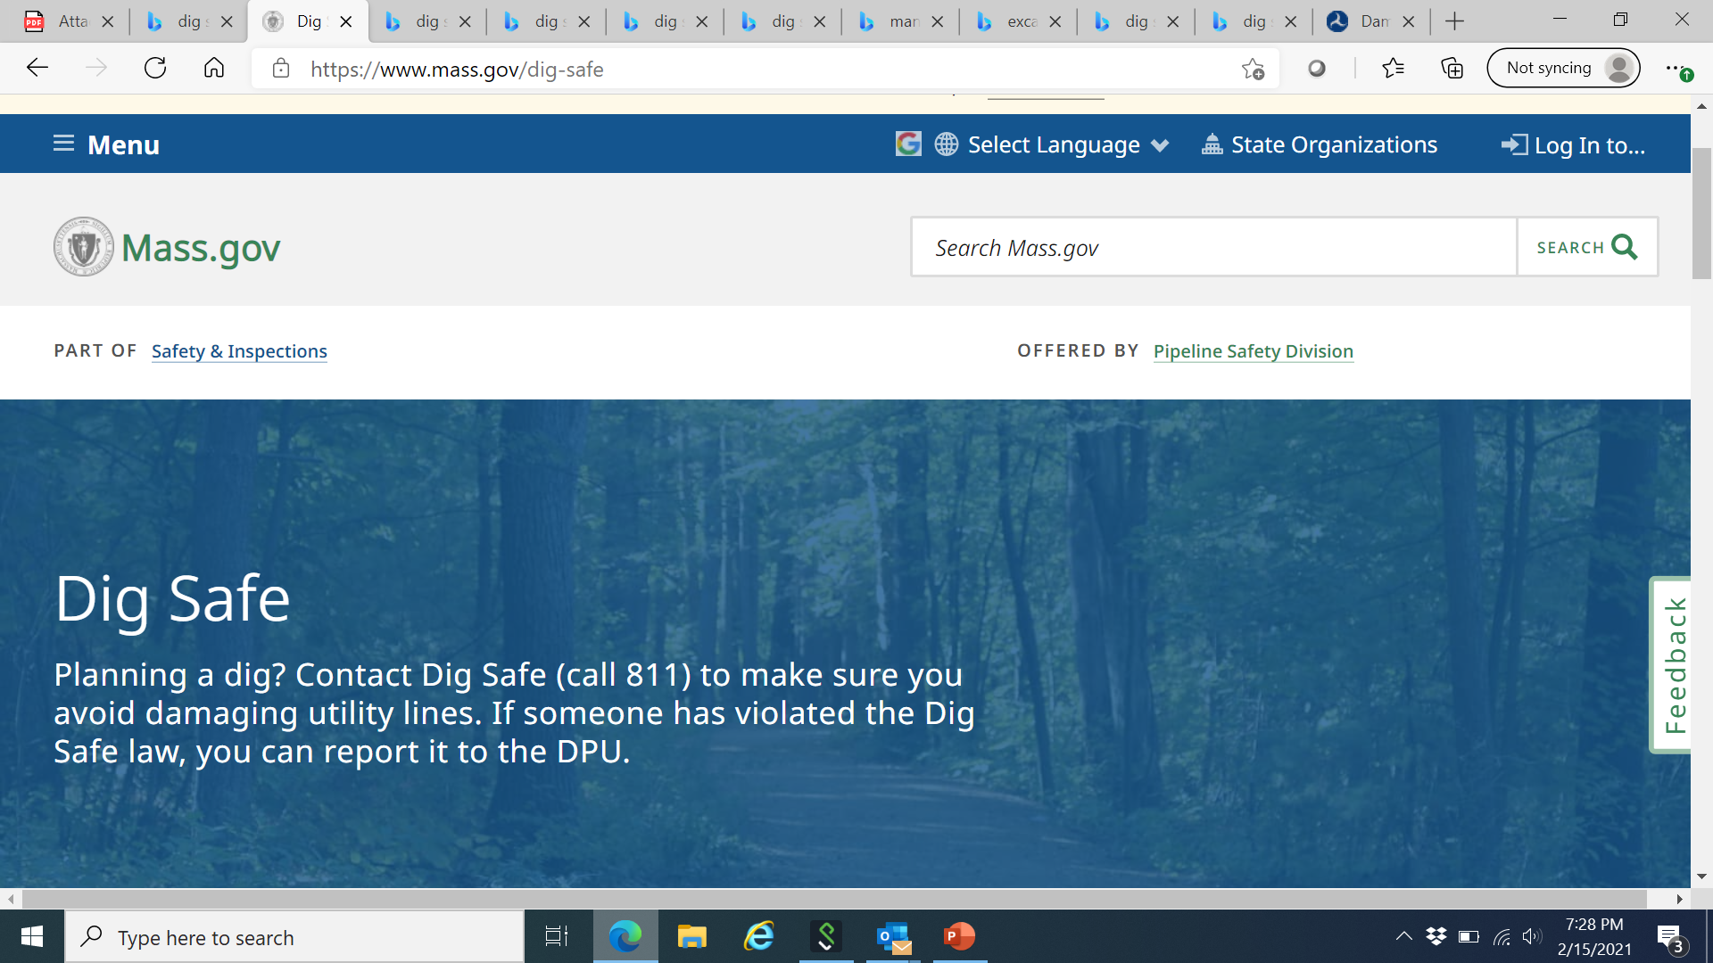


www.mass.gov/dig-safe
- Report A Dig Safe Violation To The DPU
- MA Dig Safe Regulations
Pipeline and Hazardous Materials Safety Administration
www.phmsa.dot.gov
- Works closely with the U.S. Department of Transportation
- Several online resources are available on the PHMSA site
www.digsafe.com or Call 811 - Sign Up or Sign In - Request a new Dig Safe Ticket or Renew a Dig Safe Ticket

Slide 3
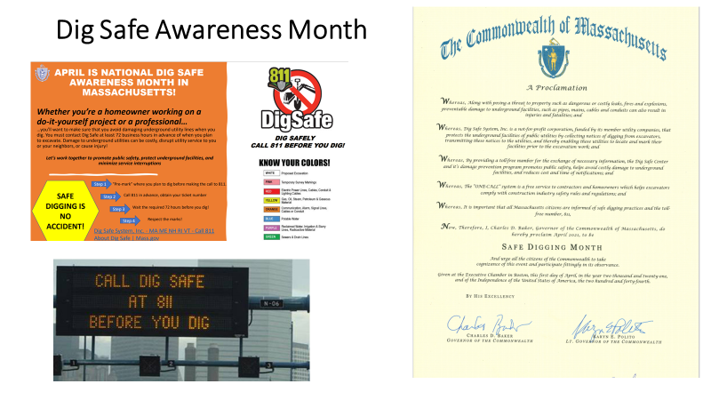

Slide 4
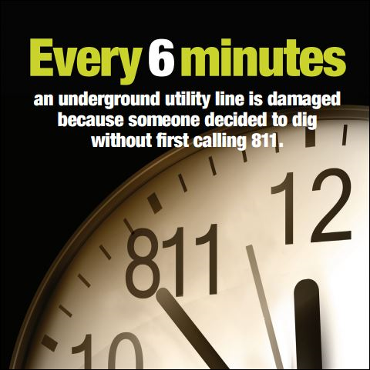
Consequences of Damage
Explosion
Fire
Electrocution
Injuries/fatalities
Property damage
Interruption of service to customers
Spills/emissions
State Violations
Damage Prevention Record

Slide 5
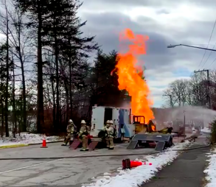
Springfield, Northern Virginia
Digging equipment strikes a gas line sparked an explosion and fire that injured three Washington Gas workers and led to the evacuation of eight homes.
Fire crews arrived to find a large volume of fire in the middle of the street with flames extending 50 to 70 feet in the air. The fire was being fed from a free flowing, six-inch gas line. Crews worked quickly to extinguish fires in two vehicles that resulted from the gas fed fire.
Feb 4, 2021

Slide 6
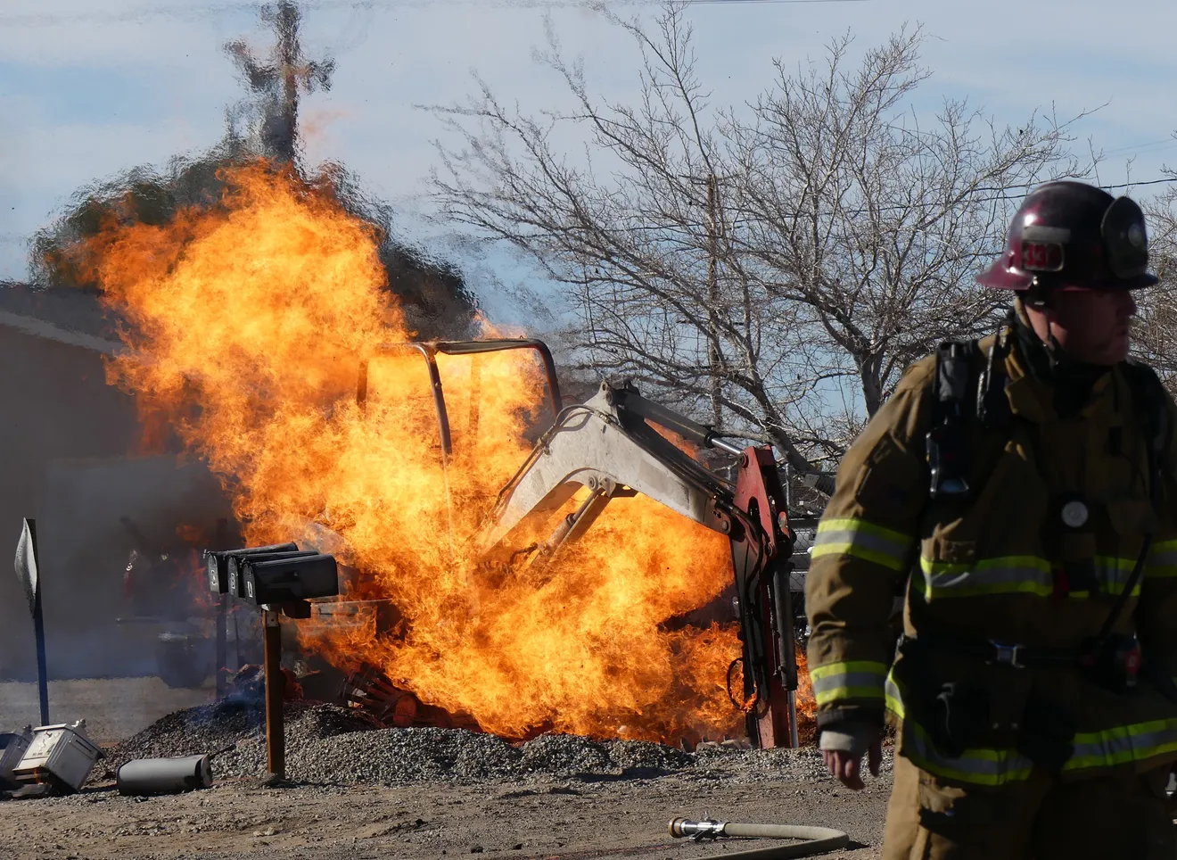
Apple Valley, California
Septic company using an excavator ruptured a gas line, which ignited the fire.
This occurred next to a residential complex and a nearby high school.
Thankfully, no injuries.
Feb 4, 2022

Slide 7
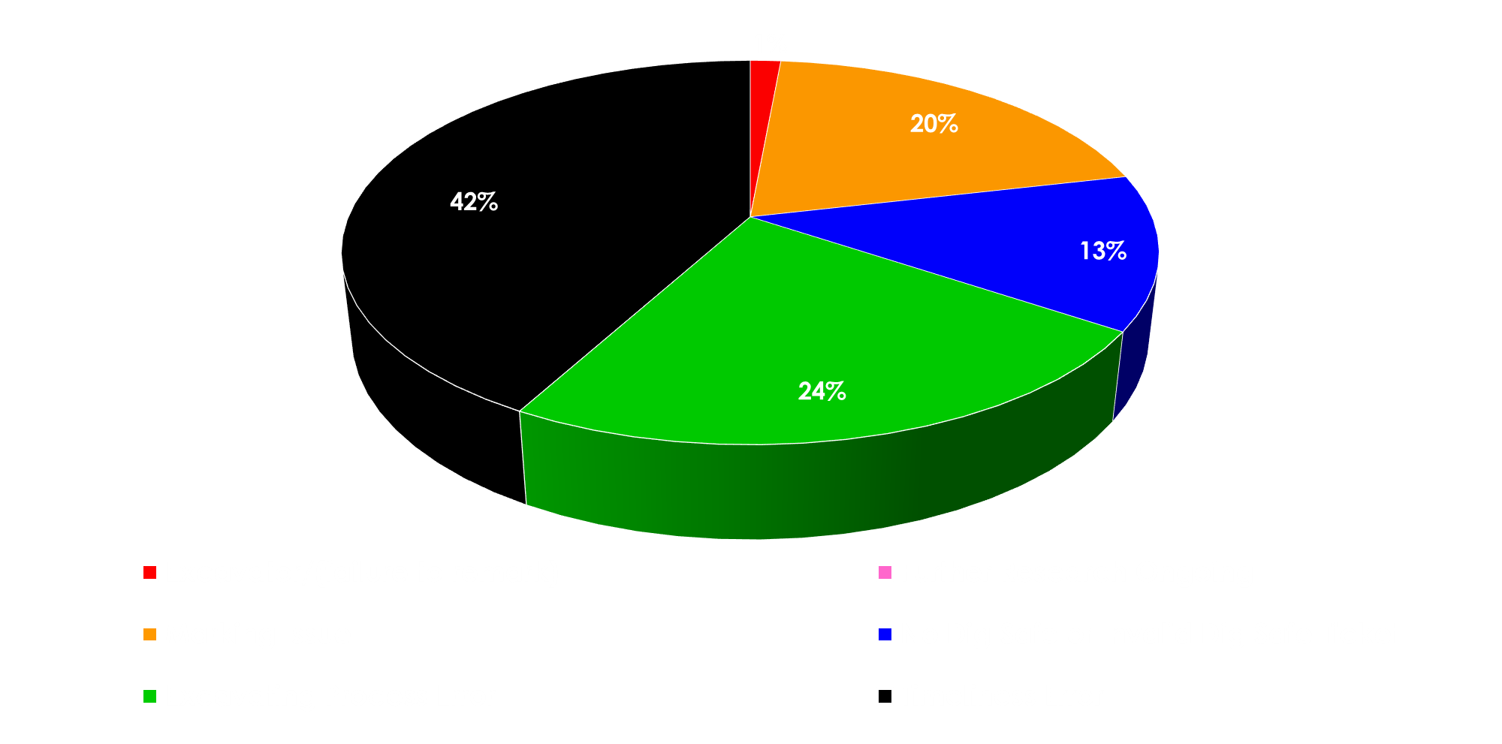
Percentages of Violations January - December 2024

Slide 8
Changes to Damage Prevention Regulations
Emergency notifications only for true emergencies: 220 CMR 99.05
Companies must mark out new installations: 220 CMR 99.06(9)
Dig Safe ticket valid for only 30 days: 220 CMR 99.07(2)
Suspend work upon call for remarking: 220 CMR 99.07(5)
Call 911 if damage leads to gas escaping: 220 CMR 99.07(8)
Requirement to report damage: 220 CMR 99.07(10)
Higher penalties for natural gas-related violations: 220 CMR 99.14 and the 2021 Act Creating a Next Generation Roadmap for Massachusetts Climate Policy

Slide 9
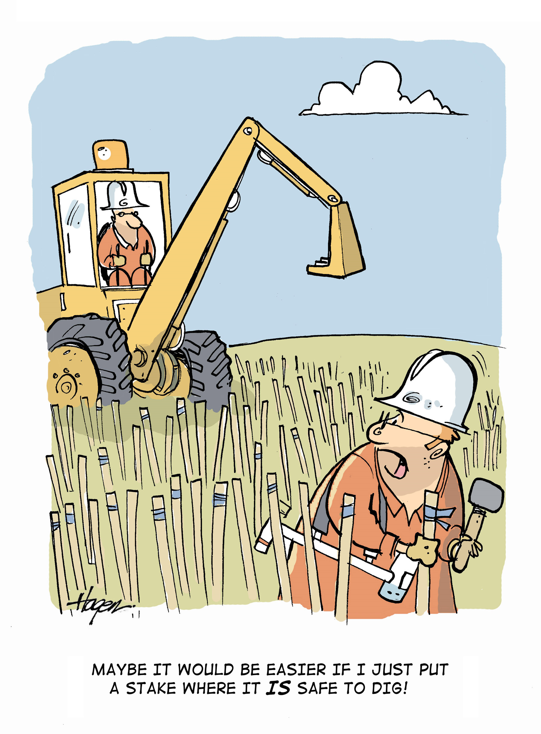
Dig Safe Violations:
What to Know

Slide 10
What is EXCAVATION?
G.L. c. 82 s. 40 defines excavation BROADLY.
“Excavation”, an operation for the purpose of movement or removal of earth, rock or the materials in the ground including, but not limited to, digging, blasting, auguring, backfilling, test boring, drilling, pile driving, grading, plowing in, hammering, pulling in, jacking in, trenching, tunneling and demolition of structures.

Slide 11
Civil Penalty Amounts
Violations related to natural gas:
Fines can be issued up to $500,000 for each violation for each day that the violation exists, up to a maximum of $10,000,000 for a related series of violations.
Fine for 1st offence start with minimum of $1,000.
Violations not related to natural gas for e.g.: electrical, communications, water, sewer, etc.:
Fine for 2nd offense within 12 months are $5,000 to $10,000.
These dollar amounts shall be doubled if similar violation(s) in the past three years.

Slide 12

Premark the area where you are planning to dig with WHITE or PINK.
THIS INLUDES PRIVATE PROPERTY.
A regular ticket must be submitted by www.DigSafe.com or Call 811.
Explain your plans in detail.
Municipalities are not required to become members of Dig Safe, Inc.
Dig Safe Ticket will provide the EFFECTIVE START DATE & TIME as well as EXPIRATION DATE.
Your ticket is ONLY VALID 30 DAYS.
Be sure to RENEW DIG SAFE TICKET if needed before expiration.
What Must Be Done BEFORE The Excavation

Slide 13
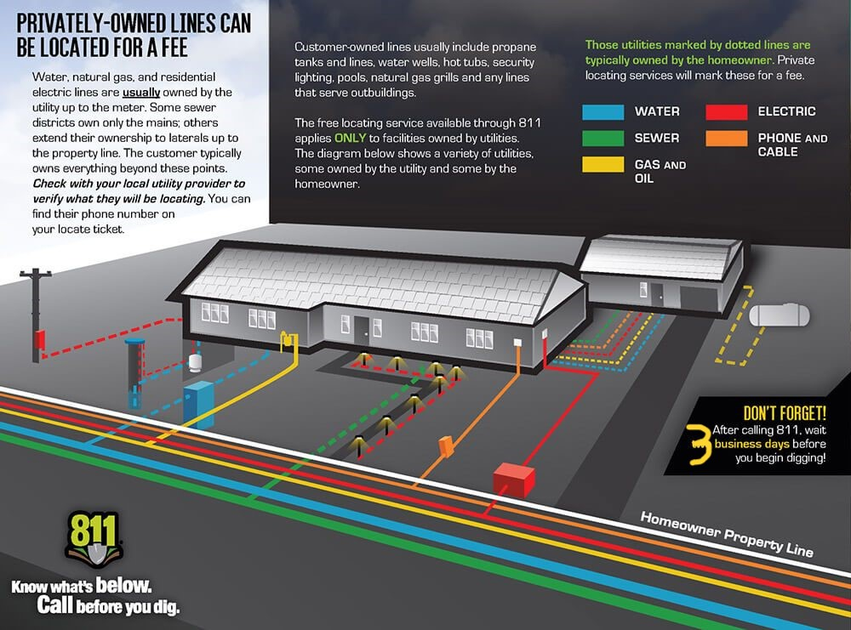
Markings On Private Property

Slide 14
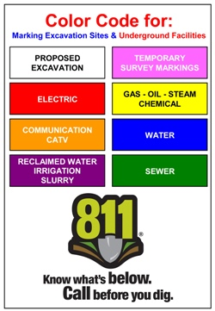

What To Do Once the Dig Safe Ticket is Validated…
Observe the Site
Ask yourself these questions:
Did all the notified Utilities respond?
Respect the Marks
& the Tolerance/Safety Zone
Tickets Expiration
A new ticket must be requested if:
The scope of work or excavation location has changed.
Excavators must refresh the marks with the same color OR call Utilities directly / Dig Safe 811 to request re-marks.
No mechanical means within the tolerance zone.
Do you suspect a potential mis-marked or unmarked utilities?
If so, you must suspend work for 24 hours allowing time for remarking
Did you take a BEFORE picture of the area with all markings visible?
The job is going to take longer than allotted 30-day expiration date.

Slide 15
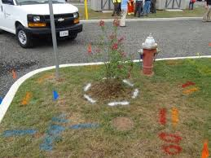
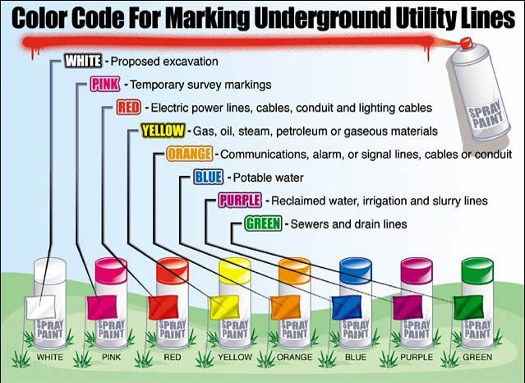
Know The Color Code For Markings

Slide 16
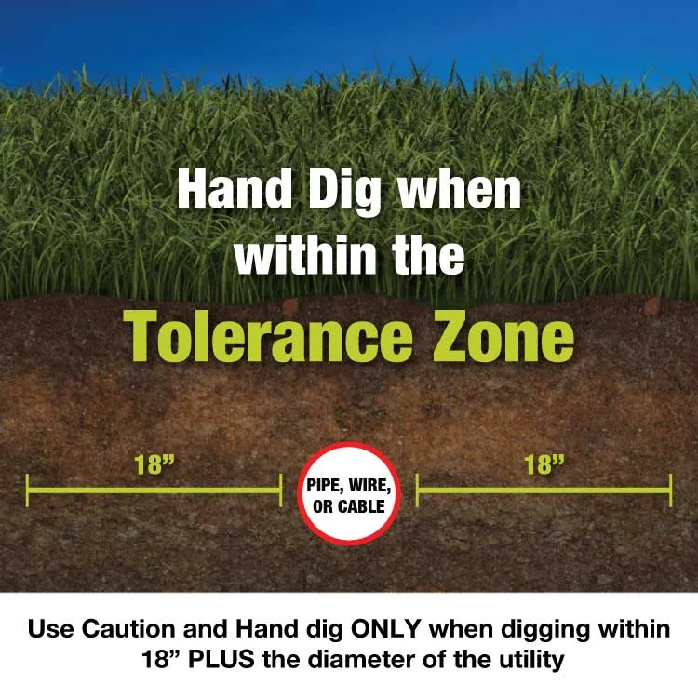
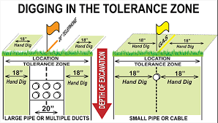
Understanding The Tolerance Zone

Slide 17



Hand Tools Can Cause Damages

Slide 18
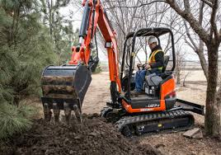
What Must Be Done DURING The Excavation:
Employ REASONABLE PRECAUTIONS
NO MECHANICAL MEANS withing tolerance zone EXCEPT when used to for initial penetration of pavement, cement, etc. Thereafter, only use of hand tools within tolerance zone.
BE CAREFUL, MA Dig Safe Law states we are “depth blind” meaning unable to guarantee actual depth of a utility due to the age of our state and underground utilities. Shallow depth is not an excuse for damage.
Employ REASONABLE PRECAUITIONS to avoid damage to any part of underground facilities to include trace wires, conduits, the protective coating, wires, services and mains.
Always protect the utility, ESPECIALLY if it is exposed such as from falling rocks and other debris, collapsing trench walls or exposed suspended utilities.
If damage occurs or utility is discovered compromised in any way, the excavator MUST notify the utility and DPU Damage Prevention.

Slide 19
What Must Be Done DURING The Excavation:
Employ REASONABLE PRECAUTIONS
Utilize a spotter to communicate with excavator while working near underground utilities.
Don’t “curl” the bucket over utilities.
Maintain markings ensuring they are visible. Do not covered markings with spoils.
Ensure all spoils are at least 2 feet away from exposed utilities.
When moving spoils, do not carry spoils over the exposed utility. Debris could fall out of the bucket onto the exposed utility causing damage.
If at any point you are concerned the excavation may damage an underground utility, stop and contact the utility directly to ask for guidance/assistance. You can always request the service be disconnected temporarily while the working to finish the job safely.

Slide 20
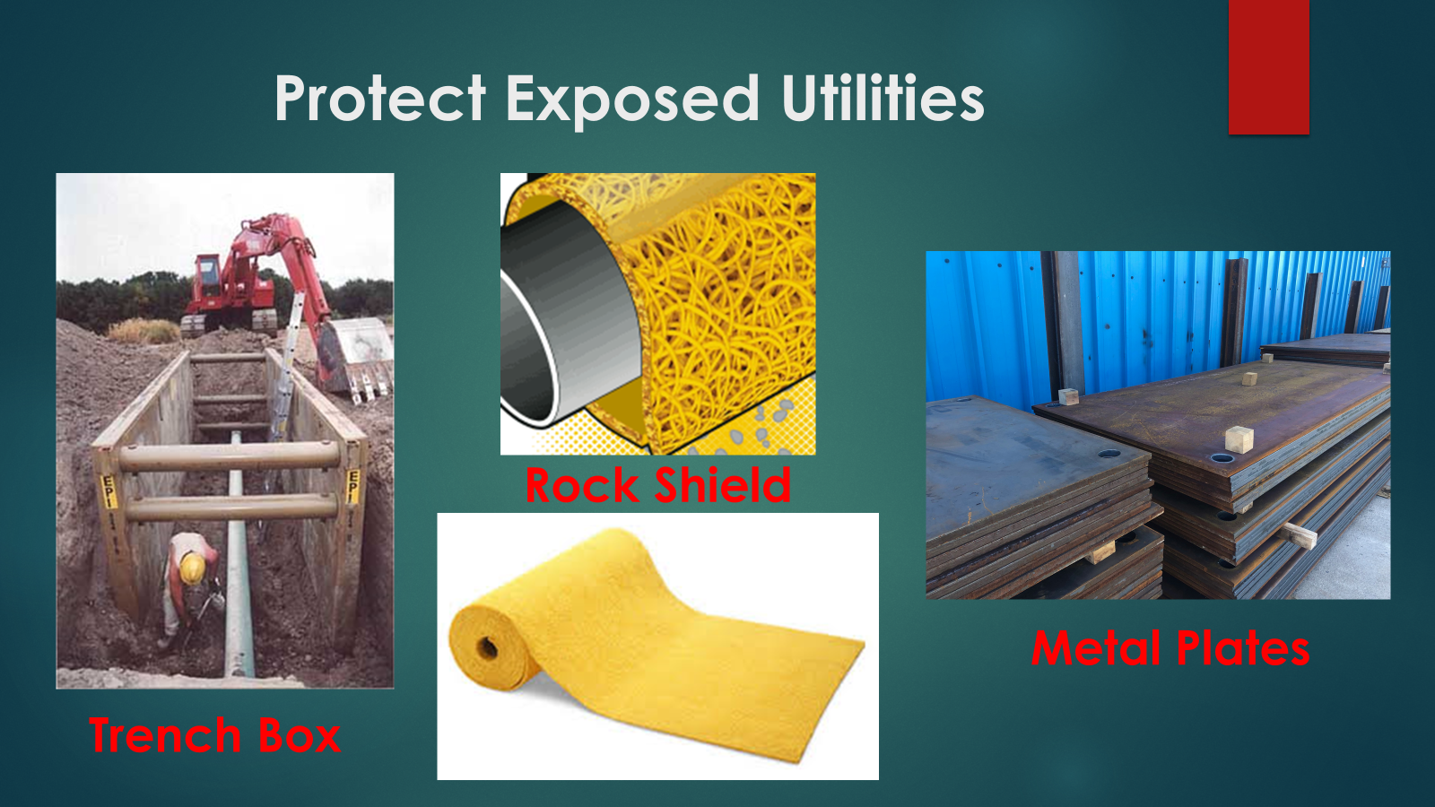

Slide 21
Call 911 for Release of Gas
Call 911 if damage leads to gas escaping: 220 CMR 99.07(8)
You must call 911 if excavation damage results in release of natural gas
  Report the damage to the utility owner at the earliest practical moment AND submit Dig Safe Violation Report (DSVR) within 30 days to DPU.
In addition, you must:
  Evacuate nearby structures if necessary.
  Attempt no repairs, unless directed to by the facility owner or operator.
  Report the damage to the DPU Damage Prevention submitting a COMPLETE DSVR along with photo documentation.

Slide 22
Emergency Excavation
New definition for Emergency: “A sudden or unexpected occurrence involving a clear and imminent danger demanding immediate action to prevent or mitigate loss of, or damage to, life, health, property, or essential public services, but not including a loss of business or profits.”
Must be true emergency: an unanticipated event, not merely to prevent loss of business or profits
E.g., Not for tent stakes on a Friday when party is on Sunday
Must use reasonable precaution to avoid damage and comply with all Damage Prevention laws and regulations
Emergency notifications are only for true emergencies: 220 CMR 99.05

Slide 23
Emergency Excavation
Call
Visit www.DigSafe.com or call 811.
Dig Safe, Inc. shall not issue Emergency ticket if it does not believe in good faith that situation is an emergency
Mark out
Companies must mark out the area within three hours of notice
Notify
Once emergency has concluded, notify Dig Safe, Inc. if further excavation is needed by obtaining a new 30-day ticket

Slide 24
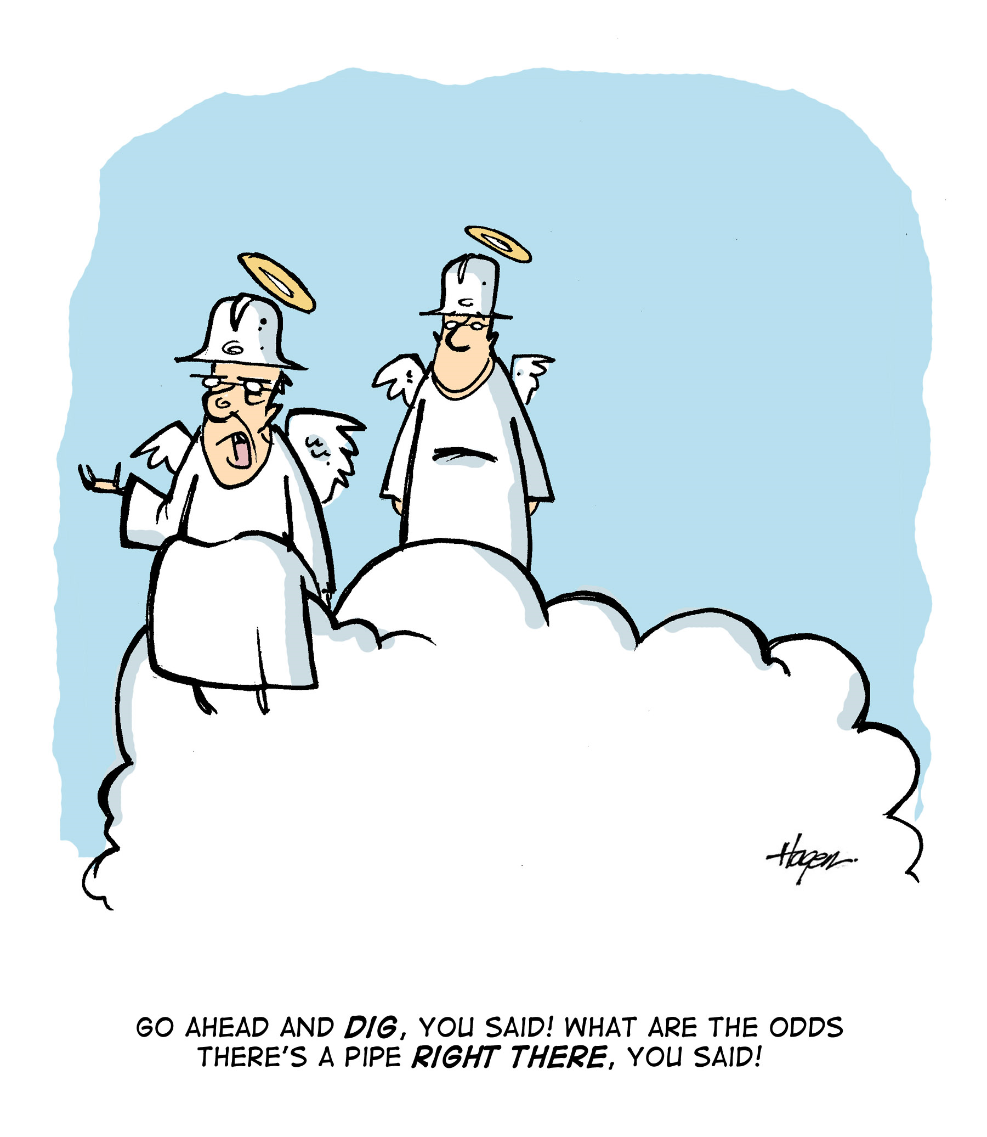
Reporting Damages/Violations
www.mass.gov/dig-safe
MA Dig Safe Law requires, ANYONE WITH KNOWLEDGE of suspected violations be reported to the DPU Damage Prevention Program.
Why is this important?
    It provides both sides of the incident, potentially saving them from an NOPV at the onset.
    If we don’t know it happened then no one is held accountable to address it preventing the same issue in the future.
    Help us improve Dig Safe Culture for everyone!

Slide 25
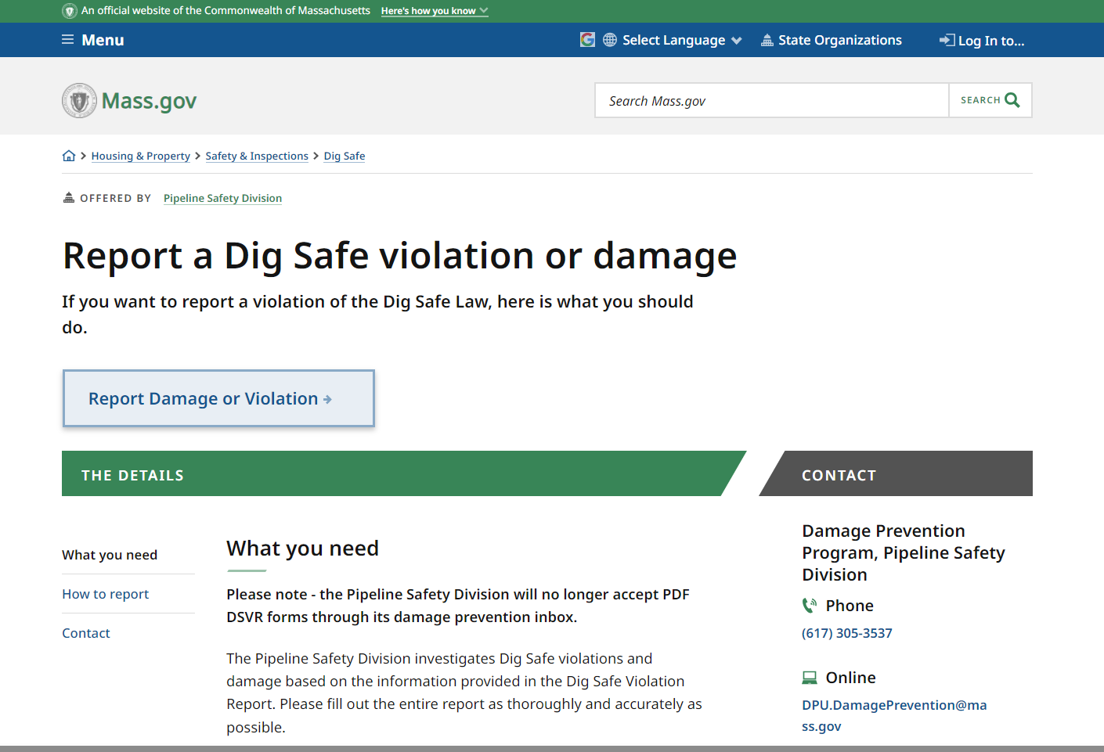
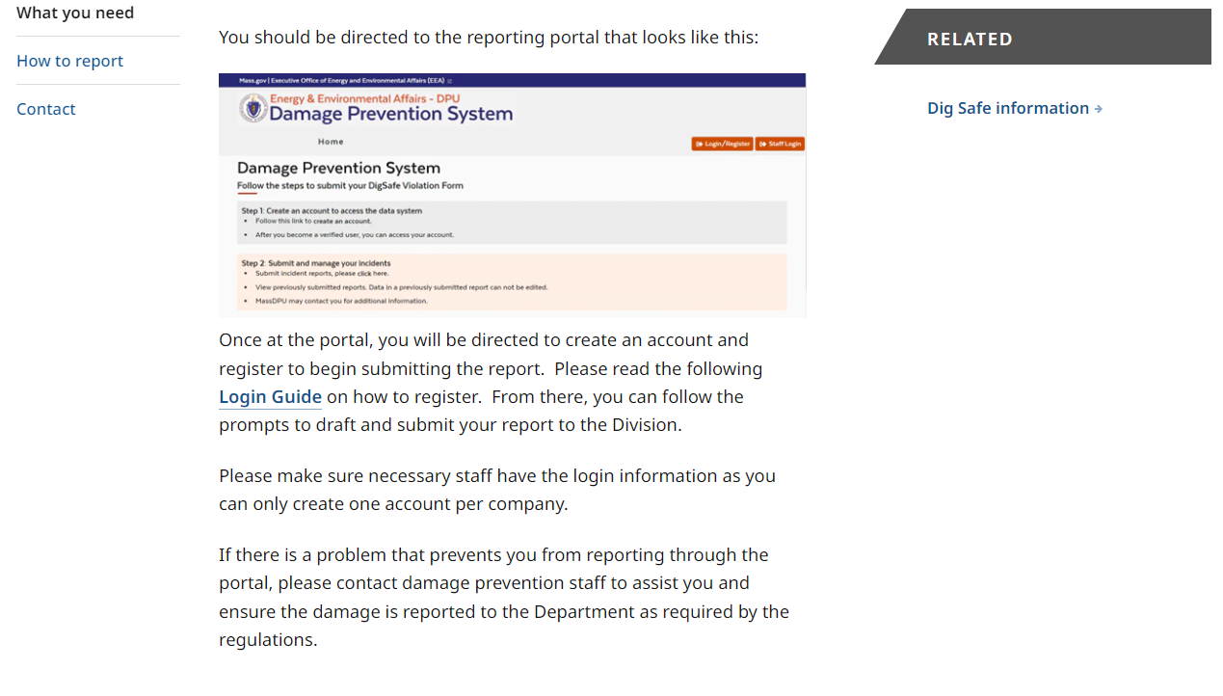
Dig Safe Violation Report (DSVR)
www.Mass.Gov/dig-safe
Email us: DPU.DamagePrevention@Mass.Gov

Slide 26
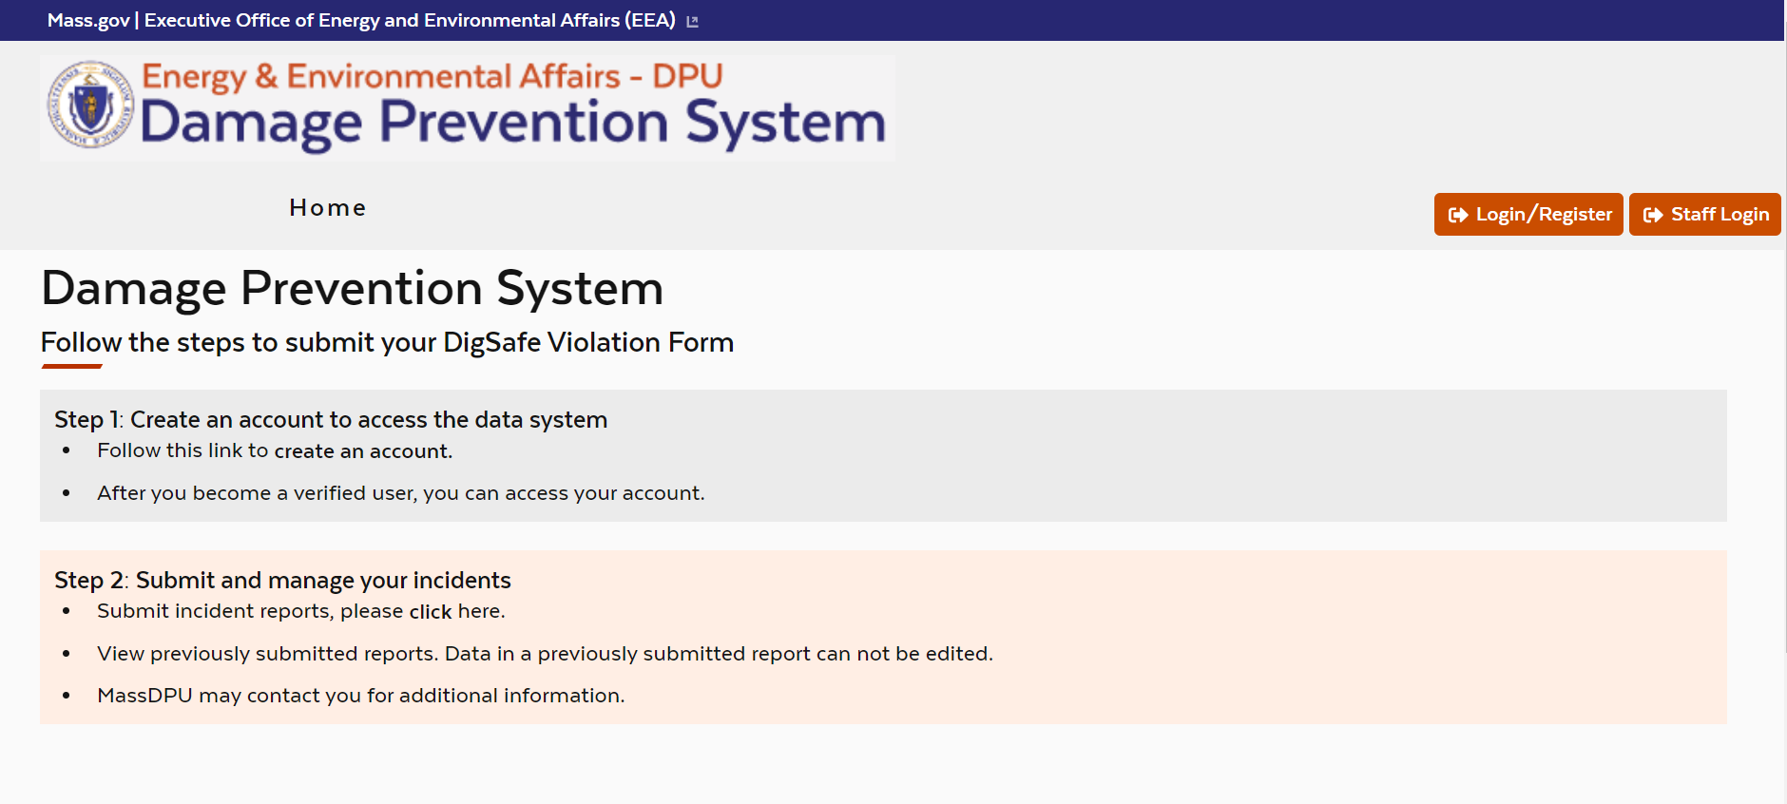
Dig Safe Violation Report (DSVR)

Slide 27
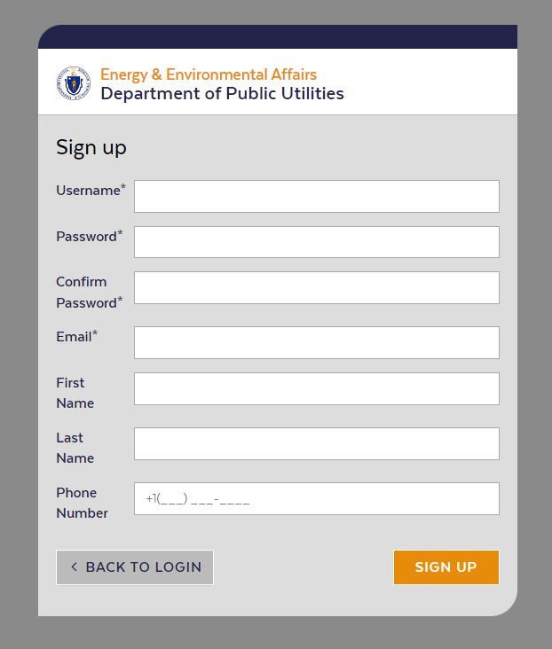
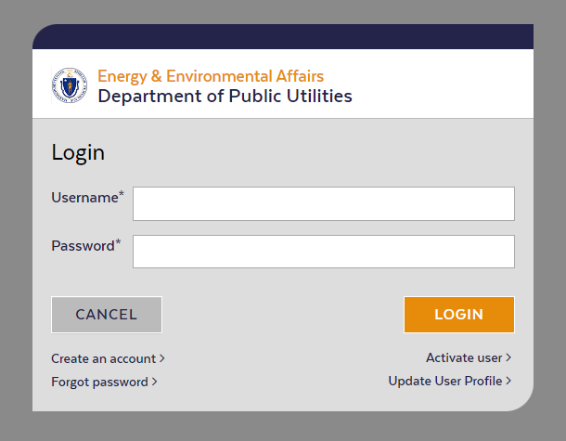
Dig Safe Violation Report (DSVR)

Slide 28
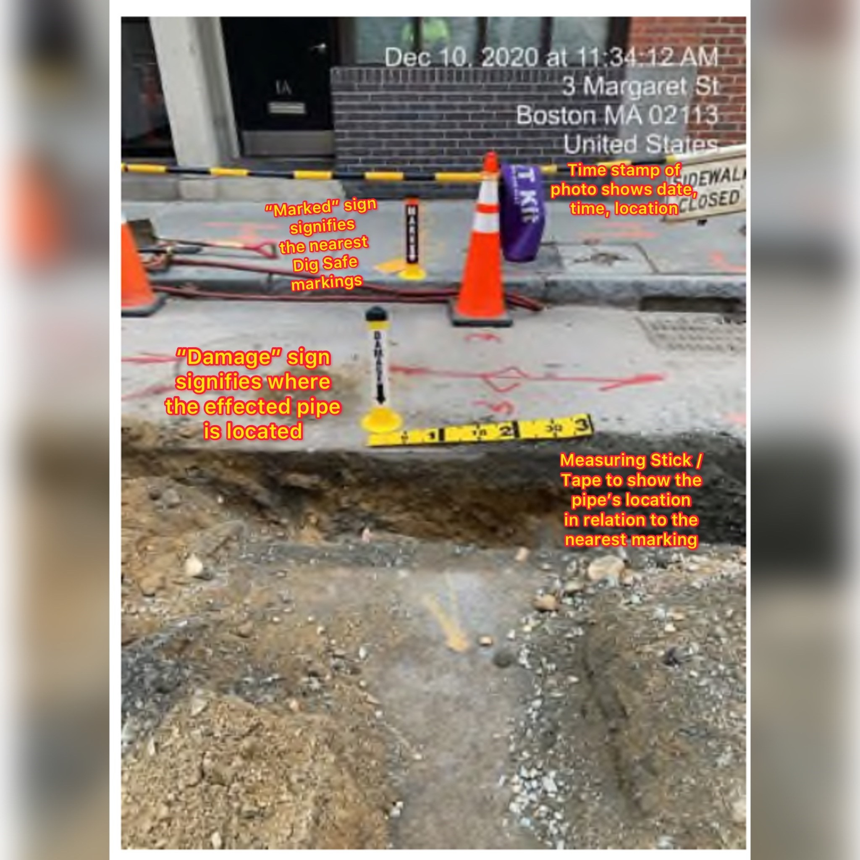
Providing Photos are Crucial!

Slide 29
ENFORCEMENT
What Happens After an Incident?

Slide 30
Flow Chart of Enforcement Process
NOPV
Informal Conference
IRD
Adjudicatory Hearing
DSVR

Slide 31
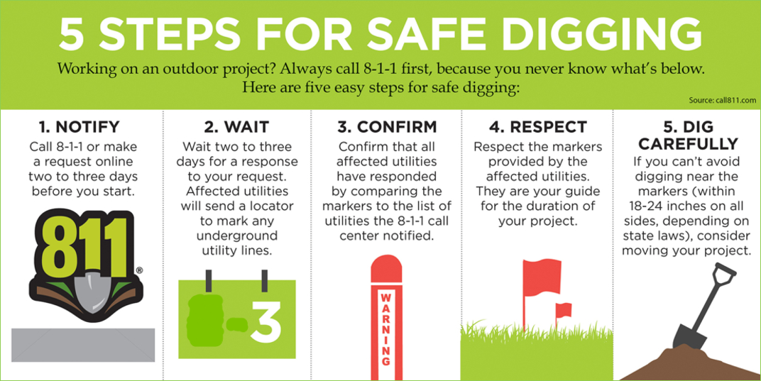
Questions?

