Slide 1
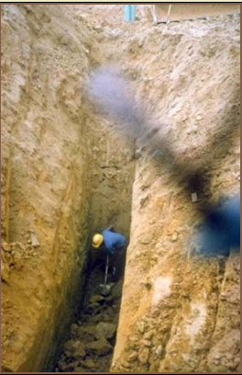
Make The Safe Choice, Make the right Choice!
What could possibly go Wrong? .

Slide 2
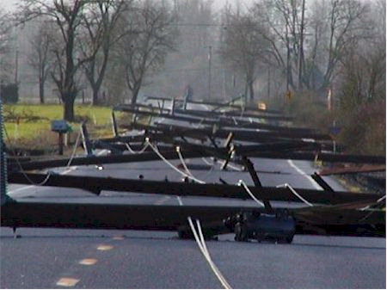
Understanding Backfeed
This section of line is not connected to electrical system on either end
A homeowner starts up their generator and plugs the cord into a wall outlet
Power is back fed into the panel, out through the meter, into the low voltage side of the transformer and out the high voltage bushings…
This line is now energized by the backyard Honda generator and you are at RISK!
Safety Message

Slide 3
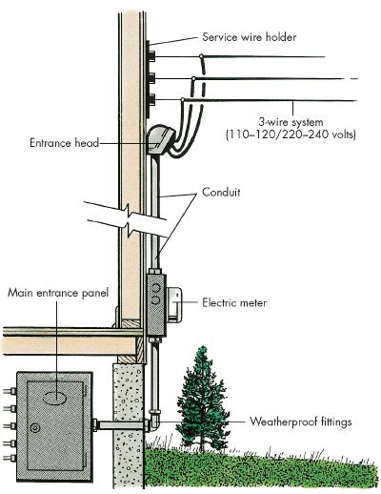
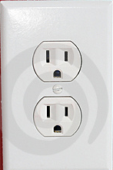
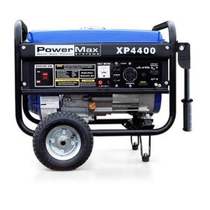
Understanding Backfeed = Source
Safety Message
House voltage goes back to low side of transformer, through transformer in reverse and out the high side as high voltage
Improperly wired

Slide 4
A Closer Look
Typical pole construction layout
Location on pole governed by NESC National Electric Safety Code
Diagram Courtesy National Grid

Slide 5
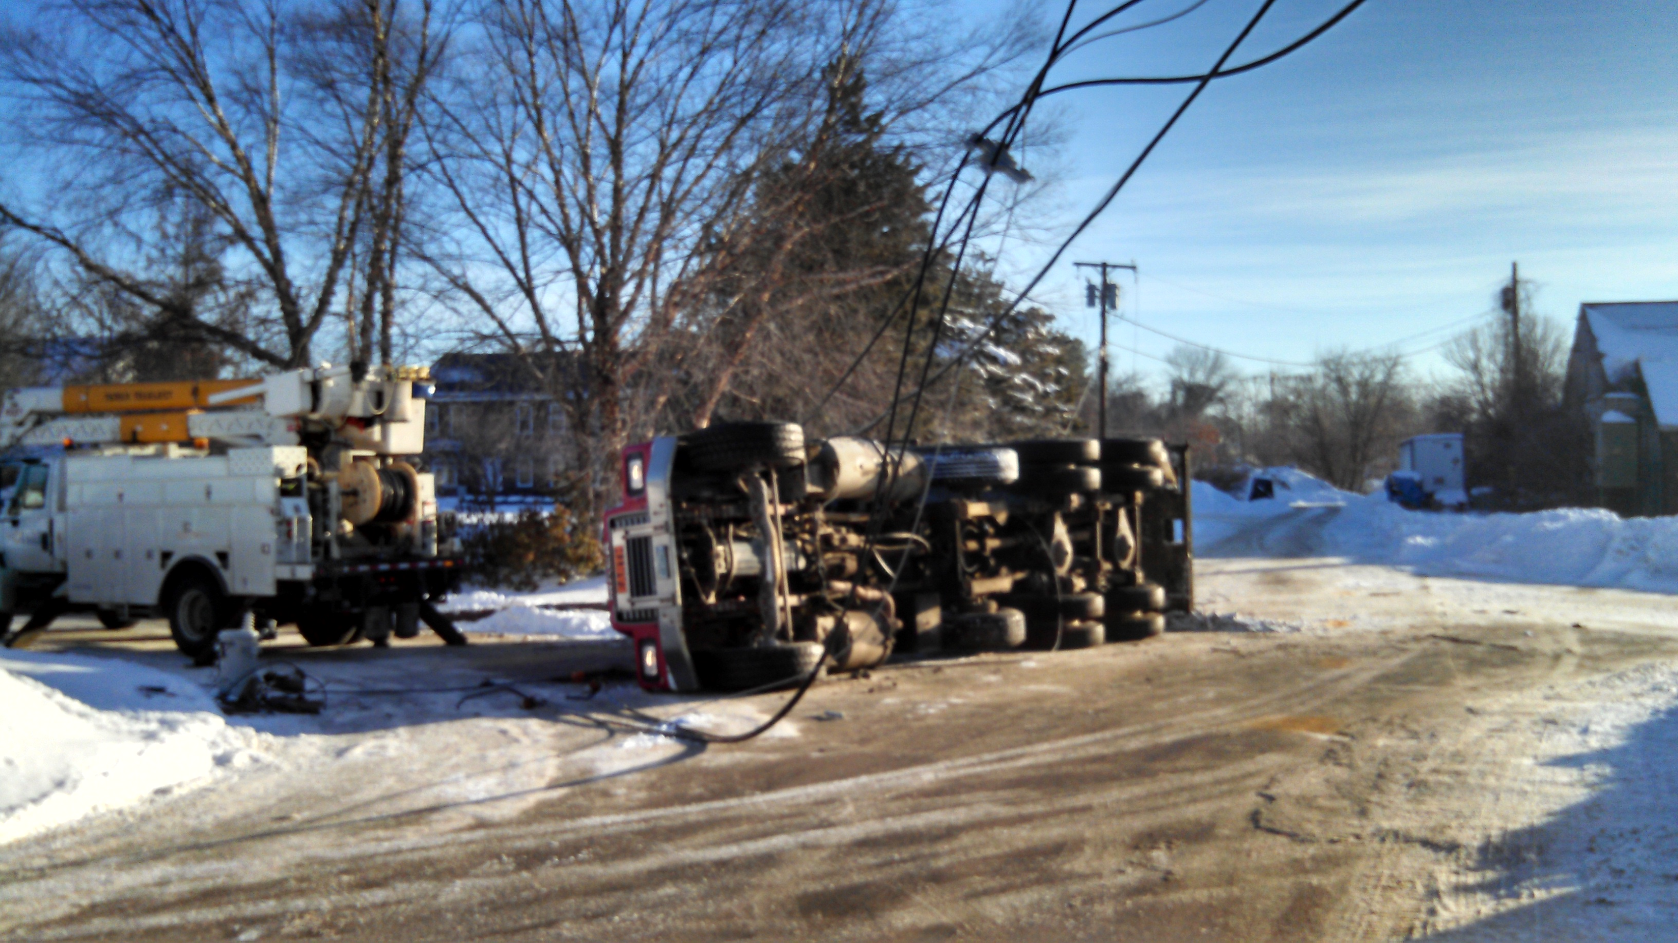
Concord NH
Dump Never Lowered The Bed Before Driving Away

Slide 6
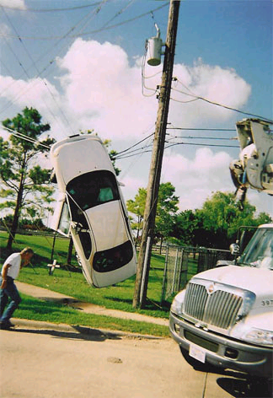
Touch Potential
Car in contact with energized wires
Touching the car will result in electric shock
That is an example of touch potential
Don’t do it

Slide 7
Hidden Hazards- Touch Potential
Definition- “Touch potential" is the voltage between the energized object and the feet of a person in contact with the object.

Slide 8
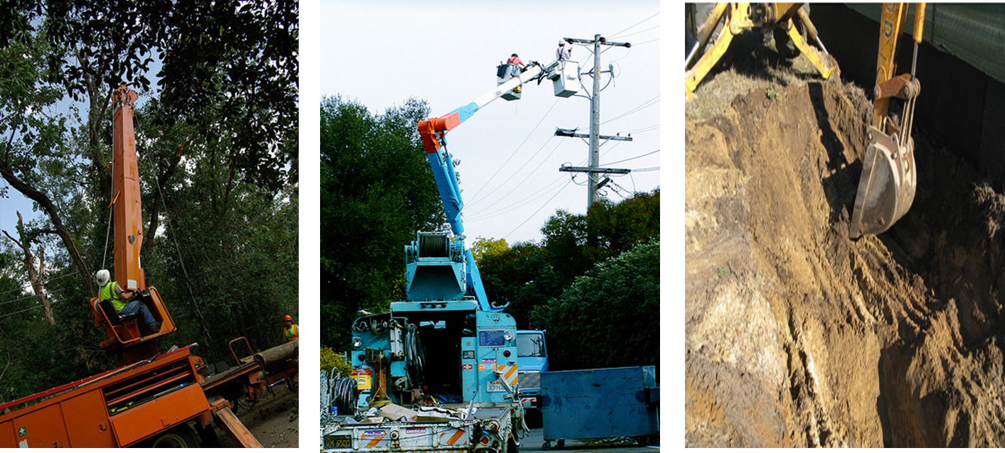
Touch Potential
Avoid touching any bucket trucks, diggers or attached trailers when booms are in the air near energized conductors- Touch Potential

Slide 9
Hidden Hazards- Step Potential
Definition- The voltage across a worker who stops across an energized path of earth

Slide 10
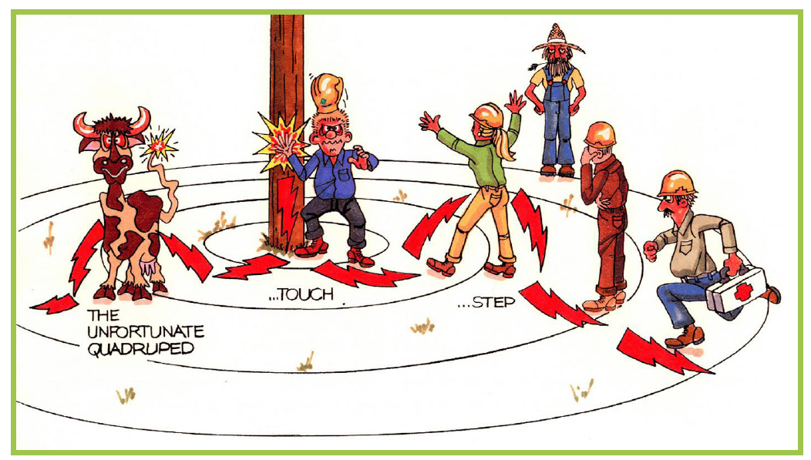
Who’s Safe??? Why?
Answers next slide
Artwork Courtesy of National Grid

Slide 11
Who’s Safe??? Why?
1- No, Touch and Step Potential 2- No, Step Potential
3- Yes, if he doesn’t move 4- No, Step Potential
5- Yes, if he doesn’t move 6- No, Step Potential
1
5
4
2
3
6
Artwork Courtesy of National Grid

Slide 12
Voltage Gradient
6’ feet away, say 800V
Say 1000V
14’ feet away, say 200V

Slide 13
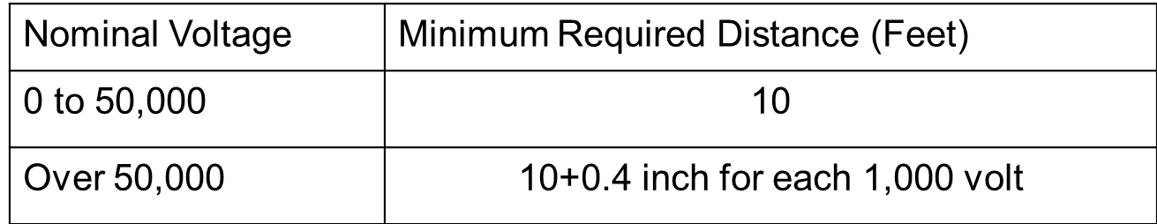
Protecting Yourself
What is a safe distance to stay back for down wires or equipment in contact with exposed electrical conductor?
  10’
  15’
  20’
  25’
  30’
  40’
Operation Clearances for Energized Overhead Lines

Slide 14
Protecting Yourself
What is a safe distance to stay back for down wires or equipment in contact with exposed electrical conductor?
  10’
  15’
  20’
  25’
  30’
  40’
Stay back 30’ from the closest piece of down wire or electrical equipment….this avoids step potential

Slide 15

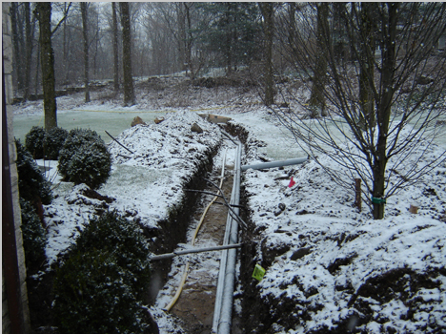
Safe Zone – The importance to call before you dig
You may not always know what is under -ground, do you?
If you expose and believe there may be damage STOP, call the local utility. The damage we see is better than not
The Utility Cares About You As Much As Our Plant

Slide 16
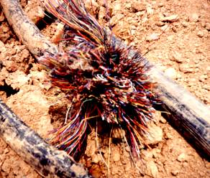
Underground Power Lines
From OSHA Training Power Point
Locate and mark the perimeter of underground lines
Exercise caution when excavating near power lines
  Some manual excavation may be required
Stay away from pad mount transformers, green metal box
Underground utility line that has been hit

Slide 17
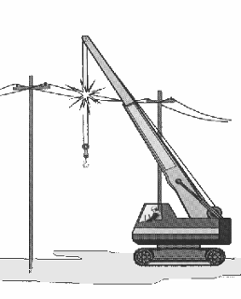
Injury Prevention
From OSHA Training Power Point
If you hit a power line
  In case of no immediate danger
    Move the equipment away
    Have someone call 911
    Stay on the equipment until you know it is safe.
    Warn others to stay away
  If you MUST get off the equipment, jump clear, Shuffle or Hop
Crane hitting a power line

Slide 18
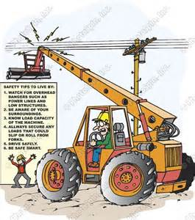
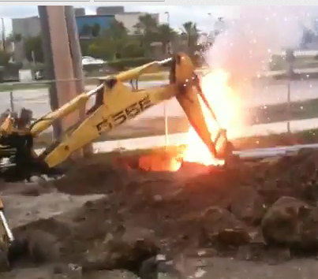
Questions??

