Slide 1
Electric Safety Awareness
February 12, 2025

Slide 2
Contact Information
Matt Paze, Electric Damage Prevention Supervisor
Phone: (617)-541-6238
Email: matthew.pazejr@eversource.com

Slide 3
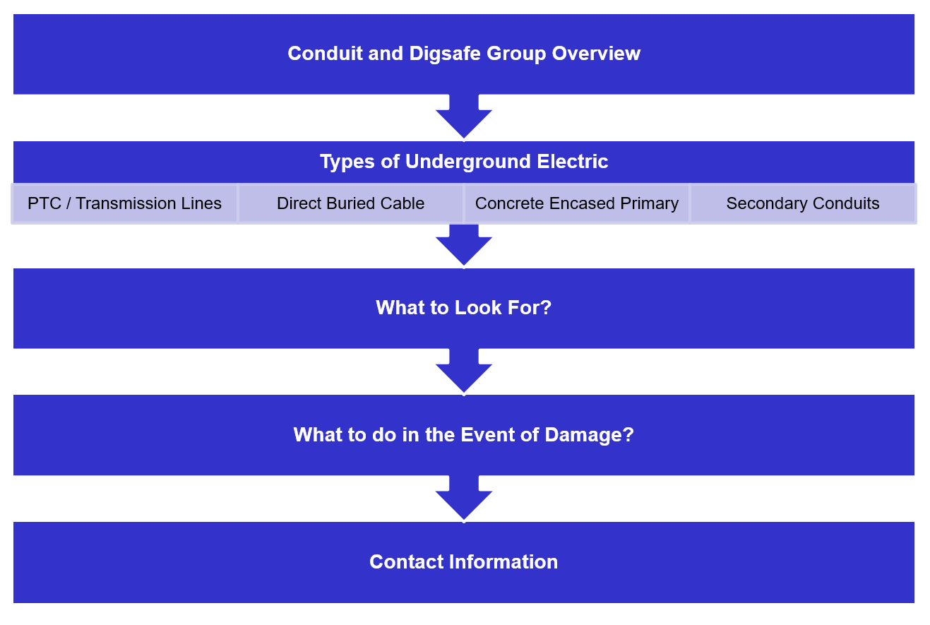
Presentation Outline

Slide 4
Conduit / DigSafe Group Overview
Digsafe:
20+ Grade-C Locating Inspectors
Handle all mark out ticket requests, WMA & EMA contracted out
Inspectors available 24/7/365
Conduit/Construction:
15+ Grade-A Conduit Inspectors
Approx. 25 Civil Subcontractors Operating Daily
Support SC’s with Construction Emergencies
$30-$40 Million per year in New Construction

Slide 5
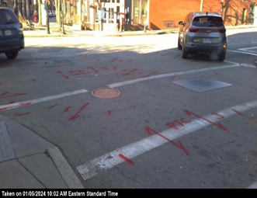
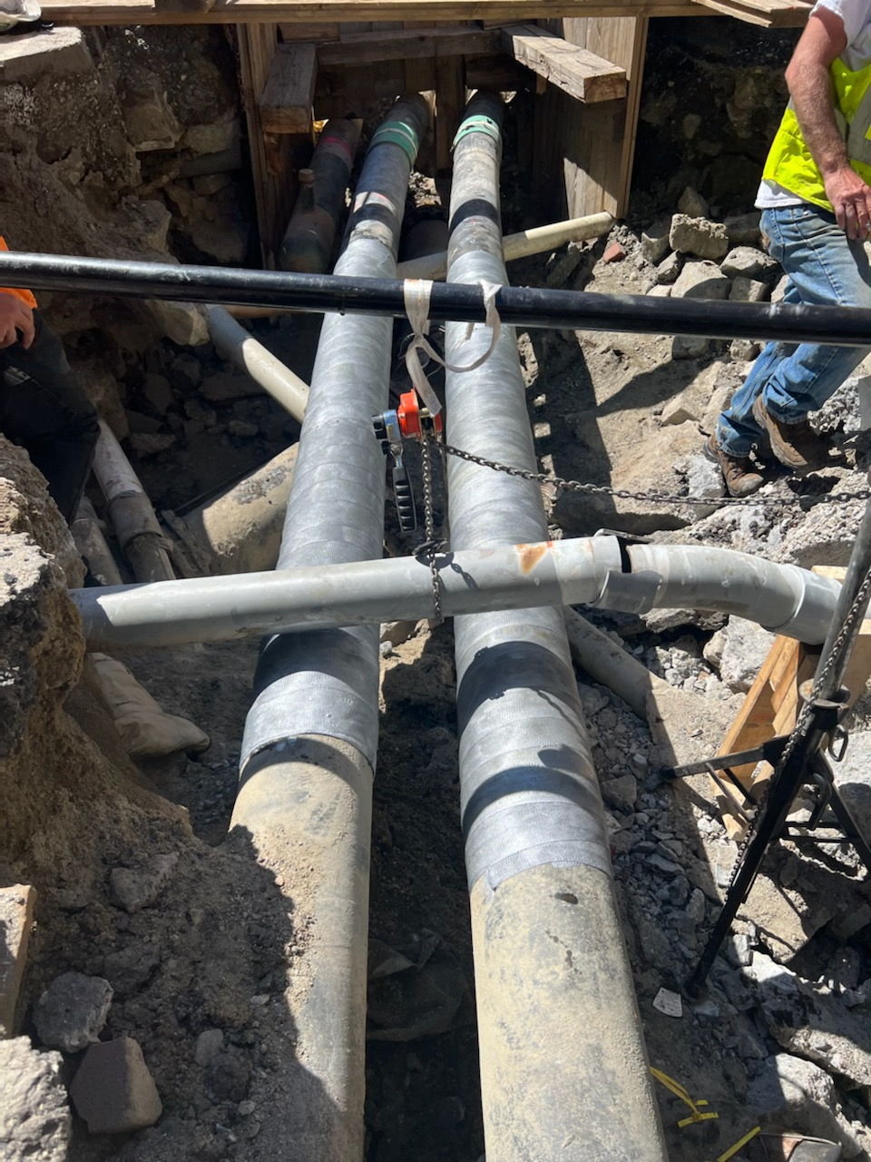
Pipe-Type Cable (PTC)
PTC (Pipe Type Cable) is our most critical underground asset
Voltage ranges from 115kV to 345kV
Steel Pipes, 6-10” in diameter, filled with cable and high-pressure oil

Slide 6
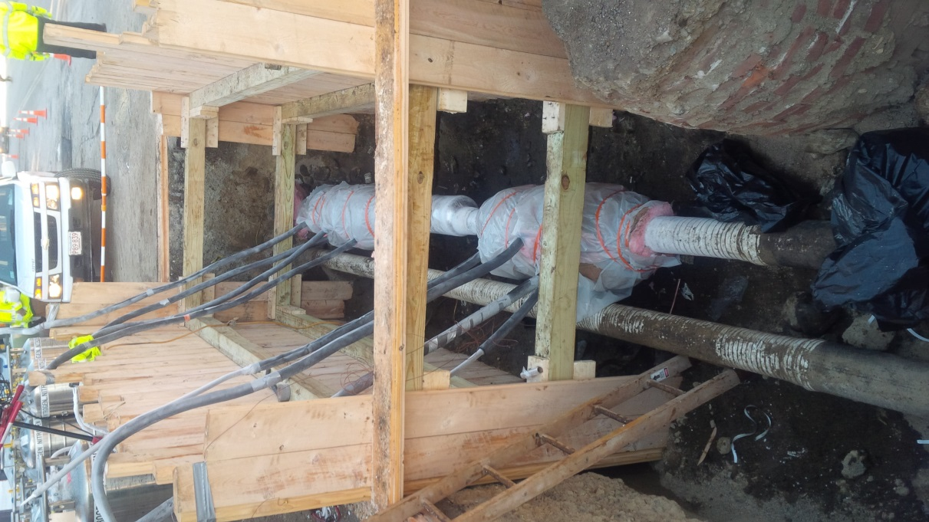
PTC: High Voltage Awareness
Daily Report of PTC Analysis
Initiate telephone contact with Excavator
Reach out to Field Personnel
Educating the contractor on meaning of PTC
New Excavator Field Training
115KV and 345KV

Slide 7
PTC: First Time Contact with Contractor
Meet and Greet (intro our team)
Stress potential for Personal Injury
  Near Fatality vs. Near Miss
Significant Repair and Clean-Up costs
  Scratched Coating produces Leaks
  Minor Cost now vs. Major Leak Later
Coordinate protective coating repairs
Awareness = Damage Prevention

Slide 8
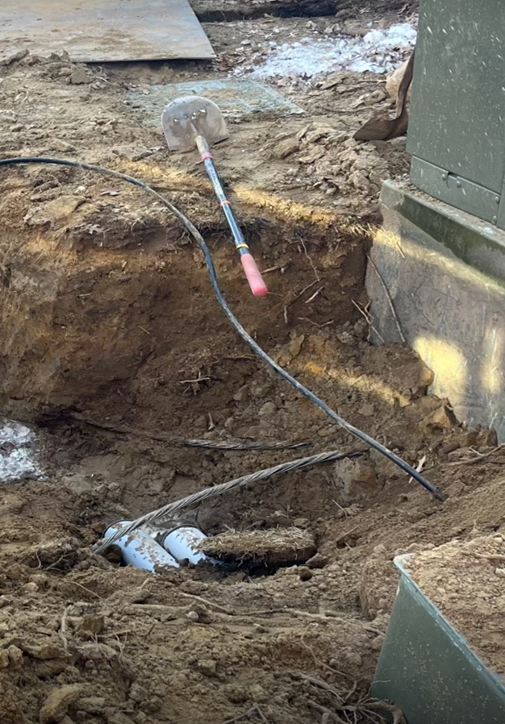
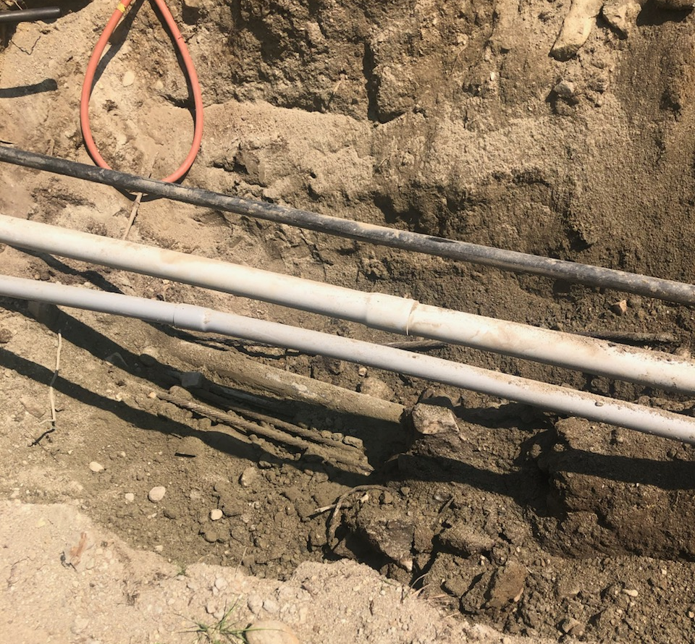
Direct Buried Cable
Common in MA, but no longer installed due to vulnerability of asset
Bare cable that is not encased in concrete and does not have conduit protection
Common in suburban developments

Slide 9
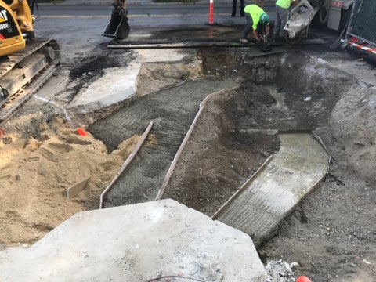
Primary Ductbanks
Multiple primary duct systems are commonly concrete encased
Conduit is typically PVC in newer construction but in older systems fiber and clay duct were commonly used
Voltage from 5kV – 24kV
Most common system found in roadways

Slide 10
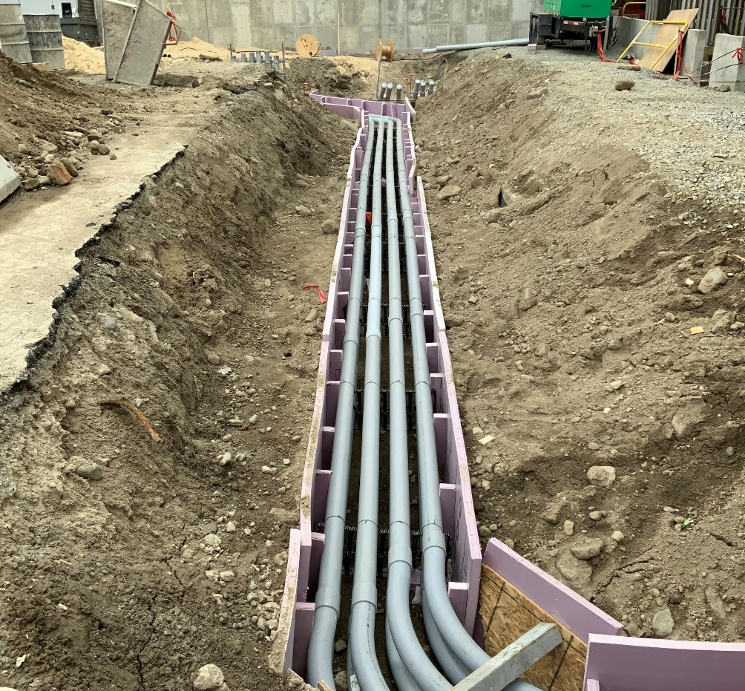
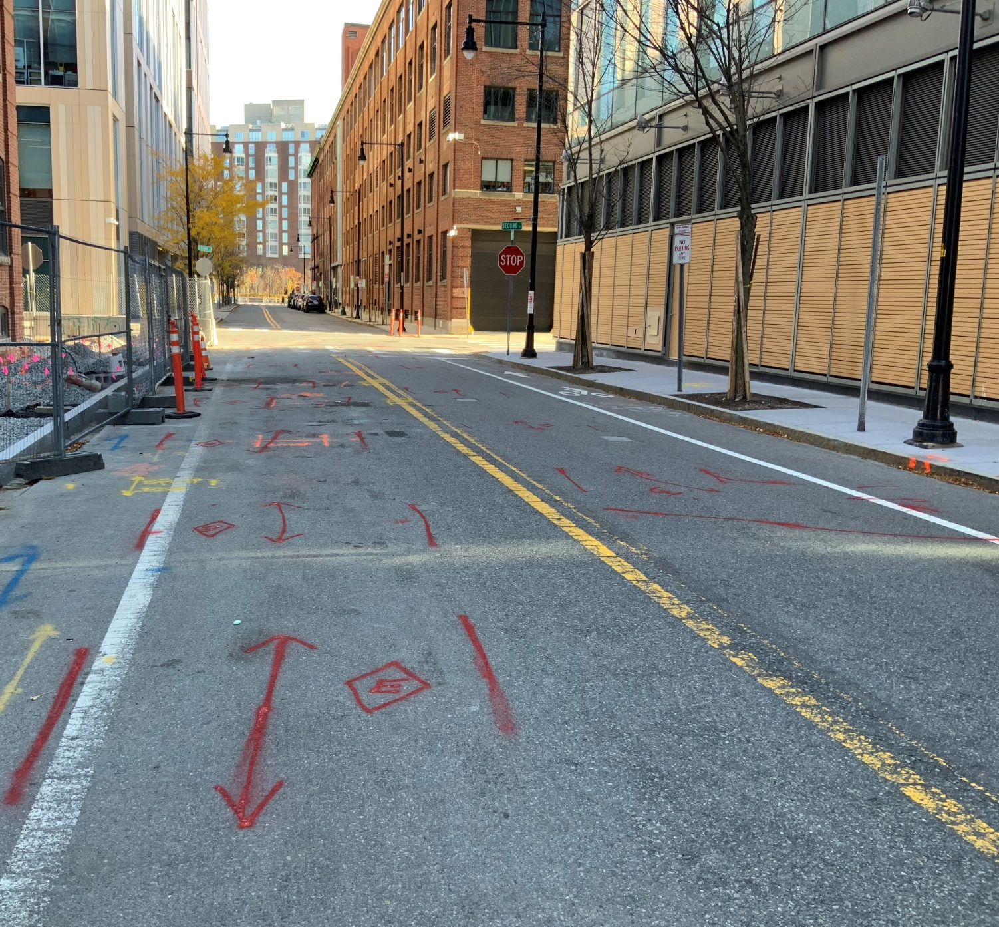
Primary Ductbanks

Slide 11
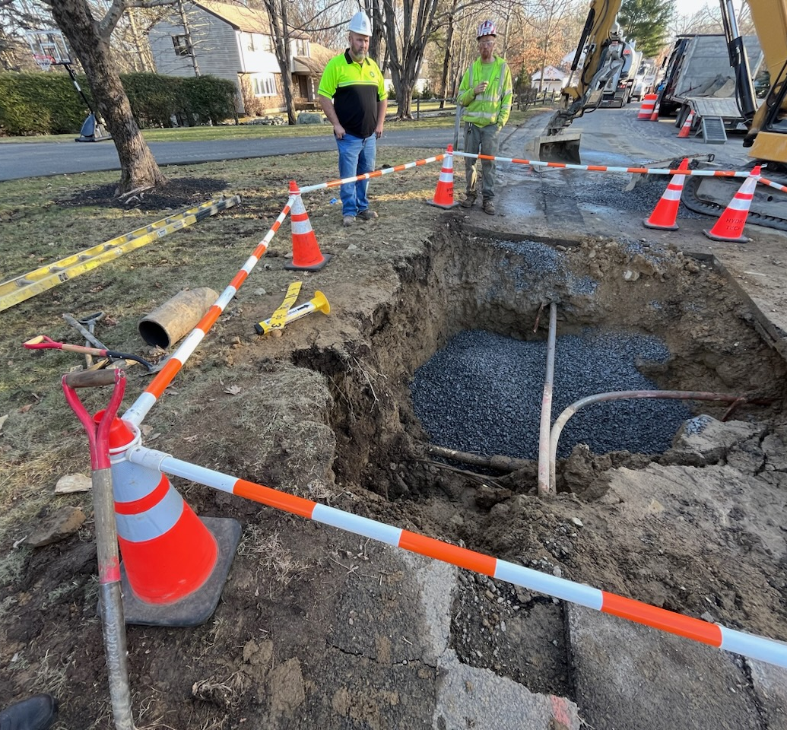
Secondary / Services
Underground secondaries are typically single conduits but occasionally run together
Generally conduit is not encased
House services, streetlights, lamps, etc.

Slide 12
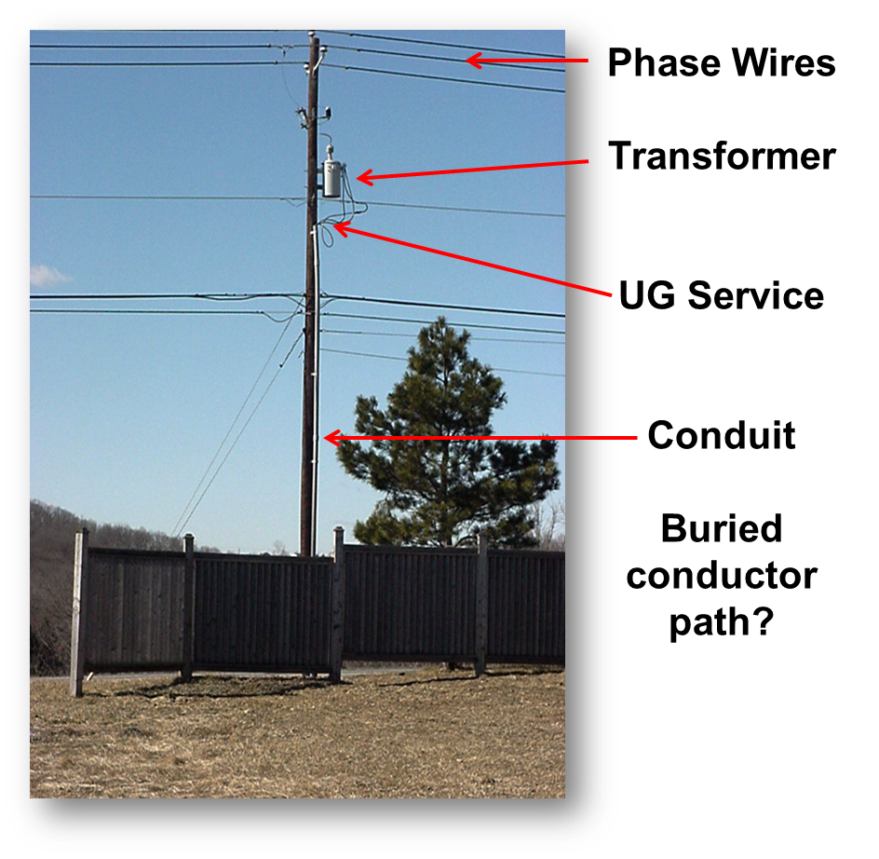
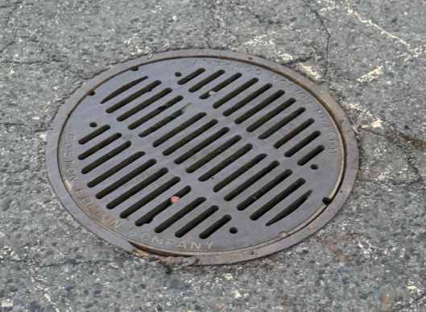
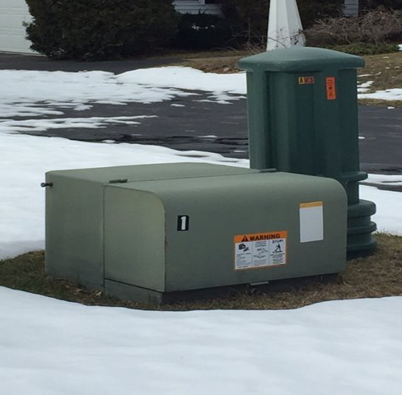
What To Look For

Slide 13
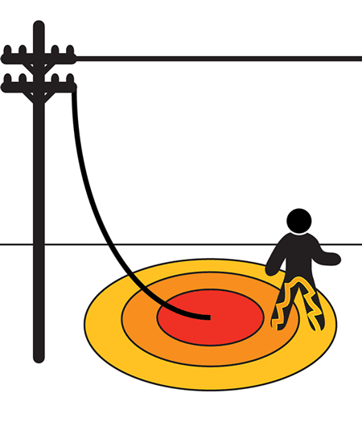
Step Potential
Step potential refers to the voltage difference between your feet when you are standing near a downed power line and your feet are in different rings of electrical current with different voltages
You can be injured without even touching the conductor
Shuffle away from the downed power line. Keep feet together and shuffle while never lifting your feet and keeping them in constant contact

Slide 14
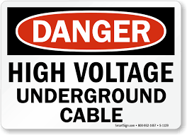
What To Do If An Electric Facility Is Damaged
For any emergency, hazard, or injury immediately dial 911
After ensuring safety of personnel, report the damage to Eversource via phone at
(800)-592-2000
Conduit Group Supervisor / Inspector will be notified and troubleshooters will be dispatched to make area safe for repairs

Slide 15
Contact Information
Matt Paze, Electric Damage Prevention Supervisor
Phone: (617)-541-6238
Email: matthew.pazejr@eversource.com

