Slide 1



February 25, 2025
Think Safe-Be Safe

Slide 2

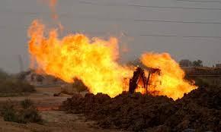

Accidents Happen Be Prepared

Slide 3
“Do’s” When a Gas Line is Damaged
STAY CALM and THINK
STOP EVERYTHING
BLOWING GAS – CALL 911 & GAS COMPANY 413-445-0286 or 413-445-0230
CLEAR THE AREA
  EVACUATE THE BUILDINGS CLOSE TO THE LEAK
REMEMBER: THE FIRE DEPARTMENT IS IN CHARGE OF THE SCENE
DAMAGED PIPE OR DAMAGED TRACER WIRE – CALL GAS COMPANY 413-445-0286 or 413-445-0230

Slide 4
When a Gas Line is Damaged, do NOT:
PANIC!
LOOK IN OR GET IN THE HOLE
ATTEMPT TO STOP THE FLOW OF GAS
OPERATE ANY VALVES ON THE GAS SYSTEM
COVER THE DAMAGE WITH A BUCKET OF EQUIPMENT
ATTEMPT TO REPAIR DAMAGE!!!!
DO NOT BACKFILL!! – Until the gas company has made the repair and gives the OK

Slide 5
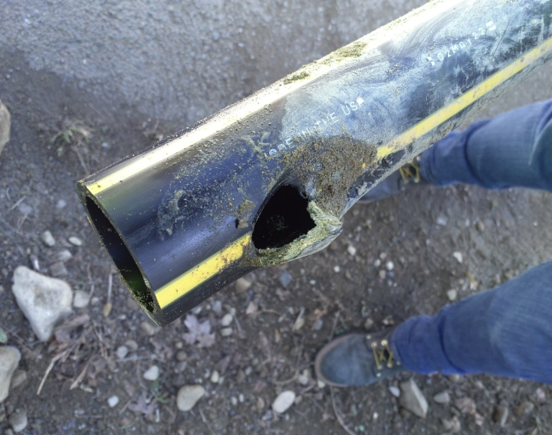
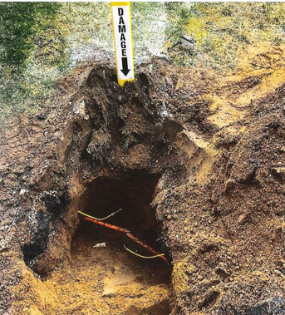
Notify Berkshire Gas if damage to a tracer wire or other facility is known.
Bill Tessier
Damage Prevention Supervisor
(413) 209-1791

Slide 6
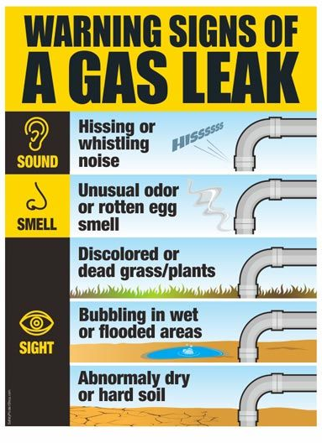

Slide 7
Berkshire Gas Company
Dispatch Center
24/7 Call Direct!
Direct lines:
1-800-292-5012 OR
1-413-445-0230

Slide 8
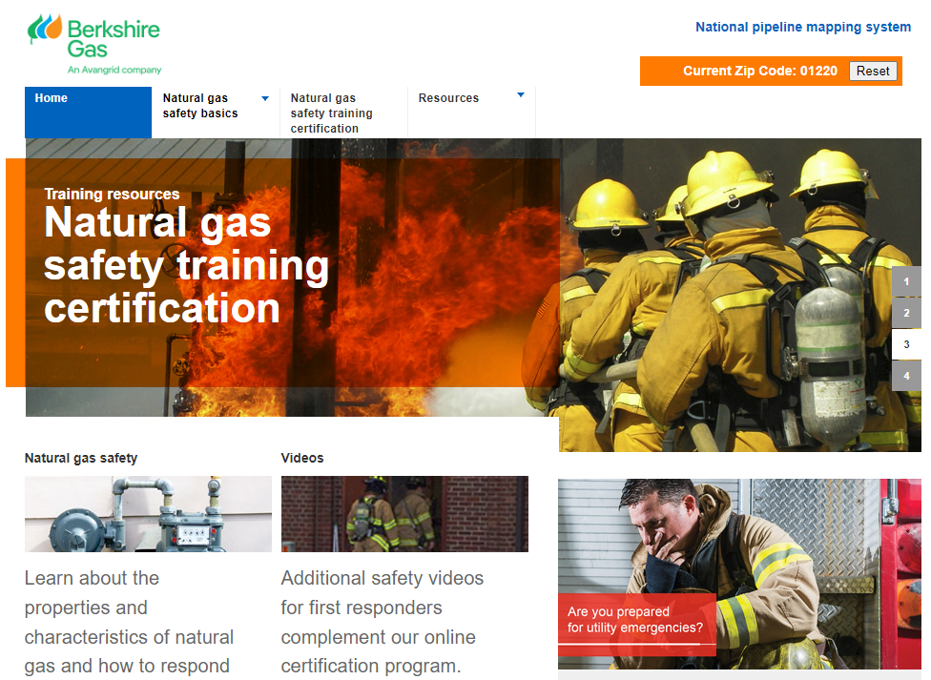
Berkshire Gas along with other Local Distribution Companies (LDC) and the Northeast Gas Association have formed an online training program www.ngafirstresponder.com

Slide 9

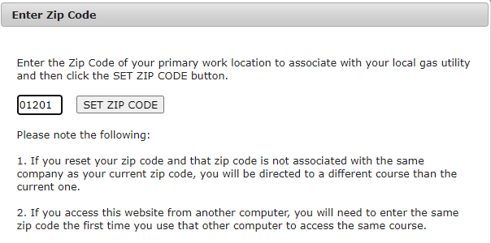
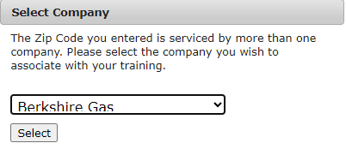
www.ngafirstresponder.com

Slide 10
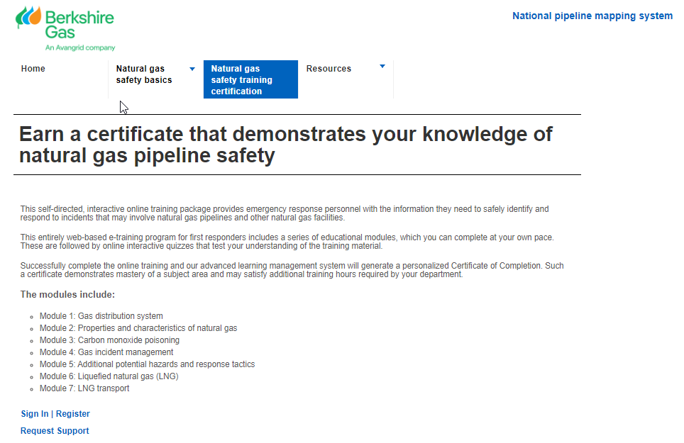
www.ngafirstresponder.com

Slide 11


DISCUSSIONS
Todays Presenters for BGC:
Bill Tessier
Damage Prevention Supervisor
(413) 209-1791
Mike Therrien
Distribution Supervisor-Adams Division

Slide 12
Think Safe-Be Safe

