Slide 1





Slide 2
Properties of Natural Gas
Fossil fuel
Composed primarily of methane
Found beneath coal beds
Non-toxic
Non-corrosive
Lighter than air
Odorless in its natural state (mercaptan added to give identifiable odor)
Colorless
Only becomes an asphyxiant when oxygen is displaced

Slide 3
Explosive Limits of Natural Gas
Flammable Range
0 % GAS
4.5 % GAS
14.5 % GAS
100 % GAS
LEAN
RICH
% GAS

Slide 4
Possible Ignition Sources
    Static electricity
    Thermostats
    Engines
    And more!!
    Other flames (pilot burner, match, cigarette lighter)
    Doorbells, light switches, appliances
    Cell phones, pages, two-way radios
Notes:
Ignition Temperature
Minimum Temperature Needed for a Mixture of Propane and Air to Ignite.
The Ignition Temperature of Propane Is Between 920° F and 1,120° F
A Common Ignition Source for Propane Is Another Flame, Such As the Flame of a Pilot Burner, Match or Cigarette Lighter.

Slide 5
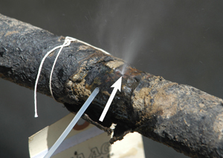
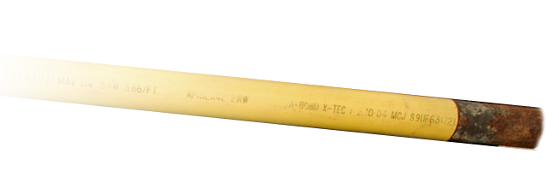
Materials in our systems
Bare and coated steel

Slide 6
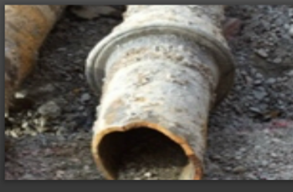
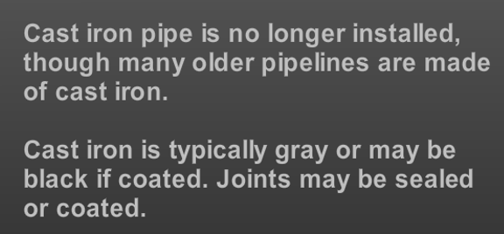
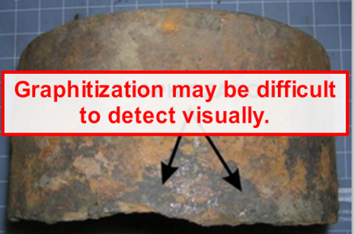
Cast Iron

Slide 7
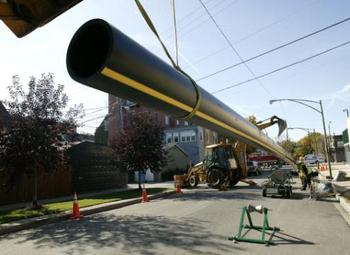
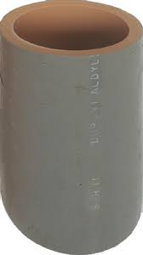
Plastic

Slide 8
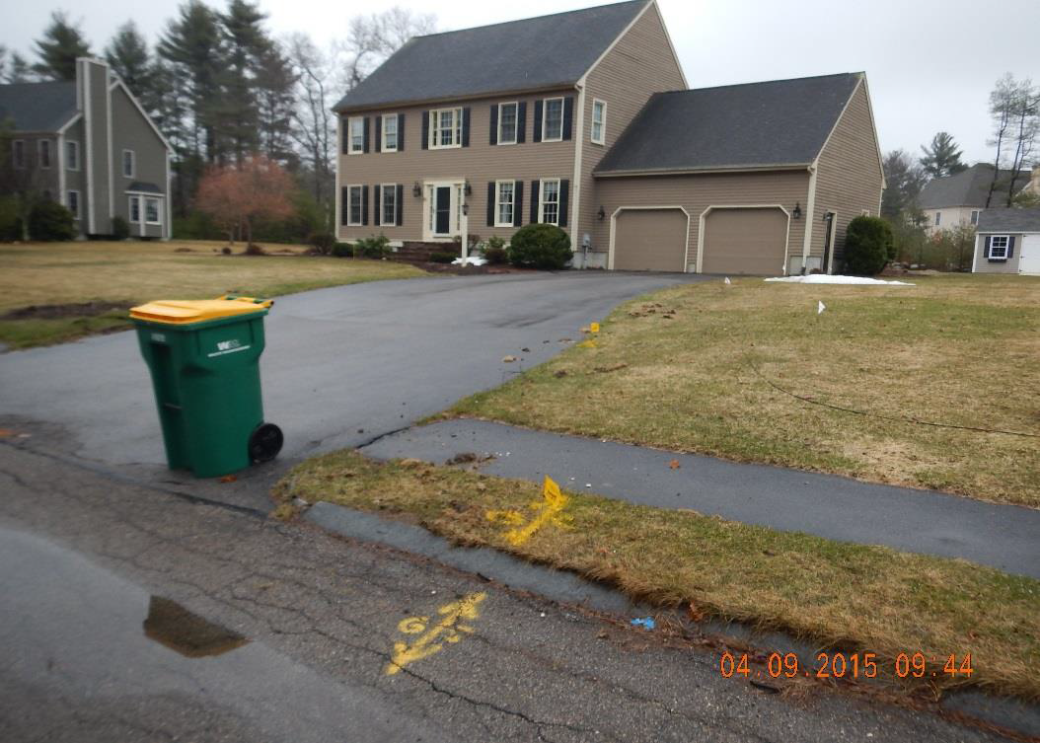
Understanding Service to a House

Slide 9
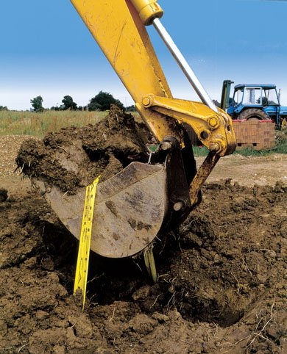
Our greatest risk is third party damage…
Site work
Road Reconstruction
Replacing Utilities
Digging a Foundation
Placing Utility Poles
Routine yard work
Cross-bore damage
Vandalism
Notes:
MOST FREQUENT CAUSES OF ACCIDENTS COME FROM
THIRD PARTY DAMAGES
THEY ARE:

Slide 10
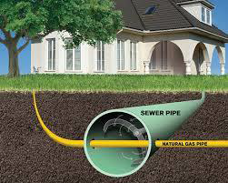
Cross Bore

Slide 11
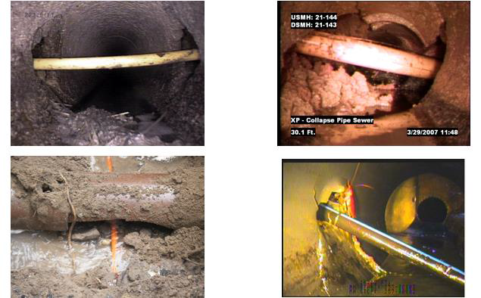
Cross Bore Examples

Slide 12
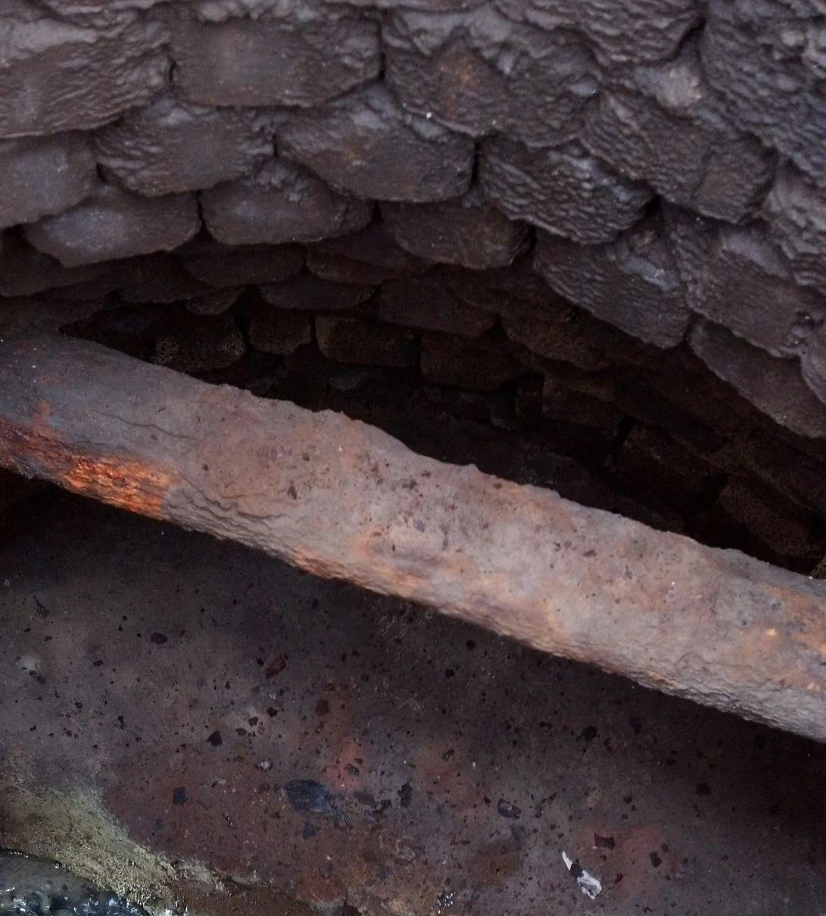
Gas Main through catch basin

Slide 13
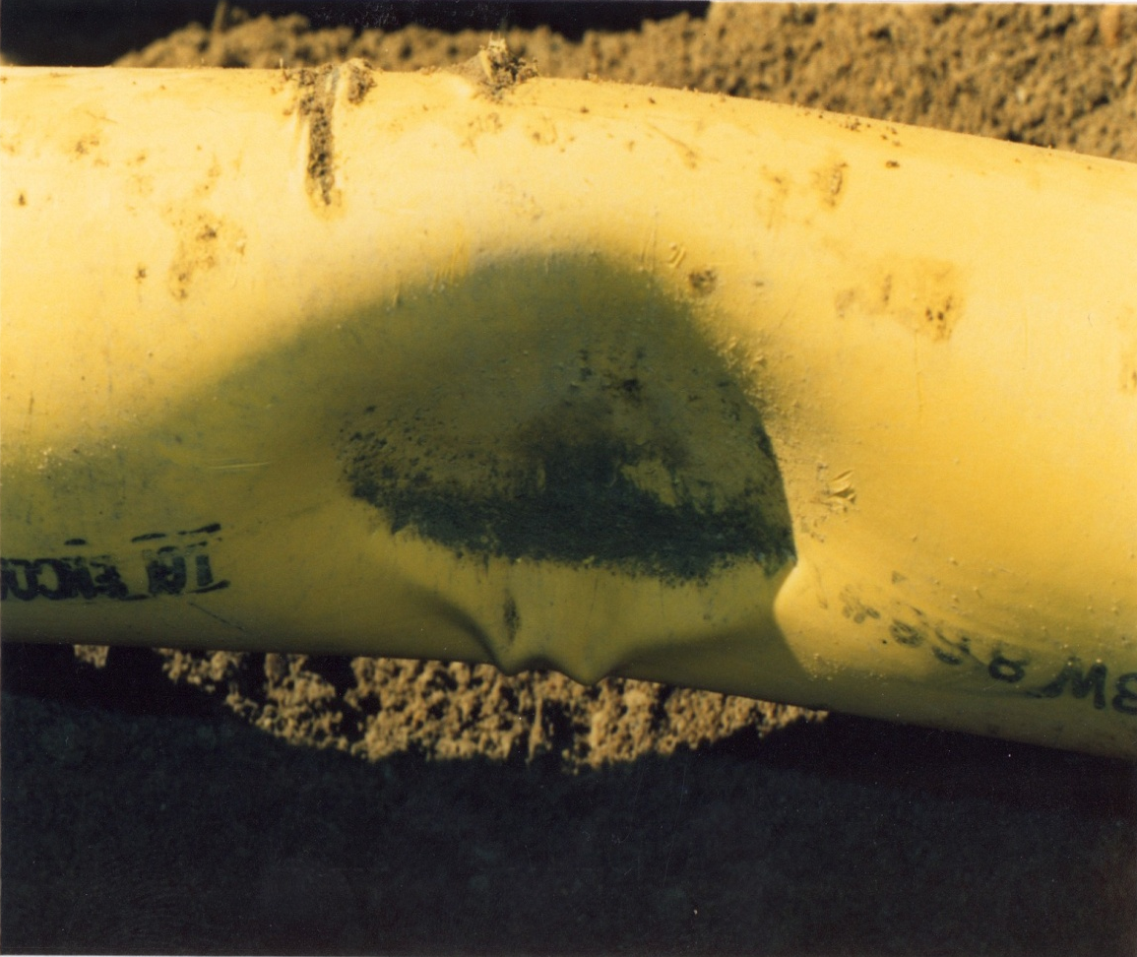
Signs of Damage
Broken tracer wire or warning tape
Coating damage
Dents or gouges
Notes:
Very important that you report all damages to us immediately.
The example here was found by one of our crews long after the damage had occurred. This was discovered while installing a gas service to a near by home. This facility is a 60 lbs main within 50 ft of residential structures; had this failed and leaked the scenario could have been catastrophic.
Report all types of minor of damages such as tape, coating, tracer wire…….. Use the Non-emergency # in your hand out to report minor occurrences.
Use the Emergency number to report major damages such as they example above immediately.

Slide 14
If you damage a gas line…
CALL the gas company
DO NOT ATTEMPT TO REPAIR DAMAGE!
DO NOT BACKFILL!

Slide 15
Signs of a ruptured gas line
  A blowing or hissing sound
  Dust blowing from a hole
  Continuous bubbling in wet area
  A gaseous smell
  Flames, if gas has ignited
Notes:
ACTION -
Scratch and sniff the smell of gas
You may hear gas if it is a high pressure line. Important to realize that you may not hear it.
You may see “heat wave” like shimmer or dust. That could be gas escaping. Important to state again that this may not be evident.
You will smell gas!

Slide 16
If you rupture a gas line…
Evacuate the area!
CALL 911
Call the gas company
Protect the public (evacuate buildings) and prevent the introduction of possible ignition sources
Leave equipment – if it’s on, leave it on; if it’s off, leave it off – just leave if safe to do so
If the gas has ignited, let it burn; do not attempt to put out the fire!

Slide 17
Understanding Excess Flow Valves

Slide 18
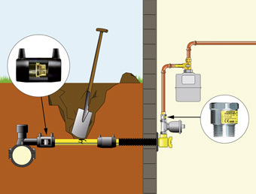
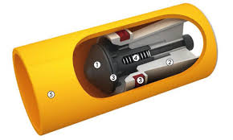
Excess Flow Valves (EFV’s)

Slide 19
Cut Away Look
FLOW

Slide 20
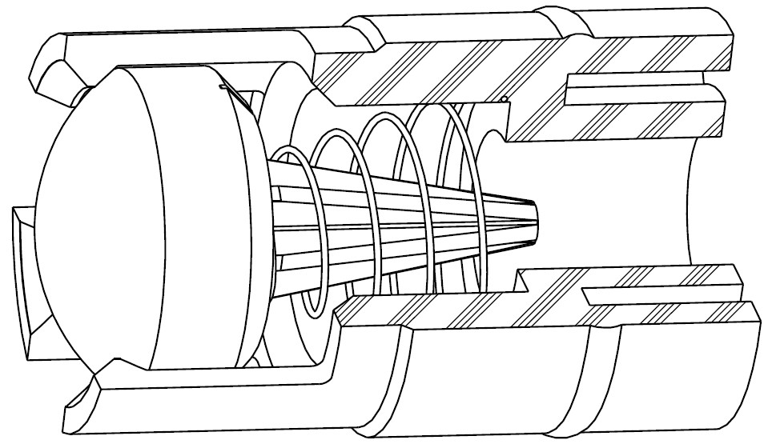
Dresser EFV – Open Position
FLOW

Slide 21
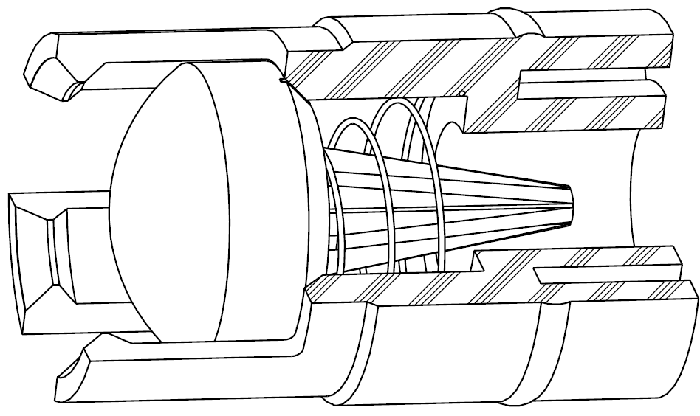
Dresser EFV – Closed Position
FLOW

Slide 22
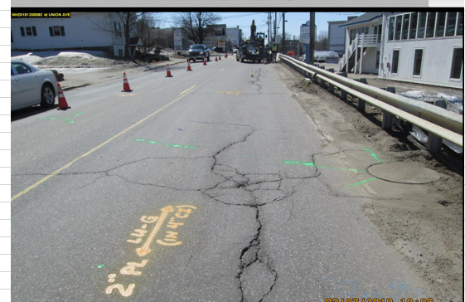
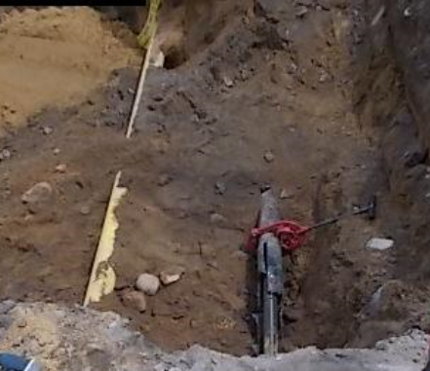
Original Mark Out
Abandoned 4” CS
2” PL inserted 4” CI
The abandoned CS is in better shape than the CI where the 2” PL was inserted. The crew member observed compromised CI condition and put their finger through, did not look inside and determined the abandoned CS was the live pipe and cut the live inserted PL in CI pipe out of the way.

Slide 23
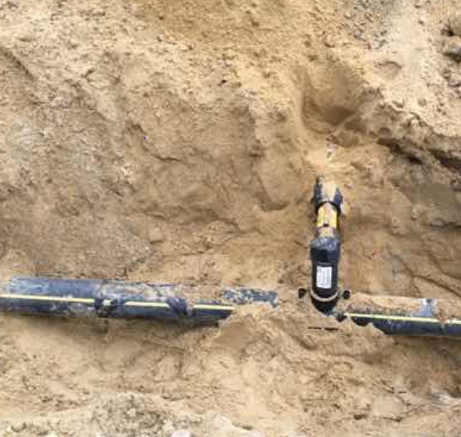
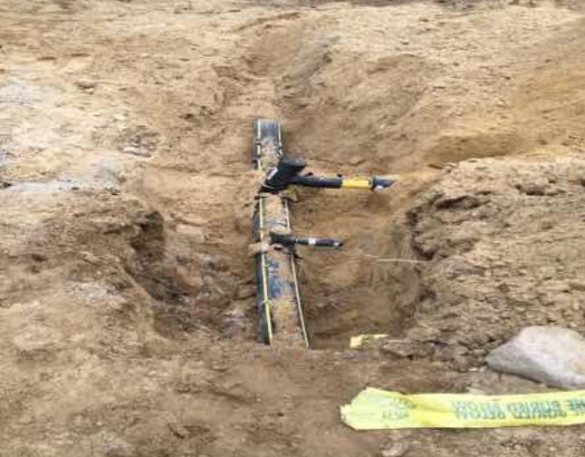
The contractor hand shoveled to expose main. They knew the high volume tee was near and after several attempts of hand digging; crew used the excavator to dig and pulled the T off of the main. Marks were only partially maintained.
Hot & Muggy, crew under production pressure…
Repair hours: 3-man crew, 10 hours, first responders 2-man crew 9 hours - $5,000
Phone call and/or maintaining of the marks would have prevented high profile hit.

Slide 24
Questions / Comments
Thank you
FOR DIGGING SAFELY

