Slide 1



Rhode Island Division of Public Utilities & Carriers
Ken McCarthy
Pipeline Safety Inspector 2
March 4, 2025

Slide 2
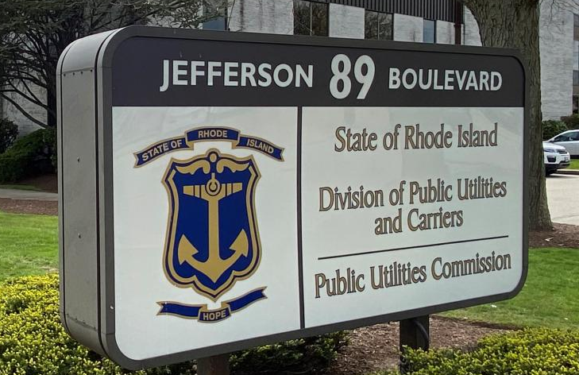
About The Division
Rhode Island Division of Public Utilities and Carriers (RIDPUC)
Program Manager: Robert Bailey, P.E.
Administrative Assistant: Casey Bellows,
Pipeline/One Call Inspectors: (Qty 4)
Raymond Church – Pipeline Safety Inspector 2
Albert Kyei-Poakwa – Pipeline Safety Inspector 2
Ken McCarthy – Pipeline Safety Inspector 2
Collin Slade – Pipeline Safety Inspector 2
Consultant:
Don Ledversis – Pipeline Safety Contractor
Office Location:
89 Jefferson Blvd.
Warwick, RI 02888

Slide 3
WHAT IS A JURISDICTIONAL PROPANE FACILITY?
§ 192.1(b): This part does not apply to-
            (5): “Any pipeline system that transports only petroleum gas or petroleum gas/air mixtures to –
              Fewer than 10 customers, if no portion of the system is located in a public place;
              A single customer, if the system is located entirely on the customer’s premises (no matter if a portion of the system is located in a public place).

Slide 4
Jurisdictional System:
More than one customer from a single source in a public place

Slide 5
Public place?
Public place :
means a place which is generally open to all persons in a community as opposed to being restricted to specific persons. Churches, schools, and commercial buildings (condo units) as well as any publicly owned rights-of-way or property, which, if frequented by persons, are public places.

Slide 7
Jurisdictional System:
10 or more customers from a single source (source can be a single tank or tanks manifolded together). The location does not matter.

Slide 8
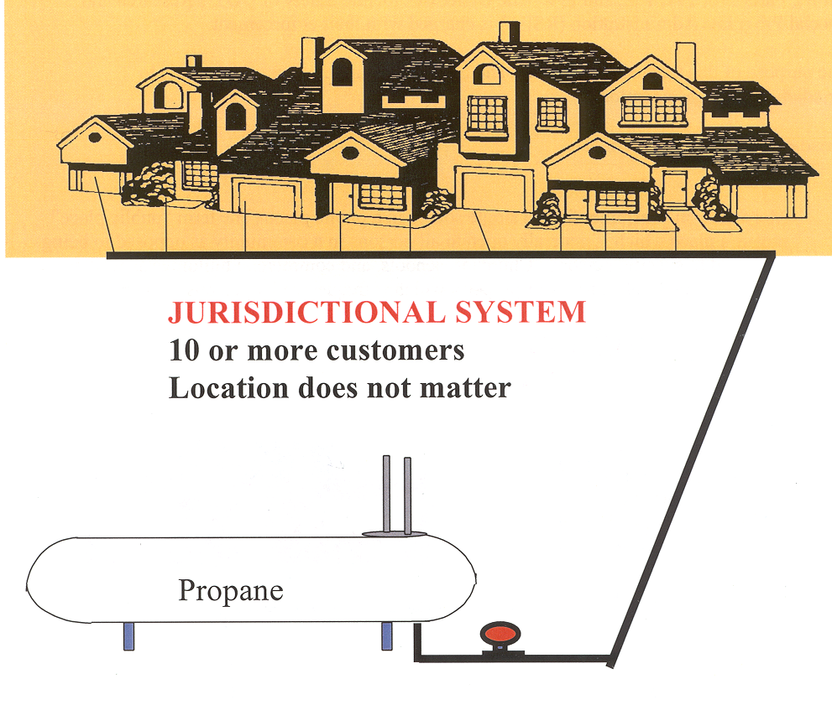

Slide 9
Non-jurisdictional system:
A single customer if the system is located entirely on the customer’s premises (no matter if a portion of the system is located in a public place).

Slide 10
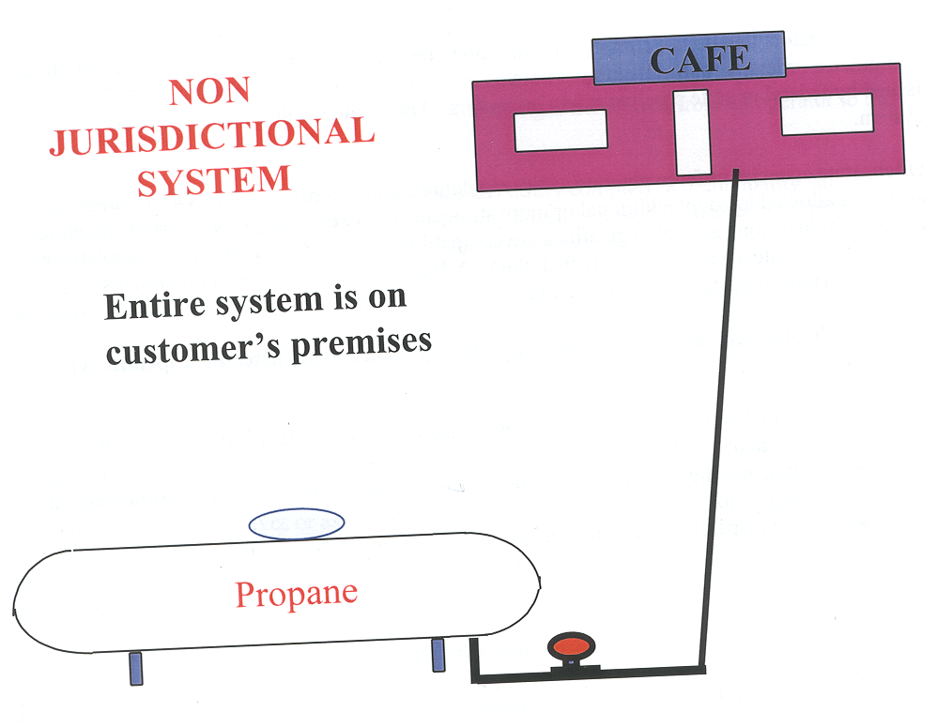

Slide 11
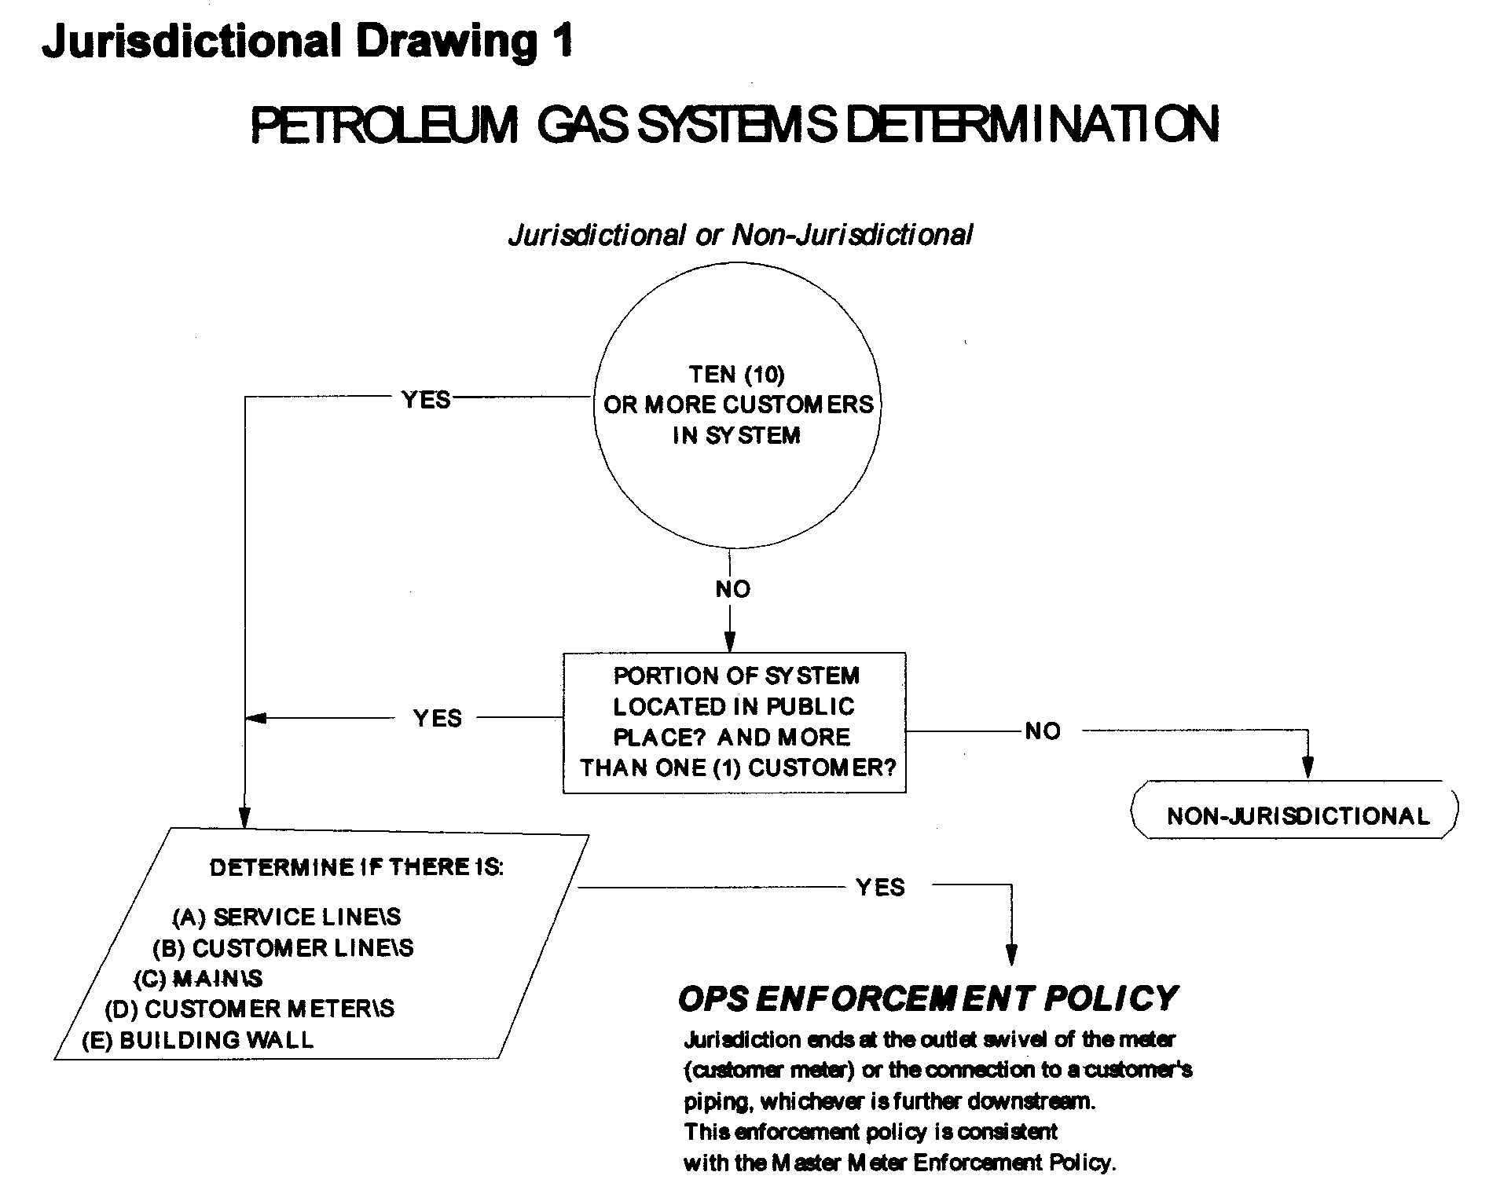

Slide 12
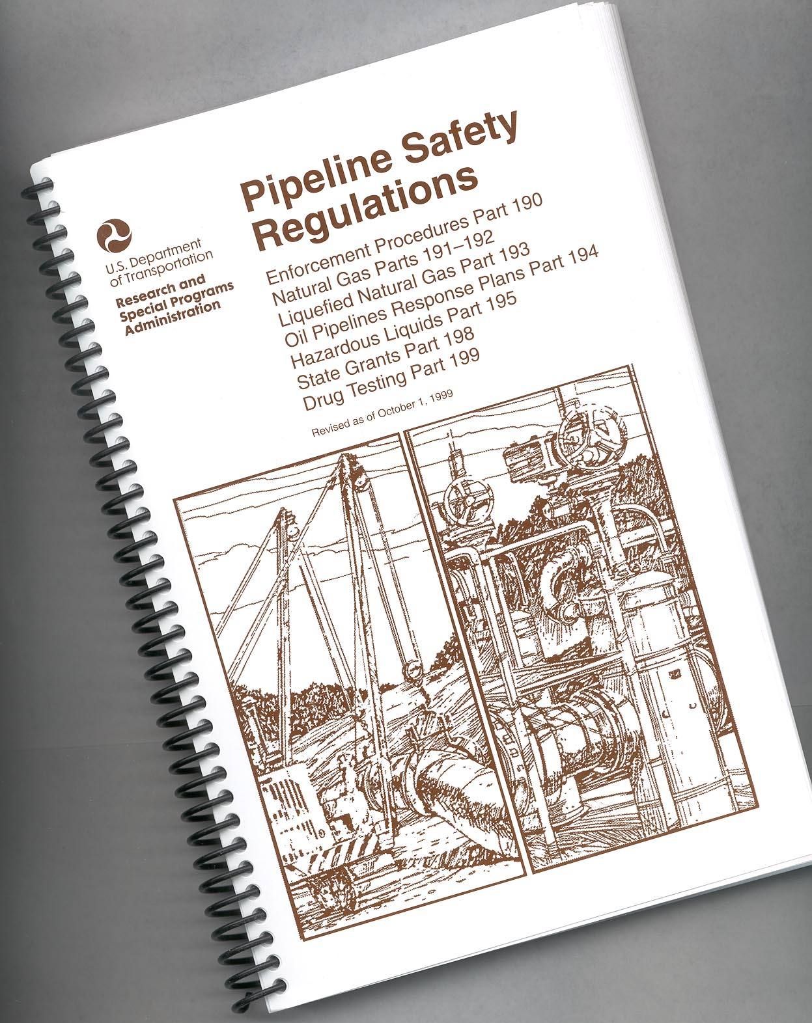
Federal Code CFR 190–192
NEPA 58

Slide 13
Key Regulatory Requirements
Part 192§ 192.11(b): must meet requirements of this part and NFPA 58
§ 192.11(c): in event of conflict, NFPA 58 prevails

Slide 14
7 Areas of Compliance
1. O&M Plan
2. Emergency Plan
3. Cathodic Protection
4. Atmospheric Protection
5. Key Valve Maintenance
6. Gas Leak Survey & Sniff Tests
7. Operator Qualification Plan

Slide 15
1. O & M : §192.605(a)
(a) General. Each operator shall prepare and follow for each pipeline, a manual of written procedures for conducting operations and maintenance activities and for emergency response. For transmission lines, the manual must also include procedures for handling abnormal operations. This manual must be reviewed and updated by the operator at intervals not exceeding 15 months, but at least once each calendar year. This manual must be prepared before operations of a pipeline system commence. Appropriate parts of the manual must be kept at locations where operations and maintenance activities are conducted.

Slide 16
2. Emergency Plan: §192.615(a) a) Written procedures should state the purpose and objectives of the operator's emergency plan and provide the basis for instructions to their appropriate personnel. The objective of the plan should be to ensure that operator personnel who could be involved in an emergency are prepared to recognize and deal with the situation in an expeditious and safe manner.

Slide 17
3. Cathodic Protection: §192.463 External
Corrosion Control: (a) Each cathodic protection system required by this subpart must provide a level of cathodic protection that complies with one or more of the applicable criteria contained in Appendix D of this part. If none of these criteria is applicable, the cathodic protection system must provide a level of cathodic protection at least equal to that provided by compliance with one or more of these criteria.

Slide 18
4. Atmospheric Protection:
CFR 49 192.479 Atmospheric corrosion control: General
CFR 49 192.481 Atmospheric corrosion control: Monitoring
CFR 49 192.491 Corrosion control records

Slide 19
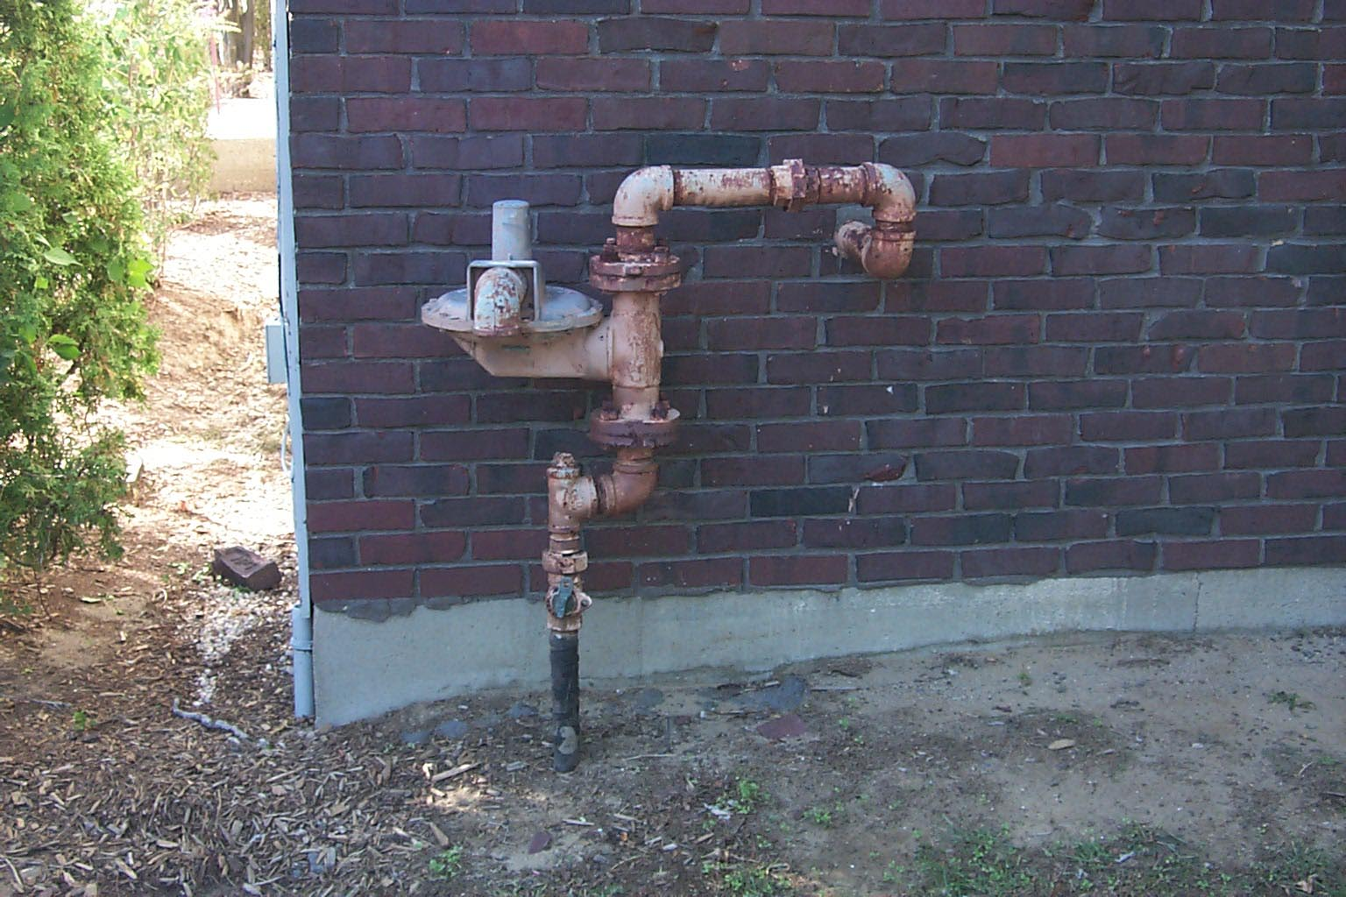
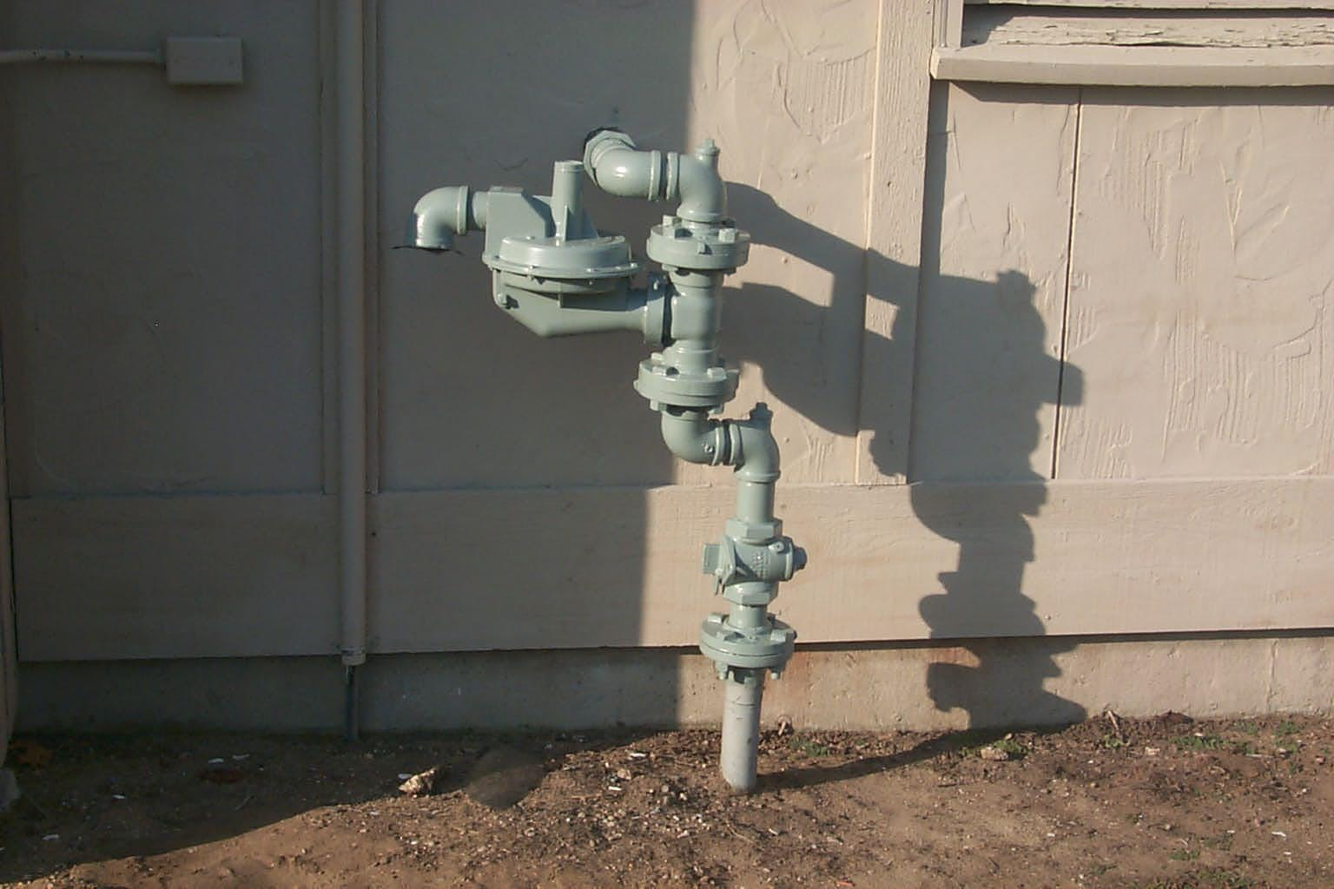
Before
After

Slide 20
5. Key Valve Maintenance. § 192.747
Inspection and Maintenance
Precautions
Inoperable Valves
Identification and record verification

Slide 21
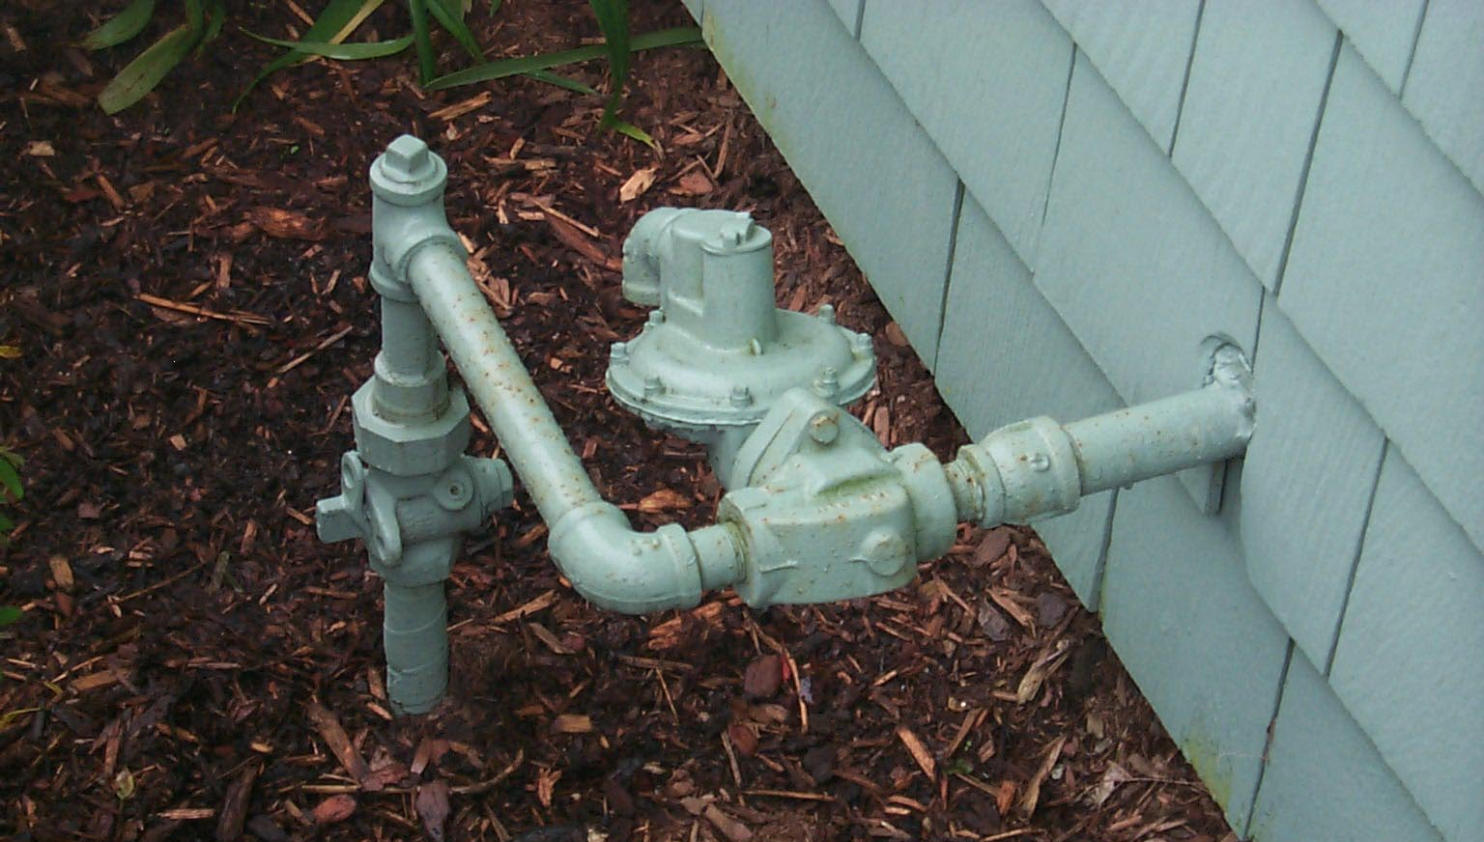
Sample of Above-Ground Key Valve

Slide 22
6. Leak Survey. § 192.723
(a) Each operator of a distribution system shall conduct periodic leakage surveys.
(b) (1) A leakage survey with leak detector equipment must be conducted in business districts at intervals not exceeding 15 months, but at least once each calendar year.
(b) (2) A leakage survey with leak detector equipment must be conducted outside business districts as frequently as necessary, but at least once every 5 calendar years at intervals not exceeding 63 months.

Slide 23
SNIFF TESTS
(a) A combustible gas in a distribution line must contain a natural odorant or be odorized so that at a concentration in air of one-fifth of the lower explosive limit, the gas is readily detectable by a person with a normal sense of smell.

Slide 24
(f) To assure the proper concentration of odorant in accordance with this section, each operator must conduct periodic sampling of combustible gases using an instrument capable of determining the percentage of gas in air at which the odor becomes readily detectable. Operators of master meter systems may comply with this requirement by-
(1) Receiving written verification from their gas source that the gas has the proper concentration of odorant; and
(2) Conducting periodic "sniff" tests at the extremities of the system to confirm that the gas contains odorant.

Slide 25
7. OPERATOR QUALIFICATION §192.805
Each operator shall have and follow a written qualification program. The program shall include provisions to:
Identify covered tasks;
(b) Ensure through evaluation that individuals performing covered tasks are qualified;

Slide 26
PLUMBERS and/or MASTER PIPE FITTERS ARE NOT QUALIFIED TO DO GAS SAFETY WORK ON ANY PHMSA REGULATED FACILITY!
DIFFERENT RULES
DIFFERENT CODES!!

Slide 27


Damage Prevention
By Federal Law as of May 18, 1998, all Jurisdictional propane operators in RI ____
be member of Dig Safe

Slide 28
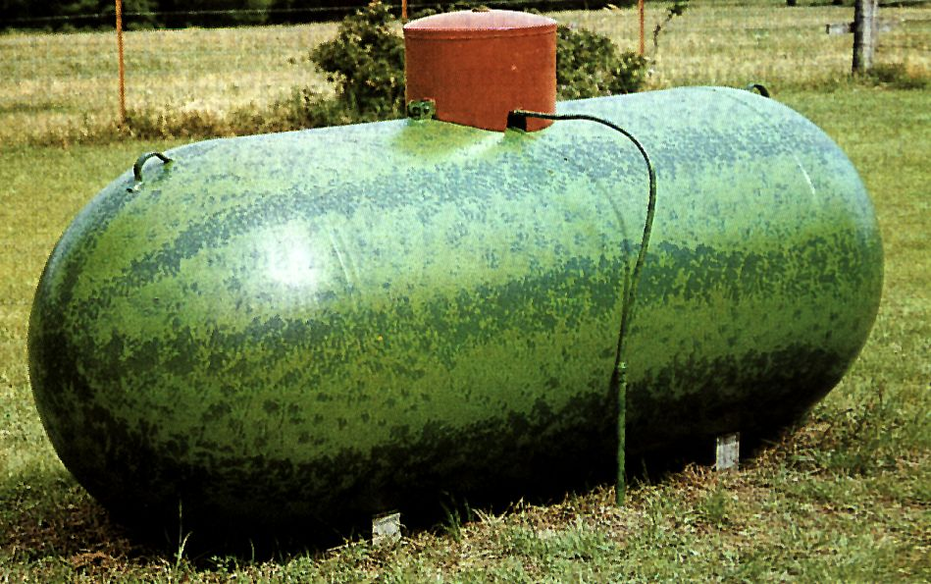
THINGS WE SEE WHILE INSPECTING

Slide 29
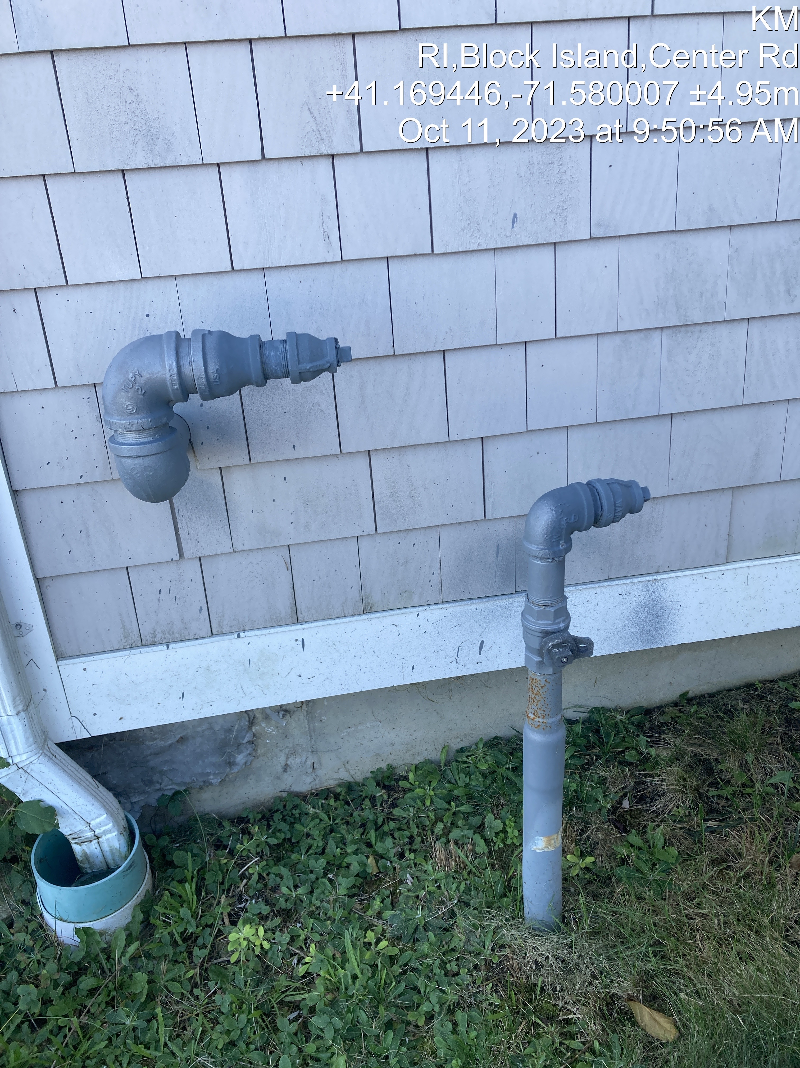
Block Island Airport 2023

Slide 30
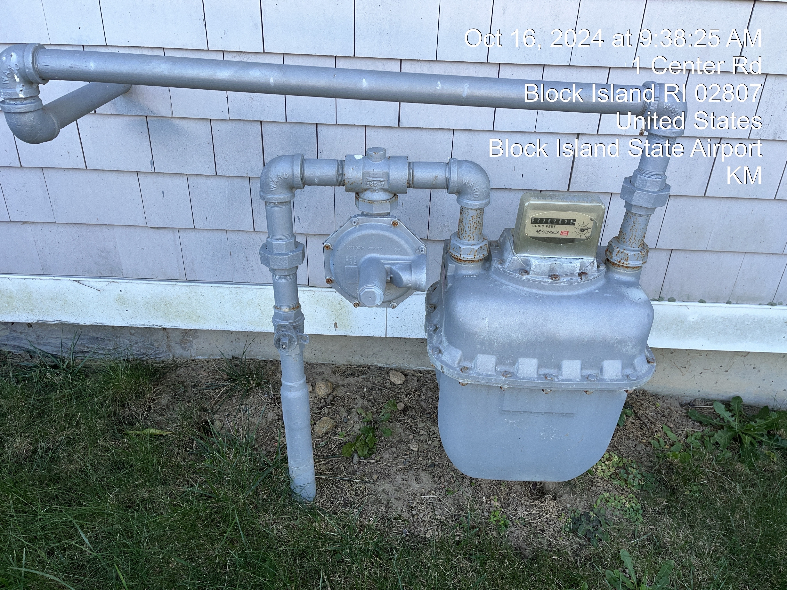
Block Island Airport 2024

Slide 31
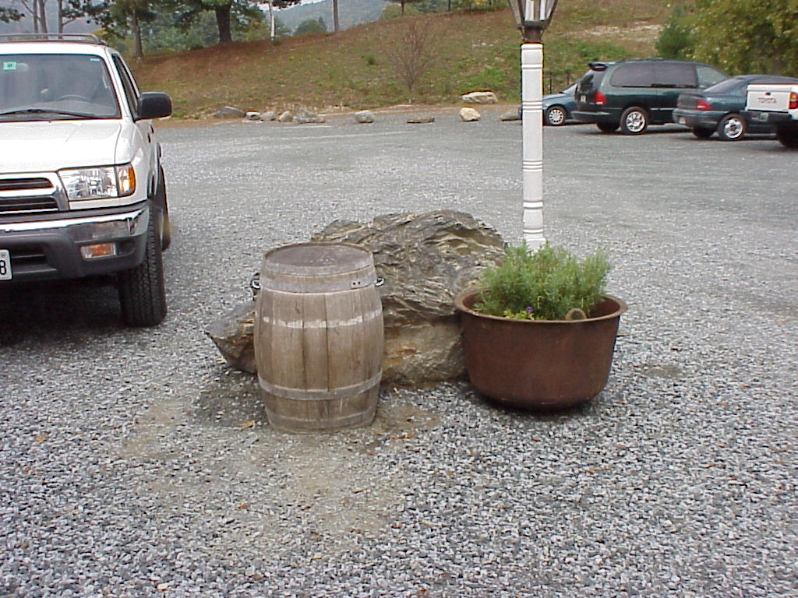
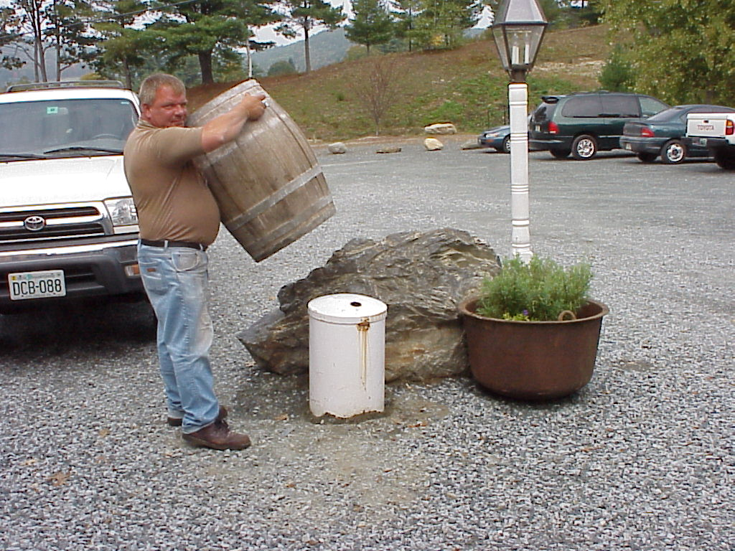
HIDDEN
FOR APPEARANCE

Slide 32
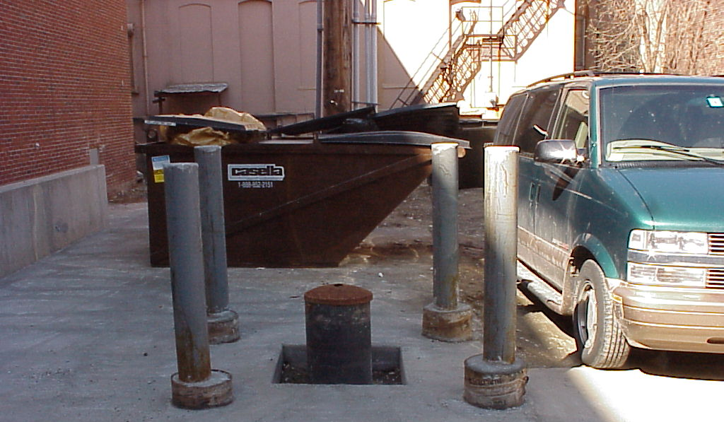

Slide 33
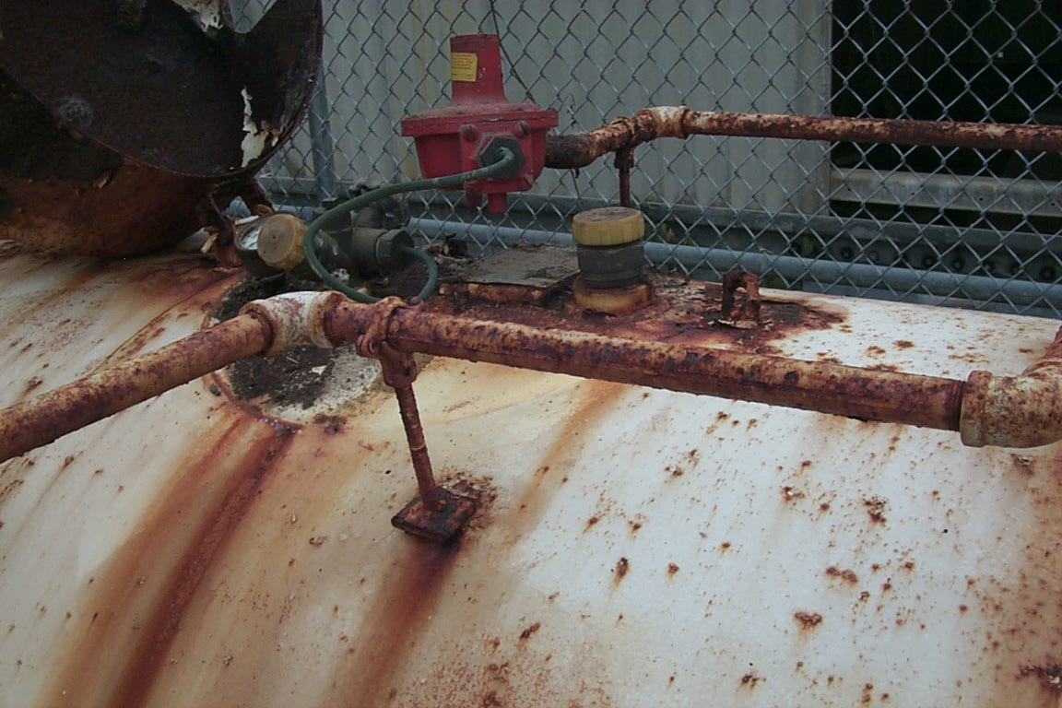

Slide 34
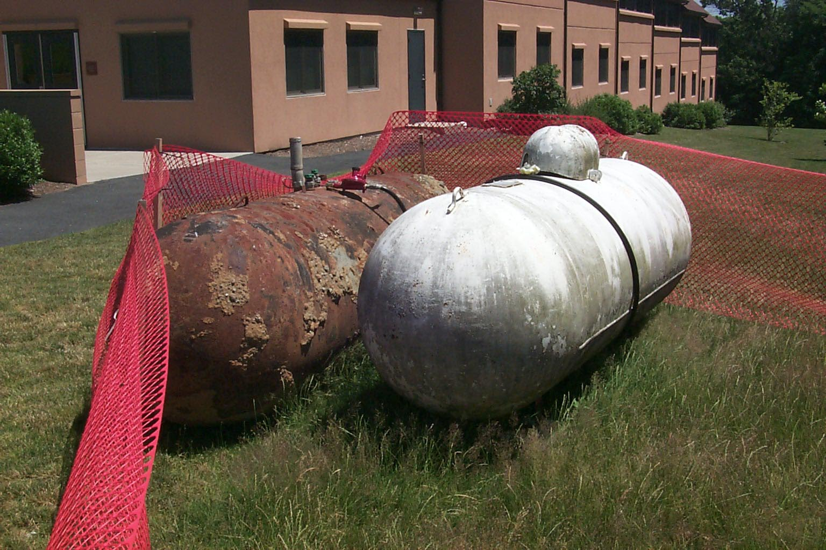

Slide 35
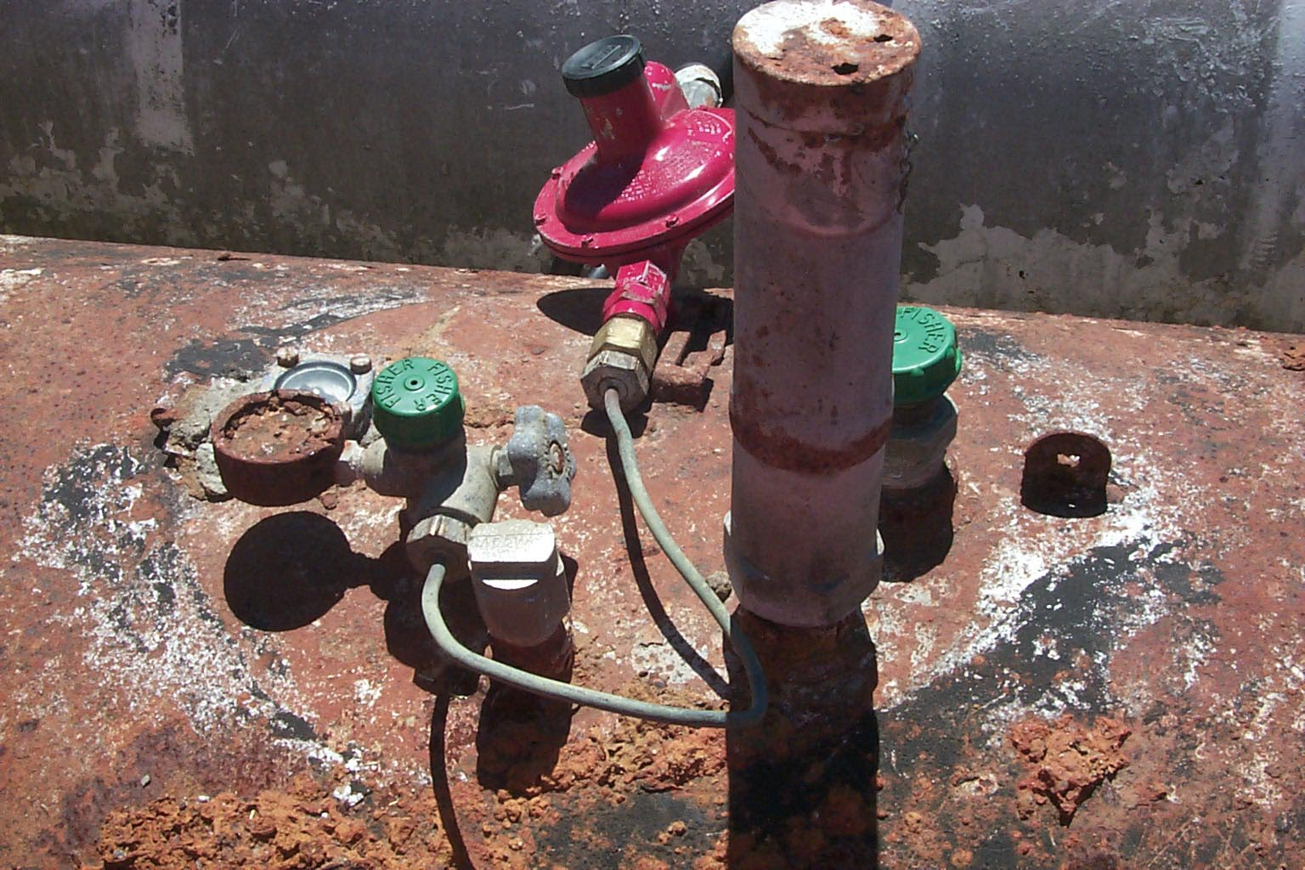

Slide 36
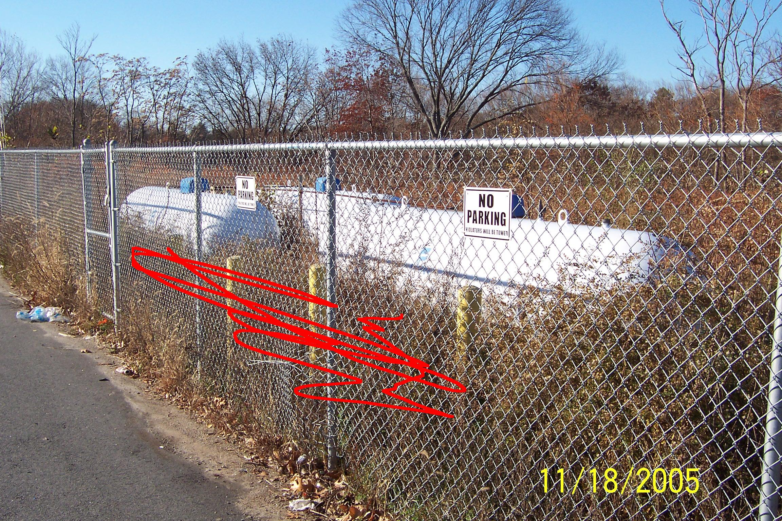
Vegetation

Slide 37
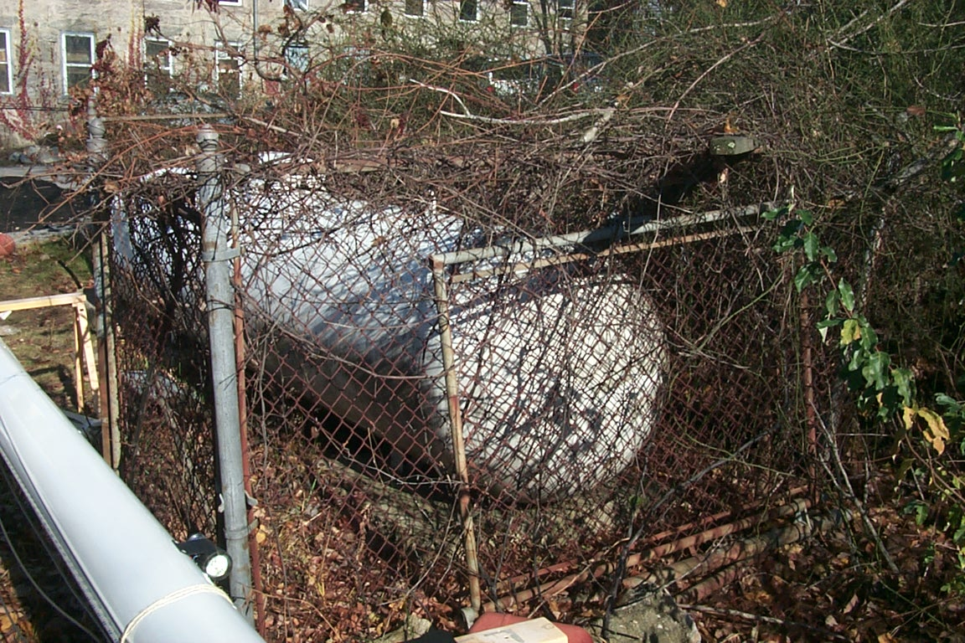

Slide 38
Propane BLEVE
B – Boiling
L – Liquid
E – Expanding
V – Vapor
E – Explosion

Slide 39
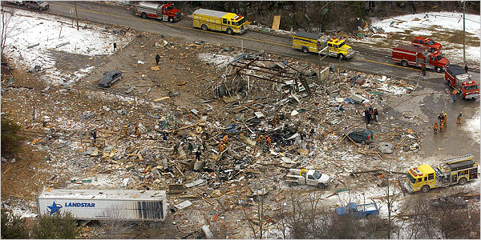
West Virginia – 4 Dead

Slide 40
QUESTIONS?
Ken.McCarthy@dpuc.ri.gov
(401) 780-2124
ripuc.ri.gov

