Slide 1
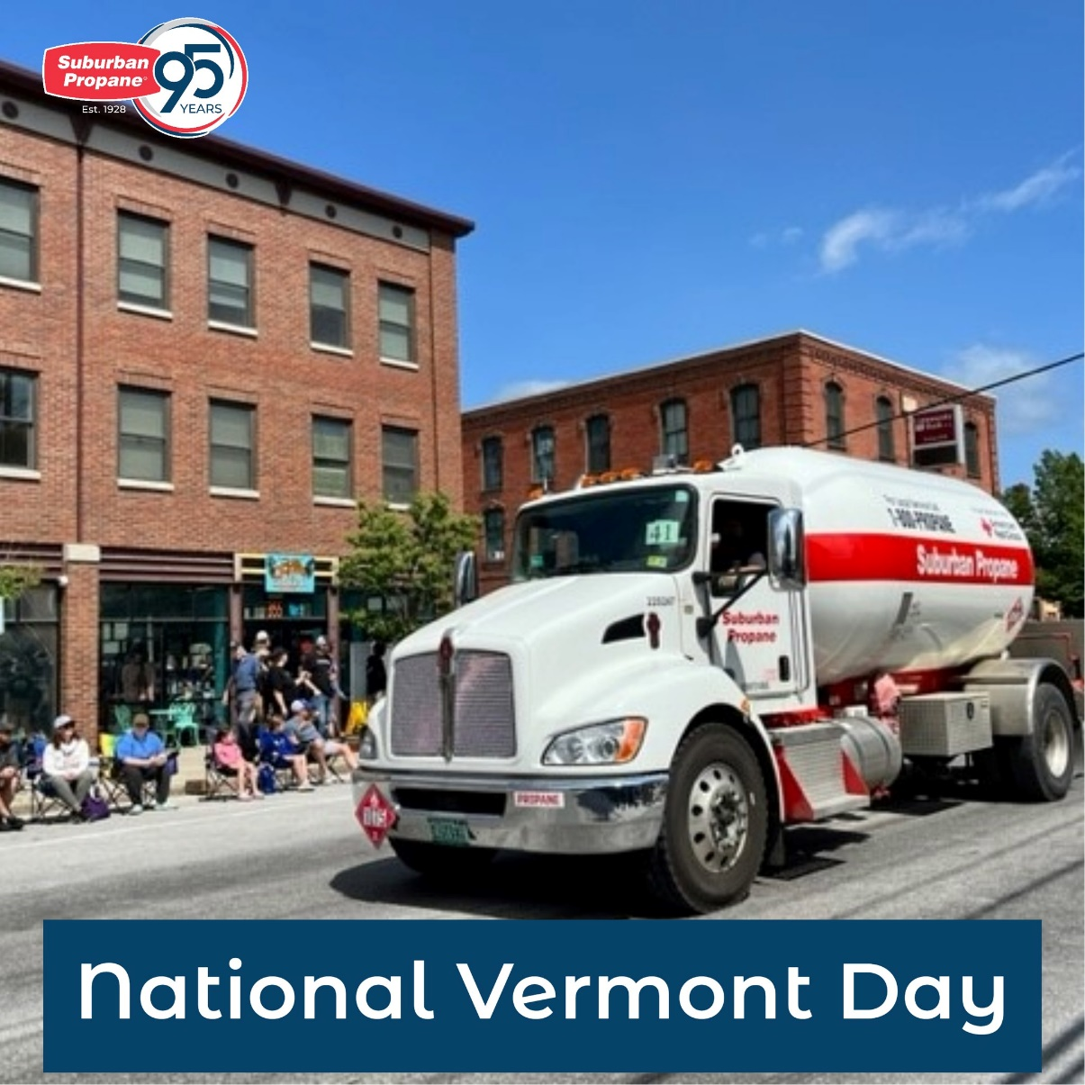
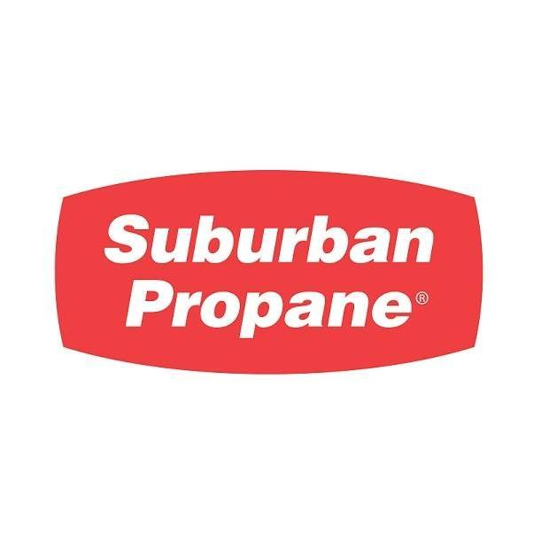
Propane Safety
Presented By

Slide 2

Please call
Dig Safe At
1- Before You Dig. 2- It's Smart.
3- It's Free. 4- It's the Law.
Notes:
Read & Show

Slide 3
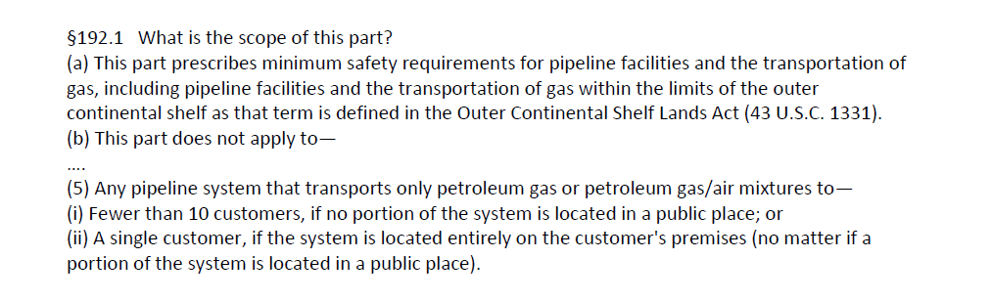
When would a Propane Systems be marked out?

Slide 4
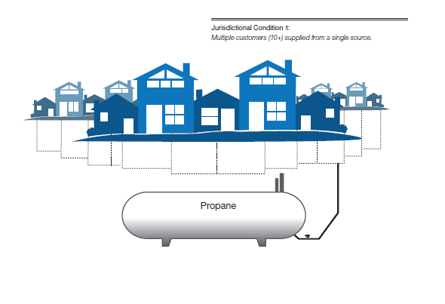

Slide 5
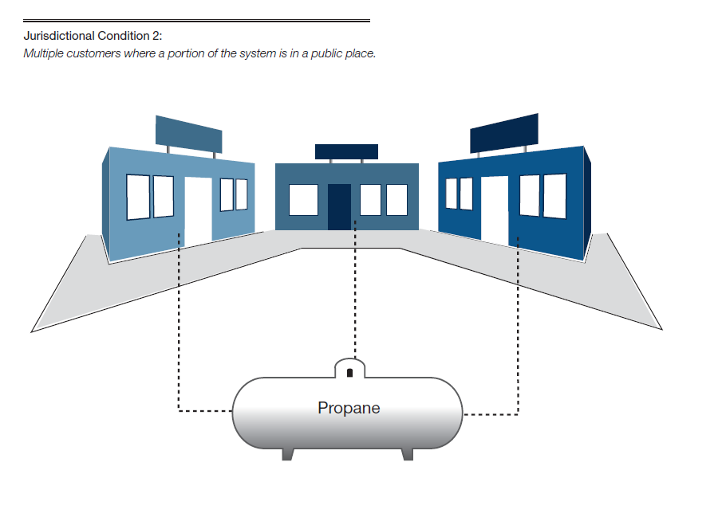

Slide 6
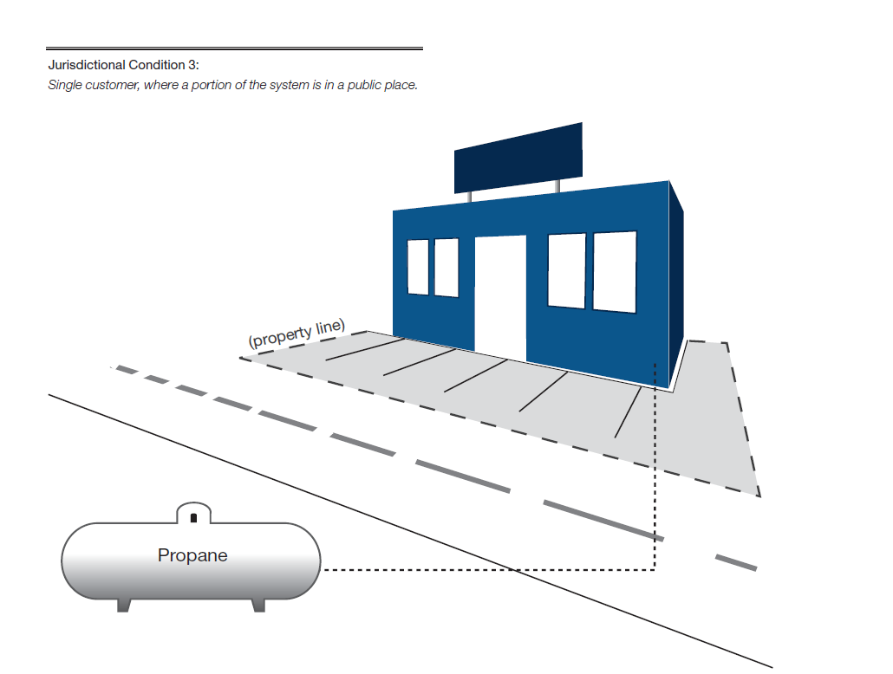

Slide 7
Managing Underground Safety
Before digging at a propane site there are three things you need to know!!!
* Physical Properties of Propane
  How to shut off the propane tank if necessary.
  The name and phone number of the propane supplier.
  And one thing you must do!!!
  Call Dig Safe

Slide 8
Physical Properties Of LP-Gas
Tasteless
Colorless
Usually Odorless
  A commercial odorant called Ethyl Mercaptan is added so that propane can be detected if leaks occur. The formula is 1lb of Mercaptan to 10,000 gallons of propane.
Mixed With The Proper Amount Of Air They Can Burn
LP-gases Are Capable Of Being Either A Liquid Or Gas
Under Outdoor Temperatures LP-Gas Expands Rapidly
  One Cubic Foot Of Propane Liquid Expands Into 270 Cubic Feet Of Propane Gas
Notes:
Physical Properties of LP-Gas
Tasteless
Colorless
Usually Odorless
Mixed With The Proper Amount Of Air They Can Burn
LP-gases Are Capable Of Being Either A Liquid Or Gas
Under Outdoor Temperatures LP-Gas Expands Rapidly
One Cubic Foot Of Propane Liquid Expands Into 270 Cubic Feet Of Propane Gas

Slide 9
Specific Gravity Of Liquids
The Specific Gravity of a Liquid Is the Comparison of the Weight of a Given Volume of One Liquid at a Certain Temperature With the Weight of the Same Volume of Water at the Same Temperature.
Commercial Propane.
  Specific Gravity of Liquid at 60°F is 0.504 (Water = 1)
Notes:
SPECIFIC GRAVITY OF LIQUIDS
The specific gravity of a liquid is the comparison of the weight of a given volume of one liquid at a certain temperature with the weight of the same volume of water at the same temperature.
For example, if the specific gravity of a liquid at 60° F is 3.0, then a given volume of that liquid at 60° F is 3 times as heavy as the same volume of water at 60° F.
In the case of propane liquid, the average specific gravity is 0.504 at 60° F. This means that propane liquid is a little more than one-half the weight of water at 60° F.
When propane is delivered to the plant, the liquid specific gravity of propane is normally marked on the bill of lading. Since different liquids have different specific gravities, this value is used to ensure that the delivery is in fact propane liquid.
The specific gravity of propane liquid is also used to determine the amount of propane liquid being delivered.

Slide 10
Vapor Density
Vapor Density Is the Comparison of the Weight of a Given Volume of a Gas at a Certain Temperature With the Same Volume of Air at the Same Temperature.
Propane Vapor Has a Vapor Density of 1.50 at 60° F
Propane Vapor Is About 1.5 Times Heavier Than Air (Air=1.00)
Since PROPANE is heavier than air disbursement takes longer than with other gases.
Notes:
Vapor Density
Vapor density is the comparison of the weight of a given volume of a gas at a certain temperature with the same volume of air at the same temperature. Propane vapor has a vapor density of 1.50 at 60° F.
The important point to remember is that propane vapor is about 1.5 times heavier than air (air=1.00).
If a leak develops in a gas line or container propane readily dissipates. However, under the right conditions, propane gas may settle in low unventilated areas and can become concentrated if there is little or no air movement

Slide 11
Flammable Limits
The Upper Limit Is the Percentage of Gas in the Richest (Most Gas) Mixture That Will Support Combustion.
The Lower Limit Is the Percentage of Gas in the Leanest (Least Gas) Mixture That Will Support Combustion.
Lower Limit
Upper Limit
0%
100%
2.15
Ref. Commercial Propane
9.60
Notes:
Flammable Limits
The Upper Limit Is the Percentage of Gas in the Richest (Most Gas) Mixture That Will Support Combustion.
The Lower Limit Is the Percentage of Gas in the Leanest (Least Gas) Mixture That Will Support Combustion.

Slide 12
Ignition Temperature
Minimum Temperature Needed for a Mixture of Propane and Air to Ignite.
  The Ignition Temperature of Propane Is Between 920° F and 1,120° F
  A Common Ignition Source for Propane Is Another Flame, Such As the Flame of a Pilot Burner, Match or Cigarette Lighter.
Notes:
Ignition Temperature
Minimum Temperature Needed for a Mixture of Propane and Air to Ignite.
The Ignition Temperature of Propane Is Between 920° F and 1,120° F
A Common Ignition Source for Propane Is Another Flame, Such As the Flame of a Pilot Burner, Match or Cigarette Lighter.

Slide 13
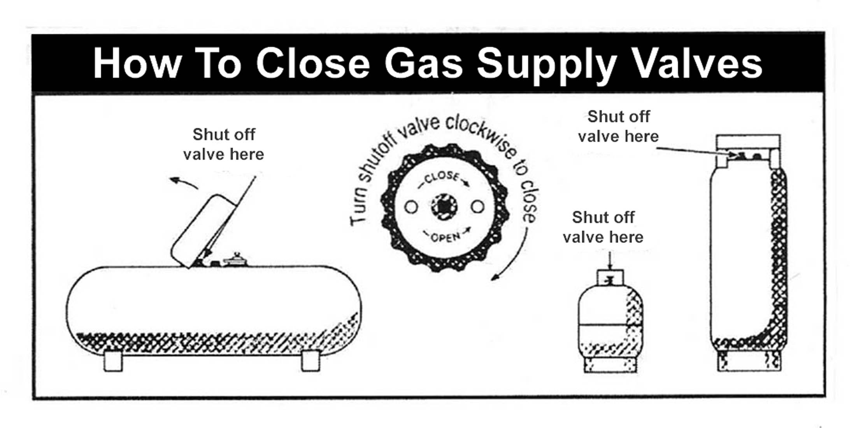
SHUTTING OFF PROPANE SUPPLY
Notes:
Find the shutoff.
Find the company name near the shutoff or on the front/side of the tank.

Slide 14
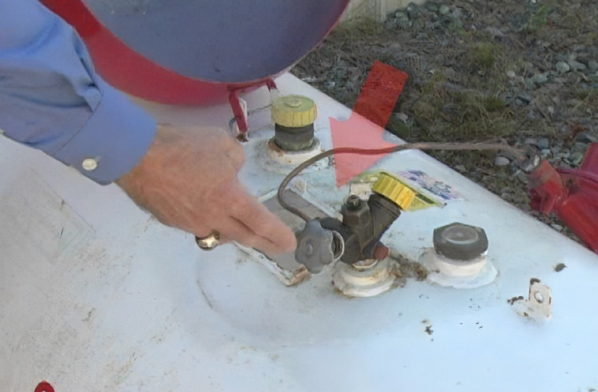
Notes:
Location of shutoff’s are on the top of the tanks ,regardless of if they are above ground or underground. Here is a Technician demonstrating the location on a above ground tank !

Slide 15
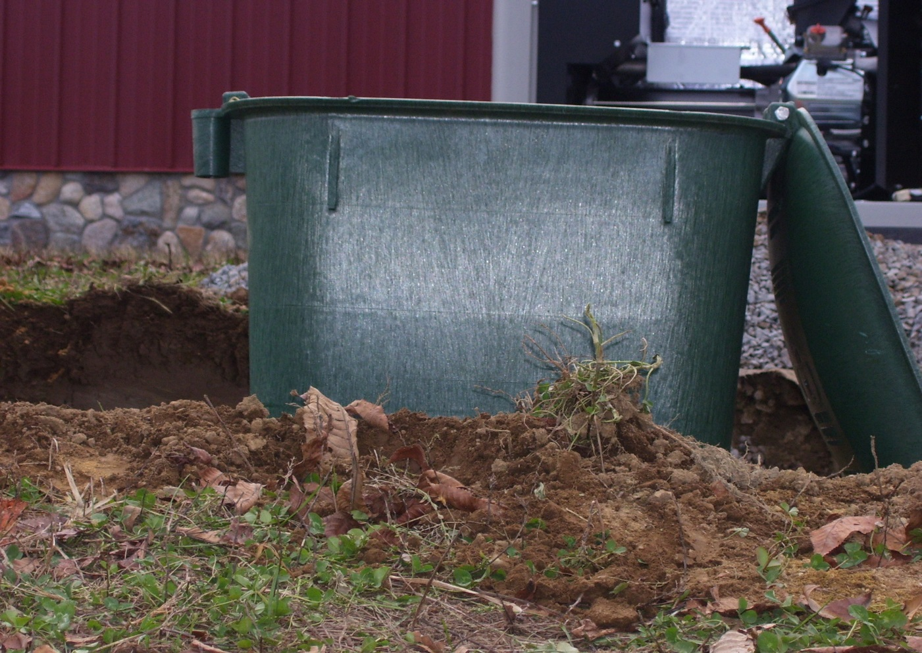
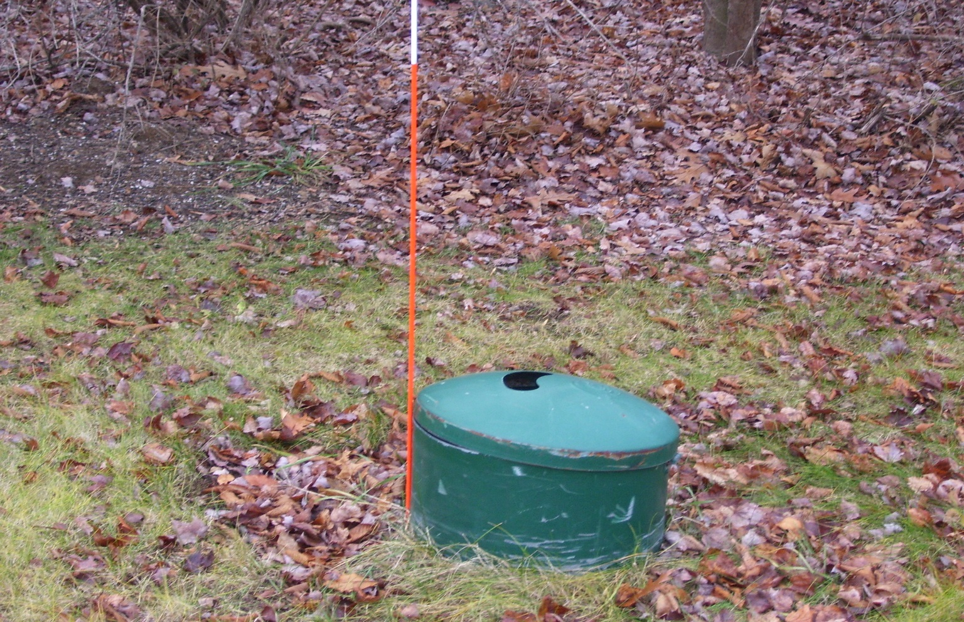

Two Common Access covers you will see out there in the field !
Notes:
This is where you will locate the service valve shutoff !

Slide 16
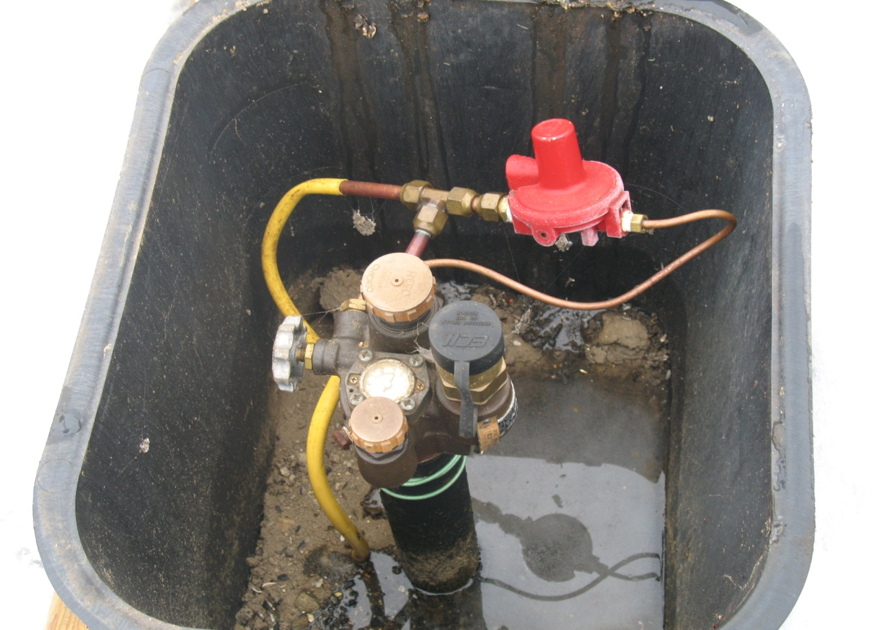
Service Valve
The cover opened shows the shut off valve handle
The arrow points to the service valve
Notes:
Here is a typical underground tank ,after opening cover location of shutoff !

Slide 17
Notes:
Propane is simple, right? Tank, Line, House? DON’T ASSUME THE LINE GOES STRAIGHT FROM TANK TO HOUSE!
Multiple tanks on property? Pool heaters, generators, patio heaters, fire logs, garage heaters:
DON’T ASSUME THE TANK YOU SEE IS THE ONLY TANK ON THE PROPERTY!

Slide 18
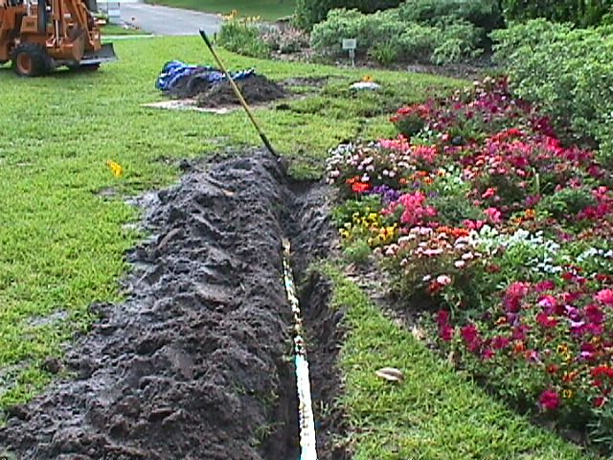
Underground Line From Tank to Home
Notes:
Even if the line is marked, remember minimum burial depth is only 12 inches!

Slide 19
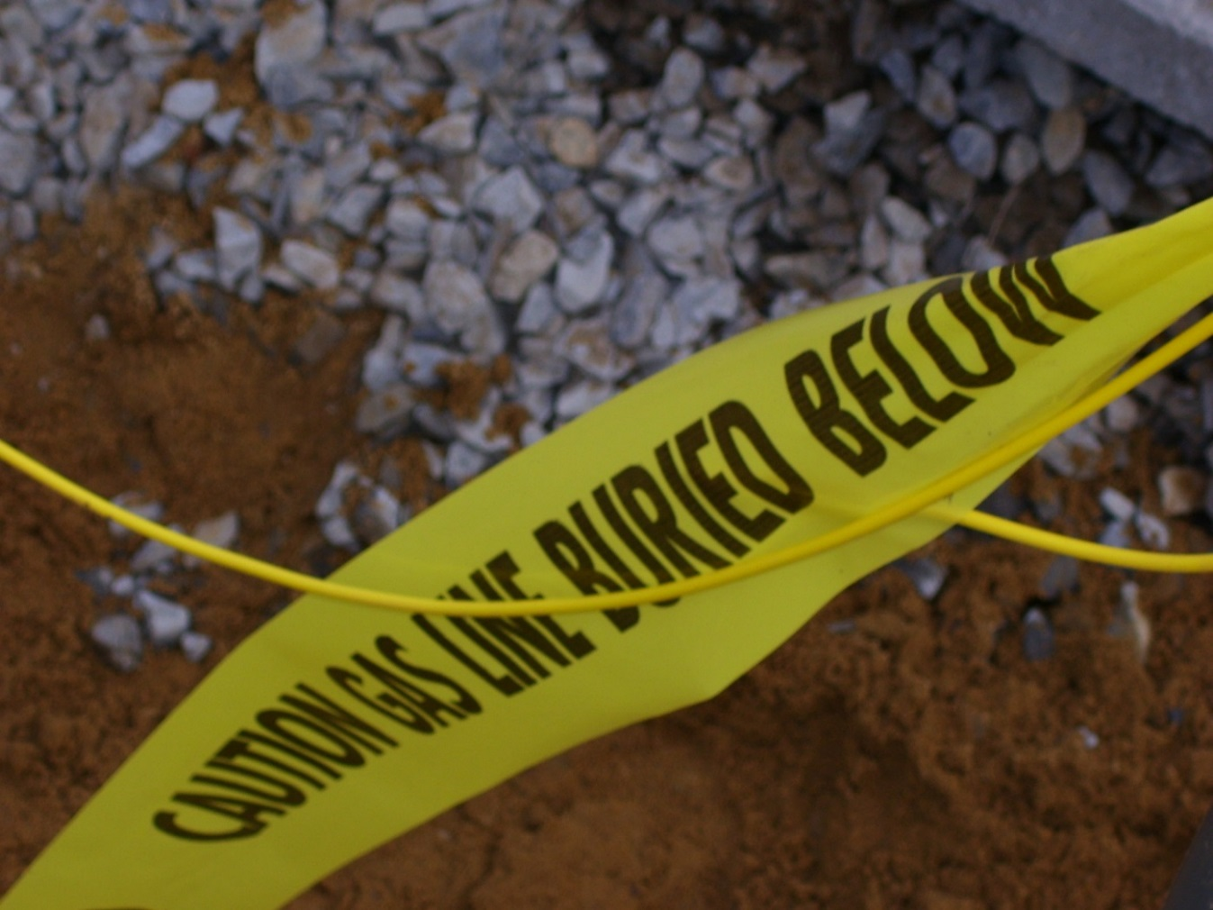
Notes:
Locater Tape or Tracer wire should be placed in trench before back filling

Slide 20
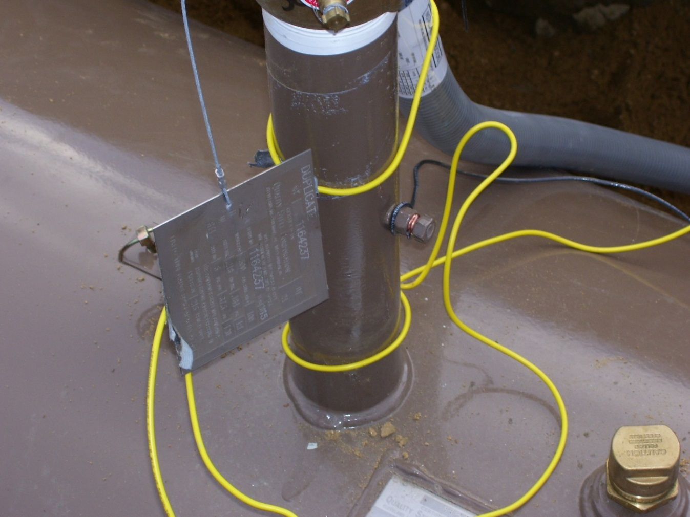
Notes:
Tracer wire also connected to tank

Slide 21
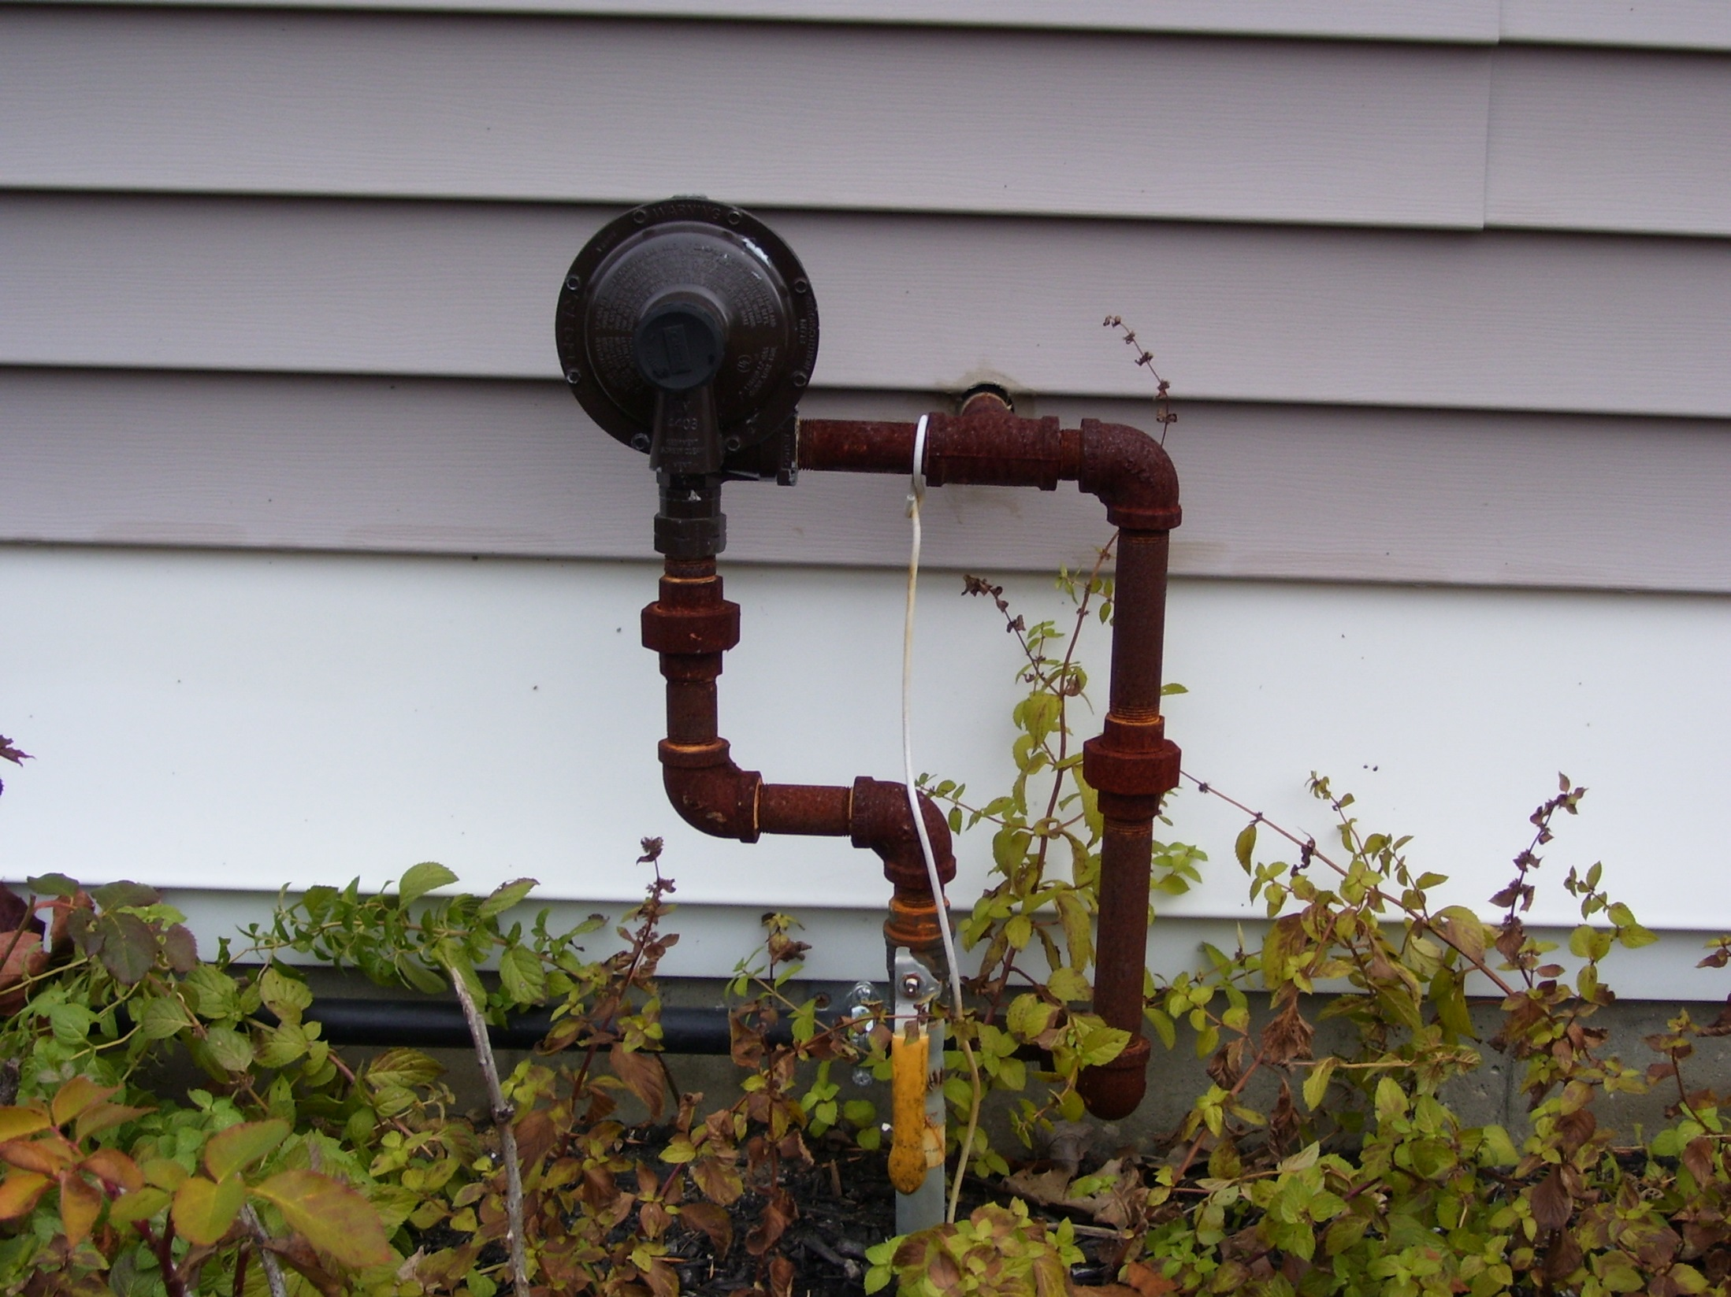
Notes:
Again where you see a regulator coming up from under ground along side house
Please check with home owner as to where tank is, if they are not sure have them call their propane supplier

Slide 22
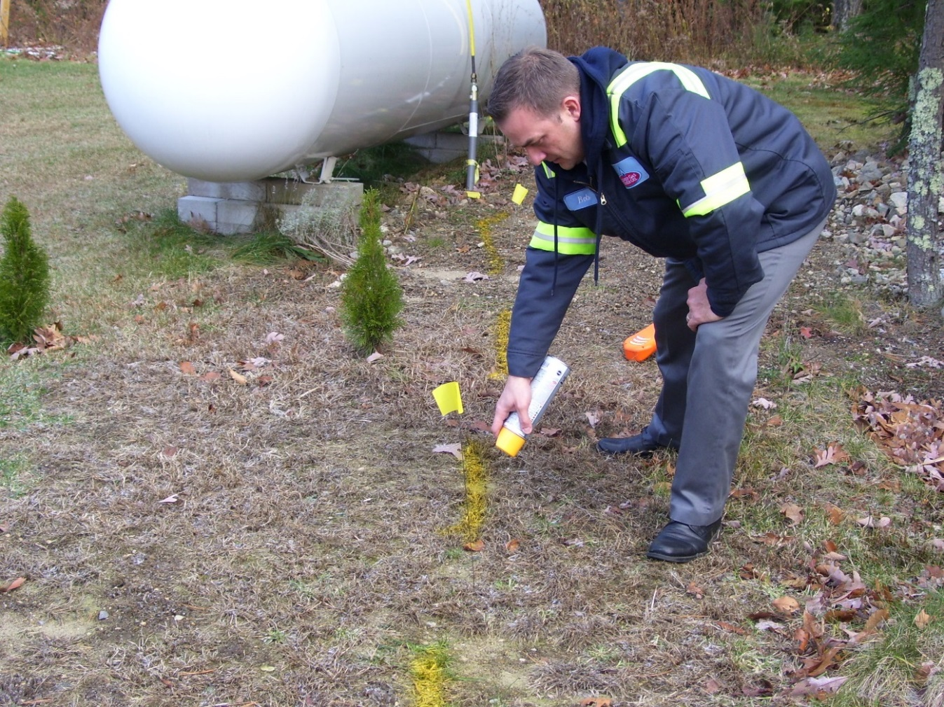
Yellow paint or Flags can be used for Gas
Notes:
Paint being applied

Slide 23
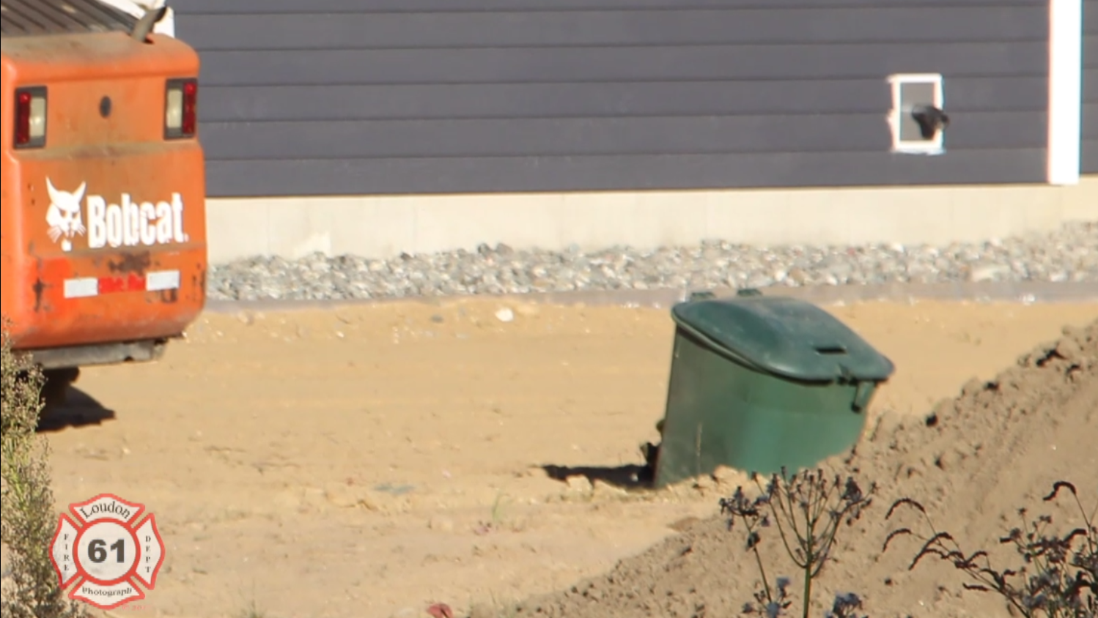
Bobcat Backs Into UG 1000

Slide 24
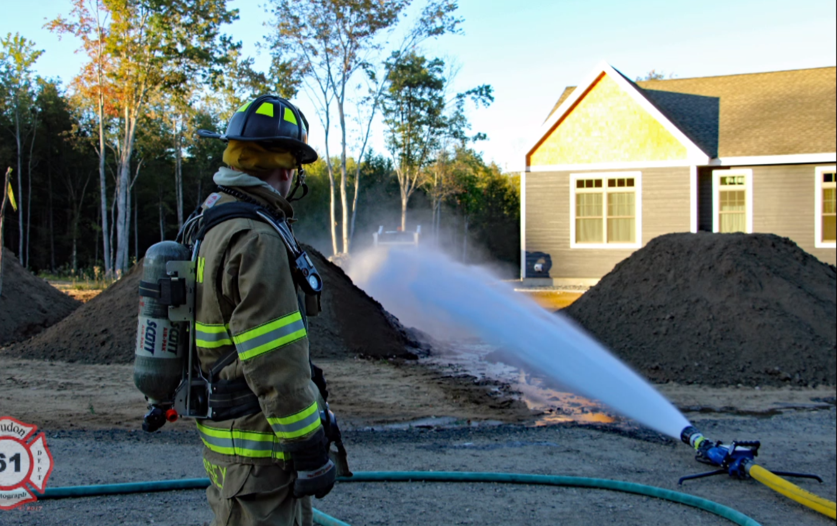
Prevent This From Happening !

Slide 25
When in doubt about the location of the lines turn off the tank
It is safer to turn off the tank than take a chance of hitting a live gas line
Call the gas company and ask them to turn the gas back on.
Do not turn on the gas yourself

Slide 26
EMERGENCY:
Call 911
Evacuate Area
Call Propane Provider
Notes:
Obviously if you have a Emergency follow the following rules !

Slide 27
QUESTIONS/CONCERNS
Notes:
Thank you so much for coming and Be Safe out there !

