Slide 1
Excavation and Trenching: Agency Priority Goal -
Occupational Safety and Health Administration

Slide 2
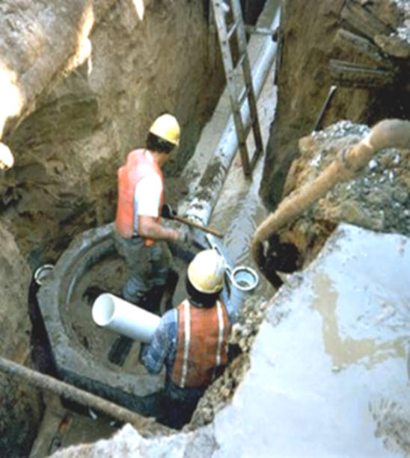
Why the National Trench Emphasis Program?
Excavating is recognized as one of the most hazardous construction operations.
Cave-in is the number one excavation hazard.
More likely to result in worker fatalities than other excavation-related accidents.

Slide 3
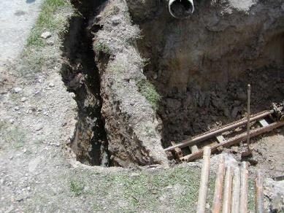
Trench Collapse Fatalities
2017: 24 fatalities
2018: 13 fatalities
2019: 21 fatalities
2020: 18 fatalities
2021: 15 fatalities
2022: 39 fatalities
2023: 6 fatalities (as of 6/1/23)
*Source OIS (Trench Collapses Only, Fed & State), Calendar Year*
Notes:
In 2017 fatalities reach 24, the next year OSHA made trenching inspections an Agency Priority Goal (next slide)
Fortunately, after 2019 there was a decrease until the 2022 when the total spiked again

Slide 4
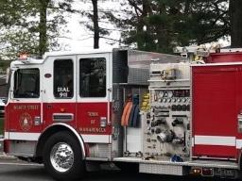
Recent Trench and Excavation Related Fatalities 2021
Worker dies in trench collapse in Johnstown.
Apr 17, 2021 · JOHNSTOWN, Colo. — a worker died in a trench collapse during a construction project
Construction worker dies after excavation trench collapses in Lindstrom
WCCO-TV (Minnesota, MN)
September 28, 2021
Long Island cemetery worker buried alive, dies inside open grave
Miami Herald (New York Daily News article)
February 25, 2021
Worker dies after being crushed by excavator in Boring
Oregon Live/The Oregonian
February 25, 2021
Construction worker dies in North Carolina trench collapse
U.S. News & World Report (Associated Press article)
May 20, 2021
Construction company faces over $70,000 in fines over fatal trench collapse in Central Valley
News 12 The Bronx (NY)
September 30, 2021
Worker killed in trench cave-in at Mamaroneck construction site
Larchmont-Mamaroneck (NY) Patch
May 4, 2021
Worker, 53, dies after concrete vaulted sidewalk collapses on him in Heart of Chicago, officials say
Chicago Tribune
May 15, 2021

Slide 5
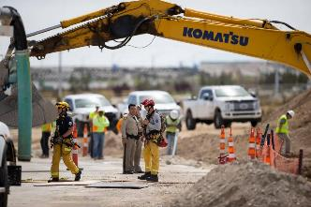
Recent Trench and Excavation Related Fatalities 2021 – 2022 Continued
Construction workers recount what happened during the deadly trench collapse near Breckenridge in November
Summit Daily (Frisco, CO)
April 21, 2022
OSHA fines Missouri-based contractor for hazardous trench conditions
KSHB-TV (Kansas City, MO)
April 8, 2022
Worker fatally injured after Austin contractor ordered them to return to collapsed trench, OSHA says
KVUE-TV (Austin, TX)
April 21, 2022
Construction worker dies after being run over by gravel truck in Walnut Creek
KNTV-TV | NBC Bay Area (San Jose, CA)
April 4, 2022
Construction worker dies in trench collapse in Tennessee
WKRN-TV (Nashville, TN)
April 18, 2022
Coroner rules on worker’s death in ‘trench collapse’
Las Vegas Review-Journal
April 20, 2022
Manchester company fined $375,000 for deadly trench collapse in Vernon
https://www.middletownpress.com/news/article/manchester-vernon-botticello-fined-fatal-trench-17756148.php
Middletown Press (New Haven, CT) , February 1, 2023

Slide 6
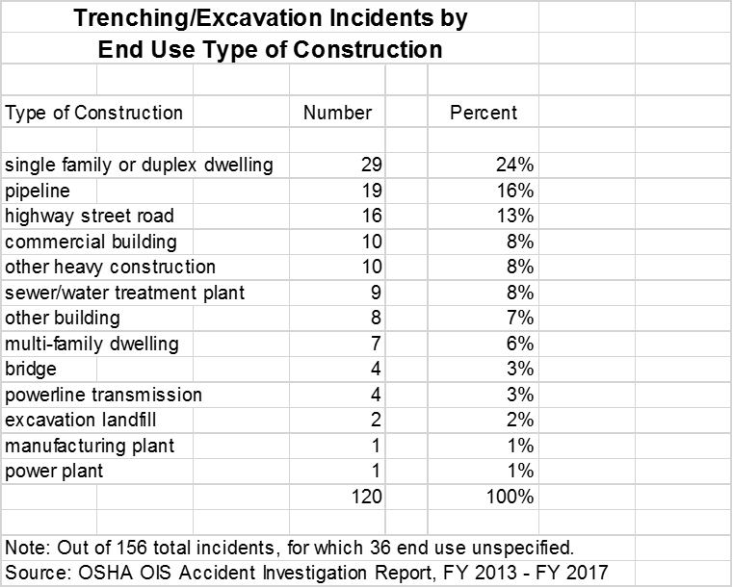
Where are trenching incidents happening?
Notes:
Top 3 areas account for 53% of all Incidents (Injuries and Fatalities)
Residential
Pipeline
Highway / street

Slide 7
OSHA OIS Inspection Data
Top 5 Subpart P Violations (10/1/22 - 4/30/23)
Standard | Total Violations | Serious Violations | Willful Violations | Repeat Violations
1926.652(a) - Cave-in Protection | 275 | 197 | 21 | 37
1926.651(c) - Access and egress | 163 | 122 | 4 | 12
1926.651(k) - Inspections by a CP | 124 | 93 | 3 | 10
1926.651(j) - Loose rock or Soil | 102 | 79 | 2 | 6
1926.652(g) - Shield Systems | 26 | 17 | 0 | 4

Slide 8
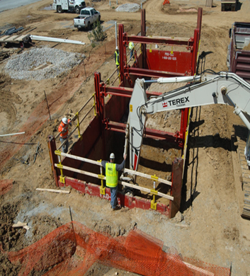
1926.652 - Requirements for protective systems
Protection of employees in excavations
Design of sloping and benching systems
Design of support systems, shield systems, and other protective systems
Materials and equipment
Installation and removal

Slide 9
Competent Persons’ Requirements
To establish competency, the individual (or individuals) identified as a competent person:
Relevant knowledge of soil types and classification, and use of protective systems.
Capable of identifying existing and predictable hazards in the surroundings, or working.
Authority to identify, correct, and control hazards, such as failures in protective systems, hazardous atmospheres, and other hazards including those associated with confined spaces.
Requirements of 29 CFR Part 1926, Subpart P.
Trenching and excavation experience.
Any certificates, degrees, or other supporting documents related to the subject matter.

Slide 10
Who and where is the Competent person on this job?
How many hazards do you see on this job?

Slide 11
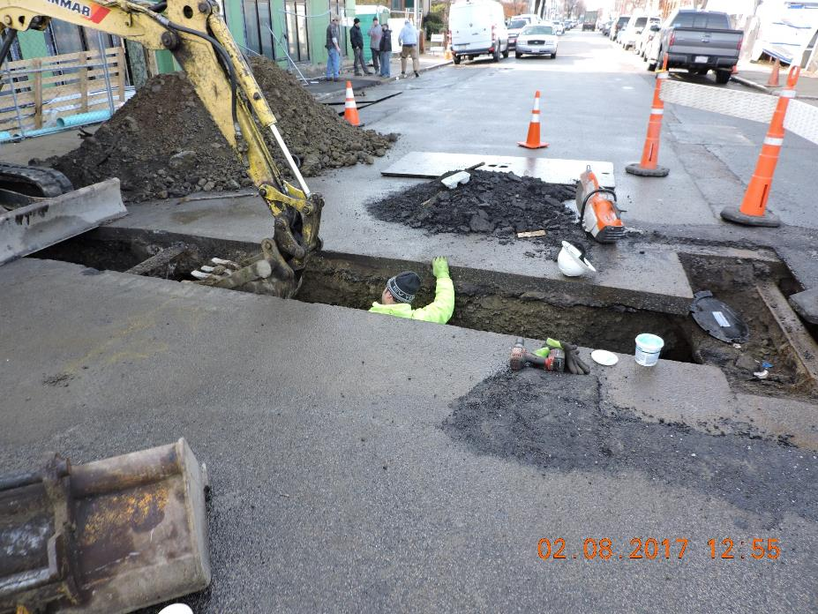
Nothing good about this photo!
No cave-in protection
No safe access
No hard hats
Material at the edge
Inadequate traffic safety
Bucket near head
Competent person???

Slide 12
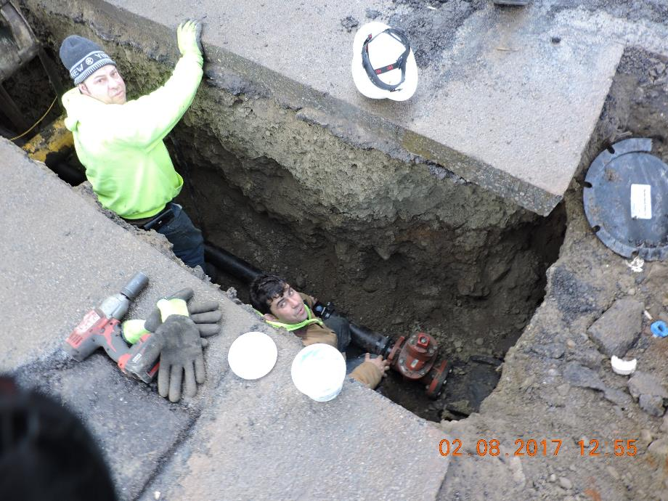
Continued
Pavement undermined
Worker crouched exposed to material and soil when or if four feet deep

Slide 13
Why Even Greater Focus on Trenching Safety? (Recent Boston double fatality cases and increase in fatalities nationwide)
This photo U.S. was sadly taken seconds before a fatal incident occurred involving these employees who were installing a septic tank liner
Notes:
This photo was sadly taken seconds before a fatal incident occurred involving these employees who were installing a septic tank liner. As you can see, there were no employee protection systems in place. The ground gave underneath and the employee in the pink shirt fell underneath the liner and succumbed to his injuries. The other employee in the grey shirt held onto the clamshell and survived.

Slide 14
Results

Slide 15
Atlantic Coast Utilities Double Fatality Boston Case- February 2021
Jordy Alexander Castaneda Romero, 27, and Juan Carlos Figueroa Gutierrez, 33, died in the Feb. 24 accident in the city’s Financial District.
Federal workplace safety regulators on Wednesday proposed $1.3 million in penalties for the construction company that employed two men who died when they were struck by a dump truck and pushed into a 9-foot deep trench at a sewer project in Boston, Massachusetts, in February.
https://www.wcvb.com/article/company-involved-in-deadly-boston-trench-incident-fined-for-serious-willful-safety-violations-osha-records-show/35621851#

Slide 16
Atlantic Drain Service Company, Inc. – Criminal Investigation, Boston, MA
At 1:00 p.m. on October 21, 2016, Robert Higgins and Kelvin Mattocks, employees of Atlantic Drain Service Co., were killed when the trench in which they were working collapsed and filled with water from a fire hydrant supply line. They were preparing a trench for installation of a new sanitary sewer line.
Both Employees were working at a depth of 11 feet and 11 inches when two events occurred:
The straight cut earth walls of the trench caved in,
Fire hydrant came loose from the water main from which it was attached.

Slide 17
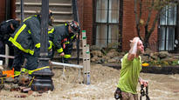

Slide 18
OSHA Trench Initiative
June 14, 2022 - OSHA National Press Release: “Alarming rise in trench-related fatalities spurs US Department of Labor to announce enhanced nationwide enforcement, additional oversight”
Emphasized enforcement of the trenching and excavation standards
Increased Compliance Officer training
Increased outreach efforts
Notes:
Trenching is part of Focus Four hazards
Press release June 14, 2022
Emphasis on inspections, training, and outreach

Slide 19
Work Zone Awareness Week
The 4th annual National Stand-Down to Prevent Struck-by Incidents will take place April 17-21, 2023 in coordination with National Work Zone Awareness Week.
Annual spring campaign held at the start of construction season to encourage safe driving through highway work zones
OSHA’s Roadway Work Zone Alliance supports the week and developed this poster
Highway Work Zones and Signs, Signals, and Barricades - Overview | Occupational Safety and Health Administration (osha.gov)
www.osha.gov/doc/highway_workzones
Notes:
WORK ZONE AWARENESS WEEK
OSHA’s Roadway Work Zone Alliance conducts an annual spring campaign, held at the start of construction season, to encourage safe driving through highway work zones.
The week-long effort encourages employers at construction sites to pause work voluntarily one day during the week to review best safety practices and to discuss struck-by hazards. Each year, more than 1,000 workers participate in these events.
This year the campaign runs April 8-12-2019.

Slide 20
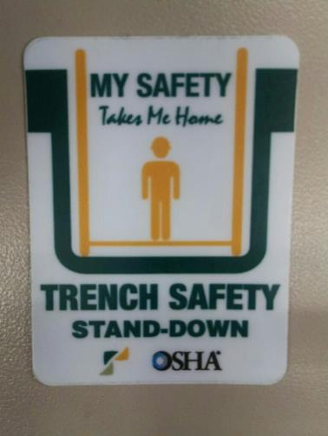
Questions?

