Slide 1
3/19 Augusta
3/20 Auburn
3/21 Eliot
4/16 Presque Isle
4/17 Brewer
4/18 Bar Harbor
2024 Excavation Safety Seminars
3/26 South Burlington
3/6 Keene
3/12 Plymouth
3/13 Concord 3/14 Hampton
2/13 Hyannis
3/14 Westport
3/15 Agawam
3/16 Pittsfield
2/27 Framingham
2/28 Fitchburg
2/29 Foxboro
3/5 Danvers
2/7 Lincoln

Slide 2
APRIL IS SAFE DIGGING MONTH

Slide 3
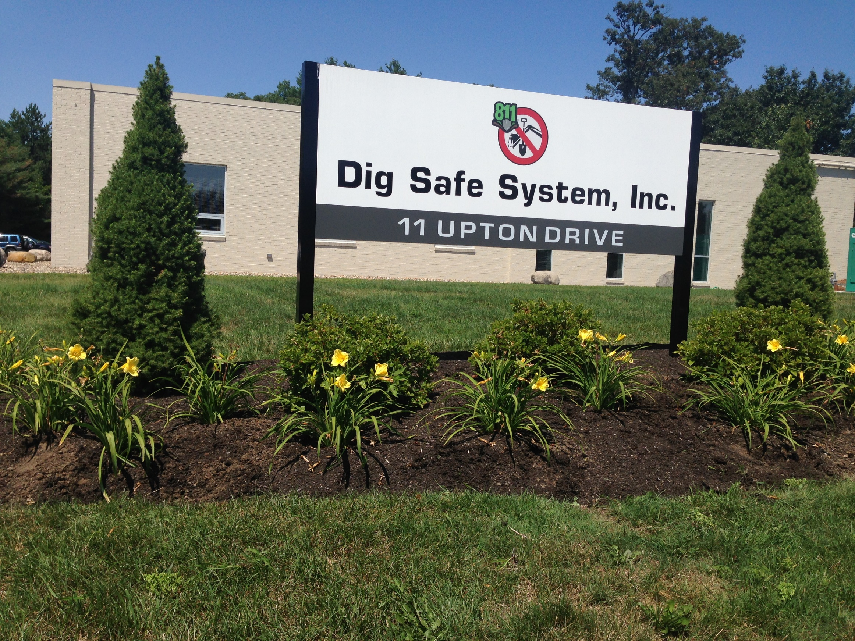
Our Team
2 Opening Supervisors
5:00am-1:30pm
2 Closing Supervisors
9:30am-6:00pm
30 Customer Service Reps
5am-6pm
8 In Office
21 Hybrid
U-Dig NY
Off Hour Calls for Emergency Tickets for New England
Back-up site for Dig Safe as part of disaster recovery plan

Slide 4
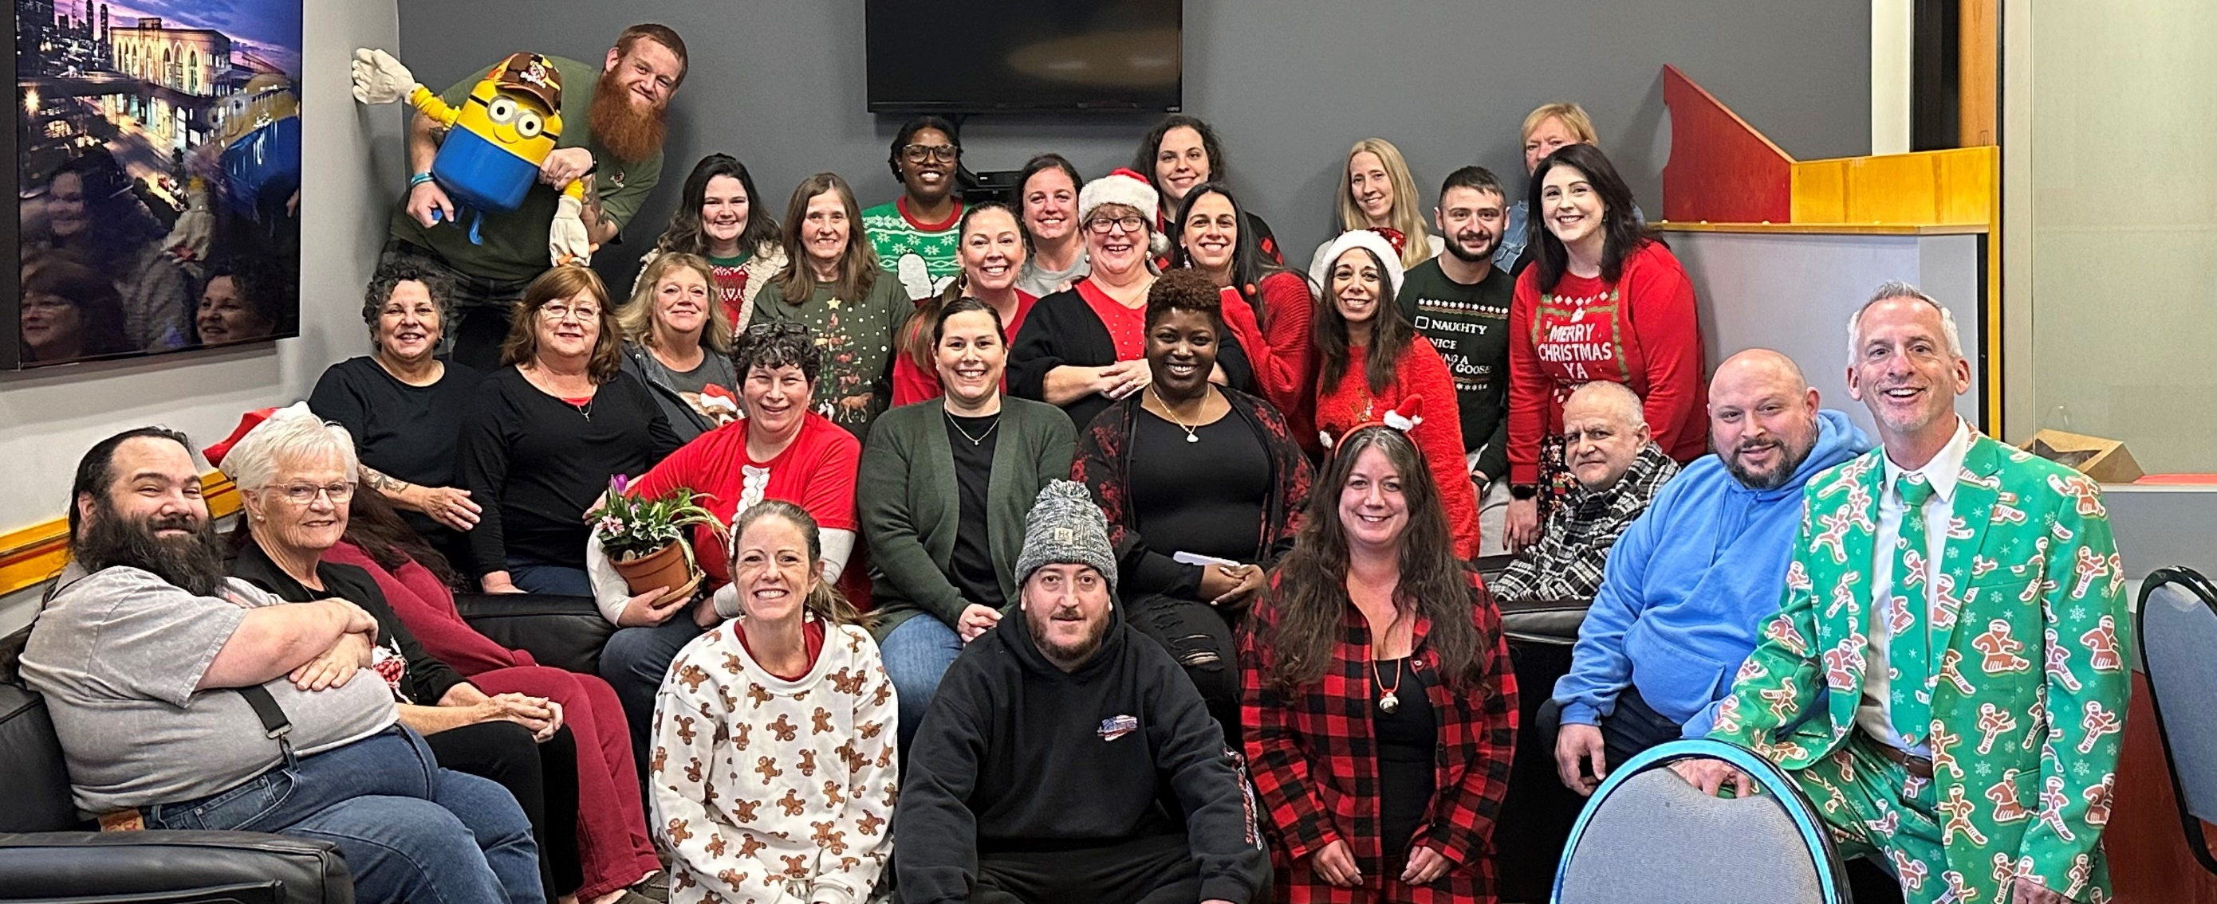
Our Team (we wear pj’s only once a year)

Slide 5
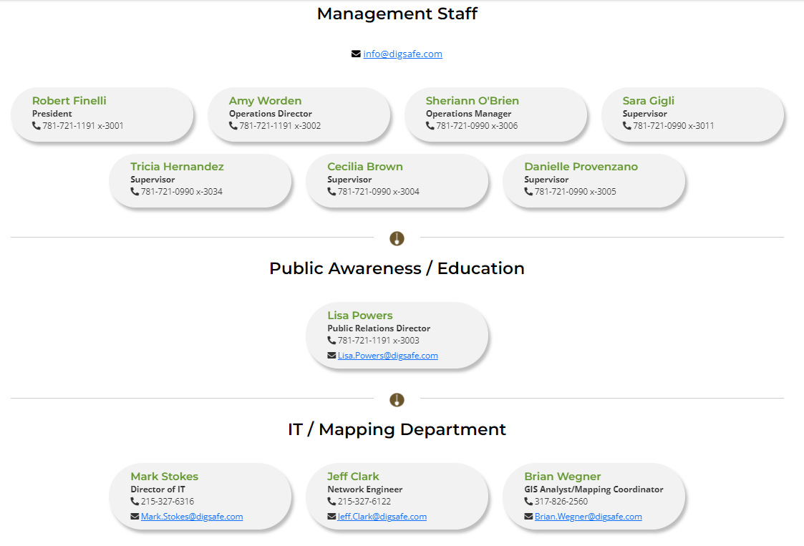
DigSafe.Com – Contact Us

Slide 6
Submit regular and emergency tickets online 24/7
Easy to use
Keep records of your tickets
Sort, Filter, Print, Share and Export Dig Safe tickets
Sign up at digsafe.com
Live Exactix class for your group on Zoom or Teams

Slide 7
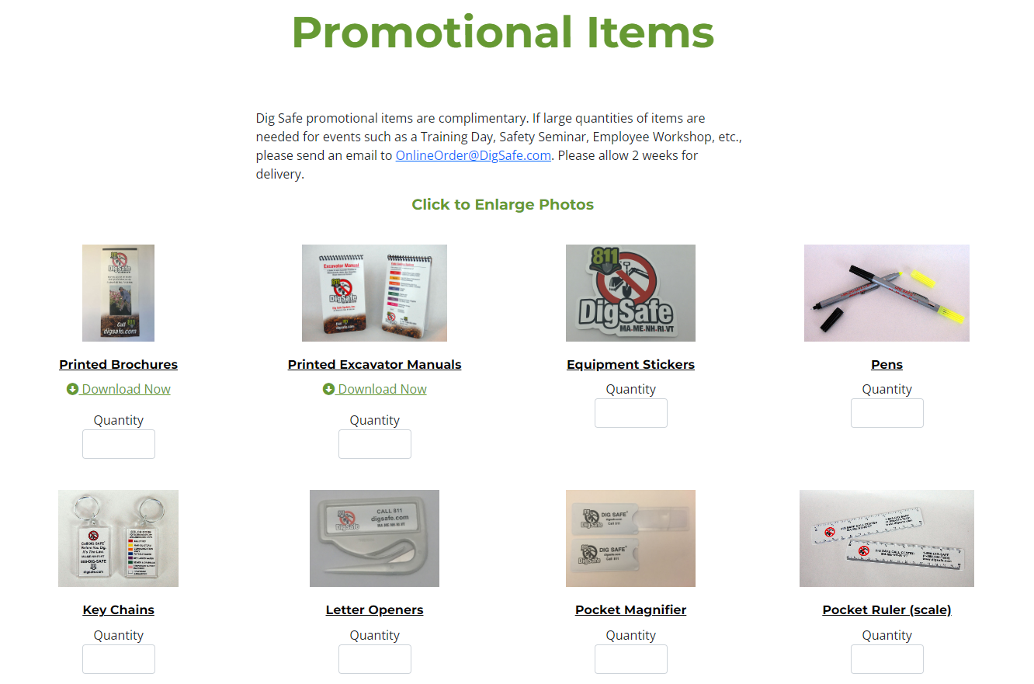
Order items for your crew at digsafe.com

Slide 8
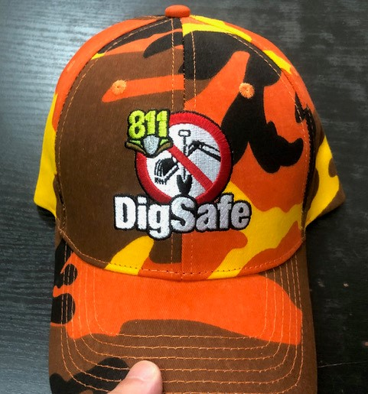
ORANGE CAMO HATS ARE BACK BY POPULAR DEMAND..

Slide 9
Lisa Powers
Public Relations Director
781.721.1191
Lisa.Powers@DigSafe.com

