Slide 1
2024
GAS TRANSMISSION TRAINING

Slide 2
Contact information
Kathy aruda
70 Wilson way
Westwood ma 02090
Phone: 508-938-7728
Algonquin Gas Transmission
Notes:
Generally every 3-4 years

Slide 3
Contact information
Wes maribito
54 Wilson st
Hopkinton ma 01748
Phone: 508-309-9029
Mike aldrich
54 Wilson st
Hopkinton ma 01748
Phone: 508-309-8684
Tennessee Gas Pipeline
Notes:
Generally every 3-4 years

Slide 4
Contact information
Lara bailey
547 Lincoln st
Richmond me
Phone: 207-737-8249
Jonathan arron
40 grossett dr
Kirkwood ny 13795
Phone: 607-721-0106
Maritimes & Northeast Pipeline
Portland Natural Gas Transmission System
Notes:
Generally every 3-4 years

Slide 5
Contact information
Bob allen
325 west rd
Portsmouth nh 03801
Phone: 603-242-2813
Jeff leary
30 hill st
South portland me 04106
Phone: 207-233-1977
Granite State Gas Transmission
Portland-Montreal Pipe Line
Notes:
Generally every 3-4 years

Slide 6
OPERATING AREAS FOR New England high pressure natural Gas Transmission companies
Algonquin Gas Transmission
Tennessee Gas Pipeline

Slide 7
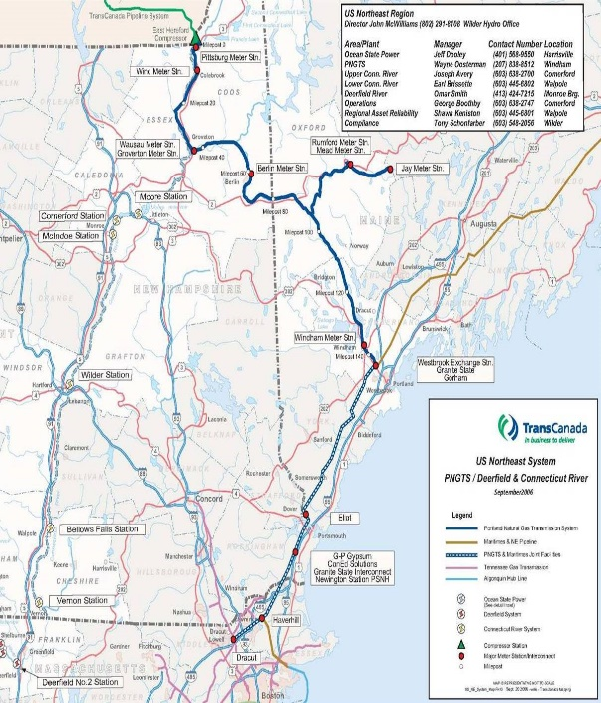
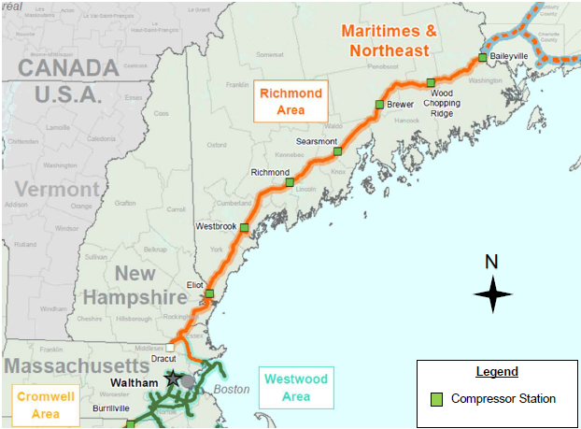
OPERATING AREAS FOR New England high pressure natural gas Transmission companies
Maritimes & Northeast Pipeline
Portland Natural Gas Transmission System

Slide 8
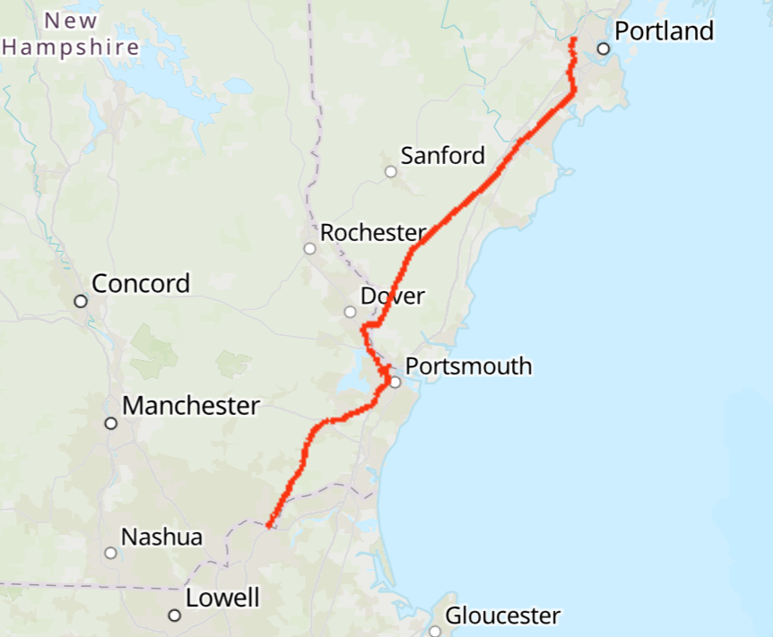
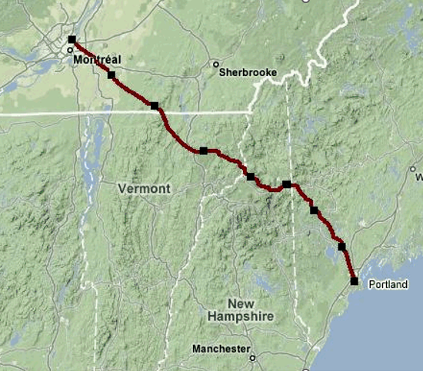
OPERATING AREAS FOR New England high pressure natural gas Transmission companies
Granite State Gas Transmission
Portland-Montreal Pipe Line

Slide 9
Emergency Contact Numbers 24/7
800-726-8383
800-231-2800
888-576-4634
800-830-9865
Algonquin Gas Transmission
-------------------------------------------------------------------------------------------------------------------------
Tennessee Gas Pipeline
-------------------------------------------------------------------------------------------------------------------------
Maritimes & Northeast Pipeline
-------------------------------------------------------------------------------------------------------------------------
Portland Natural Gas Transmission System
-------------------------------------------------------------------------------------------------------------------------

Slide 10
Emergency Contact Numbers 24/7
800-542-0967
866-253-7351
Granite State Gas Transmission
-------------------------------------------------------------------------------------------------------------------------
Portland-Montreal Pipe Line
-------------------------------------------------------------------------------------------------------------------------

Slide 11
Video presentation
Pay attention to the message in the video
it applies no matter where you are digging
Notes:
Generally every 3-4 years

Slide 12
“three seconds later”
https://www.youtube.com/watch?v=hR-rRtI7KmM&t=6s
(This 12-minute documentary is an award-winning, first-person account of a tragic drain tile accident and its impact on a close-knit community. The film was produced by the Drain Tile Safety Coalition, a non-profit organization promoting farm safety and the Farm Safe 811 system in partnership with the Pipeline Operators for Ag Safety and the Pipeline Association for Public Awareness.)
Notes:
Generally every 3-4 years

Slide 13
takeaways
You may THINK you know where the pipeline is, but it IS STILL the law to call before you dig!
It IS not ever worth an incidenT
Notes:
Generally every 3-4 years

Slide 14
THANk YOU
AND
STAY SAFE!!

