Slide 1
Massachusetts Department of Labor Standards
On-Site Consultation Program
MUST Excavation Safety Breakfast Seminars
2024

Slide 2
On-Site Consultation Program Can Help You
Free program to assist employers:
Prevent work-related injury.
Develop safety programs.
Train employers and employees.
Both Private and Public Sector Employers can use the On-Site Consultation Program.

Slide 3
2023 City Worker Injured at DPW Trench
Notes:
A Public Works employee was working in a 6.5’ trench with accumulated water and no protection. It collapsed while the employee was reaching on a ladder to shut off an exposed water valve. The employee was completely covered but was immediately rescued by his coworkers.

Slide 4
2022 City Worker Injured at Private Contractor Site
Notes:
Two city water department employees entered the unprotected part of an excavation in order to repair a water service line for a contractor. While in this portion of the trench, there was a collapse which covered both employees up to their legs. The trench was 4.5 deep in wet previously disturbed soil. This incident is important since it shows that trench collapses less than five feet deep can cause serious injury.

Slide 5
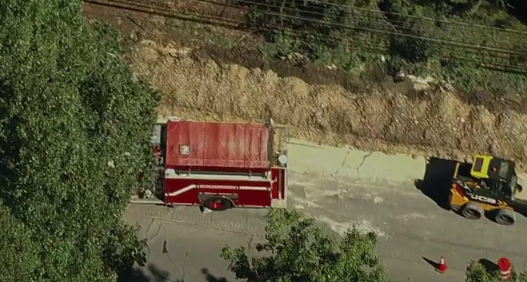
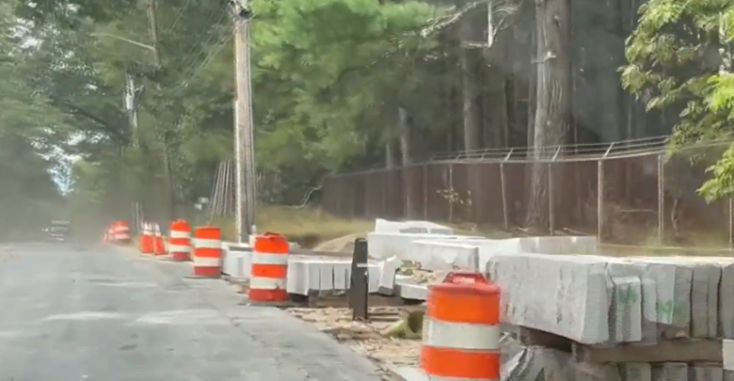
2 Private Contractor Workers Injured at Roadway Construction Site
Notes:
Two private contractor workers were taken to an area hospital after they were injured in an incident at a construction site in Concord. The two construction workers were injured when a piece of construction equipment hit them along with a four-foot piece of granite curbing that they were in the process of installing for a new sidewalk. Officials estimate the construction equipment and the granite curb that hit the construction workers had a combined weight of roughly one ton.

Slide 6
Free Health and Safety Visits to Help Contractors and Public Utilities Prevent Injury
Opening Conference
Site Walkthrough
Consultation Report

Slide 7
Benefits of On-Site Consultation Visits
Free – No cost to the employer! No fines or penalties!
Confidential – Information not shared with OSHA or DLS enforcement.
Voluntary –Management must make a request and will determine the scope.
Note: Employer must fix all identified serious hazards.

Slide 8
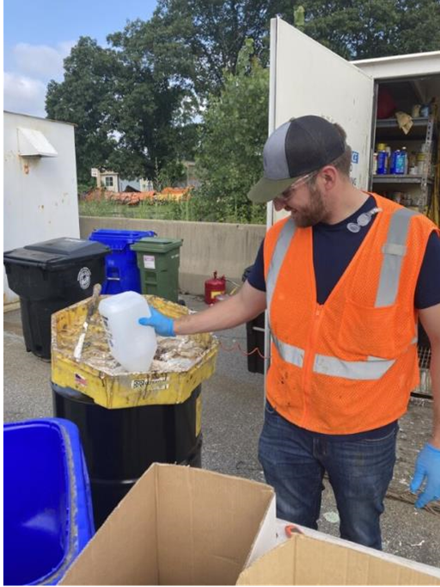
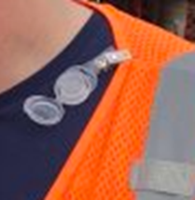
Benefits of On-Site Consultation Visits
OSHA or DLS does not inspect if you have an open consultation unless there is a serious incident or complaint.
Other Free Services
Technical Assistance
Safety Program Templates
Noise and Air Monitoring

Slide 9
Example Consultation Visit - Sewer Line Jetting
Serious Hazards Requiring Correction
No High Visibility Gear
No Fall Protection
No Face Protection
Recommendations
Police Traffic Detail
Road Closure
Notes:
Here is an example of an on-site consultation visit. This visit was to a water department during sewer line jetting of a clogged sewer line. During the visit, the consultations observed an employee not wearing high-vis clothing, no fall protection around the manhole, and both employees were not wearing face protection to protect from high pressure spray of the line jetting. Two Work Zone Safety recommendations were made: A police traffic detail should have been used and road closure should have been considered.

Slide 10
Contact DLS to Prevent Worker Injury
Web: www.mass.gov/on-site-consultation-program
Public Sector
Phone: 508-616-0461 x1
Email: SafePublicWorkplacemailbox@mass.gov
Private Sector
Phone: 508-616-0461 x2
Email: MA-OSHAConsultation@mass.gov

