Slide 1
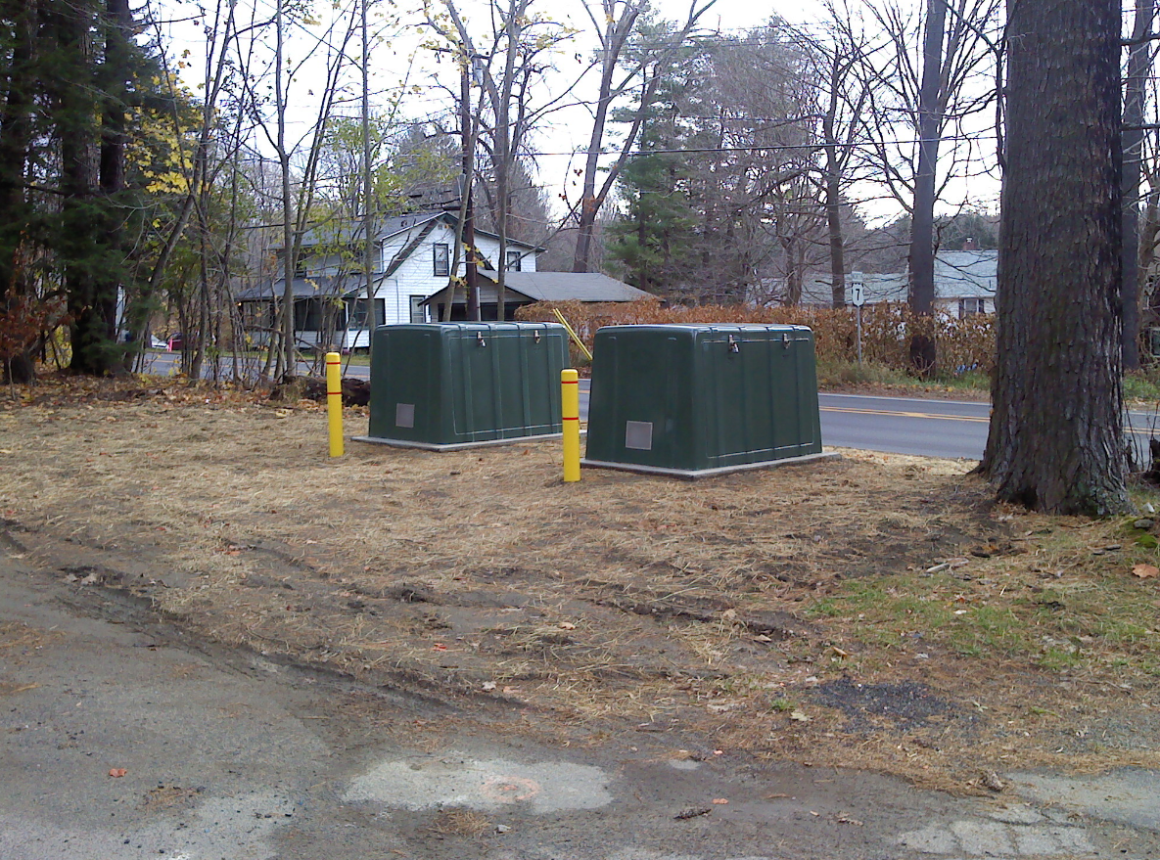

Slide 2
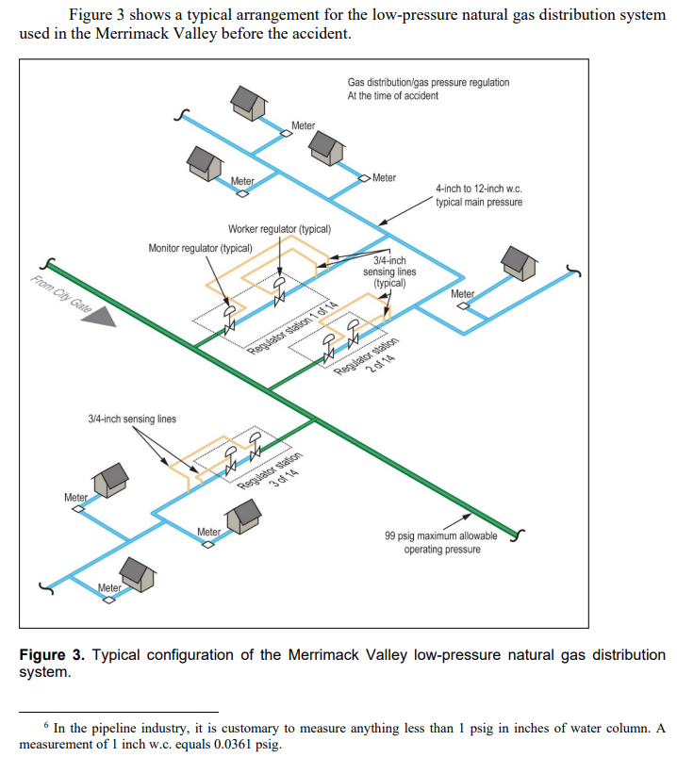
Source: NTSB Accident Report: Overpressurization of Natural Gas Distribution System, Explosions, and Fires in Merrimack Valley, Massachusetts September 13, 2018.

Slide 3
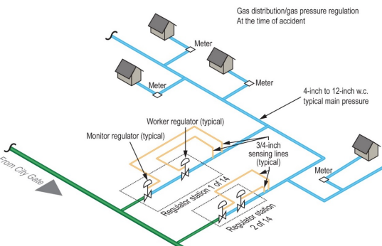
Source: NTSB Accident Report: Overpressurization of Natural Gas Distribution System, Explosions, and Fires in Merrimack Valley, Massachusetts September 13, 2018.

Slide 4
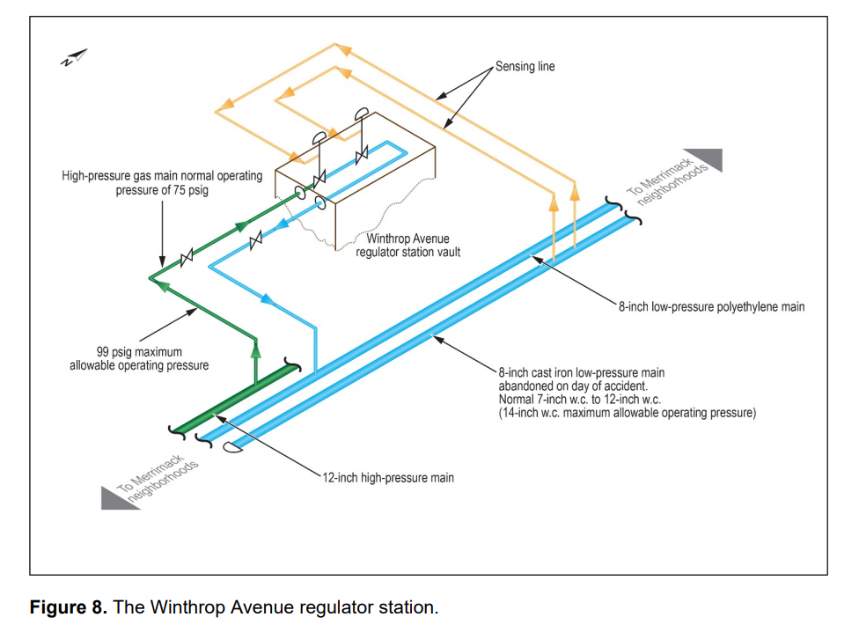
Source: NTSB Accident Report: Overpressurization of Natural Gas Distribution System, Explosions, and Fires in Merrimack Valley, Massachusetts September 13, 2018.

Slide 5
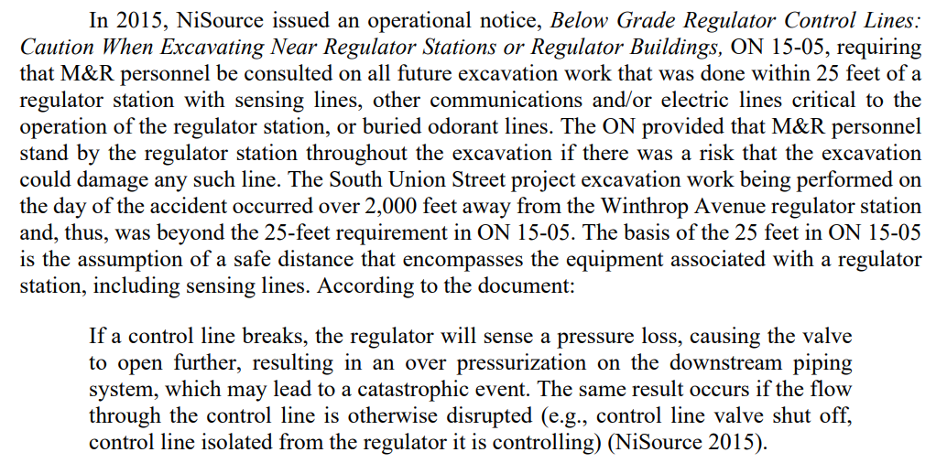
Source: NTSB Accident Report: Overpressurization of Natural Gas Distribution System, Explosions, and Fires in Merrimack Valley, Massachusetts September 13, 2018.

Slide 6
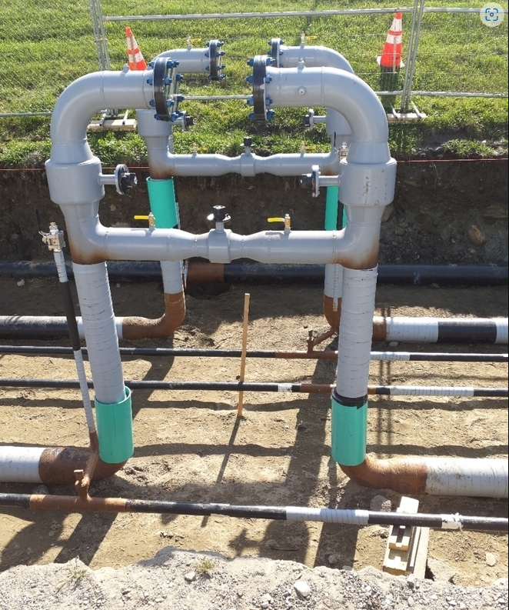

Slide 7
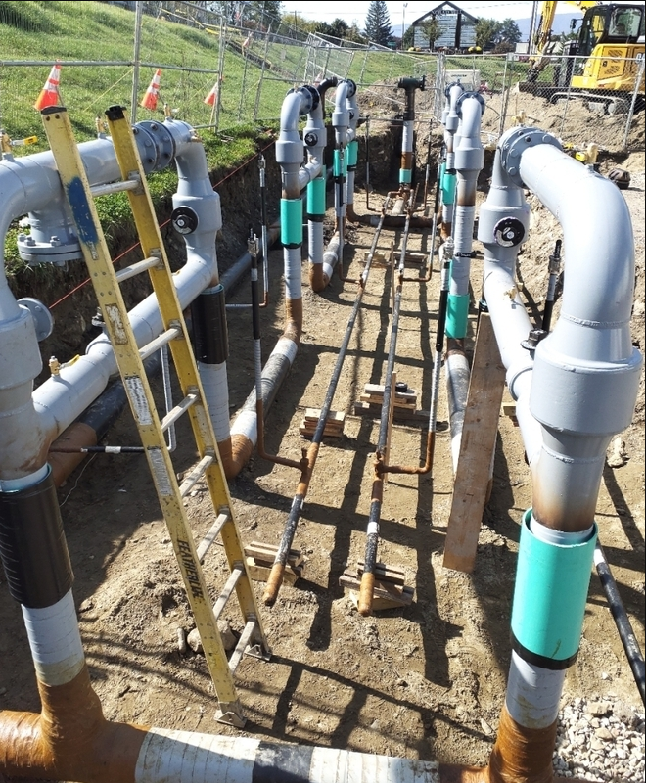

Slide 8
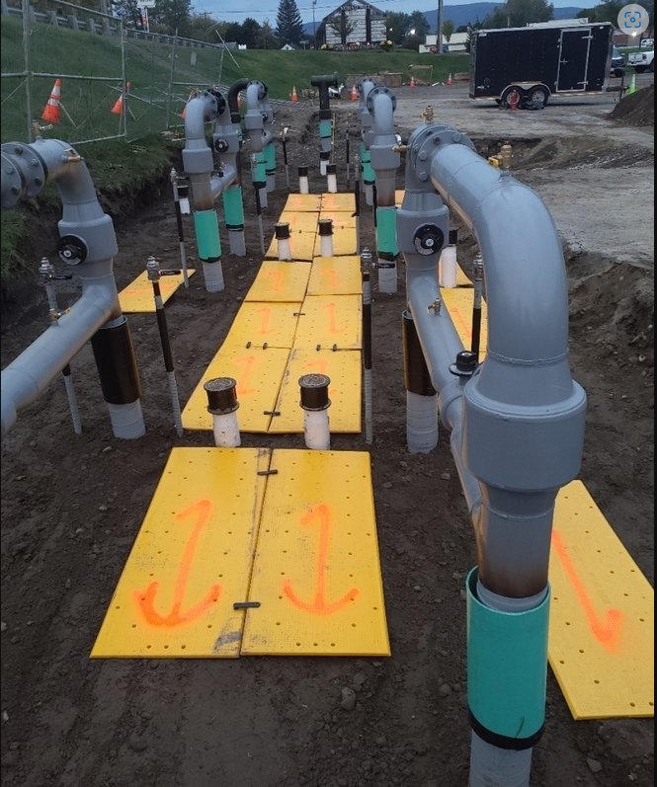

Slide 9
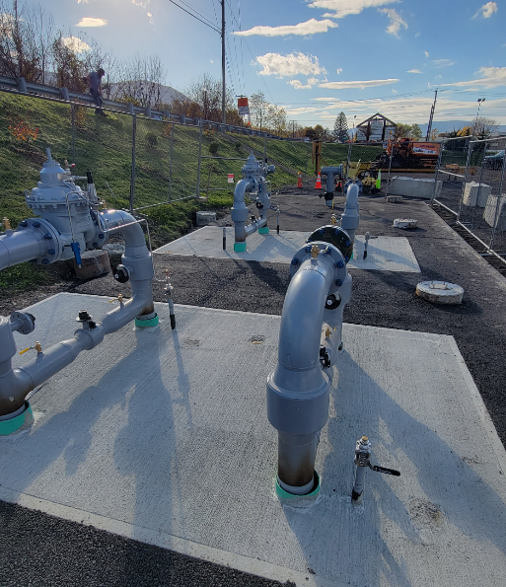

Slide 10
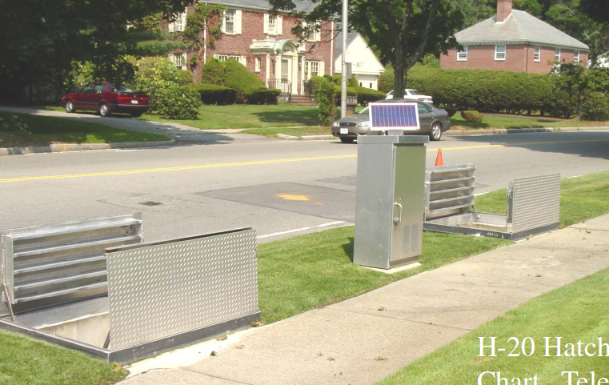

Slide 11
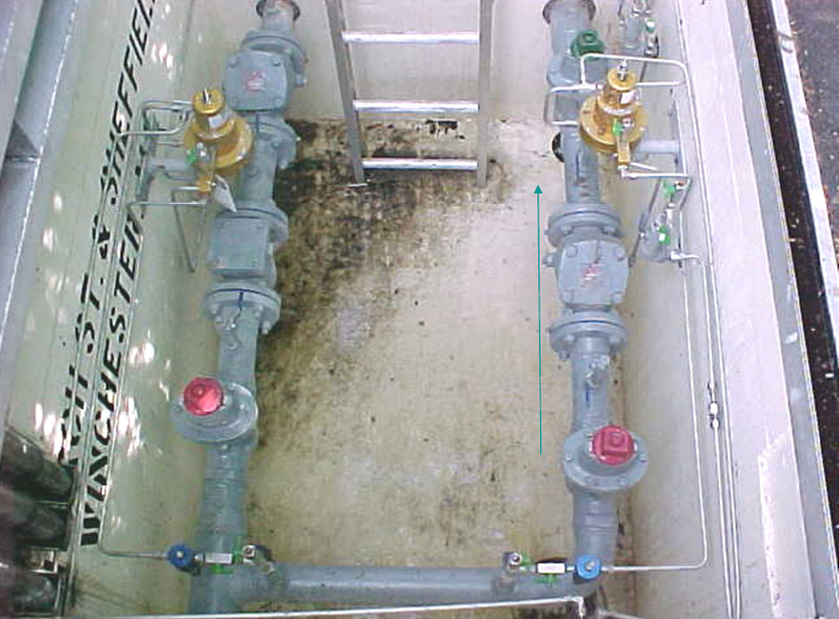

Slide 12
