Slide 1
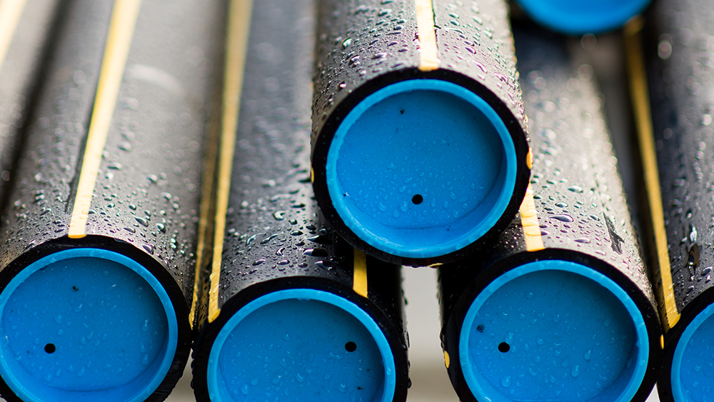
M.U.S.T. Natural Gas Presentation
March 9, 2023

Slide 2
Why we are here…
SAFETY
Commitment to ensuring a safe environment for our customers, co-workers, ourselves and our neighbors
There is an inherent risk in any type of excavation – no matter how big or small

Slide 3
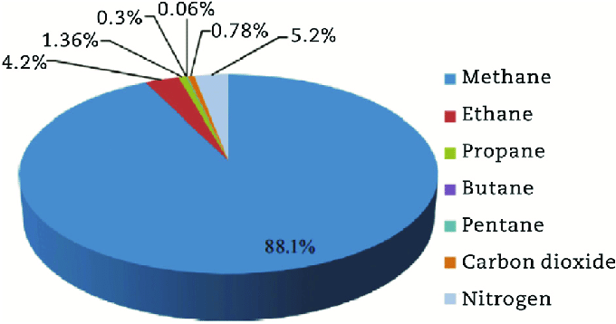
PROPERTIES OF NATURAL GAS
Natural Gas is:
Colorless; Odorless; Tasteless; Non-Toxic; Lighter than air
Odorant added (Methyl mercaptan)
Rotten-egg/cabbage smell
Natural gas is highly flammable and will burn when the gas-to-air ratio is between about 5% and 15%
Concentrations below 5% or above 15% will not burn
Liquefied gases, such as propane, have different properties than natural gas
Natural Gas Components

Slide 4
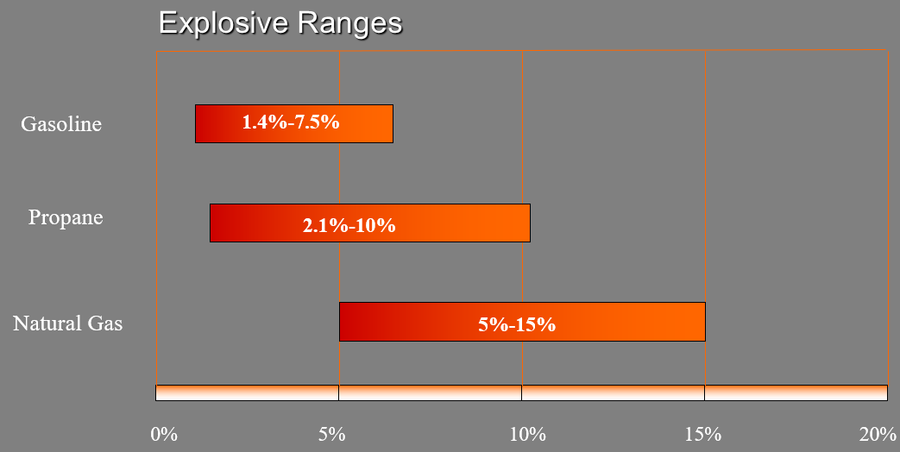
PROPERTIES OF NATURAL GAS

Slide 5
“Lighter than Air”
When released in the atmosphere:
Natural gas will rise and quickly mix with air.
Propane, gasoline and fuel oils will settle at ground level.
Natural gas:
Will follow the path of least resistance.
Can accumulate far away from initial leak by traveling through sewers and underground duct lines.

Slide 6
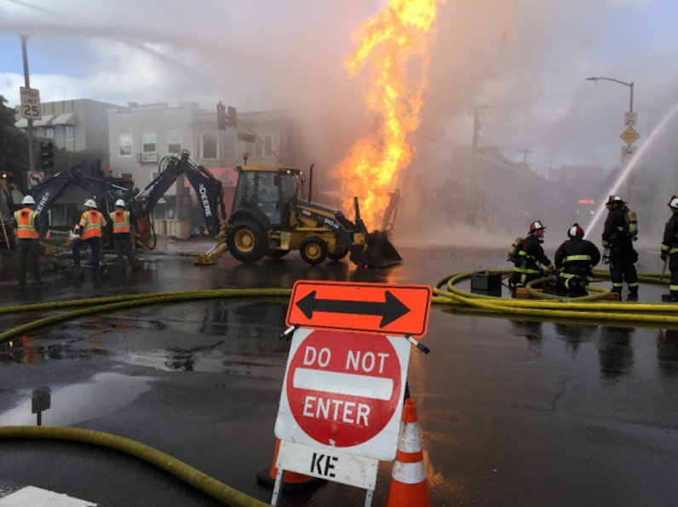
Potential Ignition Sources
Static electricity
Light switches
Your Equipment
Flashlights
Ringing telephones
Pilot lights
Open flames
Static Electricity

Slide 7
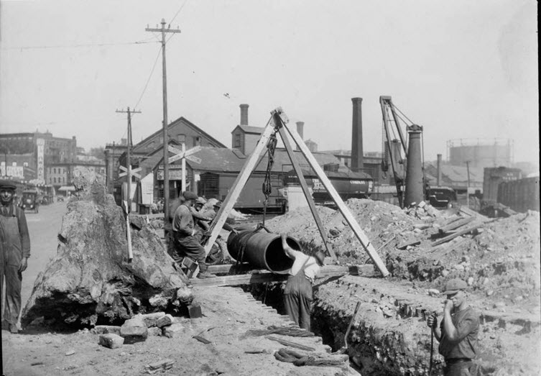
Gas Pipe Materials Types
Types:
Cast Iron (1842 to 1950)
Bell Joints
Lacks Ductility
Tensile Strength
Bare Steel
Corrosion leaks
Coated steel
Third Party Damage
Occasional localized corrosion
Plastic- High Density Polyethylene (HDPE) or Medium Density (MDPE)
Third Party Damage

Slide 8
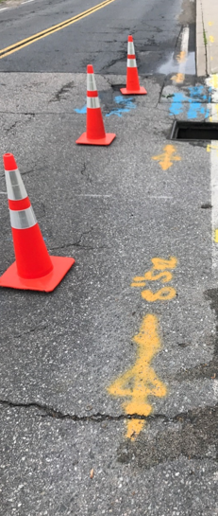
Understanding Gas Locate Marks

Slide 9
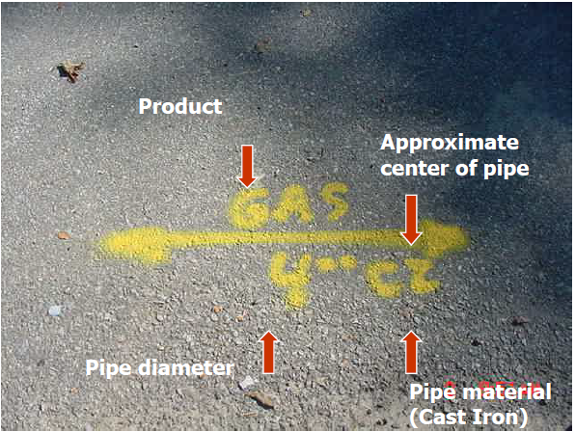
Gas Facility Marks

Slide 10
Gas Line Markings

Slide 11
Cross Bore

Slide 12
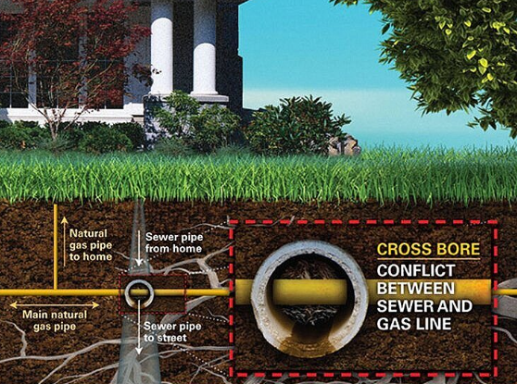
What are Cross-Bores and why is important to know?
A cross-bore is an intersection of one underground utility or structure, by a second utility that compromises the structural integrity of either the utility or underground structure.

Slide 13
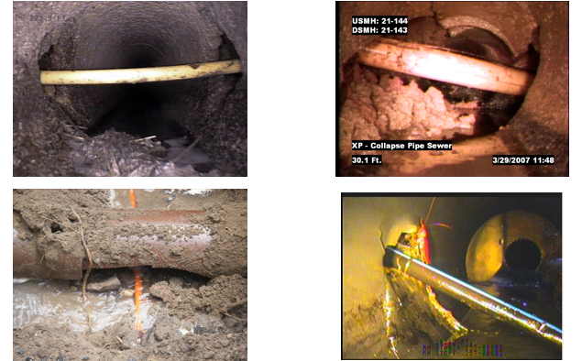
Cross Bore Examples

Slide 14
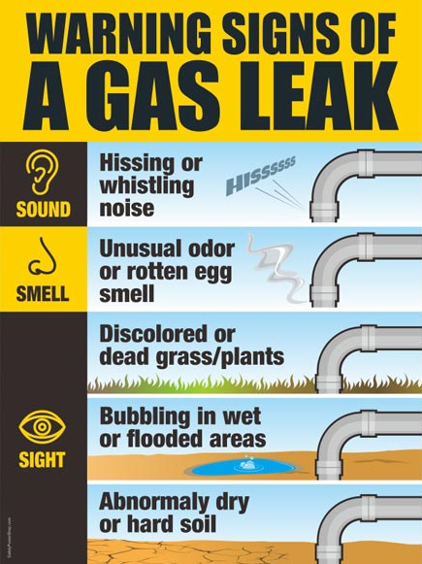
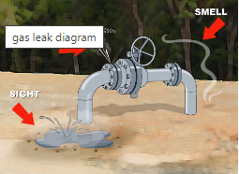
GAS LEAKS

Slide 15
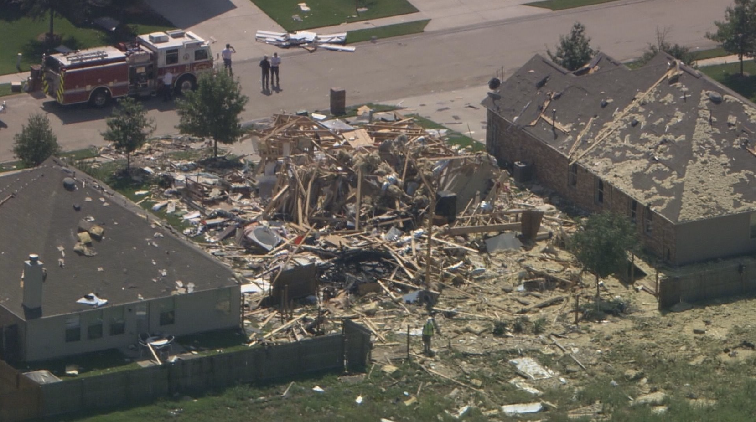
What to do when a gas line is damaged?
Stay Calm and Think
Stop Work
CALL 911
Clear the Area
Call Gas Company immediately after calling 911
An excavator damage the gas line outside the home, injuring 3

Slide 16
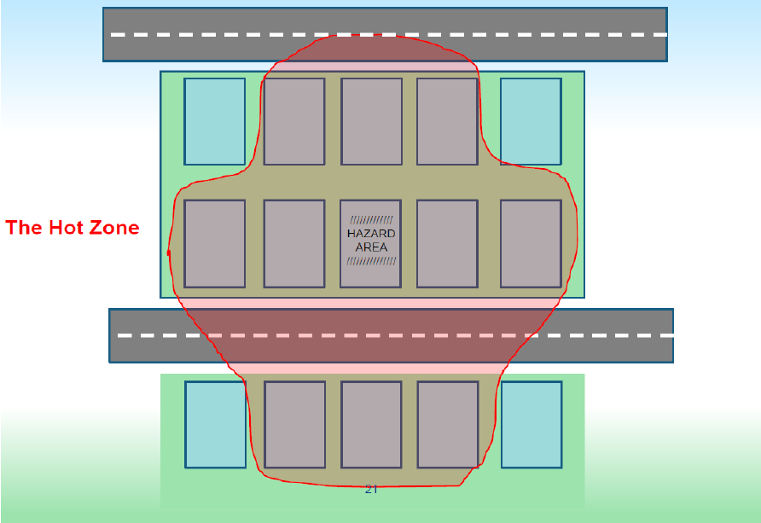
What to do when a gas line is damaged?
After calling 911
Evacuate the area
Think about adjacent structures

Slide 17
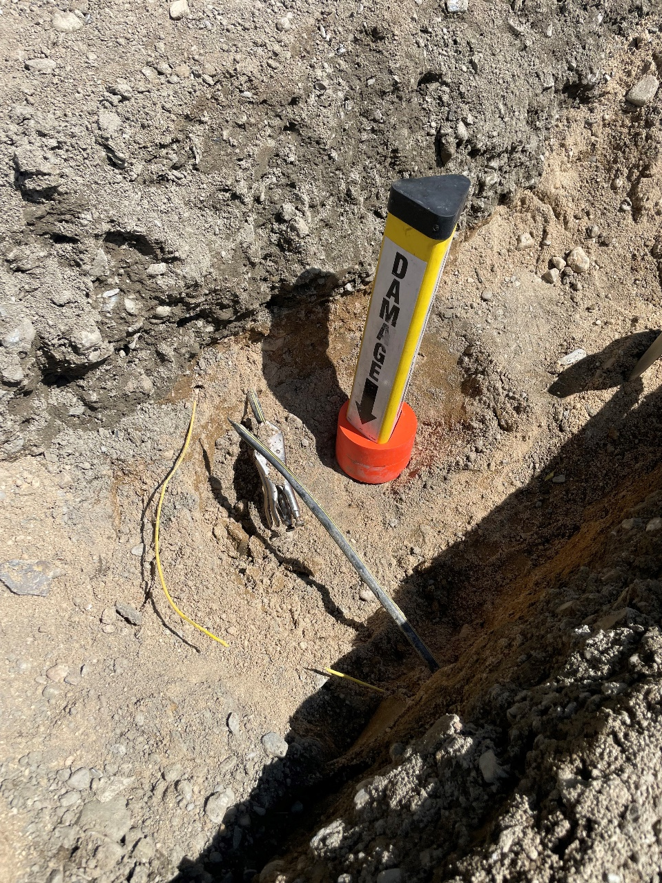
What NOT to do when a gas line is damaged
DON’T PANIC
DON’T Look in or get in the hole
DON’T Attempt to stop the flow of gas
DON’T Operate any valves on the gas system
DON’T Attempt to repair the damage
DON’T Backfill. Wait until the gas company has made the repair and gives the OK to do so

Slide 18
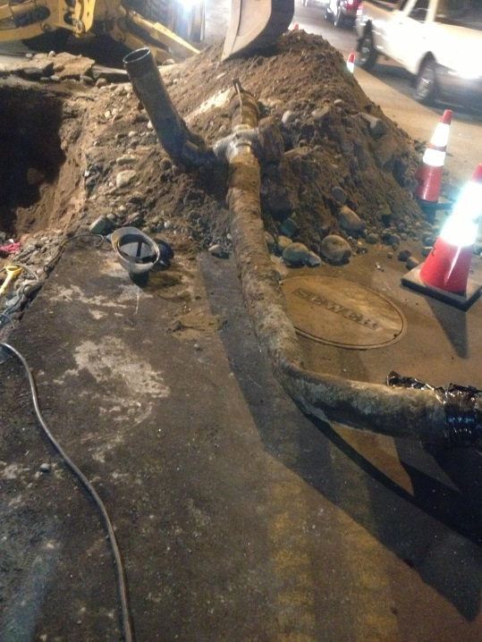
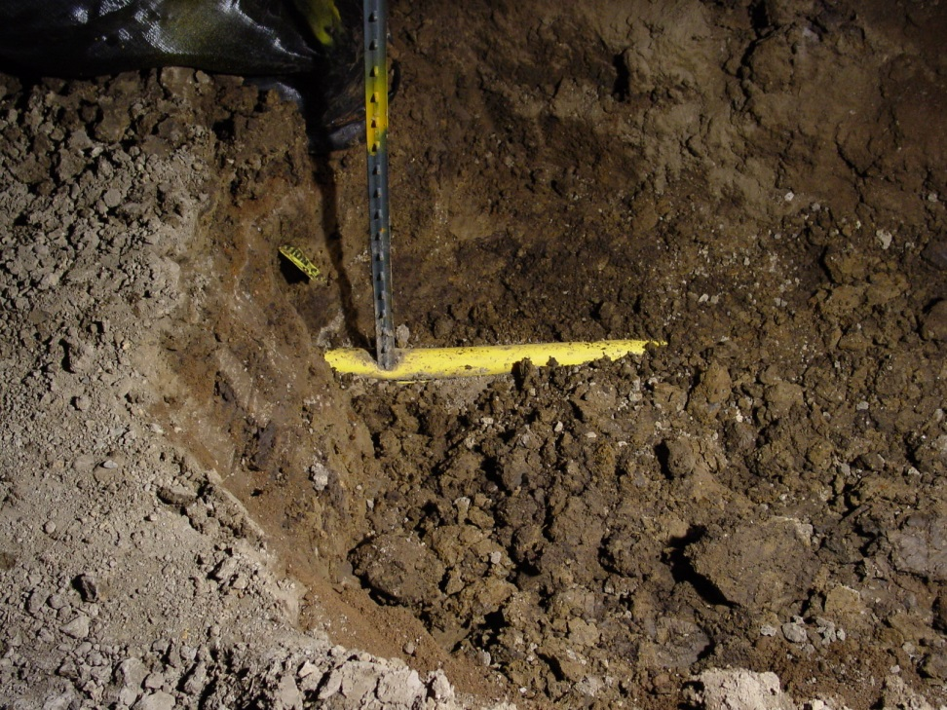
Reporting Damages
Report all Damages Immediately
Coating Damage
Could lead to future leaks.
Broken Tracer Wire or Warning Tape
Plastic is not conductive so without traceable wire and tape gas facilities can’t be located for future construction
Unmarked Gas Facilities
Notify Gas Company immediately so we can correct possible mapping discrepancies
Unitil Emergency Line (1-866-542-3547)

Slide 19
Be Safe and Hand Dig Around Our Pipes!

Slide 20
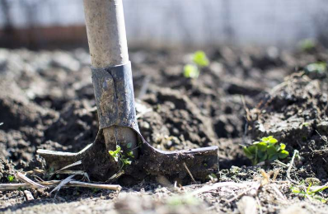
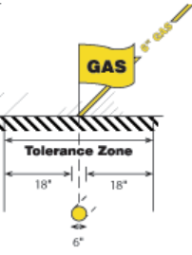
Questions?

