Slide 1
Damage Prevention – Gas Distribution
Hannah Camara – Manager, Technical Training and Compliance
Hannah.Camara@libertyutilities.com

Slide 2
Agenda
Properties of Natural Gas
Materials in our system
Tolerance Zones
Locator Roles
Safety – if you hit line – what should you do?
Cast Iron Encroachment
Cross Bores

Slide 3
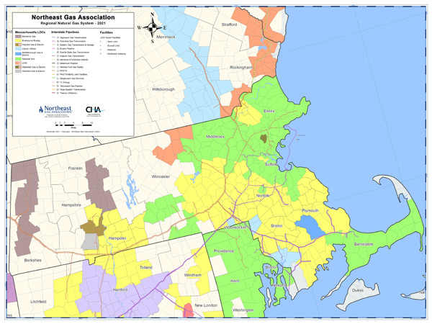
Service Territory Map

Slide 4
Basic Properties of Natural Gas
Tasteless
Colorless
Odorless

Slide 5
Possible Ignition Sources
Static electricity
Ringing the doorbell
Turning light switch on or off
House phone, cell phone, 2-way radios
Lighting any smoking materials
Vehicle engines or equipment

Slide 6
Explosive Limits of Natural Gas
0 LEL
100 LEL
Flammable Range
LEL
0 % GAS
5 % GAS
15% GAS
100 % GAS
LEAN
RICH
% GAS
5

Slide 7
Pipe Materials in Our System
Cast Iron
Sizes: 3” – 30” Pipe Diameter
Brittle (subject to cracking)
Bell & spigot joint every 12 feet
Encroachment - Need to call gas company if you uncover cast iron main
Steel
Sizes: 3/4” – 16”
Bare or Coated
Steal corrodes over time if not protected
If the coating is damaged, do not backfill.
Call the gas company to have the coating repaired
Plastic
Sizes: ½” – 12”
Not always buried in a straight line
Buried with tracer wire to locate pipe
Static electricity can cause an incident
Small diameter plastic can be severed with a shovel

Slide 8
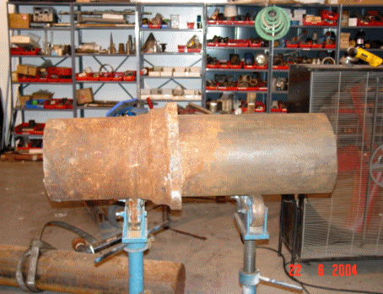
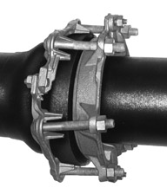
Cast Iron

Slide 9
Cast Iron Encroachment
State law requires gas company to take certain steps when cast iron pipes are “encroached” upon.
Gas companies try to work with excavators to avoid encroachment, but it is often unavoidable.
The most important thing is when you expose a cast iron main, call the gas company and they send someone out to inspect it.
The Gas Company may need to replace sections of main that are encroached upon.
Types of encroachment: Cross, Undermine & Parallel.
Notes:
If a gas main is encroached gas companies must perform Leak Surveys every day until the section of main is replaced.
Uncovered Bell & Spigot Joints must be sealed by the gas company
Gas companies try and work with excavators to avoid encroachments but it is often unavoidable.
The most important thing is when you expose a cast iron main, call the gas company and they send someone out to inspect it.

Slide 10
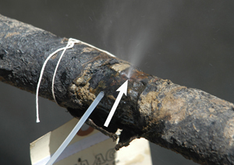
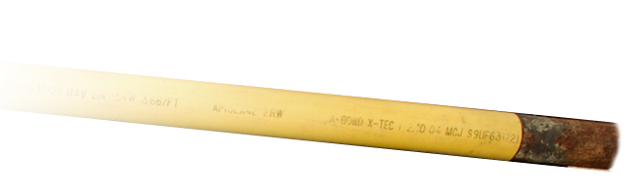
Bare & Coated Steel

Slide 11
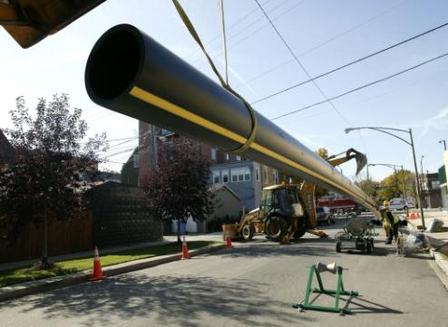
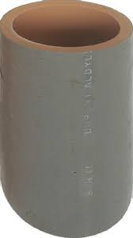
Plastic

Slide 12
Locator Roles
Respond to the site and mark the area with the appropriate color within the expected time frame.
Normal Dig Safe Ticket – 72 hours
Remark Ticket – 24 Hours
Emergency Ticket – As Soon as Practical

Slide 13
Identification and Explanation of Marks
Size of facility
Size indicated on all facilities 2 inches and over
Type of facility
CI = Cast Iron Pipe
STL = Steel pipe
PE = Plastic pipe
WI = Wrought iron

Slide 14
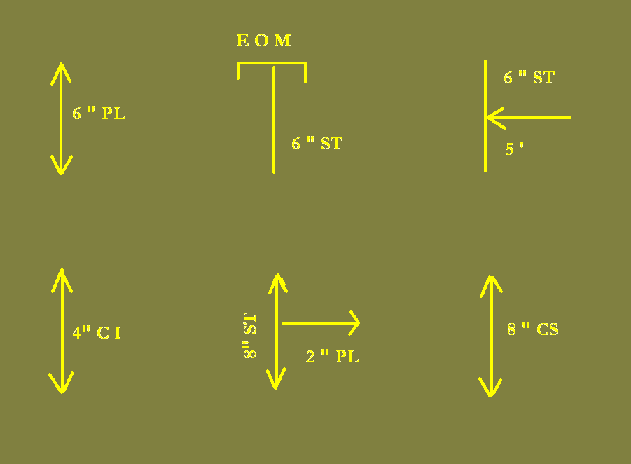
Identification and Explanation of Marks

Slide 15
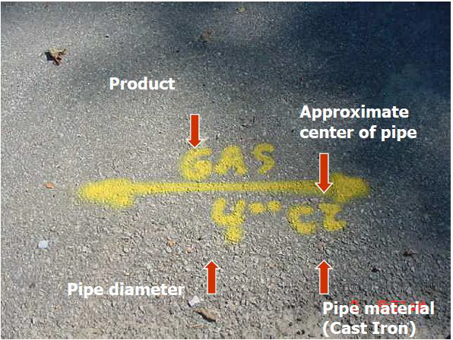
Main

Slide 16
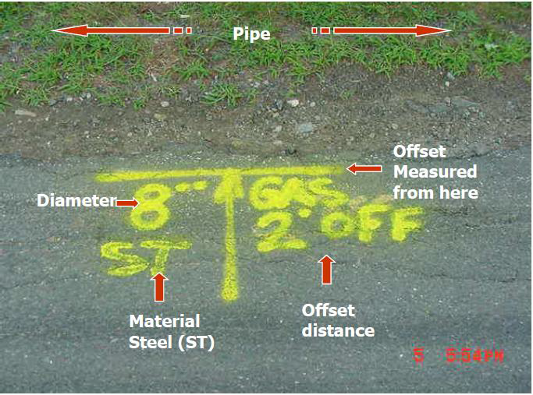
Offset

Slide 17
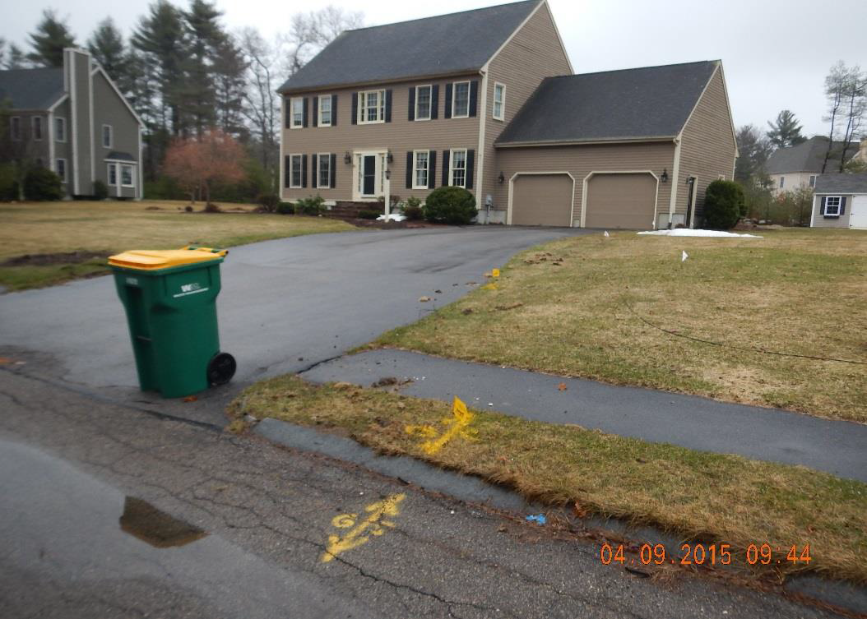
Service

Slide 18
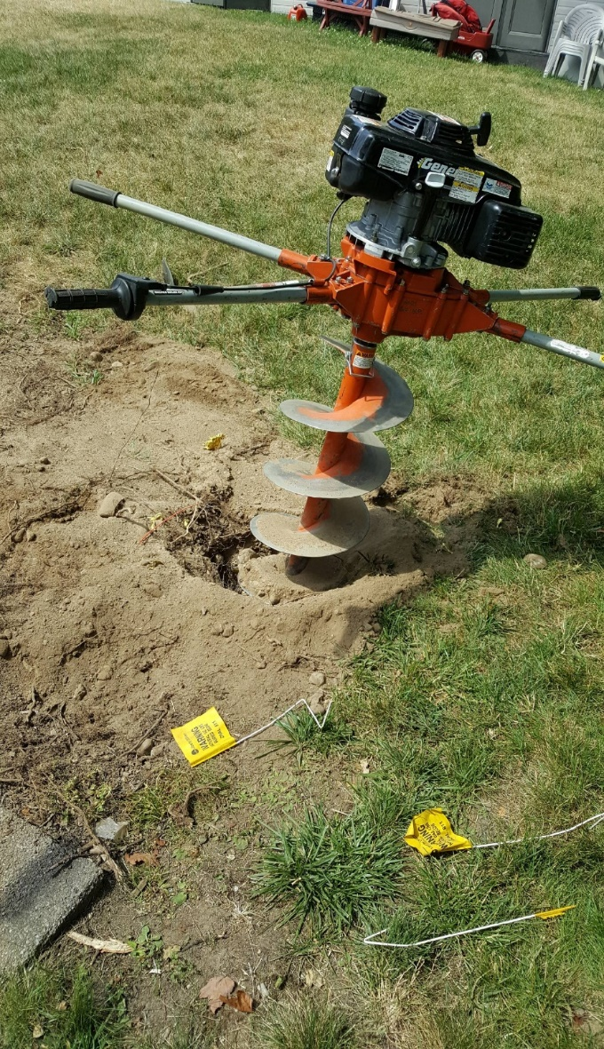
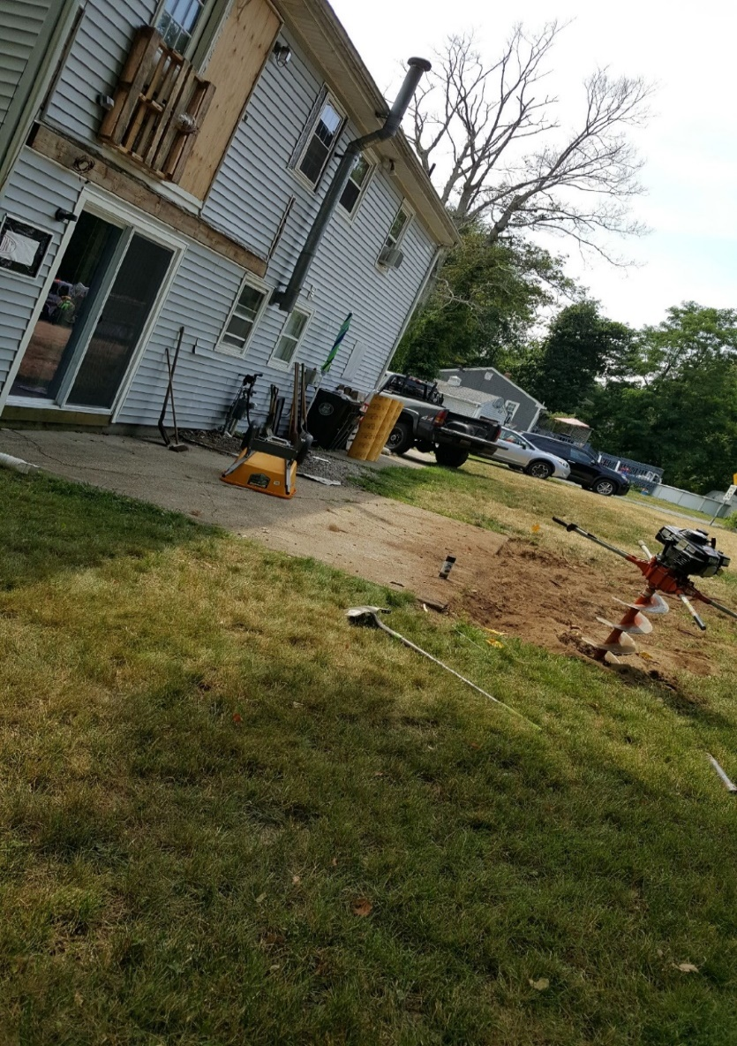
Hit Gas Service - No Valid Dig Safe Ticket
Service Line

Slide 19
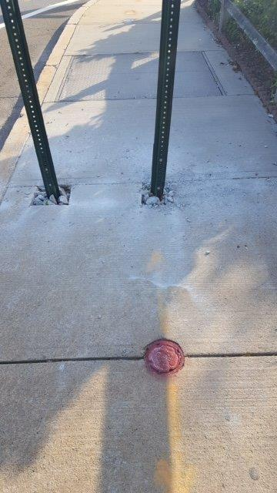
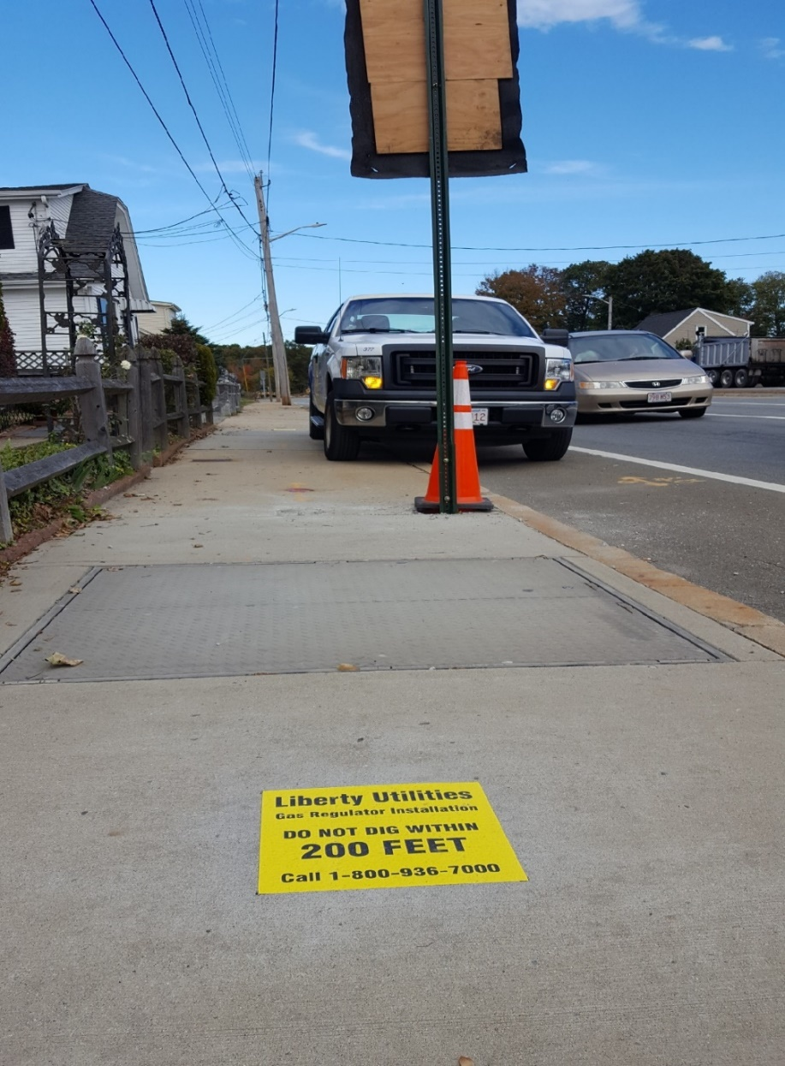
Regulator Station Vault
Regulator Vault
Permanent Markings
Notes:
Contact Liberty if digging near these vaults
Regulator Stations are used to monitor and control system operating pressures.
From Eversource: A site meeting and standby is required for excavation within 50’ of a regulator station. A minimum of 24 hours notice form the excavator is required to schedule standby personnel prior to excavation.

Slide 20

Cross Bore

Slide 21
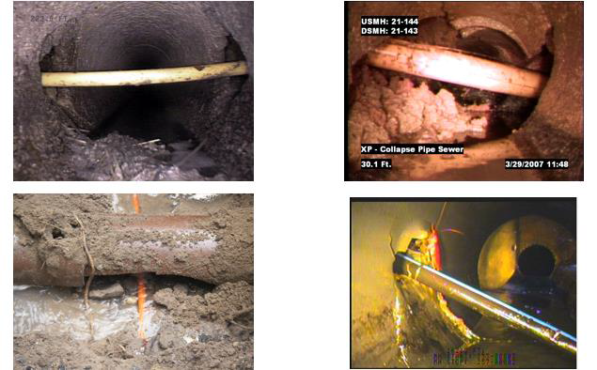
Cross Bore Examples

Slide 22
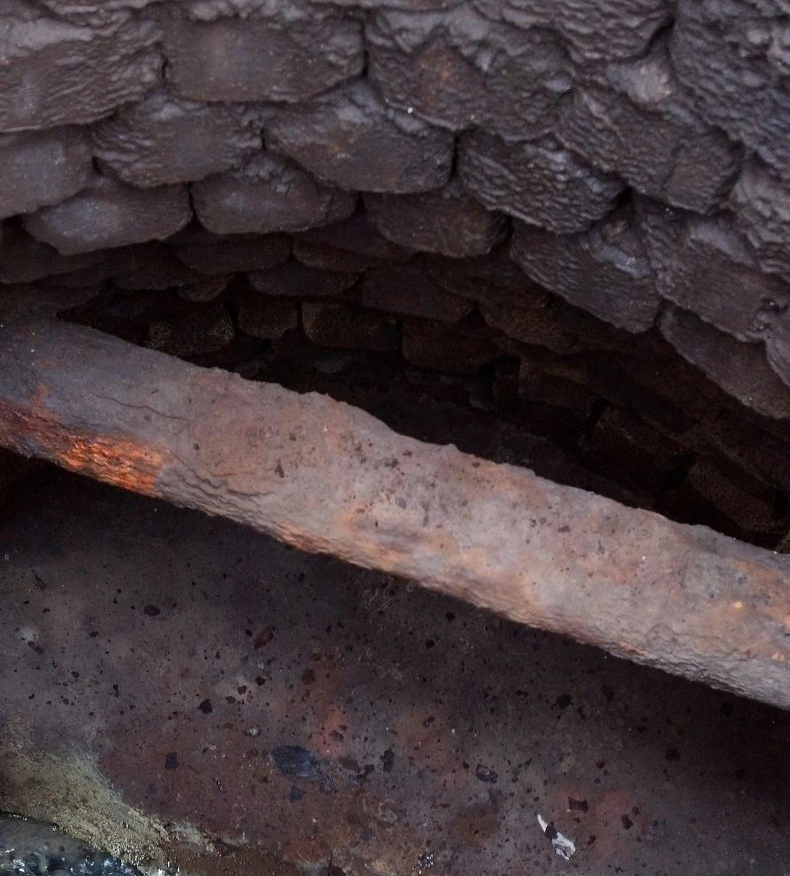
Gas Main through catch basin. Notify us!

Slide 23
A Gas Line is Hit or Ruptured-What do you do?
Shut down machinery.
Move away from the affected area.
Immediately call 911 and the gas company.
Do not attempt to repair the damage, stop the flow of gas or do anything that could cause a spark.
Keep the general public away from the area.
Fire Department in charge of the scene.
If gas is escaping inside a building or is entering a building through an opening, knock on the door the notify building occupants. Do not ring the doorbell!
Notes:
Stay calm.
Signs of a ruptured or hit pipe:
-Blowing or hissing sound.
-Dust blowing from the hole.
-Continuous bubbling in wet area.
-Rotten egg smell
Flames – gas has ignited.

Slide 24
Gas Utility Emergency Telephone Numbers
Liberty Utilities - 800-936-7000
EVERSOURCE - 800-592-2000
EGMA - 800-525-8222
National Grid Gas 800-233-5325
911 - Fire Department

Slide 25

In Conclusion
We are in this together.
Preparation is key
•Premark
•Call in a Valid Dig Safe
•Hand Dig
Keep phone numbers handy
•Program cell phones
•Stickers on all equipment

Slide 26
Thank you for Digging Safe

