Slide 1
Damage Prevention Training Department of Public Utilities Damage Prevention Program

Slide 2
Our Team
Jennifer Cabrera, Program Manager
Damage Prevention
Pipeline Safety Division
Department of Public Utilities
Lars Seadale & Meaghan Connors Oren Leifer & Will Burnand
Program Coordinator’s Compliance Officer's
Damage Prevention Program Damage Prevention Program
Pipeline Damage Prevention Pipeline Damage Prevention
Department of Public Utilities Department of Public Utilities
David Degon, Matthew MacInnis & Scott Lessing
Pipeline Engineer Inspector’s
Damage Prevention Program
Pipeline Damage Prevention
Department of Public Utilities
Emily Hamrock & Patrick Leeman
Division Counsel
Pipeline Safety Division
Department of Public Utilities

Slide 3
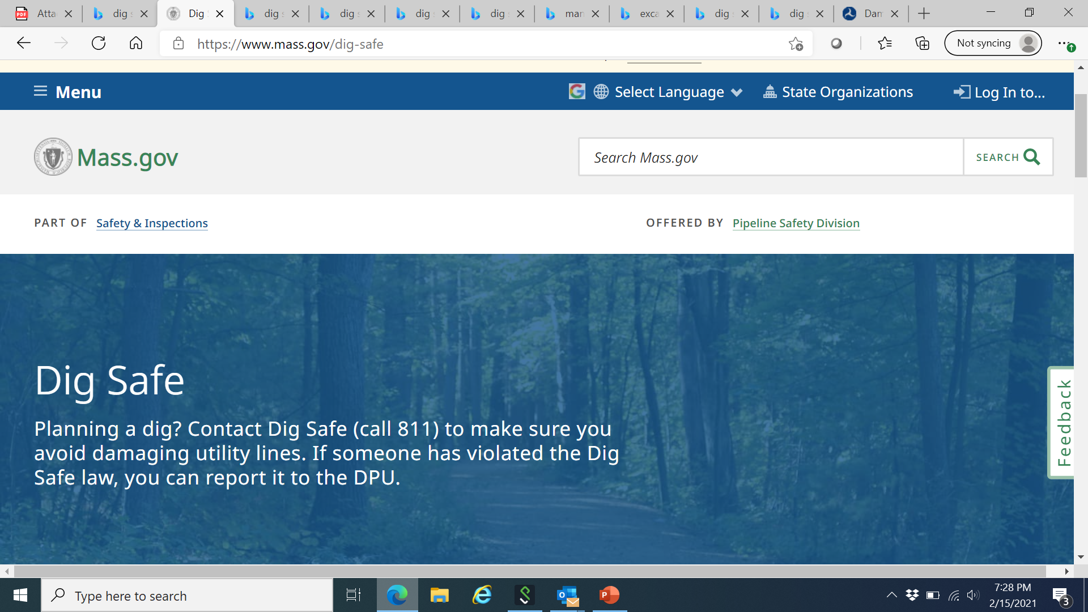
Online Resources
www.mass.gov/dig-safe
- Report A Violation To the DPU - Learn About Dig Safe
- Research Dig Safe Law - Dig Safe Regulations
www.digsafe.com or Call 811 - Sign Up or Sign In - Request a new Dig Safe Ticket or Renew a Dig Safe Ticket
Common Ground Alliance www.commongroundalliance.com
- Promoting effective damage prevention practices

Slide 4
Pipeline and Hazardous Materials Safety Administration (dot.gov)
We work closely with the U.S. Department of Transportation
Pipeline and Hazardous Materials Safety Administration.
Several online resources are available on the PHMSA
Website as it relates to pipeline safety:
Safety Awareness Overview
Pipeline Leak Recognition and What to Do
Excavation Enforcement Final Rule
Pipeline Emergency Responders Initiative (PERI)
Safety Awareness Reports Search
Historical Pipeline Incidents
Pipeline Failure Investigation Reports
Marine Damage Prevention

Slide 5
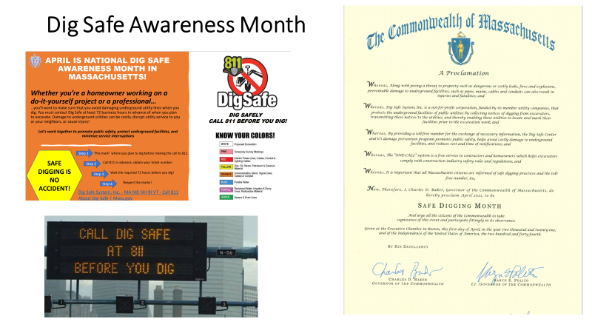

Slide 6
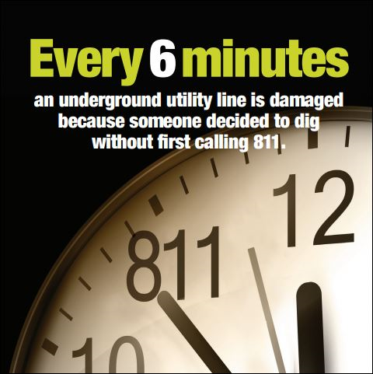
Consequences of Damage
Explosion
Fire
Electrocution
Injuries/fatalities
Property damage
Interruption of service to customers
Spills/emissions
State Violations
Damage Prevention Record

Slide 7
Recent news stories from around the country…

Slide 8
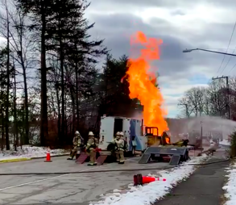
Springfield, Northern Virginia
Digging equipment strikes a gas line sparked an explosion and fire that injured three Washington Gas workers and led to the evacuation of eight homes.
Fire crews arrived to find a large volume of fire in the middle of the street with flames extending 50 to 70 feet in the air. The fire was being fed from a free flowing, six-inch gas line. Crews worked quickly to extinguish fires in two vehicles that resulted from the gas fed fire.
Feb 4, 2021

Slide 9
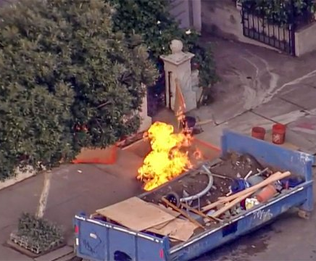
San Francisco, California
A construction crew had punctured a gas service line and one adult had suffered a minor injury…flames about 10 to 12 feet high coming from the sidewalk
Nov 2020

Slide 10
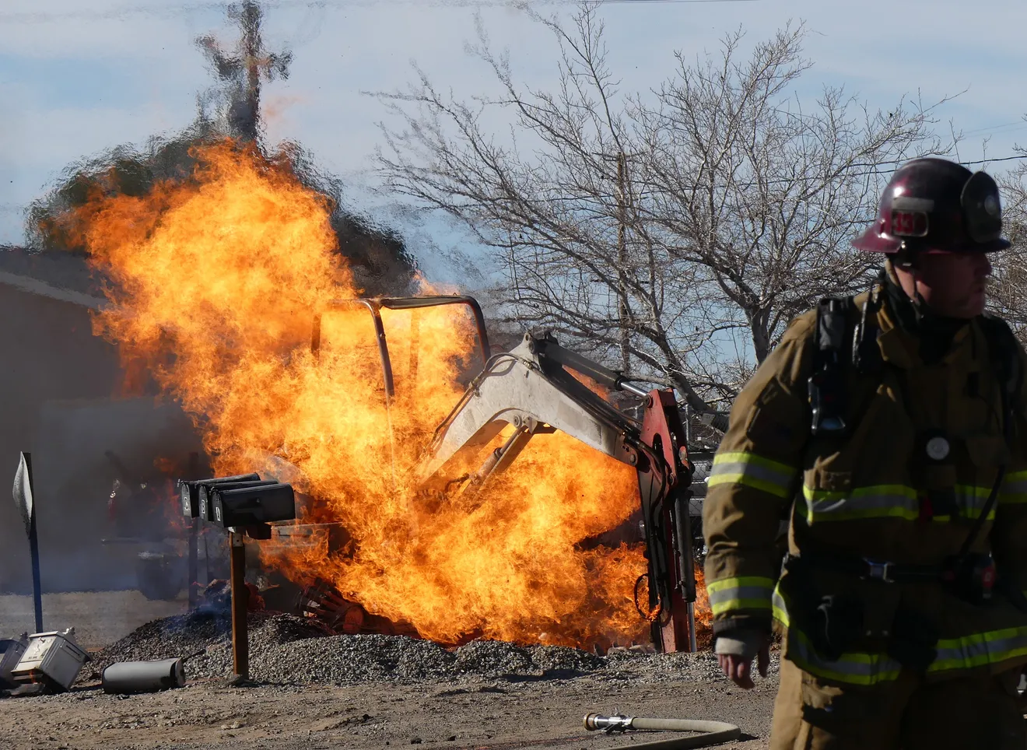
Apple Valley, California
Septic company using an excavator ruptured a gas line, which ignited the fire.
This occurred next to a residential complex and a nearby high school.
Thankfully, no injuries.
Feb 4, 2022

Slide 11
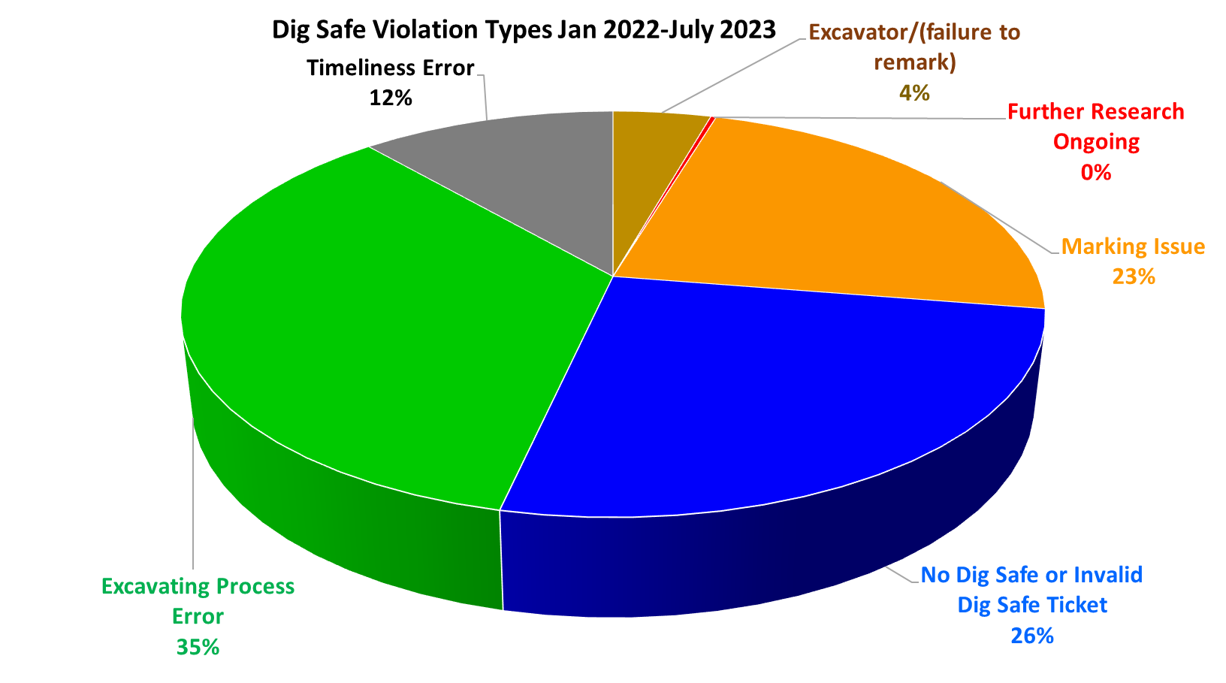
Percentages of Violations and Their Type

Slide 12
List of Key Changes to Damage Prevention Regulations
Emergency notifications only for true emergencies: 220 CMR 99.05
Companies must mark out new installations: 220 CMR 99.06(9)
Dig Safe ticket valid for only 30 days: 220 CMR 99.07(2)
Suspend work upon call for remarking: 220 CMR 99.07(5)
Call 911 if damage leads to gas escaping: 220 CMR 99.07(8)
Requirement to report damage: 220 CMR 99.07(10)
Higher penalties for natural gas-related violations: 220 CMR 99.14 and the 2021 Act Creating a Next Generation Roadmap for Massachusetts Climate Policy

Slide 13
Civil Penalty Amounts for Violations of Damage Prevention Law and Regulations
Violations not related to natural gas facilities, e.g., electrical, communications, etc.: $1,000 for first offense, $5,000 to $10,000 for second offense within 12 months.
Violations related to natural gas facilities: up to $500,000 for each violation for each day that the violation exists, up to a maximum of $10,000,000 for a related series of violations. These dollar amounts shall be doubled if similar violation(s) in the past three years.

Slide 14
What is EXCAVATION?
G.L. c. 82 s. 40 defines excavation BROADLY.
“Excavation”, an operation for the purpose of movement or removal of earth, rock or the materials in the ground including, but not limited to, digging, blasting, auguring, backfilling, test boring, drilling, pile driving, grading, plowing in, hammering, pulling in, jacking in, trenching, tunneling and demolition of structures.

Slide 15
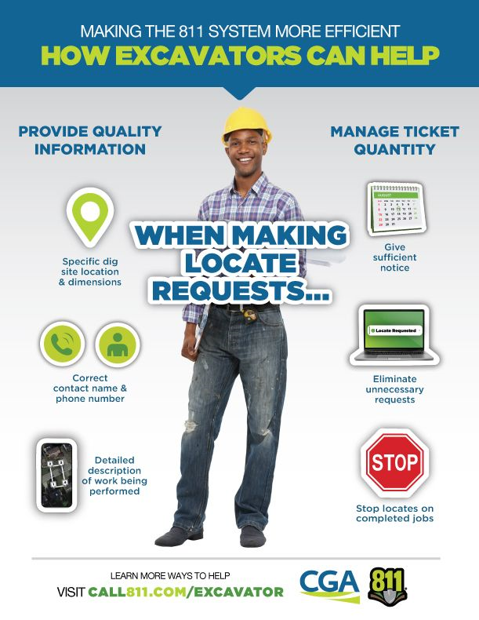
Premark the area where you are planning to dig with WHITE or PINK. THIS INLUDES PRIVATE PROPERTY. A regular ticket must be submitted by www.DigSafe.com or Call 811. Municipalities are not required to become members of Dig Safe, Inc. Explain your plans in detail. Dig Safe Ticket will provide the EFFECTIVE START DATE & TIME as well as EXPIRATION DATE. Your ticket is ONLY VALID 30 DAYS. Be sure to RENEW DIG SAFE TICKET if needed 72 hours prior to expiration.
What Must Be Done BEFORE The Excavation

Slide 16
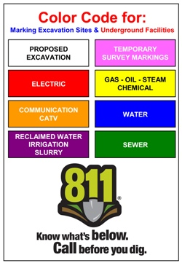
What To Do Once the Dig Safe Ticket is Validated…
Observe the Site
Ask yourself these questions:
Did all the notified Utilities respond?
Respect the Marks
& the Tolerance/Safety Zone
Tickets Expiration
A new ticket must be requested if:
The job is ongoing for more than 30 days.
The scope of work or excavation location has changed.
Excavators must refresh the original marks with the same color. Otherwise call Utility or Dig Safe 811 to request re-marks.
No mechanical means within the tolerance zone.
Do you suspect any potential mis-marked or unmarked utilities?
If you call for remark, you must suspend work in the area of remark for 24 business hours (time allowed for remarking).
Did you take a BEFORE picture of the area with all markings visible?
.

Slide 17
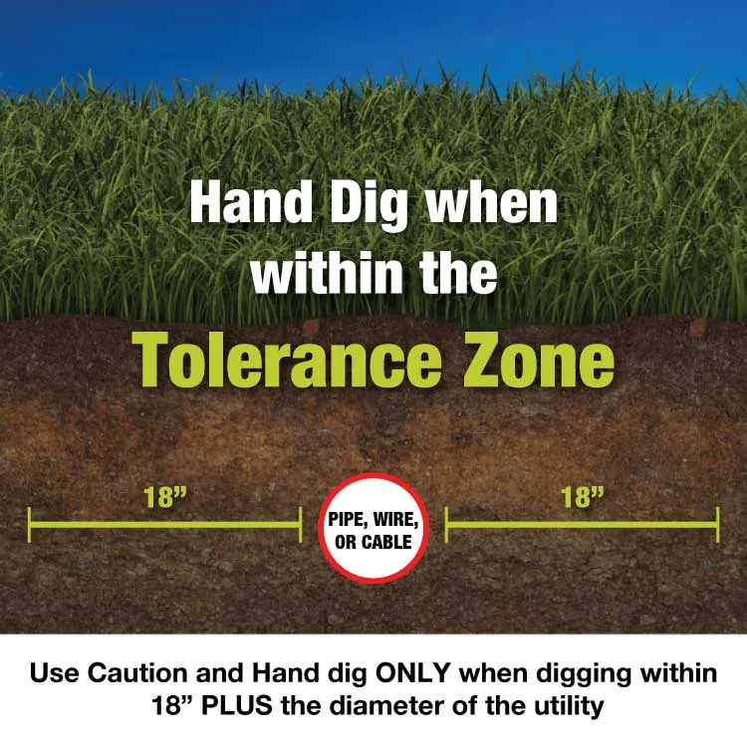
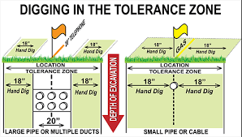
Understanding The Tolerance Zone

Slide 18
What Must Be Done DURING The Excavation: Employ REASONABLE PRECAUTIONS
- Mechanical means may only be used for the initial penetration of pavement, cement, etc. in tolerance zone. Non-mechanical means (i.e., hand tools) are used after the pavement, cement, etc. has been penetrated.
- Be careful! Some underground facilities may be shallow therefore we are DEPTH BLIND.
- Excavator must implement REASONABLE PRECAUITIONS to avoid damage to any underground facilities. This includes any weakening of structural or lateral support of such facilities, penetration or destruction of any pipe, main, wire or conduit or the protective coating thereof, or damage to any pipe, main, wire or conduit.
- Always protect the utility, ESPECIALLY if it is exposed. Falling rocks, falling debris, etc. will be considered as lack of reasonable precaution. Protect the underground facilities!
- If an excavator damages an underground utility or has reason to believe that an underground utility may be damaged or compromised in any way, the EXCAVATOR MUST NOTIFY THE UTILITY AND DPU DAMAGE PREVENTION.

Slide 19
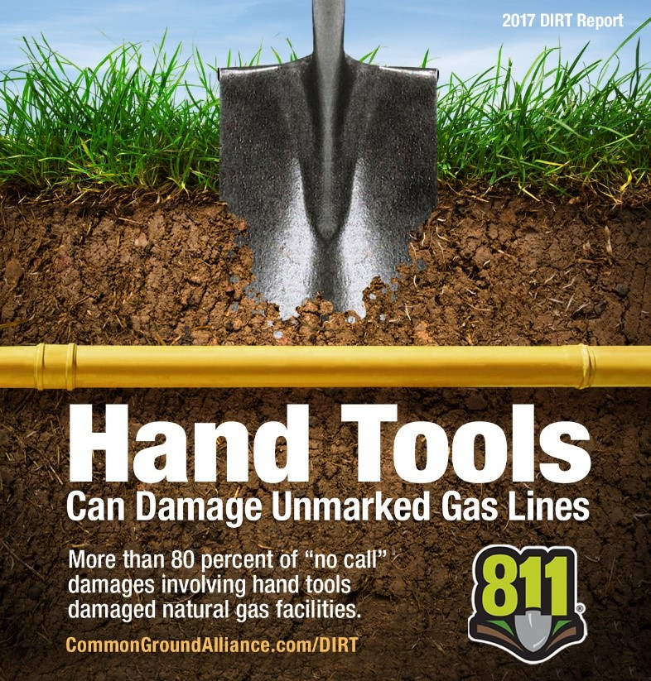
Hand Tools Can Cause Damages

Slide 20
Call 911 for Release of Gas Call 911 if damage leads to gas escaping: 220 CMR 99.07(8)
You must call 911 if excavation damage results in release of natural gas
Report the damage to the utility owner at the earliest practical moment.
In addition, you must:
Evacuate nearby structures if necessary.
Attempt no repairs, unless directed to by the facility owner or operator.
Report the damage to the DPU Damage Prevention submitting a COMPLETE DSVR along with photo documentation.

Slide 21
Emergency Excavation
New definition for Emergency: “A sudden or unexpected occurrence involving a clear and imminent danger demanding immediate action to prevent or mitigate loss of, or damage to, life, health, property, or essential public services, but not including a loss of business or profits.”
BUT: must be true emergency: an unanticipated event, not merely to prevent loss of business or profits
E.g., Not for tent stakes on a Friday when party is on Sunday
May continue to excavate after taking reasonable precautions and premarking site
Must use reasonable precaution to avoid damage and comply with all Damage Prevention laws and regulations
Emergency notifications are only for true emergencies: 220 CMR 99.05

Slide 22
Emergency Excavation (cont.)
Call
Call Dig Safe, Inc.
Dig Safe, Inc. shall not issue Emergency ticket if it does not believe in good faith that situation is an emergency
Mark out
Companies must mark out the area within three hours of notice
Notify
When emergency has been brought to conclusion, you must notify Dig Safe, Inc.
And notify Dig Safe, Inc. if further excavation needed beyond premarked area, to obtain new 30-day ticket

Slide 23
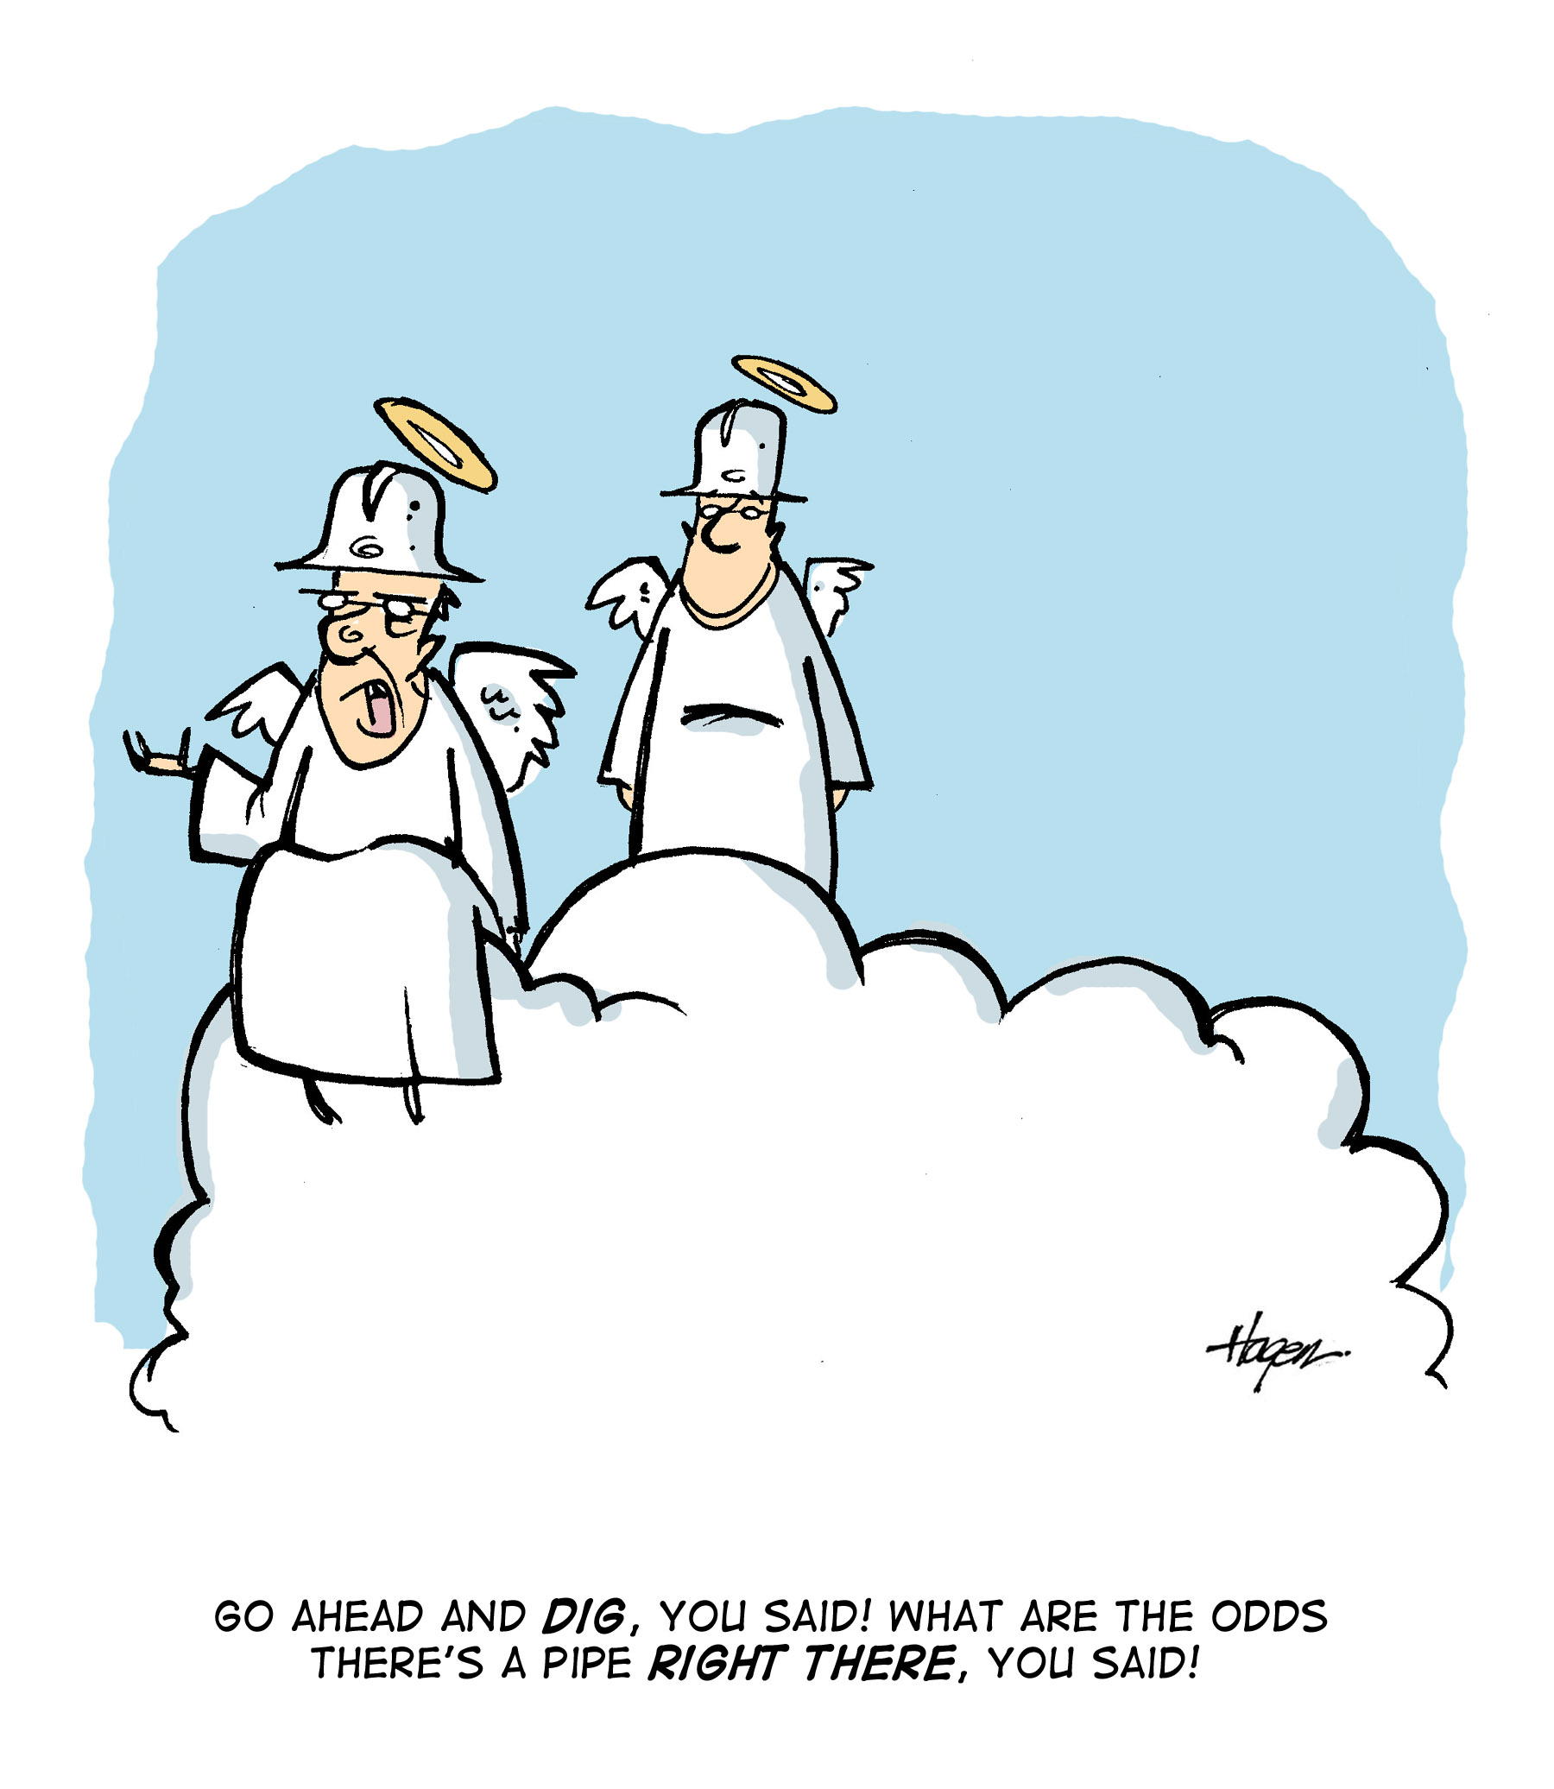
Reporting Violations/Damages
www.mass.gov/dig-safe
Dig Safe Law requires, Member Utilities & Excavators to report damage and any suspected Dig Safe violations to the DPU.
Fill out a DSVR for mismarked and unmarked facilities even when no damage occurred.
Why is this important?
Reporting Mismarked / Unmarked Facilities means a potential violation against the Utility, which means the maps will get updated and the facility won’t get damaged in the future
It provides both sides of the incident, potentially saving them from an NOPV at the onset.

Slide 24
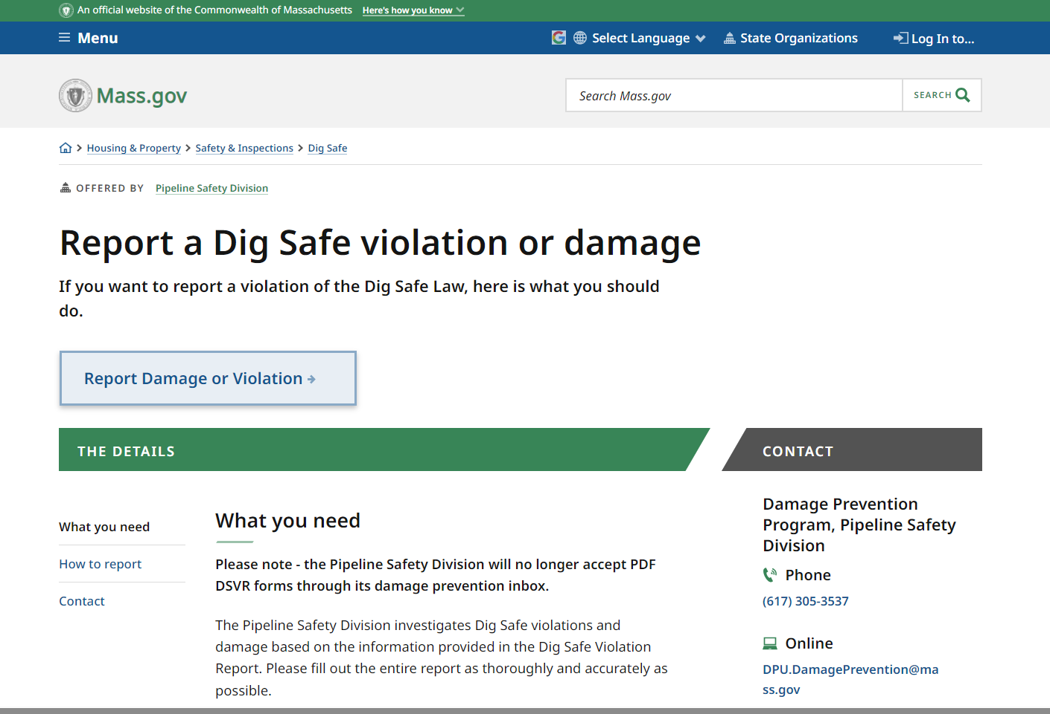
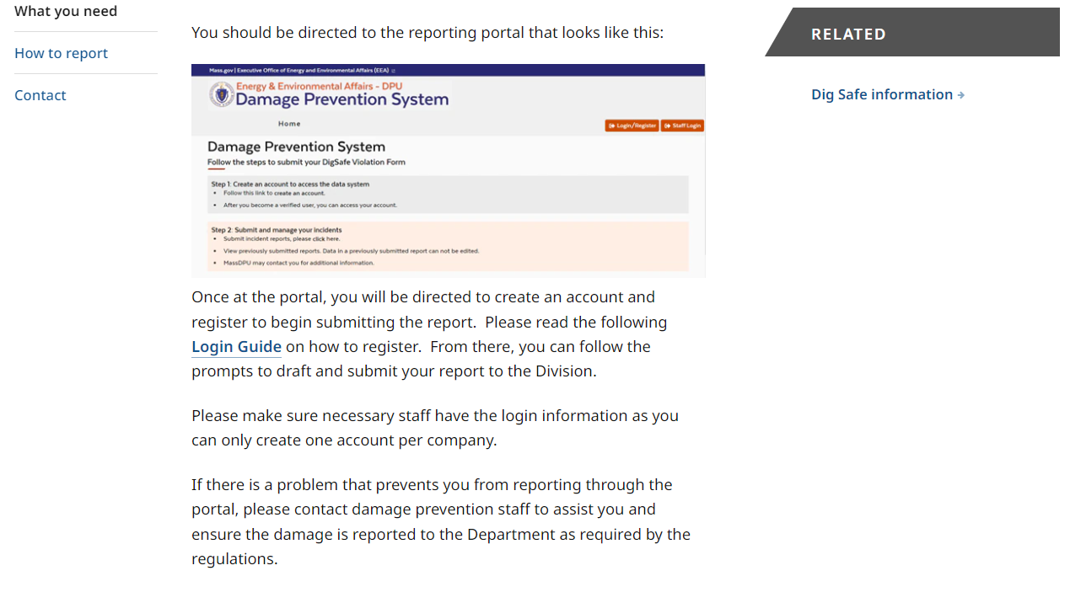
Dig Safe Violation Report (DSVR)
www.Mass.Gov/dig-safe
Email us: DPU.DamagePrevention@Mass.Gov

Slide 25
Dig Safe Violation Report (DSVR)

Slide 26
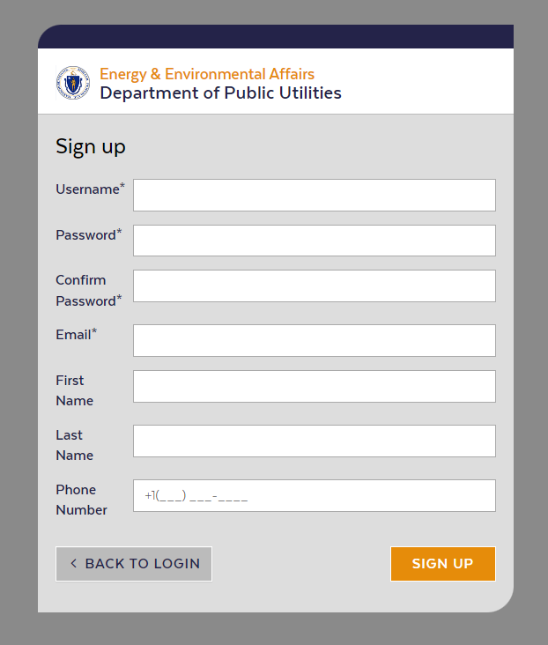
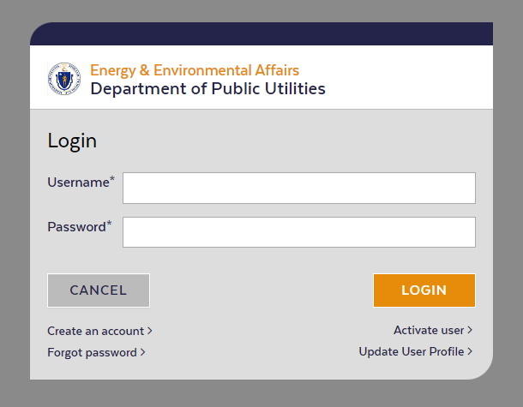
Dig Safe Violation Report (DSVR)

Slide 27
Including Photos is Crucial!

Slide 28
Flow Chart of Enforcement Process
NOPV
Informal Conference
IRD
Adjudicatory Hearing
DSVR

Slide 29
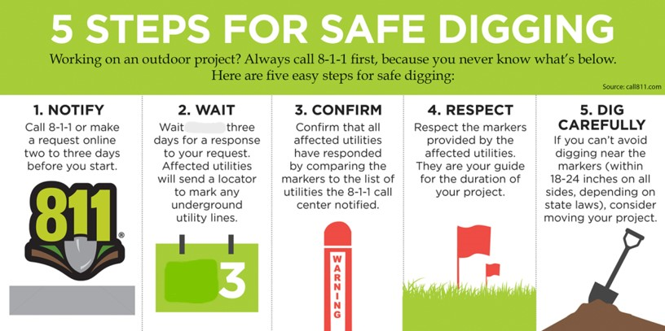
RECAP

