Slide 1
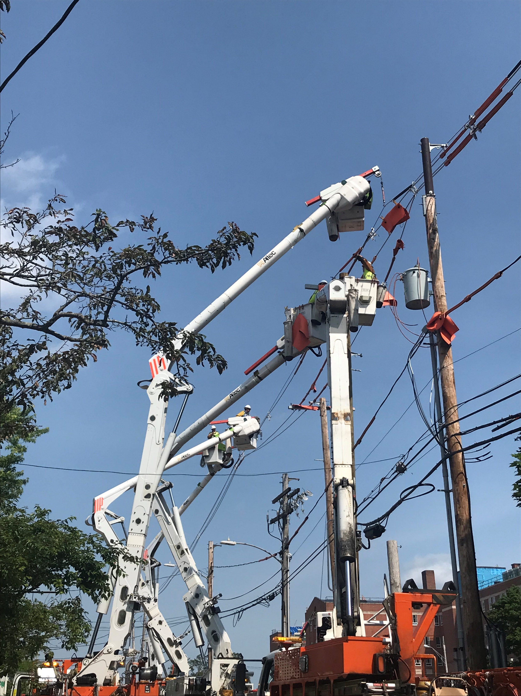
Central Maine Power Electrical Utility Safety- DigSafe
Emergency Preparedness
January 2024

Slide 2
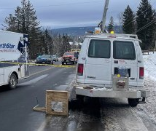
Safety Message
In January 2023, a subcontractor for a communications company was working in Rangeley, Maine. The worker was riding in the bucket without a harness as the truck was driven by another worker along the road. During the course of their work, their truck became tangled in communication wires, and as a result, the worker was thrown from the lifted bucket, and did not respond to life saving efforts.

Slide 3
Today we will review:
An introduction to Central Maine Power and CMP’s transmission and distribution systems​
Special considerations for those who work around energized structures
Safety practices and common issues faced when responding to emergency incidents involving Central Maine Power’s system​

Slide 4
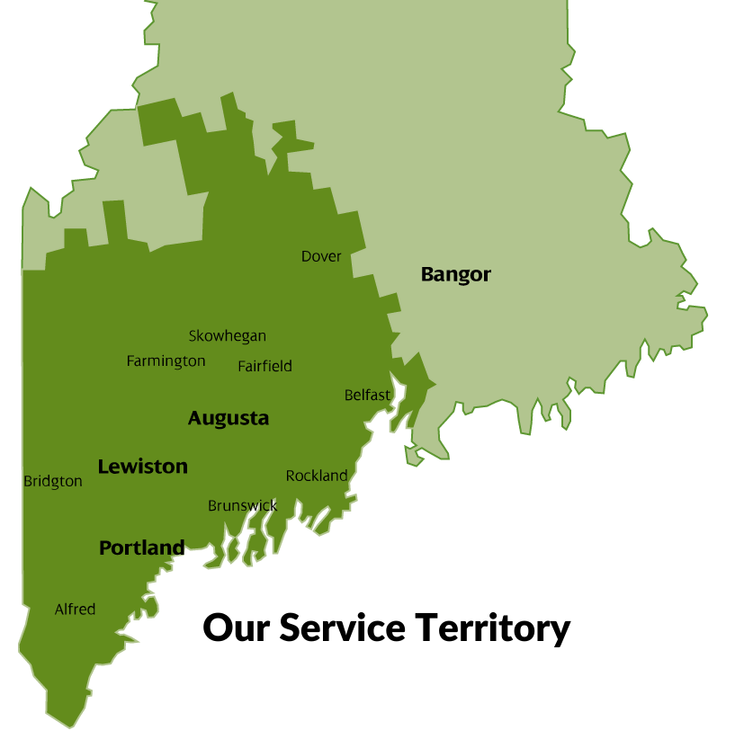
Intro to Central Maine Power
We deliver more than 9 billion kilowatt-hours of electricity yearly to more than 600,000 retail electric customers in central and southern Maine
Our 11,000-square-mile service area contains about 78% of Maine's population and major commercial and manufacturing centers.
We trace our origins back to 1899! The name Central Maine Power was coined in 1910.
Central Maine Power ceased to generate (also known as supply) power in 2000 under a utility restructuring policy put in place by the Maine Legislature.
We continue to be responsible for operating and maintaining the transmission-and-distribution system, including functions like service connections, outage restoration, and system improvements and upgrades as required.

Slide 5
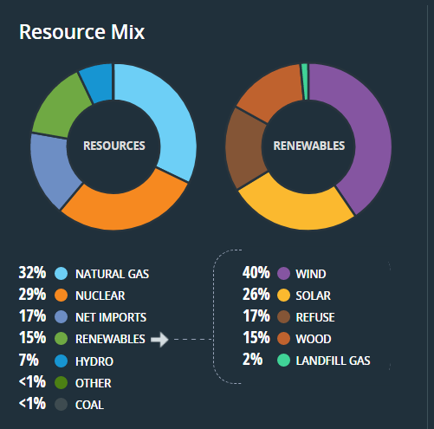
Intro to Central Maine Power: Supply vs Delivery
ISO New England (iso-ne.com) | 2/6/24
Standard Offer Rates for Central Maine Power - Residential and Small Commercial Customers | MPUC
Electricity supply is the energy that is supplied to you each month.
Customers have the option of choosing an electricity supplier or the Standard Offer.
The Standard Offer is the supplier or suppliers chosen in the competitive bidding process by the Maine Public Utilities Commission.
Currently CMP customer electric supply is provided by Constellation Energy Commodities (25%) and NextEra (75%).
CMP does not set the rate; we are mandated to bill on behalf of the suppliers, so customers do not receive two bills.

Slide 6
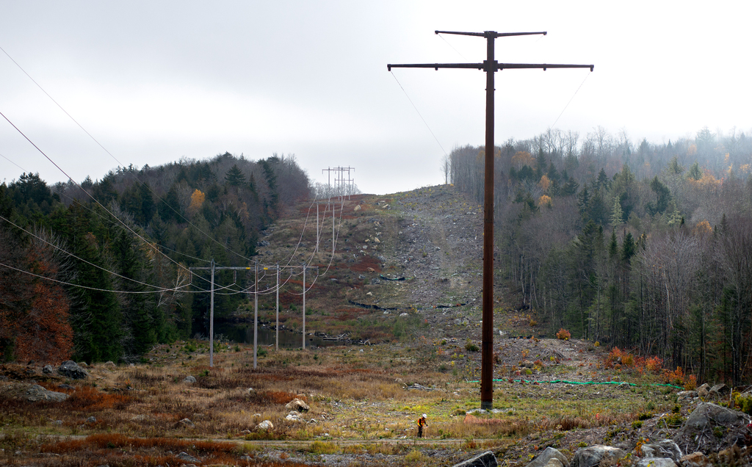
Transmission Line

Slide 7
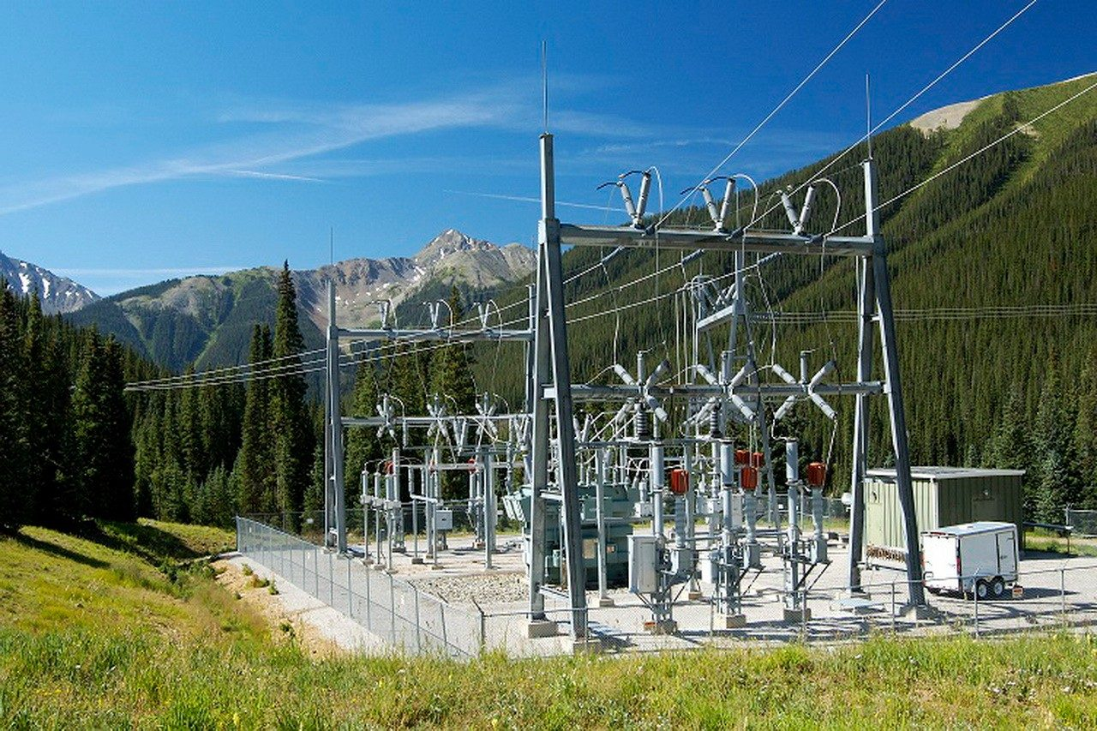
Substation

Slide 8
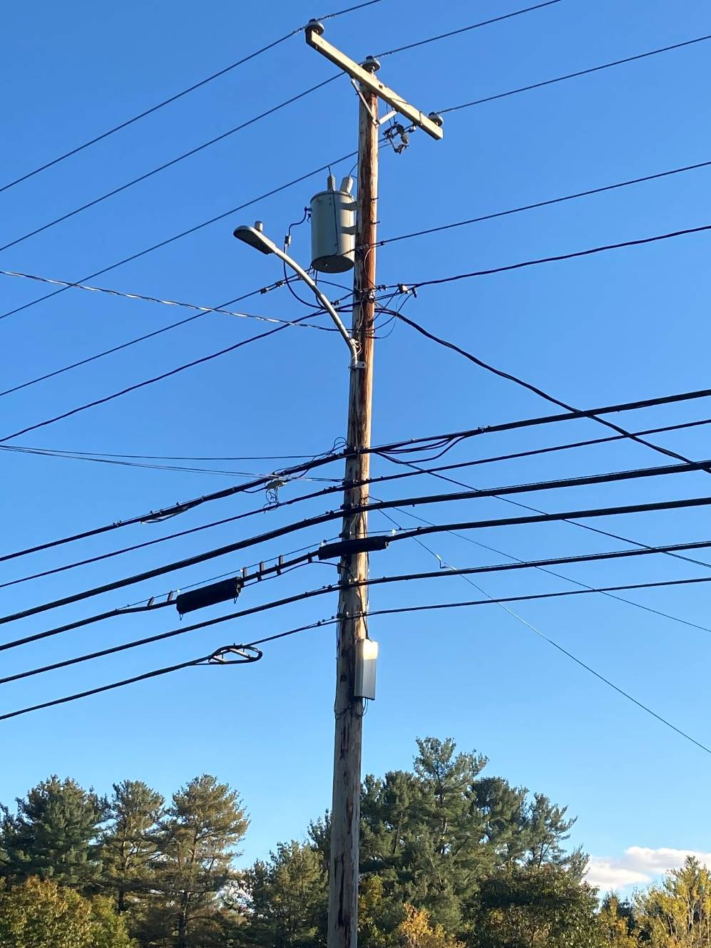
What’s on a Pole?
primaries
transformer
neutral
secondaries
communications
Notes:
Typically 7200 on top whether 3 phase or 1,

Slide 9
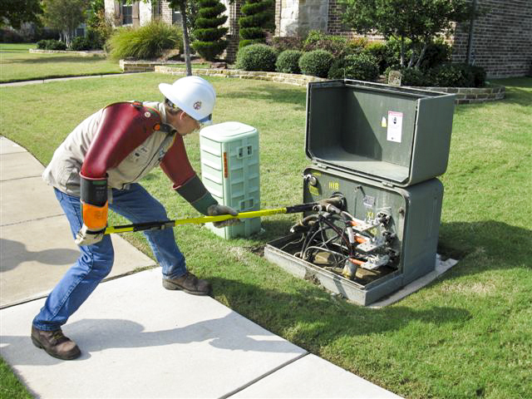
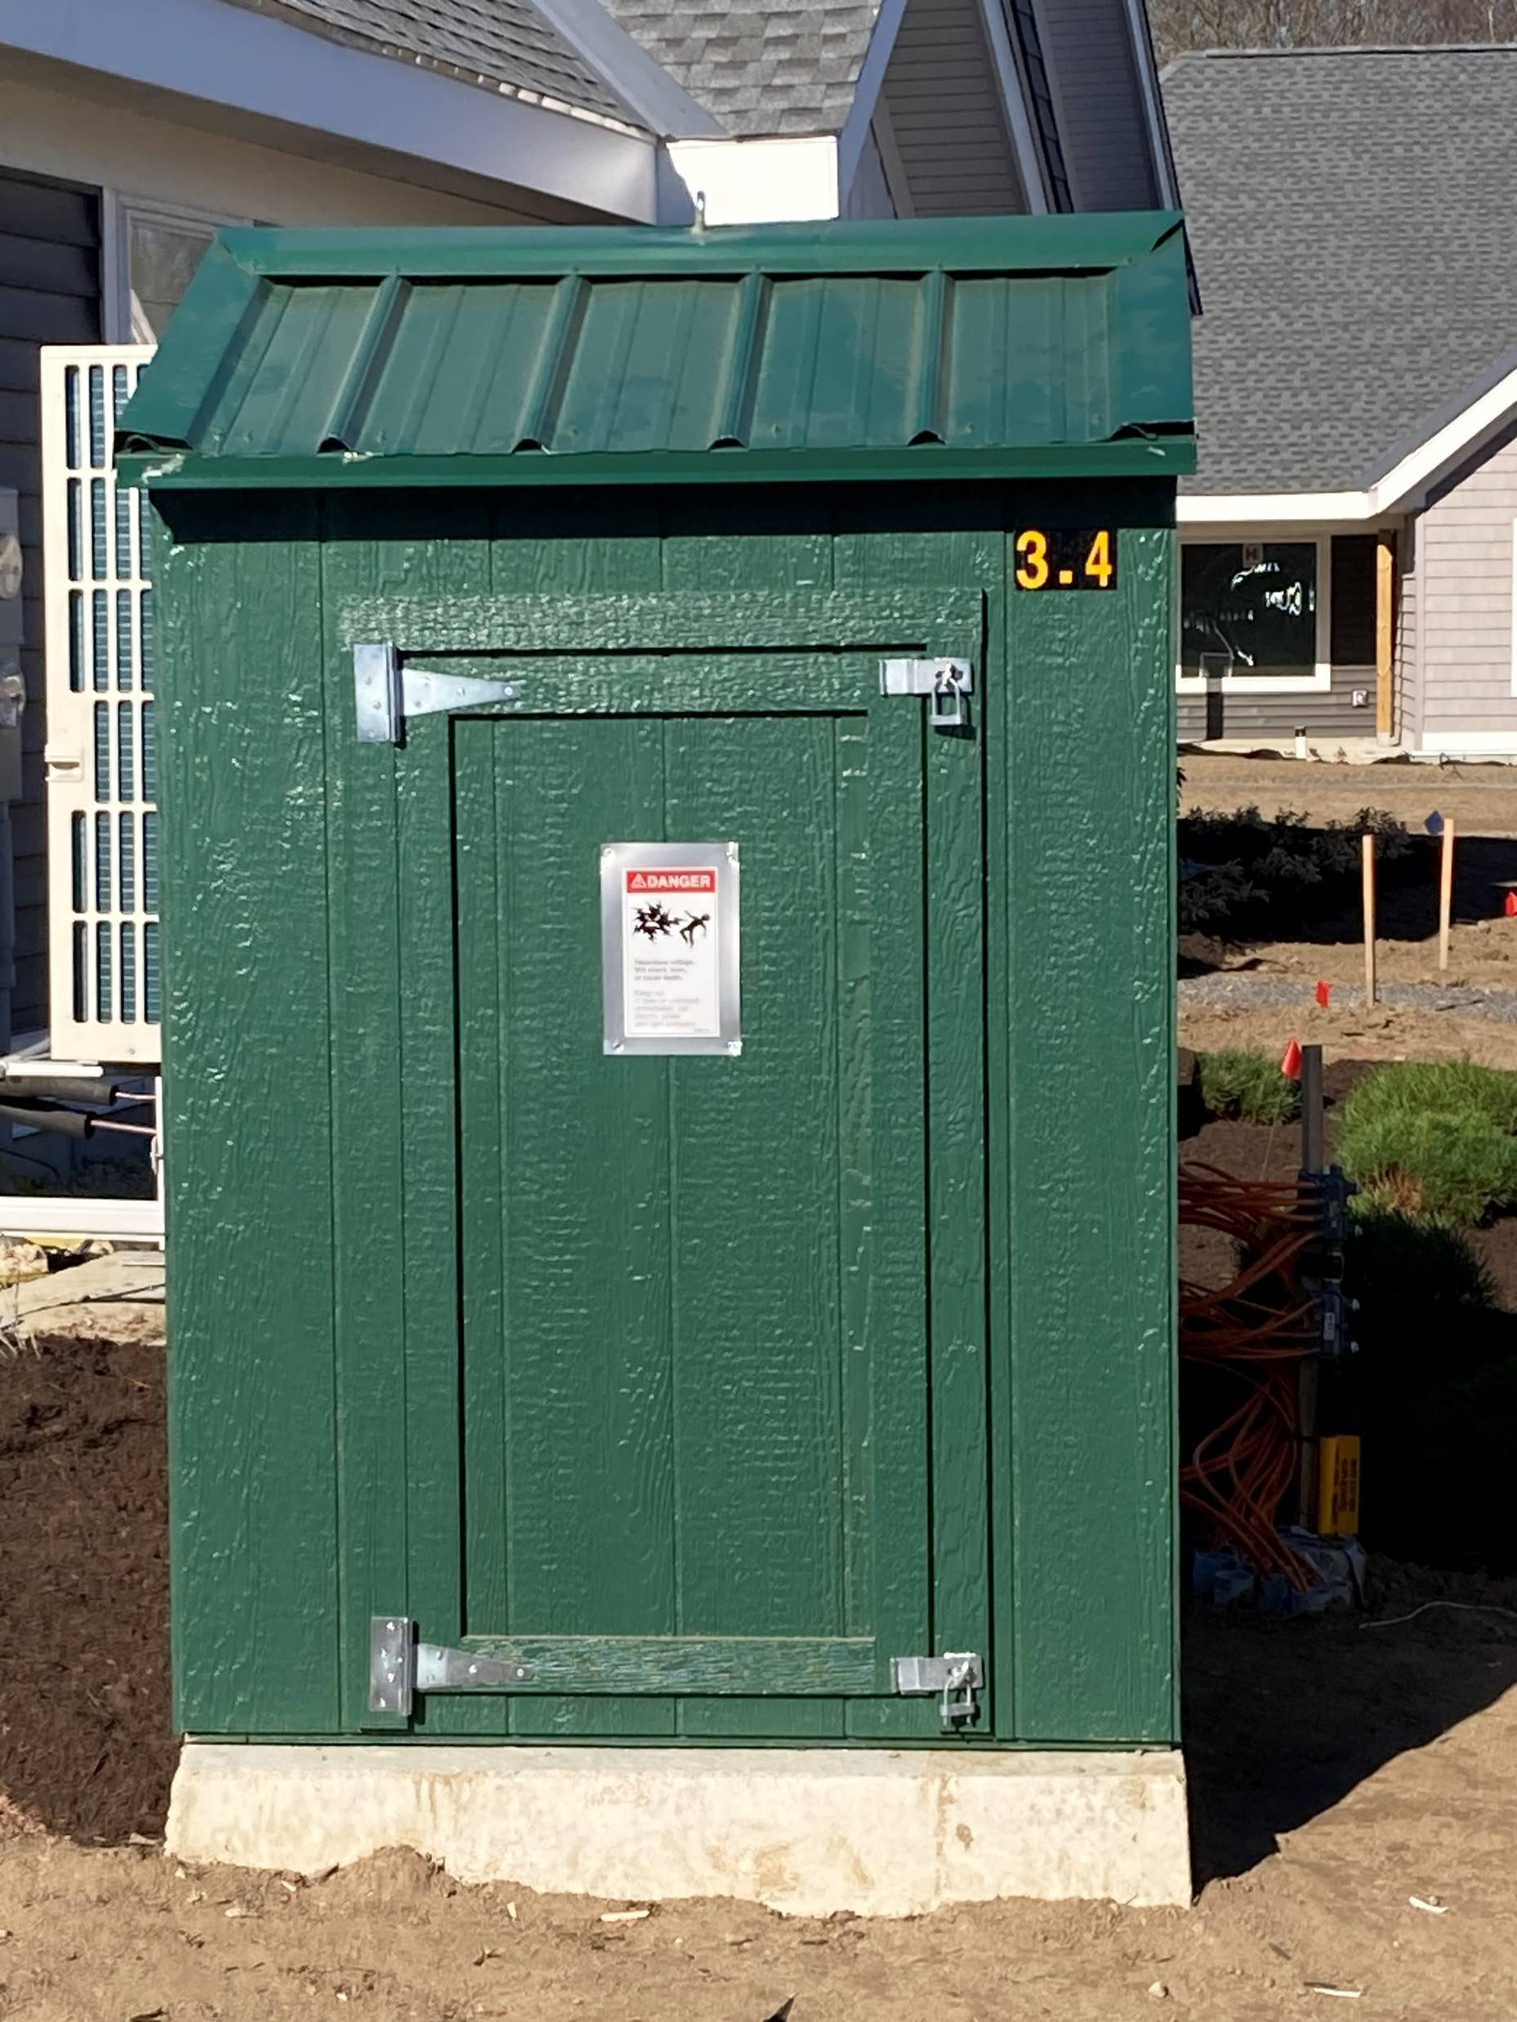
Pad Mount Transformers

Slide 10
Overhead Electrical Power Lines- The Silent Killer
The leading cause of fatal electrical incidents while on the job is contact with power lines
Power lines kill an average of 152 workers per year (2020-126, 2021-152, 2022-145)
1/4 of these workers are between 25-35 years of age
Leading causes:
- contact with heavy equipment (cranes, drilling rigs,
backhoes, dump trucks, excavators) 50%
- contact with long handled tools and hand carried items
(ladders, scaffolding, metal siding, metal poles,) 20%

Slide 11
WIRES DOWN SAFETY
Maintain a minimum of 10 feet from all conductors (MAD)
Any conductors on the pole can be energized at any time
Listen for generators in the area – generators can cause back feed
Snow is an insulator
Trees can conduct electricity
Step potential is like a hot zone for a hazardous material spill
Be aware of your surroundings, is there a wire down and lights on around you?
Do not work until you are told it is safe and grounded by a CMP employee or another electrical company worker

Slide 12
Underground Power Lines
The leading cause of fatal electrical incidents while on the job is contact with power lines
In the last 5 years 254 workers have suffered life changing injuries
4 out of 5 incidents involve a tradesperson
Research says:
- 1/3 of tradespeople do not always check for underground cables
- of these 15% don’t believe it is their responsibility and 24% don’t believe
they will be digging deep enough
- 30% increase since COVID lockdowns have been stopped
- voltages can range from 240 volts and up to 115 KV
- 15% say that if they uncovered electricity cable encased in concrete they
would attempt to break them out

Slide 13
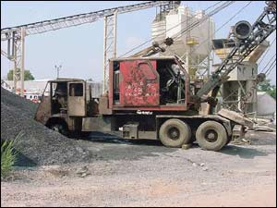
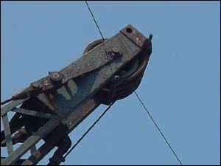
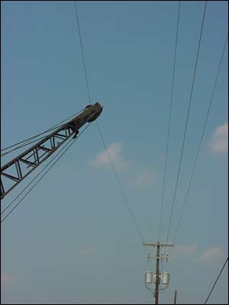
Three people were killed at a concrete plant in Telford, PA when a crane struck a 7,200 volt electrical power line.
The crane operator was electrocuted immediately, and two co-workers were themselves electrocuted when they attempted to rescue the operator

Slide 14
It happens

Slide 15
Planning for Work Near Overhead Power Lines
Walk down and survey the work site before beginning the work to identify all overhead power lines. Consider equipment travel paths and movement. LOOK UP!
All overhead power lines shall be considered energized until proven otherwise by the power utility.
Contact the owner of the lines to determine the voltage of the lines and request the lines be de-energized and grounded.

Slide 16
Power Line Clearances-overhead
Know the power line clearance requirements (Refer to NFPA 70E for safe approach distances)
For lines 50kV or less, the operator must keep all equipment parts and personnel at least 10 feet away
For lines above 50kV, this distance increases by 4 inches for each kV over 50kV
Determine your safe working clearance (the closest you can place equipment or personnel without crossing the buffer zone)

Slide 17
Safe Practices for Working Near Energized Lines
Implement a two-barrier control system to maintain effective standoff distances.
Use trained dedicated spotters that maintain radio contact with operator. Ensure spotters understand hand signals. Use of radios is preferred for communications.
Use physical barriers that prevent equipment from intrusion (insulation blankets, etc.)
Use stakes, cones, and painted lines to remind operators of demarcation lines

Slide 18
Safe Practices Handling Materials and Ladders
When working around overhead electric lines or with electrical equipment, use non-conductive ladders and tools
Never attempt to carry a ladder in a vertical position. Ladders should be lowered and turned horizontally when transported from one location to another.
Extension ladders should be collapsed before lowering from a vertical position.
Unload materials from trucks and flatbeds away from overhead lines

Slide 19
Safety Considerations
Have a job site meeting (tailboard) to discuss the planned work as it relates to the power lines. Discuss topics such as the use of long-handled tools, and equipment (raised dump trucks, back hoes, etc.) that could come in contact with power lines. Consider the two barrier controls.
Prohibit work when environmental conditions warrant (fog, precipitation, smoke, darkness, etc.)
Only use nonconductive ladders and material handling equipment. Aluminum ladders and metal scaffolds or frames are efficient conductors of electricity.
Keep all personnel from leaning on the equipment while it is operating!

Slide 20
Planning for Work - Underground
Walk down and survey the work site before beginning the work to identify all DigSafe markings. Consider equipment travel paths and movement. Spoil piles etc.
All underground power lines shall be considered energized until proven otherwise by the power utility.
Contact the owner of the lines to determine the voltage of the lines and request the lines be de-energized and grounded. Most of the time this is NOT going to happen

Slide 21
Planning for Work - Underground
Has the DigSafe been completed and fully marked out
Is everyone on scene aware of the tolerance zones and markings including the spotters
Be aware that there still may be locating issues due to bad or outdated mapping or locator error
There is no minimum depth
When in doubt stop and either hand dig or use a vacuum to accurately locate the utility lines in question

Slide 22
If Your Equipment Makes Contact with a
Power Line
Stay on the equipment and wait until the line is de-energized by the power company. Doesn’t matter whether overhead or underground!
If you must leave the equipment, such as in a fire, jump clear and attempt to land with both feet together.
Do not touch any part of the equipment when contacting the ground
Shuffle away from equipment in small steps while keeping feet together better to hop with both feet together

Slide 23
Power Line Contact
DO NOT allow anyone on ground to come near or touch the machine. Warn personnel to stay away from the machine.
Never touch a person or the machine which is in contact with a live power line.
Call for help and get power line de-energized.

Slide 24
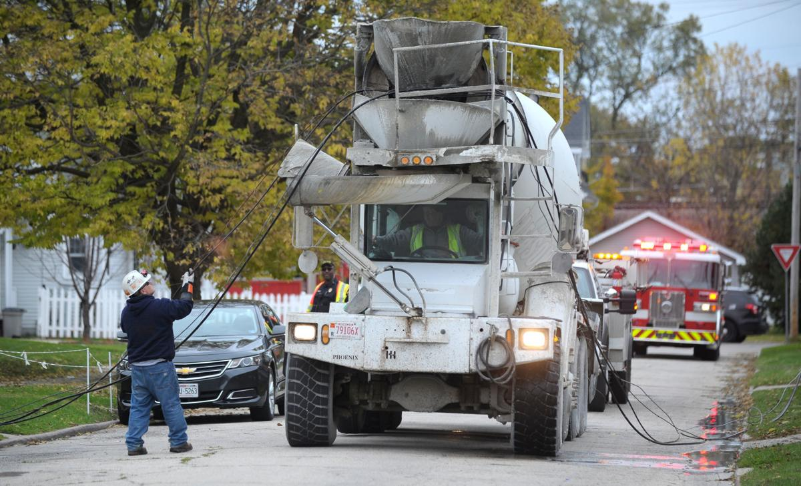
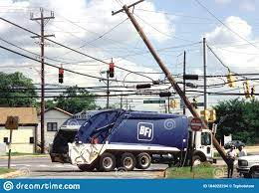
What would you do?

Slide 25
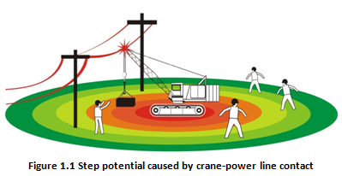
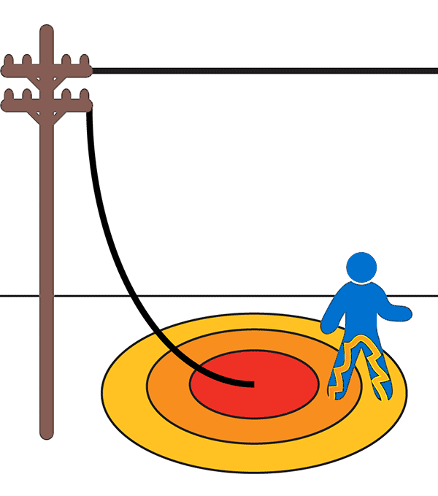
Step Potential
Step Potential is the step voltage between the feet of a person standing near an energized grounded object.

Slide 26
How to Protect Yourself
Low-hanging wires still have voltage potential even if they are not touching the ground, so don’t touch them
Never go near a downed or fallen electric power line. Always assume that it is energized. Touching it could be fatal.
Never drive over downed power lines. Assume that they are energized. And, even if they are not, downed lines can become entangled in your equipment or vehicle.
If contact is made with an energized power line while you are in a vehicle, remain calm and do not get out unless the vehicle is on fire. If possible, call for help.
If you must exit any equipment because of fire or other safety reasons, try to jump completely clear, making sure that you do not touch the equipment and the ground at the same time. Land with both feet together and shuffle/hop away in small steps to minimize the path of electric current and avoid electrical shock. Be careful to maintain your balance.

Slide 27
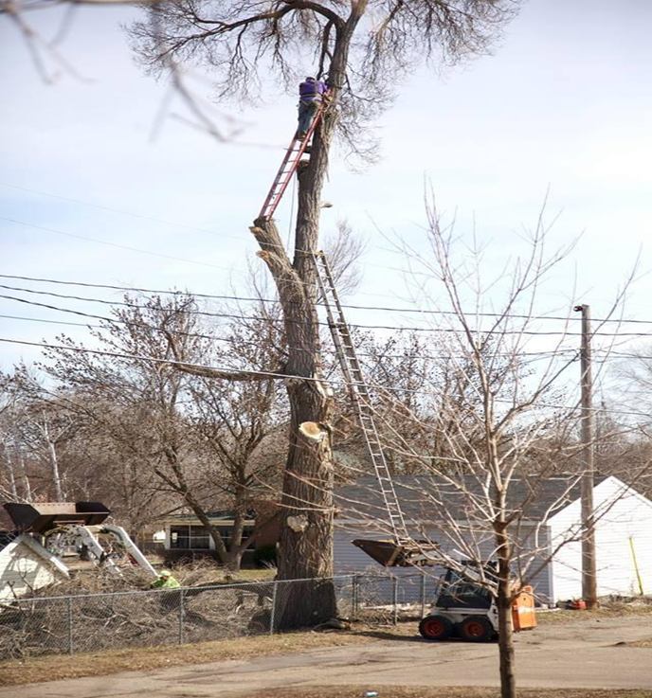
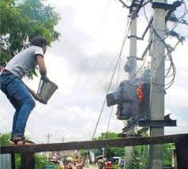
Questions Comments
Robert Wassick
Cell 207-707-2052
robert.wassick@cmpco.com
or
publiceducation@cmpco.com

