Slide 1
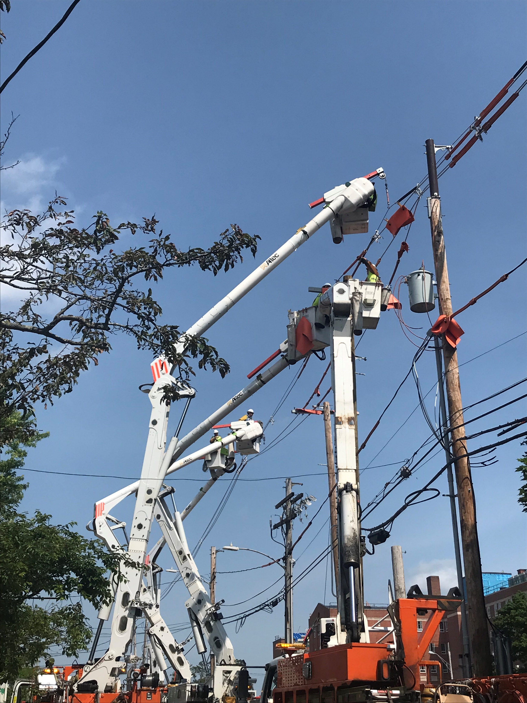
Central Maine Power
Electrical Utility Safety-
DigSafe/MUST
EmergencyPreparedness
MUST
January 2026

Slide 2
CMP Overview
An introduction to Central Maine Power and CMP’s transmission and distribution systems​
Special considerations for those who work around energized structures
Safety practices and common issues faced when responding to emergency incidents involving Central Maine Power’s system​

Slide 3
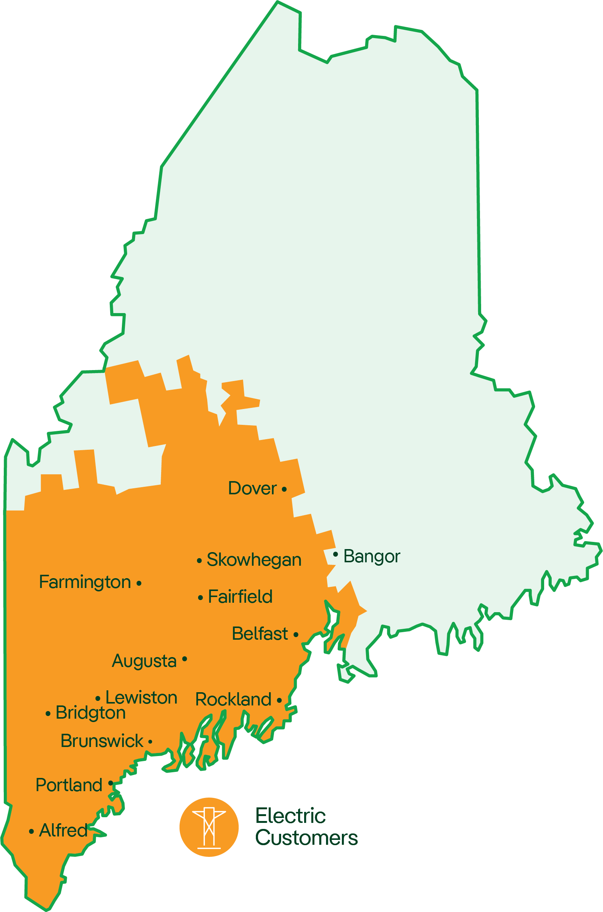
CMP Overview
We deliver power to over 680,000 customers
Our territory spans over 11,000 square miles
We maintain 24,000 plus miles of distribution wires
We at CMP ceased to generate power in the year 2000 due to ME Legislature
We continue to be responsible for operating and maintaining the transmission and distribution systems

Slide 4
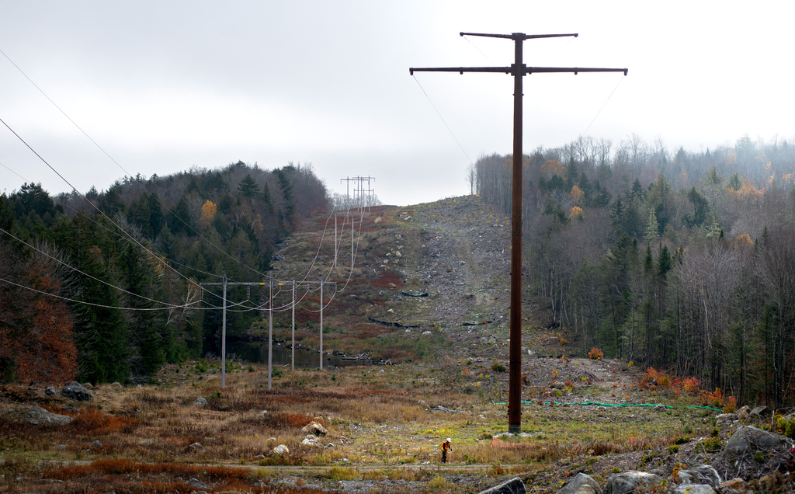
Transmission Line
115-345,000 volts
Notes:
Allowed to Hunt fish, 4 Wheel and snowmobile. No buildings or tree stands

Slide 5
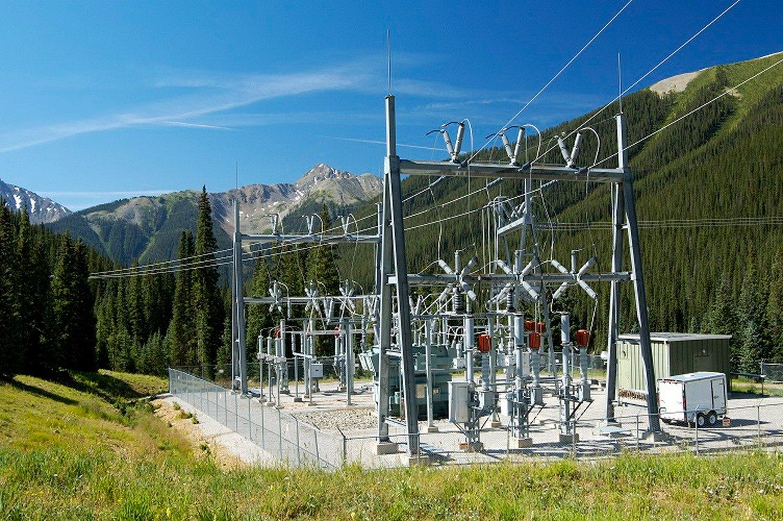
Substation
Notes:
Reduce the power, very dangerous. Gate should always be closed and locked

Slide 6
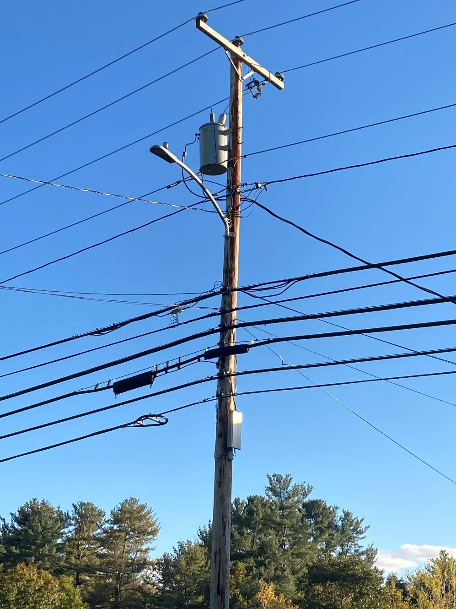
Three Phase
Primaries
Transformer
Neutral
Service Line
Comm’s
Notes:
Primaries either coated or uncoated now anything new is coated

Slide 7
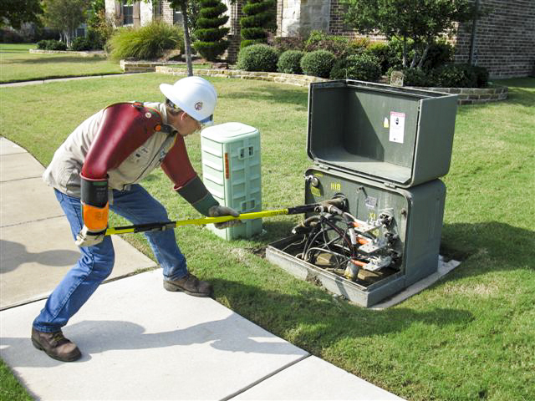
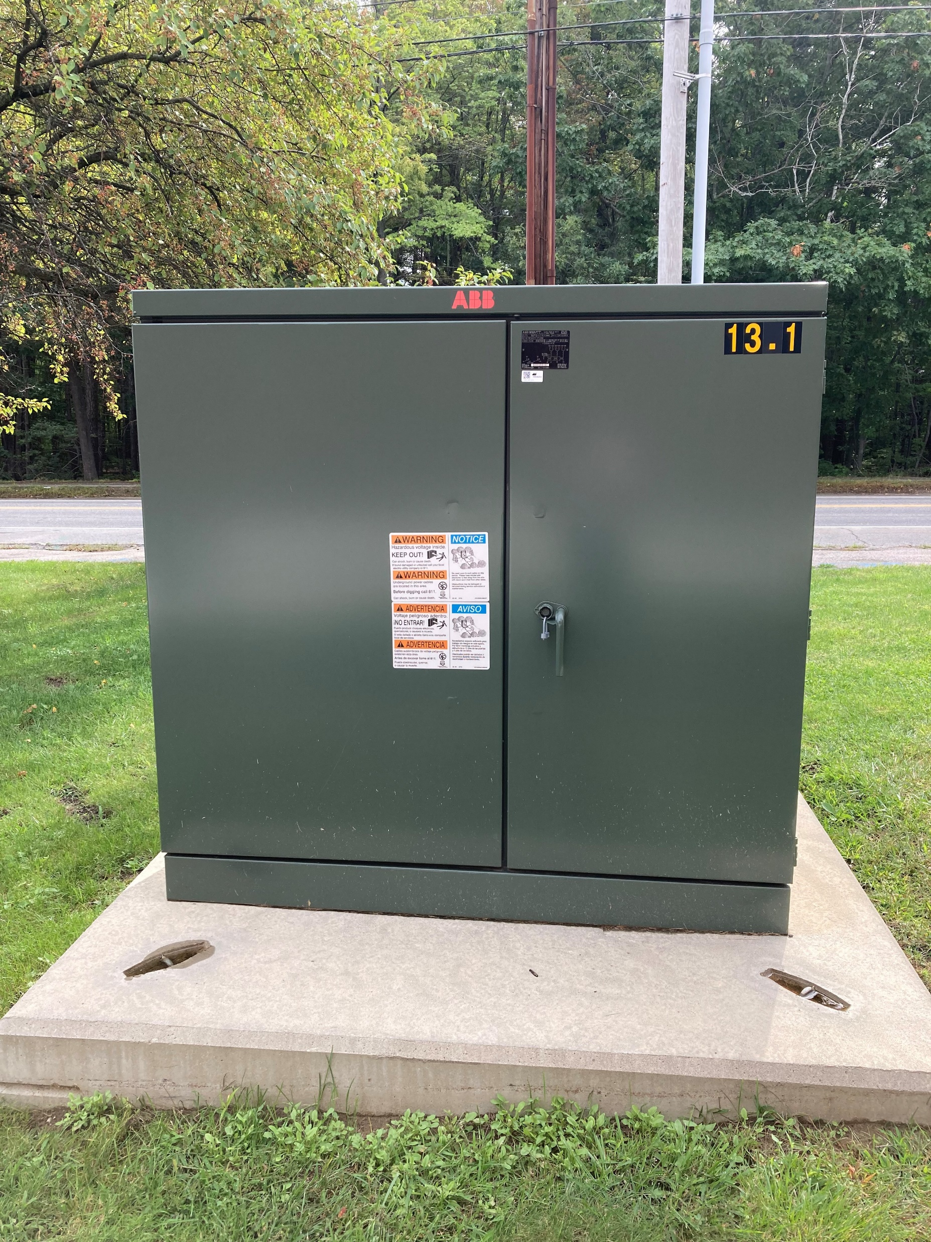
Pad Mount Transformers
Notes:
Remind if someone or something hits it we should be contacted. Remember the power doesn’t always come in the back

Slide 8
Safety Reminders
Maintain minimum of 10 feet from ALL conductors (MAD)
Any wires and equipment on a pole can be energized at any time
Be aware of your surroundings
Look up and down it may save your live!
Do NOT work until told it is safe and grounded by CMP Employee
NO LINE IS SAFE TO TOUCH!
Notes:
MAD 10’ up tp 50 K then 4” for every K over that

Slide 9

Understanding the risks
Power lines kill an average of 152 workers per year (2011-2019)​[126-2020}, {152-2021}, [145-2022],(123-2023)
A quarter of these workers are between 25-35 years of age
50% are caused by contact with heavy equipment (cranes, drilling rigs, backhoes, dump trucks, excavators)
20%​ are caused by contact with long handled tools and hand carried items (ladders, scaffolding, metal siding, metal poles
The leading cause of fatal electrical incidents while on the job is contact with power lines.
Notes:
ADD labels and fly ins

Slide 10
Understanding the risks-underground
In the last 5 years 254 workers have suffered life changing injuries and 4 out of 5 incidents involve a tradesperson
1/3 of tradespeople do not always check for underground cables
- of these 15% don’t believe it is their responsibility and 24% don’t believe
they will be digging deep enough
voltages can range from 240 volts up to 115 KV
15% say that if they uncovered electricity cable encased in concrete they would attempt to break them out
Notes:
ADD labels and fly ins

Slide 11
Safety Practices
Have a job site meeting (tailboard) to discuss planned work as it relates to power lines.
Survey work site before beginning the job to identify all powerlines above and below ground. Consider equipment paths and movement. LOOK UP and DOWN!
Contact owner of the lines to determine voltage, possibility of de-energizing, protection (covers), or ability to disconnect/reconnect.
All powerlines shall be considered energized until proven otherwise by the power utility.
Keep all personnel from leaning on the equipment when in operation.
Implement a two-barrier control system to maintain effective standoff distances:
~Use trained dedicated spotters that maintain radio contact with operator. Ensure spotters understand hand signals. Use of radios is preferred communications.
~Use physical barriers that prevent equipment from intrusion (insulated blankets, etc.)
~Use stakes, cones, painted lines and signage to remind operators of demarcation lines

Slide 12
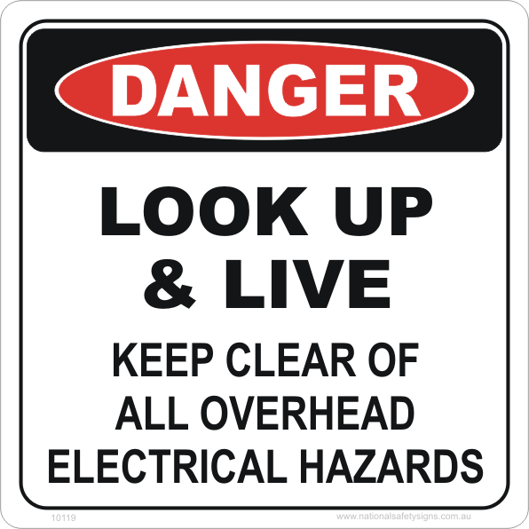
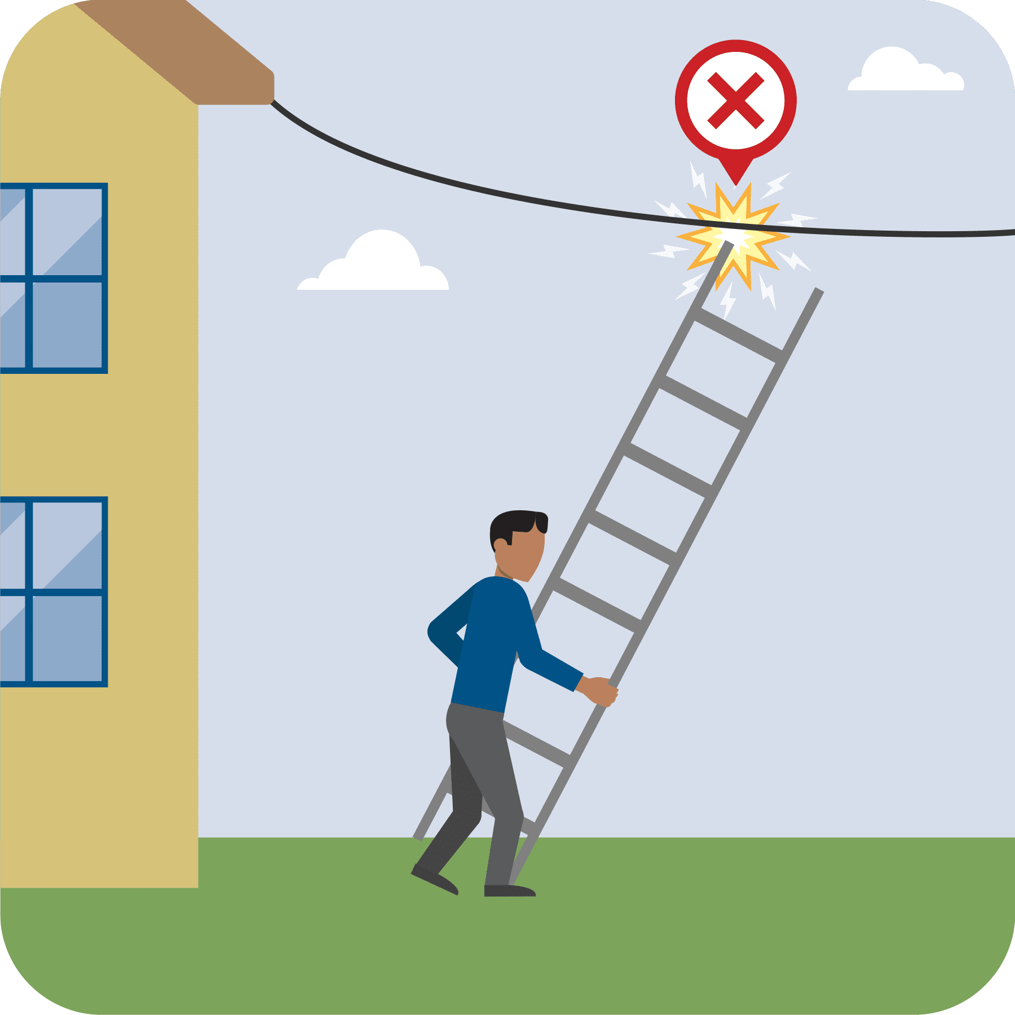
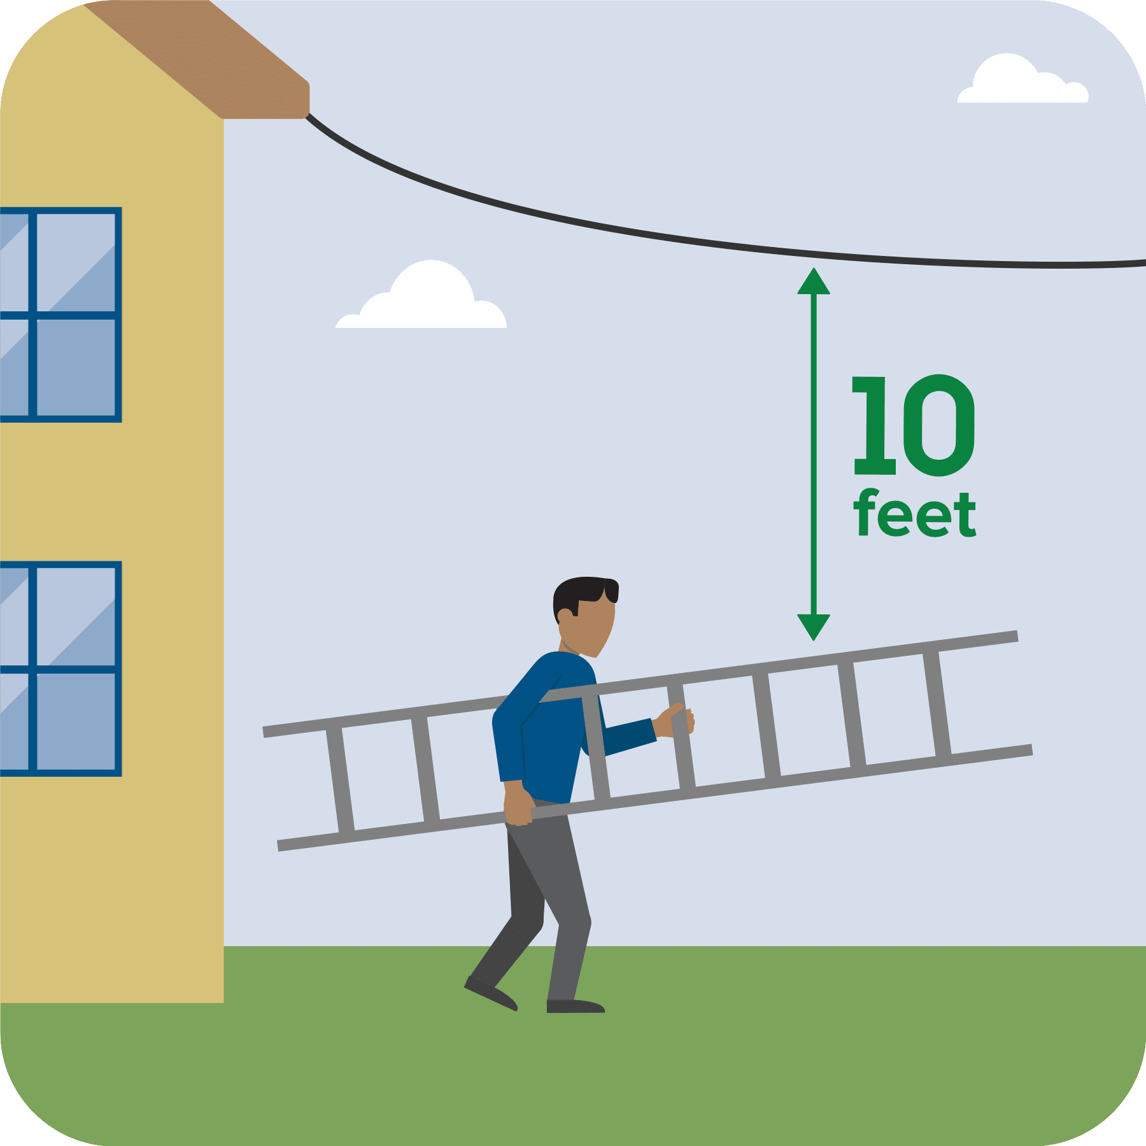
Safety Practices

Slide 13
Safety Practices
When working around overhead electric lines or with electrical equipment, use non-conductive ladders and tools
Never attempt to carry a ladder in a vertical position. Ladders should be lowered and turned horizontally when transported from one location to another.
Extension ladders should be collapsed before lowering from a vertical position.
Unload materials from trucks and flatbeds away from overhead lines
Prohibit work when environmental conditions warrant (fog, precipitation, smoke, darkness, etc.)
Only use nonconductive ladders and material handling equipment. Aluminum ladders and metal scaffolds or frames are efficient conductors of electricity.
Keep all personnel from leaning on the equipment while it is operating!

Slide 14
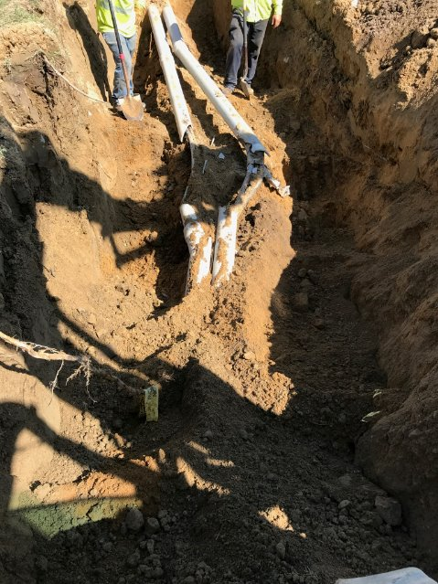
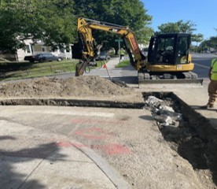
Safety Practices

Slide 15
Planning for Underground Work
Has the DigSafe been completed and fully marked out
Is everyone on scene aware of the tolerance zones and markings including the spotters
Be aware that there still may be locating issues due to bad or outdated mapping or locator error
There is no minimum depth
When in doubt stop and either hand dig or use a vacuum truck to accurately locate the utility lines in question

Slide 16
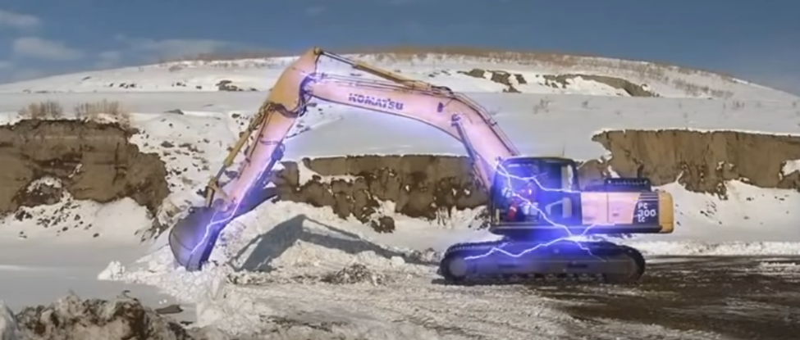
If Your Equipment Makes Contact with a
Power Line

Slide 17
Contact with Power Lines
Stay on/in the equipment and wait until the line is de-energized by the power company. Regardless if it is overhead or underground.
Call for help. 911 if necessary (they will call us) due to wires involved.
DO NOT allow anyone to come near or touch the machine. Warn personnel to stay away from the machine.
Should there be smoke or fire you will need to exit the equipment or vehicle.
To exit jump clear, land on two feet, hands to yourself
Do not make contact with equipment/vehicle once your grounded.
Shuffle or Hop away at least 30 feet.

Slide 18
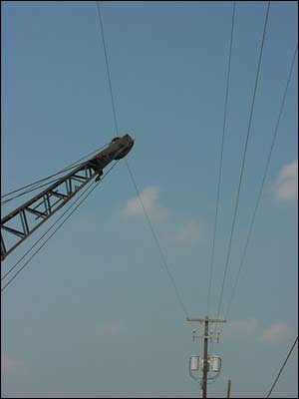
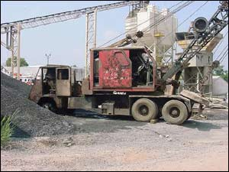
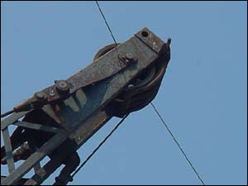
Contact with Power Lines
Telford, PA Fatal Incident
Notes:
3 fatalities, owner driving got out of the vehicle and touched the ground (3 point of contact) 2 fellow employees on scene, 1 called 9-1-1 and the other started CPR. What they think happened was that the employee who called 9-1-1 touched the vehicle and the other employee as he was doing CPR and all were fatalities.

Slide 19
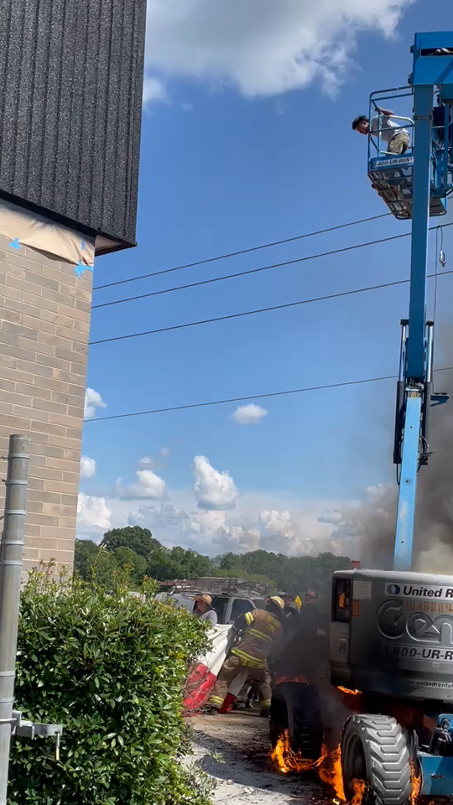
It Happens
Notes:
Oxford Alabama, may in Jeanie lift. Utility would not dump the grid or even give an ETA for a lineman

Slide 20
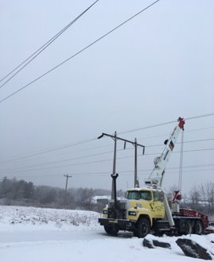
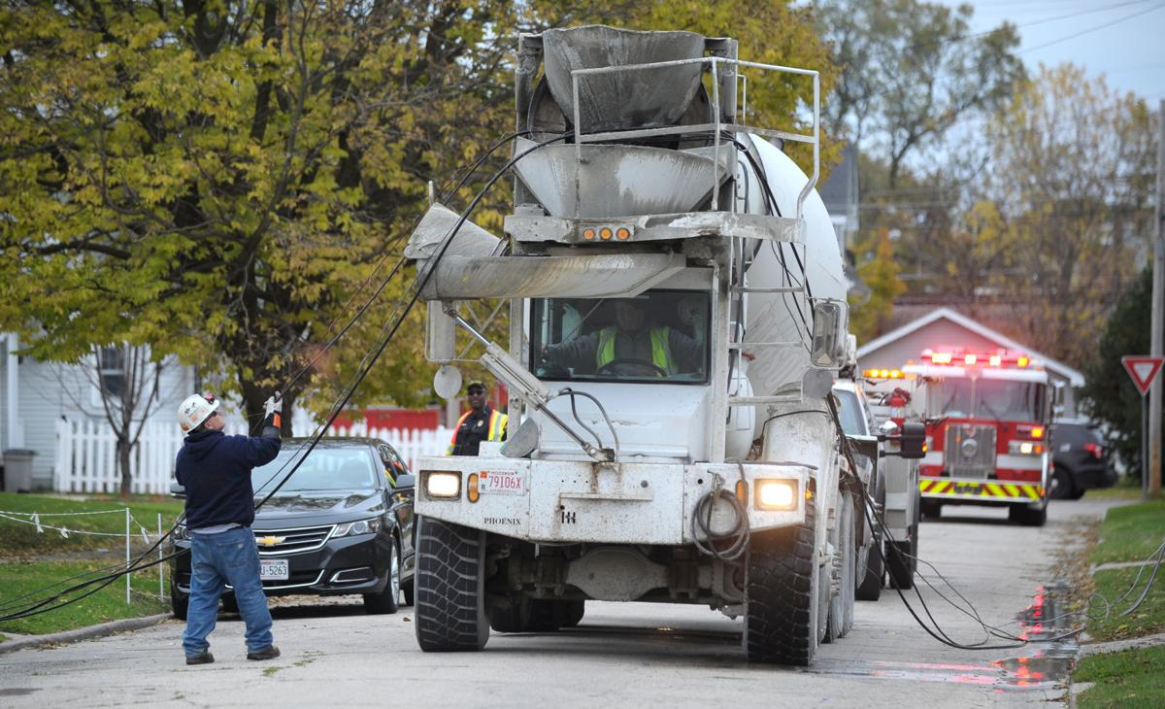
What would you do?

Slide 21
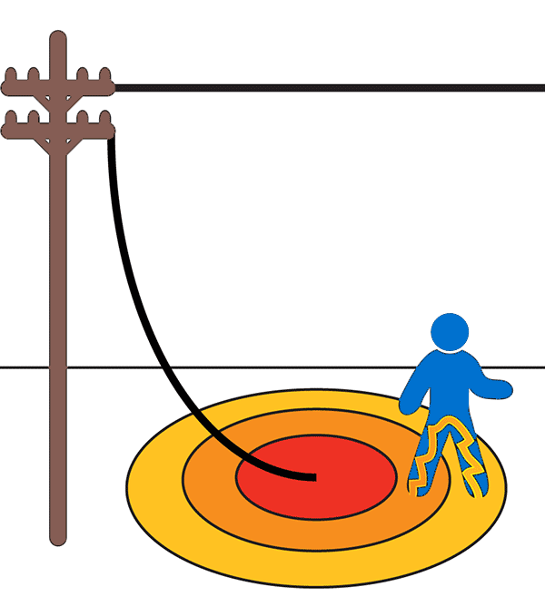
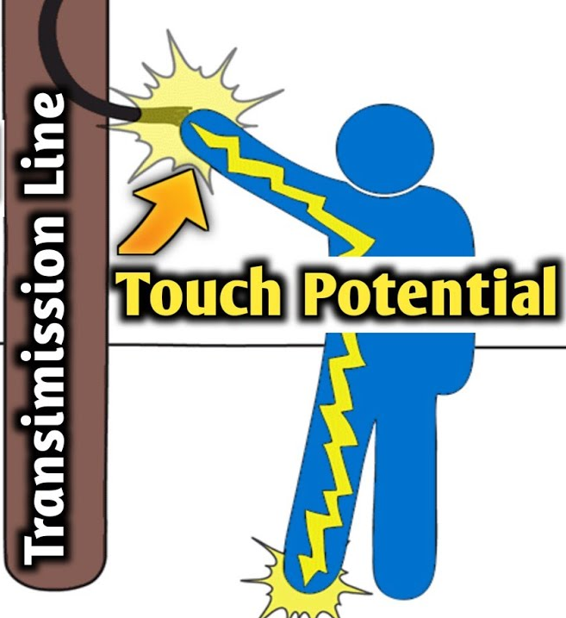
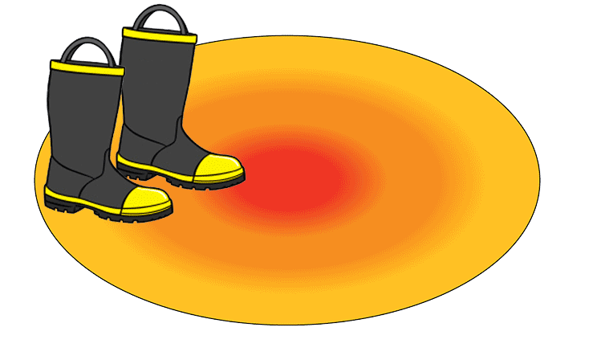
Touch & Step Potential

Slide 22
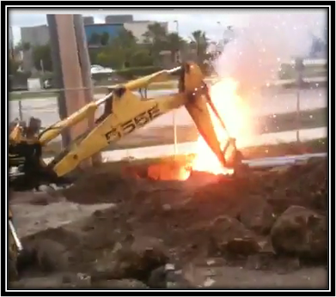
Be Safe, Be Aware!

Slide 23

Be Safe, Be Aware!

Slide 24
Safety Review
Low-hanging wires still have voltage potential even if they are not touching the ground, so don’t touch them
Never go near a low hanging or downed line. Always assume that it is energized. Touching it could be fatal
Never drive over downed power lines. Downed lines can become entangled in your equipment or vehicle
If contact is made with an energized power line while you are in a vehicle, remain calm and do not get out unless the vehicle is on fire. If possible, call for help
If you must exit any equipment because of fire or other safety reasons, try to jump completely clear, making sure that you do not touch the equipment and the ground at the same time. Land with both feet together and shuffle/hop away in small steps to minimize the path of electric current and avoid electrical shock. Be careful to maintain your balance.

Slide 25
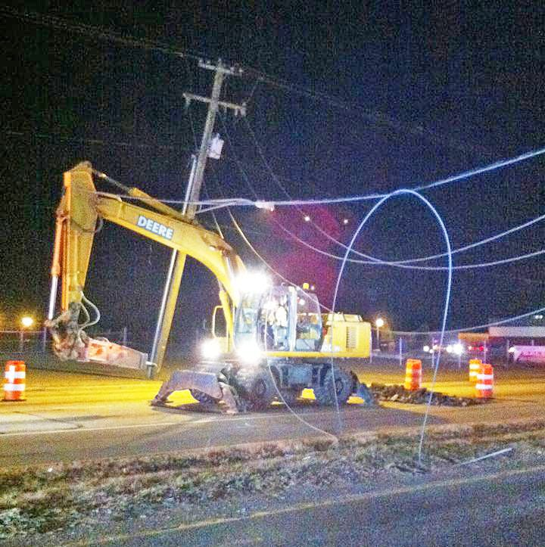
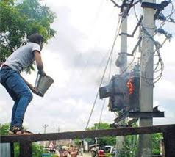

Questions Comments
Robert Wassick
Cell 207-707-2052
Danielle Barry
207.530.7168
publiceducation@cmpco.com

