Slide 1
Presented by: Dawn McKenney, Consultation Program Manager

Slide 2
SafetyWorks! Best Kept Secret…But it Shouldn’t Be
We Are From The Government & We’re Here To Help
It’s True! We are!
SafetyWorks! is a program to help small employers develop and improve safety and health programs
OSH Act 1970
Our goal is to reduce/eliminate injuries, fatalities, and workers’ comp cost for Maine workplaces and workers
We Are Not OSHA! Provided at no cost! No penalties!
We Are Not OSHA!

Slide 3
Emphasis Program

Slide 4
Common Hazards NAICS 2389 $2,320,717 Penalties Oct ‘22 – Sep ‘23
Specific Excavation Requirements
Protective Systems
Access and Egress
Emergency Warning Systems
Fall Protection
Respiratory Protection
Training
Personal Protective Equipment

Slide 5
Consultations Provided At No Cost
Review mandatory programs
Review training programs
Conduct safety and health surveys
Review Illness and Injury Logs
Air Sampling
Noise Sampling
Employer is obligated to correct any hazards found by the mutually agreed upon correction date.

Slide 6
Required S & H Programs
Hazard Communications
Lockout / Tagout (LO/TO)
Bloodborne Pathogens (BBP)
Confined Spaces
Hearing Conservation
Emergency Action Plan* (EAP)
Fall Protection
Personal Protective Equipment Assessment (PPE)
Respiratory Protection
Process Safety Management
Fire Prevention Plans*
Hazardous Materials
Commercial Dive Teams
Notes:
Info box is hyperlinked to our sample programs

Slide 7
Training
Workers have a right to get training from employers on a variety of health and safety hazards and standards that employees must follow in a language and vocabulary workers can understand
Notes:
Fire Prevention
Material Handling
Hazardous Materials
Traffic Control
Emergency Action Plan
Workplace Violence
Bloodborne Pathogens
Before doing any job task, the employee shall be trained on the hazards associated and means of protection.

Slide 8
Required Training/Documentation
Video Display Terminal (I & A)
Bloodborne Pathogens (I & A)
Confined Space (I & A)
Fire Extinguishers (A)
If expected use or based on task, i.e. welding, fire fighter
Fire Prevention (I)
Powered Industrial Trucks
3yr recertification & evaluation
Emergency Action Plan (I)
Hazard Communications (I)
PPE (I)
LOTO (I)
Authorized people observed performing (A)
Respirators (I & A)
Fall protection (I)
I-Initially Upon Hire A-Annually
Retraining shall be done, if:
Incident/Near Miss/Change in Process/Change in Expectations
Notes:
Refer students to the OSHA website, publication, regarding regulations that need or require training.

Slide 9
Training Documentation
Date
Location
Course
Instructor
Topic
Attendee Names
Do not allow employees perform tasks or use
equipment until they are trained.

Slide 10
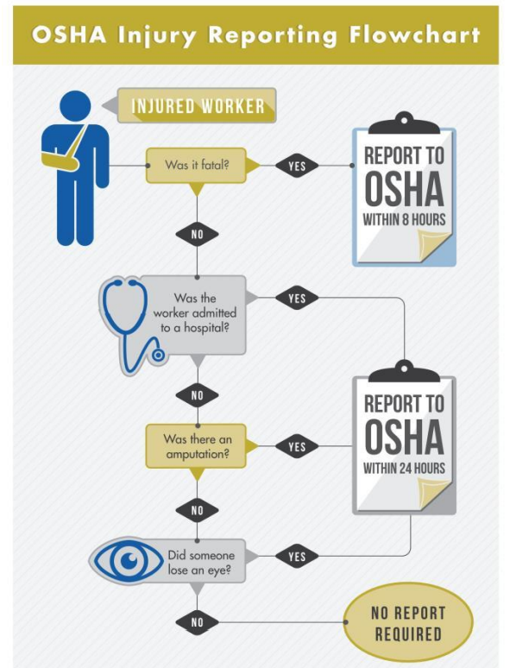
OSHA Recordable vs Reportable Injury Illness OSHA 207 626-9160

Slide 11
Training Provided At No Cost
Authorized 10 & 30 Trainers for General Industry, Construction and Maritime
Trenching & Excavation
Silica
Fall Protection
Ladders
Personal Protective Equipment
…so much more
SafetyWorks! Training Institute, local CareerCenters, or at your facility

Slide 12
How to access our services or find additional information?
www.SafetyWorksMaine.gov
www.osha.gov

Slide 13
Questions?
Comments?
Concerns?

Slide 14
Contact Information
Dawn McKenney, Program Manager
Maine Department of Labor – SafetyWorks!
Dawn.L.McKenney@Maine.gov
Main Line (207) 623-7900
Direct Line (207) 623-7920
Toll-free 1 (877) SAFE 345 (723-3345)
www.safetyworksmaine.gov

