Slide 1
MPUC 2024 MUST
PUBLIC UTILITIES COMMISSION
Chapter 895: UNDERGROUND FACILITY DAMAGE PREVENTION REQUIREMENTS

Slide 2
Recent Law Changes
Positive Response
The Notice Of Rulemaking noted that Section 6(B)(1) of the rule provides that if the operator
determines that there are no facilities in the proposed excavation area that it is obligated
to mark, it shall inform the excavator in writing, prior to the expiration of the excavator's waiting period, either by electronic facsimile or e-mail or by placing marks at the excavation site that so indicate. Given the increased use of text messaging, the amended proposed rule also proposed allowing the operator to use text messaging to notify the excavator in addition to facsimile, e-mail or writing on the ground.

Slide 3
Recent Law Changes
Propane Inclusion and Notifying 911
During its 2020 session, the Legislature enacted An Act to Make Changes to the So-called Dig Safe Law. P.L. 2019, c. 592 (Act).
The Act makes liquefied propane gas (LPG) distribution systems that have underground pipes subject to the Dig Safe Law and increases the administrative penalties for violations of the law.
During its 2019 session, the Legislature enacted An Act to Amend the So-called Dig Safe Law which requires excavators to immediately report by calling 9-1-1 if contact with, or damage to, an underground pipe or another underground facility results in the escape of any natural gas or other hazardous substance or material regulated by the United States Department of Transportation, Pipeline and Hazardous Materials Safety Administration (U.S. DOT, PHMSA). P.L. 2019, c. 322.

Slide 4
Recent Law Changes
Incident Reporting
Responsibilities of the Excavator, Reporting (Section 4(D))
The Notice Of Rulemaking noted that when an excavator has reason to believe that one or more damage prevention incidents have occurred in association with an excavation, the rule requires the excavator to submit a written incident report to the Commission within 10 days. Section 4(D)(2) of the proposed amended rule also required that the excavator notify the Commission of this by calling the Commission as soon as possible after an incident occurs.

Slide 5
Recent Law Changes
Incident Reporting
Responsibilities of the Operator, Reporting (Section 6(C)(1))
The Notice Of Rulemaking noted that when an operator has reason to believe that one or more damage prevention incidents have occurred in association with an excavation, the current rule requires the operator to submit a written incident report to the Commission within 10 days. Section 6(C)(1) of the proposed amended rule proposed requiring the operator to notify the Commission as soon as possible after an incident occurs.

Slide 6
RESPONSIBILITIES OF THE EXCAVATOR
Pre-marking. The excavator SHALL mark the approximate boundary of a proposed excavation and the excavator’s initials in white, or as otherwise established by the Dig Safe System, prior to notifying the Dig Safe System, as required by Section 4(B). If an excavator uses a single stake or other single point indicator as a pre-mark, the excavator must indicate the radius of the proposed excavation area. Alternative colors, pink or black, may be used by the excavator during snow or ice conditions.

Slide 7
Notifying Dig Safe
Member Facility Operators
Electrical
Gas, Oil, Steam
Telephone, CATV, Fiber Optic

Slide 8
Non-members
Voluntary
Water, Sewer, private property owners and some small utilities – Less than 5 employees or fewer than 300 customers

Slide 9
Facility Operator Notification
Notification MUST take
place at least
3 business days but
not more than 30 days prior to excavating

Slide 10
Notifying Private Property Owners
If the underground facilities are located on private property, provide service to a single-family residence, and are owned and operated by the owner of that property:
If the excavator waits 3 business days from the date of notification or until after the underground facilities are marked, if sooner, to commence excavation or if the markings made by the landowner pursuant to subparagraph (i) fail to identify the location of the underground facilities in accordance with subsection 6(B), an excavator damaging or injuring underground facilities is not liable for any damage or injury caused by the excavation, except on proof of negligence

Slide 11
Tolerance Zone
Hand Dig Area
Member Facilities
18” from Outer Edge
of the Facility
Non-Member Facilities
36” from Outer Edge
of the Facility

Slide 12
Yes it is but Remember
The Excavator Doing the Digging is
responsible for Doing the Checking
…and ultimately responsible for any non-compliance violations involving damaged facilities.

Slide 13
Subcontractors & Multiple Excavators
Is it OK to work under somebody else’s
Dig Safe ticket ?

Slide 14
Excavators are required to
Hand dig, Hand expose, and Protect
Underground Facilities
18 Inches
In all directions

Slide 15
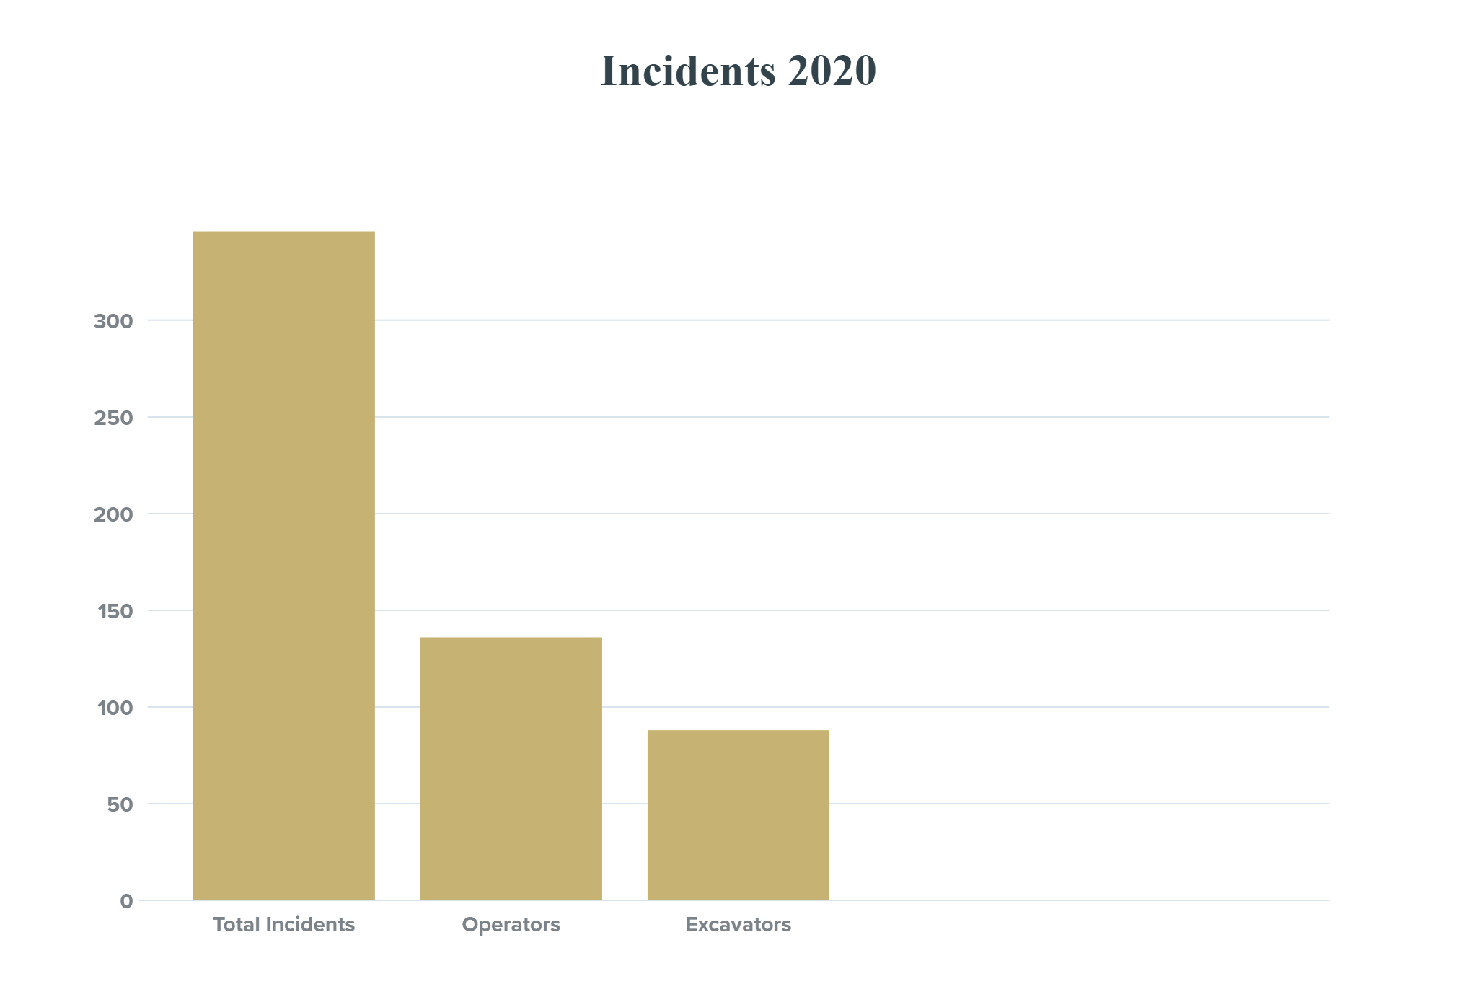
Total 346
Operators 139
Excavators 88
Waived 57

Slide 16
Questions?
Barry Truman
Damage Prevention Investigator
Damage Prevention Team
Tel: 207-287-5494
Cell: 207-592-3789
barrv.e.truman@maine.qov
Richard C. LeClair
Program Manager
Damage Prevention Team
Tel: 207-287-1369
Cell: 207-592-1098
richard.c.leclair@ maine.qov
Hattie Trask
Safety Programs Coordinator
Damage Prevention Team
Tel: 287-6075
Hattie.trask@ maine.qov

