Slide 1
Maine Public Utilities Commission
Damage Prevention Program – MUST 2026

Slide 2
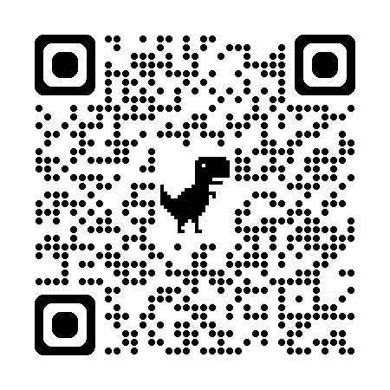
Our Staff
Richard LeClair – Damage Prevention Investigator
(207) 592-1098
Matthew Tomassone – Damage Prevention Investigator
(207) 592-3789
Hattie Trask – Safety Programs Coordinator
(207) 287-6075
MPUC Damage Prevention Website

Slide 3
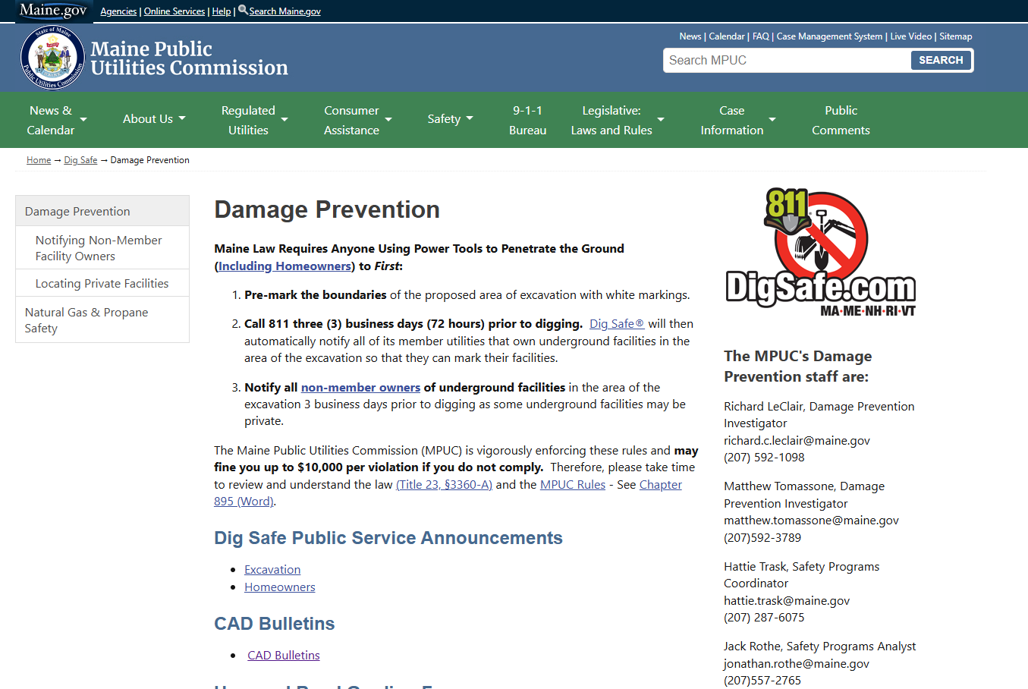
MPUC Damage Prevention Website

Slide 4
Regulatory Structure and Enforcement Process
Title 23 § 3360-A Protection of Underground Utilities
(Dig Safe Law)
11. Enforcement
The Public Utilities Commission may adopt procedures necessary and appropriate to gather information and hear and resolve complaints concerning failure to comply with the provisions of this section.

Slide 5
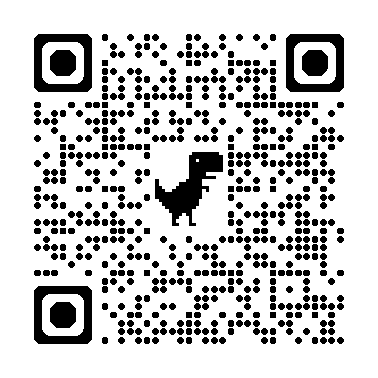
Regulatory Structure and Enforcement Process
Public Utilities Commission Chapter 895 (Rule)
§7 – Commission Activities
(B) Enforcement Action Procedure
-Preliminary Incident Investigation
-Notice of Enforcement Investigation
-Right to Contest (Informal Review / Formal
Hearing)
-Adjudicatory Hearing
-Dismissal/Training/Contempt/Penalty Result
Laws and Rules

Slide 6
Important Definitions
Excavation:
means any operation in which earth, rock or other material below the ground is moved or otherwise displaced, by means of power tools, power equipment, or explosives and includes grading, trenching, digging, ditching, auguring, tunneling, scraping, and cable or pipe driving, except tilling of soil and gardening or displacement of earth, rock or other material for agricultural purposes.

Slide 7
Important Definitions
Mechanical Means of Excavation:
Means excavation using any device or tool powered by an engine except air vacuum methods of excavation.

Slide 8
Important Definitions
Underground Facility or Facility:
means any item of personal property buried or placed below ground for use in connection with the storage or conveyance of water, sewage, electronic, telephonic or telegraphic communications, cable television service, electric energy, oil, gas liquefied propane gas or other substances and including, but not limited to, pipes, sewers, conduits, cables, valves, lines, wires, manholes, attachments, appurtenances thereto and those parts of poles below ground.
Does not include highway drainage culverts or under drains or certain LP systems (see rule changes, later)

Slide 9
Important Definitions
Underground Facility Operator:
means the owner or operator of any underground facility, other than an underground oil storage facility…or an airport aviation fuel hydrant piping system, used in furnishing electric, telephone, telegraph, gas, petroleum transportation, liquefied propane gas, or cable television service. An “underground facility operator” does not include a municipality or a public utility with fewer than five full-time employees or fewer than 300 customers or a person that owns underground facilities on its own property for commercial or residential purposes.

Slide 10
Recent Law Changes
2024 Changes to LPG / Notification
On March 25, 2024, the Governor signed “An Act to Clarify the Definition of ‘Underground Facility’ and Reduce Administrative Burdens Under the So-called Dig Safe Law”
Commission initiated rulemaking for Chapter 895 to:
-Clarify that Chapter 895 applies to LPG systems, generally
-Establish a limited exemption for LPG systems that meet certain criteria
-Reduce the number of Dig Safe tickets issued to operators (and owners) where facilities are not located in the area of the planned excavation

Slide 11
Recent Law Changes
“Underground Facility” Definition
Chapter 895 § 2(U):
This definition shall not include:
(2) Liquefied propane gas distribution systems that have underground pipes located on a residential lot if:
(a) The residential lot has no more than one structure connected by underground pipes to a liquefied propane gas distribution system;
(b) The structure that is connected by underground pipes to a liquefied propane gas distribution system contains no more than 2 dwelling units; and
(c) The liquefied propane gas tank is located 25 feet or less from that structure.

Slide 12
Recent Law Changes
Responsibilities of the Excavator….Notice
Chapter 895 § 4(B)(1)(e)(ii):
The location of the proposed excavation;
must be clearly identified and defined in Dig Safe’s System by choosing the most precise excavation site option(s):
a. Street Address, enter the parcel address or enter the address range, or enter the street name when working on the entire length of the road;
b. Global Positioning System (GPS) Coordinates;
c. Intersection of two streets; or
d. Between Intersections.
If the location can’t be identified and defined using one or more of the above tools, the map draw function must be used.

Slide 13
Recent Law Changes
Responsibilities of the Dig Safe System – System Requirements
Chapter 895 § 5(B)(4):
The Dig Safe System shall maintain its draw functionality to allow excavators to define a planned excavation area by drawing the confines of the planned excavation on Dig Safe System interactive maps.

Slide 14
Incident Reporting
Responsibilities of the Excavator, Reporting (Section 4(D))
The Notice Of Rulemaking noted that when an excavator has reason to believe that one or more damage prevention incidents have occurred in association with an excavation, the rule requires the excavator to submit a written incident report to the Commission within 10 days. Section 4(D)(2) of the amended rule also required the excavator to notify the Commission as soon as possible after an incident occurs.

Slide 16
2025 Enforcement Overview
348 Chapter 895 Violations Reported
166 Probable Violations Identified
70 Excavator – 96 Operator
$282,000 in penalties assessed
$44,000 waived with training option

Slide 17
2025 Most Common Violations
Operators:
-Failed to mark in a timely manner
-Marked in a reckless or negligent manner
Excavators:
-Failed to properly notify Dig Safe
-Failed to properly hand excavate or failed to employe reasonable precautions to avoid damaging utilities

Slide 18
The Process
Excavator: Pre-mark the site
Excavator: Notify Dig Safe
Excavator: Notify non-members
Facility Operator: Mark the site
Excavator: Maintain the marks
Excavator: Observe 18” safety zone
Operator and Excavator: Notify MPUC as soon as possible for any violation of Chapter 895.

Slide 19
When does an excavation site have to be pre-marked?

Slide 20
Before an excavator contacts Dig Safe and Non-Members, the excavator must pre-mark the boundary of proposed excavation using white paint, stakes, or flags with initials.

Slide 21
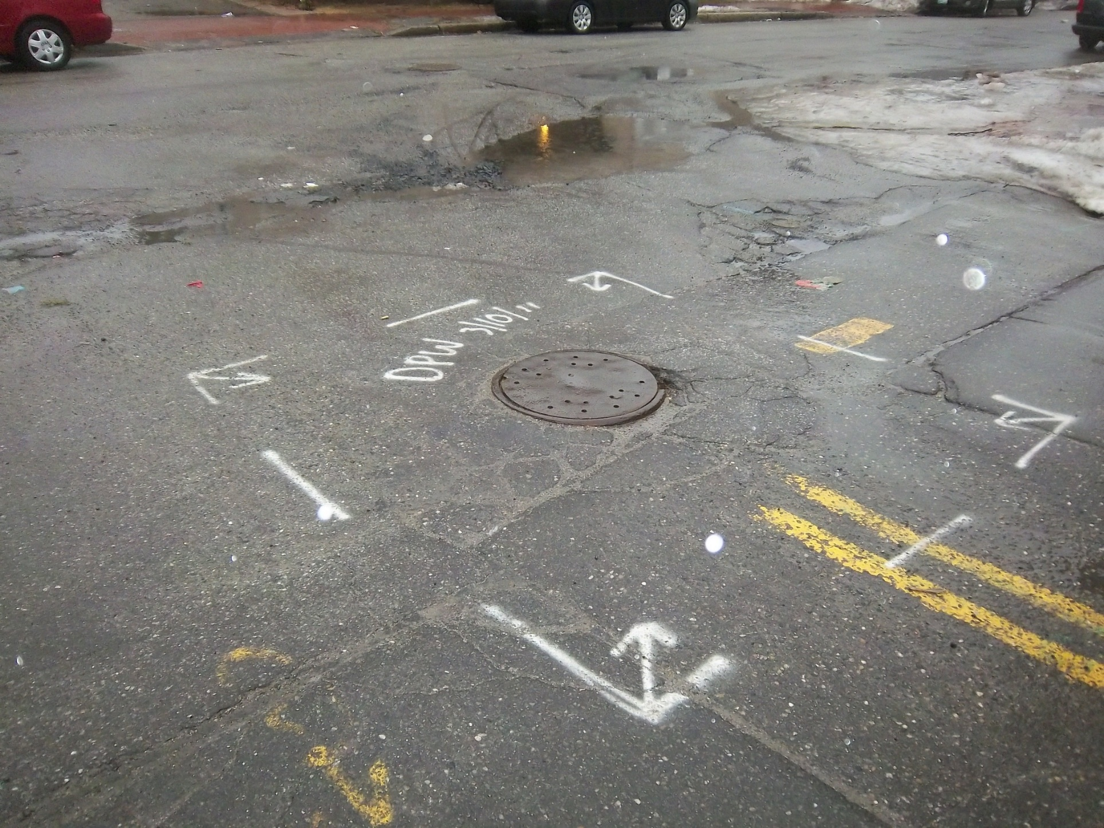
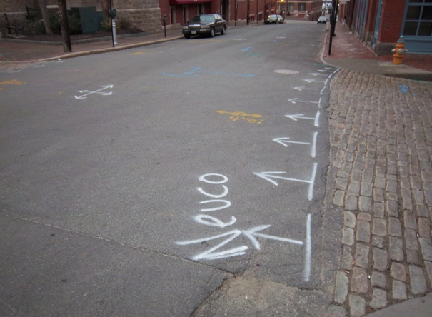
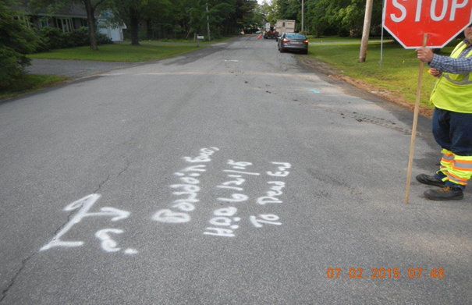
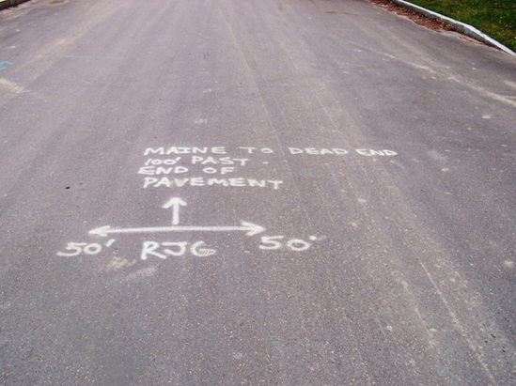
Pre-mark Spacing Is Line of Sight
Per Common Ground Alliance Recommendations

Slide 22
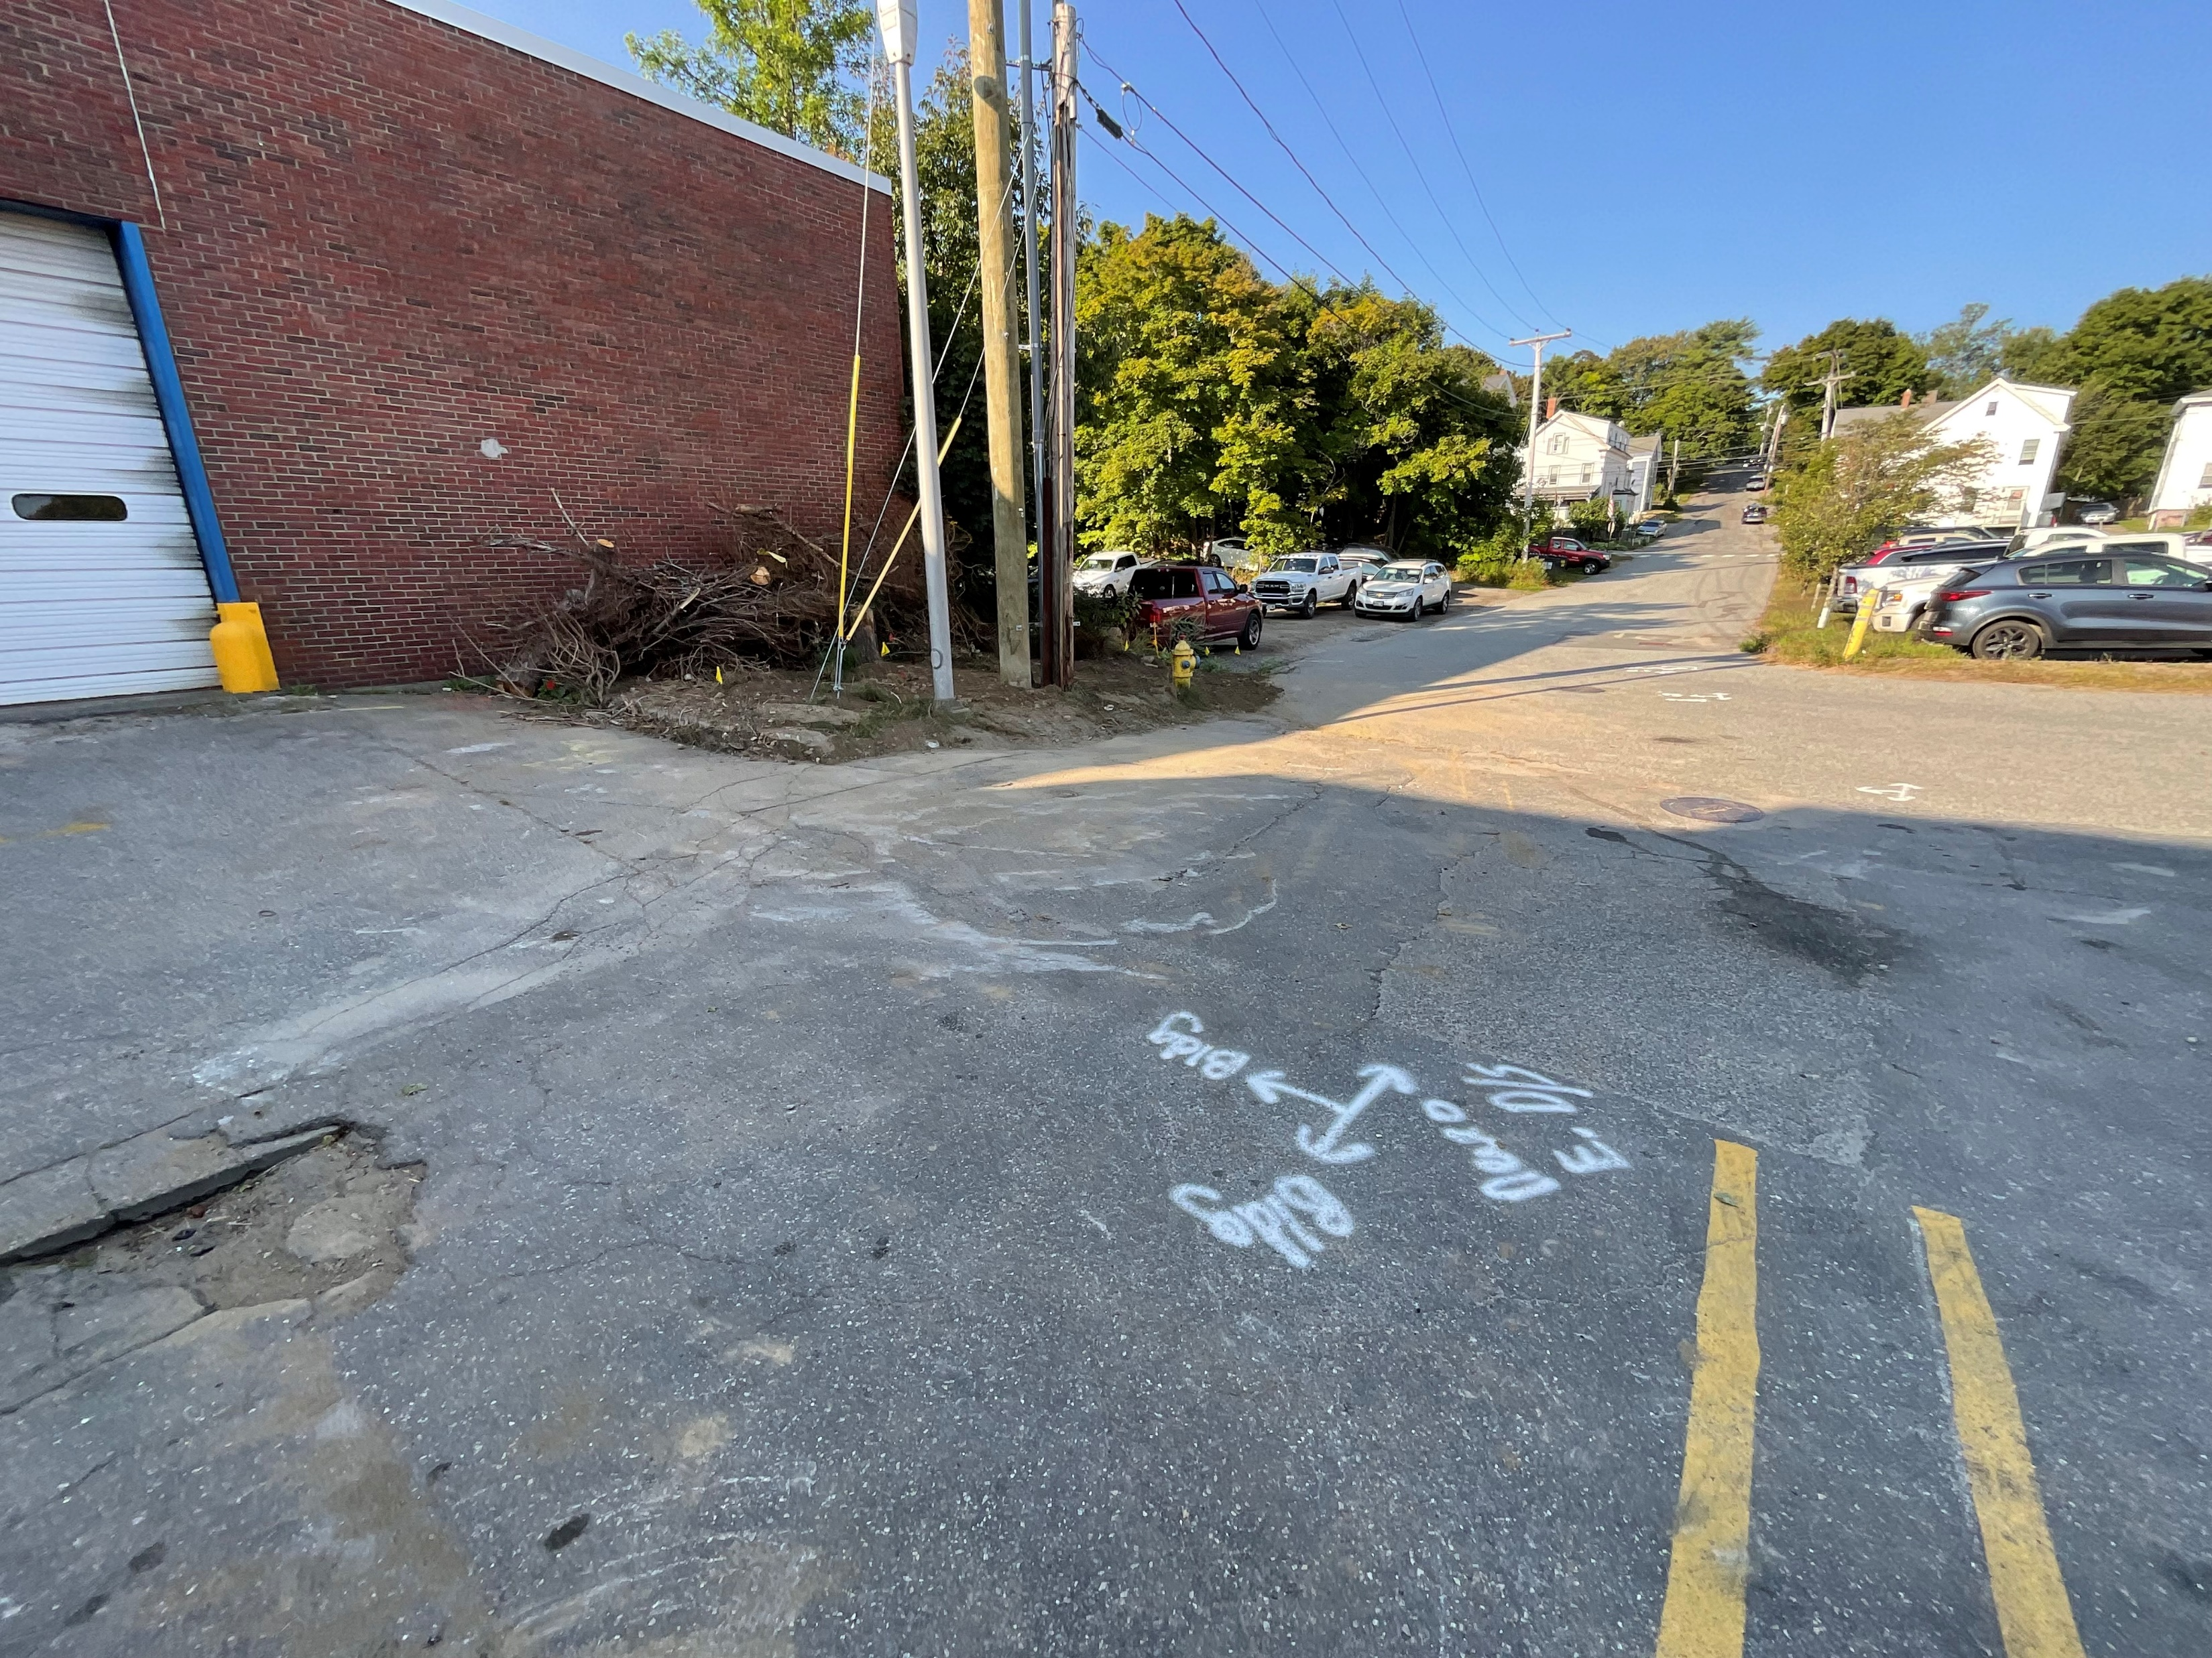
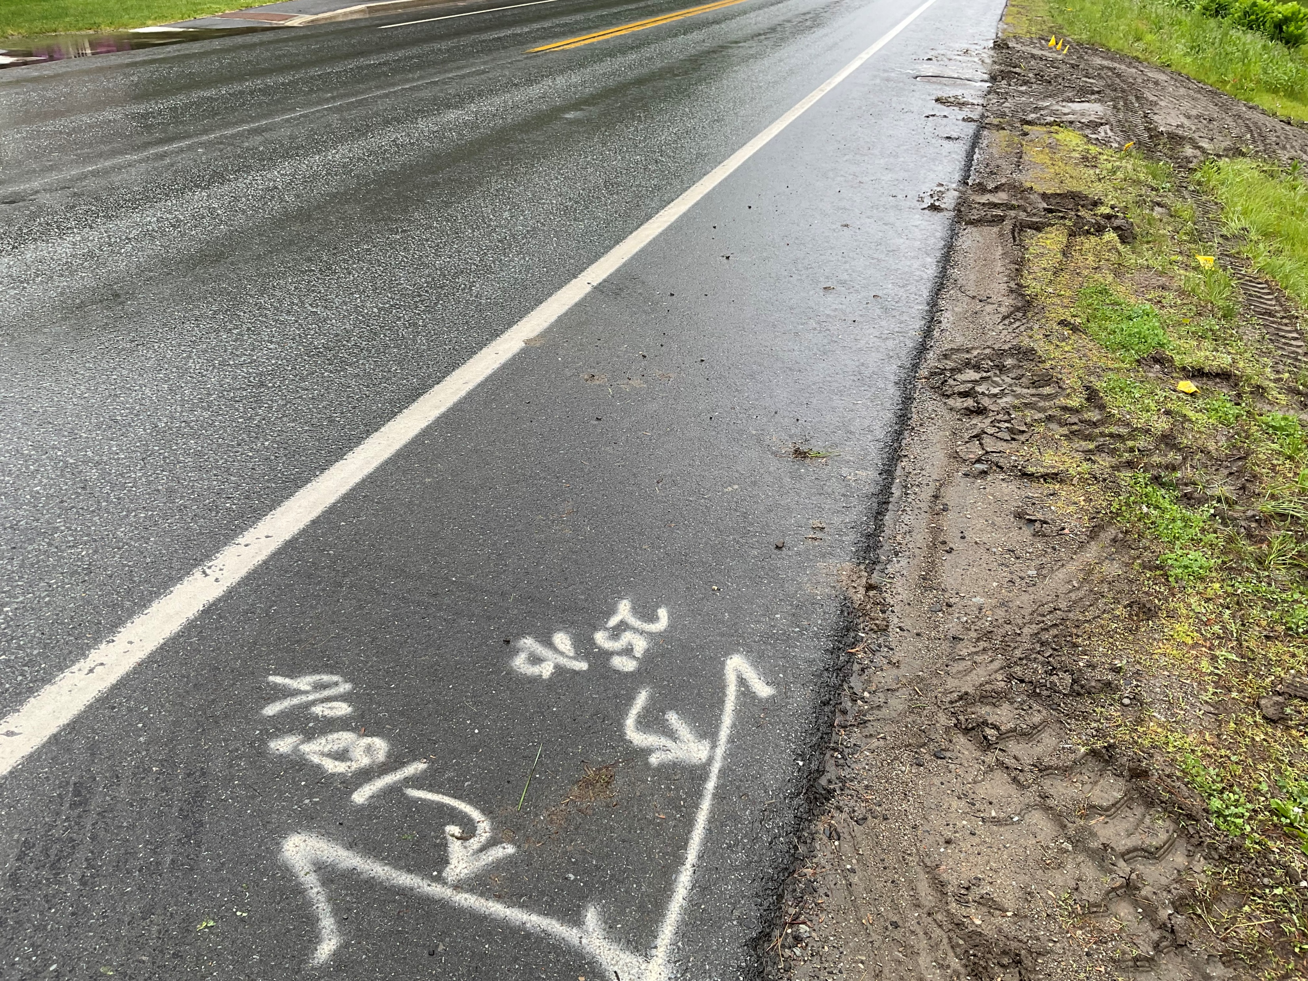
Premarked area must coincide with Dig safe ticket
Be specific and consistent
  intersections
  GPS coordinates
  landmarks

Slide 23
Notification
Member Facility Operators
Electrical, Gas, Oil, Steam
Telephone, CATV, Fiber Optic
Non-Members
Water, Sewer, private property owners and some small utilities

Slide 24
Notifying Private Property Owners
From Chapter 895:
Further Notice Requirements: In addition to other notice requirements under this section and except for an employee with respect to that employee’s employer’s facility, an excavator shall notify any person who is not a member of the system and has underground facilities in the area of the proposed excavation. This notice must be in writing or in person.

Slide 25
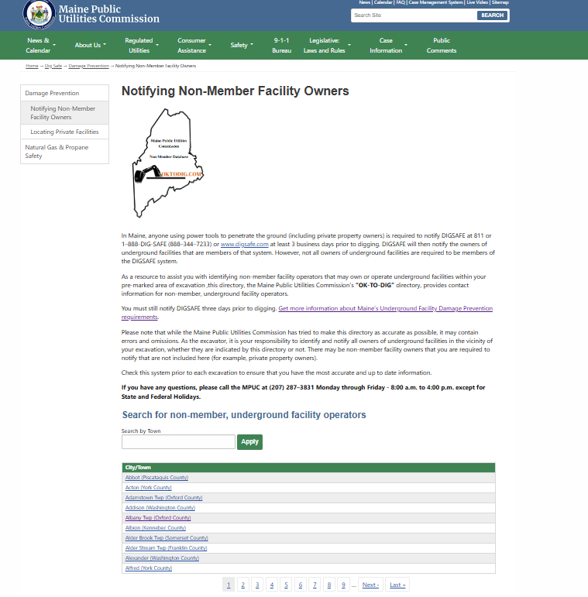
OKTODIG.COM

Slide 26
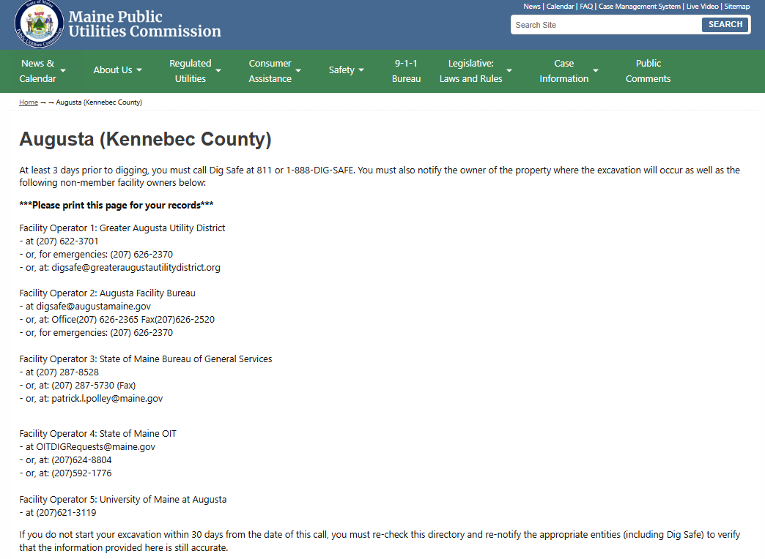
OKTODIG.COM

Slide 27
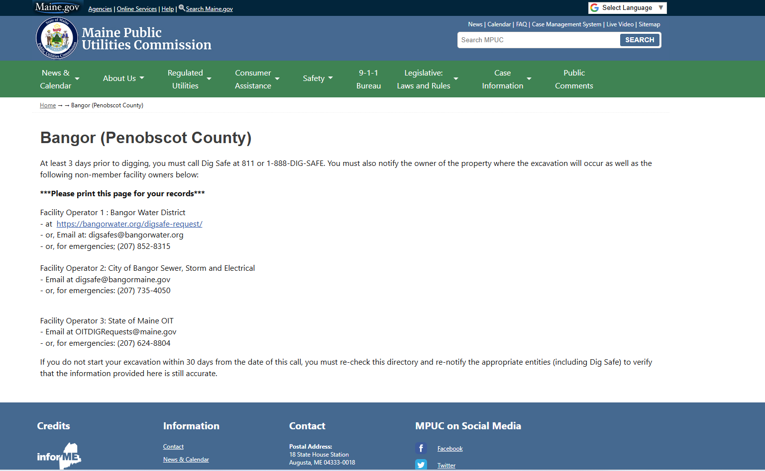
OKTODIG.COM

Slide 28
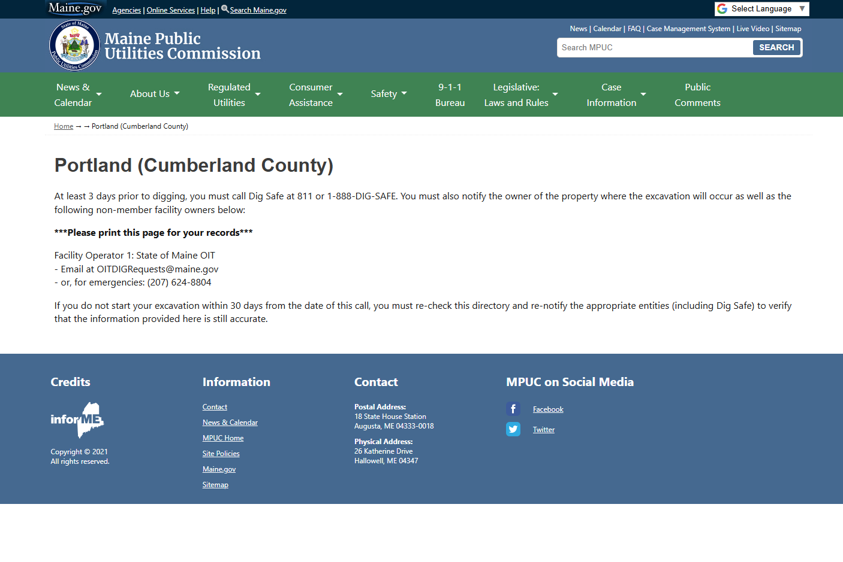
OKTODIG.COM

Slide 29
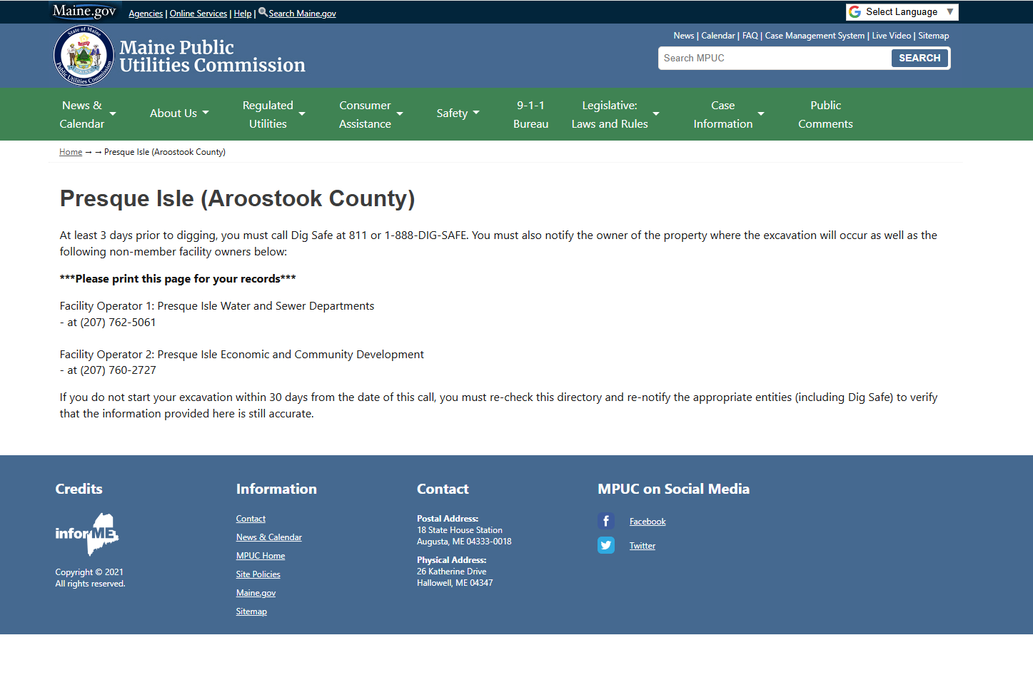
OKTODIG.COM

Slide 30
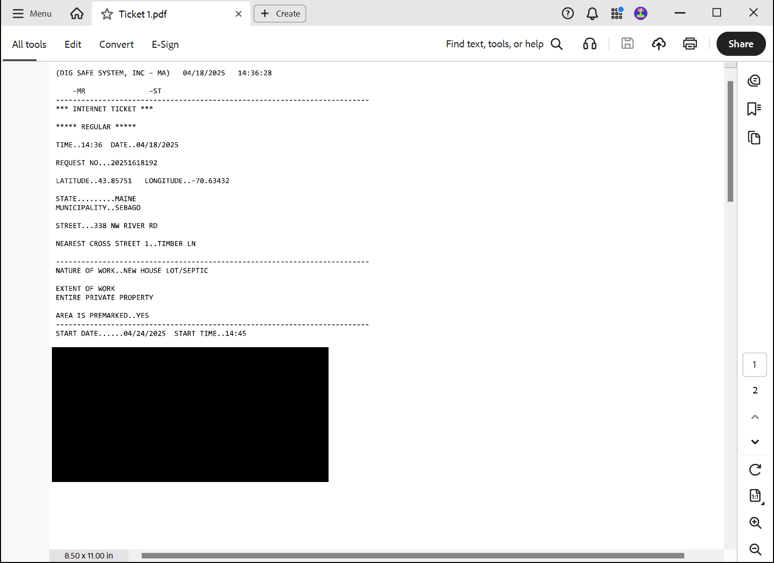
Valid Ticket
At least 72 hours, not including weekends and holidays, prior to commencement of excavation
Not more than 30 days prior to commencement of excavation
Renotification if excavation not completed within 60 calendar days after notification

Slide 31
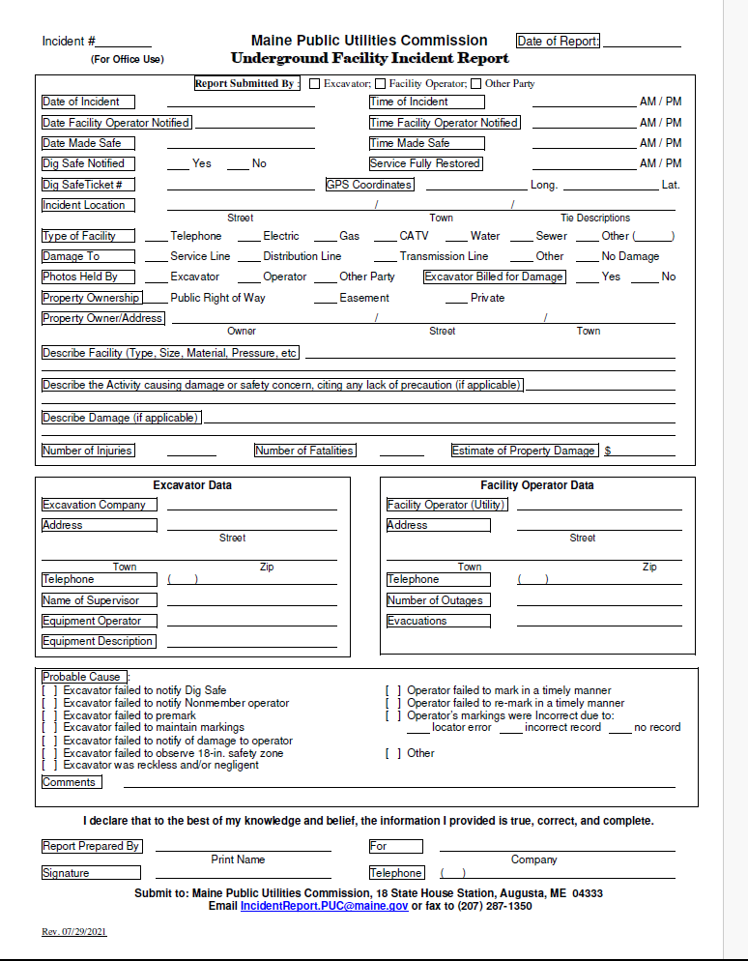
Incident Reporting Form
-Type of facility
-Describe damage / impact
-Injuries / Fatalities / Property Damage
-Probable Cause
-Contact Information / Photos / Videos
-Operator and Excavator must both report Chapter 895 Violations

Slide 32
Training Scheduling
Damage Prevention Training
Instructor: Investigator Matt Tomassone or Richard Leclair
Location: 45 Commerce Drive, Suite 8 Augusta, ME
Time: 8am but can arrive as early as 7:30 to look over material
Target Audience: Utility Operators, Excavator Community, General Public
Type: Informative (No Test)
Duration: 2- 2 ½ Hours
Cost: Free Training
Registration/Sign-up: Contact Hattie Trask at hattie.trask@maine.gov or (207) 287-6075.
For those wishing to provide training to a large group/company, on site-trainings at your facility may also be available.

Slide 33
Training Agenda
Training Manual
History & Overview of “The Law”
Definitions
The Rule
Excavators
Facility Operators
Dig Safe System, Inc.
Exactix Online Ticket System
Non-Member Notification
Ticket Types
MPUC

Slide 34
Training Totals
PUC Trainings: 67
On-Site Trainings: 431
MUST Trainings: 495
GRAND TOTAL: 993

Slide 35
Questions?
Richard C. LeClair
Damage Prevention Investigator
Damage Prevention Team
Tel: 207-287-1369
Cell: 207-592-1098
richard.c.leclair@ maine.qov
Matthew Tomassone
Damage Prevention Investigator
Damage Prevention Team
Cell: 207-592-3789
Matthew.Tomassone@maine.qov
Hattie Trask
Safety Programs Coordinator
Damage Prevention Team
Tel: 287-6075
hattie.trask@ maine.qov

