Slide 1
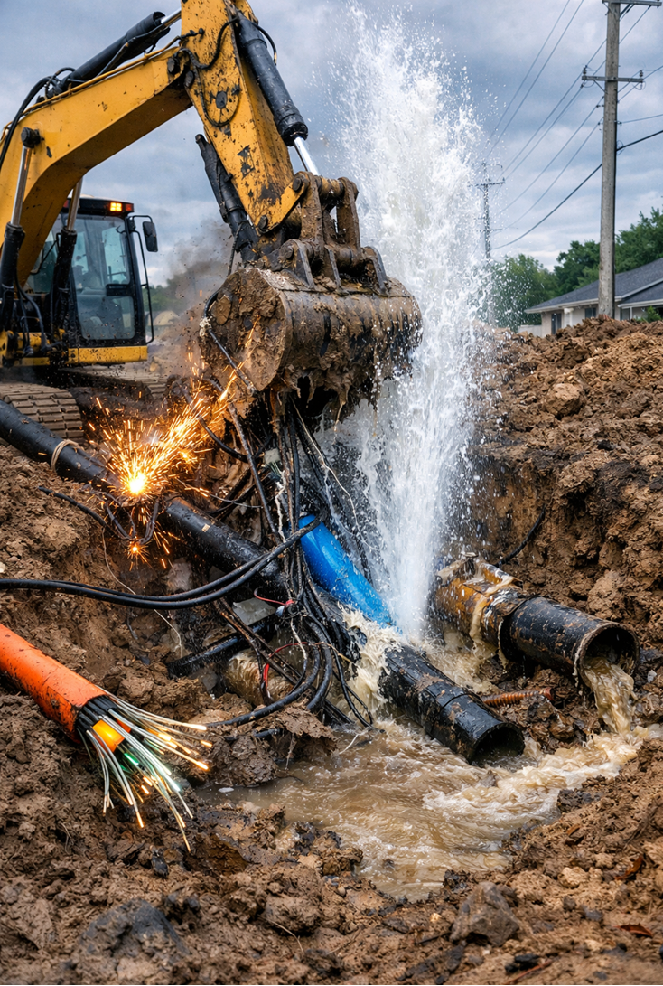

New Hampshire’s Underground Damage Prevention Program
New Hampshire Department of Energy
Division of Enforcement
Underground Damage Prevention
Presented by Bryan Connelly

Slide 2


Underground Damage Prevention
N.H. Dept. of Energy
Jurisdictional Propane Systems
Natural Gas Lines
Division of Enforcement
Electrical Facilities
Safety & Cybersecurity

Slide 3
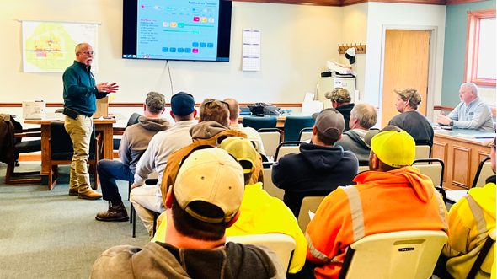
What is the Purpose of the Underground Damage Prevention Course?
To mitigate damage to underground facilities through education
To protect the public, operators, and excavators from harm
Explains when Excavators should obtain a Dig Safe ticket
Responsibility of Dig Safe to notify Member Utilities
Explaining what the Tolerance Zone is
Duties of the Operator as well as the Excavator
Defines what an Emergency Situation is

Slide 4


New Hampshire Excavator Manual
The New Hampshire Excavator Manual is available at www.energy.nh.gov
Explains RSA 374 and En 800 Rules for the Underground Damage Prevention Program
Page 28-30 List member utilities that are notified.
Page 31-58 list of NH towns and utilities.
Information is kept current on the NH Department of Energy Website

Slide 5


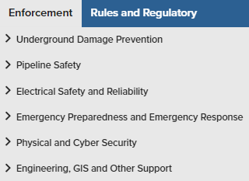
Ways to Communicate https://www.energy.nh.gov/

Slide 6

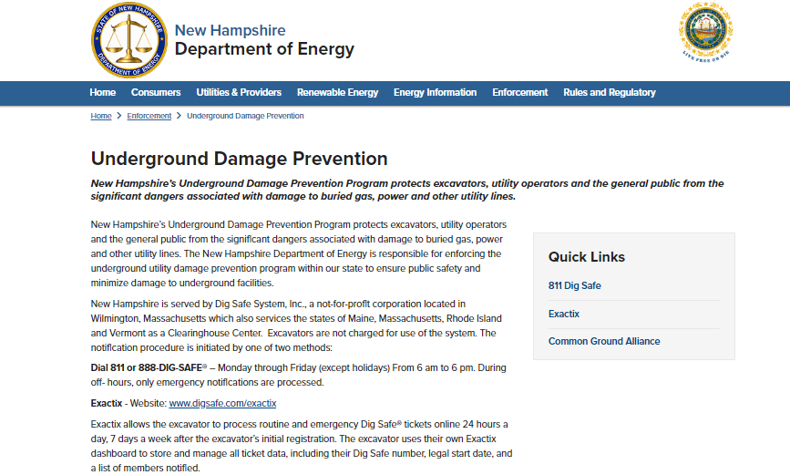

Emails to: UGDPP@ENERGY.NH.GOV

Slide 7
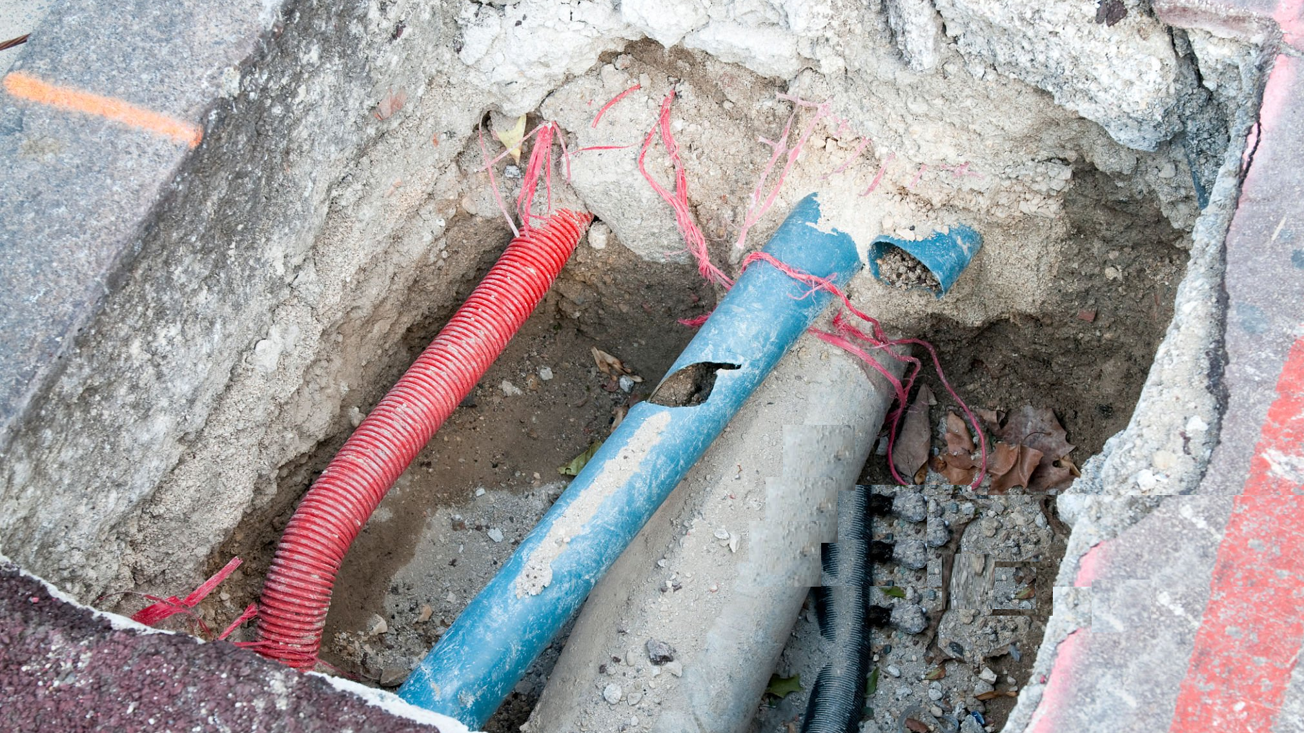
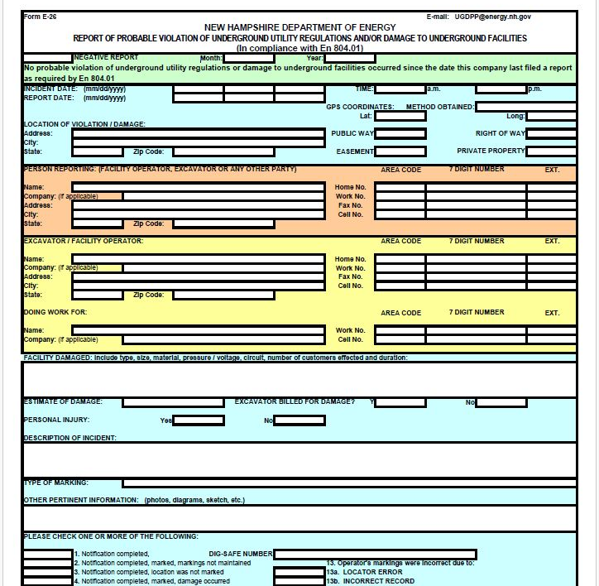
Enforcement Process:
A Utility company must submit an E-26 form to report any damage to underground facilities
Include Detailed Facility Damage Information, Description of the Incident
Must submit a Negative Report when No Reportable Incidents have Occurred
E-26 to the DOE within 20 days from notification of damage

Slide 8
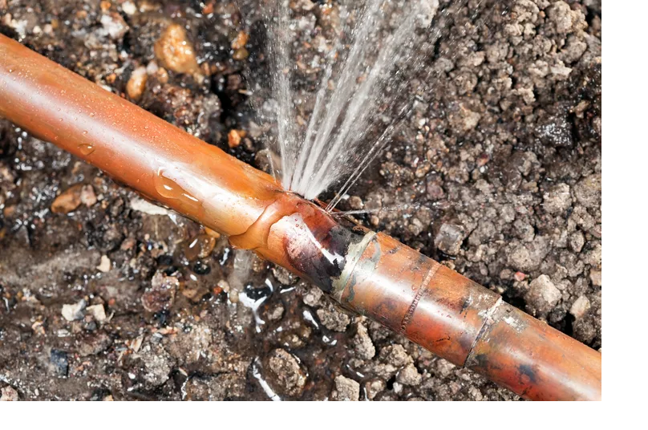
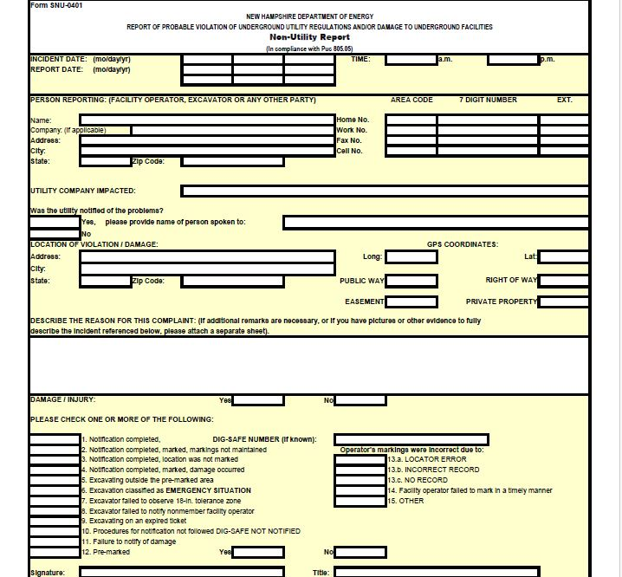
Enforcement Process:
Excavators submit an SNU-0401 to report damage to underground facilities:
Submit SNU-0401 within 72 hours excluding weekends and holidays
Provide as much detail as possible, include pictures and/or videos
A way to communicate: No mark, miss-mark, false positive response

Slide 9


What The Rules Say En 800: Underground Damage Prevention Program
Purpose and Application 801 To protect the public, operators, and excavators from harm, damage, and interruption of services
Definitions 802 Emergency Situation, Excavation, Hand digging, Operator, Premark, Tolerance Zone, Underground Facility
System Requirements (Duties of the Notification Center (Dig Safe Systems Inc) 803 Receives notification from excavators that intend to dig. Relays that information to potentially affected operators
Duties of Operator 804 To report damage to the NH DOE. To have utilities in affected areas marked accurately
Duties of an Excavator 805 Excavation within 100 feet of an underground utility. Get a Dig Safe ticket. Practice Reasonable Care. Report Damage
Markings in the Tolerance Zone 806 Establishes marking standards. Markings to be done within 72 hours.
Enforcement Procedures 807

Slide 10
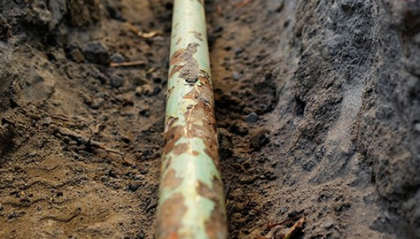
Fines:
If the NHDOE believes there has been a violation to RSA 374:48-56, En 800, or both:
Notice of Probable Violation
per 374:55 (VIII) Civil Penalty From $500 to $5000
Attend Underground Damage Prevention Training
Informal hearing: both parties attend, no sworn testimony
Notice of Violation

Slide 11
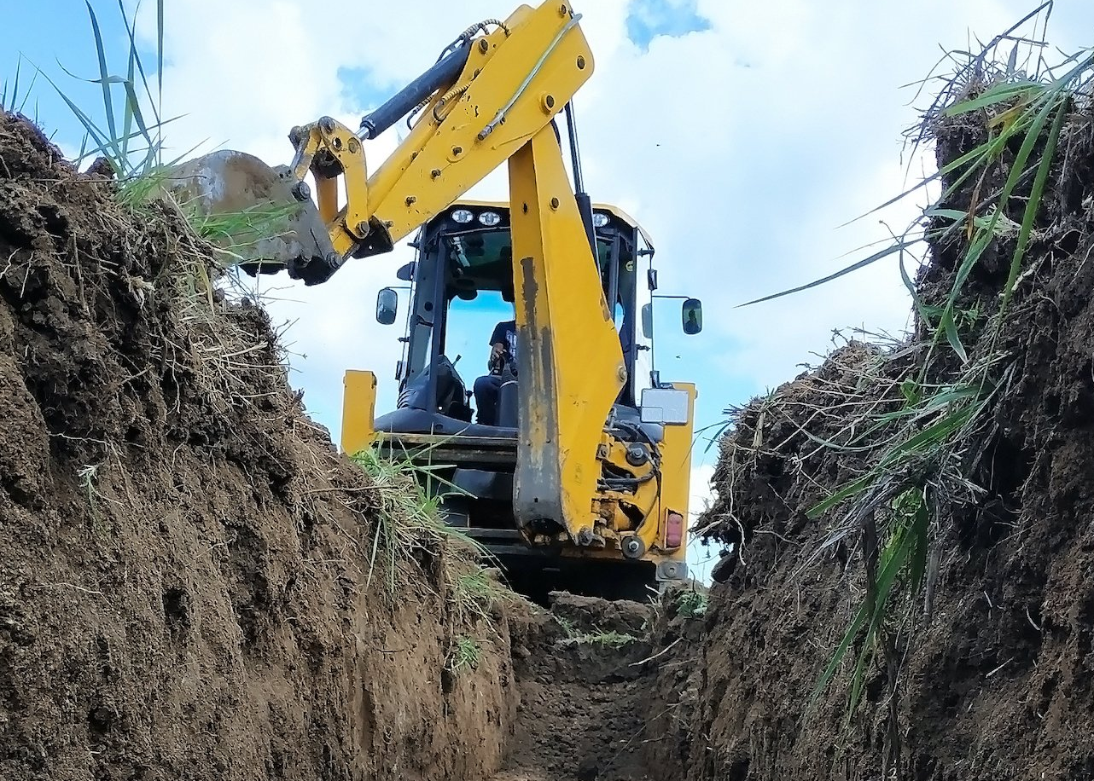
Key Elements For a SAFE EXCAVATION
Plan Ahead
Premark Before Calling
Obtain Dig Safe ticket
Wait 72 hours
Maintain the Marks
Practice Reasonable Care
Call and Update Ticket before day 27
Notify Utility of Damage
Notify of Damage form SNU

Slide 12

Frequent Reasons For Operator Violations
Failure To Mark Location – 33.5%
Failure To Correctly Mark Facility – 17%
Failure To Mark Within 72 Hours – 11%
Incorrect or No records – 8%

Slide 13
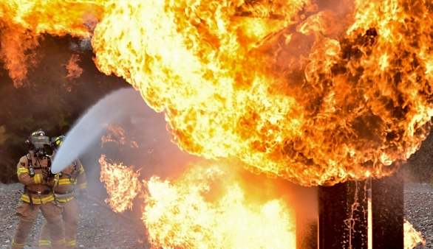
Frequent Reasons For Excavator Violations
Damage to Marked Facilities – 33%
No Dig Safe Ticket – 25%
Failure To Renew Dig Safe Ticket – 10%
Failure To Maintain Marks – 7%
Excavating Outside of the Pre-Marked Area – 3%

Slide 14
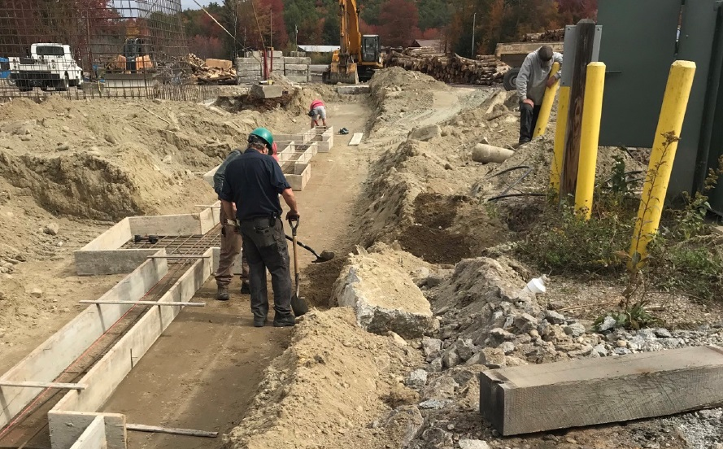
Excavating on an Expired Dig Safe Ticket
1
Story about 2022113

Slide 15
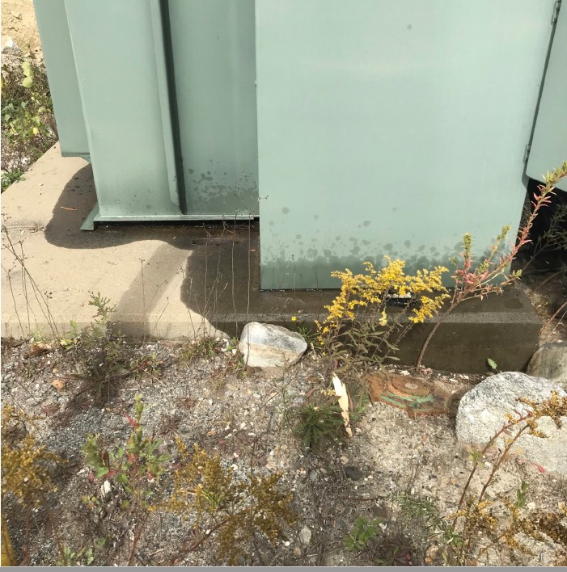
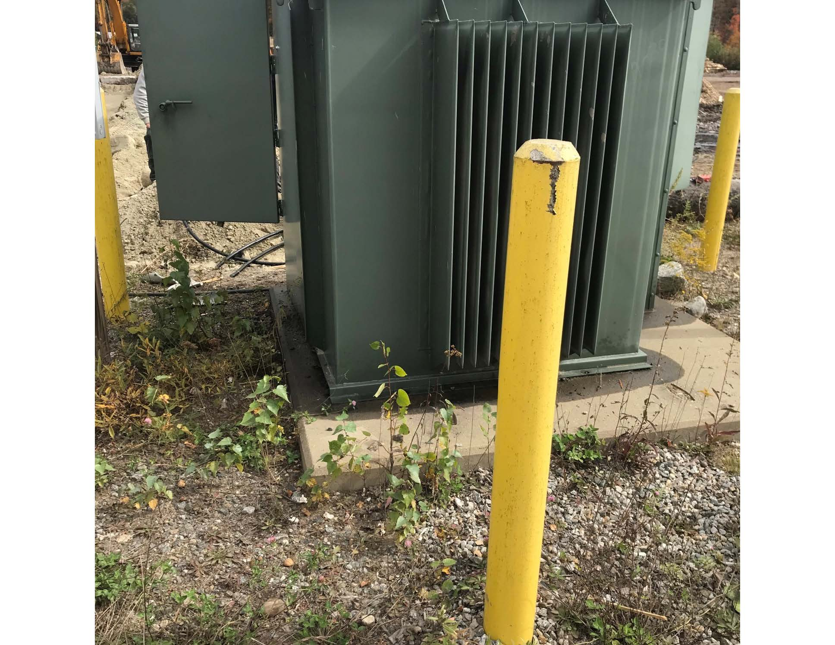

Slide 16
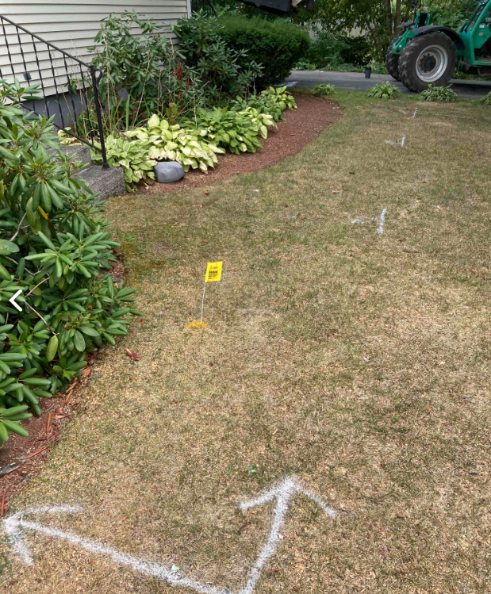
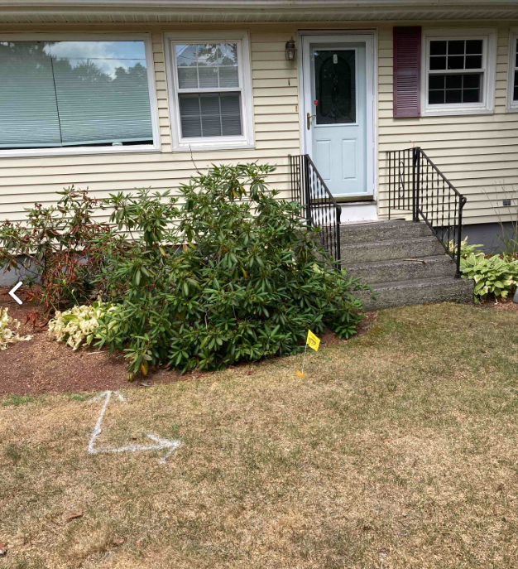
Excavating Outside of the Pre-marked Area
2

Slide 17
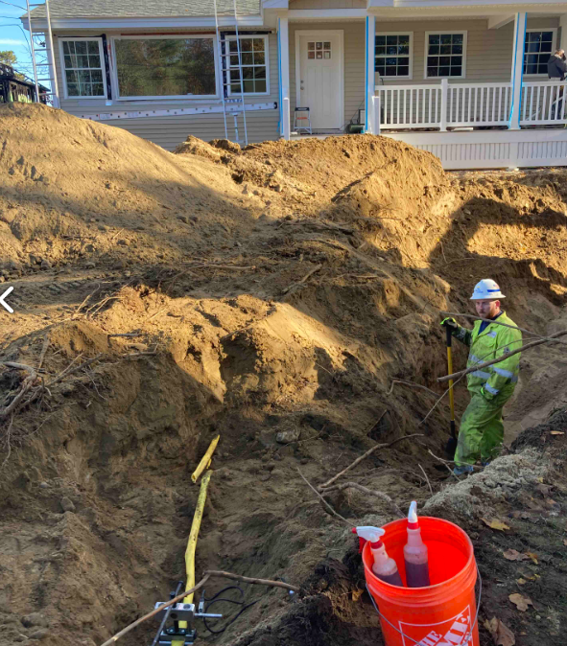
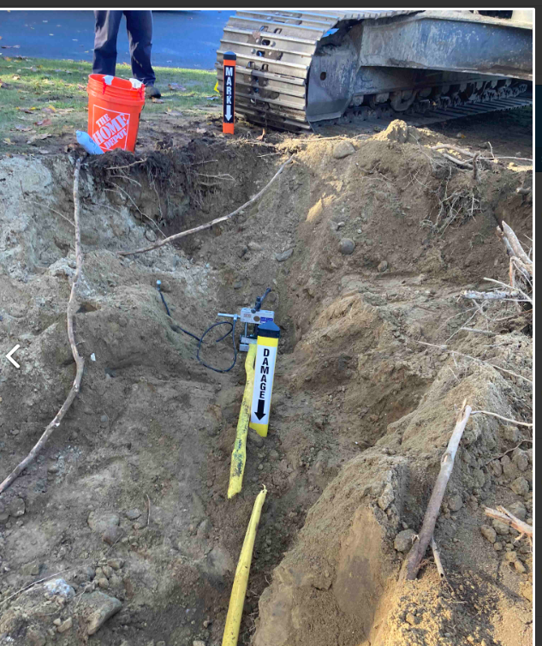

Slide 18
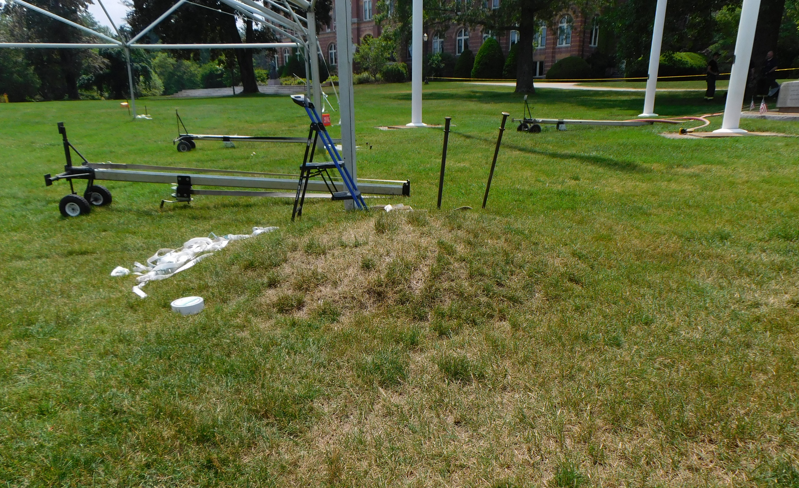
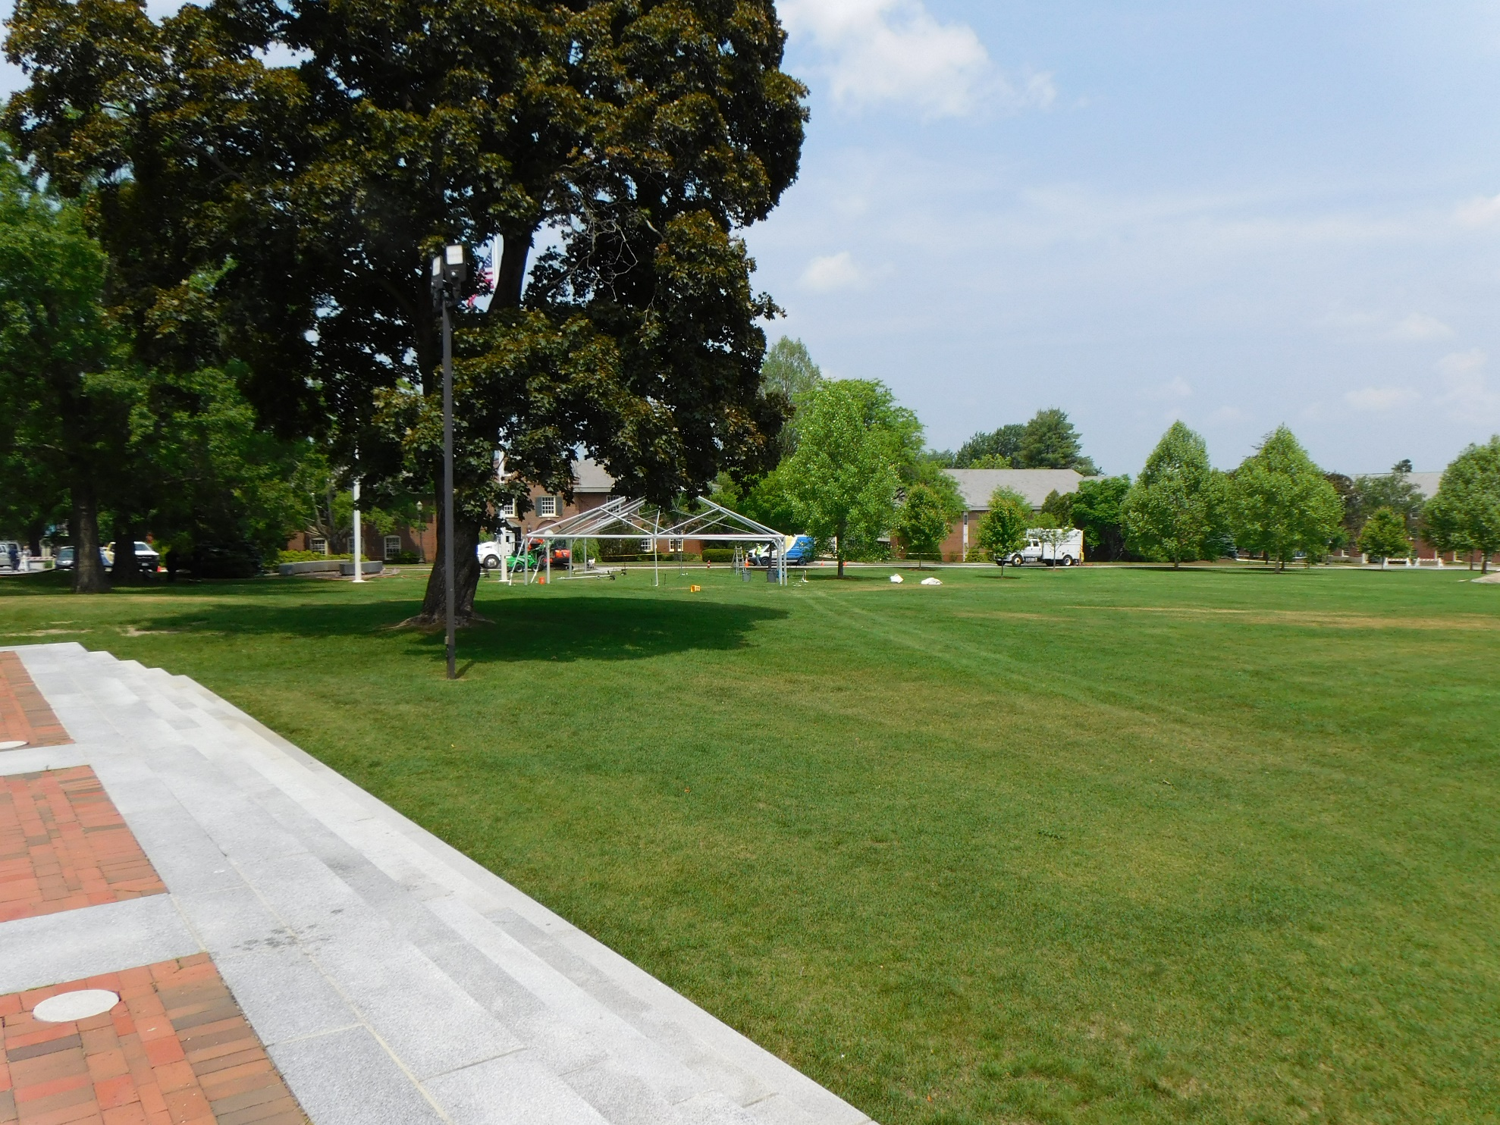
Excavating without a Dig Safe Ticket
3
Notes:
.

Slide 19
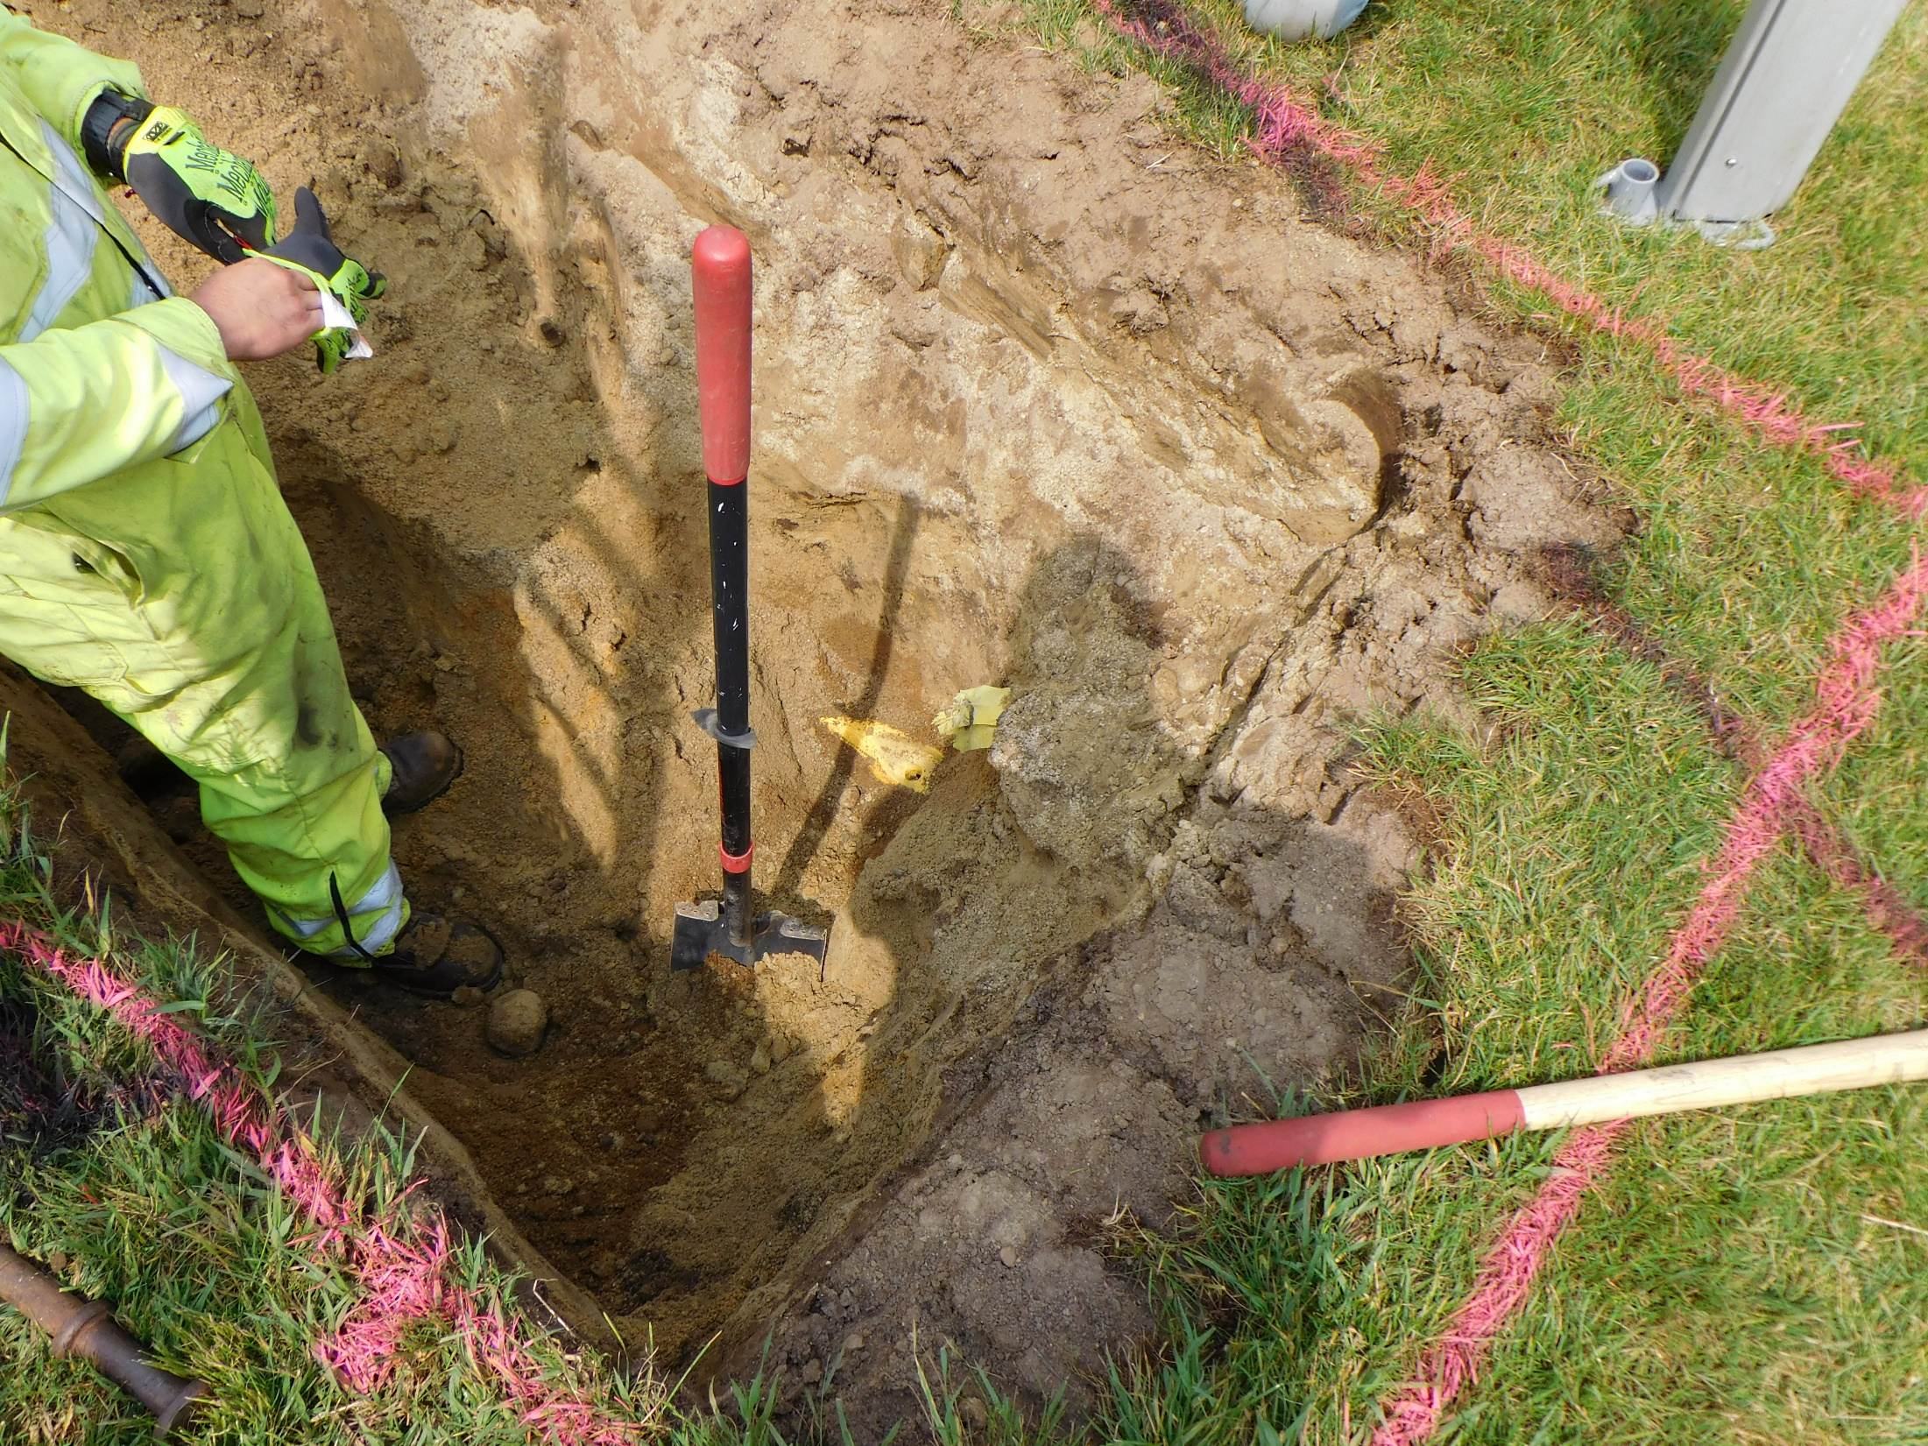
Excavating Within 100’ of an Underground Utility

Slide 20
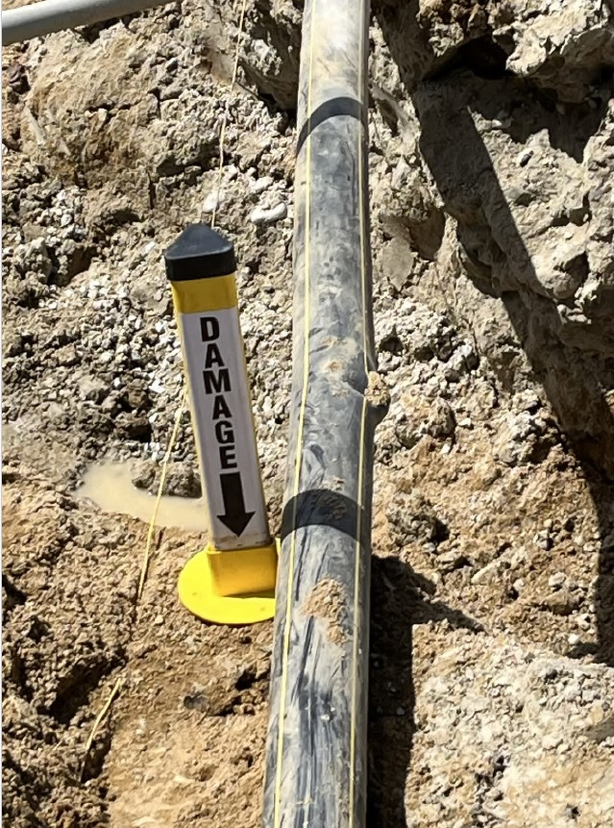
If Damage Occurs…
Call 911 if there is damage and gas is being released.
Call affected utility company.
Take photos/video of the pre-marks and Dig Safe marks.
Take photos/video of the actual damage.
File detailed SNU with the Division of Enforcement.

Slide 21
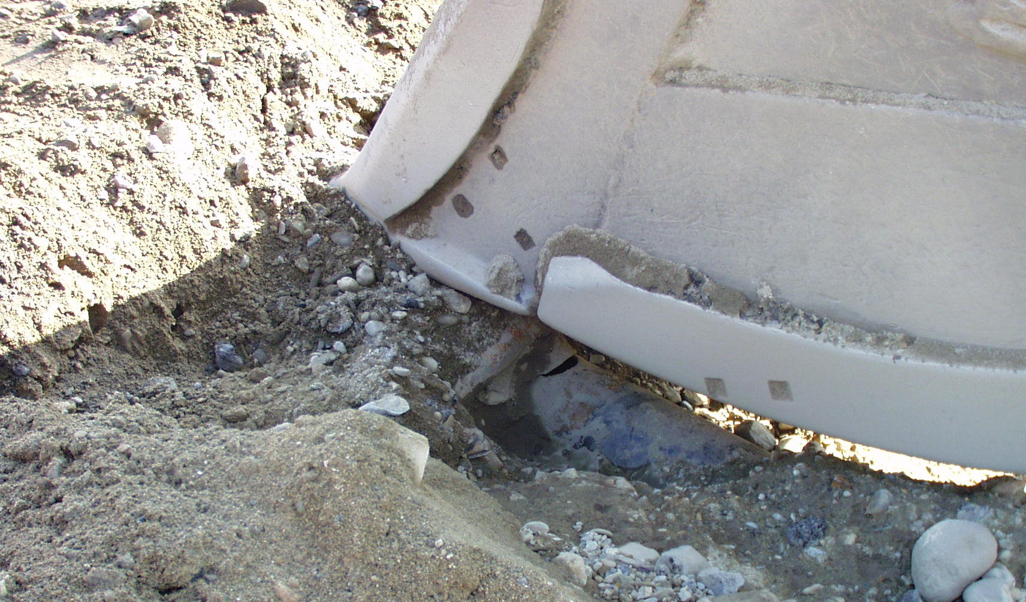


Practice Reasonable Care
Remember… Call 811. Not 911

Slide 22
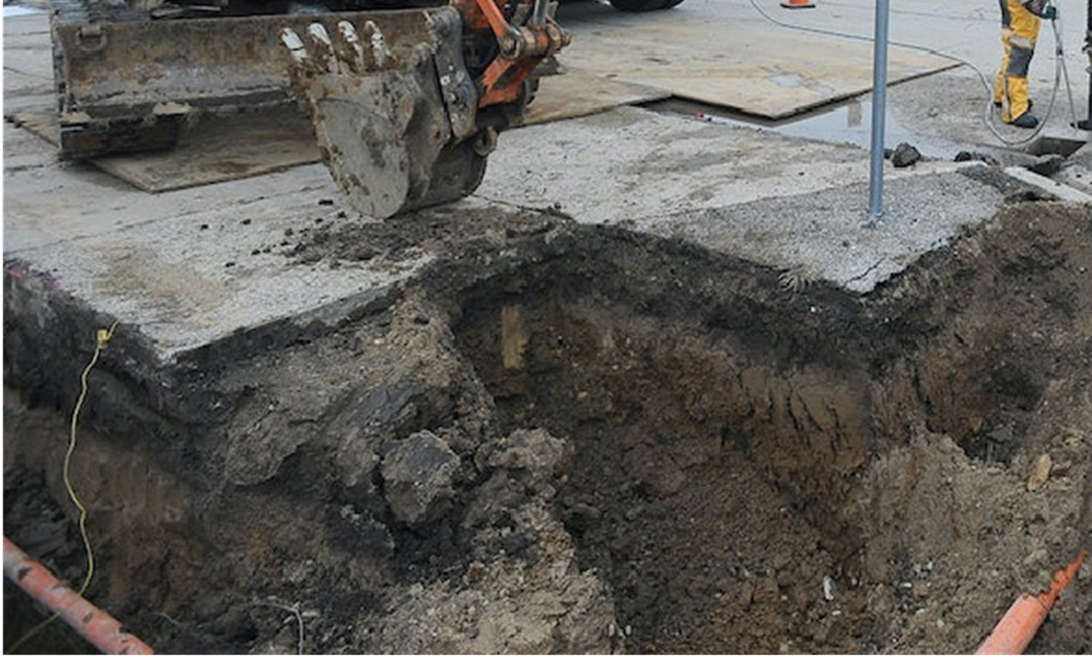
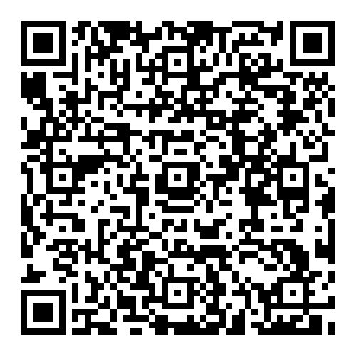
The NH Department of Energy, Division of Enforcement:
Contact Us
www.energy.nh.gov
Mike Soucy – Director Michael.R.Soucy@energy.nh.gov
ugdpp@energy.nh.gov
James Murphy – Gas Safety Administrator James.G.Murphy@energy.nh.gov
21 South Fruit Street, Concord
New Hampshire, 03301
Bryan Connelly – Underground Damage Prevention Specialist Bryan.M.Connelly@energy.nh.gov
603-271-6532

