Slide 1



Notes:
These are the four major electric utilities in NH.

Slide 2
This program is designed to provide basic knowledge and Safety awareness on the following topics:
Privately owned underground electric wires
Underground wires - Padmounted transformers and Sector cabinets
Step Potential
Overhead wires – Transmission & Distribution & Working Clearances
Wire Down Safety, General Safety Topis & Discussions

Slide 3
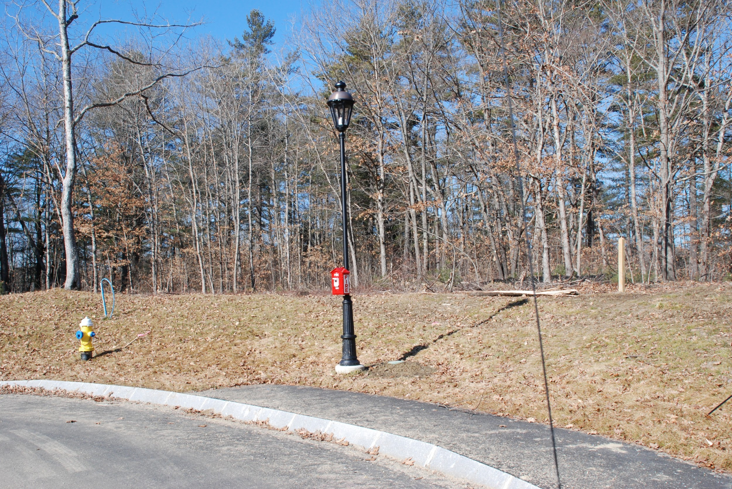
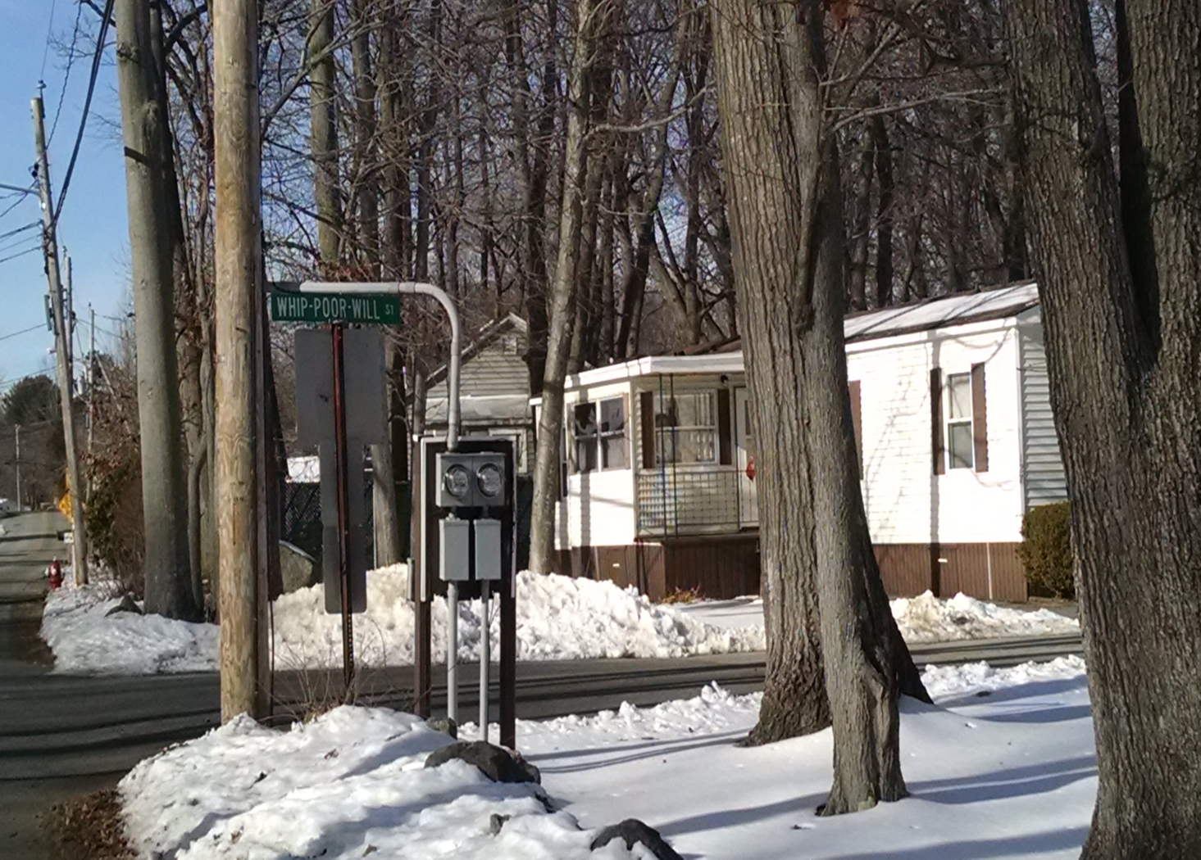
This is a privately owned decorative lamp post, fed from a privately owned underground cable/wire that the developer or homeowner association would be responsible for marking. It is the excavator's responsibility to recognize and contact the owner to have the underground marked.
Another example can be found in mobile home parks where the cables beyond these two meters are privately owned. The excavator is responsible for contacting the park association to have these marked.

Slide 4
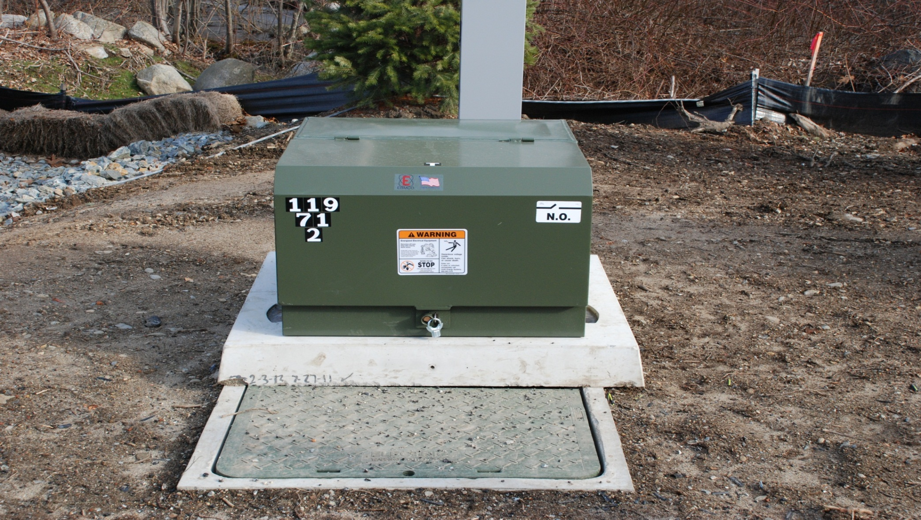
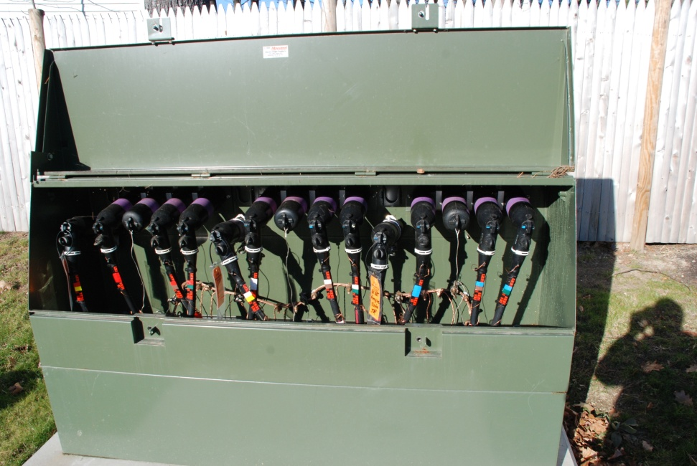
Padmounted Transformers and Sector Cabinets

Slide 5
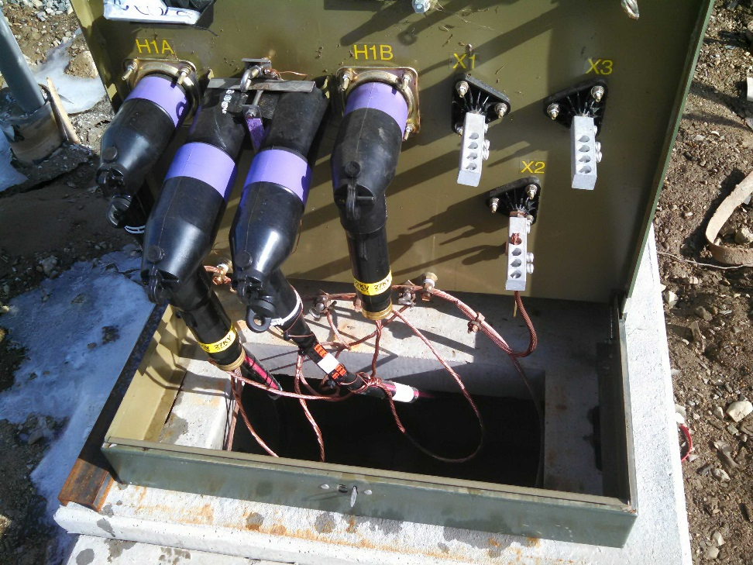
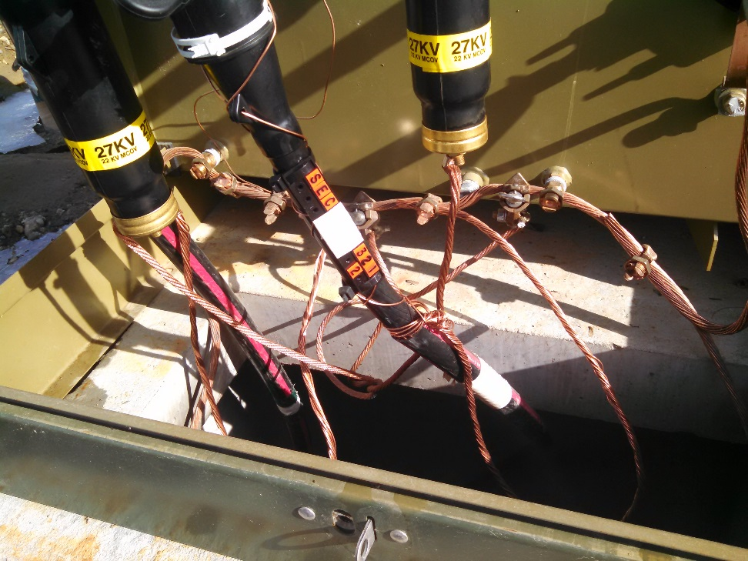
Padmount Cabling & Grounding
These pictures show the underground cables and grounds within a transformer. The grounding wire (copper color) is connected to the transformer which is also located around the perimeter of the concrete pad (Ground Grid) which is very shallow. Prior dig ins have resulted in tens of thousands of dollars in damages as well as oil spill clean up costs.
Notes:
This picture shows the underground cables within the padmounted transformer. The picture on the right shows how the grounding wire (copper color) is connected to the transformer which is also located around the perimeter of the concrete pad as mentioned in the prior slide. There have been occasions where excavations have taken place along the perimeter of the concrete pad where the excavator was not aware of the grounding wire being present and so shallow resulting in pulling on the ground wire which has led to the wire pulling out of the transformer lugs resulting in an oil leak causing tens of thousands of dollars damage and oil spill clean up.

Slide 6
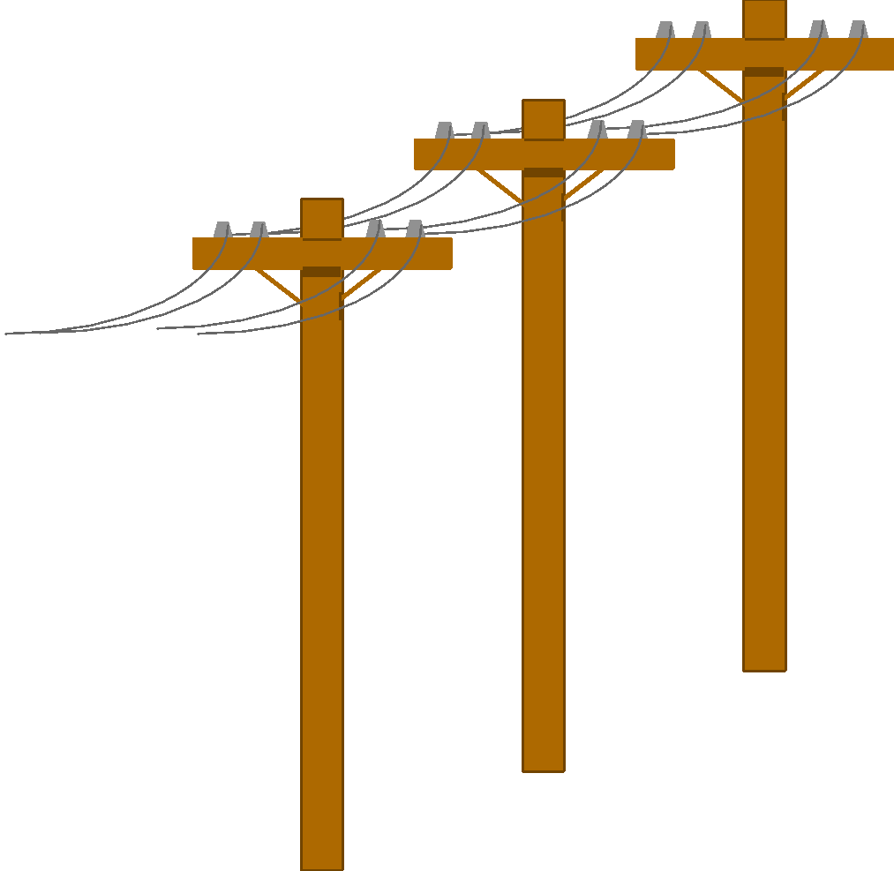

Step Potential
Energized wires on the ground can discharge into the earth, creating a difference in voltage potential.
Stepping across the differences in potential can allow current to flow through the body.
Current Flows
(Arrows)
Voltage Gradients
(Dashed Lines)

Slide 7

Step Potential
Step Potential is the step voltage between the feet of a person standing near an energized grounded object.

Slide 8
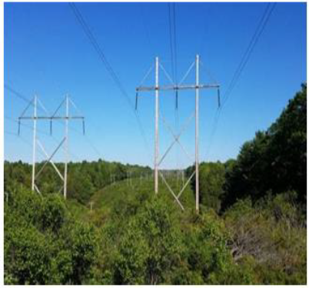
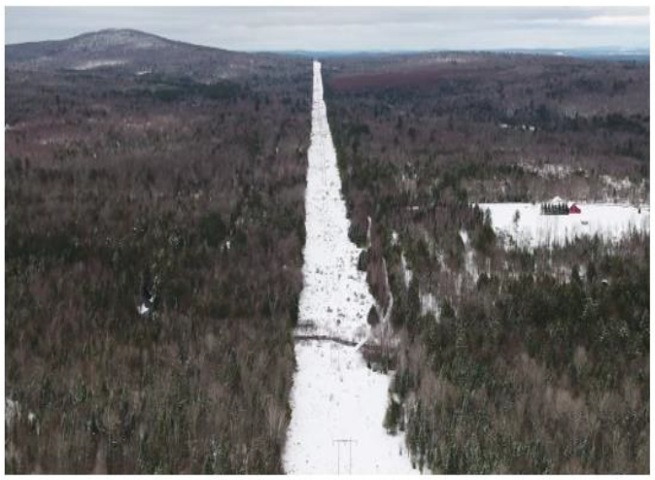
Overhead Lines - Transmission

Slide 9
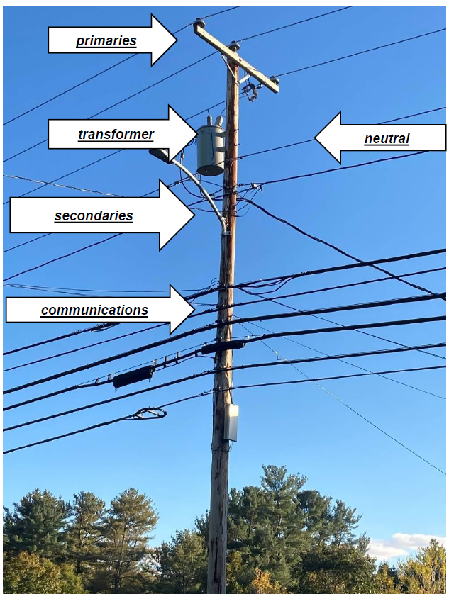
Overhead Lines – Distribution
What’s on a Pole?
What’s on a Pole?
What’s on a Pole?

Slide 10
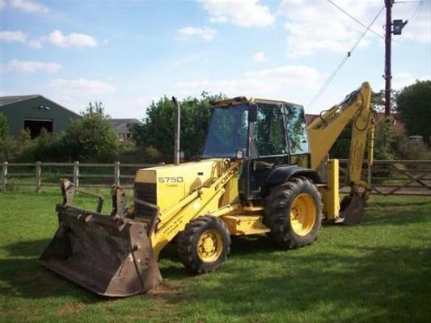
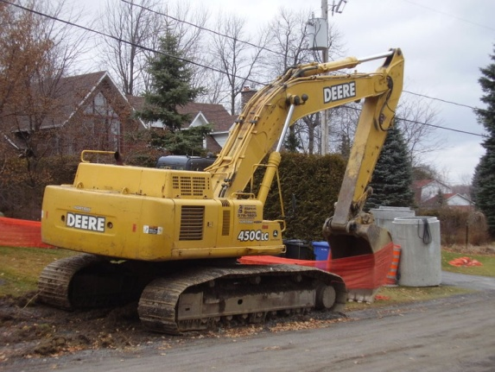
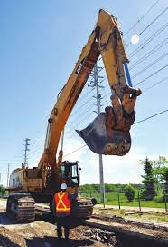
Working Clearances - OSHA
Backhoes, Excavators & Cranes
  Know the power line clearance requirements (Refer to the National Fire Protection Association (NFPA-70E) for safe approach distances).
  For lines 50kV or less, the operator must keep ALL equipment, material and personnel at least 10ft. Away.
  Crane operation has other specific rules (4” per kV) and if voltage is not known crane must remain 20 feet away unless de-energized and grounded. This is very unlikely.

Slide 11
Wire Down Safety
Maintain a minimum of 10 feet from all conductors (MAD).
Any conductors on the pole can be energized at any time.
Listen for generators in the area –generators can cause back feed.
Trees can conduct electricity.
Be aware of your surroundings, is there a wire down and lights on around you?
Do not work until you are told it is safe and grounded by an Electric Utility employee.

Slide 12
Overhead Electrical Power Lines-The Silent Killer
The leading cause of fatal electrical incidents while on the job is contact with power lines!!
Power lines kill an average of 152 workers per year(2011-2019){2020-126} [2021-152]
25 percent of these workers are between 25-35 years of age.
Leading causes:
<> Contact with heavy equipment (cranes, drilling rigs, backhoes, dump trucks, excavators) 50%
<> Contact with long handled tools and hand carried items (ladders, scaffolding, metal siding, metal poles,) 20%

Slide 13
Three people were killed at a concrete plant in Telford, PA when a crane struck a 7,200-volt power line.
The crane operator was electrocuted immediately, and two co-workers were also electrocuted when they attempted to rescue the operator.

Slide 14
It Happens

Slide 15
Planning for Work Near Overhead Power Lines
Conduct a full Walk down and survey the work site before beginning work to identify all overhead power lines. Consider equipment travel paths and movement. LOOK UP!
All overhead power lines shall be considered energized until proven otherwise by the Electric Utility.
Contact the owner of the lines to determine the voltage, and to request a line to be de-energized and grounded.
Implement a two barrier control system to maintain effective standoff distances. Examples include:
Use trained dedicated spotters that maintain radio contact with operator. Ensure spotters understand hand signals. Use of radios is preferred for communications.
Use physical barriers that prevent equipment from intrusion (insulation blankets, Hard Guard, Marker Balls etc.)
Use stakes, cones, and painted lines to remind operators of demarcation lines.

Slide 16
Safe Practices Handling Materials and Ladders
When working around overhead electric lines or with electrical equipment, use non-conductive ladders and tools
Never attempt to carry a ladder in a vertical position. Ladders should be lowered and turned horizontally when transported from one location to another.
Extension ladders should be collapsed before lowering from a vertical position.
Unload materials from trucks and flatbeds away from overhead lines

Slide 17
Overhead Considerations – In Summary
Conduct a job site meeting (tailboard) with everyone involved, to discuss the planned work as it relates to the power lines. Discuss topics such as the use of long-handled tools, and equipment (raised dump trucks, back hoes, etc.) that could come in contact with power lines. Consider the two barrier controls.
Prohibit work when environmental conditions warrant (fog, precipitation, smoke, darkness, etc.)
Only use nonconductive ladders and material handling equipment. Aluminum ladders and metal scaffolds or frames are efficient conductors of electricity.
Keep all personnel from leaning on the equipment while it is operating!

Slide 18
Underground Power Lines
The leading cause of fatal electrical incidents while on the job is contact with power lines!!
In the last 5 years, 254 workers have suffered life changing injuries.
4 out of 5 incidents involve a tradesperson.
Research says:
1/3 of tradespeople do not always check for underground cables. Of those people, 15% do not believe it is their responsibility, and 24% do not believe they will be digging deep enough.
There has been a 30% increase since COVID lockdowns have ended.
Voltages can range from 240 volts and up to 115 KV
15% say that if they uncovered electricity cable encased in concrete, they would attempt to break them out.

Slide 19
Planning for Work Near Underground Power Lines
Conduct a full Walk down and survey the work site before beginning the work to identify all DigSafe markings. Consider equipment travel paths and movement.
All underground power lines shall be considered energized until proven otherwise by the power utility.
Contact the owner of the lines to determine the voltage of the lines and request the lines be de-energized and grounded.
Has the DigSafe been completed and fully marked out?
Is everyone on scene aware of the tolerance zones and markings including the spotters?
Be aware that there still may be locating issues due to bad or outdated mapping or locator error.
There is no minimum depth!!!
When in doubt, stop and either hand dig or use a vacuum to accurately locate the utility lines in question.

Slide 20
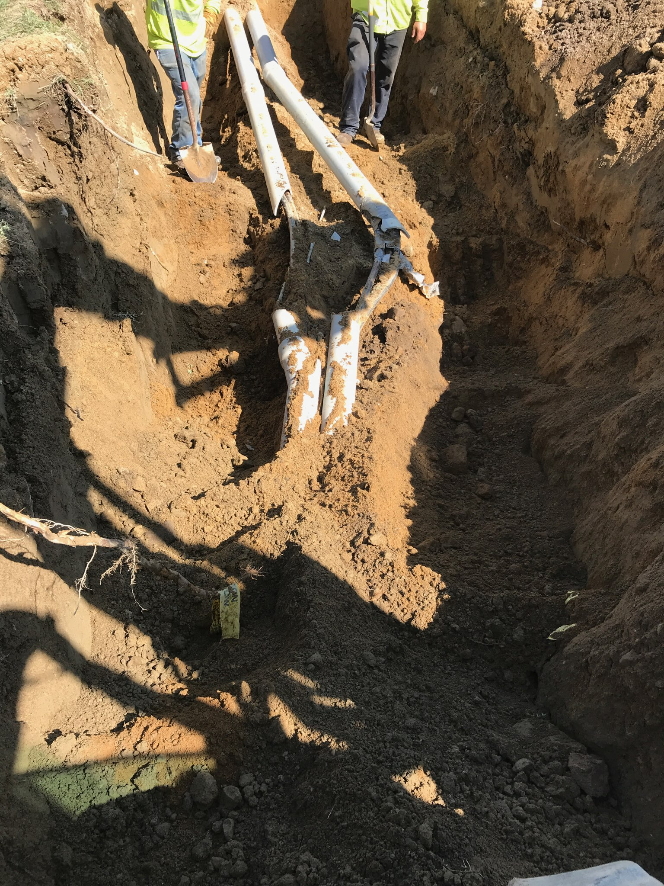
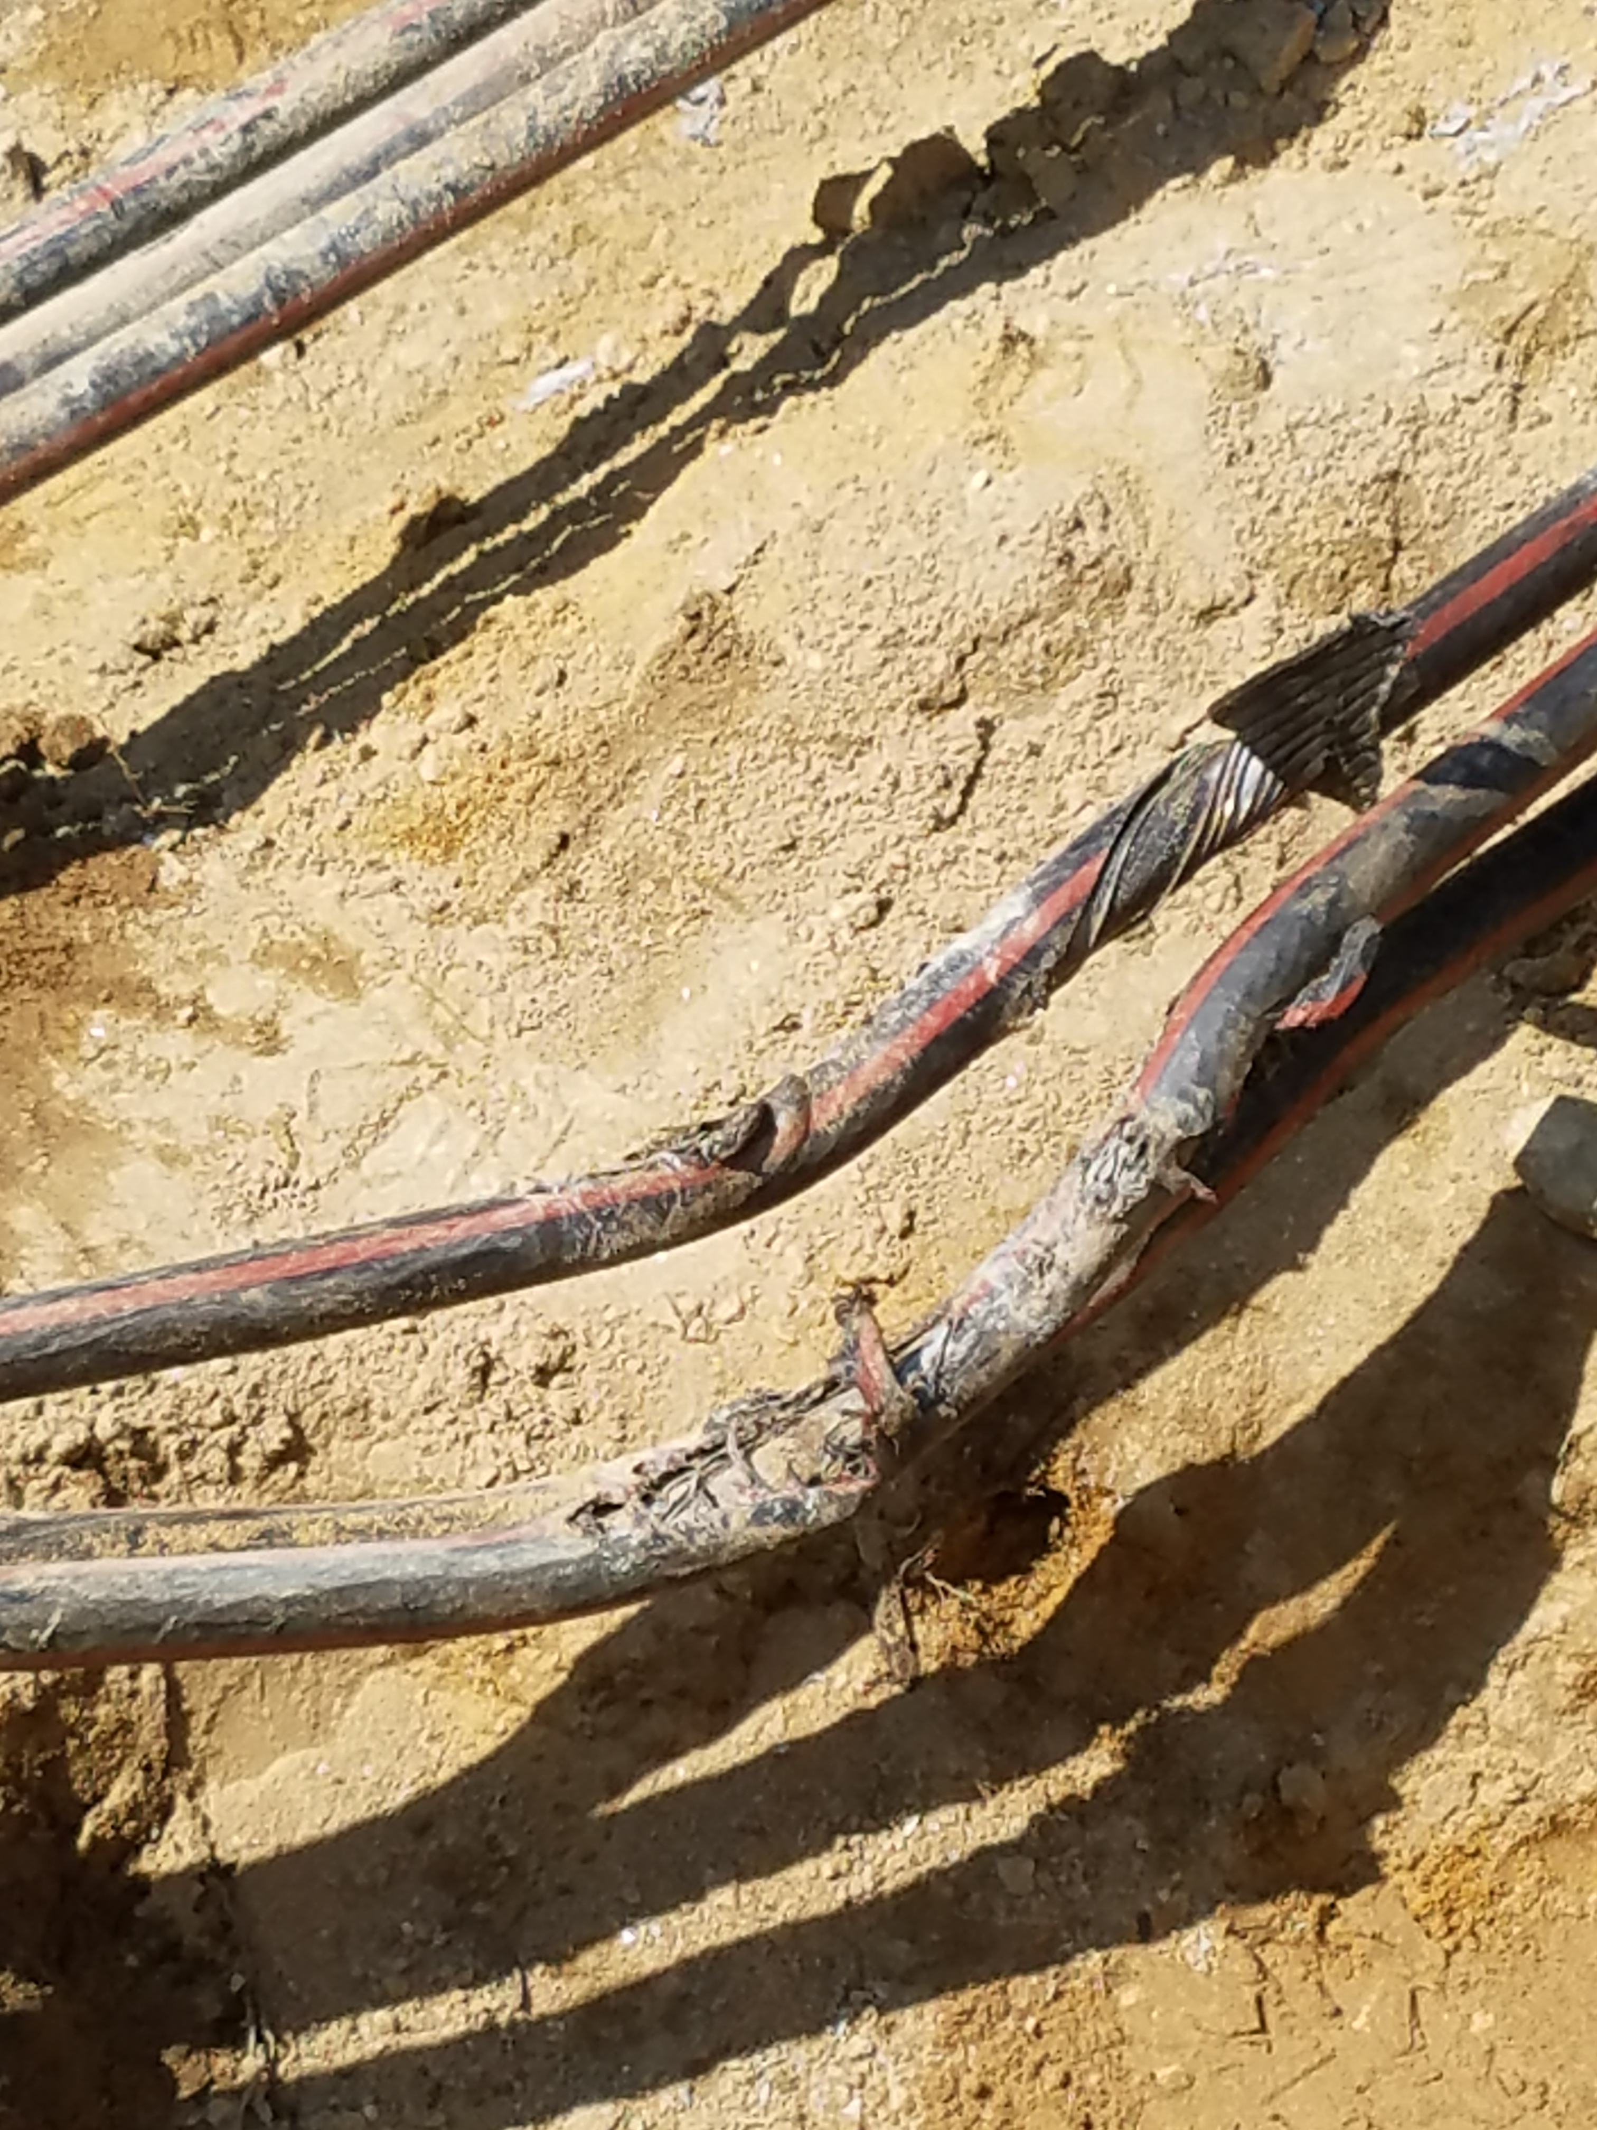
Examples of Dig Ins

Slide 21
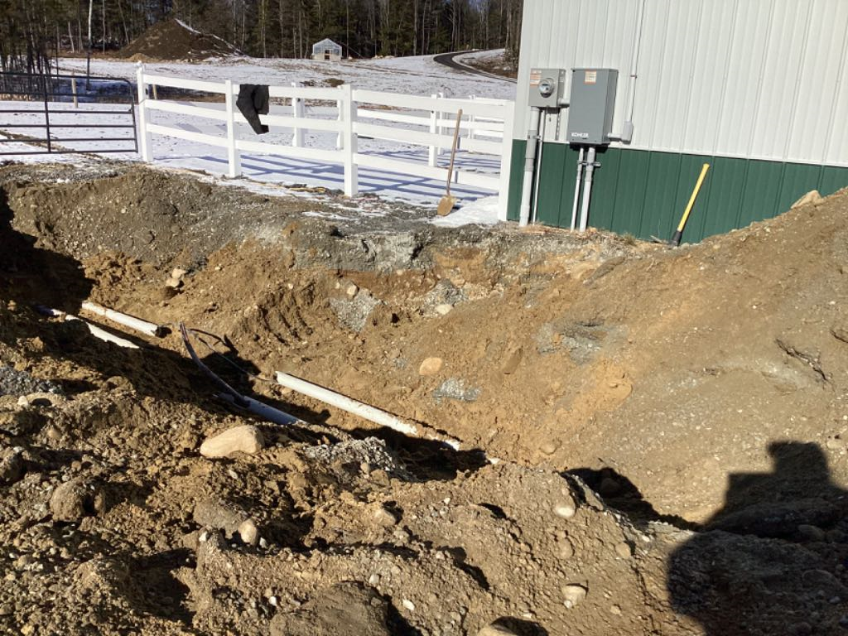
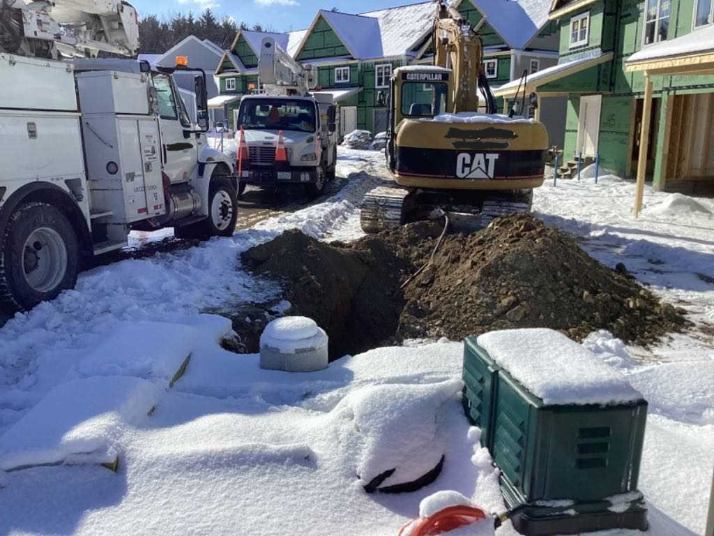
And… More

Slide 22
SO… What Do I Do If…
If Your Equipment Makes Contact with a Power Line:
Stay on the equipment and wait until the line is de-energized by the power company!! Does not matter whether overhead or underground.
If you must leave the equipment, such as in a fire, jump clear and attempt to land with both feet together. Remember the Step Potential.. Do not touch any part of the equipment when contacting the ground.
Shuffle away from equipment in small steps while keeping feet together.
Better to hop with both feet together when possible.

Slide 23
What Would You Do?
Power Line Contact
DO NOT allow anyone on ground to come near or touch the vehicle or machine. Warn ALL people and personnel to stay away!!
Never touch a person or the vehicle/machine which is in contact with a live power line. Call for help and get power line de-energized.

