Slide 1





Slide 2
Liberty Keene - Natural Gas and Propane
Natural Gas – (Since 2019)
  Small portion of System is Natural Gas
    Monadnock Marketplace and part of Key Rd.
  Compressed Natural Gas Facility at Production Ave.
  This System Operates at 60 PSI
Propane – (Since 1859)
  Most of the System is Propane Air blend (30%/70%)
    System covers about 140 Streets in Keene
  Propane Air Facility at Emerald Street
  This System Operates between ½ to 1 ½ PSI

Slide 3
Properties of Natural Gas and Propane
Natural Gas –
  Fossil fuel, Colorless, Odorless
    Odorant added for Identifiable Smell
  Non-toxic, Non-corrosive
  Lighter than Air
    Rises and Mixes with Air
Propane –
  Fossil fuel, Colorless, Odorless
    Odorant added for Identifiable Smell
  Non-toxic, Non-corrosive
  Heavier than Air
    Sinks, Pools, Stays In Excavation and will displace Oxygen

Slide 4
Explosive Limits of Natural Gas
Flammable Range
0 % GAS
5 % GAS
15 % GAS
100 % GAS
TO LEAN
TO RICH
% GAS

Slide 5
Explosive Limits of Propane Gas
Flammable Range
0 % GAS
2 % GAS
10 % GAS
100 % GAS
TO LEAN
TO RICH
% GAS

Slide 6
Possible Ignition Sources
    Other Flames (pilot burner, match, cigarette lighters)
    Doorbells, Light Switches, Appliances
    Cell Phones
    Static Electricity
    Thermostats
    And more!!
Notes:
Ignition Temperature
Minimum Temperature Needed for a Mixture of Propane and Air to Ignite.
The Ignition Temperature of Propane Is Between 920° F and 1,120° F
A Common Ignition Source for Propane Is Another Flame, Such As the Flame of a Pilot Burner, Match or Cigarette Lighter.

Slide 7
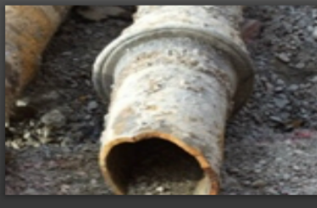
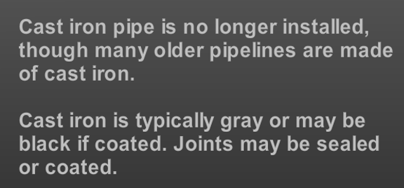
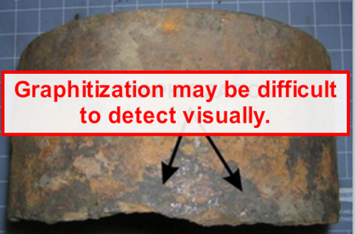
Materials in Our System -
Cast Iron - Mains
Cast Iron Pipe may need to be Supported if Exposed
Also, Depending on how much is Exposed or how large the Excavation is, the Cast Iron may need to be Replaced

Slide 8
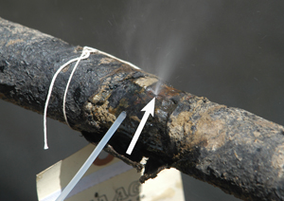
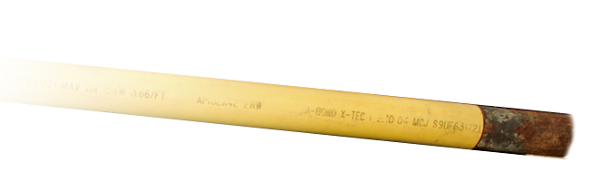
Materials in Our Systems –
Wrought Iron And Bare and Coated Steel
Mains and Services
Many Old Pipes can be a “Sleeve Pipe” for Smaller Lines

Slide 9
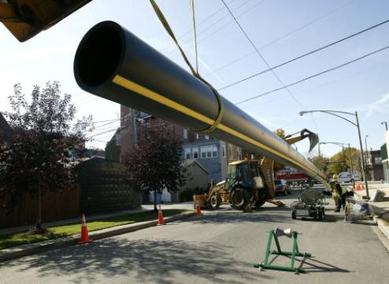
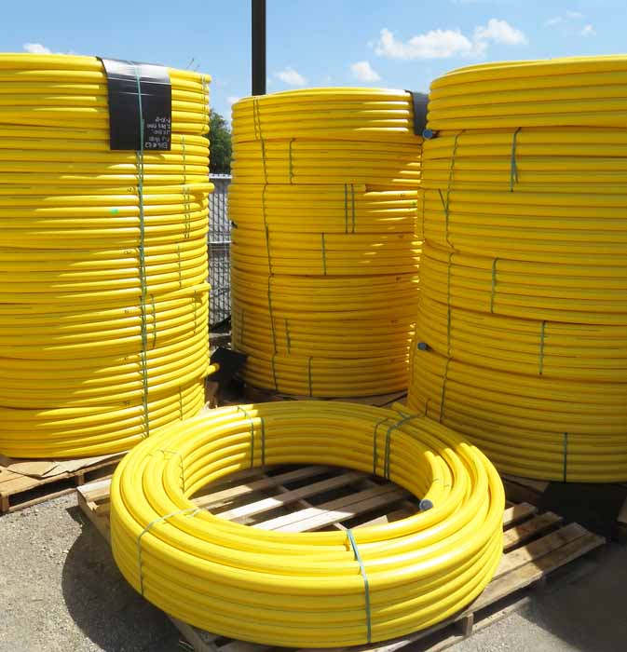
Materials in Our System -
Plastic - Mains And Services

Slide 10
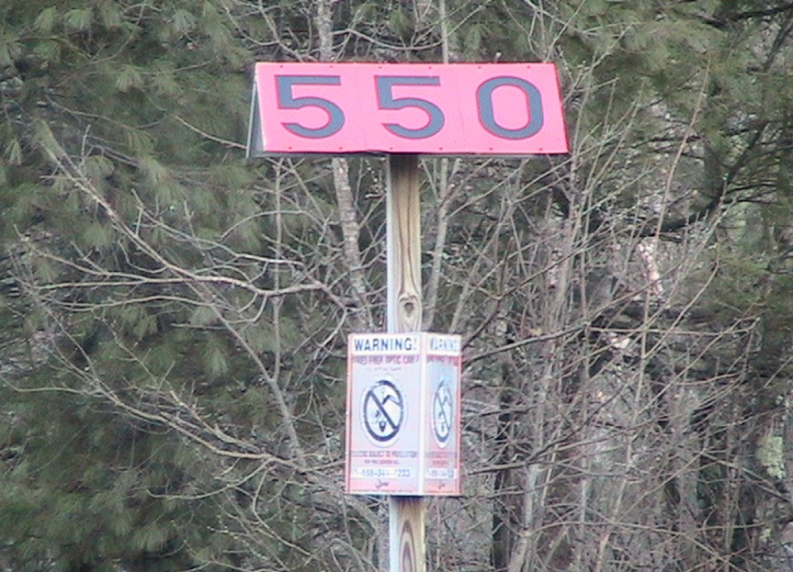
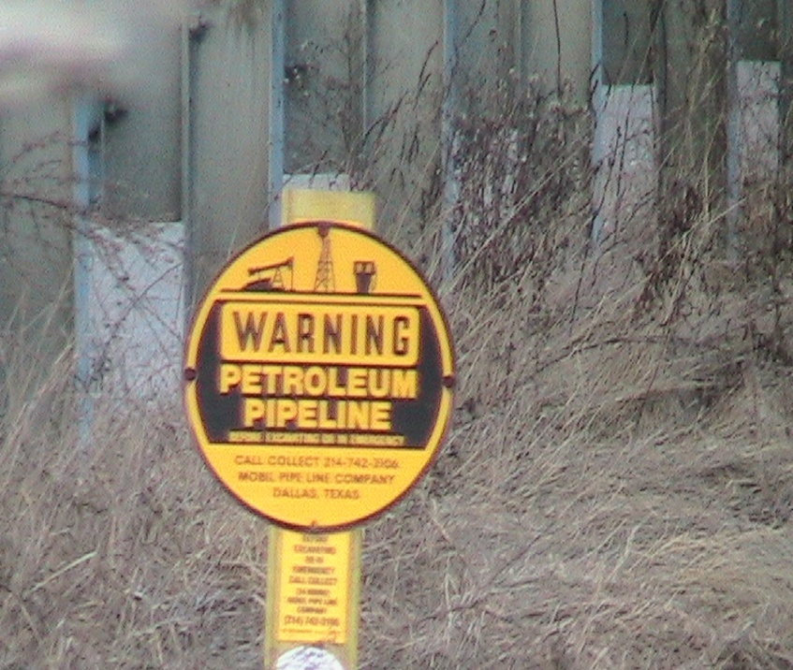
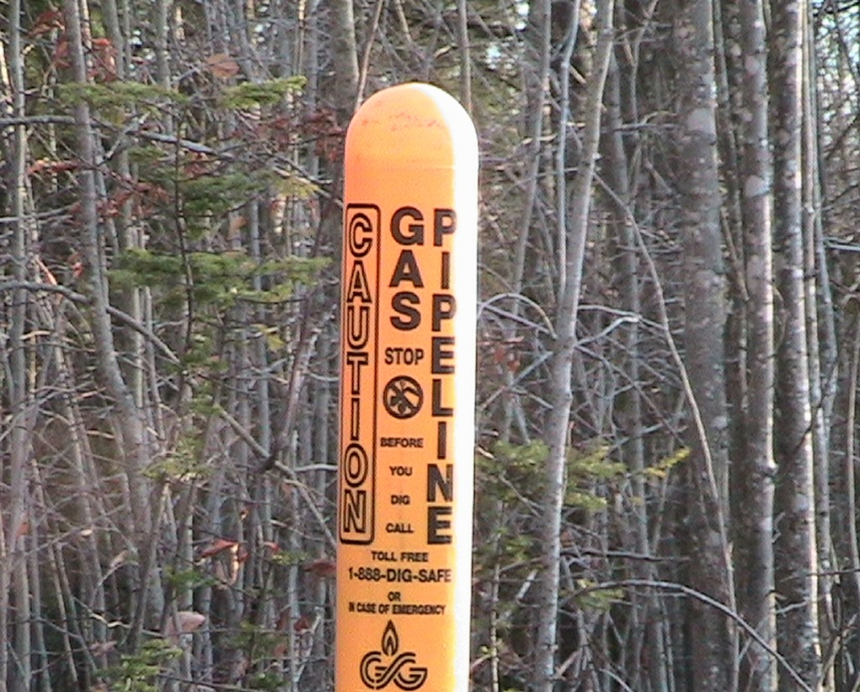
Marker Posts

Slide 11
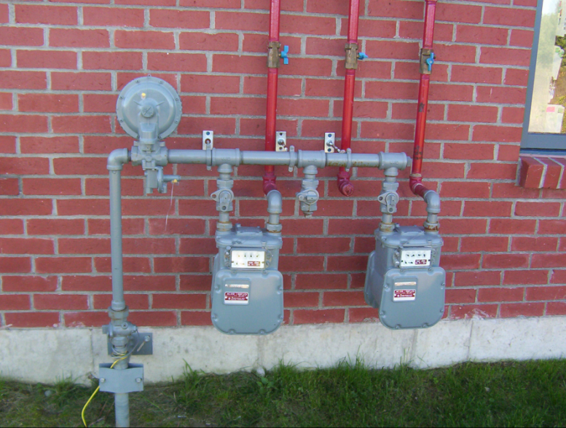
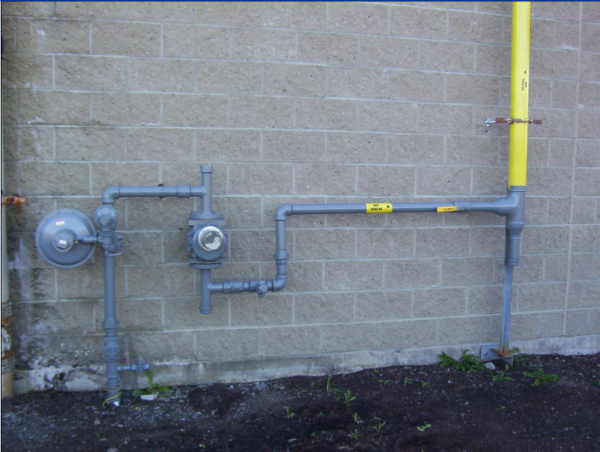
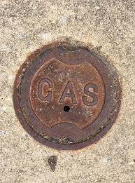
Gas Meter Sets and Valves
Tracer Wire

Slide 12
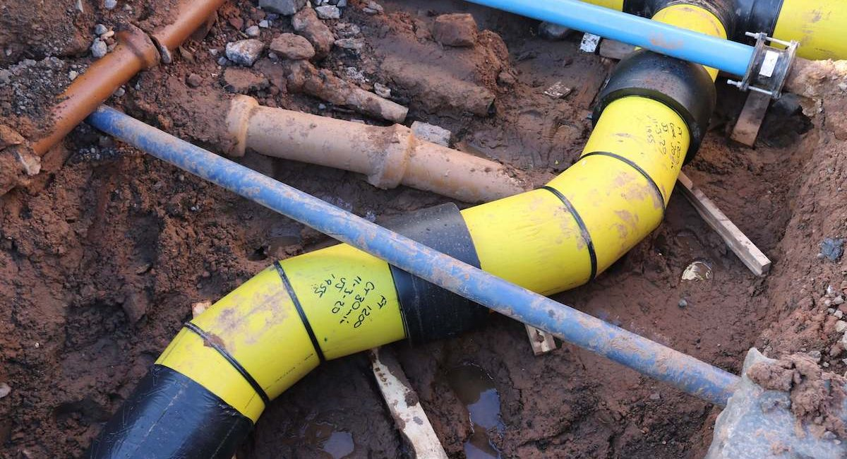
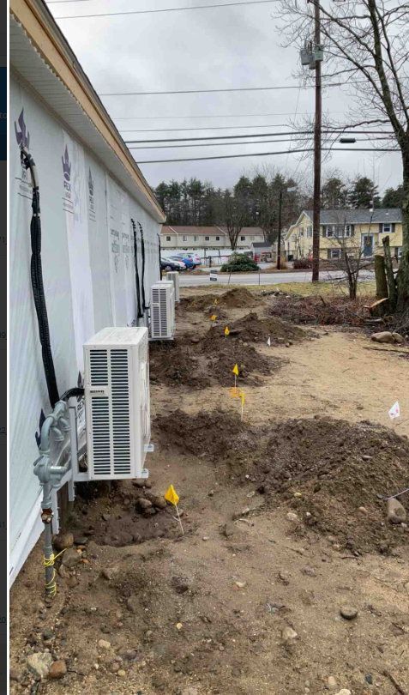
Understanding Layout and Markings for Mains and Services
Contractors are responsible for maintaining marks.
As illustrated here, services and mains are often not straight and have various depths depending on other items in the ground.
DigSafe marks are blind to depth.
LUG – Liberty Utilities Gas
2” CTD. ST. SVC. –
2” Coated Steel Service
8” PL Main –
8” Plastic Main

Slide 13
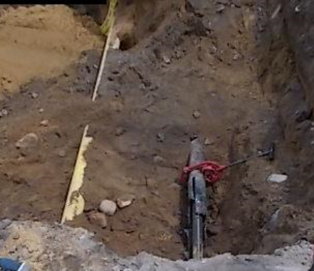
Sleeved & Inserted Lines
2” PL Inserted into 4” CI
Abandoned 4” CS
The abandoned 4” CS appears to be in better condition than the CI, which has the LIVE 2” PL line inserted. The CI had holes in it but could not see Pipe inside. So, assumed the CS Pipe was the “Active” Pipe.
If markings are not Clear or were Missing, Causing Uncertainty … CALL the Utility Owner
DON’T TAKE CHANCES

Slide 14
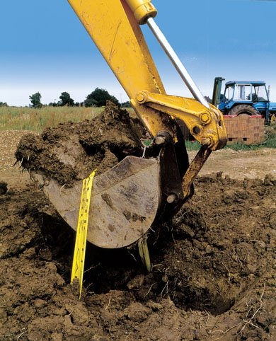
Our Greatest Risk is Third Party Damage…
Site Work
Road Reconstruction
Replacing Utilities
Digging a Foundation
Placing Utility Poles
Routine Yard Work
Cross-Bore Damage
Notes:
MOST FREQUENT CAUSES OF ACCIDENTS COME FROM
THIRD PARTY DAMAGES
THEY ARE:

Slide 15
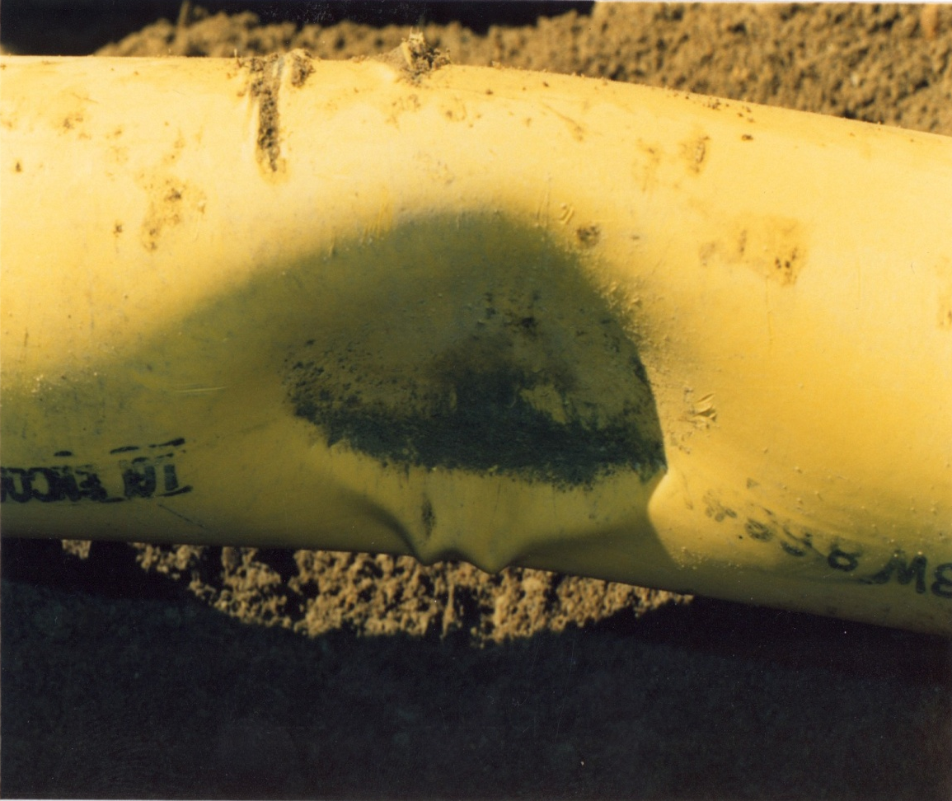
Signs of Damage
Broken tracer wire or warning tape
Coating Damages
Dents or Gouges
Report Damage – Do Not Backfill
Notes:
Very important that you report all damages to us immediately.
The example here was found by one of our crews long after the damage had occurred. This was discovered while installing a gas service to a near by home. This facility is a 60 lbs main within 50 ft of residential structures; had this failed and leaked the scenario could have been catastrophic.
Report all types of minor of damages such as tape, coating, tracer wire…….. Use the Non-emergency # in your hand out to report minor occurrences.
Use the Emergency number to report major damages such as they example above immediately.

Slide 16
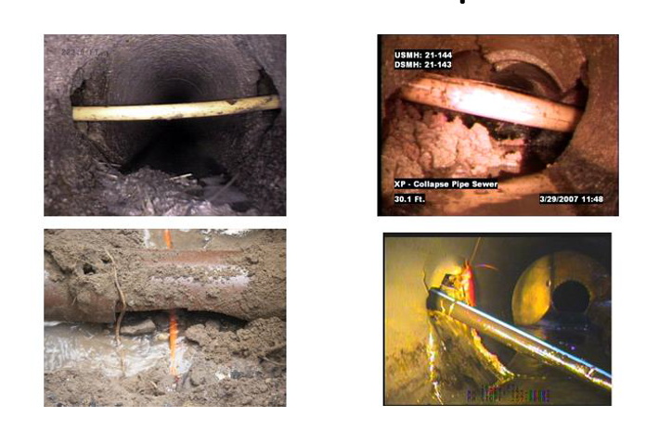
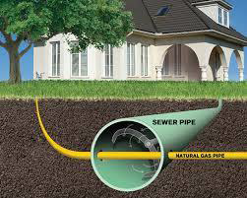
Cross Bore Examples & Damages

Slide 17
If You Damage a Gas Line…
  CALL the Utility Company
  DO NOT ATTEMPT TO REPAIR DAMAGE!
  DO NOT BACKFILL!

Slide 18
Signs of a Ruptured Gas Line
  A blowing or hissing sound
  Dirt or Dust blowing from a hole
  Continuous bubbling in wet area
  A gaseous smell
  Flames, if gas has ignited
Notes:
ACTION -
Scratch and sniff the smell of gas
You may hear gas if it is a high pressure line. Important to realize that you may not hear it.
You may see “heat wave” like shimmer or dust. That could be gas escaping. Important to state again that this may not be evident.
You will smell gas!

Slide 19
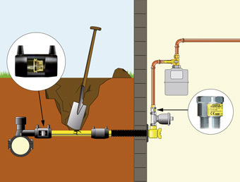
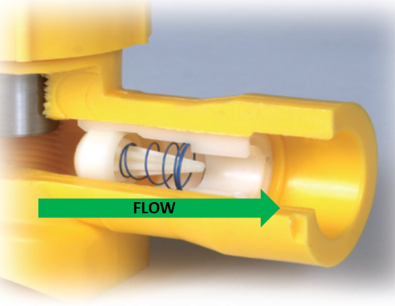
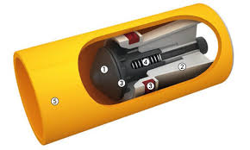
Understanding Excess Flow Valves

Slide 20
If You Rupture a Gas Line…
  Evacuate the area!
  CALL 911 from a Safe Location
  Call the Gas Company
  Protect the public, evacuate buildings, and prevent the introduction of possible ignition sources
  Leave equipment – if it’s on, leave it on; if it’s off, leave it off – just leave if safe to do so
  If gas has ignited, let it burn; do not attempt to put out the fire!

Slide 21
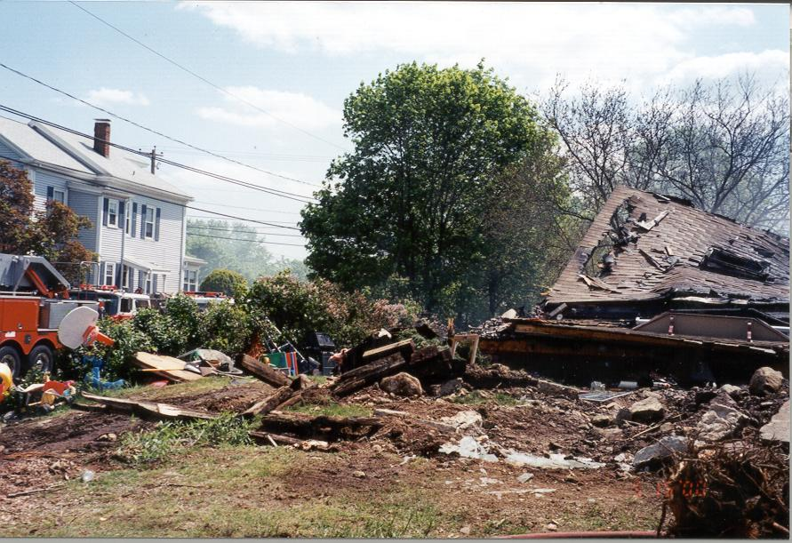
Excavator digging for foundation addition and hit a Gas line.

Slide 22

Questions / Comments
Thank you
FOR DIGGING SAFELY

