Slide 1




Propane/Air & Natural Gas Presentation

Slide 2
Liberty Keene – Propane and Natural Gas
Propane – (Since 1859)
  Most of the System is Propane Air blend (30%Propane/70%Air)
    System covers about 140 Streets in Keene
  Propane Air Facility at Emerald Street
  This System Operates between ½ to 1 ½ PSI
Natural Gas – (Since 2019)
  Small portion of System is Natural Gas
    Monadnock Marketplace and part of Key Rd.
  Compressed Natural Gas Facility at Production Ave.
  This System Operates at 60 PSI

Slide 3
Properties of Natural Gas and Propane
Propane –
  Fossil fuel, Colorless, Odorless
    Odorant added for Identifiable Smell
  Non-toxic, Non-corrosive
  Heavier than Air
    Sinks, Pools, Stays In Excavation and will displace Oxygen
Natural Gas –
  Fossil fuel, Colorless, Odorless
    Odorant added for Identifiable Smell
  Non-toxic, Non-corrosive
  Lighter than Air
    Rises and Mixes with Air

Slide 4
Explosive Limits of Propane Gas
Flammable Range
0 % GAS
2 % GAS
10 % GAS
100 % GAS
TO LEAN
TO RICH
% GAS

Slide 5
Explosive Limits of Natural Gas
Flammable Range
0 % GAS
5 % GAS
15 % GAS
100 % GAS
TO LEAN
TO RICH
% GAS

Slide 6
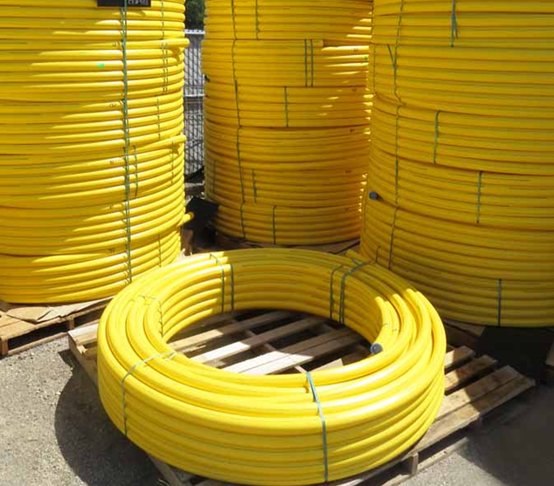
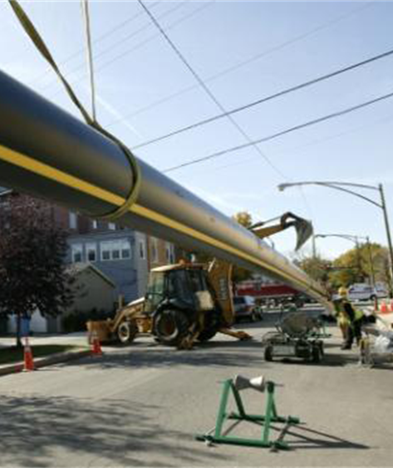
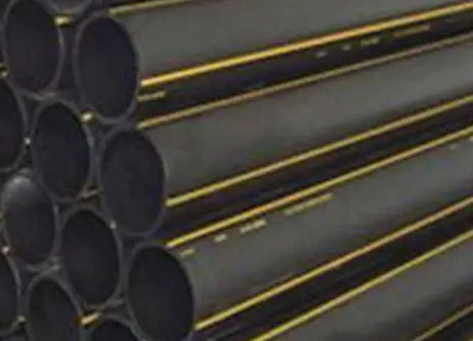
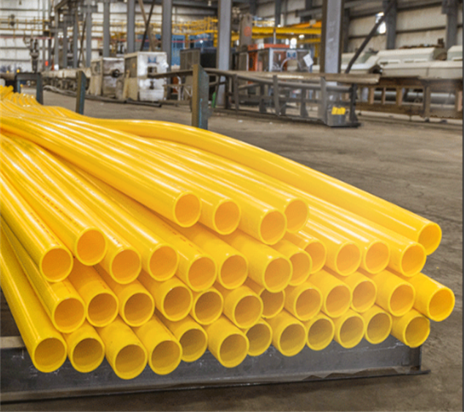
Gas Distribution System Materials-
Plastic – Mains and Services
Plastic or “Polyethylene” materials are normally used in today’s construction.
It’s available in High or Medium Density depending on the operating pressure required.
Easier to handle and work with than steel
However – Can be Easily Damaged

Slide 7
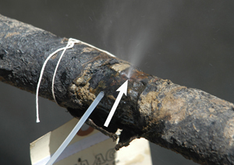
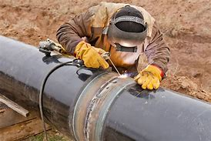
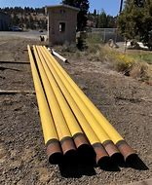
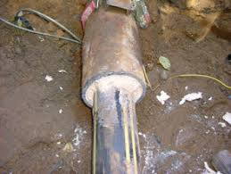
Gas Distribution System Materials-
Bare and Coated Steel – Mains and Services
Steel Lines can be operated at Higher Pressures
Steel Lines can be more durable than Plastic
Steel can be hard to work with
Steel is susceptible to Corrosion if not properly protected
Pipes that aren’t protected cause leaks
Many Old Pipes can become a “Sleeve Pipe” for New Smaller Lines by “Insertion”

Slide 8
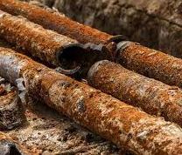
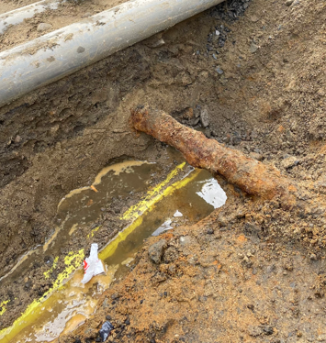
If you expose or undermine CI, CALL Liberty so we can inspect the pipe!
Gas Distribution System Materials-
Cast Iron –
Mains and Services
Although CI is no longer installed today, it can still be in use and active.
Typically, when it is exposed during excavating – it appears very rusty.
It is important to excavate carefully around CI as it can be brittle or soft and crack easily.
If too much CI is exposed and undermined, it may need to be supported or even replaced.

Slide 9



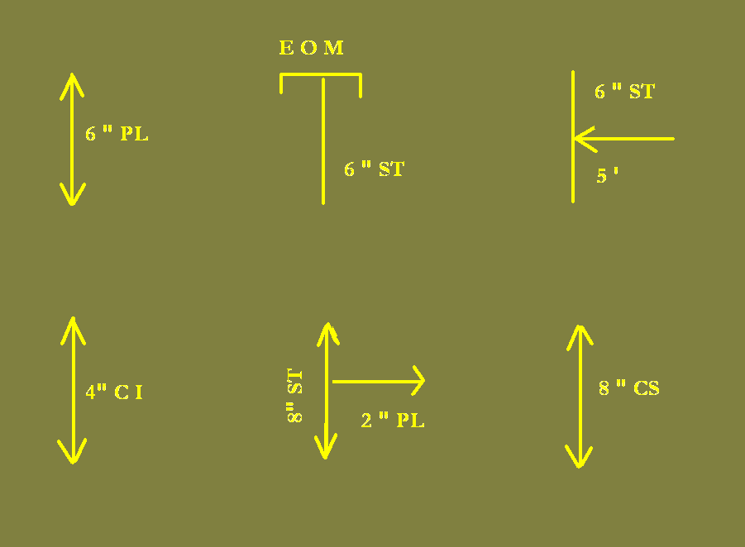
Understanding Layout and Markings
Here are some
common Gas Markings
You need to understand the Marks, so you understand what you will encounter when excavating.
Contractors are responsible for maintaining marks. Request offset marks, take pics/videos
Utilities often cross each other and are installed in various directions and depths

Slide 10
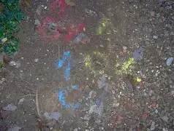
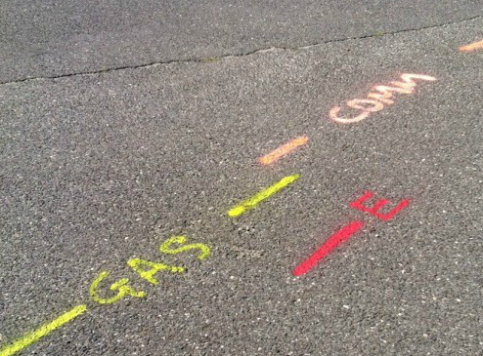
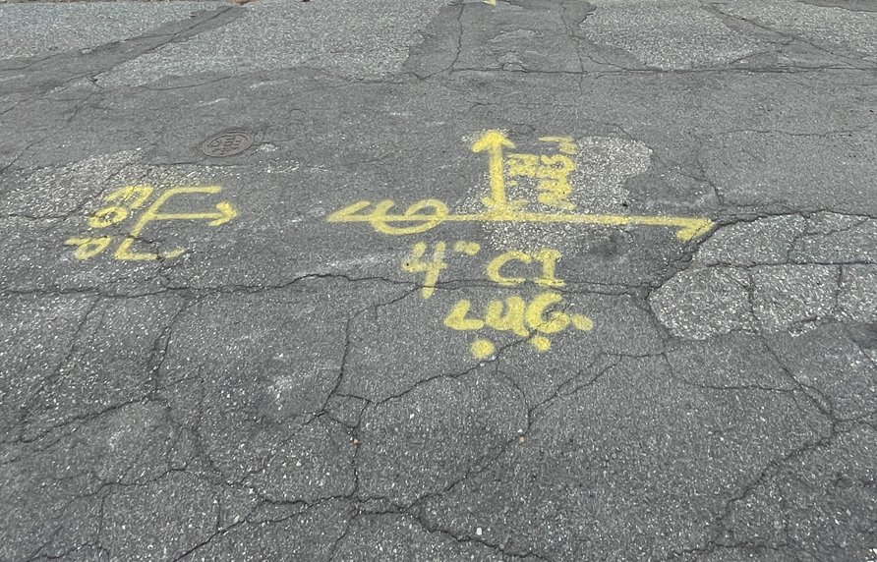
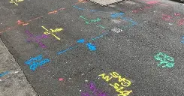
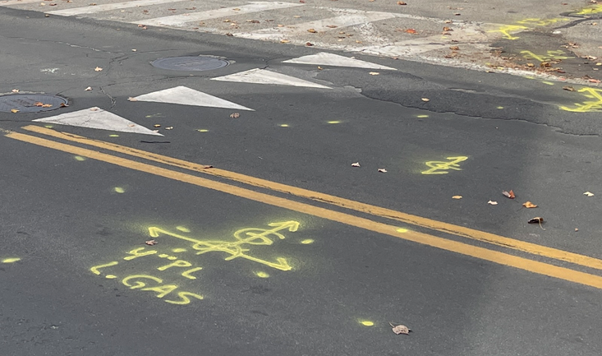
Real World Markings….

Slide 11
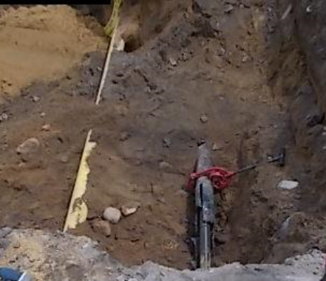
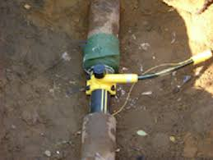
IF MARKINGS ARE NOT CLEAR – MISTAKES CAN BE MADE
2” PL Inserted into 4” CI
Abandoned 4” CS
The abandoned 4” CS appears to be in better condition than the CI. The CI has a LIVE 2” PL line inserted. The CI had holes in it but the contractor could not see the Pipe inside. It was assumed the 4” CS was the “Active” Pipe, so the contractor cut the CI Pipe causing a leak.
Inserted Pipe: Main/Service
If markings are not Clear or were Missing, Causing Uncertainty … CALL the Utility DON’T TAKE CHANCES

Slide 12
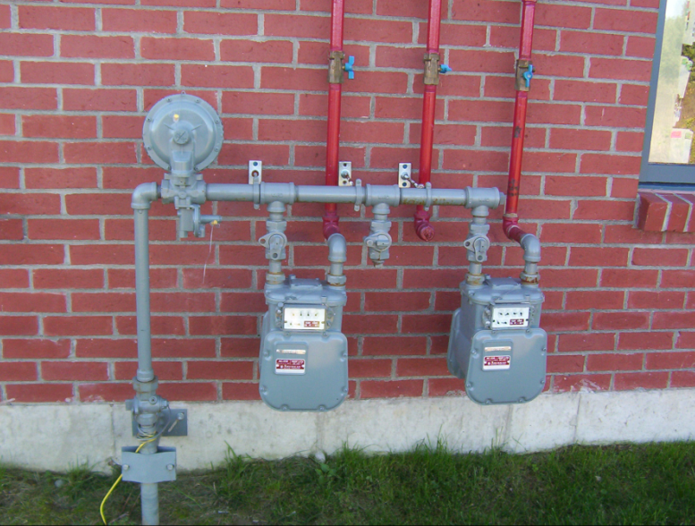
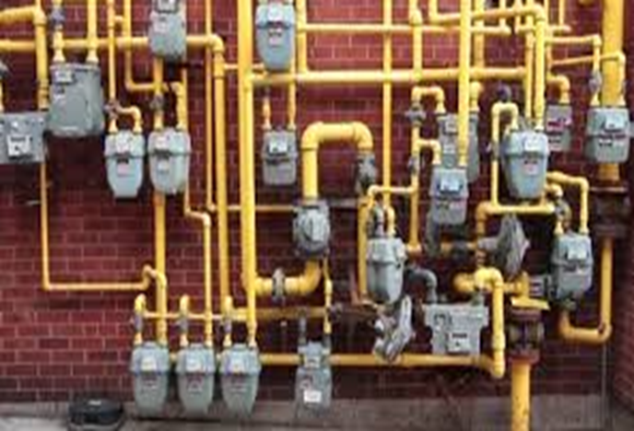
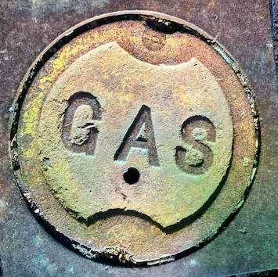
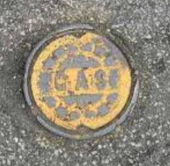
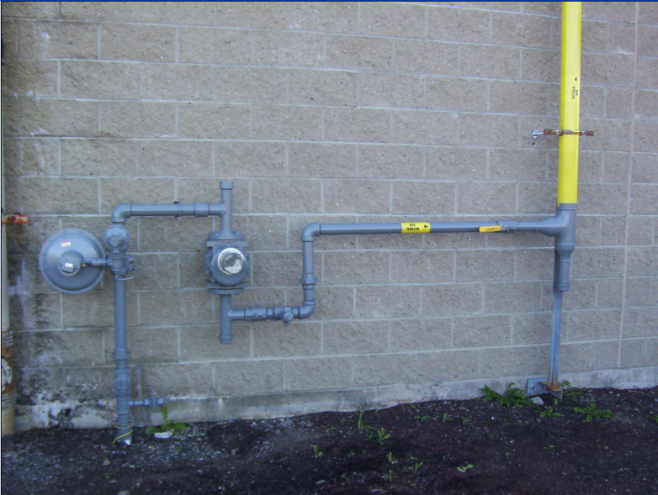

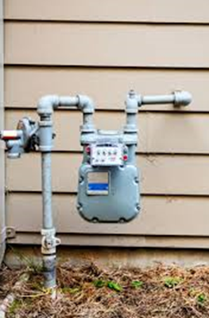
LEARN to Recognize Signs of Gas, not yet marked…

Slide 13
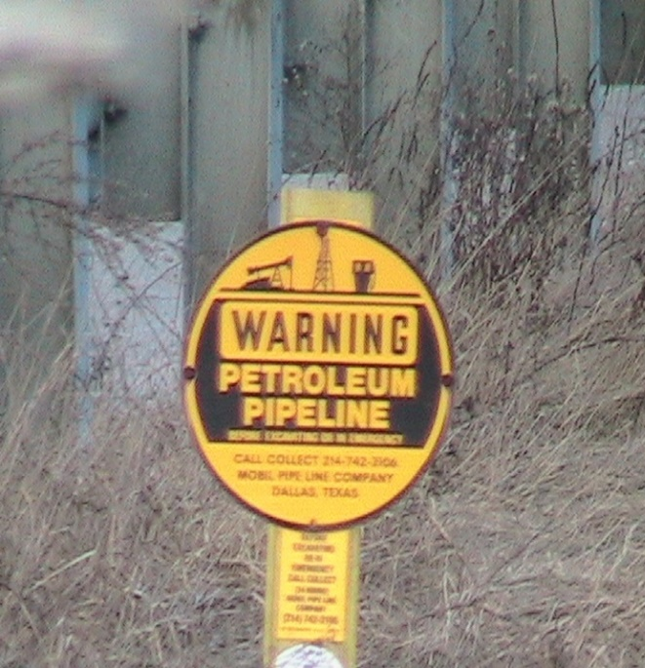
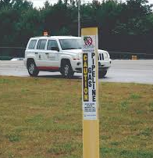
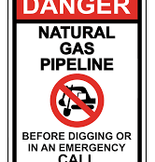
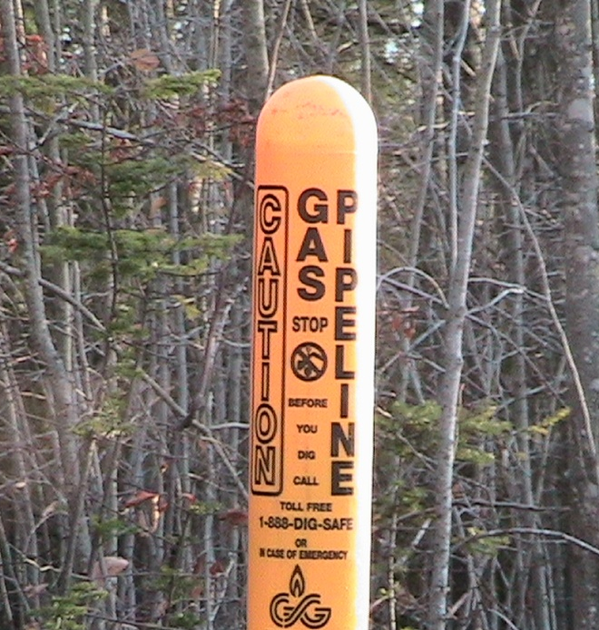
More Signs… Gas Line Markers !

Slide 14

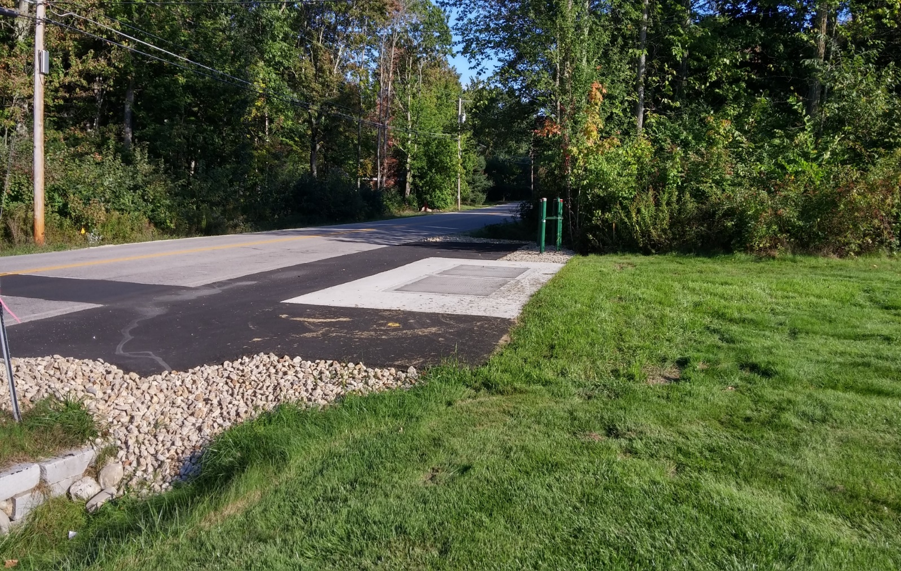
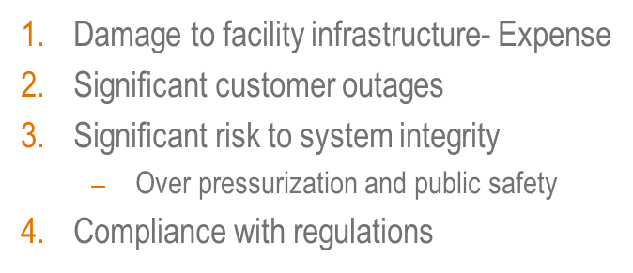

Recognize the not so obvious Signs of Gas in the Area – REG STATIONS
Verification of sense line locations
Verification of station critical valves
Required Tech Standby for Close Proximity
Location sense lines closer to facility or above ground
Temp Relocate of sense lines
Steel plating of assets outside facility

Slide 15
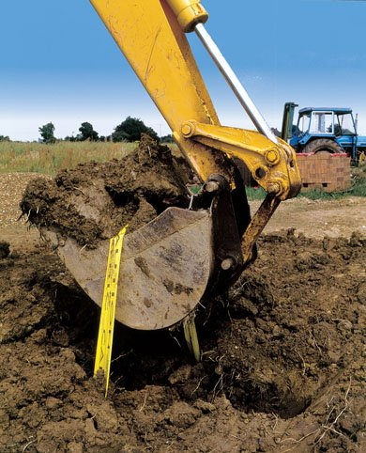
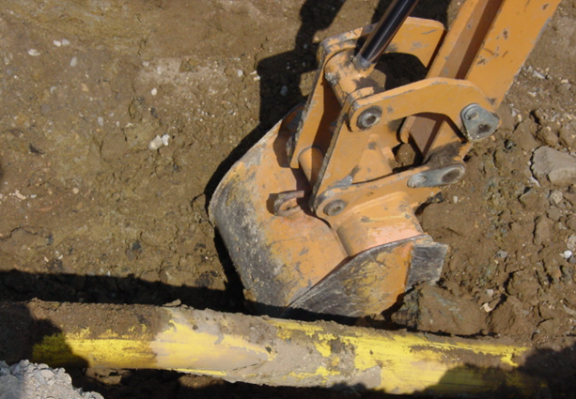
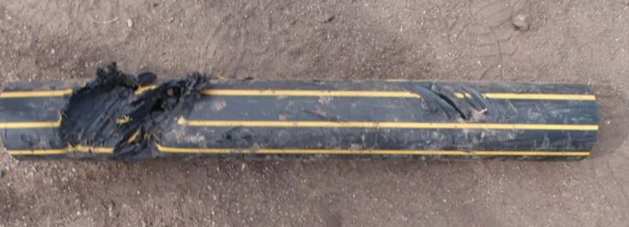
Our Greatest Risk is Third Party Damage…
Site Work
Road Reconstruction
Replacing Utilities
Digging a Foundation
Placing Utility Poles
Routine Yard Work
Cross-Bore Damage
Notes:
MOST FREQUENT CAUSES OF ACCIDENTS COME FROM
THIRD PARTY DAMAGES
THEY ARE:

Slide 16
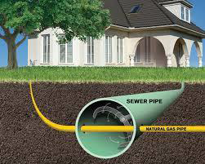
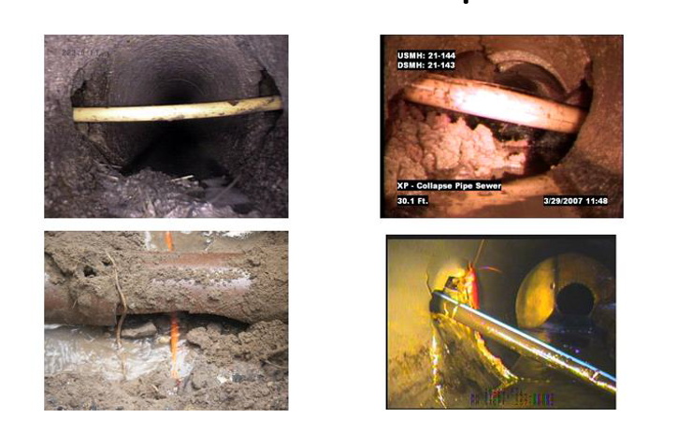
Examples of Cross Bore Damages

Slide 17
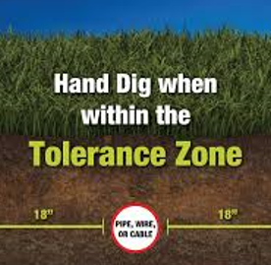
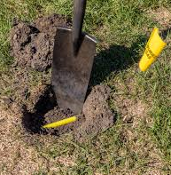
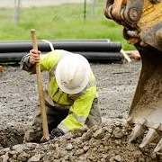

If you are within 18” of the gas line markings – you are within the “Tolerance Zone” – and are required to HAND DIG to expose the gas pipe

Slide 18

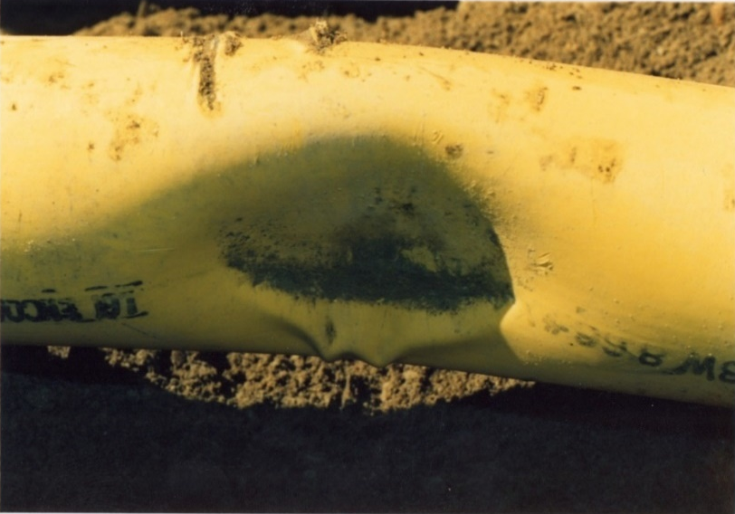

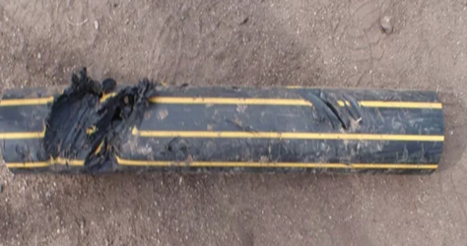
Signs of Damage
REPORT DAMAGES
DO NOT BACK FILL
CALL UTILITY COMPANY
Notes:
Very important that you report all damages to us immediately.
The example here was found by one of our crews long after the damage had occurred. This was discovered while installing a gas service to a near by home. This facility is a 60 lbs main within 50 ft of residential structures; had this failed and leaked the scenario could have been catastrophic.
Report all types of minor of damages such as tape, coating, tracer wire…….. Use the Non-emergency # in your hand out to report minor occurrences.
Use the Emergency number to report major damages such as they example above immediately.

Slide 19

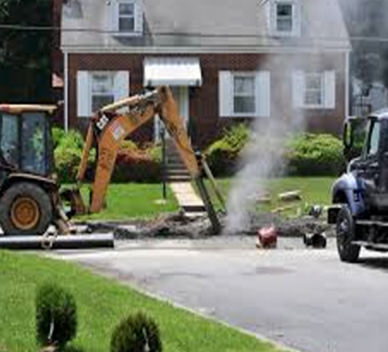
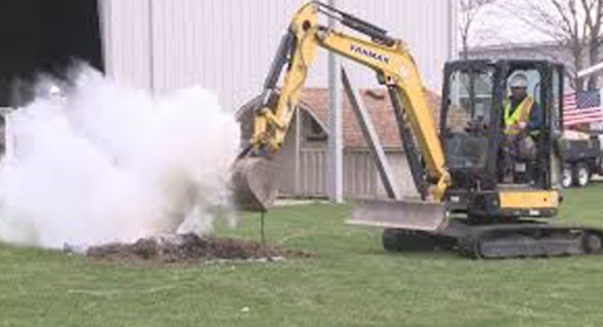
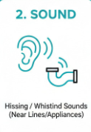
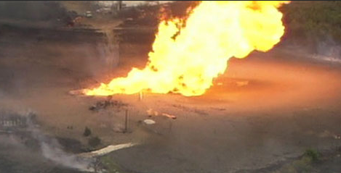

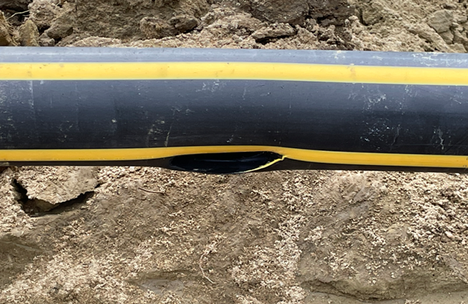
Signs of a Ruptured Gas Line
A Gaseous Smell
A Blowing or Hissing Sound
Dirt or Dust Blowing from the Ground
Flames, if Gas has Ignited
Notes:
ACTION -
Scratch and sniff the smell of gas
You may hear gas if it is a high pressure line. Important to realize that you may not hear it.
You may see “heat wave” like shimmer or dust. That could be gas escaping. Important to state again that this may not be evident.
You will smell gas!

Slide 20
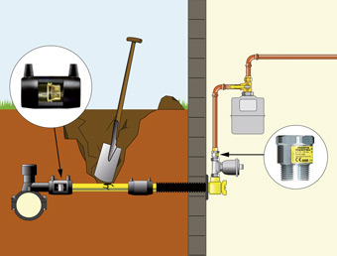
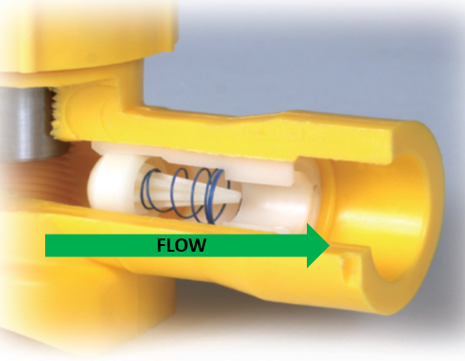
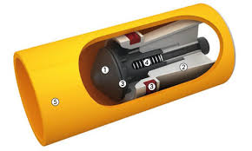
Understanding Excess Flow Valves
Do not attempt to repair or stop the flow of leaking gas

Slide 21
If You Damage a Gas Line…
  CALL the Utility Company
  DO NOT ATTEMPT TO REPAIR DAMAGE!
  DO NOT BACKFILL!

Slide 22
  Stay Calm and Think
  Leave equipment and site as is – get to safety
  CALL 911 from a Safe Location
  Call the Gas Company
  If gas has ignited, let it burn; do not attempt to put out the fire!
  Prevent possible ignition sources . .
If You Rupture a Gas Line…

Slide 23

What are Possible Ignition Sources
Other Flames (pilot burner, match, cigarette lighters)
Doorbells, Light Switches, Appliances
Thermostats
Cell Phones, 2-Way Radios
Static Electricity
Abrasive Saw or Grinders, Sparks
And more!!
Notes:
Ignition Temperature
Minimum Temperature Needed for a Mixture of Propane and Air to Ignite.
The Ignition Temperature of Propane Is Between 920° F and 1,120° F
A Common Ignition Source for Propane Is Another Flame, Such As the Flame of a Pilot Burner, Match or Cigarette Lighter.

Slide 24
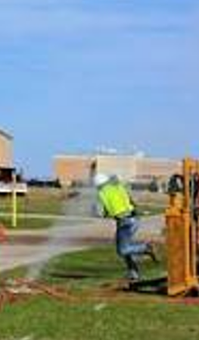
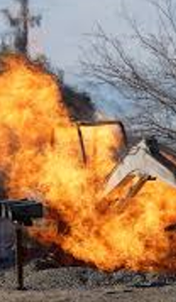


Slide 25

REMEMBER

Slide 26

Questions / Comments
Thank you
FOR DIGGING SAFELY

