Slide 1
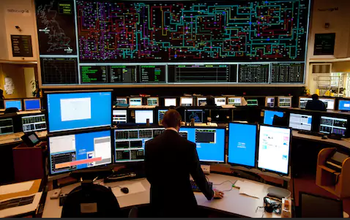
RIE Gas Division
Rhode Island Energy - Damage Prevention
Rhode Island Energy

Slide 2
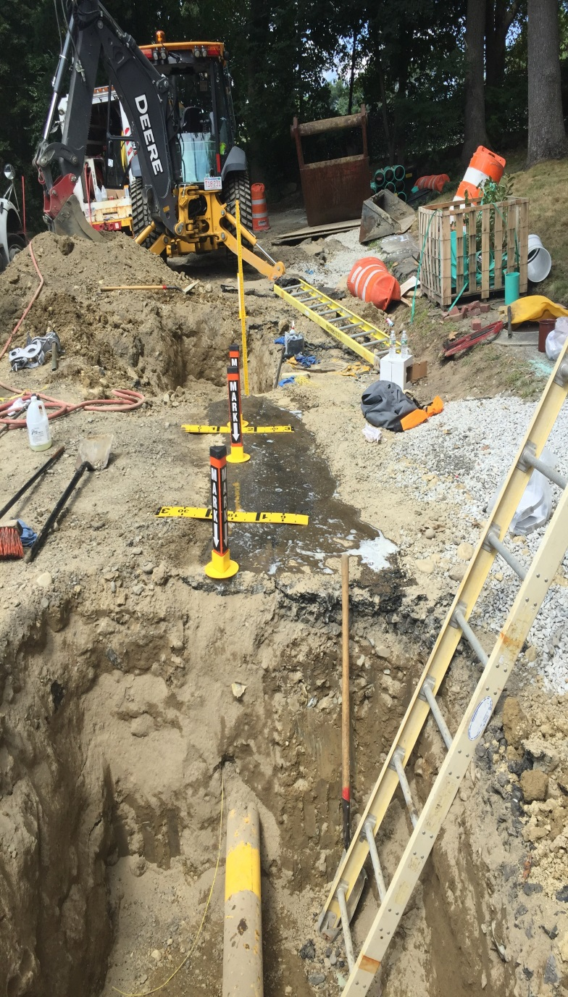
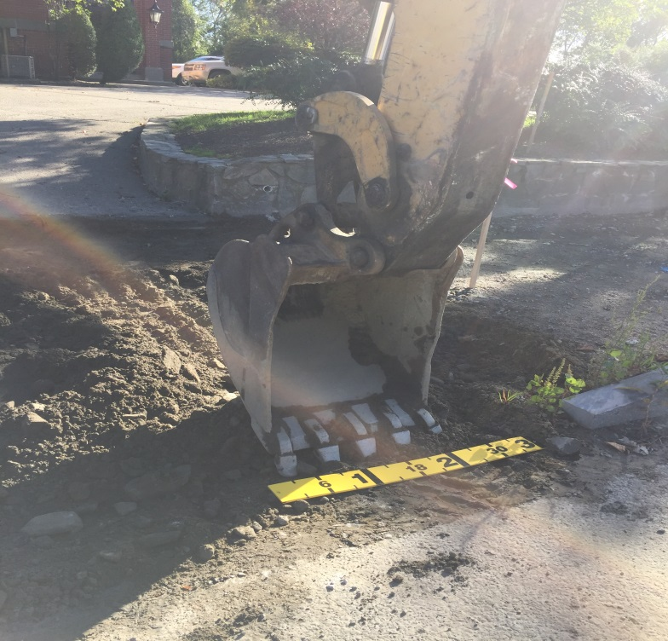
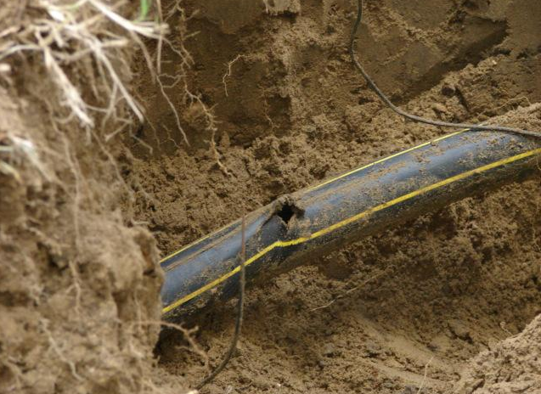
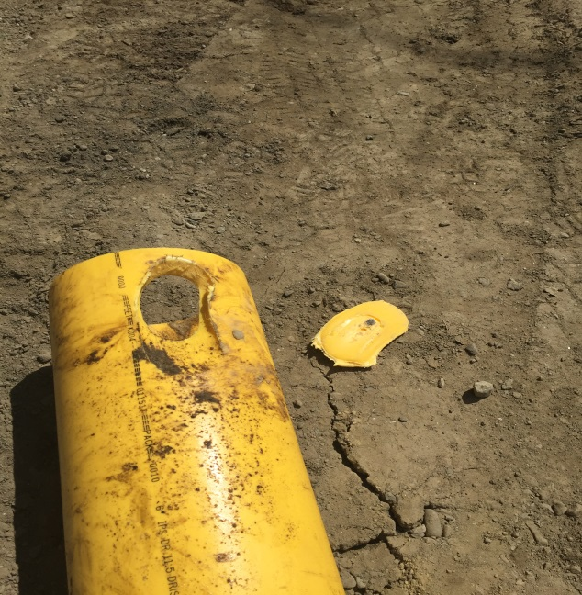
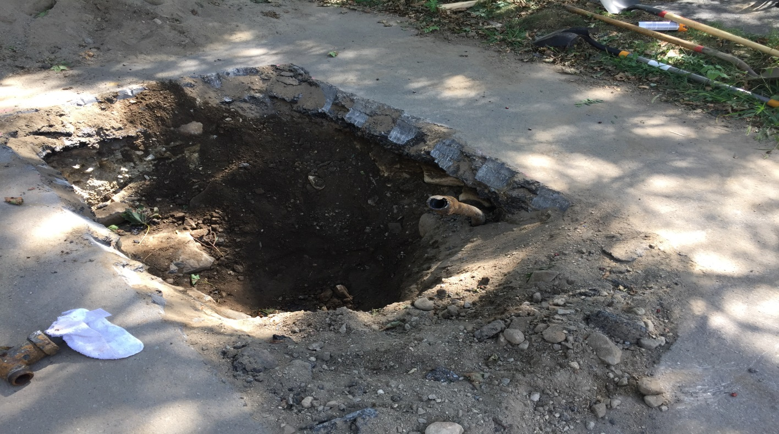
Excavation Damage results in the majority of gas line failures!
Notes:
The number one cause of damage to underground facilities: EXCAVATION DAMAGES
Excavation damage refers to any damage to underground natural gas facilities caused by activities such as construction, excavation, and land clearing.
This type of damage can be caused by unintentional actions, or lack of awareness and it can lead to leaks, explosions, and other safety hazards.

Slide 3
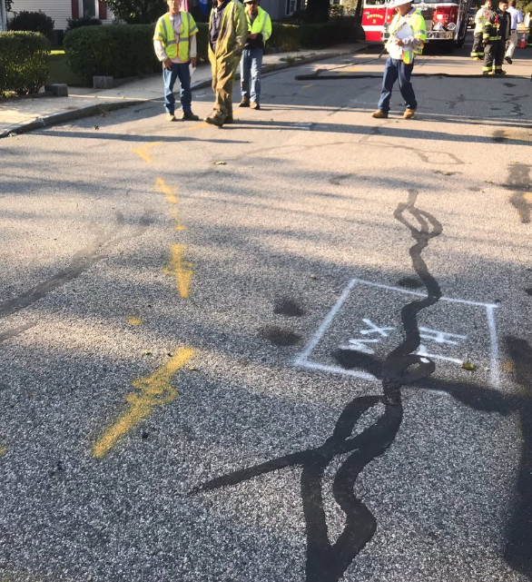
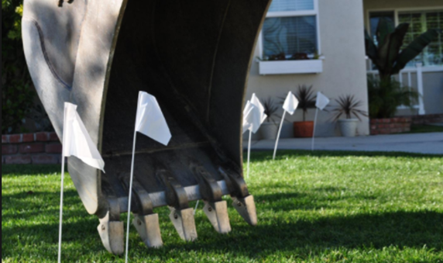
Site Preparation Excavator Checklist
Premark the Site
Valid Dig Safe Ticket
Area is covered by the location of the ticket
The excavator(s) are listed on the ticket
Wait 72 business hours but not more than 30 days
Locators have marked utilities on time & accurately
Notes:
Site Prep:
Premark the Site
Valid Dig Safe Ticket
Area is covered by the location of the ticket
The excavator(s) are listed on the ticket
Wait 72 business hours but not more than 30 days before digging
Locators have marked the utilities on time & accurately???
Call us if unsure or have questions about marks

Slide 4
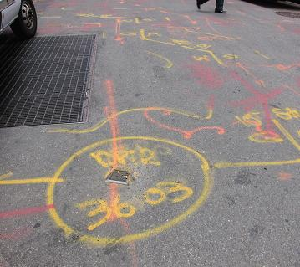
Knowledge
Be Aware of the Dig Safe Laws and Rules
Know what Gas Pipes look like
Understand Gas Markings
Understand Properties of Gas
Notes:
Next I want to give you some slides on stuff you should Know
Recognize Gas Markings
Be Aware of the Dig Safe Laws and Rules
Know what Gas Pipes look like
Understand Properties of Gas

Slide 5
Dig Safe Law
Premarking is Required
Call in a Dig Safe Ticket at least 72 hours, excluding weekends and holidays, prior to excavating but not more than 30 days before expected work
Maintain the Marks
If the marks are removed or destroyed call in a remark
If the scope or job changes call in a new ticket
Allow 18 inches on each side of the pipe and hand dig in the Safety Zone
If the facility is exposed use soft excavation, while also protecting and supporting the structure to avoid damage
Notes:
Dig safe law hi-lights,
Pre-marking is Required
Call in a Dig Safe Ticket at least 72 hours, excluding weekends and holidays, prior to excavating but not more than 30 days before expected work
Maintain the Marks
If the marks are removed or destroyed call in a remark
If the scope or job changes call in a new ticket
Allow 18 inches on each side of the pipe and hand dig in the Safety Zone
If the facility is exposed use soft excavation, while also protecting and supporting the structure to avoid damage

Slide 6
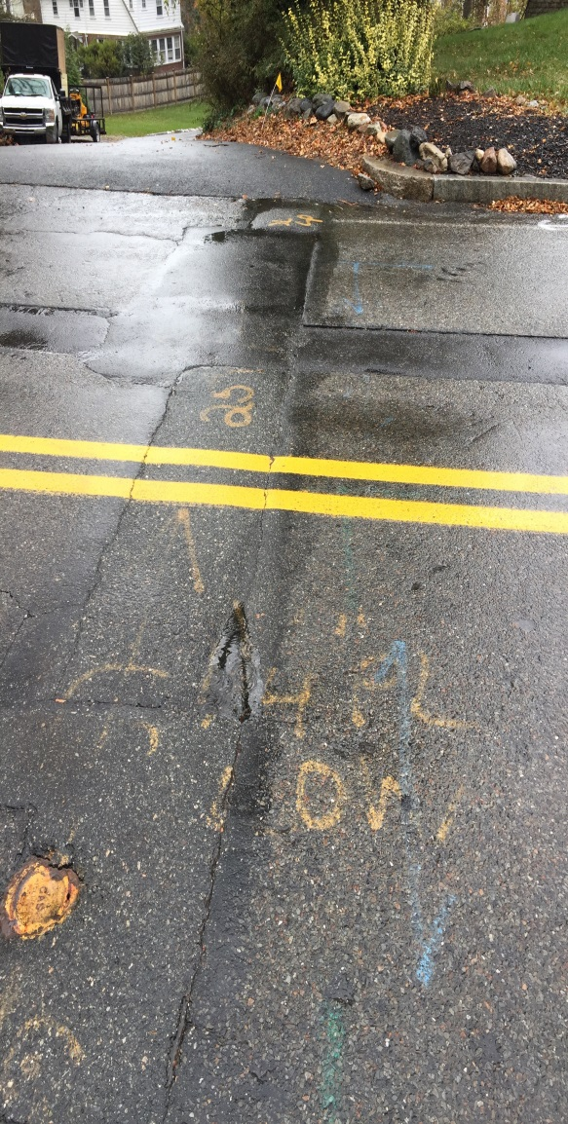
Dig Safe Marks are invalid when…
The excavation does not commence within 30 days of the notification to Dig Safe
The markings become faded, illegible or destroyed
A company installs new underground facilities in a marked area still being excavated
An emergency condition is brought to conclusion
Notes:
Invalid Marks
The excavation does not commence within 30 days of the notification to Dig Safe
The markings become faded, illegible or destroyed
A company installs new underground facilities in a marked area still being excavated
An emergency condition is brought to conclusion
When in doubt Call us or call in new ticket

Slide 7
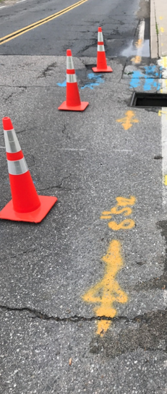
Gas Marks
Centerline VS Offsets
Notes:
More examples marks including off sets

Slide 8
Gas Pipe Material
IRONS
Cast, Wrought, Ductile Iron
Brittle (subject to cracking)
Bell & spigot joint every 12 feet
Exposed joints need to be encapsulated to prevent leaks.
Need to call gas company if you uncover cast iron main
STEEL
Bare, Coated and Wrapped
Corrodes over Time if not protected
Once corrosion begins, a leak is inevitable
If the coating is damaged – DO NOT BACKFILL – Call the Gas Company to have it repaired
PLASTIC
Not always buried in a straight line
Buried with tracer wire
Static Electricity can cause an incident
Small diameter plastic can be severed with a shovel
Notes:
IRONS
Cast, Wrought, Ductile Iron
Brittle (subject to cracking)
Bell & spigot joint every 12 feet
Exposed joints need to be encapsulated to prevent leaks.
Need to call gas company if you uncover cast iron main
STEEL
Bare, Coated and Wrapped
Corrodes over Time if not protected
Once corrosion begins, a leak is inevitable
If the coating is damaged – DO NOT BACKFILL – Call the Gas Company to have it repaired
PLASTIC
Not always buried in a straight line
Buried with tracer wire
Static Electricity can cause an incident
Small diameter plastic can be severed with a shovel

Slide 9
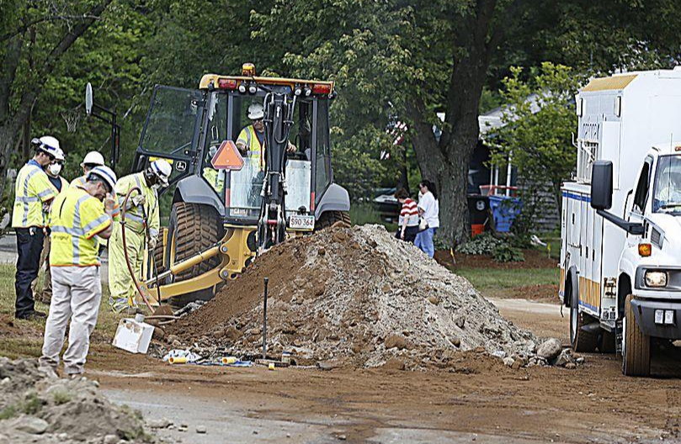
Behaviors of Natural Gas
Odorless – Mercaptan is added for rotten egg smell
Lighter than air (propane-heavier than air)
Follows path of least resistance
Will rise through dirt – until hits pavement or frost – then moves laterally – possibly against a foundation, through cracks or openings – structure may fill with gas
It will continue to travel until the source of damage is made safe by trained gas employees
Notes:
Lets quickly mention the Behaviors of Natural Gas
Odorless – Mercaptan is added for rotten egg smell
Lighter than air (propane-heavier than air)
Follows path of least resistance
Will rise through dirt – until hits pavement or frost – then moves laterally – possibly against a foundation, through cracks or openings – structure may fill with gas
It will continue to travel until the source of damage is made safe by trained gas employees

Slide 10
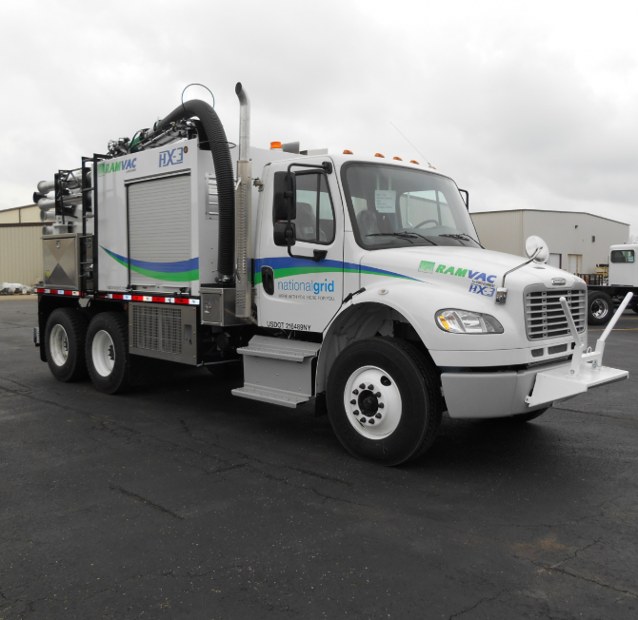
Recommended Safe Excavation Best Practices
Review
Review Potential Hazards of Job Site during Job Brief
Ensure
Ensure job is reviewed with anyone entering the site; communication is key
Look
Look for Marked Utilities and Hand Dig or use vacuum excavation to Locate them
Use
Use Spotters
Protect /support
Protect /support exposed pipe is so that nothing falls on it and breaks it
Make
Make sure proper sloping and shoring when trenching
Call
Call Safety Stops when encountering Abnormal Operating conditions
Notes:
Recommended Safe Excavation and Best Practices
Review Potential Hazards of Job Site during Job Brief ( RIE can meet onsite for concerns)
Ensure job is reviewed with anyone entering the site; communication is key
Look for Marked Utilities and Hand Dig or use vacuum excavation to Locate them
Use Spotters
Ensure exposed pipe is protected so that nothing falls on it and breaks it
Make sure proper sloping and shoring when trenching
Call Safety Stops when encountering Abnormal Operating conditions

Slide 11
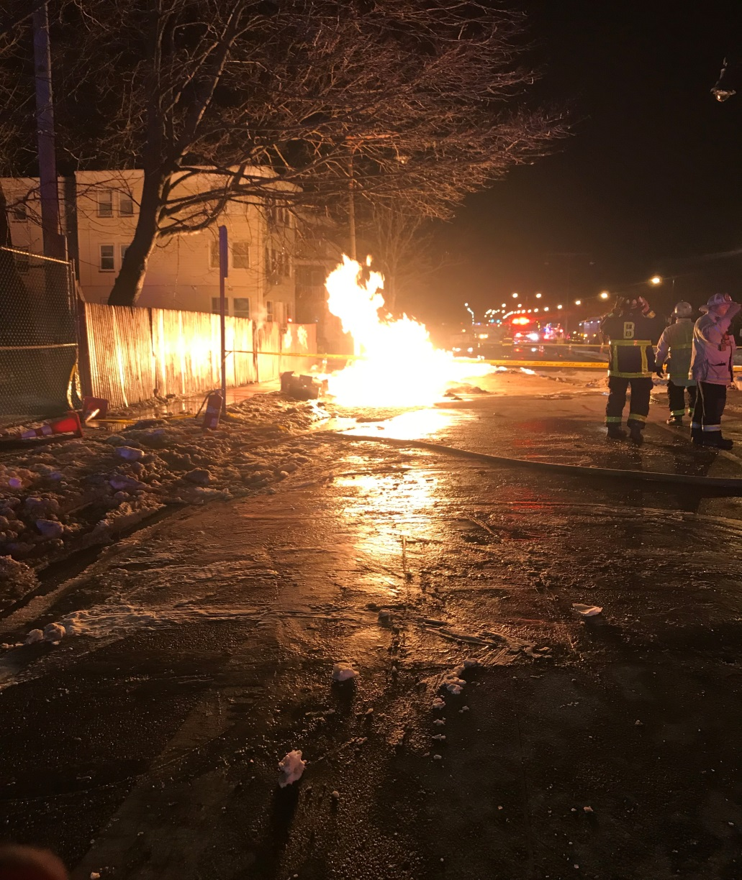
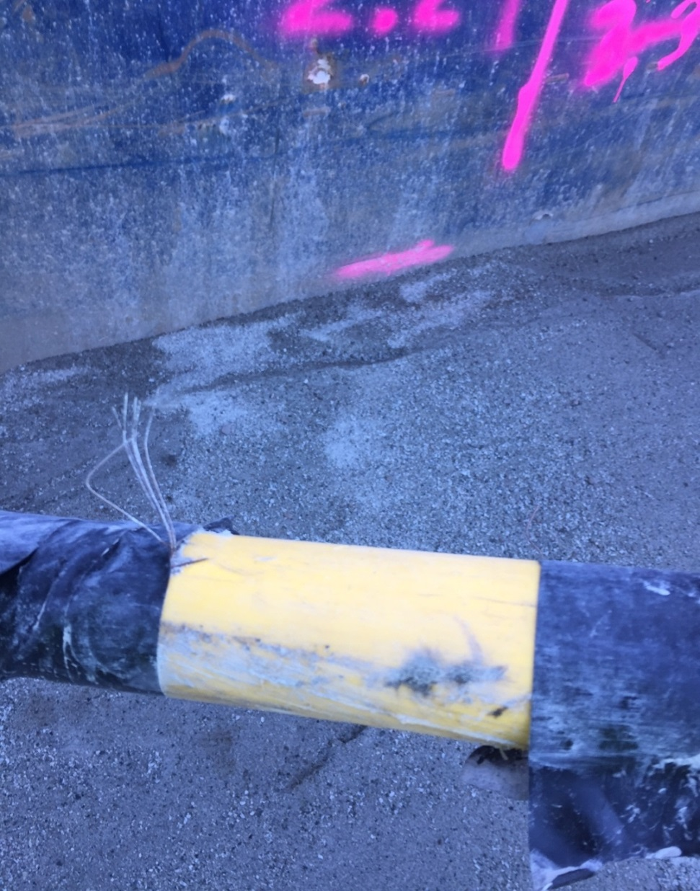
Signs of a Hit Gas Pipe
Blowing or hissing sound
Dust blowing from the hole
Continuous bubbling in wet area
Rotten egg smell
Flames (if gas has ignited)
Notes:
lets talk about what to do in Emergencies
Signs of a Hit Gas Pipe
Blowing or hissing sound
Dust blowing from the hole
Continuous bubbling in wet area
Rotten egg smell
Flames (if gas has ignited)

Slide 12
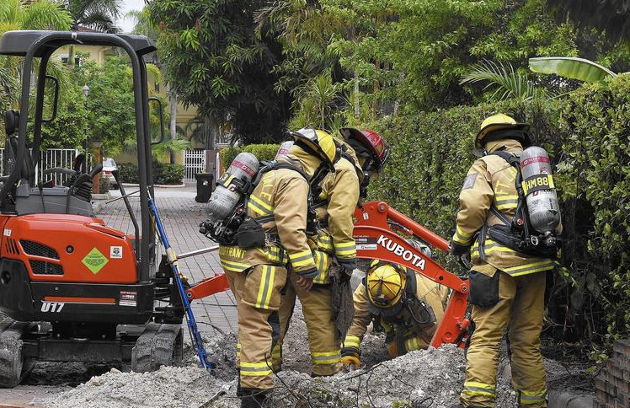
What TO DO When a GAS Line is Damaged
Stay Calm & Think
Stop Work
Rupture or release of gas – CALL 911
Call Gas Company immediately
RIE Emergency # 1-800-640-1595
Clear the Area
Evacuate the buildings close to the leak
Shut off engine/equipment
REMEMBER: Fire Dept. is in charge of the scene
Notes:
What TO DO When a GAS Line is Damaged
Stay Calm & Think
Stop Work
Rupture or release of gas – CALL 911
Call Gas Company 1-800-640-1595 immediately after calling 911
Clear the Area
Evacuate the buildings close to the leak
Shut off engine/equipment
REMEMBER: Fire Dept. is in charge of the scene

Slide 13
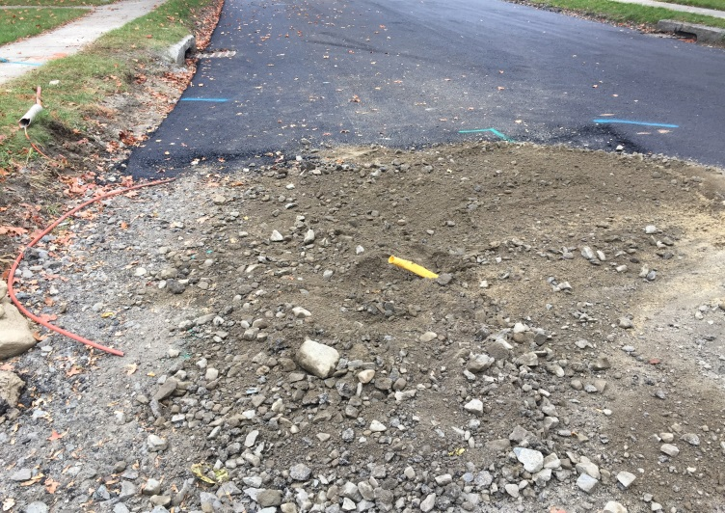
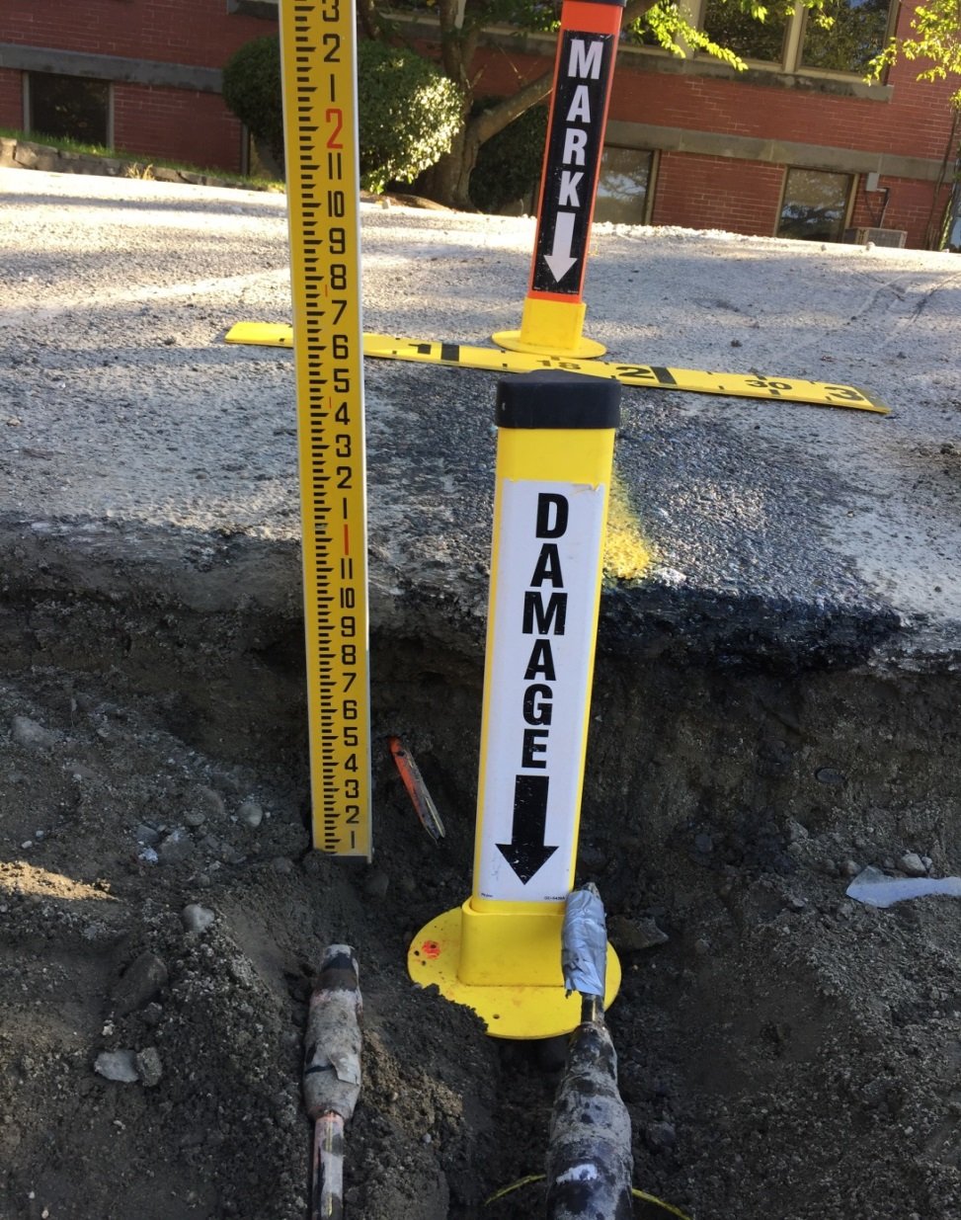
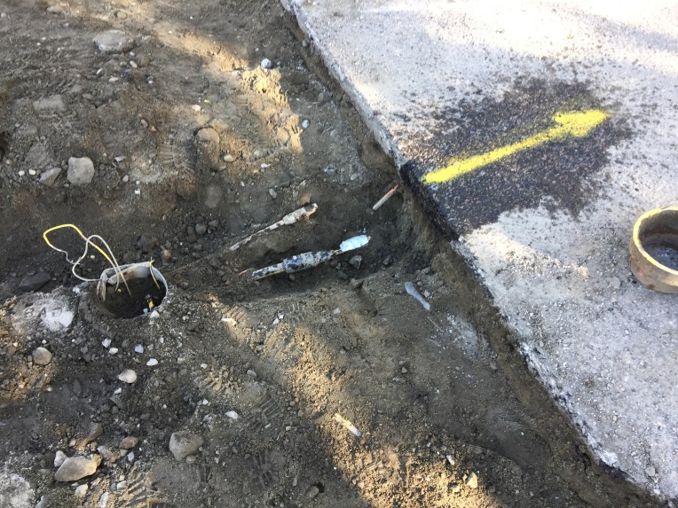
What NOT to Do When a Gas Line is Damaged
DON’T PANIC!
DON’T Look in or get in the hole
DON’T Attempt to stop the flow of gas
DON’T Operate any valves on the gas system
DON’T Attempt to repair the damage!
DON’T Backfill!! Wait until the gas company has made the repair and gives the OK to do so
DON’T Call Dig Safe
Notes:
What NOT to do When a Gas Line is Damaged
DON’T PANIC!
DON’T Look in or get in the hole
DON’T Attempt to stop the flow of gas
DON’T Operate any valves on the gas system
DON’T Attempt to repair the damage!
DON’T Backfill!! Wait until the gas company has made the repair and gives the OK to do so
DON’T Call Dig Safe

Slide 14
Possible Ignition sources
Ringing the doorbell
Turning light on or offswitch
House phone – cell phone – 2-Way radios
Static electricity
Lighting any smoking materials
Vehicle engines or equipment
Notes:
The slide shows possible ignition sources
Ringing the doorbell
Turning light switch on or off
House phone – cell phone – 2-Way radios
Static electricity
Lighting any smoking materials
Vehicle engines or equipment

Slide 15
Report all Damages
Report all Damages dents kinks gouges and scrapes immediately
Coating Damage
could lead to future leaks.
Broken Tracer Wire or Warning Tape
Plastic is not conductive so without traceable wire and tape gas facilities can’t be located for future construction
Unmarked Gas Facilities
Notify Rhode Island Energy immediately so we can correct possible mapping discrepancies
Notes:
You have damage but no leak we still need to know
Report all Damages dents kinks gouges and scrapes Immediately
Report Coating Damage-could lead to future leak
Report Broken Tracer Wire or Warning Tape --Plastic is not conductive so without traceable wire and tape gas facilities can’t be located for future construction
Unmarked Gas Facilities - Notify Rhode Island Energy immediately so we can correct possible mapping discrepancies

Slide 17
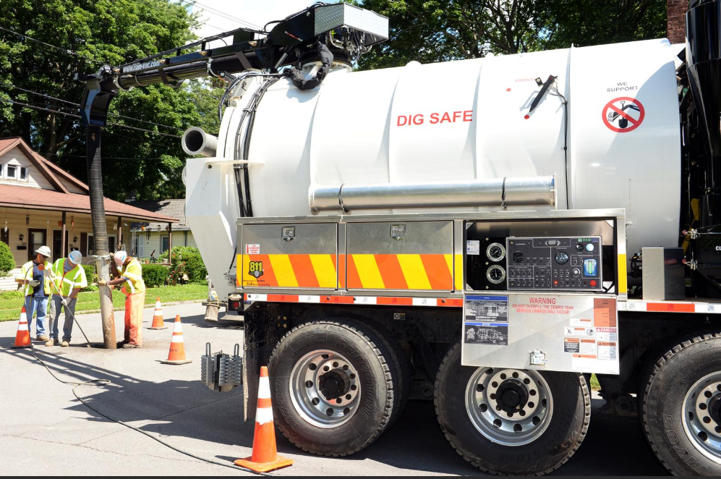
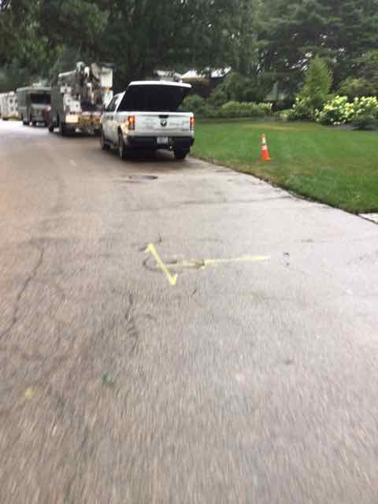
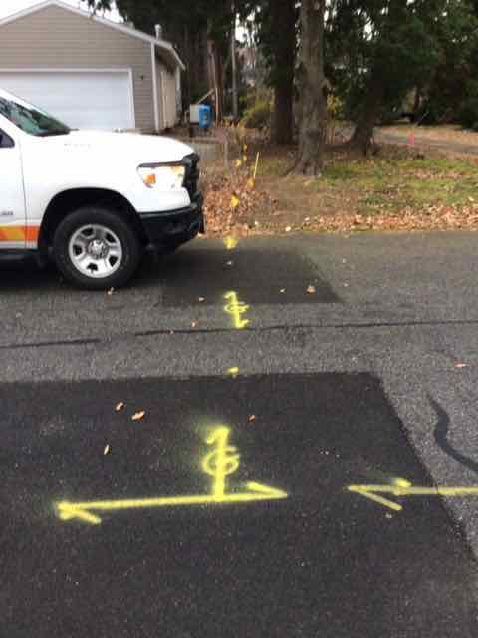
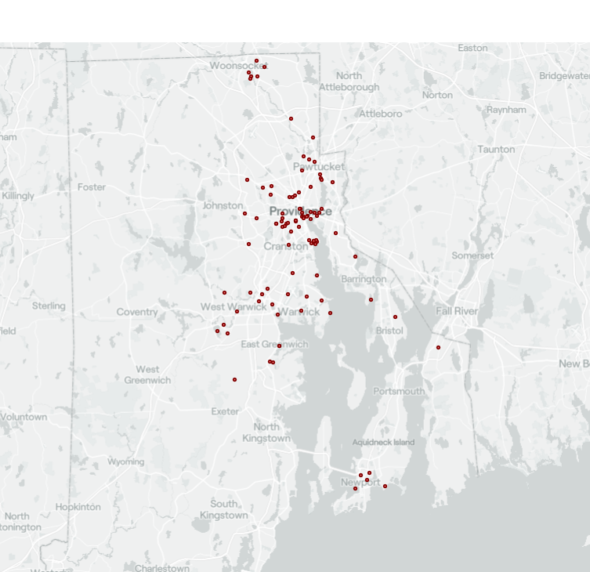
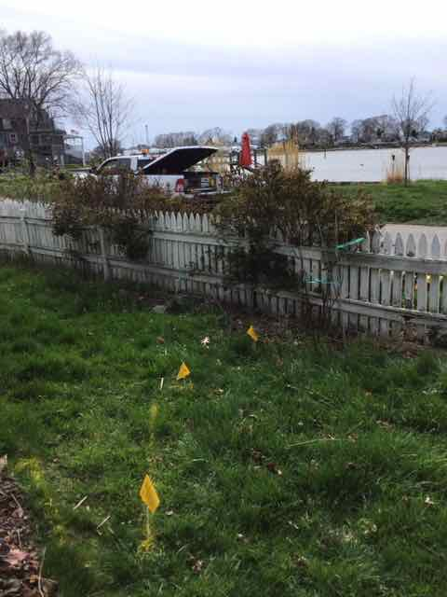
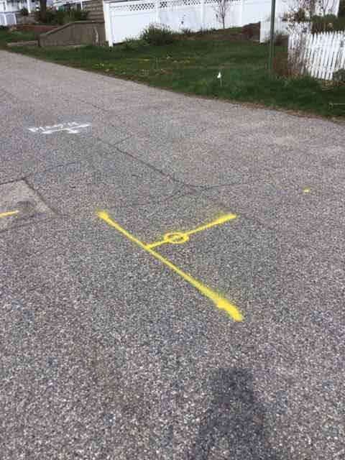
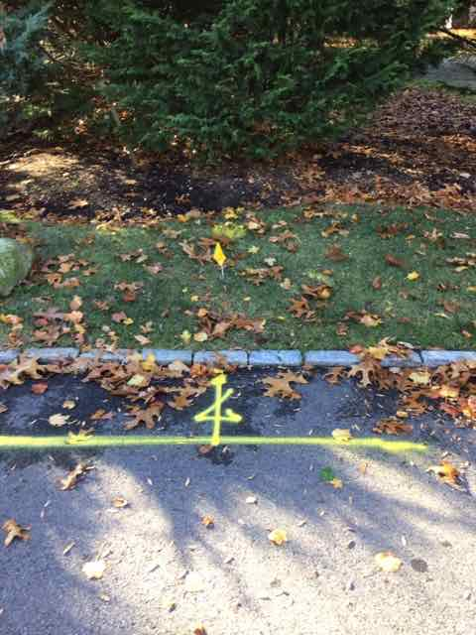
Thank You For Digging Safely!
Notes:
Thank you for having us and thank you for digging safely

