Slide 1
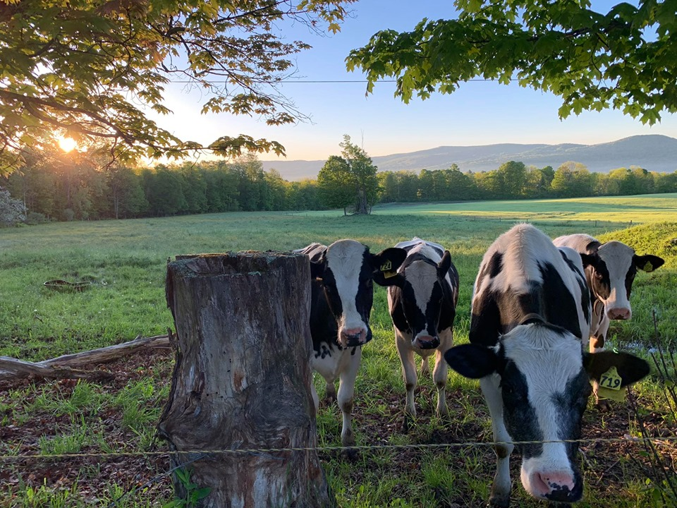
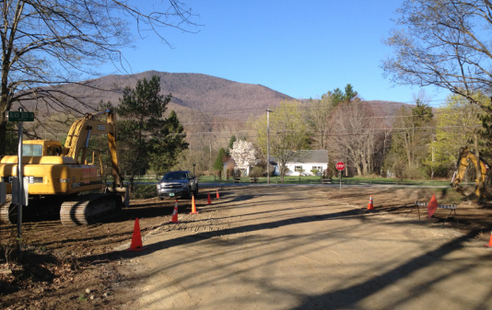
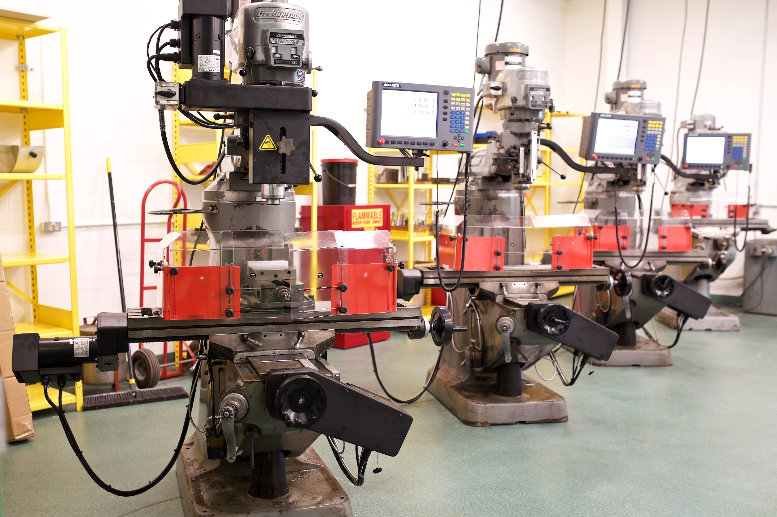
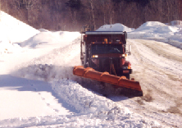
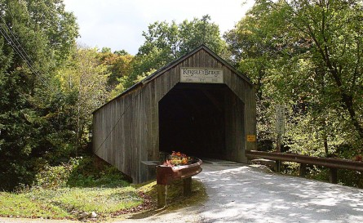
Vermont DOL Consultation
Project WorkSAFE

Slide 2
Project WorkSAFE Consultation
What, Who is Project WorkSAFE?
No Cost Consultation - FREE!
Voluntary
Completely separate from Vermont OSHA (VOSHA) enforcement - NOT VOSHA
No citations or penalties issued
Completely confidential
Scope – designed for your specific needs
Employer Obligations:
Correct serious job safety & health hazards in a timely manner
Notes:
Employer is required to correct any serious hazards or imminent dangers in a timely manner. Typically, 30-days
Opening conference; review injury/illness records; review S&H programs; walkthrough of facility; Closing Conf; Written Report
Management; Supervisors; Employees

Slide 3
VOSHA Enforcement vs. Consultation
What is VOSHA and what are their fees?
Penalties will continue to rise with inflation and hadn’t been increased in over 20 years in Vermont.
Notes:
OSHA wants employers and employees to be safe by requiring minimum standards to be met. OSHA does this through providing minimum Standards, training/education, Enforcement and Compliance Assistance. You can be visited by Enforcement if there are any reportable injuries which include:
All work-related fatalities within 8 hours.
All work-related inpatient hospitalizations, all amputations and all losses of an eye within 24 hours.
You could be visited due to a complaint or a planned inspection (essentially, your number gets pulled out of a hat).
Compliance Assistance doesn’t want anyone to get cited, we want to work with you to keep you and your employees safe by making sure you are meeting the minimum standards as best that you can.
The objective of this course is to help you with VOSHA citations; If enforcement finds nothing else during their visit they will look for these basic items and you could be cited. If your business has a lot of violations they will probably feel frustrated and hit you with several of them. However, if they see you are doing your best, even with the little stuff they are more likely to cut you a break and you may even get away without a single fine.

Slide 4
Project WorkSAFE Consultation (Texas Version)
Just Google “Project WorkSAFE”
https://youtu.be/nn7b5k90MmM
Notes:
This was a great video from out Texas counter parts and feel it’s a great way to know compliance assistance.

