Slide 1
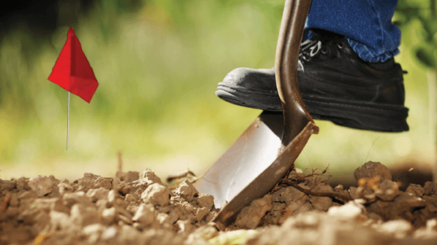

Green Mountain Power
Being Safe Around Electrical Lines

Slide 2
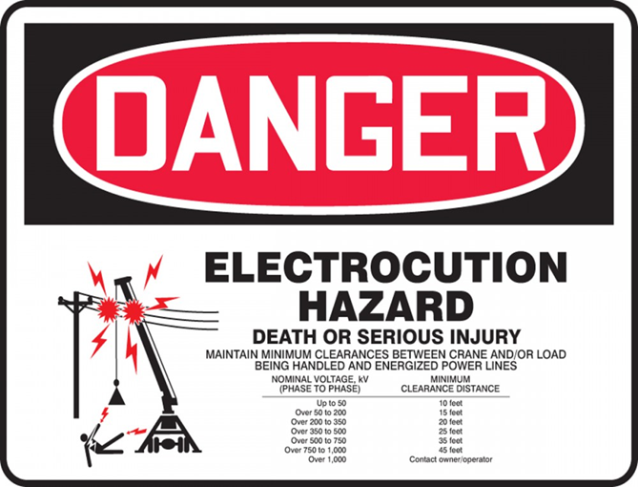
OSHA Clearances for
Overhead Wires
Maintain a 10-ft minimum clearance for non-transmission voltage and a 20-ft. minimum clearance from transmission powerlines. Putting cover on the wires, doesn’t mean the clearance distance can be smaller. The cover is just for visual indications there are overhead wires present.
For transmission powerlines, if a 20-ft minimum clearance is not possible, three options are available under OSHA 29 CFR 1926.1408 regulations:
  Option 1 – contact the electric utility and arrange for the powerline to be de-energized and visibly grounded.
  Option 2 - Use a dedicated spotter following the OSHA requirements.
  Option 3 - Determine the line voltage and use OSHA table for establishing minimum clearance distances.
When moving equipment under power lines, the vehicle structure must be lowered as much as possible (boomed down) or cradled. Remember, that the phone line is usually the bottom attachment, and getting caught in the telephone line breaks a lot of our poles. Check heights whenever moving in areas with overhead lines.

Slide 3
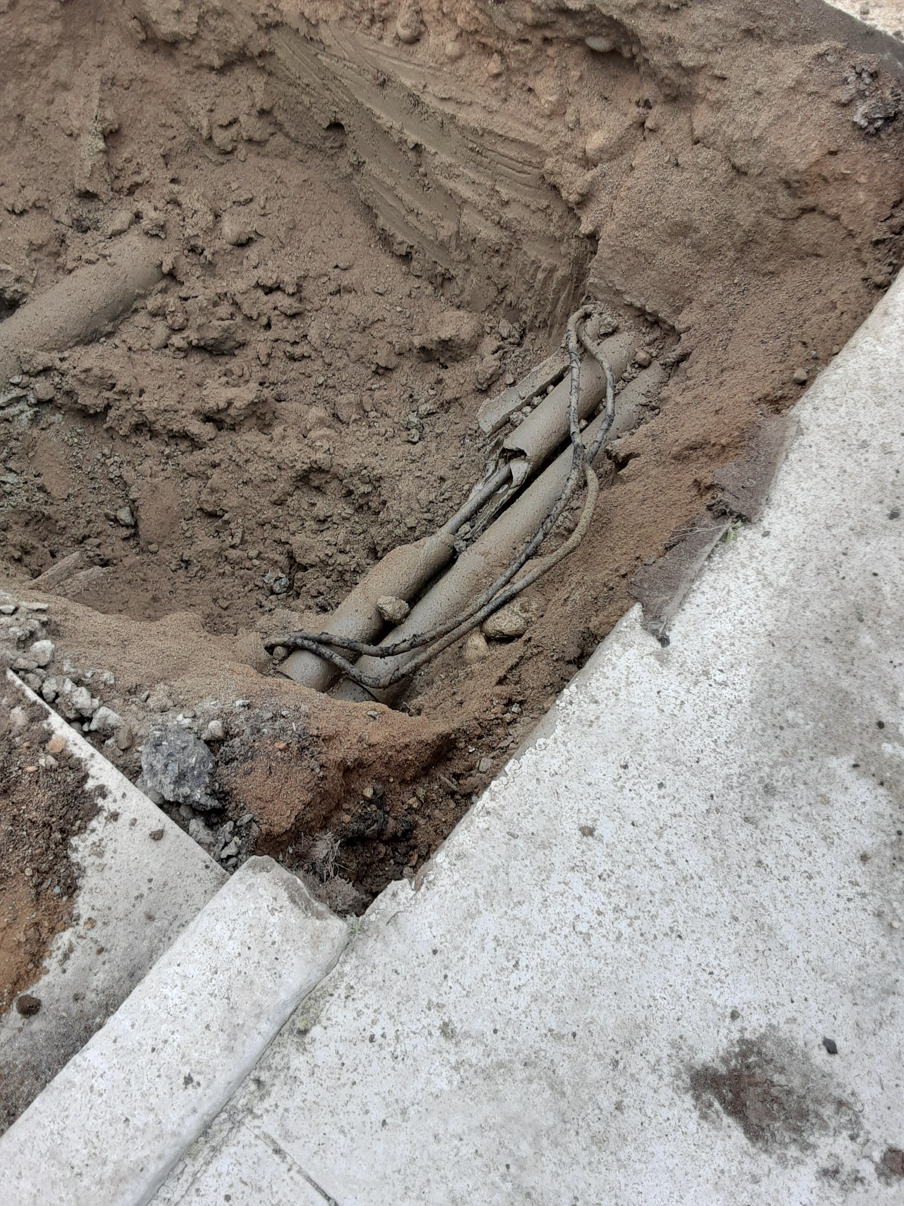
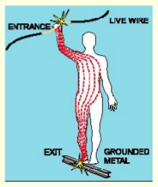
Electrical Shock
Severity of the shock depends on
  Path of current through the body
  Amount of current flowing through the body
  Length of Time the body is in the circuit
Received when current passes through the body
LOW VOLTAGE DOES NOT MEAN LOW HAZARD
A current of .1 ampere for just 2 seconds can be fatal. Current kills, not voltage. The amount of current depends on body resistance.
  Resistance of the heart is low, 10 milliamps to kill, but skin is more resistant.

Slide 4
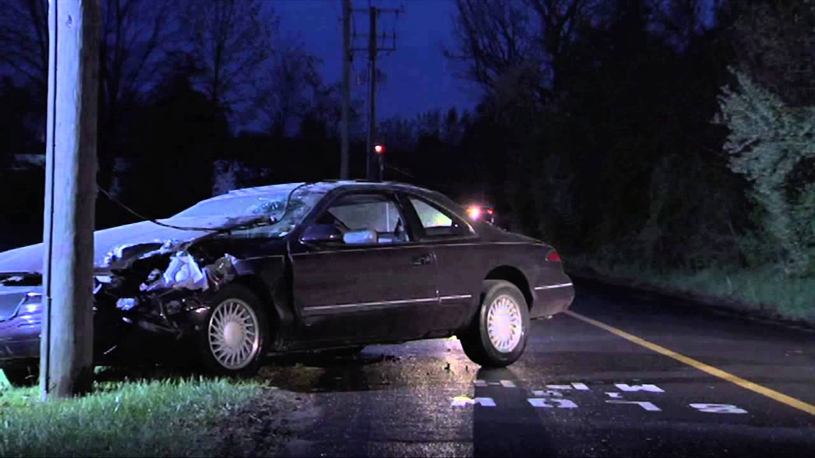
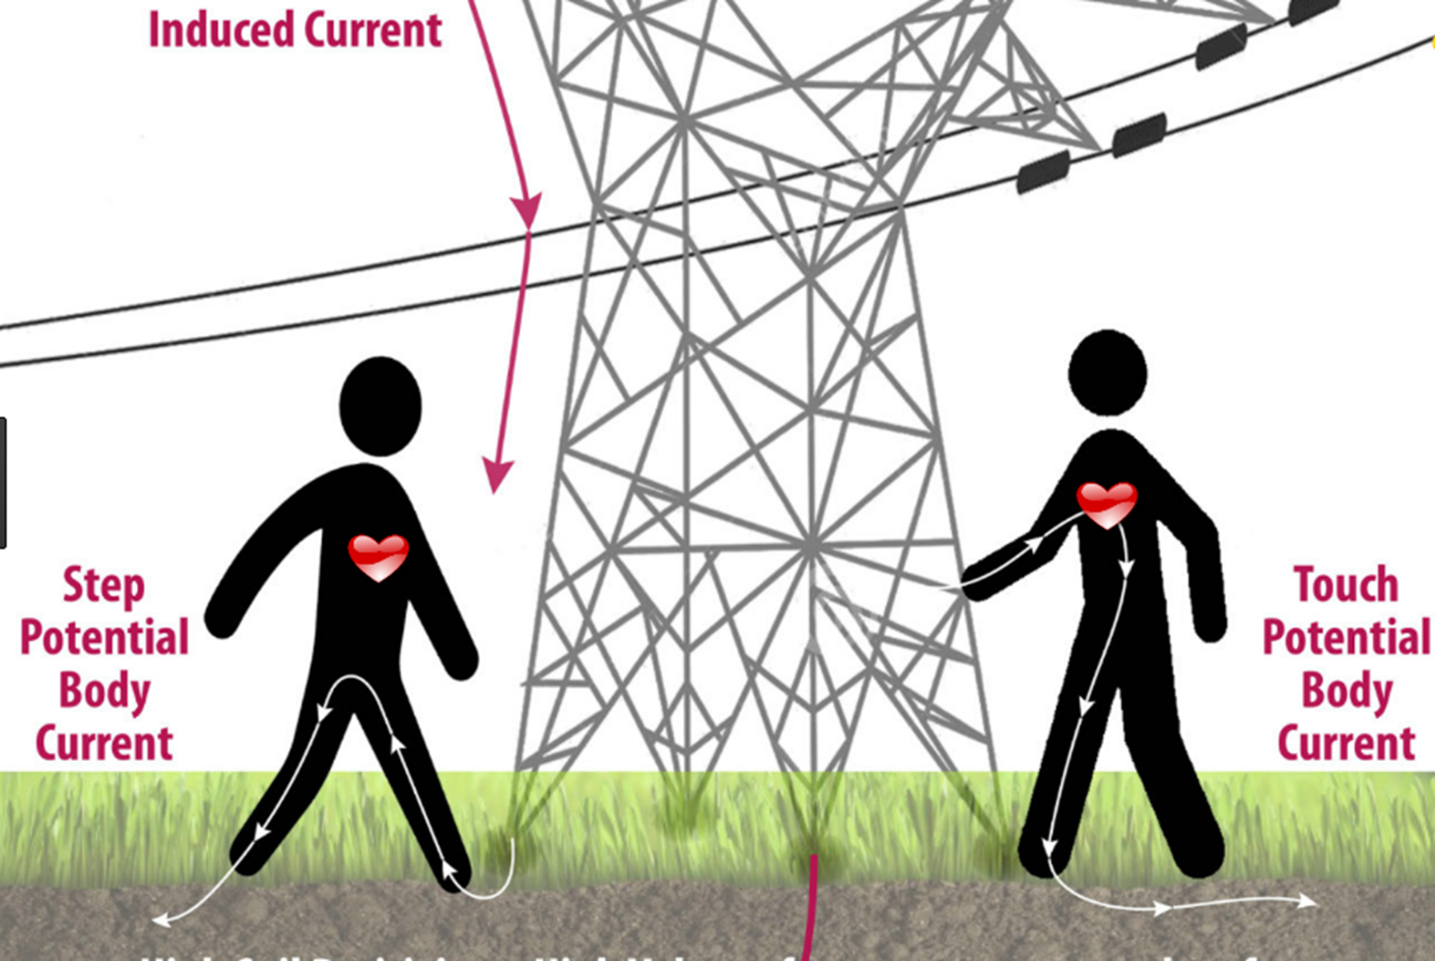
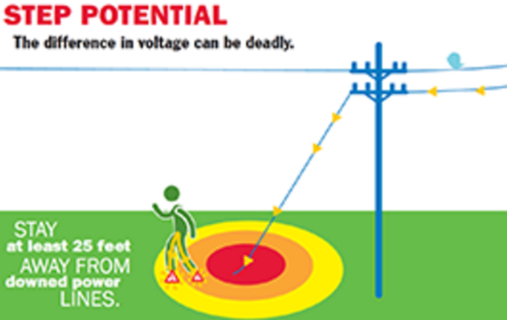
Step Potential Hazard

Slide 5
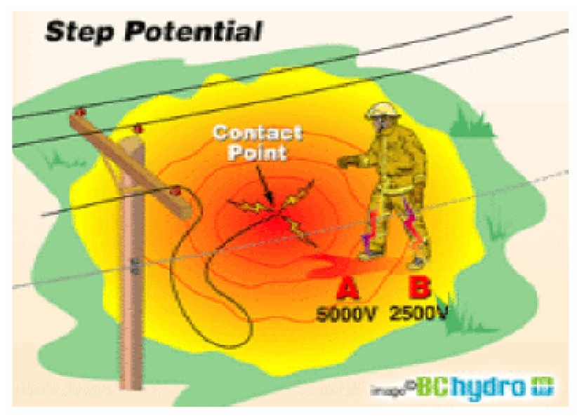
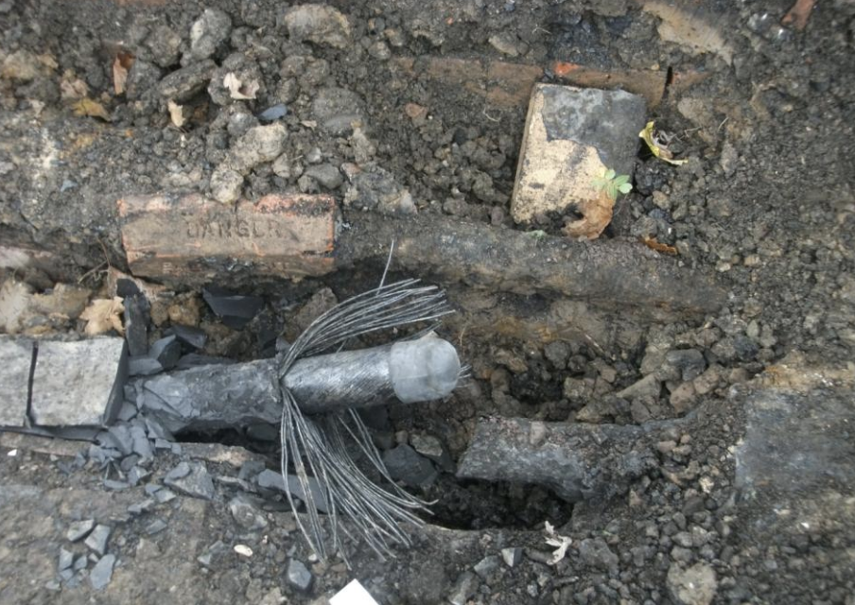
Step Potential Hazard
As current flows through the earth’s surface, it creates a voltage drop
A person standing with their feet apart creates a bridge between different voltages.
The wider apart a person’s legs are, the larger the voltage difference across the body.

Slide 6
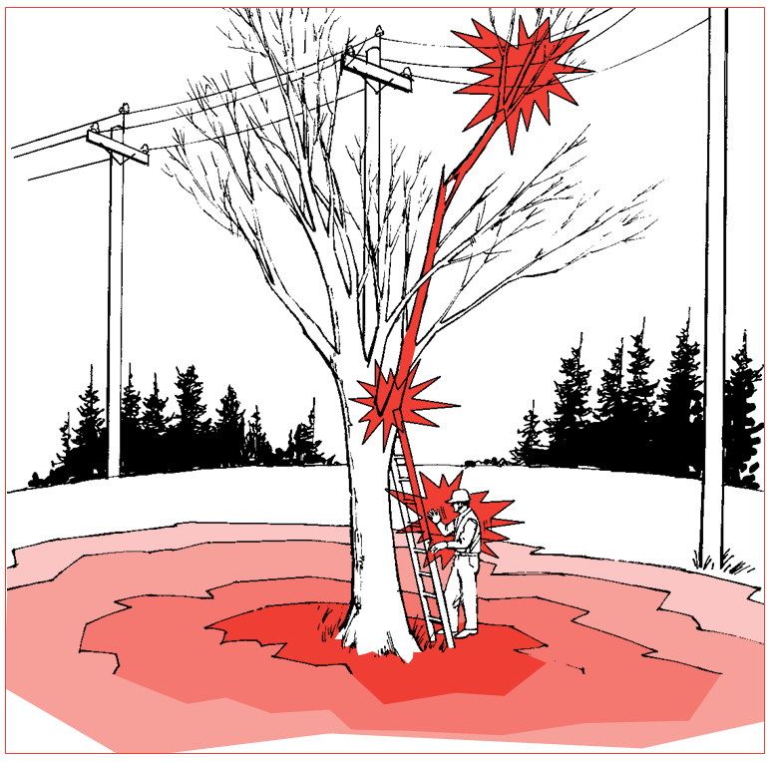
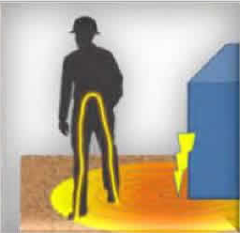
Step Potential Hazard
A step potential hazard can exist anytime an electrical wire comes in contact with another surface including:
  Power Line touching the ground.
  Tree on line (step potential radiates from where the trees rests on the ground).

Slide 7
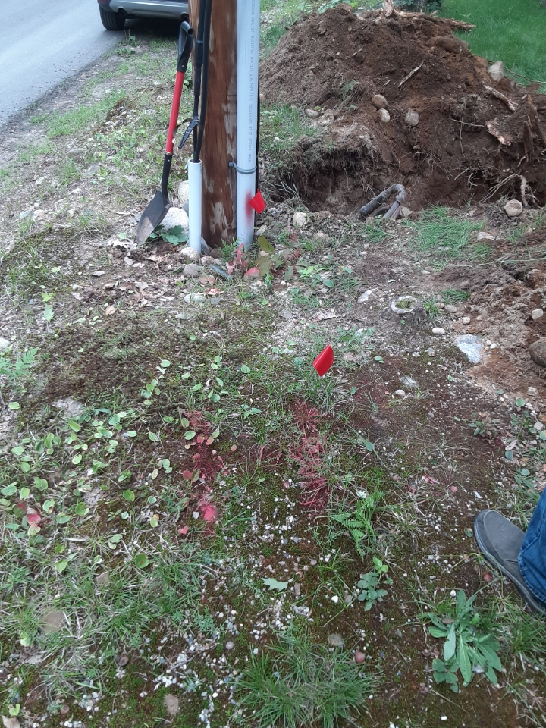
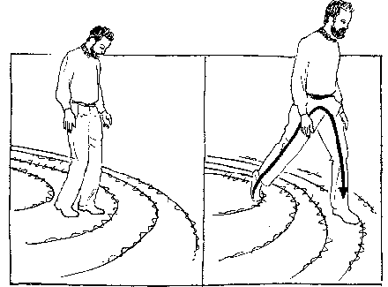
Keep Feet
Close Together
If you find yourself in a voltage potential situation, keep your body within the same voltage by keeping your feet together
OK – Feet together and touching, drag your feet while walking
Not OK – Wide stance
OK Not OK

Slide 8
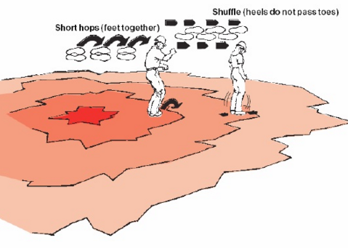
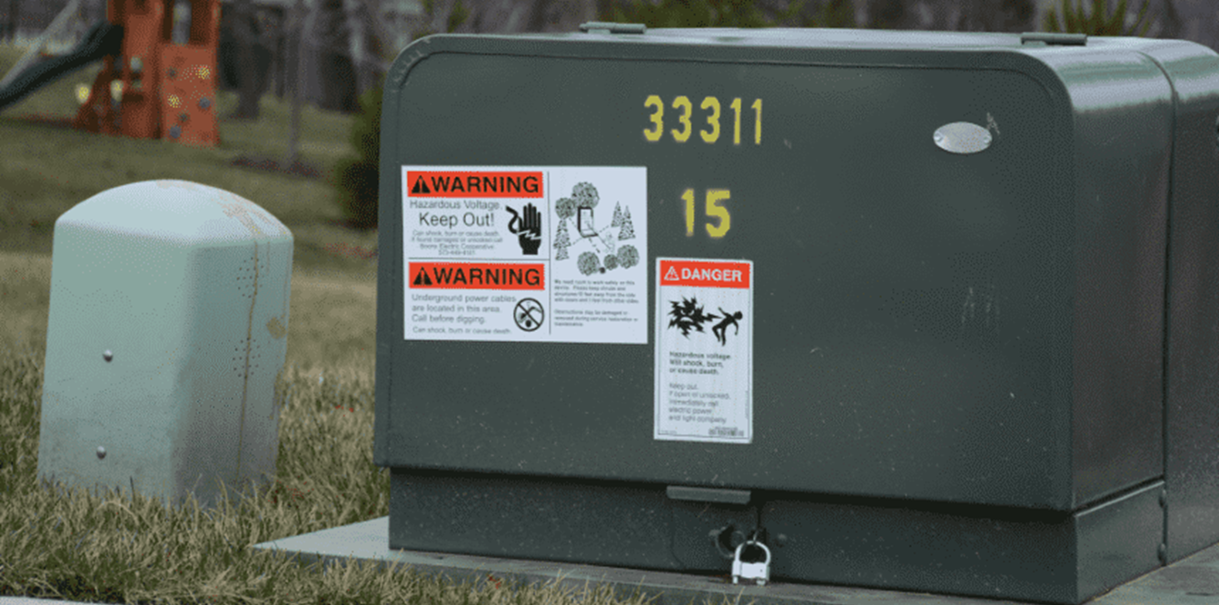
What To Do . . .
The voltage drops as you move away from the point of contact.
Keep your feet as close together as illustrated and shuffle away from the hazard.
Reliability
Communications infrastructure
CDC social vulnerability
Community’s interest in partnering with GMP

Slide 9
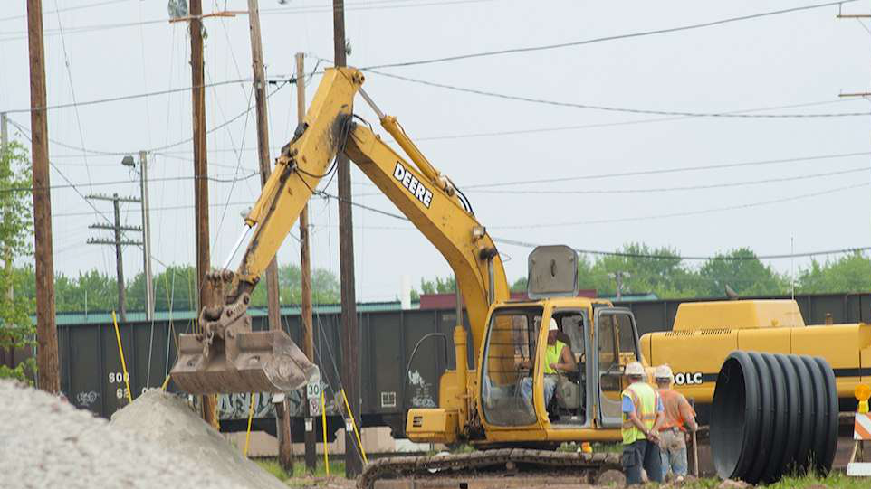
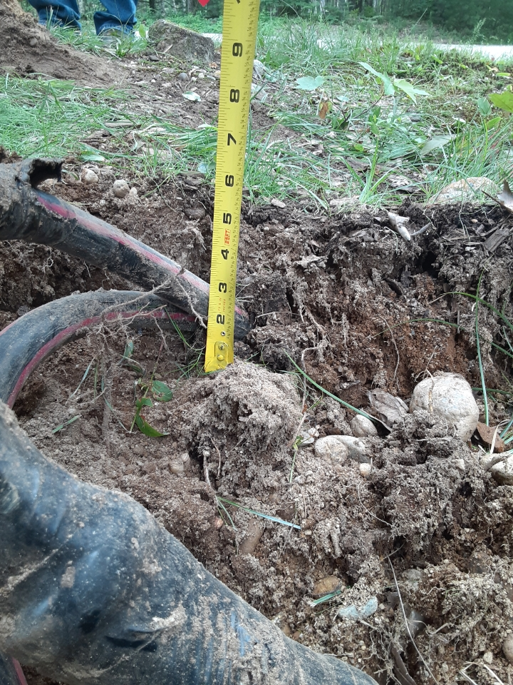
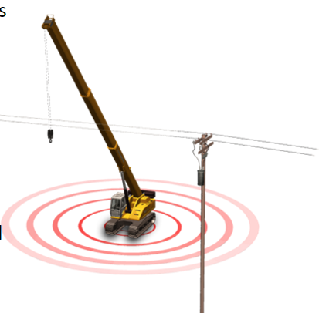
Equipment Contact
A piece of equipment touching an energized power line can create a voltage potential on the ground similar to a wire on the ground.
When you exit the cab, you may be standing in a hazardous step potential zone.
Trying to “Jump Clear” doesn’t take into consideration step potential.

Slide 10
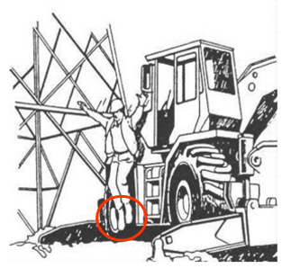
Get Away SAFELY
If you must get out, jump with your feet together.
Do not touch the machine or outriggers.
Hop or shuffle out of the area.

Slide 11
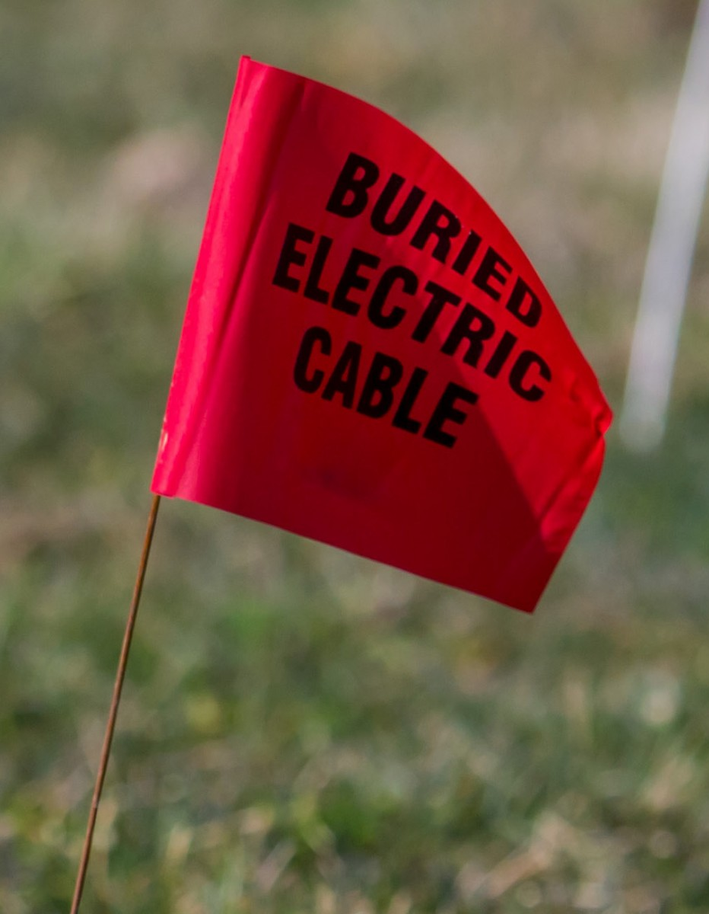
Call BEFORE YOU DIG!
Vermont requires a 72 notice before digging.
Pre-marking area is key to the locator. More information is better.
Make sure you receive a clear ticket before digging. Delays may happen due to weather or other circumstances.
Centerline Utility Services is GMP’s contract locate company.
If there is any question on marks, call back in for a re-mark, or contact GMP and we assist in getting the work zone safe.
You are responsible to maintain your marks. If they have been washed away or no longer visible, call in for a remark.
Reliability
Communications infrastructure
CDC social vulnerability
Community’s interest in partnering with GMP

Slide 12
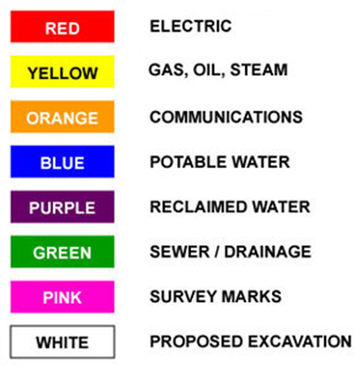
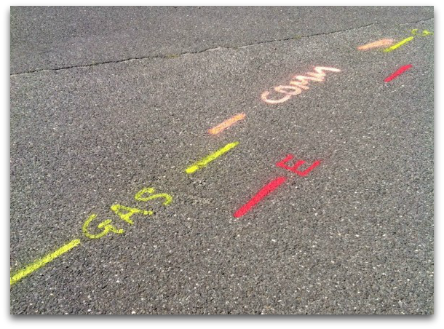
Call BEFORE YOU DIG!
Centerline may screen tickets from GMP GIS data, like telecoms, and if there are no facilities at the location, they will clear the ticket and there might not be any marks at the site. They mark up to the meter, not beyond it.
Remember, there are utilities and municipalities that may not be part of a dig safe program. They would need to be contacted separately.
Chart shows what different utilities mark outs may look like. White for your proposed is key to locator.
Reliability
Communications infrastructure
CDC social vulnerability
Community’s interest in partnering with GMP

Slide 13
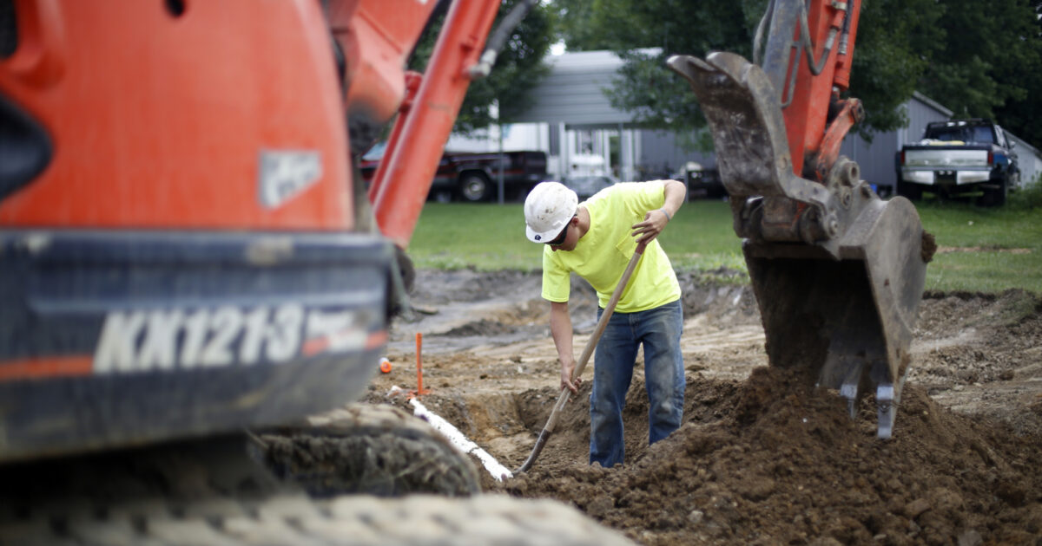
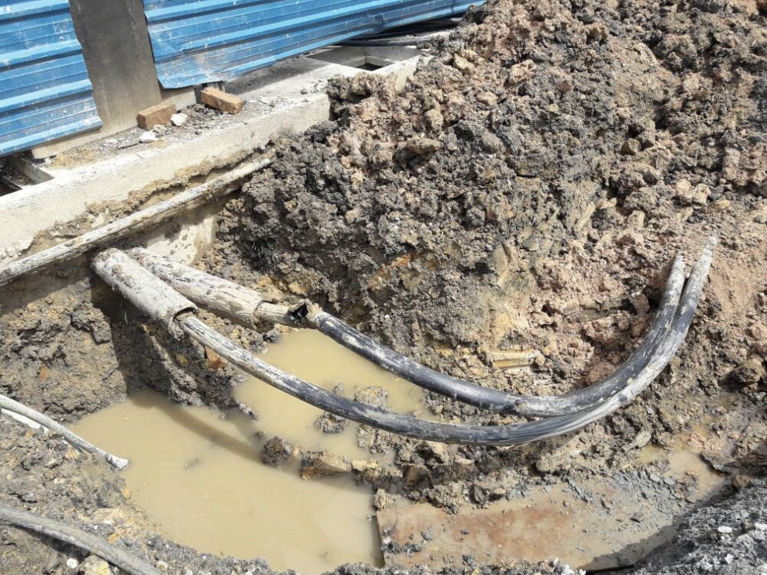
QUESTIONS?
888-835-4672
GreenMountainPower.com
Eric Lemery
Eric.Lemery@greenmountainpower.com

