Slide 1
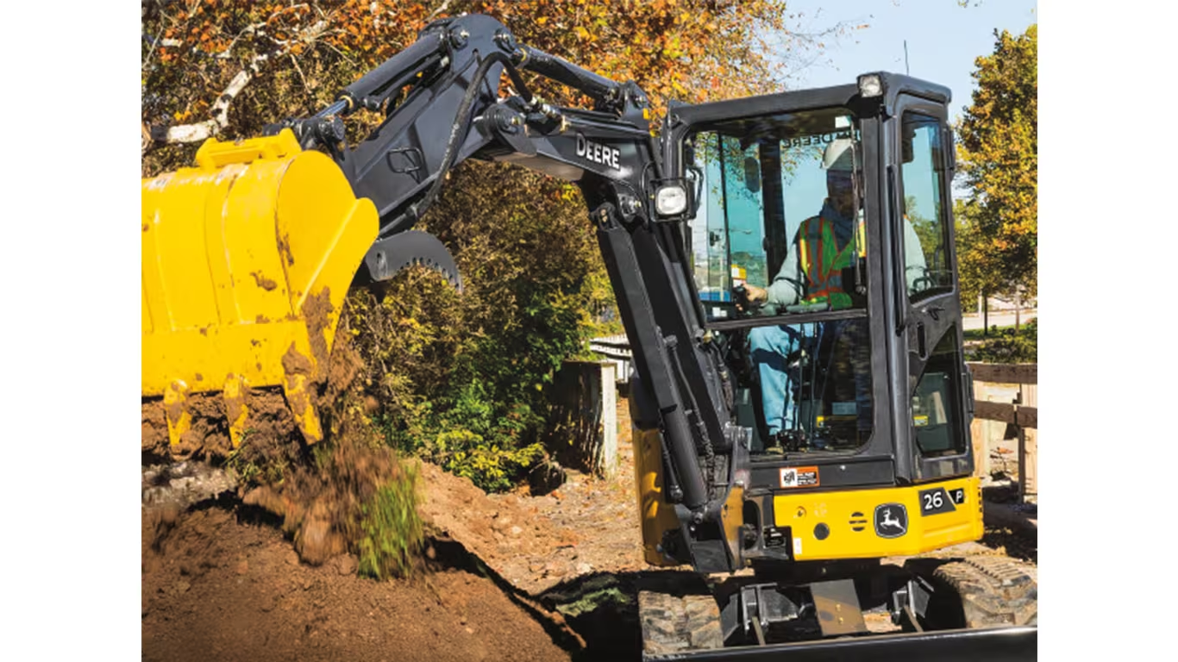
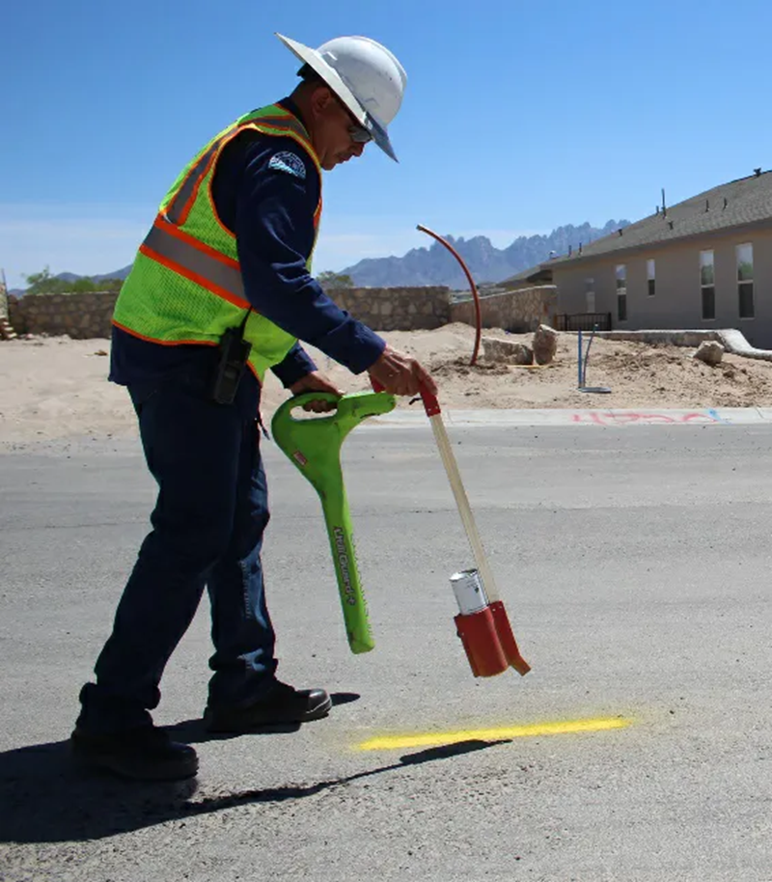

Slide 2
Engineering Division
The Engineering Division specializes in electricity, nuclear power, pipeline safety (natural gas and propane), and underground damage prevention.
Bill Jordan – Director
Lindsey Wells – Admin. Services Coordinator

Slide 3
Vermont Statutes and Rules
Statute - 30 V.S.A. Chapter 86 - Underground Utility Damage Prevention System
Public Utility Commission Rule 3.800 - Underground Utility Damage Prevention

Slide 4
Definition of “Excavation Activities”
§ 7001(4) "Excavation activities" means any activities
Disturb the subsurface of the earth or could damage underground utility facilities and that may involve the removal of earth, rock, or other materials in the ground
Demolition of any structure by the discharge of explosives
Use of powered or mechanized equipment, including digging, trenching, blasting, boring, drilling, hammering, post driving, wrecking, razing, tunneling, or pavement
Concrete slab removal within 100 feet of an underground utility facility.

Slide 5
Definition of “Excavation Activities”
Excavation activities shall NOT include the tilling of the soil for agricultural purposes, routine home gardening with hand tools outside easement areas and public rights-of-way, activities relating to routine public highway maintenance, or the use of hand tools by a utility or locator to locate or service facilities, provided the utility has a written damage prevention program.

Slide 6
Public Utility Commission Rule 3.800 - Definitions
"Routine highway maintenance" includes
Snow removal
Patching
Salting
Grading
Other day to day operations
NOT
Ditching
Signpost setting
Guardrail placement or removal
Culvert work.
Operations which do not disturb the subsurface of the earth, or which involve only the replacement of a post in the same location, shall be deemed to be routine.

Slide 7
30 V.S.A. § 7004. Notice of excavation activities
No person or company shall engage in excavation activities, except in an emergency situation, without premarking the proposed area of excavation activities and giving notice as required by this section.
(b) Prior to notifying Dig Safe, the person shall premark the area of proposed excavation activities in a manner that will enable operators of underground facilities to identify the boundaries of the proposed excavation activities.

Slide 8
30 V.S.A. § 7004. Notice of excavation activities
(c) At least 48 hours, excluding Saturdays, Sundays, and legal holidays, but not more than 30 days before commencing excavation activities, each person required to give notice of excavation activities shall notify Dig Safe, and shall contain a reasonably accurate and readily identifiable description of the geographical location of the proposed excavation activities and the premarks.

Slide 9
30 V.S.A. § 7004. Notice of excavation activities
Dig Safe member states
VT
MA
ME
NH
RI
Dig Safe Tickets are valid for 30 days from the date of notification.

Slide 10
30 V.S.A. § 7004. Notice of excavation activities
(e) Notice of excavation activities shall be valid for an excavation site until one of the following occurs:
the excavation is not completed within 30 days of the notification;
the markings become faded, illegible, or destroyed; or
the company installs new underground facilities in a marked area still under excavation.

Slide 11
30 V.S.A. § 7006. Marking of underground utility facilities
The utility is required to mark facilities within 48 hours (not including Saturdays, Sundays, and legal holidays) of the receipt of the notice, marking the approximate location of its underground utility facilities in the area of the proposed excavation activities ….
Note: “Approximate location of underground utility facilities” means a strip of land extending not more than 18 inches on either side of the underground utility facilities. [30 V.S.A. § 7001(7)]

Slide 12
Legal Holidays A Any legal holiday which falls on a Saturday shall be observed on the preceding Friday. Any legal holiday which falls on a Sunday shall be observed on the following Monday.
NEW YEAR’S DAY (January 1st)
MARTIN LUTHER KING DAY (3rd Monday in January)
PRESIDENT’S DAY (3rd Monday in February)
MEMORIAL DAY (Last Monday in May)
JUNETEENTH (June 19th)
INDEPENDENCE DAY (July 4th)
BATTLE OF BENNINGTON DAY (August 16th)
LABOR DAY (1st Monday in September)
INDIGENOUS PEOPLES DAY (2nd Monday in October)
VETERAN’S DAY (November 11th)
THANKSGIVING DAY (4th Thursday in November)
CHRISTMAS DAY (December 25th)

Slide 13
30 V.S.A. § 7006a. Maintenance of underground utility facility markings
After utilities have marked underground facilities, the excavator is responsible for maintenance of the markings.
In the event markings are obliterated, destroyed, or removed, the excavator MUST notify Dig Safe that remarking is needed.
The utility must remark within 48 hours, excluding of Saturdays, Sundays, and legal holidays.

Slide 14
30 V.S.A. § 7006b. Excavation area precautions
Any person engaged in excavating activities in the approximate location of underground utility facilities marked shall take reasonable precautions to avoid damage to underground utility facilities, including any substantial weakening of the structural or lateral support of such facilities or penetration, severance, or destruction of such facilities. The person engaged in excavation activities shall expose underground facilities to verify their location and depth, in a safe manner, at each location where the work will cross a facility and at reasonable intervals when paralleling an underground facility. Powered or mechanized equipment may only be used within the approximate location where the facilities have been verified.

Slide 15
30 V.S.A. § 7007 Notice of Damage - Excavators
When any underground utility facility is damaged during excavation activities, the excavator shall immediately notify the affected company. Under no circumstances shall the excavator backfill or conceal the damaged area until the company inspects and repairs the damage, provided that the excavator shall take reasonable and prudent actions to protect the public from serious injury from the damaged facilities until the company or emergency response personnel arrive at the damaged area.
An excavator who causes damage to a pipeline that results in a release of natural or other gas or hazardous liquid shall promptly report the release to emergency responders by calling 911.

Slide 16
PUC Rule 3.805(C) Notice of Damage - Utilities
Upon discovery of damage to underground facilities by excavation activities or other action that may constitute a probable violation, a utility shall submit an Underground Facility Damage Prevention Report.
Required for utilities
Optional for excavators

Slide 17
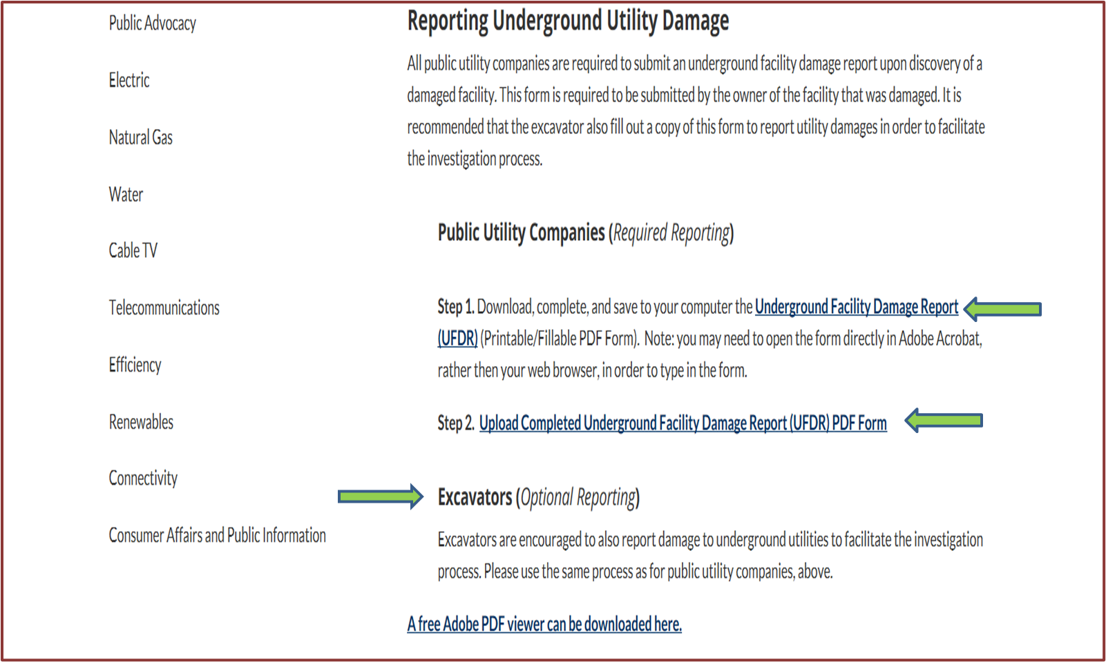
Underground Facility Damage Reports (UFDR)
https://publicservice.vermont.gov/publications-resources/damage_prevention

Slide 18
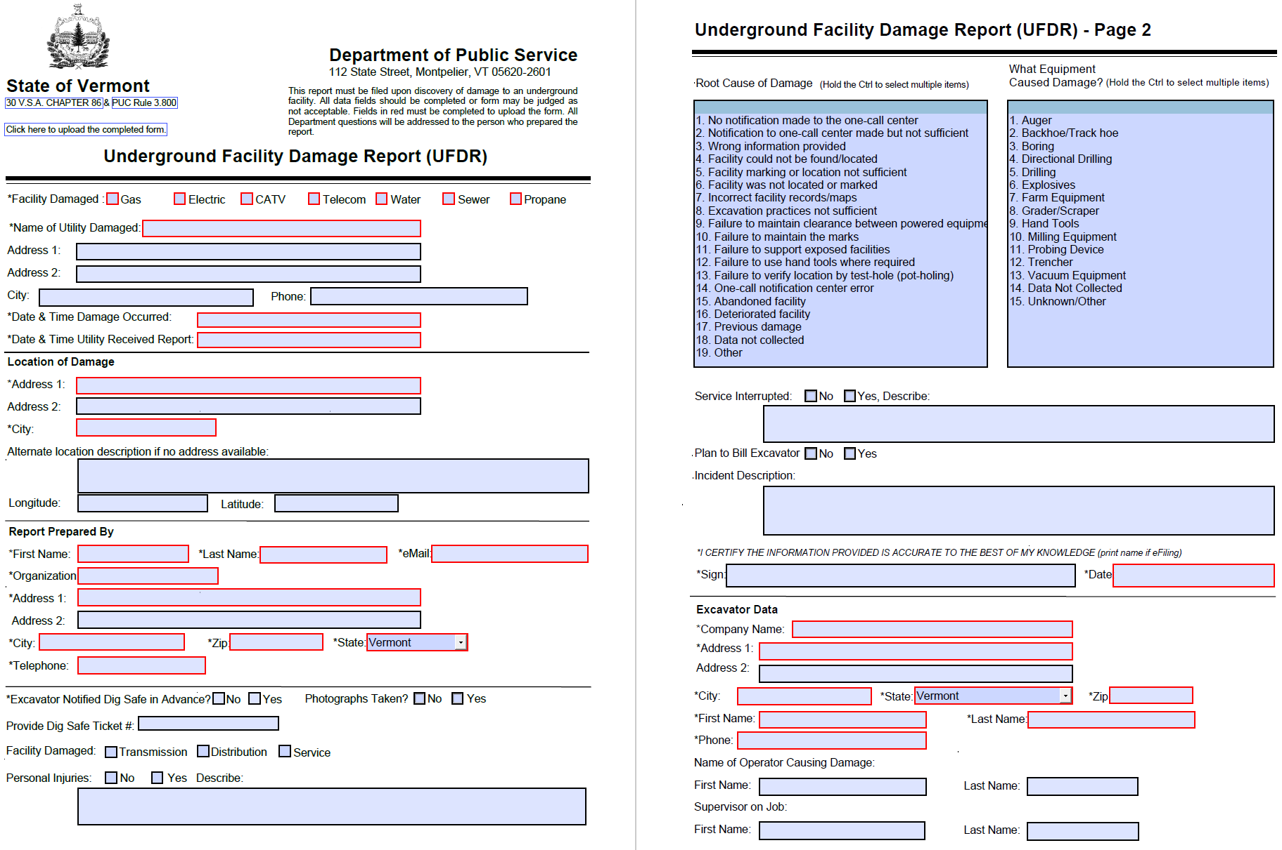
Underground Facility Damage Reports (UFDR)

Slide 19
Underground Facility Damage Reports (UFDR)
 | 2021 | 2022
UFDRs - Electric | 12 | 13
UFDRs - Gas | 15 | 19
UFDRs - Telecom/Cable | 81 | 54
UFDRs - Water/Sewer | 0 | 1
UFDRs - Total | 108 | 87
Dig Safe Tickets in VT | 37,217 | 39,073

Slide 20
Civil Penalties
30 V.S.A. § 7008: Any person or company who violates any provisions of section 7004, 7006, 7006a, 7006b, or 7007 of this title shall be subject to a civil penalty of not more than:
$500.00 for the first offense,
$1,000.00 for the second offense within one year of the date of the first offense,
$1,500.00 for the third offense within one year of the first offense, and
$5,000.00 for the fourth or subsequent offense within one year of the date of a previous offense
PUC Rule 3.807(J): In imposing a civil penalty on any person, the Commission shall consider the gravity of the violation, the culpability of the person responsible for the violation, any history of prior violations, the good faith of the person in attempting to achieve compliance, the size of the business of the person being charged, the likely deterrent effect of the penalty, and any other relevant or mitigating factors.

Slide 21
Contact Information
Bill Jordan
Director of Engineering
(802) 522-3959
bill.jordan@vermont.gov
Lindsey Wells
Admin Services Coordinator
(802) 261-5733
Lindsey.wells@vermont.gov

